Slide 1

Crab Age Prediction
Project
Presented by:
Johnny Vogt
Mike Flores
March 21, 2025
Notes:
Good morning. My name is Mike Flores, and I’m pleased to welcome you to our presentation on the Crab Age Prediction Project. I’ll be joined today by Johnny Vogt, who will also be co-presenting.

Slide 2
Human resources slide 2
AGENDA
Executive Summary (.25)
Data Overview and Insights (3)
Modeling Summary (1.5)
Shiny Application (2)
Conclusion and Next Steps (.25)
2
Notes:
Here’s the Agenda on what we’ll cover today:
Project Objective Summary – We’ll begin with a summary of the project objectives to provide context for our work.
Modeling Summary – We’ll walk through the modeling approach—highlighting the regression model we selected, how it was refined, and the key performance results.
Data Overview & Key Insights – We’ll dive into the data itself, sharing important trends and relationships uncovered through our exploratory analysis.
Shiny Application - We’ll also showcase our Shiny app, which provides an interactive way to explore crab age predictions and feature relationships.
Conclusion & Next Steps - We’ll close with final conclusions and outline potential next steps.
Questions – Finally, we’ll open it up for any questions you may have.

Slide 3
Executive Summary
This project explores crab aging using predictive modeling and exploratory data analysis (EDA). The goal is to support biological research by identifying which physical features are most indicative of a crab’s age.
Objective
Develop a reliable linear regression model to predict crab age using measurable traits such as shell weight, body dimensions, and sex, while minimizing Mean Absolute Error (MAE).
Predictive Model Summary
Linear regression is a statistical method used to model the relationship between a dependent variable and one or more independent variables. In this project, we applied multiple linear regression to predict crab age based on measurable physical characteristics.
Our modeling process included:
Data cleaning and EDA to guide feature selection
Key predictors: Length, Height, Shell Weight, Shucked Weight, and Sex
Fitted a multiple linear regression model using these features
Evaluated over 500 randomized 70/30 train-test splits
Achieved consistent average MAE of 1.459, confirming stability and generalizability
3
Notes:
This project explores how we can predict crab age using physical traits like shell weight, body size, and sex. Our goal was to support biological research through a reliable predictive model.
We used multiple linear regression and started with thorough data cleaning and analysis to guide feature selection.
Key predictors included Length, Height, Shell Weight, Shucked Weight, and Sex.
After testing the model over 500 randomized train-test splits, we achieved a consistent average MAE of 1.459 — showing strong and stable performance.

Slide 4

Data Overview & Insights
4

Slide 5
Cost Analysis – KNN Model Predictions
Cost of Attrition = $10,000: Cost incurred when an employee leaves the company (e.g., hiring, training, lost productivity).
Cost of Retention Intervention = $2,500: Cost associated with attempting to retain an employee (e.g., bonuses, promotions, PTO, reskilling, additional support).
The formula used:
Total Cost = (Cost of Attrition × Missed Attrition) + (Cost of Retention Intervention × Missed Retention)
Total Cost = ($10,000 × 16) + ($2,500 × 38)
Total Cost = $255,000
5
5
Notes:
As you already know, attrition is costly. On average, losing an employee costs Frito Lay $10,000, while intervention costs only $2,500.
Using our KNN Model Predictions, we calculated:
Missed Attrition (False Negatives cases): 16 employees → $160,000 in costs
Missed Retention (False Positive efforts): 38 employees → $95,000 in costs
Total Cost Estimate: $255,000
This analysis helps determine whether intervention is a cost-effective strategy compared to letting attrition occur naturally.

Slide 6
Data Dictionary
6
Notes:
Here is the summary of all the data provided. As you can see, it’s quite detailed.

Slide 7
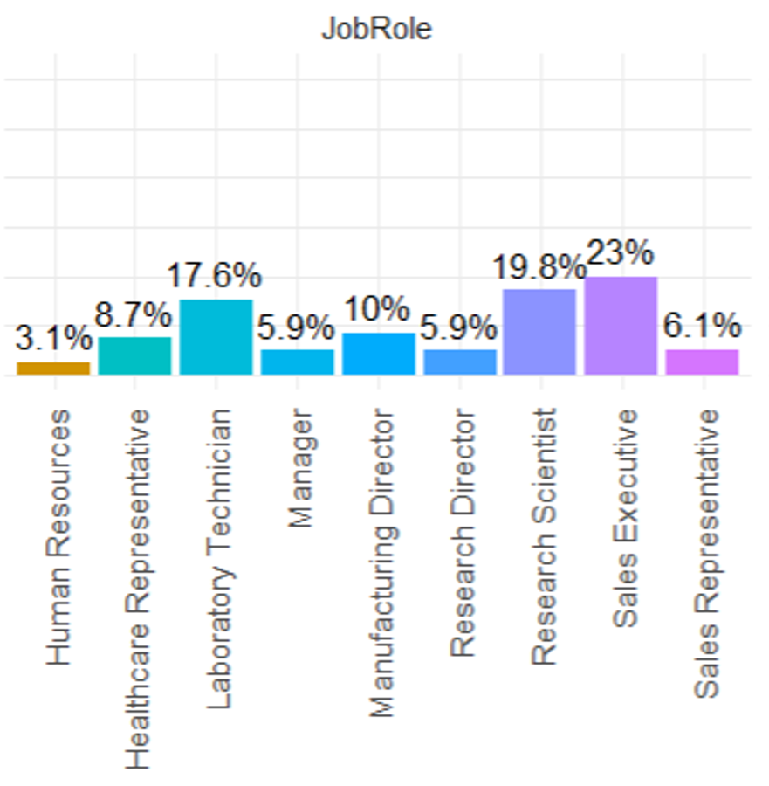
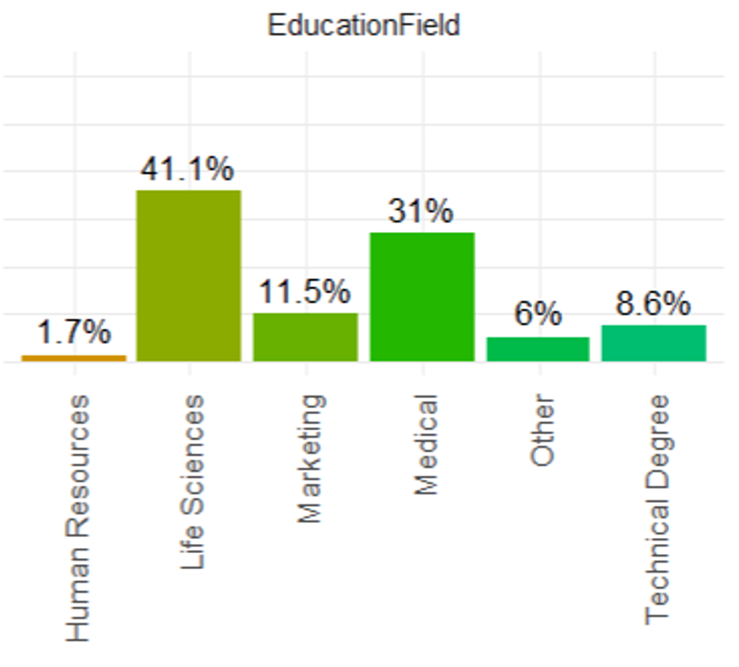
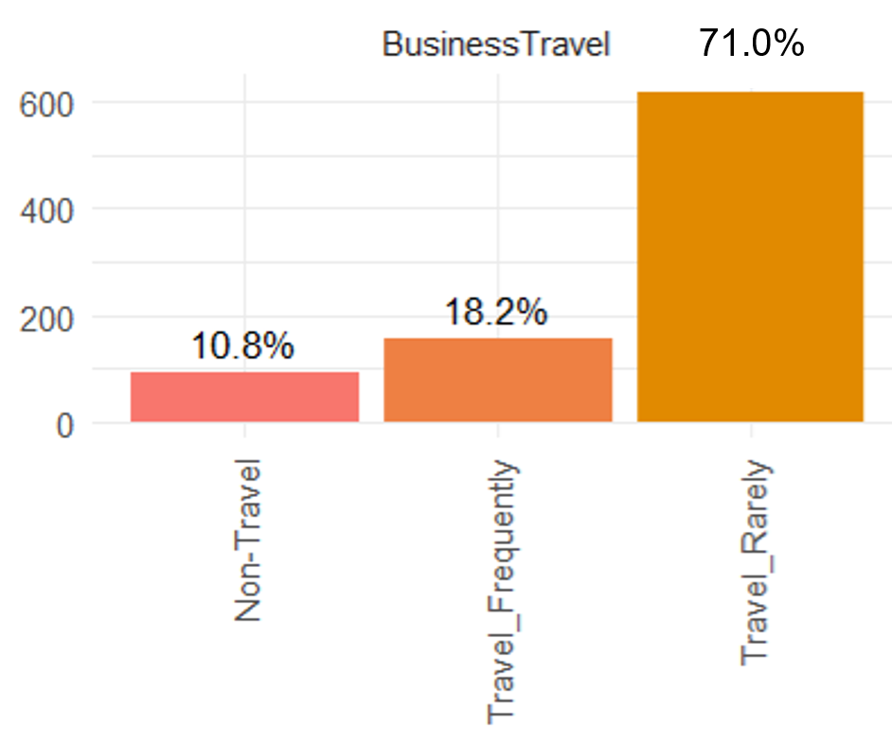
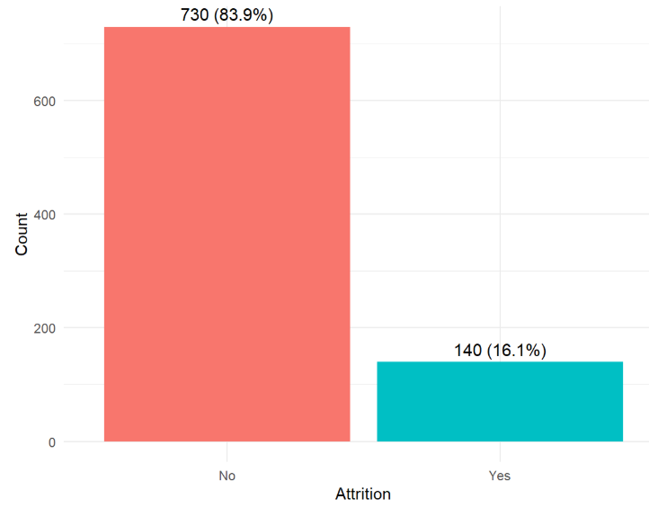
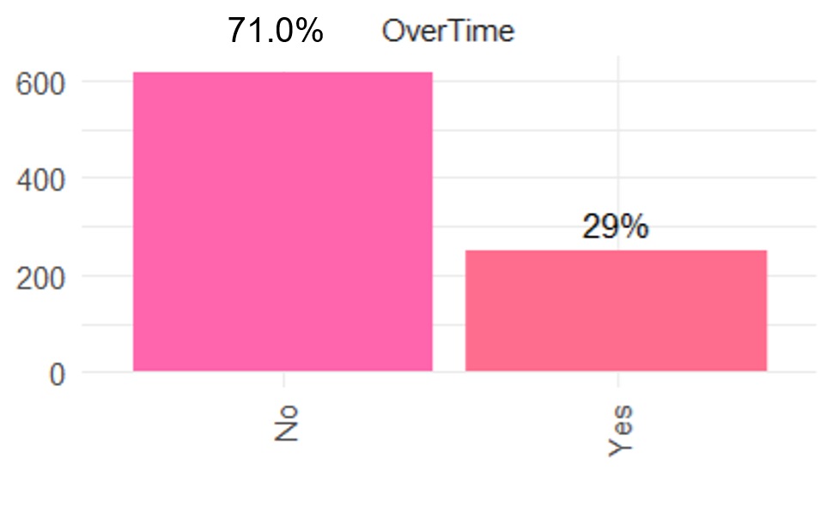
Data Overview – Attrition Frequency
Attrition Rate: 140 employees (16%) left the company, making retention a key concern.
Business Travel: 158 employees travel frequently, which may contribute to attrition compared to the 618 who rarely travel.
Overtime: 252 employees work overtime, which could impact job satisfaction and burnout, while 618 do not.
Education Field: Life Sciences (40%) and Medical (31%) dominate, showing potential industry-specific retention patterns.
Job Roles & Leadership: 33% (287) of employees hold leadership roles, which may indicate retention challenges at different career levels.
7
Notes:
Now, let’s look at some of the key insights from our data:
16% of employees (140 out of 870) left the company, making retention a priority.
33% of employees hold leadership roles, indicating that turnover risk may vary across career levels.
Frequent business travel correlates with higher attrition.
Similarly, overtime work also correlates with higher attrition.
Education background plays a role, with Life Sciences and Medical fields dominating the workforce.
These insights help us understand what factors may be driving employee turnover.

Slide 8
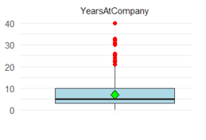
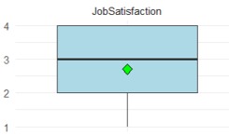
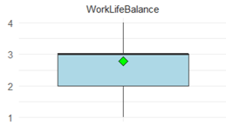
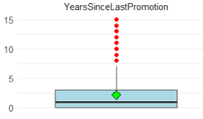
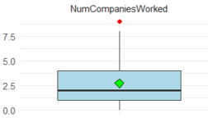
Data Overview – Quantitative Variable Statistical Summary
Years at Company: Tenure ranges from 0 to 40 years, averaging 7 years. 50% have stayed 5 years or less, while 25% have been here for 3 years or less.
Job Satisfaction: Scores range from 1 to 4, averaging 2.71. Half rate it 3 or lower, and 25% report low satisfaction (2 or less), affecting retention.
Work-Life Balance: Ratings span 1 to 4, averaging 2.78. Half rate it 3 or lower, suggesting work-life challenges that may drive attrition.
Years Since Last Promotion: Time since last promotion ranges from 0 to 15 years, averaging 2.17 years. 25% have waited at least 3 years, which may impact motivation.
Num Companies Worked: Employees have worked at 0 to 9 companies, averaging 2.73. 25% have worked at 4+ companies, indicating higher mobility.
8
Notes:
Here are some key quantitative findings:
Tenure: Employees have worked 0-40 years, with an average of 7 years.
Job Satisfaction: Ranges from Low to Very High, with 50% rating it High or lower, highlighting potential dissatisfaction.
Work-Life Balance: Half the employees rate it 3 out of 4, indicating room for improvement.
Years Since Last Promotion: A quarter of employees have waited 3+ years for a promotion, which may impact motivation.
Previous Work Experience: 25% have worked at 4+ companies, indicating a higher likelihood of job switching.
By analyzing these factors, we can develop better retention strategies.

Slide 9
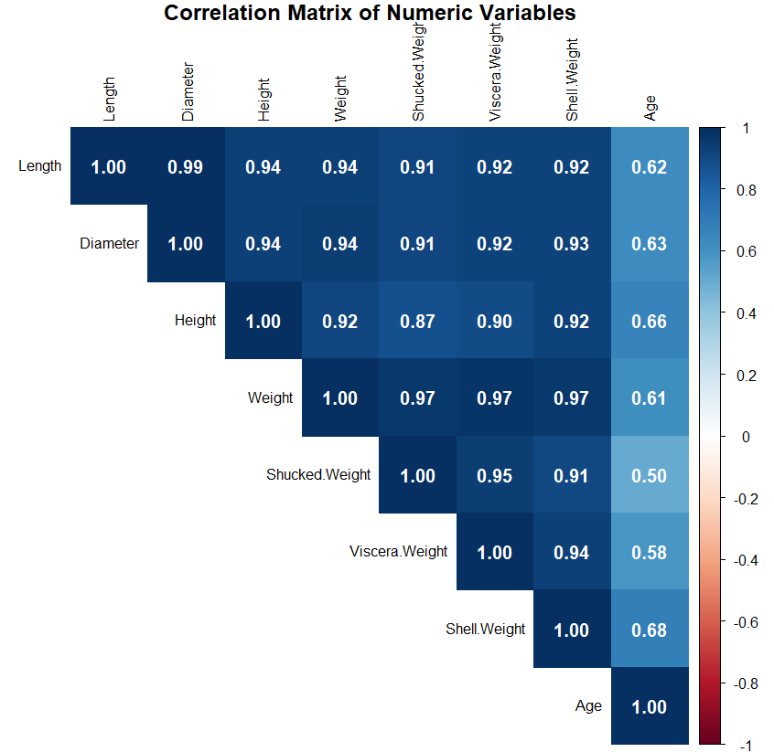
Correlation Between Variables – Relationships to Attrition
All features are positively correlated with Age confirming their alignment with biological growth patterns.
Length, Diameter, Height, Weight, and Shell Weight have strong correlations (> 0.6) with Age.
Shucked Weight and Viscera Weight show moderate correlation and may provide additional value.
Weight will be excluded from the model as it is a composite of other included variables.
9

Slide 10


Modeling
Summary
Linear Regression
10

Slide 11
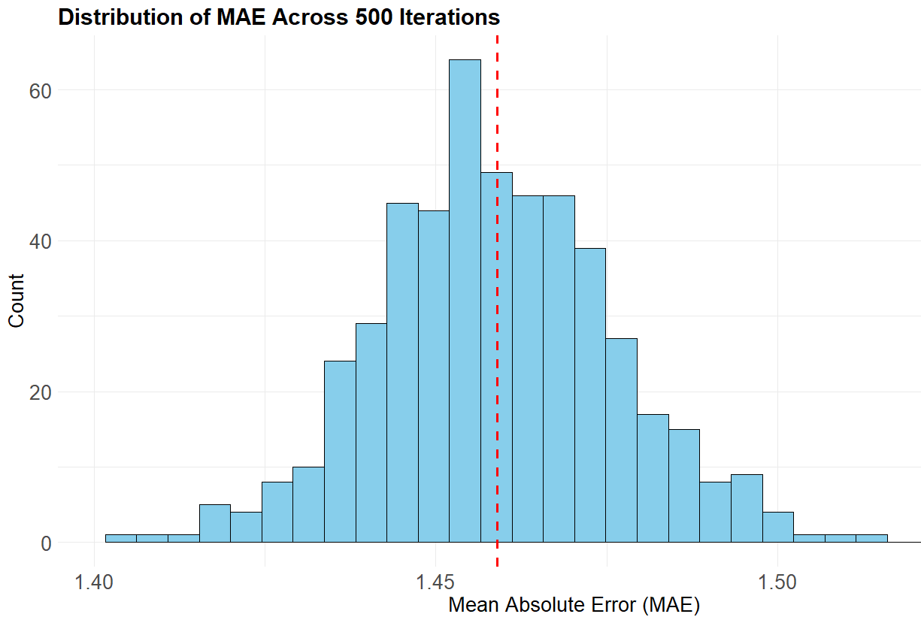
Linear Regression Model Summary
Linear Regression model - Trained model using lm() with Age as the response variable.
crab_age_model <- lm(Age ~ Length + Height + Shucked.Weight + Shell.Weight + Sex, data = crab_age)
Chosen predictors: Length, Height, Shucked Weight, Shell Weight, and Sex.
Features were chosen based on exploratory analysis and strong correlation with Age.
Model performance evaluated using Mean Absolute Error (MAE) as a measure of prediction accuracy.
MAEAVE = 1.459
11
Notes:
We used a linear regression statistical modeling technique to examine the relationship between the crab dataset variables.
We then trained model using the R’s lm() function using Age as the response variable and features the Length, Height, Shucked Weight, Viscera Weight, Shell Weight, and Sex as explanatory variables.
These features were selected based on prior exploratory analysis and their observed correlation with crab age.
After fitting the model, we generated predictions using the full dataset and evaluated performance using Mean Absolute Error (MAE). This metric provides an interpretable measure of average prediction error. The resulting MAE gives us a benchmark for the model's accuracy and helps assess how well it generalizes to unseen data.

Slide 12
Crab Prediction – Shiny Application Demonstration
12

Slide 13
Conclusion & Next Steps
Applied linear regression to predict crab age using multiple physical features.
Achieved consistent MAE of 1.459 across 500 randomized train/test splits, confirming model reliability.
Results highlight how crab traits evolve with age, offering insights for biological research and species monitoring.
Future work could explore non-linear or ensemble models to capture more complex patterns and improve accuracy.
13

Slide 14
QUESTIONS?
Thank You
Contact Info:
Mike Flores
Johnny Vogt
mflores@smu.com
jvogt@smu.com
14
Notes:
That concludes our presentation. I’d be happy to answer any questions you may have.
You can also reach us at contact info shown.
Thank you for your time!

