Slide 1
6372 Midterm Study Guide

Slide 2
MSDS 6372 Midterm1
Date: June 21st (Saturday), 2pm-5pm Central
Midterm provided in the Files Folder. Put your responses in different color text. Submit to the midterm section of Canvas.
Format: Mixture of conceptual questions (Multiple choice, short answer) and small analysis questions (short answer analysis questions). Code and output will be given. The focus will be on communicating what the output is saying or how you would react to the output).
Units 1,2,3,4,6, 7
1,2,3,4 Emphasized
6,7 much less except for specifics (see slide)

Slide 3
Unit 1 MLR and Regression in General
Parametric versus Nonparametric Regression
Core difference
Explain versus predict (differences)
Know assumptions of MLR, suggest how to fix
Interpret a regression coefficient for the model
The importance of ”adjusting” for additional variables in the model
Slide 28-30 of this deck
Know the difference between additive and nonadditive models
Stretch question might involve a contrast

Slide 4
Unit 2 Feature Selection
The Bias-Variance trade off
Know the MSE metric (difference between train MSE and validation (or CV) MSE
What does it mean for a model to suffer from bias? Variance?
Some metrics work better than others for assessing the bias-variance trade off. Which ones?
K fold CV
Basic steps to perform cross validation
What are some pros of CV MSE over Validation MSE

Slide 5
Making predictions on a validation set or via cross validation is useful for
Making practical decisions on if your model predicts well enough or not on a future data set
Determining how many predictors should be included in the model
Optimizing additional parameters in a model such as the penalty and mixing terms in GLM-net
All of the above
Only A and B

Slide 6
Unit 2 Feature Selection
What is the main function of feature selection?
How does the penalty in penalized regression work
What is the different between GLM-net, LASSO, and Ridge
Which penalized regression technique actually forces some coefficients to be 0?
Why can we NOT simply run a feature selection tool and just assume that the model it “spits out” is good to go?

Slide 7
Unit 3 Bootstrap
What main statistical problems does the bootstrap procedure address in the MLR setting?
How does one obtain a bootstrap sample?
How does one obtain a bootstrap confidence interval?
How is the bootstrap procedure utilized in bagging a predictive model?

Slide 8
Unit 4 Communication
Scenario/consulting question
Using the right tool (MLR, Feature selection, Boostrapped MLR, nonparametric tool, repeated measures)
I give you a scenario, you give a suggested approach to deal with the scenario
No questions on missing data or imputation
Be able to interpret the MSE or determine an MSE that you would want to achieve to reach a particular goal (prelive question)

Slide 9
Unit 6/7
Be able to obtain information from a covariance matrix
Know the basic idea of the Multivariate Normal
Be able to determine a matrix so that when multiplied by a data set you create a new data set based on combinations of the original variables (HW)
What settings would constitute running a repeated measures (GLS) model?
What is the main issue of applying an MLR model when a GLS model should be conducted?
What is the role of the correlation function (structure) and using AIC, BIC for model fits
GLS is essentially running MLR, what is the main difference in statistical output when there is strong dependence among the MLR errrors and we account for that using GLS?

Slide 10
Example Exam Questions

Slide 11
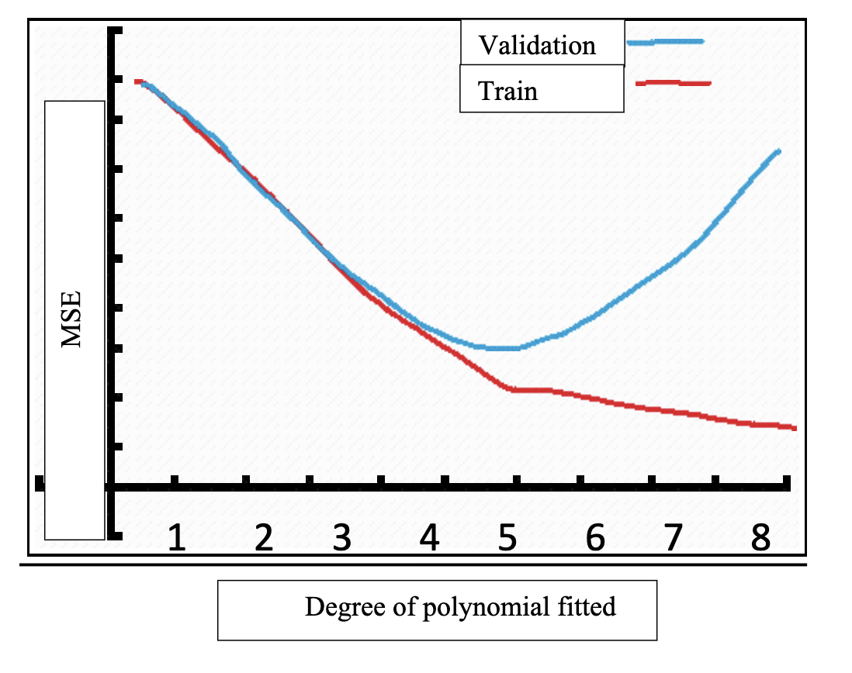
Suppose we are modeling a continuous response with a single predictor variable which is highly nonlinear. Suppose that the true relationship is a polynomial of degree 5. Use the plot below to graph out what the hypothetical MSE curve looks like as a function of the degree of polynomial fit using multiple linear regression. Sketch a curve for both the training and validation MSE. Make sure you distinguish the two curves somehow (add a second graph, different colors, dotted/solid line, etc).

Slide 12
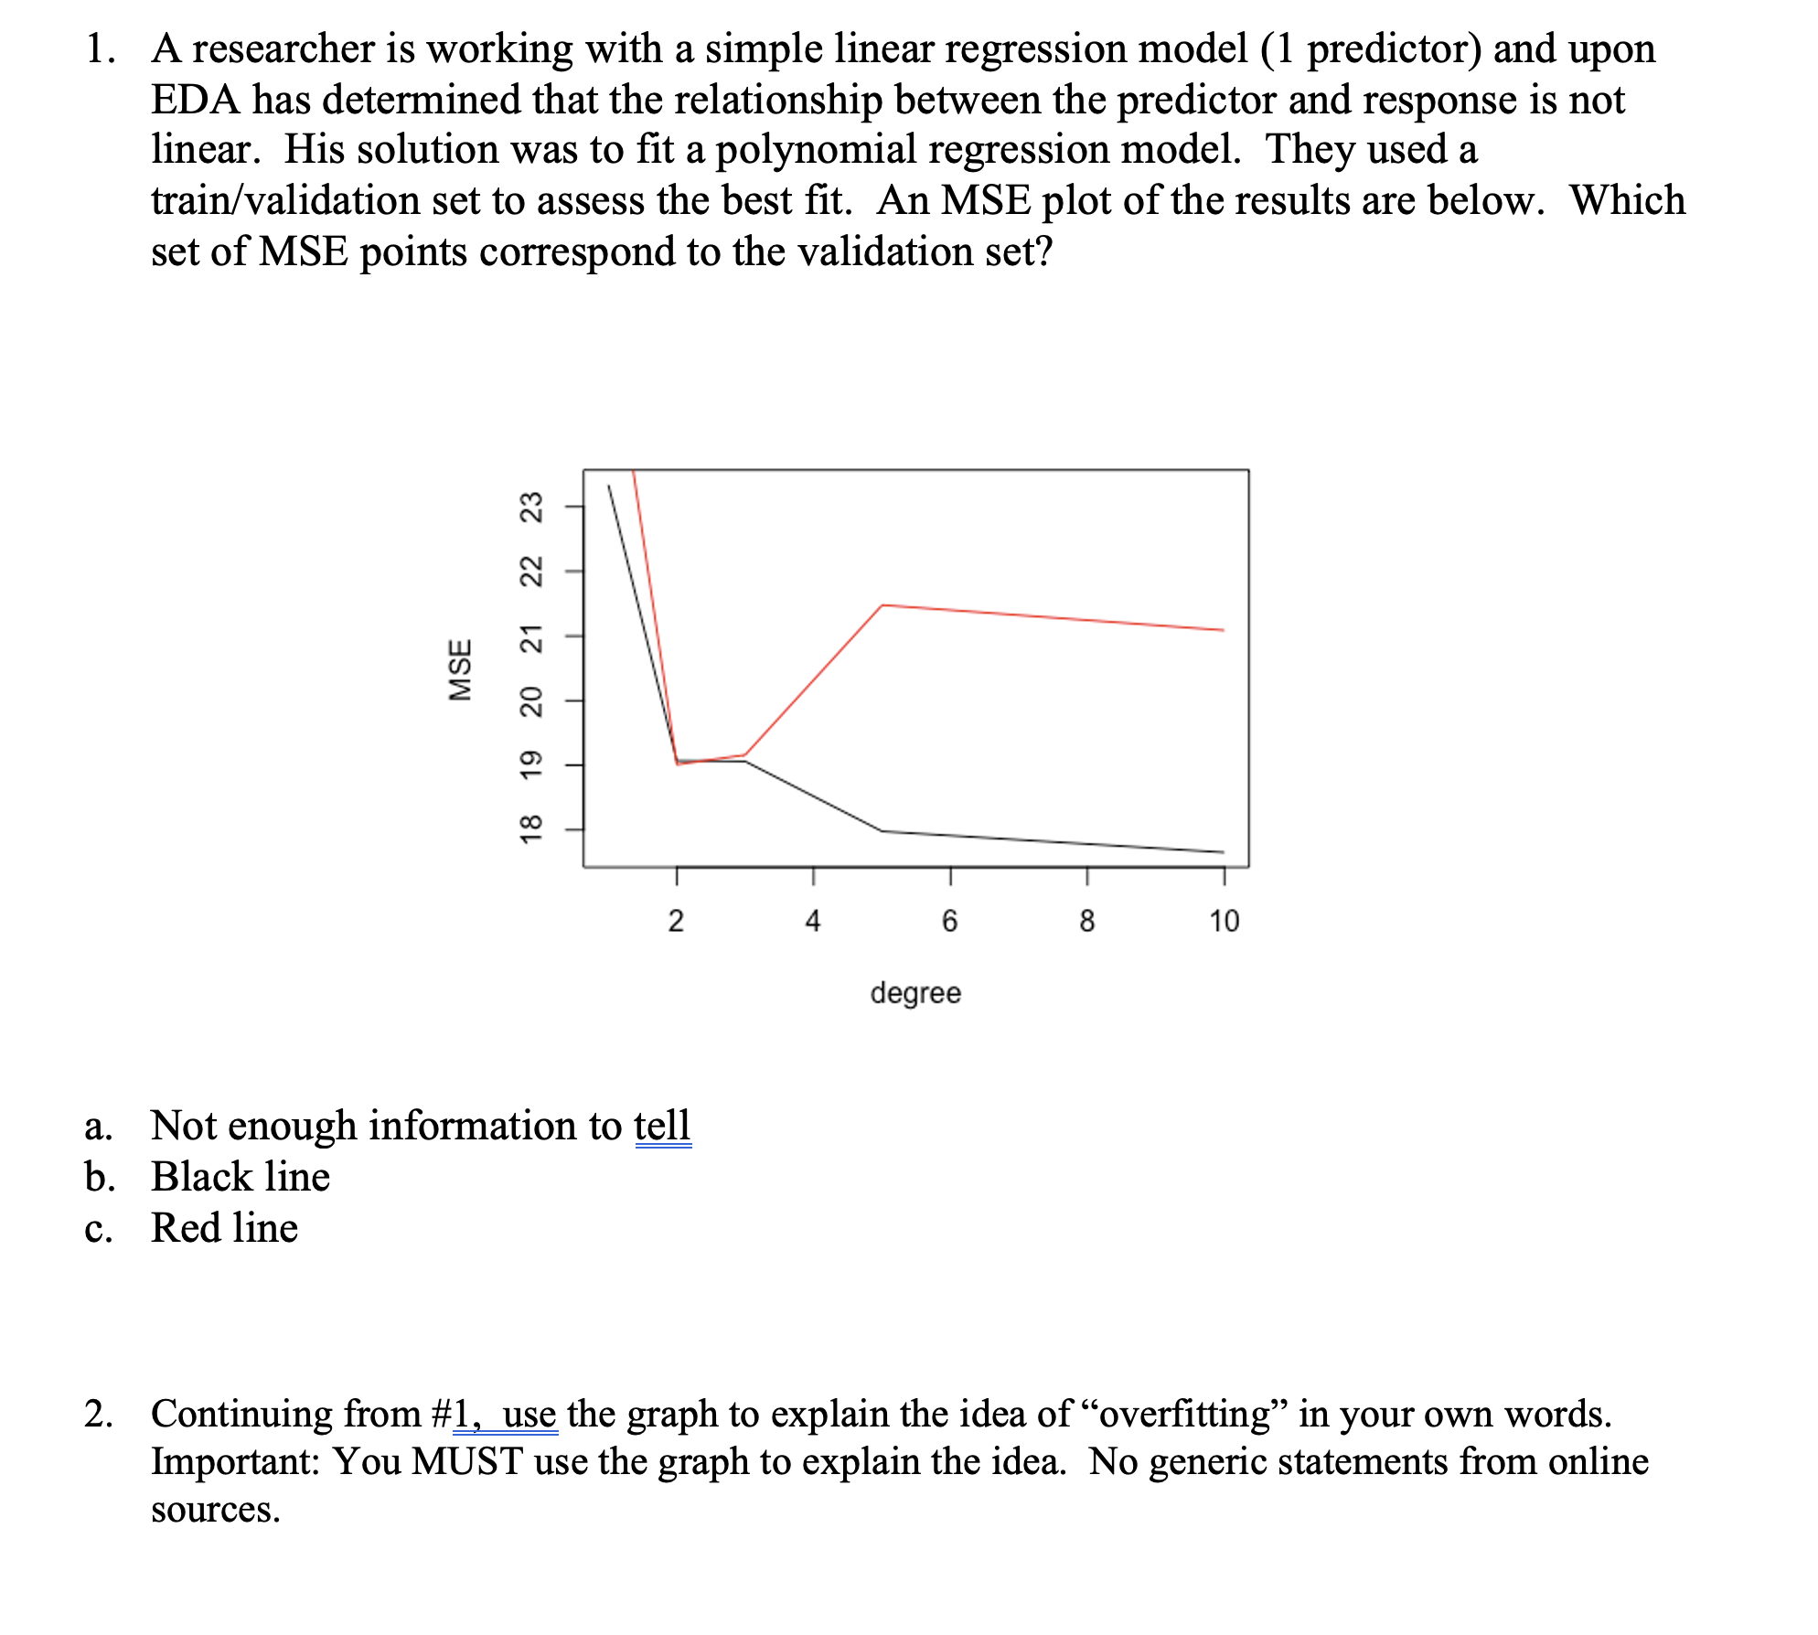

Slide 14
A regression model was conducted, using a genetic variable measuring the amount of Interferon in a persons blood sample as the response. The results are below. The model statement is provided and the explanatory variables include Condition (sick or healthy) as well as Age. Assuming that the results in the table were produced from a model where all the assumptions are met, provide a formal interpretation of the “ConditionSick” coefficient.
 | Estimate | Std. Error | P-value
Intercept | 9.23 | 0.70419 | <.001
ConditionSick | -0.67 | 0.58 | 0.254
Age | 0.35 | 0.03 | <.001

Slide 15
A predictive modeler is not happy with his current multiple linear regression model’s prediction accuracy. He currently is using 6 continuous predictors and 2 categorical. These are the only variables he currently has to work with and he is using them as is. All regression coefficients are both statistically and practically significant. Given his current standing and the current information, provide a suggestion (or suggestions) to help him possibly improve prediction accuracy. If any of your suggestions depend on a question then communicate that as well.

Slide 16
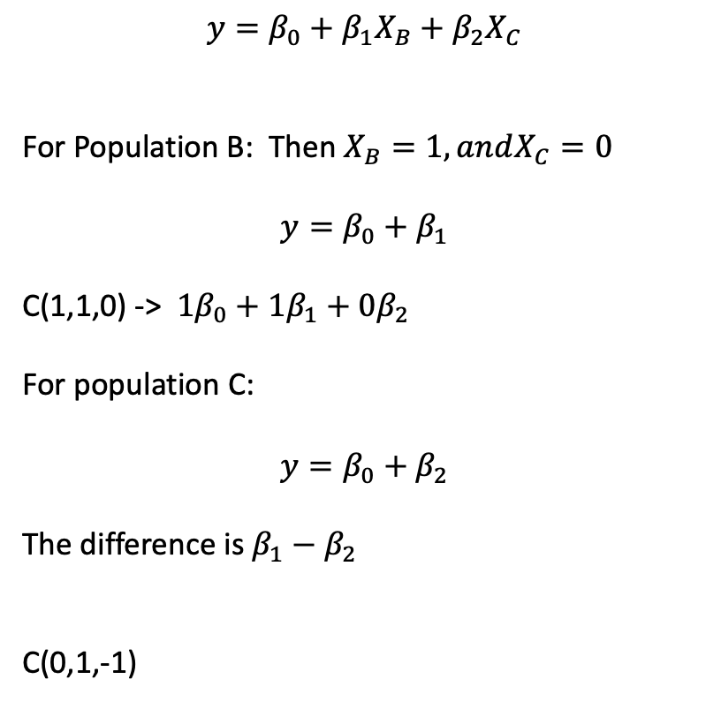
$$y=β_{0}+β_{1}X_{B}+β_{2}X_{C}$$
For Population B: Then $X_{B}=1, andX_{C}=0$
$$y=β_{0}+β_{1}$$
C(1,1,0) -> $1β_{0}+{1β}_{1}+0β_{2}$
For population C:
$$y=β_{0}+β_{2}$$
The difference is $β_{1}−β_{2}$
C(0,1,-1)

Slide 17
Key Slides from Lectures

Slide 18
Unit 1

Slide 19
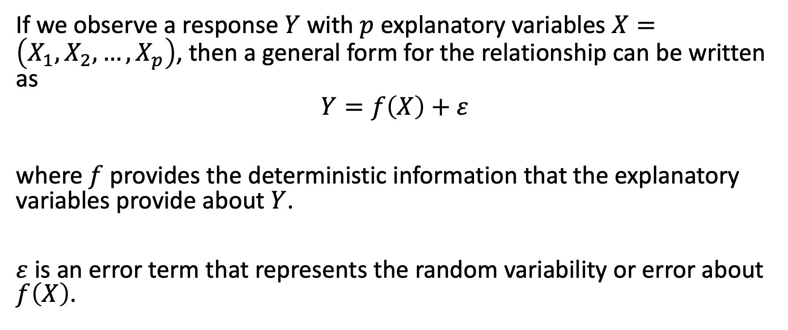
A General Regression Model Structure
If we observe a response $Y$ with $p$ explanatory variables $X=\left(X_{1},X_{2},…,X_{p}\right)$, then a general form for the relationship can be written as
$$Y=f\left(X\right)+ε$$
where $f$ provides the deterministic information that the explanatory variables provide about $Y$.
$ε$ is an error term that represents the random variability or error about $f\left(X\right)$.

Slide 20

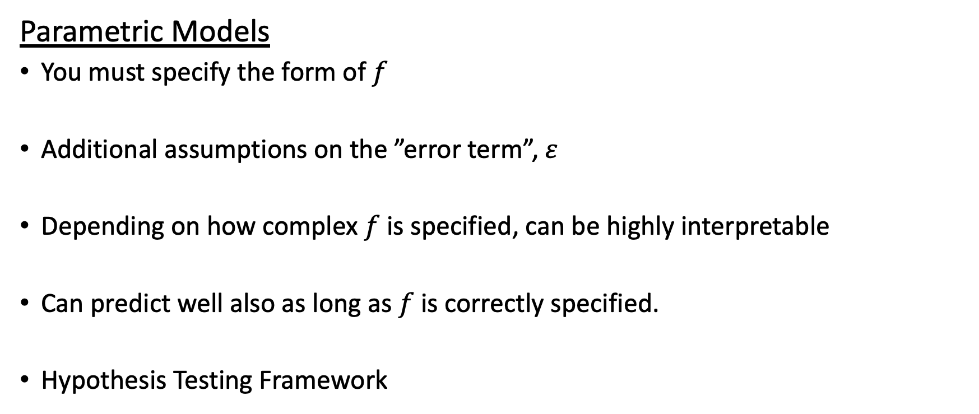
Two Approaches to Estimating $f$
Parametric Models
You must specify the form of $f$
Additional assumptions on the ”error term”, $ε$
Depending on how complex $f$ is specified, can be highly interpretable
Can predict well also as long as $f$ is correctly specified.
Hypothesis Testing Framework
Notes:
It is up to you, the analyst, to determine a mathematical equation that does a good job of explaining the relationship between the explanatory variables and response.
Analyst typically must place additional assumptions on the ”error term”, $ε$.
Depending on how complex $f$ is specified, can be highly interpretable and typically offer hypothesis testing strategies to answer different questions.
Can predict well also as long as $f$ is correctly specified.

Slide 21
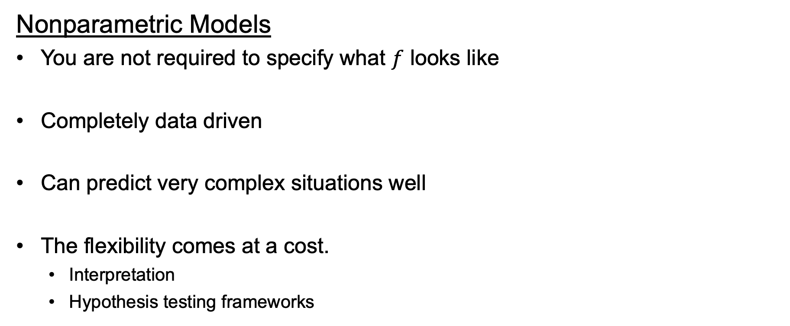
Two Approaches to Estimating $f$
Nonparametric Models
You are not required to specify what $f$ looks like
Completely data driven
Can predict very complex situations well
The flexibility comes at a cost.
Interpretation
Hypothesis testing frameworks
Notes:
Some times referred to as “machine learners”, because they do not require the analyst to determine a candidate equation
It is completely data driven so they have minimal assumptions compared to parametric models
Can predict very complex situations well when it is very hard for the modeler to specify something close to the true $f$ for a parametric model.
The flexibility comes at a cost. Interpretation and general hypothesis testing.

Slide 22
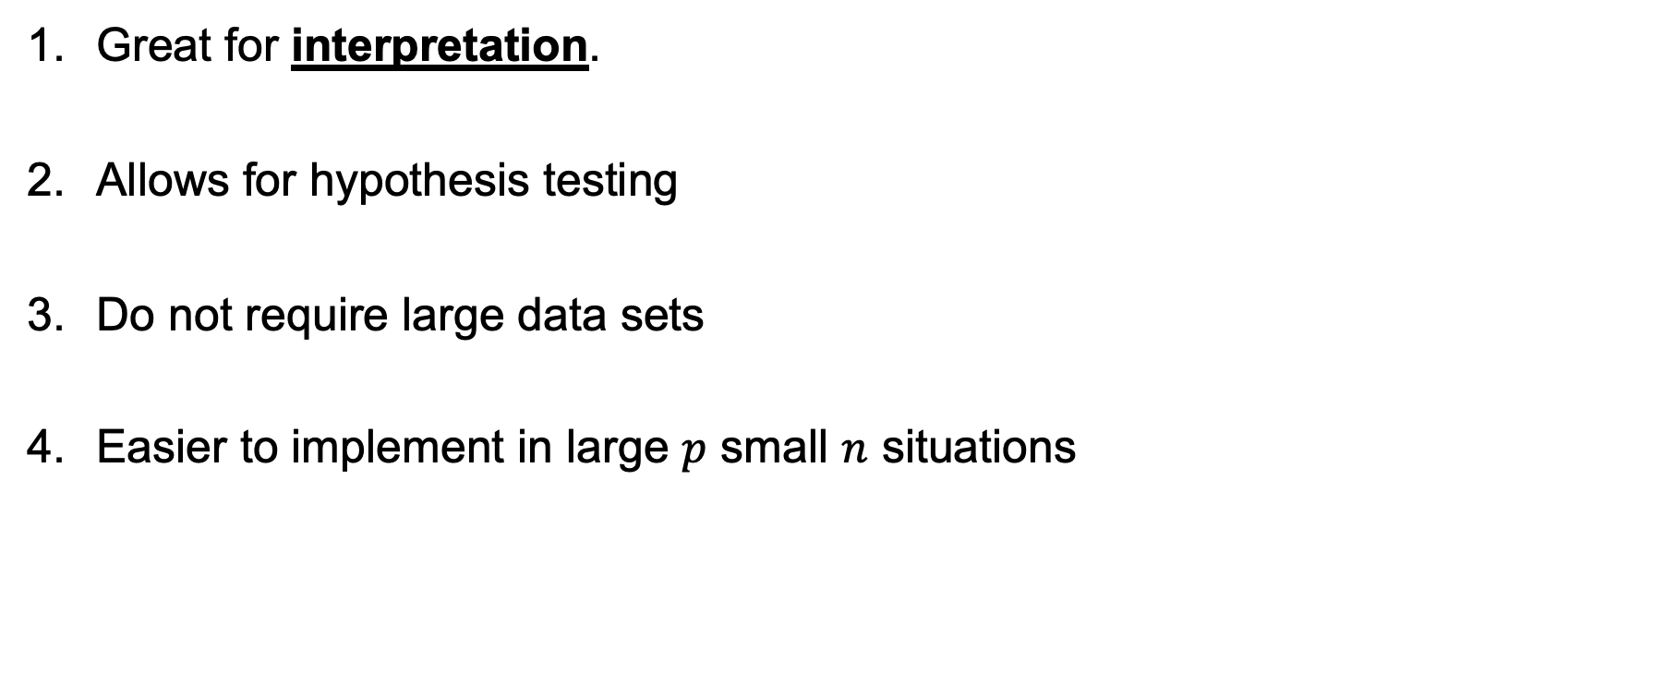
Parametric Pros
Great for interpretation.
Allows for hypothesis testing
Do not require large data sets
Easier to implement in large $p$ small $n$ situations
Notes:
Parameteric models are great for interpretation. Since we define what $f$ looks like we typically can explain, in words, what the relationship between Y and the X’s are. Nonparametric models can only provide very basic insight into what is going on.
Parametric models allow for hypothesis testing to ask specific questions about specific explanatory variables.
Parametric models typically do not require as much data (smaller sample sizes) since it is not totally data driven like nonparametric models.

Slide 23
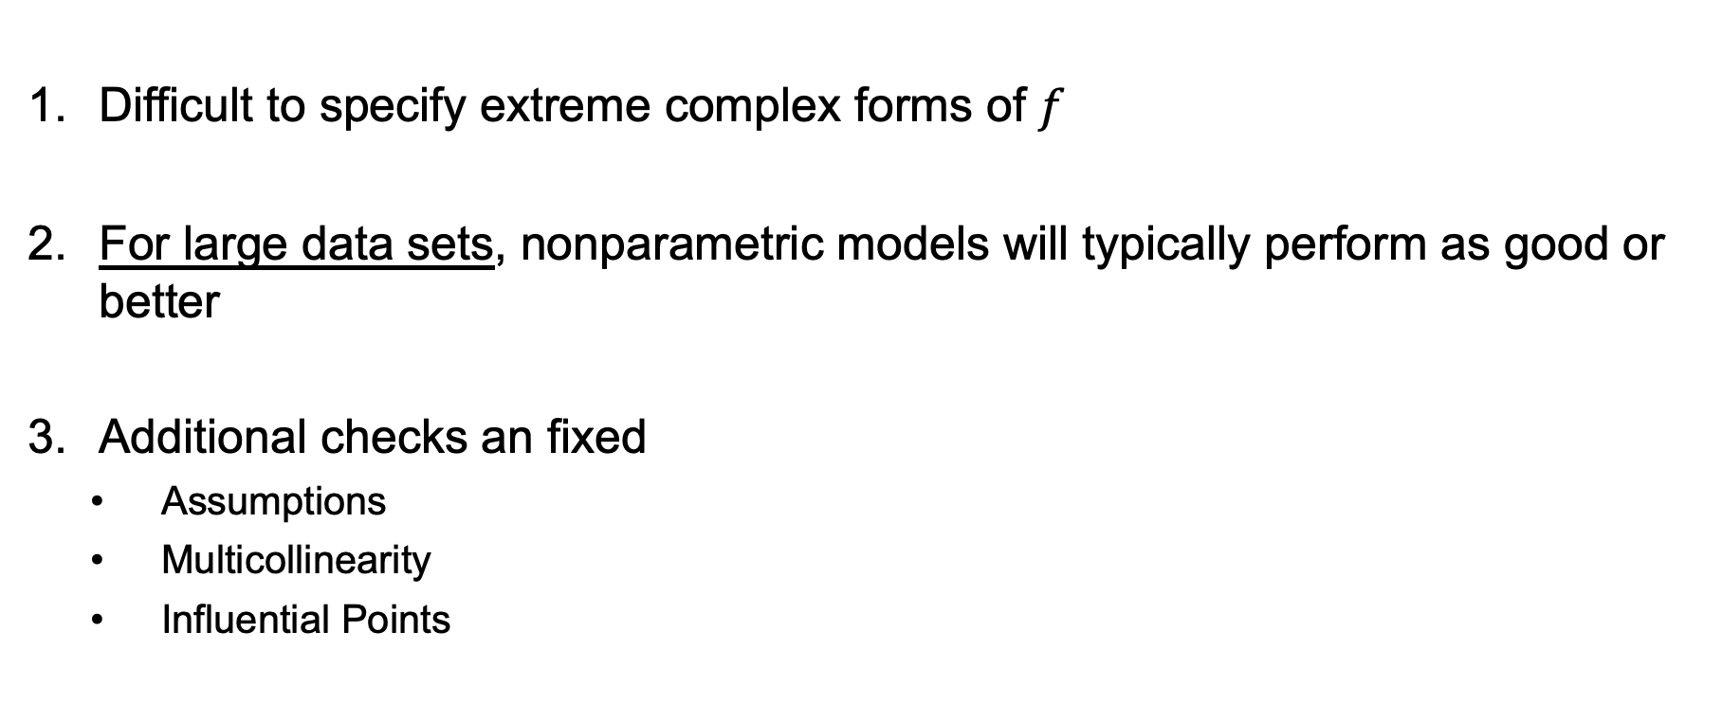
Parametric Cons
Difficult to specify extreme complex forms of $f$
For large data sets, nonparametric models will typically perform as good or better
Additional checks an fixed
Assumptions
Multicollinearity
Influential Points
Notes:
Parametric models are easier to implement when the number of predictors (p) is quite large relative to the sample size.
Nonparametric models are great when the true function, $f(X)$, is extremely complicated. So complicated that we do not have enough time or mental capability to describe it in a parametric way. Parametric models can still be used, but it takes much more work and thought from the analyst.
When data sets are large, nonparametric models will typically perform as good or better than nonparametric ones from a prediction accuracy perspective. They perform similarly when the true from of $f(X)$ can be expressed easily with a parmetric method.

Slide 24
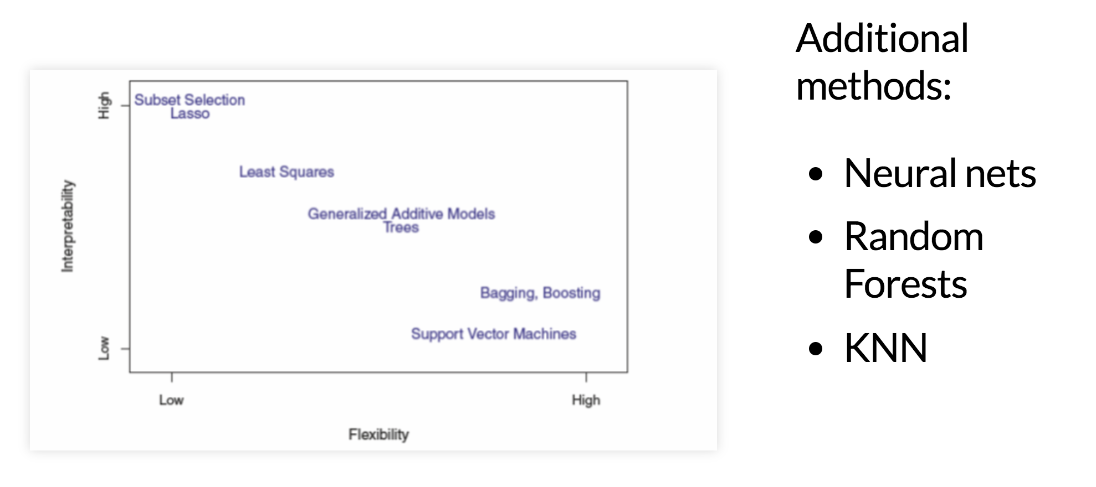
Interpretation vs Flexibility
Parametric Models
Nonparametric Models
Notes:
Cite figure ISLR book Figure 2.7

Slide 25
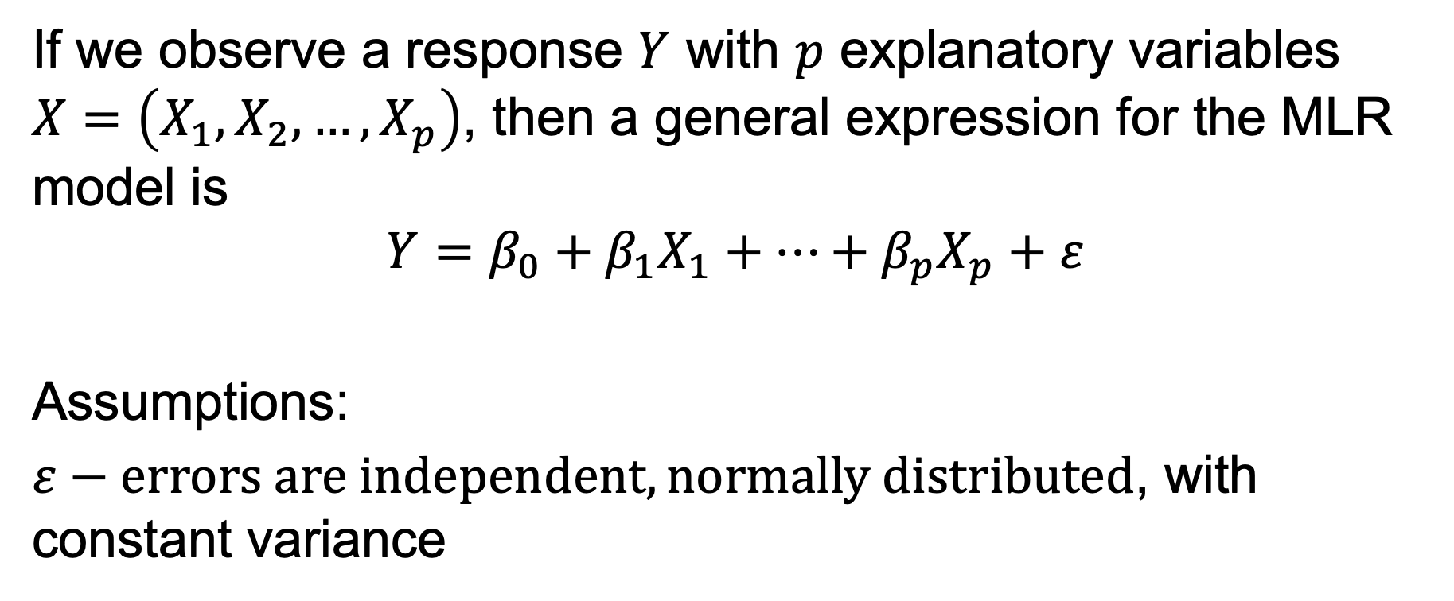
The MLR Model
If we observe a response $Y$ with $p$ explanatory variables $X=\left(X_{1},X_{2},…,X_{p}\right)$, then a general expression for the MLR model is
$$Y=β_{0}+β_{1}X_{1}+…+β_{p}X_{p}+ε$$
Assumptions:
$ε−errors are independent, normally distributed$, with constant variance

Slide 26
Residual Diagnostics
Residual vs Fitted (predicted values) to check constant variance
q-q plot and/or histogram for normality
Independence assumption is made based on the data collecting process.
If observations are taken on the same subject or thing (repeated measures)
If observations are collected over time (time series)

Slide 27
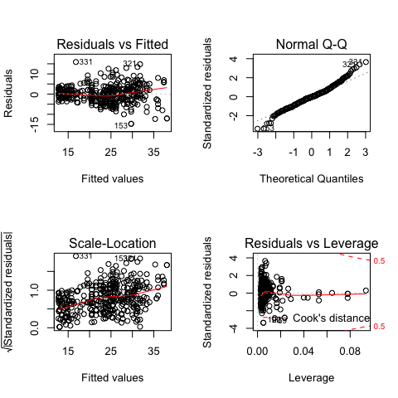
Residual Panel in R
Constant Variance
Normality
Outliers with high leverage
Constant Variance

Slide 28
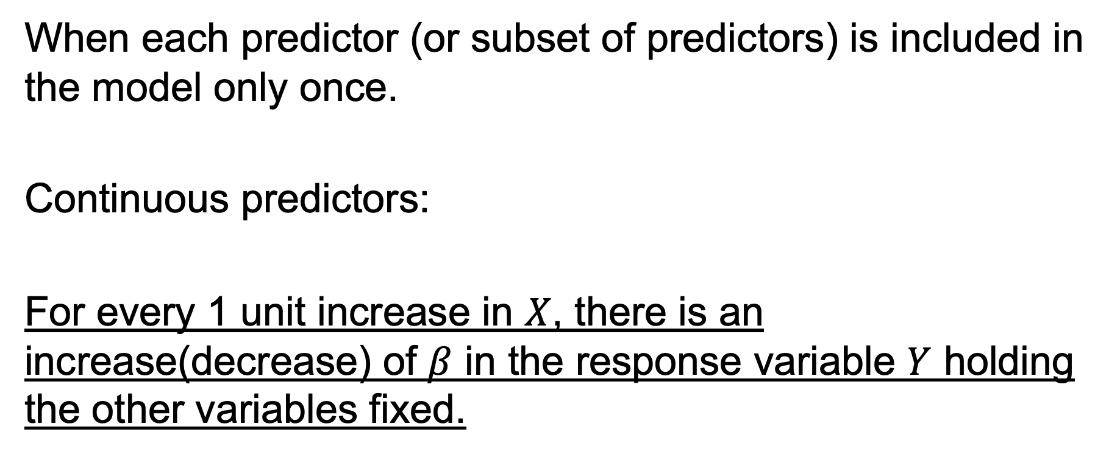
Interpreting Coefficients
When each predictor (or subset of predictors) is included in the model only once.
Continuous predictors:
For every 1 unit increase in $X$, there is an increase(decrease) of $β$ in the response variable $Y$ holding the other variables fixed.

Slide 29
Adjusting for Confounders
The phrase “holding all other variables fixed” should not be taken lightly.
It’s the most advantageous property MLR has.
Get away from the generic terminology.
Put it in context to the real-world.

Slide 30
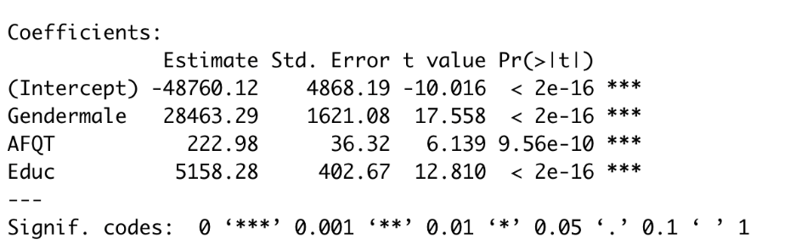
Scenario 1: Sex Discrimination, Part IV
Key statistical conclusion
It is estimated that a male with the same IQ level and education level has an average salary that is $28,463.29 higher than females

Slide 31
Transformations
Transformations are valuable tools when the assumptions of a linear regression model are not met.
Some basic rules of thumb apply when examining the residual vs. fitted graphs.
Variance not constant
Transform Y
Trend
Transform X
Add additional terms involving X

Slide 32
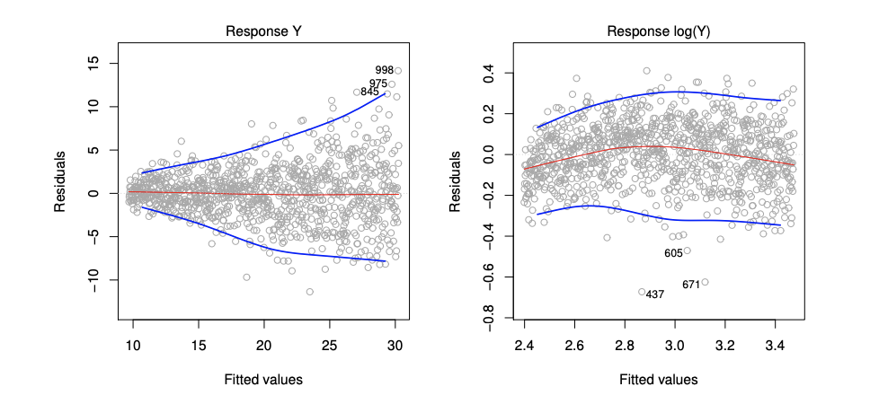
Constant Variance Issues
Notes:
ISLR Figure 3.11

Slide 33
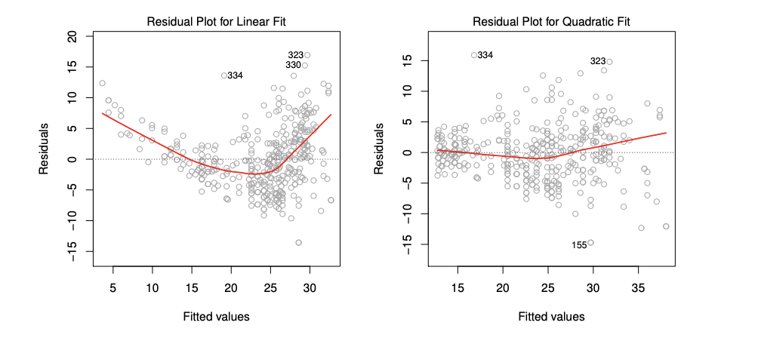
Trend in Residual vs. Fitted Plot

Slide 34
Transformation Pros and Cons
Produces models where assumptions are met
Reliable statistical inference on the regression coefficients
Interpretation of the coefficients is still readily available for log transformations
Interpretation is difficult when using exotic transformations
Nonissue if predicting only
Notes:
Produces models where assumptions are met, allowing for reliable statistical inference on the regression coefficients
If using log transformations, interpretation of the coefficients is still readily available
If using other transformations, interpretation of the model is difficult, and its use should be considered based on the goals of the model. It doesn’t matter if all you want to to do is predict.

Slide 35
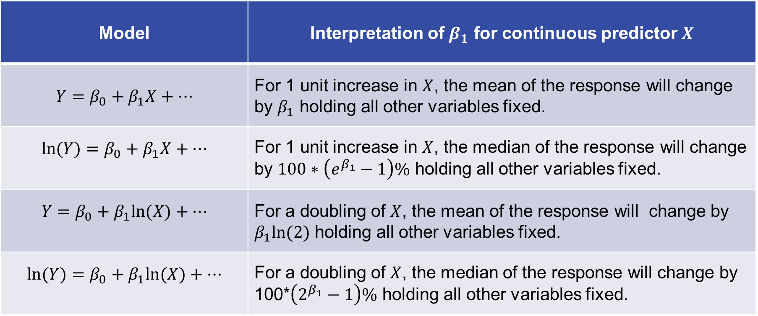
Summary of Interpretations
Model | Interpretation of $β_{1}$ for continuous predictor $X$
$$Y=β_{0}+β_{1}X+…$$ | For 1 unit increase in $X$, the mean of the response will change by $β_{1}$ holding all other variables fixed.
$$ln⁡(Y)=β_{0}+β_{1}X+…$$ | For 1 unit increase in $X$, the median of the response will change by $100∗\left(e^{β_{1}}−1\right)\%$ holding all other variables fixed.
$$Y=β_{0}+β_{1}ln⁡(X)+…$$ | For a doubling of $X$, the mean of the response will change by $β_{1}ln(2)$ holding all other variables fixed.
$$ln⁡(Y)=β_{0}+β_{1}ln⁡(X)+…$$ | For a doubling of $X$, the median of the response will change by 100*$\left(2^{β_{1}}−1\right)\%$ holding all other variables fixed.

Slide 36
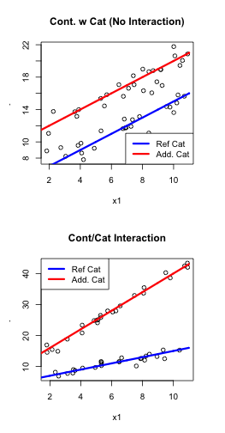
Visualizing Interactions
Additive
lm(y ~ x1 + x2)
Nonadditive (interaction)
lm(y ~ x1 + x2 + x1:x2)

Slide 37
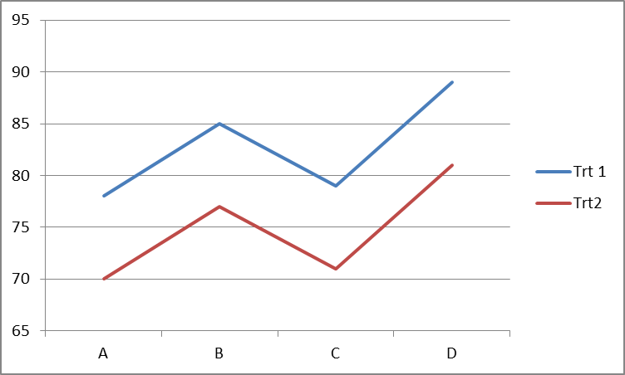
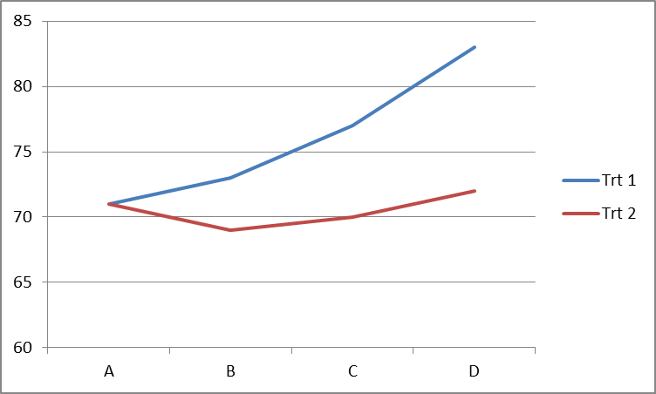
Visualizing Interactions (cont.)
Two category variables
Additive
lm(y ~ x1 + x2)
Nonadditive (interaction)
lm(y ~ x1 + x2 + x1:x2)
Two category variables interaction

Slide 38
Unit 2

Slide 39
The “Error” with MSE
If we calculate the MSE metric on the data set that was used to build the model, then:
The MSE values are not reliable for comparing models
Favors complicated models
Can be driven to 0 artificially
No guarantee that the MSE will be reproduced on future data

Slide 40
Assessing Reproducibility
Take the data set and divide it into two data sets.
The first set has most of the data (70–80%) and is referred to as the training set.
The remaining data forms the second data set and is called the validation set.
Use the training set to build your candidate models.
Use your models from step 2 to compute the MSE of the validation data only.

Slide 41
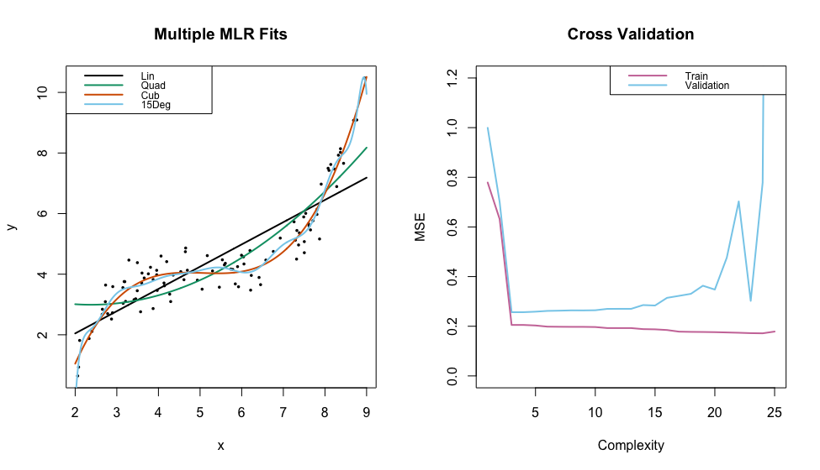
Parametric Example

Slide 42
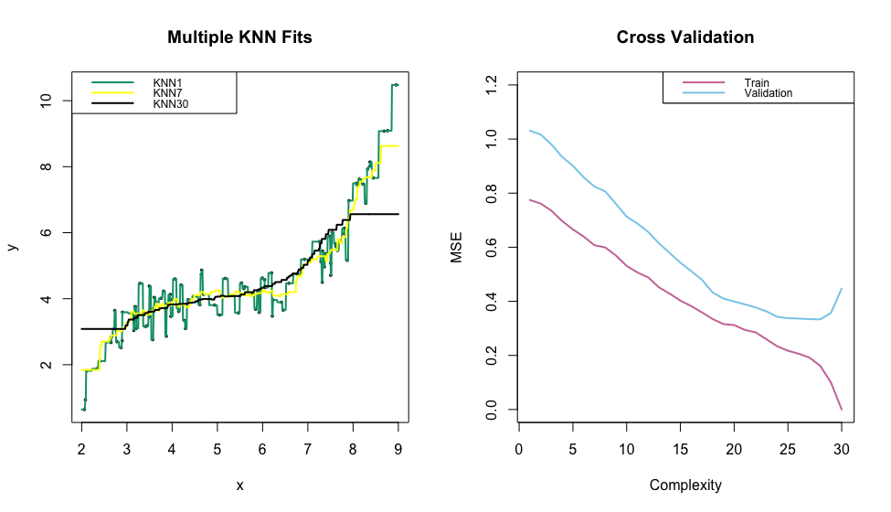
Nonparametric Example

Slide 43
What about Previous Metrics?
Common regression metrics to assess fit
R-squared
Adjusted R-squared
Information criterion
All these metrics are computed on the training data!
AIC/BIC are preferred
Adjusted R-squared and R-squared tend to favor a more complicated model and will have issues when trying to reproduce

Slide 44
Final Takeaway
Building models using various methods is typically straightforward in software. What is important to always keep in mind is that:
Evaluating models should always be taken on an independent set of data.
It is helpful to plot validation MSE’s in a graph that highlights models from least to most complexity to help find the “sweet spot.”

Slide 45
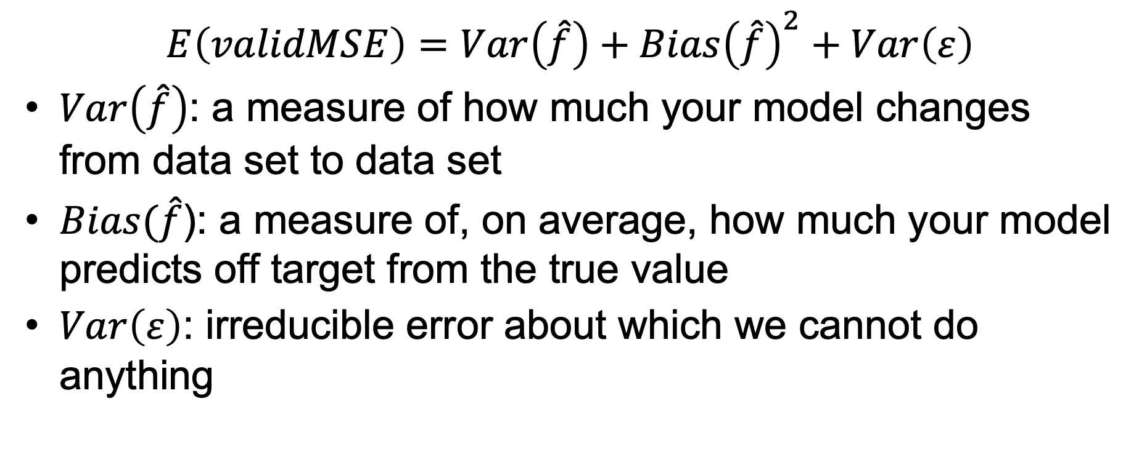
Decomposition of MSE (cont.)
$$E\left(validMSE\right)=Var\left(\hat{f}\right)+Bias{\left(\hat{f}\right)}^{2}+Var\left(ε\right)$$
$Var\left(\hat{f}\right)$: a measure of how much your model changes from data set to data set
$Bias(\hat{f}$): a measure of, on average, how much your model predicts off target from the true value
$Var\left(ε\right)$: irreducible error about which we cannot do anything

Slide 46

Visualizing Bias and Variance
Consider that we have a single predictor variable and the true relationship it has with the response is a cubic:
$$y=β_{0}+β_{1}x+β_{2}x^{2}+β_{3}x^{3}+ε$$

Slide 47
Putting It All Together
MSE
Not Complicated Enough
True Complexity
Too Complicated
Bias
Variance
High
Low
High
Low
Low
Low
Low
High
Low
High
Scenario 1
Scenario 2
Scenario 3
Scenario 4
Scenario 5

Slide 48
Putting It All Together
Key
MSE
Train
Validation
Not Complicated Enough
True Complexity
Too Complicated
Bias
Variance
High
Low
High
Low
Low
Low
Low
High
Low
High
Scenario 1
Scenario 2
Scenario 3
Scenario 4
Scenario 5

Slide 49
Putting It All Together
Key
MSE
Train
Validation
Not Complicated Enough
True Complexity
Too Complicated
Bias
Variance
High
Low
High
Low
Low
Low
Low
High
Low
High
Scenario 1
Scenario 2
Scenario 3
Scenario 4
Scenario 5

Slide 50
Putting It All Together
Key
MSE
Train
Validation
Not Complicated Enough
True Complexity
Too Complicated
Bias
Variance
High
Low
High
Low
Low
Low
Low
High
Low
High
Scenario 1
Scenario 2
Scenario 3
Scenario 4
Scenario 5

Slide 51
Putting It All Together
Key
MSE
Train
Validation
Not Complicated Enough
True Complexity
Too Complicated
Bias
Variance
High
Low
High
Low
Low
Low
Low
High
Low
High
Scenario 1
Scenario 2
Scenario 3
Scenario 4
Scenario 5

Slide 52
Putting It All Together
Key
MSE
Train
Validation
Not Complicated Enough
True Complexity
Too Complicated
Bias
Variance
High
Low
High
Low
Low
Low
Low
High
Low
High
Scenario 1
Scenario 2
Scenario 3
Scenario 4
Scenario 5

Slide 53
Putting It All Together
Key
MSE
Train
Validation
Not Complicated Enough
True Complexity
Too Complicated
Bias
Variance
High
Low
High
Low
Low
Low
Low
High
Low
High
Scenario 1
Scenario 2
Scenario 3
Scenario 4
Scenario 5

Slide 54
Putting It All Together
Key
MSE
Train
Validation
Not Complicated Enough
True Complexity
Too Complicated
Bias
Variance
High
Low
High
Low
Low
Low
Low
High
Low
High
Scenario 1
Scenario 2
Scenario 3
Scenario 4
Scenario 5

Slide 55
Putting It All Together
Key
MSE
Train
Validation
Not Complicated Enough
True Complexity
Too Complicated
Bias
Variance
High
Low
High
Low
Low
Low
Low
High
Low
High
Scenario 1
Scenario 2
Scenario 3
Scenario 4
Scenario 5

Slide 56
Putting It All Together
Key
MSE
Train
Validation
Not Complicated Enough
True Complexity
Too Complicated
Bias
Variance
High
Low
High
Low
Low
Low
Low
High
Low
High
Scenario 1
Scenario 2
Scenario 3
Scenario 4
Scenario 5

Slide 57
Putting It All Together
Key
MSE
Train
Validation
Not Complicated Enough
True Complexity
Too Complicated
Bias
Variance
High
Low
High
Low
Low
Low
Low
High
Low
High
Scenario 1
Scenario 2
Scenario 3
Scenario 4
Scenario 5

Slide 58
Putting It All Together
Key
MSE
Train
Validation
Not Complicated Enough
True Complexity
Too Complicated
Bias
Variance
High
Low
High
Low
Low
Low
Low
High
Low
High
Scenario 1
Scenario 2
Scenario 3
Scenario 4
Scenario 5

Slide 59
Terminology Link
Models that have poor validation MSE due to variance is also communicated as the model suffering from “overfitting.”
Models that suffer from validation MSE due to bias can be considered “underfitting,” but this term is typically not used in everyday discussion compared to “overfitting.”

Slide 60
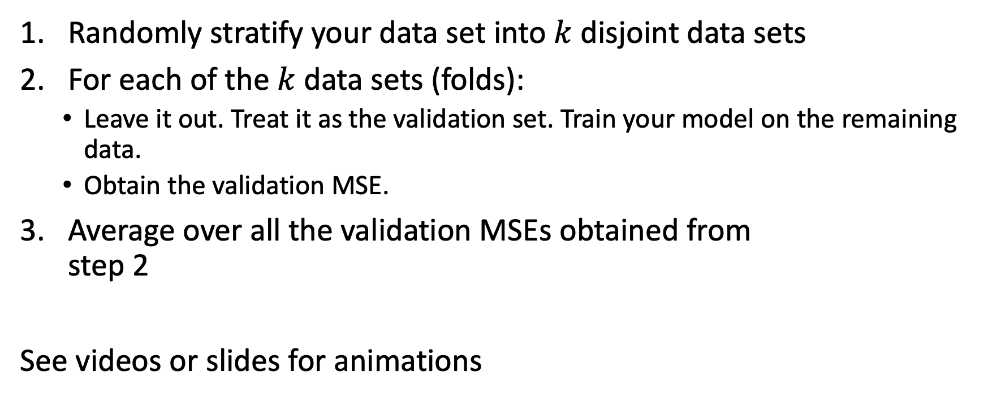
k-Fold Cross-Validation
Randomly stratify your data set into $k$ disjoint data sets
For each of the $k$ data sets (folds):
Leave it out. Treat it as the validation set. Train your model on the remaining data.
Obtain the validation MSE.
Average over all the validation MSEs obtained from step 2
See videos or slides for animations

Slide 61
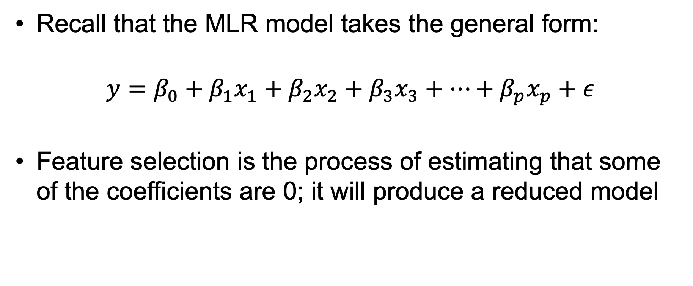
Feature Selection (Functionally)
Recall that the MLR model takes the general form:
$$y=β_{0}+β_{1}x_{1}+β_{2}x_{2}+β_{3}x_{3}+…+β_{p}x_{p}+ε$$
Feature selection is the process of estimating that some of the coefficients are 0; it will produce a reduced model

Slide 62
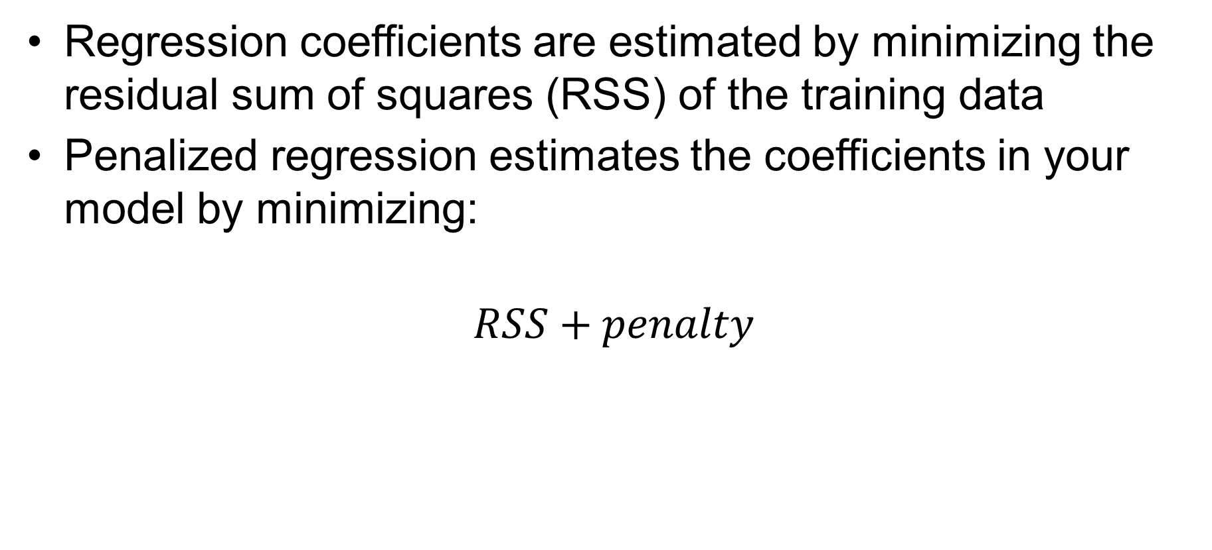
Penalized Regression (High Level)
Regression coefficients are estimated by minimizing the residual sum of squares (RSS) of the training data
Penalized regression estimates the coefficients in your model by minimizing:
$$RSS+penalty$$
The penalty term has its own mathematical form, but it is controlled by a parameter $λ$.

Slide 63
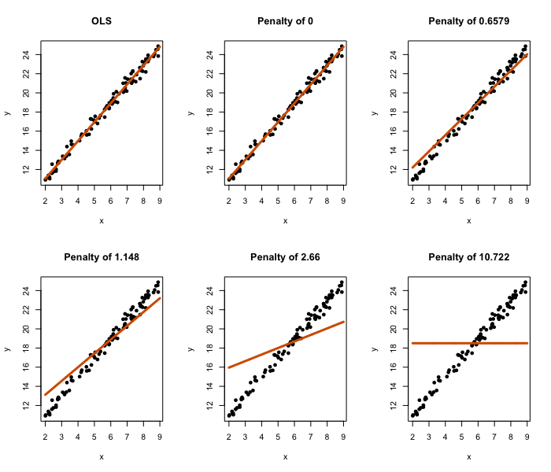
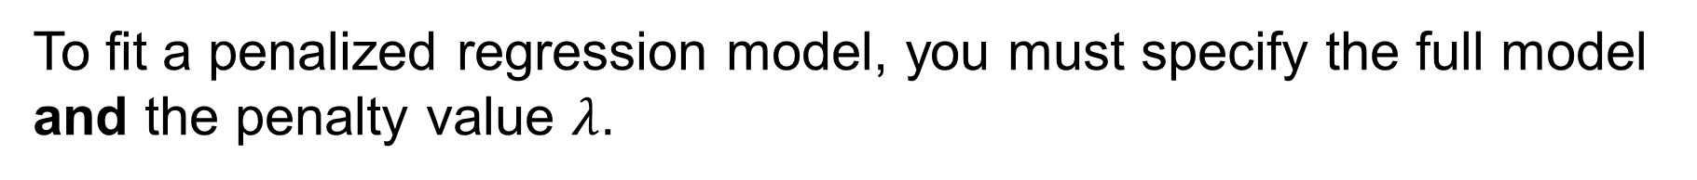
Simple Case of Penalized Regression
To fit a penalized regression model, you must specify the full model and the penalty value $λ$.

Slide 64
Simple Case of Penalized Regression (cont.)
The stronger the penalty, the closer the estimated slope gets to 0.

Slide 65
Visualizing Penalty Effects in MLR
Coefficients vs. penalty
Zoomed in version
19
17
12
6
19
17
12
6
1.0
50
CV Selected penalty
0.5
0
0.0
Coefficients
Coefficients
-50
-0.5
-100
-1.0
-2
0
2
4
-2
0
2
4
Log lambda
Log lambda

Slide 66
The Main Idea
Overly complicated models will have an artificially low train MSE.
Coefficients estimated use training data
By adding a penalty term, we bias the coefficients toward 0.
Force the fit to be a bit worse on training data
Should reproduce better on future data sets
Some coefficients will effectively be 0.
Removed from the model entirely
Final question: How do you pick the penalty term?
See videos/full slides for technical details
Notes:
We know that a full model that is overly specified will have an artificially low train MSE (coefficients are estimated based on this)
By adding a penalty term, we bias the coefficients toward 0 forcing the fit to be a little bit worse on the training data, but should reproduce better on future data sets since its not as dependent on the train
Some coefficients will be effectively 0 and thus is removed from the model
The only question now is how do we pick the appropriate penalty value?

Slide 67

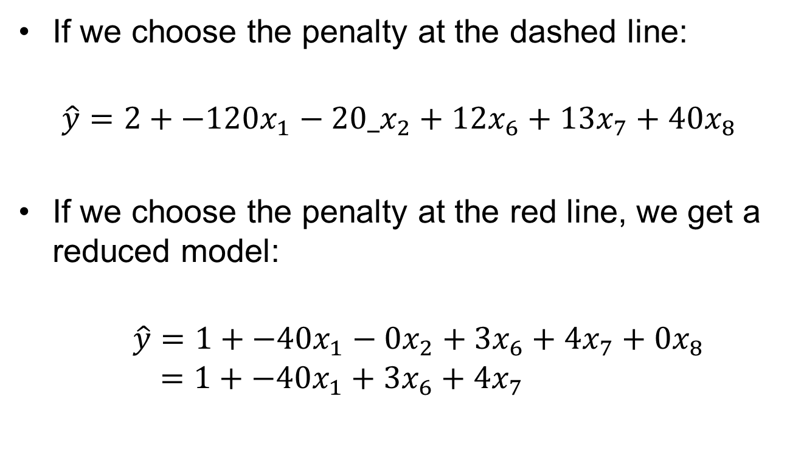




Penalty Controls Complexity
If we choose the penalty at the dashed line:
$$\hat{y}=2+{−120x}_{1}−20_x_{2}+{12x}_{6}+13x_{7}+40x_{8}$$
If we choose the penalty at the red line, we get a reduced model:
$$\hat{y}=1+{−40x}_{1}−0x_{2}+{3x}_{6}+4x_{7}+0x_{8}$$
$$=1+{−40x}_{1}+{3x}_{6}+4x_{7}$$
19
17
12
6
50
CV Selected penalty
$$x_{8}$$
$$x_{6}$$
$$x_{7}$$
0
$$x_{2}$$
Coefficients
-50
$$x_{1}$$
-100
-2
0
2
4
Log lambda

Slide 68
Penalty Selection via k-Fold
k-fold cross-validation is used to determine the optimal penalty term.
If a more complex model is needed, then the penalty will be very small.
In this example, the chosen penalty results in six coefficients retained out of 17 total.

Slide 69
Unit 3

Slide 70
Difficulties with MLR
No transformation really works to make assumptions look reasonable.
I found a transformation that works, but the transformation doesn’t allow for interpretation, which is what I need for my problem.
I need model complexity, but it’s suffering from high variance.

Slide 71
A Solution
The bootstrap is a procedure that allows us to circumvent these issues
Can also be used to help solve a lot of other statistical procedures with similar issues
Is utilized heavily in many nonparametric predictive modeling tools such as the well-known random forest algorithm

Slide 72
Bootstrap Key Analogy
The population is to the sample
as
the sample is to the bootstrap samples.

Slide 73
Bootstrap: Main Idea
Mimics the idea of creating the sampling distribution by creating multiple samples from your original sample (bootstrap samples)
Available sampling distribution allows for computing the standard error for any statistic of interest
The entire distribution can be used to compute a confidence interval
Notes:
Mimics the idea of creating the sampling distribution by creating multiple samples (bootstrap samples)
With multiple samples available, we can compute whatever statistic we are interested in on each data set
Calculating the standard deviation of the statistics provides an estimate of the SE
The entire distribution can be used to compute a confidence interval or perform a hypothesis test

Slide 74
Bootstrap Sampling Pseudo Code
Determine the sample size of your data set, $n$.
Randomly pick an observation from your data set; once selected, put it back (sample with replacement).
Repeat step 2 until you get $n$ data points (bootstrap sample).
Repeat steps 2 and 3 many times $(B times)$ to obtain numerous bootstrap samples.

Slide 75
Role as population
Your Sample
2
7
3
4
10
6
Random
select
Bootstrap Sample 1

Slide 76
Role as population
Your Sample
2
7
3
4
10
6
Bootstrap Sample 1
3
Random
select

Slide 77
Role as population
Your Sample
2
7
3
4
10
6
Bootstrap Sample 1
3
7
Random
select

Slide 78
Role as population
Your Sample
2
7
3
4
10
6
Bootstrap Sample 1
3
7
3
Random
select

Slide 79
Role as population
Your Sample
2
7
3
4
10
6
Bootstrap Sample 1
3
7
3
10
3
2
Random
select
Continue until bootstrap sample has same number of data values as your original sample. This completes one bootstrap sample.

Slide 80
Role as population
Your Sample
2
7
3
4
10
6
Bootstrap Sample 1
3
7
3
10
3
2
Bootstrap Sample 2
4
10
7
6
10
2
Bootstrap Sample B
6
6
10
4
4
7
Random
select
Repeat the sampling procedure numerous times to generate numerous bootstrap samples.

Slide 81
Role as population
Bootstrap Sample 1
3
7
3
10
3
2
Bootstrap Sample 2
4
10
7
6
10
2
Bootstrap Sample B
6
6
10
4
4
7
Your Sample
2
7
3
4
10
6
Random
select
$$\overline{X}=4.7$$
$$\overline{X}=6.5$$
$$\overline{X}=6.2$$
Bootstrap Sampling Distribution
Standard deviation of the means is 1.51.
Bootstrap SE estimate for the means is
𝑆𝐸($\overline{X}$)=1.51
0.3
0.2
Density
0.1
0.0
2
4
6
8
10
Mean statistics

Slide 82
Bootstrapping in MLR
Two main approaches
Bootstrapping pairs: good for when assumptions of normality and/or constant variance is not met
Bootstrapping residuals: good for normality assumption and dealing with leverage
Special type: wild bootstrap good for constant variance issue

Slide 83
Bootstrapping Pairs
Works the same as previously described
Sample with replacement of each row of the data set
Each observed response value will always be paired with its observed explanatory values
Estimate all regression coefficients for each bootstrap sample so that a sampling distribution for each coefficient is available

Slide 84
Bootstrapping Residuals Algorithm
General model $Y=f\left(x\right)+ε$ is fitted to data
Residual are calculated as $\hat{ε}=y−\hat{f}(x)$ from the fitted data
Create bootstrap resamples of the residuals
For each bootstrap resample of residuals:
Create a new bootstrapped response using each of the bootstrap residuals with the equation $Y_{boot}=\hat{f}(x)+{\hat{ε}}_{boot}$
Estimate the new regression coefficients from this data set to obtain sampling distribution

Slide 85
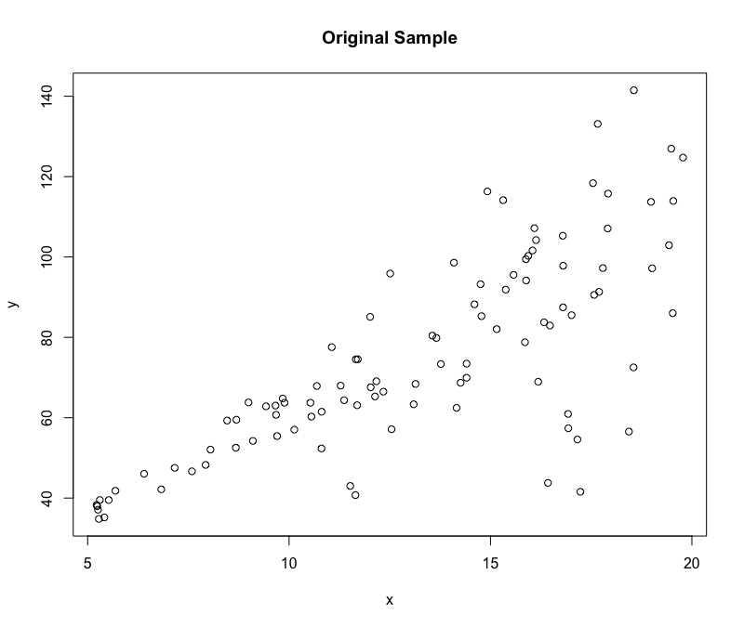
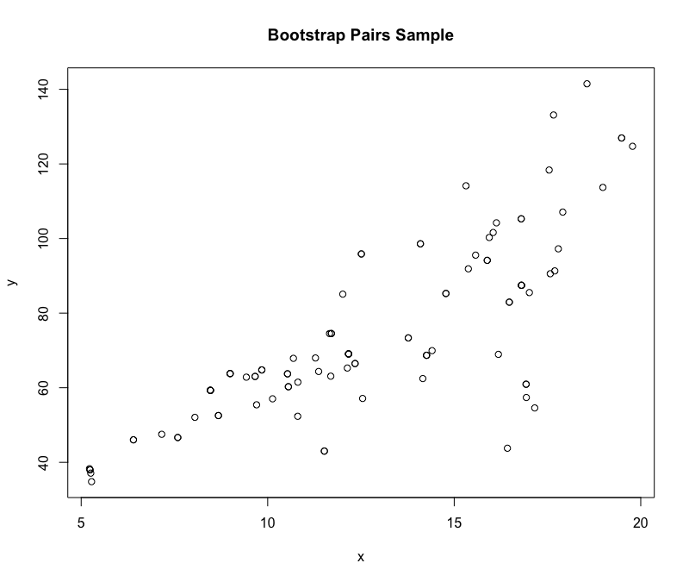
Bootstrapping Pairs
Nonconstant variance property is represented!

Slide 86
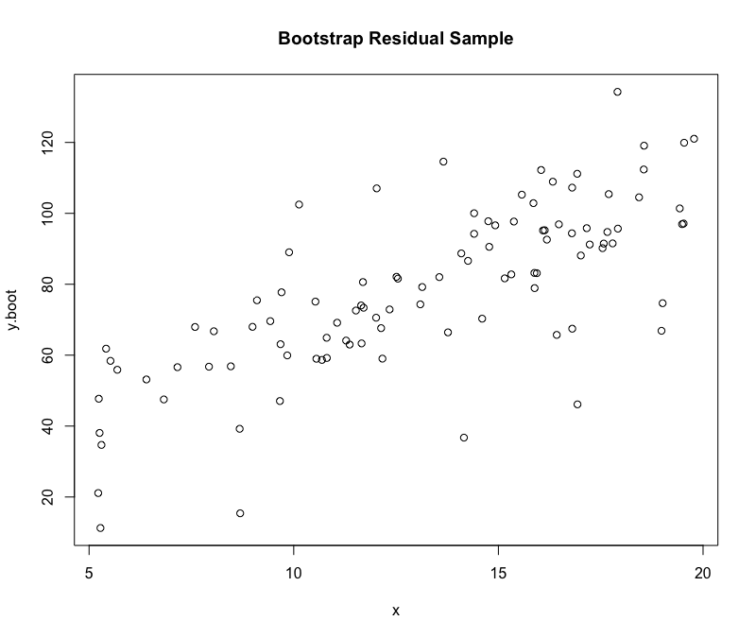
Bootstrapping Residuals
Nonconstant variance property is not represented!

Slide 87
Considerations
Independence of each observation is still needed
If there is a constant variance issue, do not consider bootstrapping residuals unless incorporating a modified method such as the wild bootstrap
Categorical variables with low sample sizes in some of the levels
Consider collapsing levels before starting

Slide 88
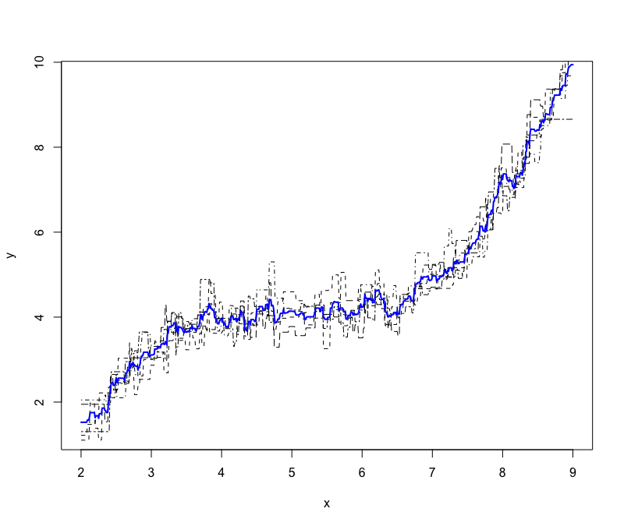
Ensembling Visual (cont.)
Note how ensemble prediction (solid, blue line) smooths out the overfitting (dampens variance).

Slide 89
Big Picture
Ensembles are a “have your cake and eat it, too” approach to the bias-variance trade-off.
Fit models that suffer from high variance.
Dampen the variance by averaging.
Your final model could have low bias and lower variance.

Slide 90
Bootstrap Aggregation
Bootstrap aggregation (bagging) is a modification of the ensembling strategy to boost prediction performance of a single modeling tool.
Jargon: You can “bag” an MLR model or “bag” a tree model, etc.

Slide 91
Bootstrap Aggregation (cont.)
Since the modeling tool doesn’t change, we will get the same predictive model when applied to the same data set, so there is no benefit of ensembling.
Solution: Get different model fits by using different data sets each time. Bootstrap resampling can do this for us!

Slide 92
Bagged Regression Tree
Bootstrap 1
Tree 1
Bootstrap 2
Tree 2
Bootstrap 3
Tree 3
Bootstrap 4
Tree 4

Slide 93
Bagged Regression Tree
Make a new prediction
Bootstrap 1
Tree 1
$${\hat{y}}_{T1}$$
Bootstrap 2
Tree 2
$${\hat{y}}_{T2}$$
Bootstrap 3
Tree 3
$${\hat{y}}_{T3}$$
Bootstrap 4
Tree 4
$${\hat{y}}_{T4}$$

Slide 94
Bagged Regression Tree
Make a new prediction
Bagged prediction
Bootstrap 1
Tree 1
$${\hat{y}}_{T1}$$
Bootstrap 2
Tree 2
$${\hat{y}}_{T2}$$
$$\frac{\left({\hat{y}}_{T1} \text{+}{\hat{y}}_{T2}+{\hat{y}}_{T3}+{\hat{y}}_{T4}\right)}{4}$$
Bootstrap 3
Tree 3
$${\hat{y}}_{T3}$$
Bootstrap 4
Tree 4
$${\hat{y}}_{T4}$$

Slide 95
Unit 4

Slide 96
Interpreting MSE, Part I
Answer: interpret the MSE value
$MSE$: estimate of how variable your prediction errors are
$RMSE=\sqrt{MSE}$ : standard deviation of your prediction errors
Validation errors
250
200
150
Frequency
100
50
0
–10,000
–5,000
0
5,000
10,000
Errors

Slide 97
Interpreting MSE, Part II
Suppose that the graph on the right is a histogram of the residuals from a regression model to predict housing prices in Ames, Iowa
$RMSE=\$3,000$
Validation errors
250
200
150
Frequency
100
50
0
–10,000
–5,000
0
5,000
10,000
Errors

Slide 98
Interpreting MSE, Part III
If the errors are normally distributed with a standard deviation of $3,000…
We know that roughly 95% of all the errors fall between $±2σ$
So, for our predictive model, 95% of all our predictions are off by no more than $6,000
Validation errors
250
200
150
Frequency
100
50
0
–10,000
–5,000
0
5,000
10,000
Errors

Slide 99
Practical Significance
Is being off by up to $6,000 good?
This will depend on the project goals.
At face value, given that homes cost hundreds of thousands of dollars, being off by no more than $6,000 seems pretty good.
It may not be low enough for other reasons.
Marketing wants to be able to sell your predictive tool to companies and boast a $±\$500$ margin of error.
Even if only a few thousand dollars off, it impacts the cost of a future decision by a meaningful amount.

Slide 100
Unit 6/7

Slide 101
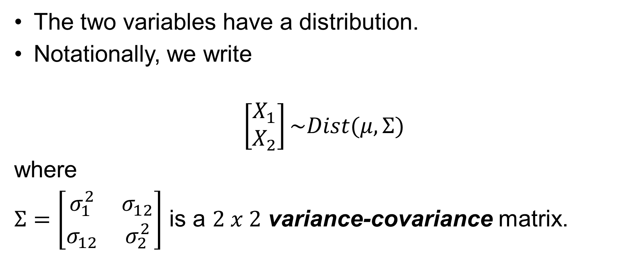
Matrix Representation (cont.)
The two variables have a distribution.
Notationally, we write
$$\left[\begin{matrix}X_{1} \\ X_{2}\end{matrix}\right]\sim Dist(μ,Σ)$$
where
$Σ=\left[\begin{matrix}σ_{1}^{2} & σ_{12} \\ σ_{12} & σ_{2}^{2}\end{matrix}\right]$ is a $2 x 2$ variance-covariance matrix.

Slide 102
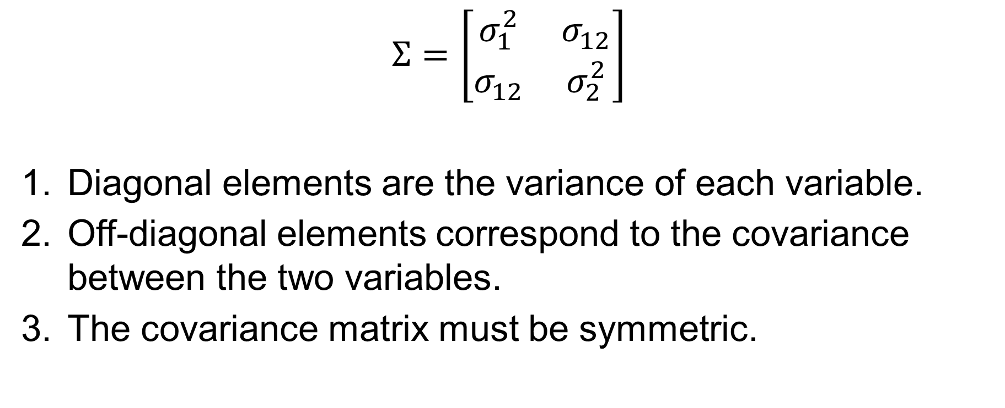
Covariance Matrix
$$Σ=\left[\begin{matrix}σ_{1}^{2} & σ_{12} \\ σ_{12} & σ_{2}^{2}\end{matrix}\right]$$
Diagonal elements are the variance of each variable.
Off-diagonal elements correspond to the covariance between the two variables.
The covariance matrix must be symmetric.

Slide 103
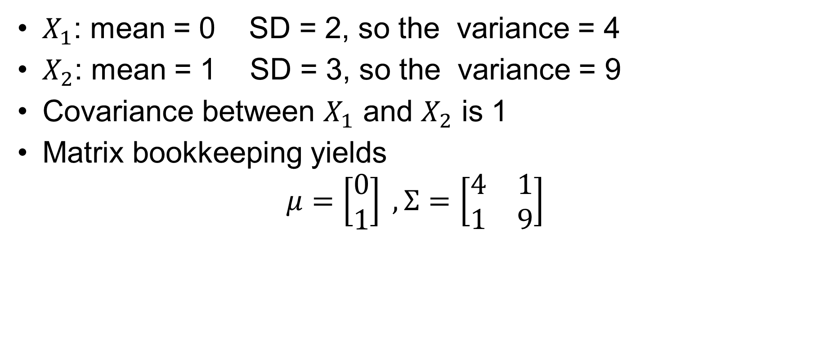
Numeric Example
$X_{1}$: mean = 0 SD = 2, so the variance = 4
$X_{2}$: mean = 1 SD = 3, so the variance = 9
Covariance between $X_{1}$ and $X_{2}$ is 1
Matrix bookkeeping yields
$$μ=\left[\begin{matrix}0 \\ 1\end{matrix}\right] , Σ=\left[\begin{matrix}4 & 1 \\ 1 & 9\end{matrix}\right]$$

Slide 104
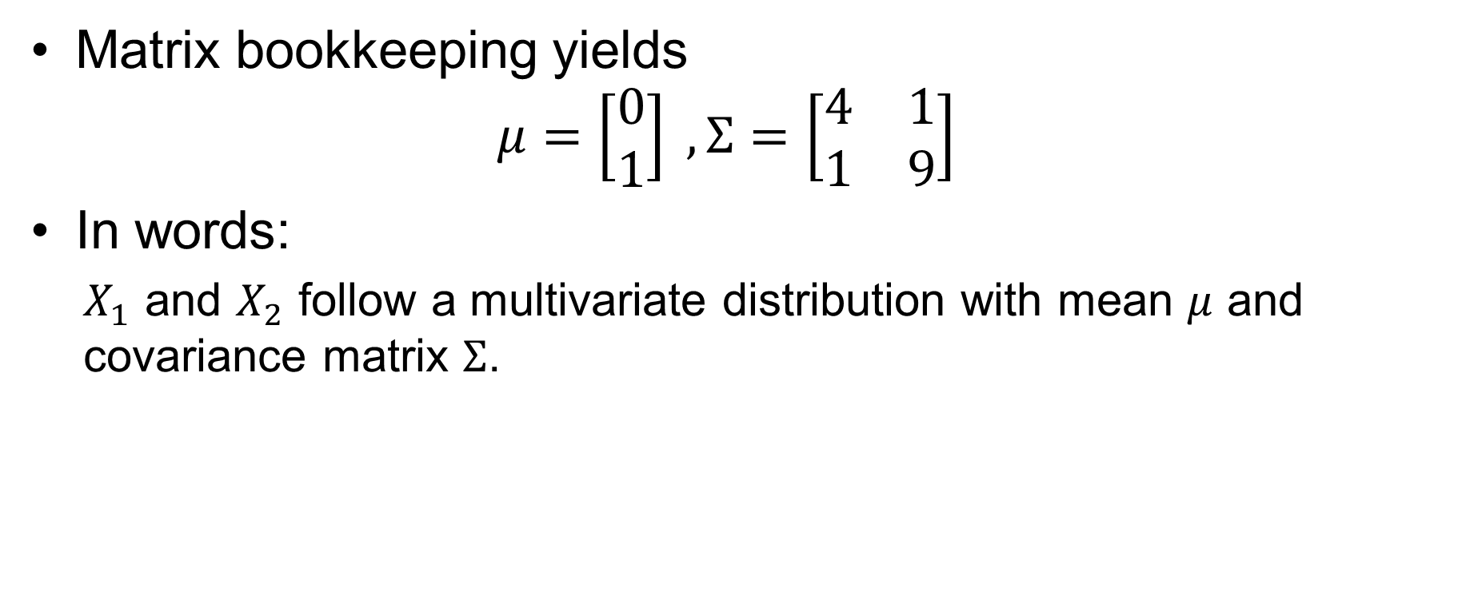
Numeric Example (cont.)
Matrix bookkeeping yields
$$μ=\left[\begin{matrix}0 \\ 1\end{matrix}\right] , Σ=\left[\begin{matrix}4 & 1 \\ 1 & 9\end{matrix}\right]$$
In words:
$X_{1}$ and $X_{2}$ follow a multivariate distribution with mean $μ$ and covariance matrix $Σ$.

Slide 105
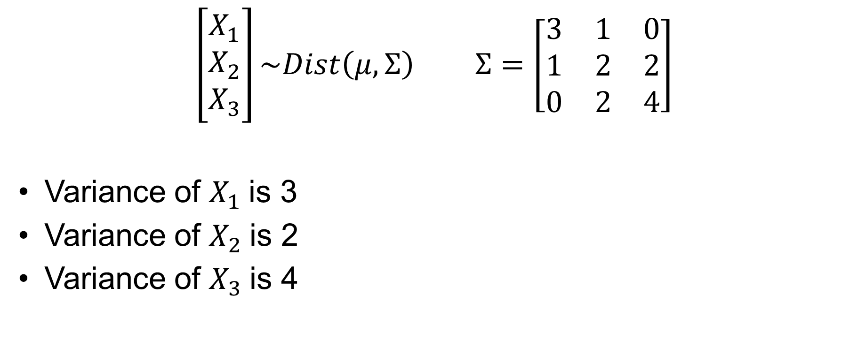
Ease of Information
$\left[\begin{matrix}X_{1} \\ X_{2} \\ X_{3}\end{matrix}\right]\sim Dist\left(μ,Σ\right)$ $Σ=\left[\begin{matrix}3 & 1 & 0 \\ 1 & 2 & 2 \\ 0 & 2 & 4\end{matrix}\right]$
Variance of $X_{1}$is 3
Variance of $X_{2}$is 2
Variance of $X_{3}$is 4

Slide 106
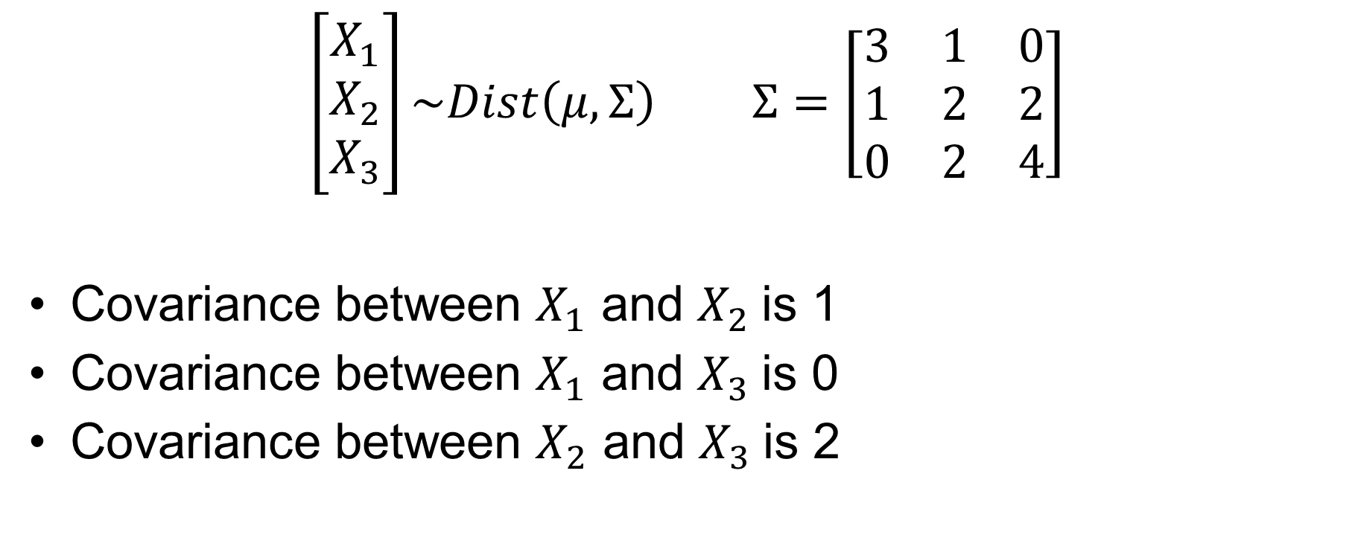
Ease of Reading Information
$\left[\begin{matrix}X_{1} \\ X_{2} \\ X_{3}\end{matrix}\right]\sim Dist\left(μ,Σ\right)$ $Σ=\left[\begin{matrix}3 & 1 & 0 \\ 1 & 2 & 2 \\ 0 & 2 & 4\end{matrix}\right]$
Covariance between $X_{1}$ and $X_{2}$is 1
Covariance between $X_{1}$ and $X_{3}$is 0
Covariance between $X_{2}$ and $X_{3}$is 2

Slide 107

Covariances to Correlation
Correlations can be computed directly from the covariance matrix.
$$COR\left(X_{1},X_{2}\right)=\frac{COV(X_{1},X_{2})}{σ_{1}σ_{2}}$$

Slide 108

Correlation Examples
$\left[\begin{matrix}X_{1} \\ X_{2} \\ X_{3}\end{matrix}\right]\sim Dist\left(μ,Σ\right)$ $Σ=\left[\begin{matrix}3 & 1 & 0 \\ 1 & 2 & 2 \\ 0 & 2 & 4\end{matrix}\right]$
$$COR\left(X_{2},X_{3}\right)=\frac{COV(X_{2},X_{3})}{σ_{2}σ_{3}}=\frac{2}{\sqrt{2}\sqrt{4}}=0.71$$

Slide 109

Correlation Examples (cont.)
$\left[\begin{matrix}X_{1} \\ X_{2} \\ X_{3}\end{matrix}\right]\sim Dist\left(μ,Σ\right)$ $Σ=\left[\begin{matrix}3 & 1 & 0 \\ 1 & 2 & 2 \\ 0 & 2 & 4\end{matrix}\right]$
$$COR\left(X_{1},X_{3}\right)=\frac{COV(X_{1},X_{3})}{σ_{1}σ_{3}}=\frac{0}{\sqrt{3}\sqrt{4}}=0$$

Slide 110
Multivariate Normal Distribution
Multiple variables
Has a mean vector and covariance matrix
Has a joint distribution that categorizes the likelihood of specific combinations of observations
Some data sets will behave in a way that is consistent with the multivariate normal distribution (MVN)

Slide 111
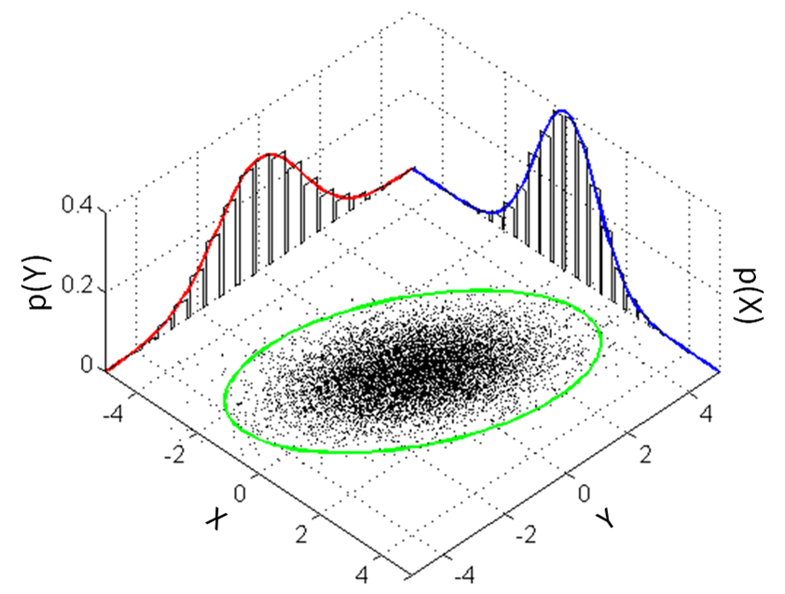
MVN Distribution
Each individual variable will behave like a normally distributed variable.
The relationship between the variables will be linear.
Data points will be denser around the mean vector (point).
Source: Wikipedia

Slide 112
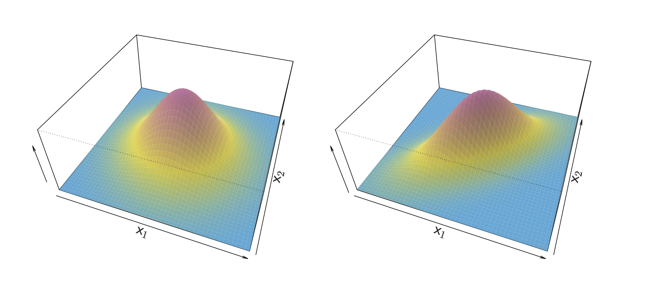
Theoretical MVN Density Curves
Correlation of 0
Correlation of 0.7

Slide 113
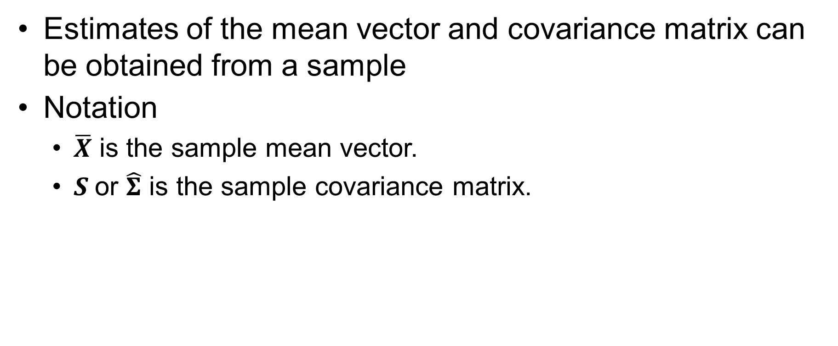
Estimating Parameters from Data
Estimates of the mean vector and covariance matrix can be obtained from a sample
Notation
$\overline{X}$ is the sample mean vector.
$S$or $\hat{Σ}$ is the sample covariance matrix.

Slide 114
Family Tree of Linear Models
Linear models (constant variance, normality)
Errors are independent
ANOVA
Errors are correlated
t-tests
SLR
Time series
Repeated measures

Slide 115
When Errors Are Correlated
Applying a method that ignores this fact can produce misleading p-values and confidence intervals
A method should be used to model the correlation between the errors (additional parameters in the model)
When correlation is accounted for:
Statistical inference is valid
Can be used to make better predictions

Slide 116
Identifying Repeated Measures
It is up to you to identify repeated measure settings.
Can’t determine based on a graph
Sometimes can’t determine from the data
You have to ask questions on how the data were collected.
Repeated measures can fall into any previous methods.
Repeated measures one-way ANOVA
Repeated measures MLR

Slide 117
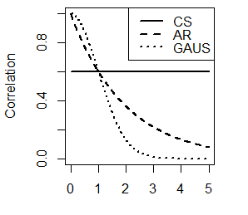
Correlation Structures
Correlation structures are theoretical formulas that represent our assumption of what the trend in the correlogram truly is
Common structure includes:
Compound symmetry
Autoregressive
Gaussian

Slide 118
Generalized Least Squares (GLS)
GLS generalizes the OLS technique for multiple linear regression to allow for correlated errors
In addition to specifying a model with response and predictors, the user specifies a correlation structure and software estimates parameters that govern the structure

Slide 119
Generalize Least Squares (GLS) (cont.)
GLS uses the estimates of the correlation structure and updates:
Regression coefficients
Standard errors of the regression coefficients
These estimates are more reliable than MLR
As long as the correlation structure is close to the truth

Slide 120
Estimating the Correlation in Practice
Alternatives to correlograms are variograms and semivariograms (spatial modeling)
In practice, many repeated measures data sets are not big enough to adequately estimate and visualize the correlation structure (highly variable, hard to see)

Slide 121
Estimating the Correlation in Practice (cont.)
Analyst typically:
Use theoretical justification for the structure used
Fit multiple structures and compare their AIC metrics
Explore correlograms to help make a decision
My experience
Compound symmetry works well (humans, biological, etc.)
Structures that rapidly decrease should be used sparingly unless many of your time points are equally spaced

Slide 122
Repeated Measure Workflow
Identify that you are in a repeated measures setting
Perform EDA based on whatever MLR equivalent setting you are in
Boxplots, mean plots for ANOVA type settings
Scatterplot of predictor and response for SLR
Combinations of above for general MLR setting
Feature selection tools from regular MLR can be used to assess bias-variance trade-off of complex models

Slide 123
Repeated Measure Workflow (cont.)
Residual diagnostics (Regular MLR)
Normality and constant variance checks
Update MLR to GLS
Multiple correlation structures
Select the best fit using AIC
Can use correlogram to help decide
Conduct inference on the regression coefficients to answer the research question
p-values and confidence intervals are more trustworthy

