Slide 1



GearShift Analytics
www.gearshift.com
“Under the Hood: What Drives Car Prices?”
“WHERE AUTOMOTIVE SPECS MEET PREDICTIVE POWER.”
PRESENTED BY: SUE CAMARA & JOHNNY VOGT

Slide 2
Who we are
Johnny Vogt
SMU Data Science Student
13 Years of Experience in the IT Field
6 Years in the Army
7 Years with Raytheon
Sue Camara
SMU Data Science Student
Logistics and Supply Chain (Postal Service)
Resteraunteur
Charity Organizer

Slide 3


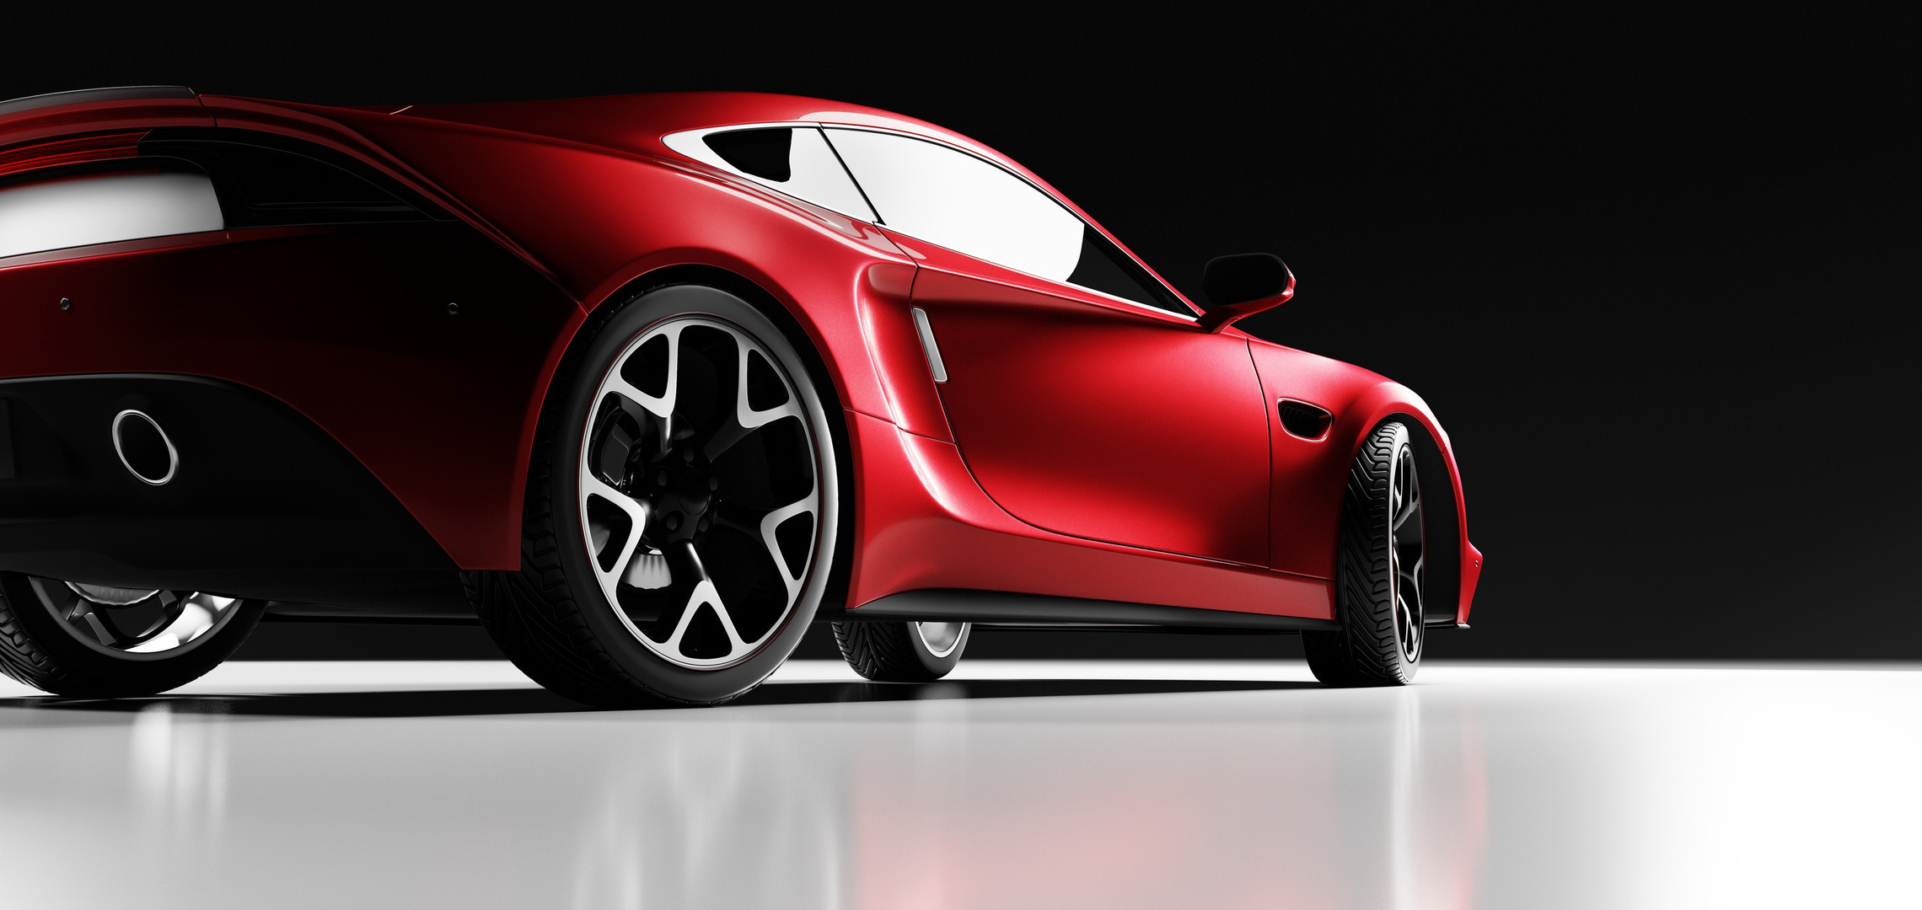

Gear Shift Analytics
Objectives
Dataset
Automobile MSRP dataset (~11,900 vehicles, 14 attributes) Includes specs (horsepower, cylinders, MPG, size, style, etc.) + price (MSRP).
Objective 1
Identify variables and trends that affect MSRP
Build a MLR based off the preliminary analysis
Objective 2
Investigate interactions between variables and non-linear trends
Fit two models
Comples MLR (Polynomials, Interactions)
Non-parametric Models
LETS GET STARTED

Slide 4
Gear Shift Analytics
The Big picture
Our Goal
“Under the Hood: What Drives Car Prices?”
Using relevant variables, create models that accurately predict MSRP.
LET’S GOOOOOO!

Slide 5
Cleaning up Data and Why
Removed Variables
Highway MPG, Engine Cylinder, Vehicle Size, No. Of Doors, Make
HighWay MPG was removed because City MPG
Eng. Cylinder was removed because of Eng. HP
Vehicle Size and No. Of Doors was removed because of Vehicle Style
Make was removed because of Market Category
Removed Entries that had empty Values. (99 Entries)
Considered them mistakes and error in collecting data
Removed <1% data
The data removed from visual standpoint seem to cover a spread of MSRPs
Converted Year into a category (For Academic Curiosity)
Pre-2001 and Post-2001
There is a stark contrast between these date and by converting it to a categorical variable could help the data better fit the models

Slide 6
Removed Data Statistics
MSRP
Range: 7523 – 295000
Median:33950 Mean: 45413
HP (69 N/A)
Range 66 - 651
Cylinder (30 N/A)
Range 0 (Electric) - 12
Doors (6 N/A)
Median: 4

Slide 7
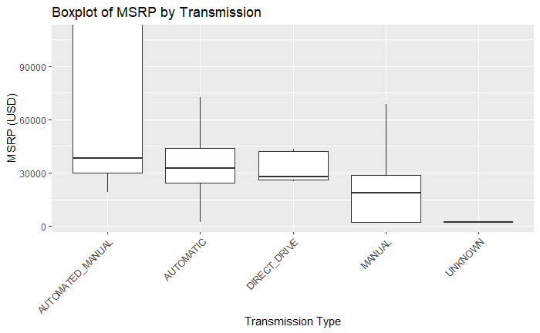
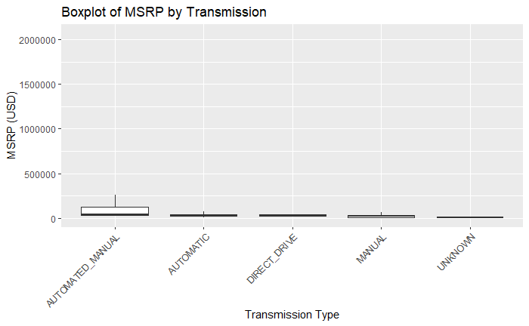
Dealing with Outliers
Due to MSRP having have a lot of outliers, some of them holding a lot of leverage. We created two data sets.
Full Dataset (including Outliers)
Reduced Dataset (excluding outliers that are past 3 standard deviations from the mean.
All Plots will be shown without outliers or focused on majority of the data because the outliers heavily skew the data
Plots below illustrate the effect that outliers have on the plot

Slide 8




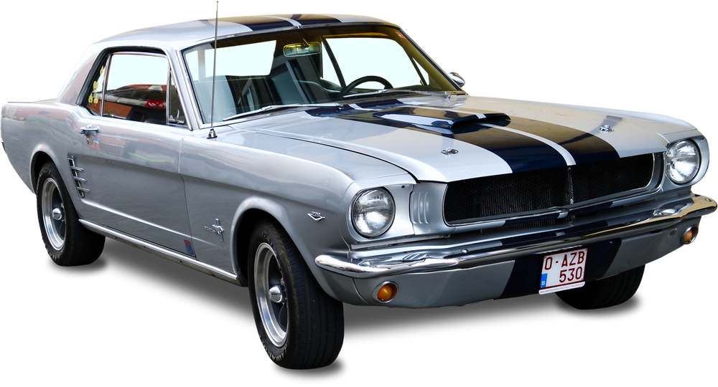
Gear Shift Analytics
table of variables
Numeric
Categorical
MSRP
Year
HorsePower
Fuel Type
Transmission
Driven Wheels
Market Category
Vehicle Size
Vehicle Style
numeric
city.mpg
EPA city miles per gallon.

Slide 9

Gear Shift Analytics
Summary of Statistics
Numerical variables
Variable
Min
Median
Q1
Mean
Q3
Max
MSRP
2000 | 20990 | 29960 | 40556 | 42200 | 2065902
1990 | 2007 | 2015 | 2010 | 2016 | 2017
55 | 170 | 227 | 249 | 300 | 1001
7 | 16 | 18 | 19.33 | 22 | 137
Year
Horsepower
City MPG
city.mpg
EPA city miles per gallon.

Slide 10
Gear Shift Analytics
Summary of Statistics
Categorical variables
Variable
No. Of Categores | Least Common | Most Common
11 | Natural Gas (2) | Regular Unleaded (7172)
5 | Unknown (19) | Automatic (8266)
4 | Four Wheel Drive (1403) | Front Wheel Drive (4787)
72 | Crossover,Exotic, Luxury, High-Perf (1) | N/A (3742)
16 | Convertible SUV (29) | Sedan (3048)
Fuel Type
Transmission
Driven Wheel
Market Category
city.mpg
EPA city miles per gallon.
Vehicle Style

Slide 11
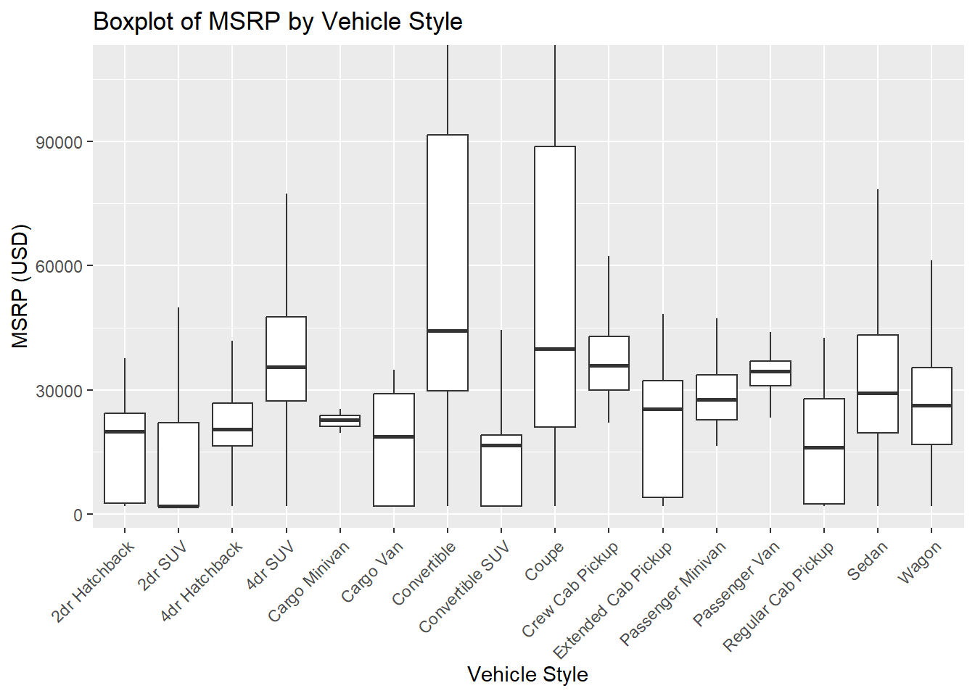
EDA: MSRP vs Vehicle Style
Plot clearly shows that vehicle styles have varying degrees of Means and Medians
Further Investigation could include running ANOVA to determine that each Style IS statistically significant from each other.
Tried putting color for for info...no bueno

Slide 12
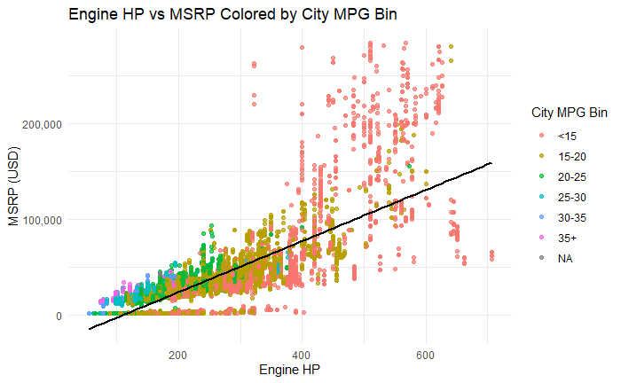
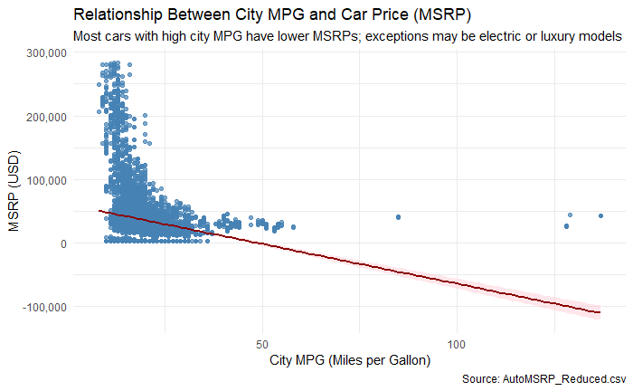
Horse Power and City MPG vs. MSRP
Interesting stuff here. As HP increases the MSRP has a positive increase, but MPG seems to go down
MPG has some weird trends.
Has a negative correlation with MSRP
Aside from Electric and Luxury cars, most cars do not go above 40MPG

Slide 13
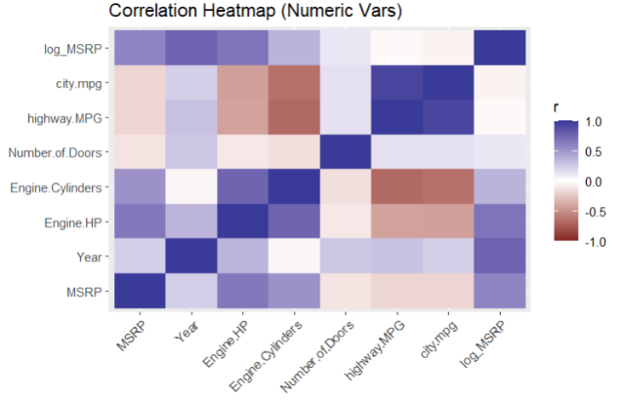
Heat Map with all Continous Variables
Positive Correlation
City and Highway MPG (Removed)
Engine HP and Cylinders (Removed)
Negative Correlations
MPG and HP (Possible Interactions)

Slide 14
Modeling
We created multiple models (20 +)
Investigating differences including and excluding outliers
Investigated differences between Logging the Response Variable (MSRP)
Made Model based on Simple MLR with Feature Selection
Forward, Backwards, and Stepwise
Used Penalized Regression to create a model
Created a Model using Interactions and a Polynomial
Created Models using Non-Parametric functions

Slide 15
Simple MLR
Forward/Backwards/Stepwise
All had the same conclusion to keep all predictors in
Penalized Regression
Removed quite a few predictors from Market category
Logging the Response Variable (MSRP) helps the models meet assumptions
Creating models without outliers, helps the model predict with vehicles closer to the average of the dataset.

Slide 16
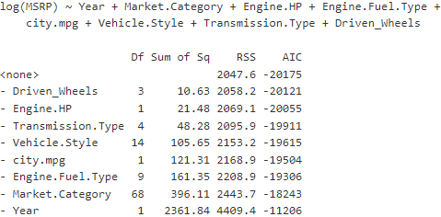
Forward/Backwards/Stepwise Model
Training off a data set that excluded outliers and using the Natural Logarithm, the Feature selection process decided that this was the best model.
In the model, there are several significant variables; Year, Horsepower, and MPG
Holding all other variables constant.
An increase in year is associated with a 10.7% increase to MSRP
Horsepower has an 10% associated increase to MSRP for every 100 units
Miles Per Gallon is associated with a 4.4% drop for ever additional mpg

Slide 17
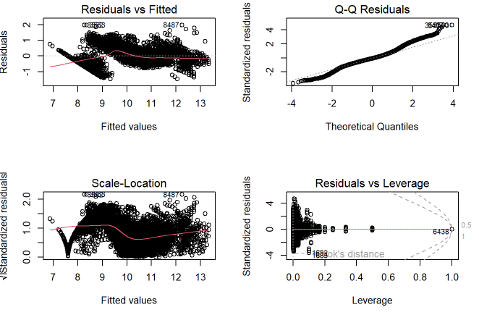
Assumption for Simple MLR (NoOut/Log)
Residuals vs. Fitted:Scattered across, but distinct pattern on the left side of plot
Q-Q Plot: Follows closely on the line of reference, except on the right tail, indicating some outliers
Scale-Location: Seems to have a lot of scatter across line of reference, but the left side of the plot shows a weird pattern and a little fanning.
Residual vs. Leverage: Most of the plot lies on the left side of the plot. There are some points on the right side of the plot, but they do not have enough leverage, but they are highly influential and should be considered, especially since this model removed outliers.

Slide 18
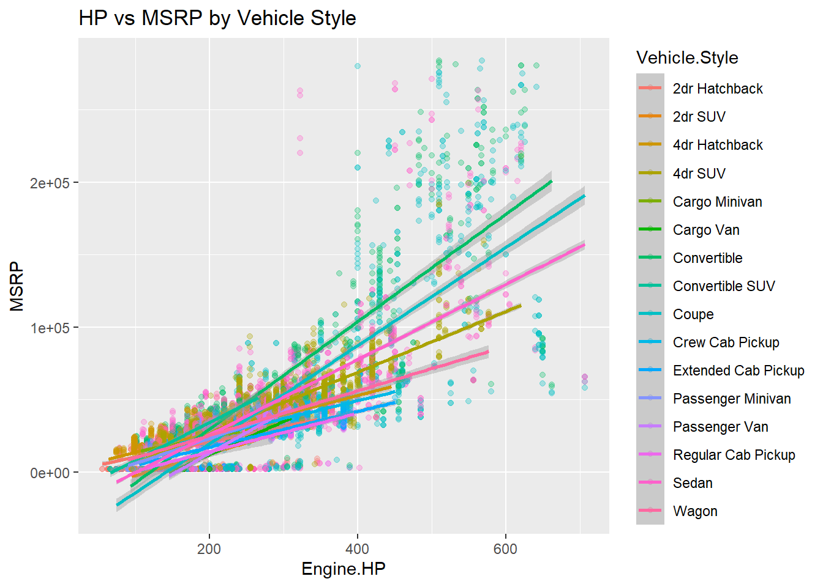
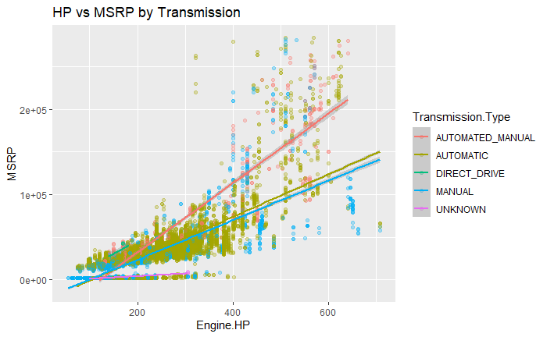
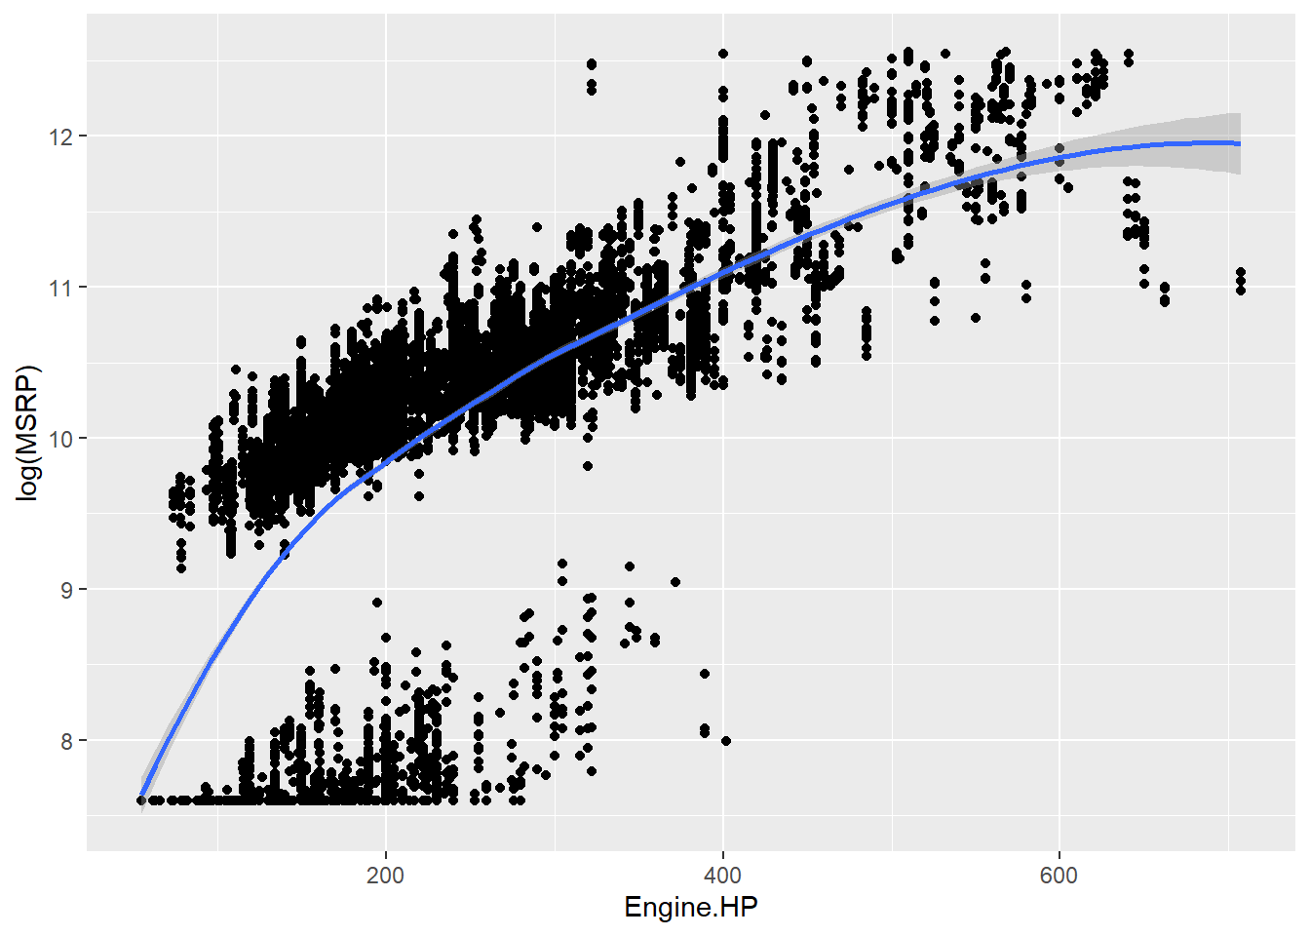
Complex MLR
Preliminary EDA stuff
Discuss the interactions
Why we including these interactions
Why used some Polynomials

Slide 19
Complex MLR Coefficients
In this model, the predictors, horsepower:Style and MPG:FuelType are interacted with each other (percentages are an adjustment to the default percentage)
Allowing the model to have the flexibility to adjust the effects of MPG and HP
MPG has an positive assocation with electric vehicles (+4.2%) vs. Premium Unleaded has an negative effect (-5.2%)
An SUV has an positive effect with Horsepower (+0.26%) vs. A Crew Cab Pickup has an negative effect (-0.21%)
We also added a quadratic effecton Horsepower and this had dampened the positive effect for the predictor as it grows larger.

Slide 20
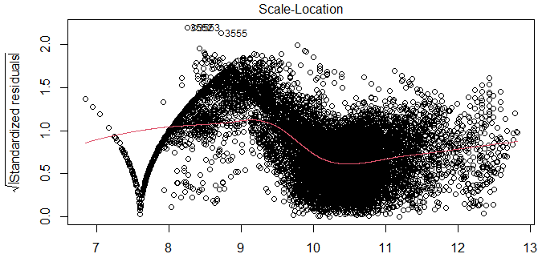
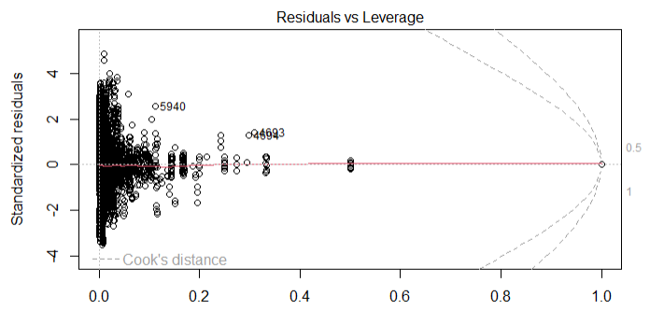
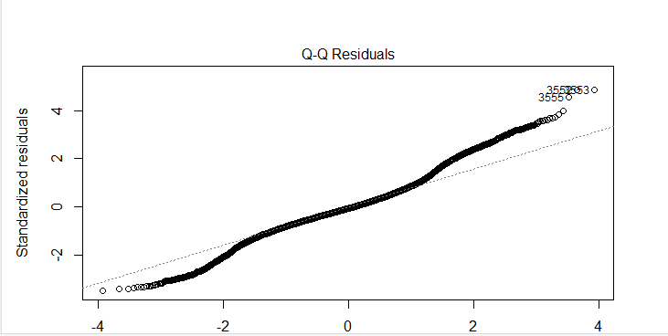
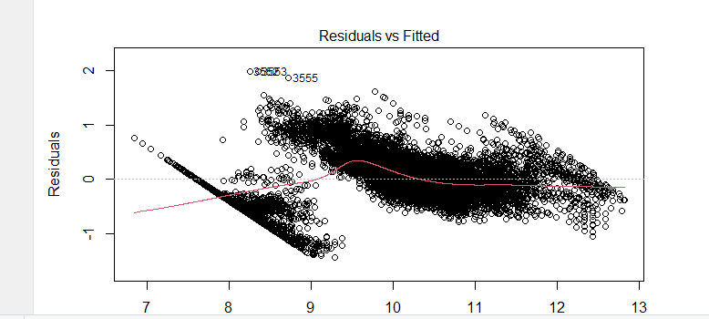
Assumptions Complex MLR
QQ Plot: Quite straight, with some deviation for line of reference
One very influential point, but not a lot of leverage
The Scale plot does not represent a line, which shows a deviation from the assumptions
The Residual vs. Fitted plot, shows pattern, groupings, but still maintains a large amount of scattered randomness. The grouping could be due to the year attribute.

Slide 21
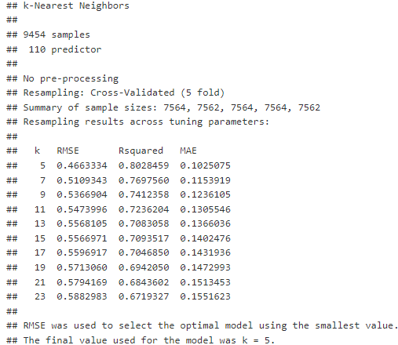
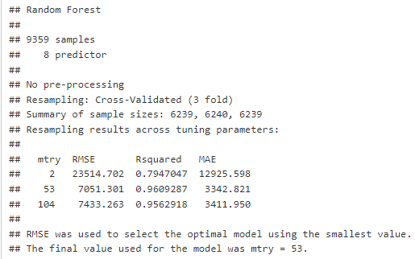
Non-parametric Models
KNN and RF
KNN model uses distance-based models that predicts based of values of similar likeness (K Values are not translated back to dollar)
RandomForest is an ensemble model that uses bootstrapping and aggregates their predictions into a single estimate.

Slide 22
Model Comparison
KNN was not translated back to Dollar
If need be I can make a plot for each one to visually show which one does best?
Model | RMSE | MAE | R^2
Simple | 19,559 | 9741 | 0.7449
Complex | 18396.22 | 9444.5 | 0.7706
KNN | 0.4663334 | 0.1025075 | 0.8028459
RF | 7051.301 | 3342.821 | 0.9609287

Slide 23
Things to keep in consideration
Year was investigated further by making it into a factor and making it into pre/post 2001, but the assumptions of the models were not met
Possible Violations of other models, need to go back and look at it
Market Category has A LOT of variables
Market category had a lot of N/A variables that we kept in as its own separate category

Slide 24
Conclusion
Go Over the objectives
Review how we answer them

