Slide 1
Leveling Up
GameStop
Bringing power back to the gamers
Notes:
Good Evening, My name is Johnny Vogt and I’ll be talking about Gamestop and how we can revive this once former retail Juggernaut

Slide 2

Pitfall of Continuous Growth
The price wall of gaming is getting steeper and heading towards an unsustainable model.
Video Games have gotten expensive
Hardware have gotten expensive
Notes:
As games get more complex and bulkier, the price of gaming has gone up
New gmes cost roughly 60-80 dollars on initial purchase, not including future DLC or microtansactions.
Consoles too! They need to keep up as well, with new consoles costing from 400 – 600 dollars to keep up with the resource demand that games require from consoles
This is heading towards an unsustainable growth and will eventually price out the average consumer.

Slide 3
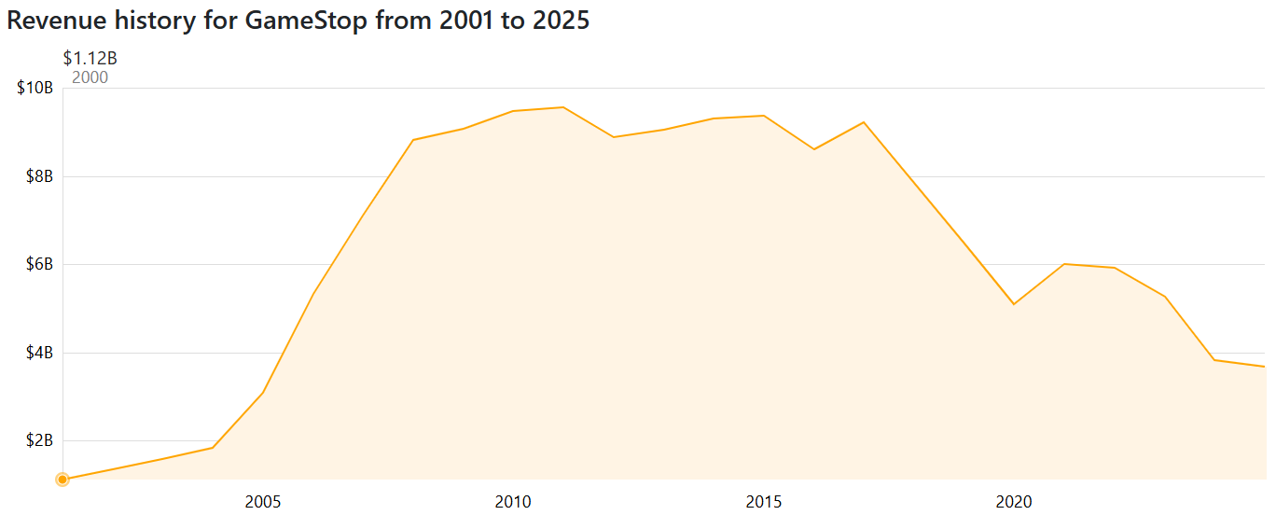

Whats wrong with GameStop?
Brick and Mortar Gaming is coming to an end
The used game market is only reserved for retro gaming and that a niche field
Started Cost Cutting measures, such as closing stores and shifting away from games and into collectibles
Notes:
GameStop is dying, theres no if ands or buts. Their business model has been dying and they haven’t pivoted at all. In fact they’ve gone backwards. The company have already started to cut cost, closing their stores nationwide and moved towards selling merch, straying further from their core business. As you can see from the graph, they hit their peak around 2010 -2015, than it plummeted due to the prevalence into digital downloads killing one of their largest source of revenue which was buying and selling “used” games, due to the overall decrease of gamers having physical games to sell back.

Slide 4

How to avoid a “Game Over”
Transition towards a modern version of an Arcade
Multiple Stations geared toward gaming
Local Tournament
  Feeders into larger tournaments
Go back to their roots and bring back affordable gaming to the players
Notes:
I propose that GameStop should move towards an arcade model. They should set up multiple gaming stations that would have a mix of console, PCs, and retro gaming systems. With the equipment already bought, the stores could start host local tournaments and working with local school esport teams and have a feeder system to larger and larger tournaments bringing competitive gaming to the every gamestop’s local community and bringing revenue from advertisment and exposure. Overall this would allow gamestop to provide gamers a means to the hobby at an affordable price

Slide 5


Why GameStop and why arcade?
Brand Appeal and Consumer Trust
2000+ Locations across the US
We already use this kind of model in other sectors
  Gyms
  Pool Halls
  Dave and Buster, etc.
Notes:
Why gamestop? Its a failing business, a store that seems to have lost it’s flair that it had from a decade ago.
That is exactly why we should pick gamestop because of the nostalgia, because of the brand appeal, and most importantly their prime real estate. There are whole generations of gamers that mourn the fall of gamestop, including myself although we are slightly complicit in its fall from grace. The nostalgia factor it self should bring in healthy and skeptical optimism that would be missing from any other company coming from outside the industry. The company already have locations ALL over america and have created a pipeline within the gaming industry and customers. Making it easy to scale up if successful. Everyone here can probably find a gamestop fairly easily within a short drive from themselves.
and I’m sure that the idea of this probably feels wrong already and thats because we are obsessed with ownership of video games, not that there is anything wrong with that, but conceptually we’ve already accepted this type of business model in PLENTY of sectors for example..gyms and dave and busters.Both of which are companies that provided a high upfront cost to expensive equipment and charge users a small fee to utilize their equipment There is nothing radiclally different with the model, just a different industry.

Slide 6
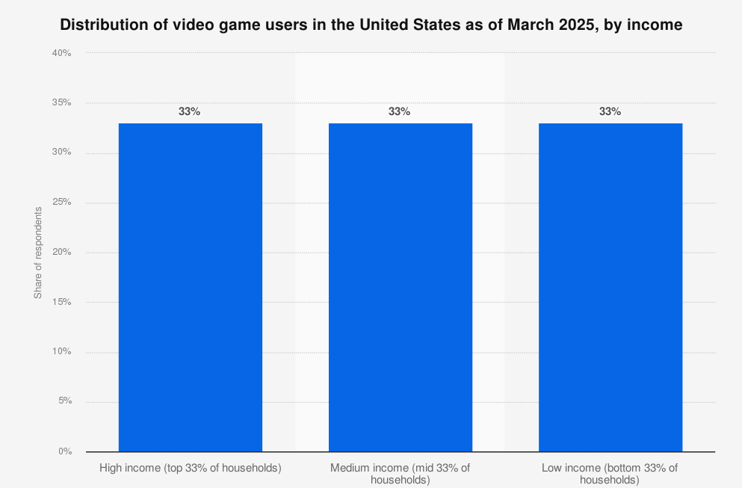
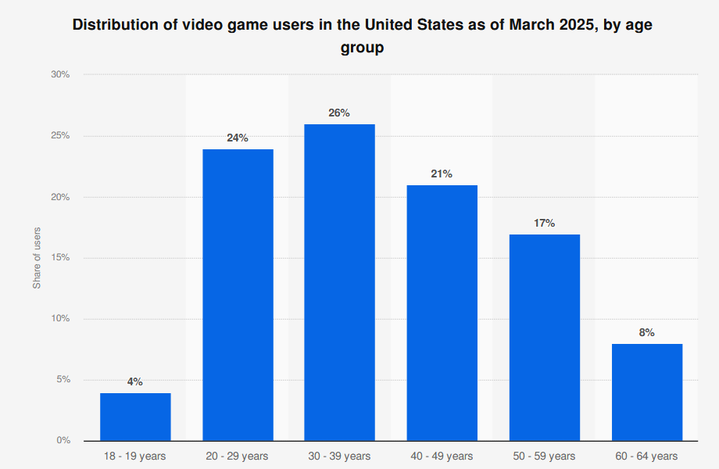

Demographics
Breakdown by Income
Age Spread of Gamers
Notes:
Ideally, we would advertise to ALL AGEs, but thats not realistic. As you can see on the bar chart of gamers of different household income. The distribution of gamers do not change based off one’s income group, meaning the demand is spread equally across ALL American household incomes. The age demographics show a slightly different story with most gamers are younger, and it doesn’t even account for gamers younger than 18. Which would likely skew the data ever further toward the younger population. That is exactly where we will aim our price point.

Slide 7
Subscription Model
Tier | Monthly Price | Access | Type of Gaming | Event/Extra
Bronze | $9.99 | Weekday (30 hr/mo) | Console/Retro Game | 1 Free Tournament Entry
Silver | $24.99 | All-Week (50 hr/mo) | All Systems | 3 Free Tournament Entries
Gold | $49.99 | All-Week,Unlimited Hours | All Systems | Unlimited Tournament Entries, 1-on-1 Coaching
Platinum | $99.99 | Family Access (4), Unlimited access | All Systems | Free Tournament Entries, Reserved Private Room, 1-on-1 Coaching
Hourly Rate: $3
Concessions: Prices May Vary
Notes:
The model broken up into four tiers with differing price points and offerings. Beginning at $10 a month for 30 hour of gaming and Maxing out at $100 for Unlimited acces and family passes.

Slide 8

How to win and how to grow
Streams of Revenue
  Streamed Content
  Concessions
  Events
  Sponsors
  Cyber Cafe
Possible Partners
  Game Developers
  Intel/AMD/NVIDIA
  Venues for Events
Notes:
There are more ways to make money than just subscriptions.
Gamestop could start working with esport teams or gaming influencers and start streaming content and tournaments and that would bring in advertising revenue
Even equipment could be provided at bulk discount through partnerships with a number of supplier such as AMD/NVIDIA, iBUYPOWER, Dell/AlienWare

Slide 9


Possible Roadblocks
Culture isn’t there yet
  May take a lot of money and time to change culture
People don’t like to leave the house to play games
Possible High Renovation cost
  Gaming Systems
  Licenses to play games
  Furniture
Industry Giants may not be a fan of the model in the long run
Notes:
The biggest hurdle would be to get people to want to come game at another location outside of their comforts of their own home.
The upfront cost of renovation and licenses to play games
If there is a drop in sales from individual, there could be resistance industry giants especially since gamestop is a large brand, you could assured that they are watching.

Slide 10


EndGame
Engages the youth
  Creates a safe space after school
As console and game developers and continue to find ways to raise the prices on the players, we will find ways to make it affordable
Shift in model helps GameStop bring greater value to gamers
Notes:
Overall, this creates a safe place for kids to hang out after school at a cheap price. Most kids will go home and play anyways, might as well try to make some money and ask them to play at game stop.
If successful, the sentiment towards gamestop will be favorable as the industry tries to make more and more money from the wallets of their consumers, Gamestop will be seen as the bulwark against greed and try to prevent gaming from pricing out the average gamer. Bringing gamestop back to its roots, which is to bring power back to the player.
Thank You So much for your time.

Slide 11
Contact Me
Email: jvogt@smu.edu
Cell: 1-800-382-5633

Slide 12


References
Slide 3
  CompaniesMarketCap. (2025). GameStop (GME) - Revenue. CompaniesMarketCap. https://companiesmarketcap.com/gamestop/revenue/
Slide 6
  Statista. (2024, July). U.S. video game users by age 2024. Statista. https://www.statista.com/forecasts/1277856/video-game-users-age-market-usa
  Statista. (2024). Share of consumers who have ever played video games in the U.S. by income. Statista. https://www.statista.com/forecasts/499713/share-consumers-ever-play-video-games-by-income-usa

