Slide 1
FLS Unit 11
Time Series
Johnny Vogt

Slide 2
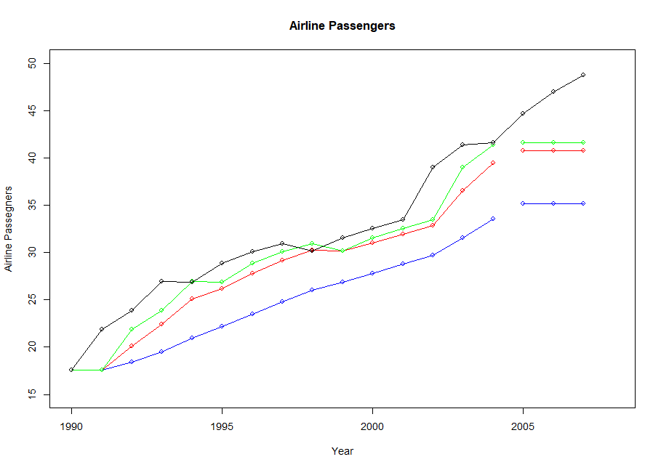
Activity 1: SES
This plot has four lines
Black: Actual Values
Blue: alpha = .2
Gives more weight to older observations, which explains why the line predicts lower than the other lines
Red: alpha = .6
As the alpha value increases, it gives more weight to recent observations, which raises the line
Green:Default
This one uses the default, which is optimized according to the data
The three straight lines are the mean forecasts of their models.
It’s a straight line because SES does not account for seasonality/trend, so it only predicts one value until it’s given more data.
The last three points on the black line are the actual values observed on that year.

Slide 3
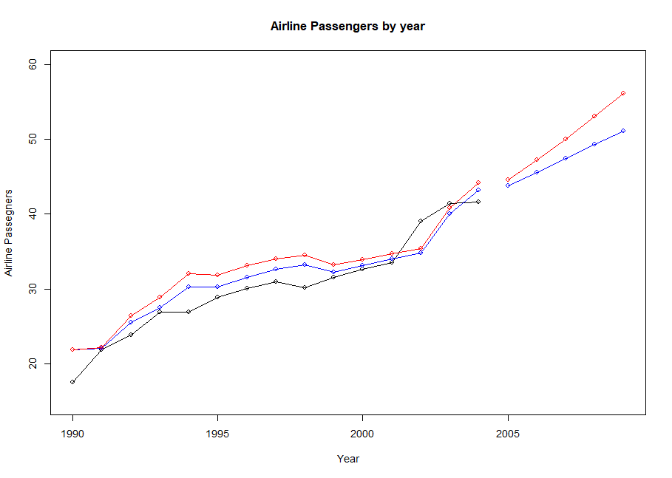
Activity 2: Holt Linear
This plot includes three lines, the two colored lines were created using Holt’s Linear Model and the black line are the actual values..
The Blue and Red lines are nearly identical, except the Red line has an “exponential = true”
The exponential smoothing is evident because you can see that although they have the same alpha and beta value, the red line has a higher value at every point because it grows exponentially.
When you plot the means of the forecast, it becomes ever more evident because you can see with it’s h-value at 4 (horizon) that red line grows at an exponential rate.

Slide 4
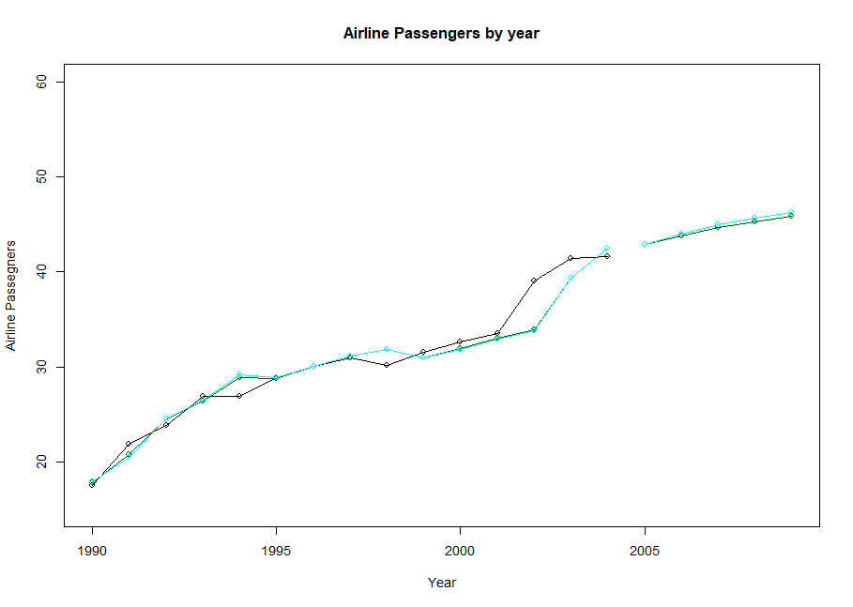
Activity 2: Holt Linear Dampening
This both lines are dampened and the Cyan line has the exponential setting set to true.
The dampening lessens the effect of trends on the next forecast.
Prevents the forecast from getting too extreme, which is more likely for models instructed to grow exponentially
The cyan line still grows faster than the dark green line, but the exponential effect has been severely “dampened”

Slide 5
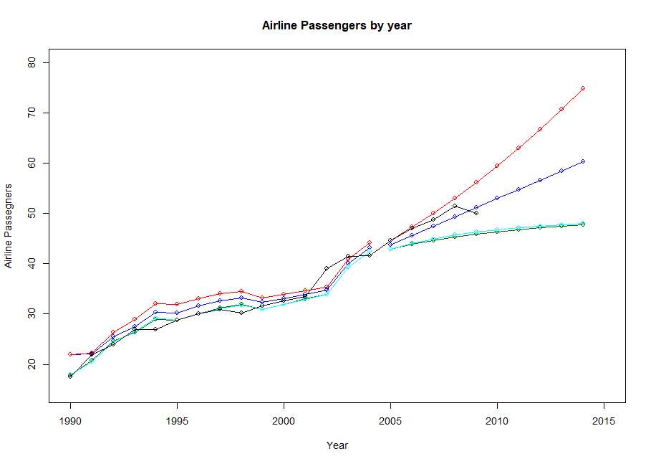
Activity 2: Holt Linear
As the black line continues, you can see that for this particular model, dampening did not help.
The red and blue lines seem to predict more accurately than the cyan and dark green lines.
Although it was trending to follow the red line, there was a sharp drop in airline passengers.
If using real life data, it was probably the 2008 Housing bubble.

Slide 6
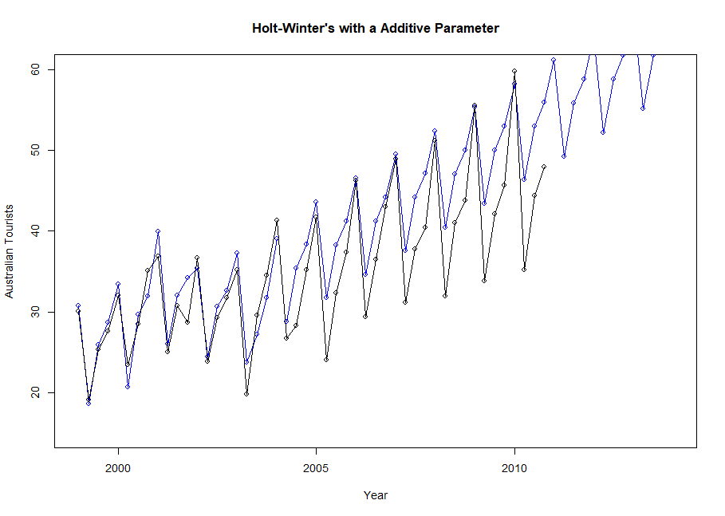
Activity 3: Holt-Winters Seasonal- Additive
The “hw” model accounts for seasonal trends, which can be easily seen by the positive and negative patter that we see annually with Australian tourists.
Interestingly, this model is fairly accurate when predicting the peaks of the trend.
After learning more about the differences between + and * HW Models, The additive model keeps the same Amp, but the level grows faster than a multiplicative beecause the seasonal variation doenst increase as time passes.

Slide 7
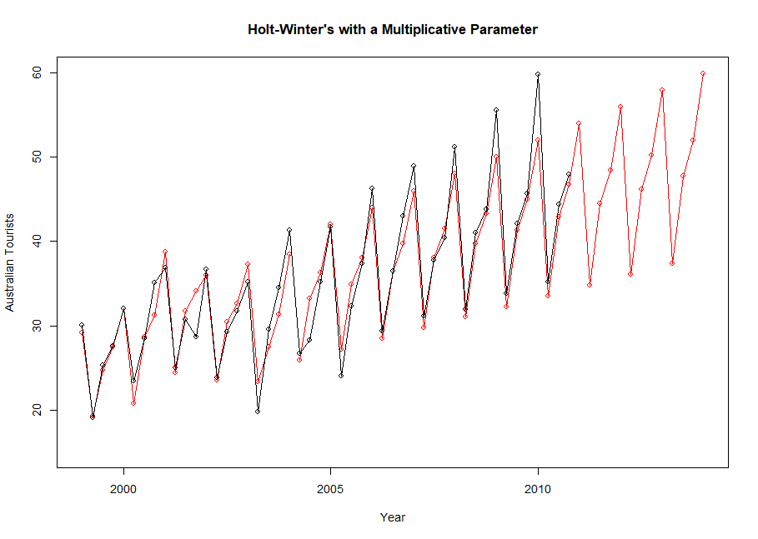
Activity 3: Holt-Winters Seasonal - Multiplicative
In contrast, this model shows when you multiply the variables of the HW Model
Level, Trend, and Seasonal
This model seems to keep the same frequency but the amplitude seems to grow over time with the level.
If kept forecasting, the hw model will predict an unreasonably large amplitude.

Slide 8
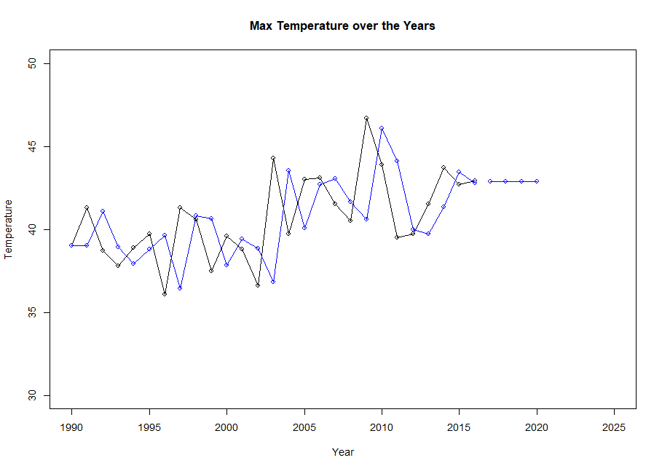
Activity 4: SES - Melbourne
The prediction only goes one year our and it’s strongly based on the previous observation, so this model doesn’t predict any significant change in temperature.
I couldn’t get the AIC or BIC with the SES model. Everything pointed me to the formulas, but I couldnt understand how to solve for “log-liklihood”
mainlyI didnt understand what exactly the k parameter was and how to choose it.

Slide 9
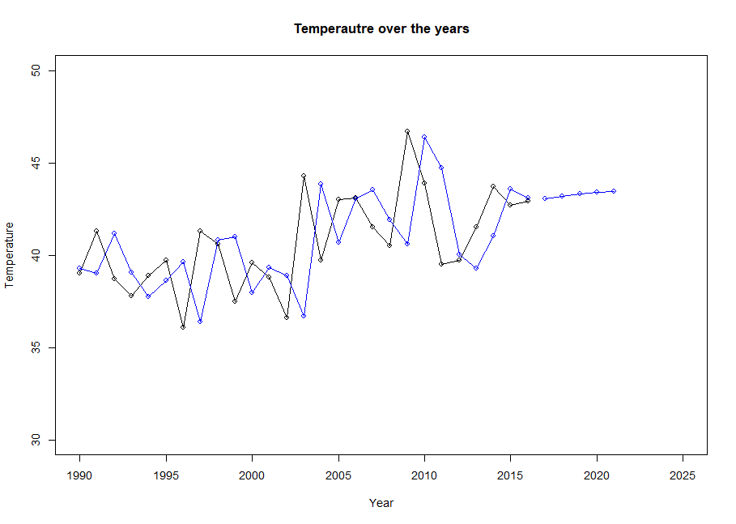
Activity 4 - Damped Holt’s Linear
This plot follows a dampened holt model.
The predictions are do not grow as much as it could because the effect of either additive or multiplicative are “dampened”.
AIC:157.55
BIC: 162.73

Slide 10
Activity 4: Which one is better?
RMSE
The SES model has a RMSE of 2.88
The Holt model has a RMSE of 2.99
Without being able to obtain a AIC/BIC for the SES Model, all we could do is rely on the RMSE and the the RMSE is slightly lower, showcasing that it’s likely to be closer to the actual value on average.
The real question would probably be, which model to use for which situation.
If you have the leniency to predict continuously, while updating your model, the ses model would likely work for you because it doesn’t predict further than one iteration (year).
However, if you needed to predict multiple iterations (years), than the holt model would likely work your in favor, being able to account for seasonality in its model.

Slide 11
Activity Four

