Slide 1
Week 2
Asynchronous Work
Johnny Vogt

Slide 2
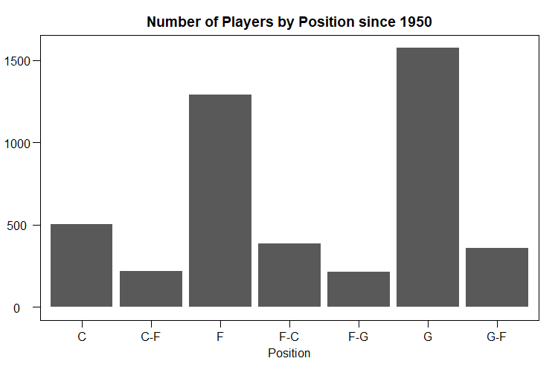
Visually Representing number of players in each Position
Removed “George Karl” from the list since his position is listed as N/A and adds an extra category that isn’t relevant to most of the prompts.
Further Research Suggest, he plays a Guard Position. Since most of the prompts are about forwards and centers, it was easier to just remove him from the dataset
From the graph, most players have a specific position that they play as (Center, Forward, or Guard). Some players have a unique set of skills that allow them to adventure with other positions. I went under the assumption that “C-F” was a Center that played Forward for a period of time.
<Primary Position> - <Secondary Position>
Code:
PlayersBBall[PlayersBBall$name != "George Karl",] %>% ggplot(aes(x= position)) +
geom_bar() +
ggtitle("Number of Players by Position since 1950") +
xlab("Position") +
ylab("Player Count") +
theme_par()

Slide 3
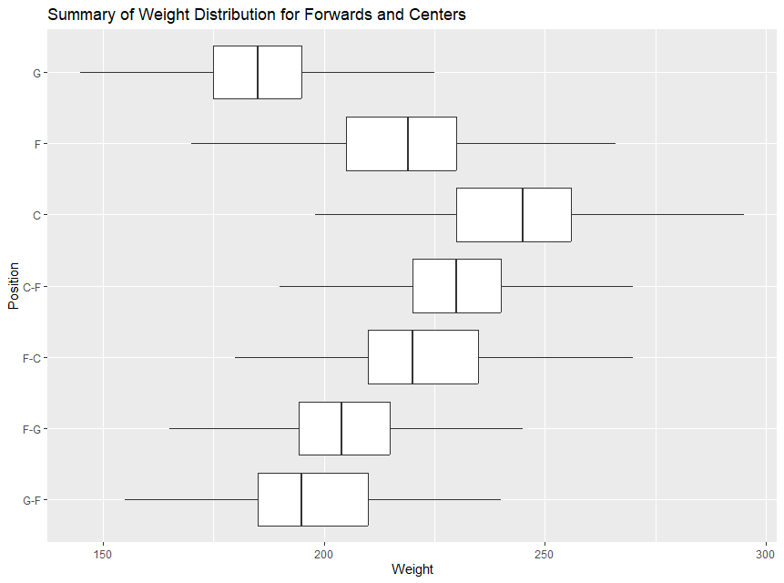
Weight of Centers vs. Weight of Forwards
Code:
PlayersBBall$position <- reorder(PlayersBBall$position, PlayersBBall$weight, FUN = median)
PlayersBBall[PlayersBBall$name != "George Karl",] %>% ggplot(aes(x = weight, y = position)) +
geom_boxplot(outliers = FALSE) +
ggtitle("Summary of Weight Distribution for Forwards and Centers") +
xlab("Weight") +
ylab("Position")
Chose a box plot because it clearly shows the median weight of each position, and if we were to investigate which position were “heavier”, you should use the median as a marker to describe the average of the each position.
Reordered the data by position based off the median weight of each player. I thought it was going to put the heaviest median at the bottom, but I wanted to group any position that had “C” together to make it easier to visually see that median weight of any position that includes Center is at least equal or above other positions.
Removed Outliers since they skew the data with very UNLIKELY data (likely outside the significance level)

Slide 4
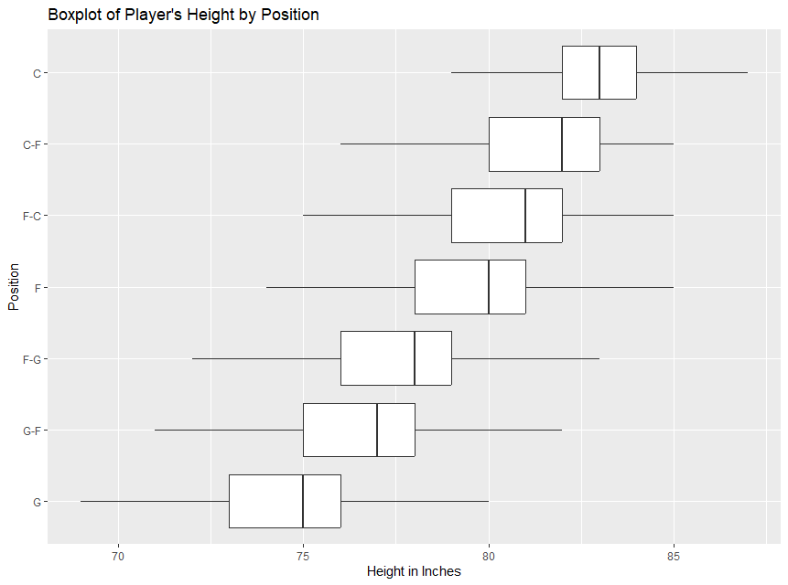
Player’s Height Distribution by Height
Code:
#function made to convert height(6-10, 6-3) to inches
ft_to_inches <- function(height_str) {
parts <- strsplit(height_str, "-") [[1]]
feet <- as.numeric(parts[1])
inches <- as.numeric(parts[2])
total_inches <- feet * 12 + inches
return(total_inches)
}
Convertedht_PlayersBBall <- PlayersBBall %>% mutate(new_height = sapply(height,ft_to_inches))
Convertedht_PlayersBBall$position <- reorder(Convertedht_PlayersBBall$position, Convertedht_PlayersBBall$new_height, FUN = median)
Convertedht_PlayersBBall[Convertedht_PlayersBBall$name != "George Karl",] %>% ggplot(aes(x = new_height, y = position)) +
geom_boxplot(outliers = FALSE) +
ggtitle("Boxplot of Player's Height by Position") +
xlab("Height in Inches") +
ylab("Position")
~~Continue to next slide

Slide 5
Player’s Height Distribution by Height (Cont.)
Since the height was not given to us as a proper numeric, I had to transform the data to something that was easier to manage. After considering multiple different options, I had decided on using a function and feeding the column through the function as the easiest path.
I had created both a scatter plot and a boxplot, although the scatter plot was more appealing, the box plot describes other positions better and it clearly shows that the average (median) for Center positions are greater than Forwards.

Slide 6
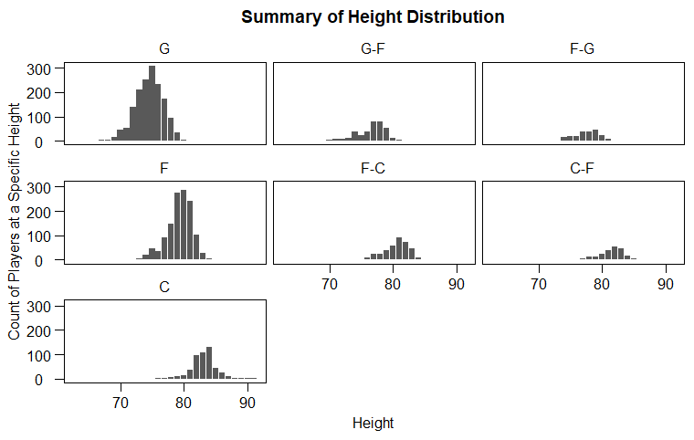
Height distribution by Position
Code:
Convertedht_PlayersBBall[Convertedht_PlayersBBall$name != "George Karl",] %>% ggplot(aes(x = new_height)) +
geom_bar() +
ggtitle("Summary of Height Distribution") +
xlab("Height") +
ylab("Count of Players at a Specific Height") +
theme_par() +
facet_wrap(~position)
Removed George Karl due to the N/A Position.
Although the boxplot from the previous prompt explains this prompt, this was opportunity to showcase the data in a different way.
Tried making a histogram, but the geom_bar had a cleaner look.
Used the new dataset that I created from the previous prompt to make a cleaner bar. The original data would sort in a weird way because it treated the numbers closer to a floating point rather than a measurement of length.
(6-0, 6-1, 6-10, 6-11, 6-2, 6-3,....)

Slide 7
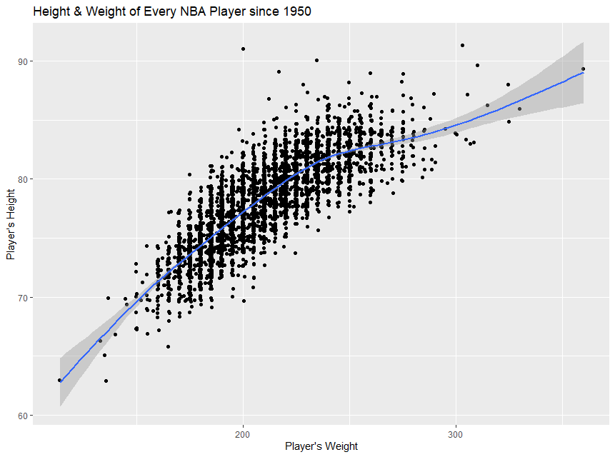
Relationship between Height and Weight
Code:
Convertedht_PlayersBBall %>% ggplot(aes(x = weight, y = new_height)) +
geom_point(position = "jitter") +
geom_smooth() +
ggtitle("Height & Weight of Every NBA Player since 1950") +
xlab("Player's Weight") +
ylab("Player's Height")
There is a relationship, although there a is ALOT of variation.
Used jitter to show that there are alot of players that are spread between different variations height and weight.
Regardless of the spread, it is still clear that there is a relationship. The taller a player gets, the weight of the player increases.

Slide 8
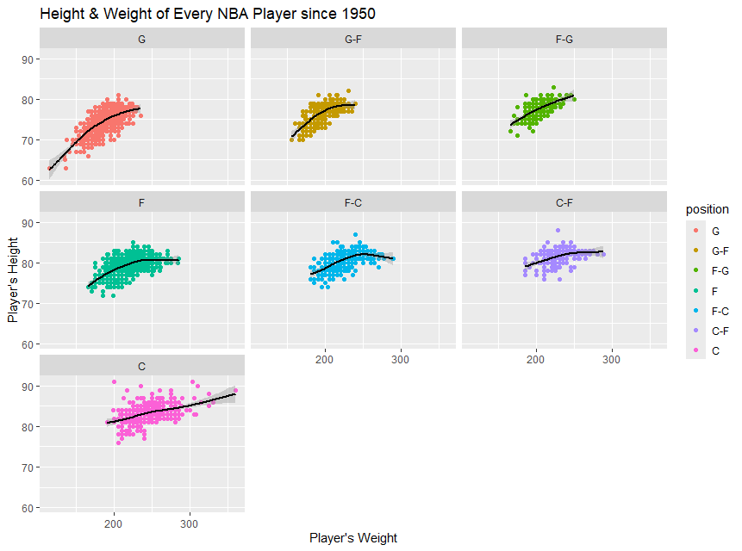
Height and Weight by Position
Code:
Convertedht_PlayersBBall[Convertedht_PlayersBBall$name != "George Karl",] %>% ggplot(aes(x = weight, y = new_height, color = position)) +
geom_point() +
geom_smooth(color = "black") +
ggtitle("Height & Weight of Every NBA Player since 1950") +
xlab("Player's Weight") +
ylab("Player's Height") +
facet_wrap(~position)
Removed George Karl to remove the N/A Box (probably wouldve been easier to just find his data and input it in)
Every position has a visible relationship between the height and weight with varying degrees.
Guard Positions seem to have the strongest relationship as the player’s height raises, their weight is likely to be higher as well.

Slide 9
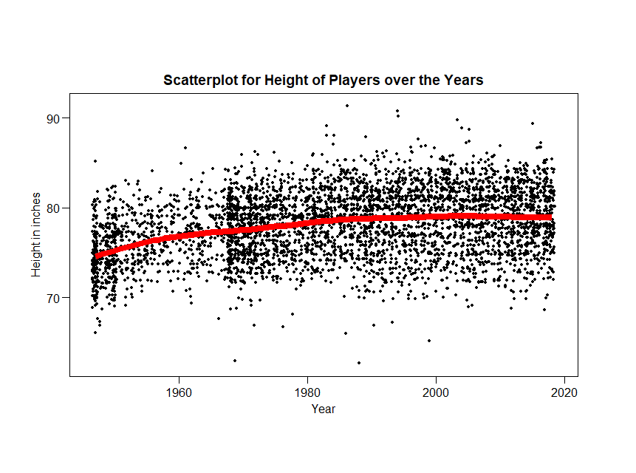
Height over the years
Code:
Convertedht_PlayersBBall %>% ggplot(aes(x = year_start, y = new_height)) +
geom_point(size = 1, position = "jitter") +
geom_smooth(color="red", linewidth = 3) +
ggtitle("Scatterplot for Height of Players over the Years") +
xlab("Year") +
ylab("Height in inches") +
theme_par()
From the data, It seems that there is a slight increase in player height, Although the outliers could be affecting the line since geom_smooth utilizes the mean to draw the line.
Utilizing the median may be more effective, but there are too many years to make a boxplot for each of them. Possibly a “Time Series” plot may accurately display data,
The current data set doesnt have the right data to make a good Time Series Plot, there needs to be some transformation

Slide 10
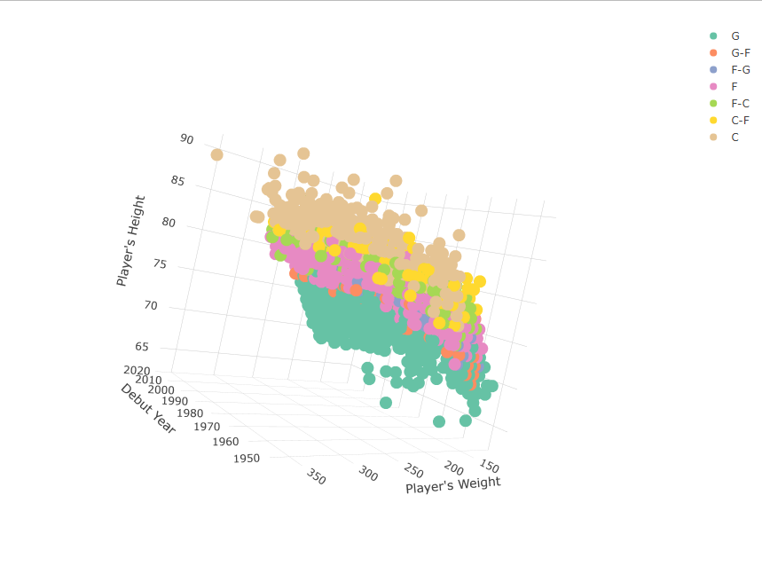
3-D Height v. Weight v. Year by Position
Code:
library(plotly)
H_W_Y <- plot_ly(Convertedht_PlayersBBall, x = ~weight, y = ~new_height, z = ~year_start, color = ~position, sizes=c(1,1)) %>%
add_markers() %>%
layout(scene = list(xaxis = list(title = "Player's Weight"),
yaxis = list(title = "Player's Height"),
zaxis = list(title = "Debut Year")))
H_W_Y
Very crowded amount of data, very cool plot, but ultimately, seems superfluous. Most data when presented wont have the opportunity to examine this properly by being able to spin and analyze the data thoroughly.
Able to showcase multiple relationship in one graph.

Slide 11
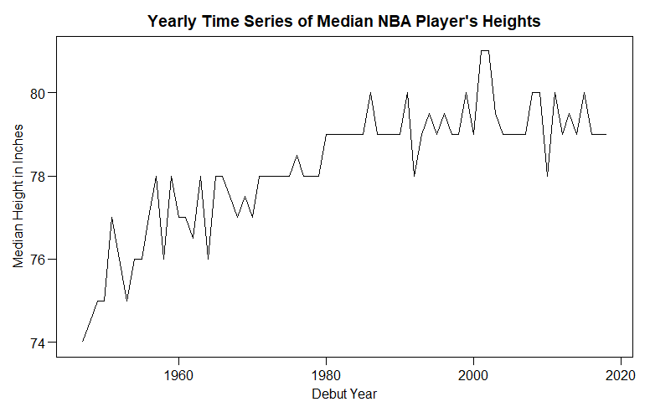
Time Series (Top 50 ggplot2 Visualization)
Code:
med_ht_by_year <- Convertedht_PlayersBBall %>%
group_by(year_start) %>%
summarise(median_height = median(new_height)
med_ht_by_year %>% ggplot(aes(x=year_start, y = median_height)) +
geom_line() +
ggtitle("Yearly Time Series of Median NBA Player's Heights") +
xlab("Debut Year") +
ylab("Median Height in Inches") +
theme_par()
Needed to create a new dataset from the Large Dataset, due to needing a median of all of the height Measurements for each year in “year_start_
This clearly shows a positive relationship with the median height of NBA Players. (1947:74in - 2020:79in)
Players being drafted in 2020 are 5 inches taller than players that started in 1950s
Possibly the best way to demonstrate the height change over the years.
Definitely required additional reading and researching on how to get the median height.
Once I saw this plot on the website, I knew I needed to figure this out.

Slide 12
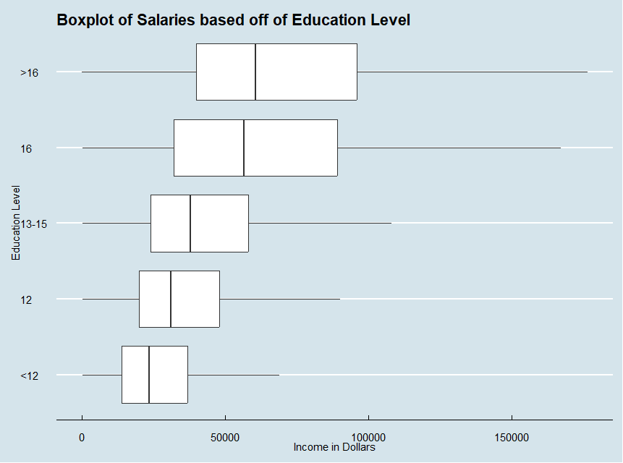
Education Level V. Salary
Code:
Education_Income <- read_csv("Unit 2/Education_Income.csv")
Education_Income$Educ <- reorder(Education_Income$Educ, Education_Income$Income2005, FUN = median)
Education_Income %>% ggplot(aes(x = Income2005, y = Educ)) +
geom_boxplot(outliers = FALSE) +
ggtitle("Boxplot of Salaries based off of Education Level") +
xlab("Income in Dollars") +
ylab("Education Level") +
theme_economist()
Reordered the Education Level to make it look like it’s highest Level to lowest Level
Removed Outliers to showcase the data without it being skewed by a few data points.
The data suggests that the more education that a person obtains, it is likely that their salary will increase and It seems that any education after 16 years of education has an negligible effect on salary.

Slide 13
Full Code( Just copy/paste and Increase font size)
Part t 1
#Importing PlayersBBall Dataset
library(readr)
library(ggplot2)
library(ggthemes)
library(gganimate)
library(tidyverse)
PlayersBBall <- read_csv("Unit 2/PlayersBBall.csv")
View(PlayersBBall)
#Visually represent number of players in each position
PlayersBBall[PlayersBBall$name != "George Karl",] %>% ggplot(aes(x= position)) +
geom_bar() +
ggtitle("Number of Players by Position since 1950") +
xlab("Position") +
ylab("Player Count") +
theme_par()
#Investigate the distribution of the weight of Centers between the weight of Forwards
PlayersBBall[PlayersBBall$position != "G",] %>% ggplot(aes(x = weight, fill = position )) +
geom_histogram() +
theme_par()
PlayersBBall$position <- reorder(PlayersBBall$position, PlayersBBall$weight, FUN = median)
PlayersBBall[PlayersBBall$name != "George Karl",] %>% ggplot(aes(x = weight, y = position)) +
geom_boxplot(outliers = FALSE) +
ggtitle("Summary of Weight Distribution for Forwards and Centers") +
xlab("Weight") +
ylab("Position")
#Investigate the distribution of the height of Centers and the height of Forwards
PlayersBBall[PlayersBBall$position != "G",] %>% ggplot(aes(x = height, y = height, color = position)) +
geom_point()+
geom_jitter()+
ggtitle("Summary of Height Distribution for Forwards and Centers") +
xlab("Weight") +
ylab("Position")
view(PlayersBBall)
#GSUB did Not work lol
player_ht <- gsub("-", " ", PlayersBBall$height)
#function made to convert height(6-10) to inches
ft_to_inches <- function(height_str) {
parts <- strsplit(height_str, "-") [[1]]
feet <- as.numeric(parts[1])
inches <- as.numeric(parts[2])
total_inches <- feet * 12 + inches
return(total_inches)
}
Convertedht_PlayersBBall <- PlayersBBall %>% mutate(new_height = sapply(height,ft_to_inches))
Convertedht_PlayersBBall
Convertedht_PlayersBBall$position <- reorder(Convertedht_PlayersBBall$position, Convertedht_PlayersBBall$new_height, FUN = median)
Convertedht_PlayersBBall[Convertedht_PlayersBBall$name != "George Karl",] %>% ggplot(aes(x = new_height, y = position)) +
geom_boxplot(outliers = FALSE) +
ggtitle("Boxplot of Player's Height by Position") +
xlab("Height in Inches") +
ylab("Position")
Convertedht_PlayersBBall[Convertedht_PlayersBBall$position != "G",] %>% ggplot(aes(x = new_height, y =new_height, color = position)) +
geom_point()+
geom_jitter()+
ggtitle("Summary of Height Distribution for Forwards and Centers") +
xlab("Weight") +
ylab("Position")
Convertedht_PlayersBBall$new_height
#Investigate the if the distribution of height is different between any of the position
Part 2.
Convertedht_PlayersBBall[Convertedht_PlayersBBall$name != "George Karl",] %>% ggplot(aes(x = new_height)) +
geom_bar() +
ggtitle("Summary of Height Distribution") +
xlab("Height") +
ylab("Count of Players at a Specific Height") +
theme_par() +
facet_wrap(~position)
#Investigate the relationship between height and weight, how does height change as the weight change
Convertedht_PlayersBBall %>% ggplot(aes(x = weight, y = new_height)) +
geom_point(position = "jitter") +
geom_smooth() +
ggtitle("Height & Weight of Every NBA Player since 1950") +
xlab("Player's Weight") +
ylab("Player's Height")
#Is there a H/W relationship for each position
Convertedht_PlayersBBall[Convertedht_PlayersBBall$name != "George Karl",] %>% ggplot(aes(x = weight, y = new_height, color = position)) +
geom_point() +
geom_smooth(color = "black") +
ggtitle("Height & Weight of Every NBA Player since 1950") +
xlab("Player's Weight") +
ylab("Player's Height") +
facet_wrap(~position)
#Investigate the claim that the height of players have increased over the years
Convertedht_PlayersBBall %>% ggplot(aes(x = year_start, y = new_height)) +
geom_point(size = 1, position = "jitter") +
geom_smooth(color="red", linewidth = 3) +
ggtitle("Scatterplot for Height of Players over the Years") +
xlab("Year") +
ylab("Height in inches") +
theme_par()
Convertedht_PlayersBBall %>% ggplot(aes(x = year_start)) +
geom_line(aes(y = new_height)) +
ggtitle("Lollipop Chart for Height of Players over the Years") +
xlab("Year") +
ylab("Height in inches") +
theme_par()
#Create a 3D plot of Height v. Weight v. Year and color code the position
library(plotly)
H_W_Y <- plot_ly(Convertedht_PlayersBBall, x = ~weight, y = ~new_height, z = ~year_start, color = ~position, sizes=c(1,1)) %>%
add_markers() %>%
layout(scene = list(xaxis = list(title = "Player's Weight"),
yaxis = list(title = "Player's Height"),
zaxis = list(title = "Debut Year")))
H_W_Y
#Go to the website (found in PowerPoint) pick one and provide insight
######Time Series############animate(g_animated, fps = 1)
med_ht_by_year <- Convertedht_PlayersBBall %>%
group_by(year_start) %>%
summarise(median_height = median(new_height))
############
Convertedht_PlayersBBall %>% ggplot(aes(x=year_start, y = new_height))
geom_boxplot()
print(med_ht_by_year)
summar
g <- Convertedht_PlayersBBall[Convertedht_PlayersBBall$name != "George Karl",] %>% ggplot(aes(x = new_height,y = new_height)) +
geom_point(position = "jitter") +
xlab("Height in Inches") +
ylab("Height in Inches") +
ggtitle("Height Over the Years")
g_animated <- g +
transition_states(year_start) +
enter_fade() +
exit_fade()
med_ht_by_year %>% ggplot(aes(x=year_start, y = median_height)) +
geom_line() +
ggtitle("Yearly Time Series of Median NBA Player's Heights") +
xlab("Debut Year") +
ylab("Median Height in Inches") +
theme_par()
View(Convertedht_PlayersBBall)
install.packages("gganimate")
#Import Education Inncome data and test the claim that the mean/median of incomes increase as the education level rises.
Education_Income <- read_csv("Unit 2/Education_Income.csv")
View(Education_Income)
summary(Education_Income)
str(Education_Income)
#Reordering Based off the Median of the of the Income, Helps
Education_Income$Educ <- reorder(Education_Income$Educ, Education_Income$Income2005, FUN = median)
Education_Income %>% ggplot(aes(x = Income2005, y = Educ)) +
geom_boxplot(outliers = FALSE) +
ggtitle("Boxplot of Salaries based off of Education Level") +
xlab("Income in Dollars") +
ylab("Education Level") +
theme_economist()

Slide 14
Data Science
News Of the Week

Slide 15
Copyright Lawsuits Against AI
Overall there are 150+ Suits in the US alone covering various kinds of copyright/trademark violations
Active Lawsuits:
Author’s Guild v. OpenAI - Novels used to train language Models
New York Times v. Microsoft/OpenAI - Use of New articles for Model Training
Andersen v. Stability AI - Visual Artists used for Training
UMG et al. v. Anthropic - Songs used for lyric generation (Reached Settlement)

Slide 16
Implication Of The Cases
Every lost case will likely cause AI to choose between paying for data or have to retrain their model with less data.
If companies choose to train without data, the AI could start to lose reputation
AI won’t be as reliable, AI could
Proper Compensation for use of data.
How do you determine the cost of data?
Trickle Down implications?
Use of AI cost more
Does Paid Data weigh more than “Open-Source” Data

Slide 17

Privacy Concerns
Clearview is a Facial Recognition Company that is used by law enforcements to help with identification. Clearview utilizes publicly available data for its own database, the potential for misuse of the tool should be heavily monitored.
DeepFakes are starting to crop up all over the internet
AI Voice Cloning has the potential to cause as much damage as deepfakes.

Slide 18
Personal Take and Industry Responsibility
I’m not trying to bash AI, but trying to highlight the fact that the usage and development of AI is in its infancy
A Lot of companies seem to have lack of accountability and tries to take advantage of a field of technology that isn't well-regulated (Wild West-like Opportunity)
It is our collective responsibility as an industry and society to pave the path of ethical and proper usage of AI

Slide 19
Citations
Andersen v. Stability Ai. BakerHostetler. (2025, January 6). https://www.bakerlaw.com/andersen-v-stability-ai/
Brittain, B. (2025, January 3). Anthropic reaches deal on ai “guardrails” in lawsuit over music lyrics | reuters. https://www.reuters.com/legal/litigation/anthropic-reaches-deal-ai-guardrails-lawsuit-over-music-lyrics-2025-01-03/
Frequently asked questions. Clearview AI. (n.d.). https://www.clearview.ai/faq
Pope, A., Stein, M. A., Barsky, B. A., Iezzoni, L. I., Ormsbee, M. M. H., & Harris, J. F. (2024, April 10). NYT V. openai: The Times’s about-face. Harvard Law Review. https://harvardlawreview.org/blog/2024/04/nyt-v-openai-the-timess-about-face/
Smith, A. (2025, January 1). Briefly: Authors Guild V. OpenAI, inc., 345 F.R.D. 585 (S.D.N.Y. 2024). LinkedIn. https://www.linkedin.com/pulse/briefly-authors-guild-v-open-ai-inc-345-frd-585-smith-nee-royster-ifpkf/

