Slide 1
FLS: Unit 3
DS6306
Johnny Vogt
January 2025

Slide 2
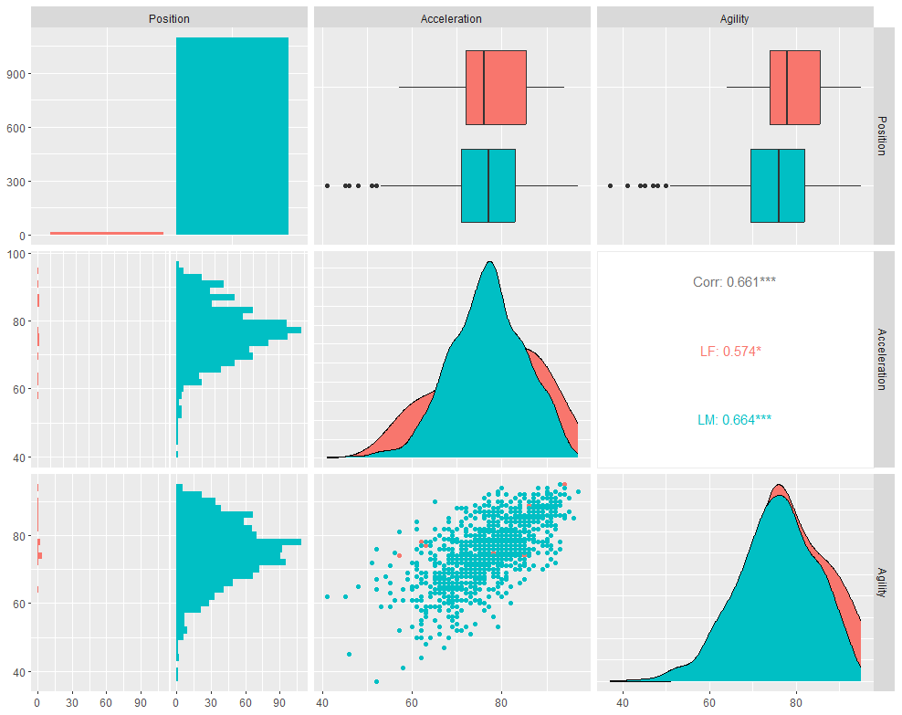
FIFA Left Forwards (LF) vs. Left Midfielders (LM)
There are ALOT more LM players than LF Players
The Forward position have been utilized less and less in soccer over the years, relying on more dynamic Midfielders. It is likely that plenty of midfielders used to be Forwards, but transitioned to Midfielders to adjust to the modern playstyle.
Interestingly enough, LFs have a high Agility Median, but a lower Acceleration Median compared to LMs
LFs have stronger Agility left skew than LMs
LFs have a larger range in Acceleration than LMs

Slide 3
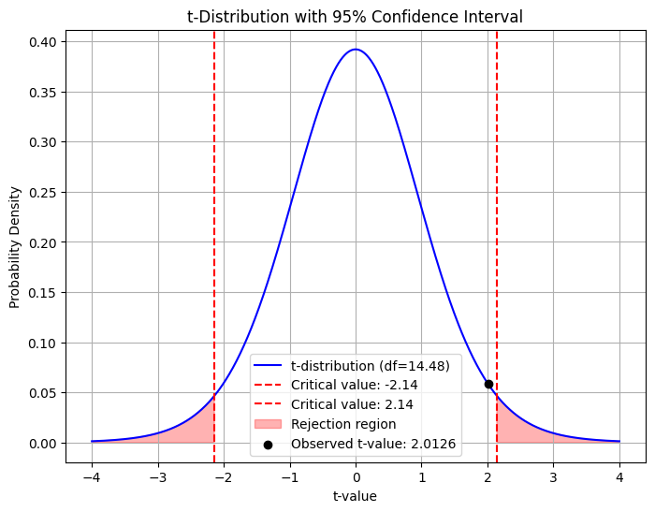
2 Sample T-Test
H-Null: Mean of LF Agility and the Mean of LM Agility are Equal or H-Alt: Mean of LF Agility and the Mean of LM Agility are NOT Equal
LF Mean: 79.7333
LM Mean: 75.37808
See Graphic
T-Statistic: 2.0126
P-Value: 0.06314
Fail To Reject H-Null
We fail to discern that H-Null is a false hypothesis. The evidence from the data provided is not significant enough to suggest that the difference between true means are different. Since the data does not definitively prove that the means are different, We fail to reject H-Null.
*Asked Perplexity to create distribution graphic

Slide 4
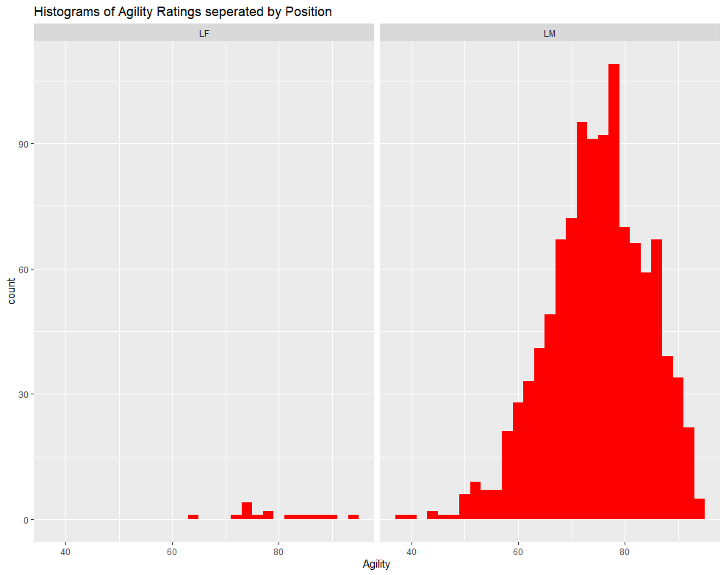
Post T-Test analysis and critiques
I do not think the the assumption of the test are reasonably met. Although technically, we collected “ALL” of the LF, the sample size is very small and the distribution is very flat and non-normal.
Distribution of Sample means would provide more of a normal distribution and would be a better datapoint to conduct the T-Test off of.
Visually, I do not think there is enough data to suggest that the Standard Deviations are different.
LF Standard Deviation: 8.31
LM Standard Deviation: 9.26

Slide 5
FIFA LF/LM Code
#GGALLY Plot
lf_lm <- fifa %>% filter(Position == "LF"| Position == "LM")
lf_lm %>%
select(Position, Acceleration, Agility) %>%
ggpairs(aes(color = Position))
#T Test
agi_LF <- lf_lm %>% filter(Position == 'LF') %>% select(Agility)
agi_LM <- lf_lm %>% filter(Position == 'LM') %>% select(Agility)
t.test(agi_LF,agi_LM)
t.test(agi_LM,agi_LF)
#HIstogram
lf_lm %>% ggplot(aes(x = Agility)) +
geom_histogram(fill = "red") +
facet_grid(~Position) +
ggtitle("Histograms of Agility Ratings seperated by Position")

Slide 6
Exploratory Data Analysis (EDA)
Categorical Values: Form and Wage
Form - Overall Ratings split between five Categories
Code:
fifa_added_forms <- fifa %>% mutate(Form = cut(Overall, breaks = c(0,60,70,80,90,100), labels = c("Poor","Fair", "Good", "Excellent", "Perfect")))
Sub-Category
Poor ( 0 - 60)
Fair (61 - 70)
Good (70 - 80)
Excellent (81 - 90)
Perfect (91 - 100)
Position
The position that the player assumes on the field.
Potential
The highest overall rating that a player could achieve over time

Slide 7
EDA - Variables
Continuous Variables
Age
The age of the player at the time the data was collected
Wage - Weekly Payment towards player
Needed to Convert Currency to a numeric, in order to work with the data
Code:
currencyconv <- function(x) { x <- gsub("€", "", x) x <- gsub("K", "000", x) as.numeric(x) } fifa_new_form_wage <- fifa_added_forms %>% mutate(cleanwage = sapply(Wage, currencyconv))

Slide 8
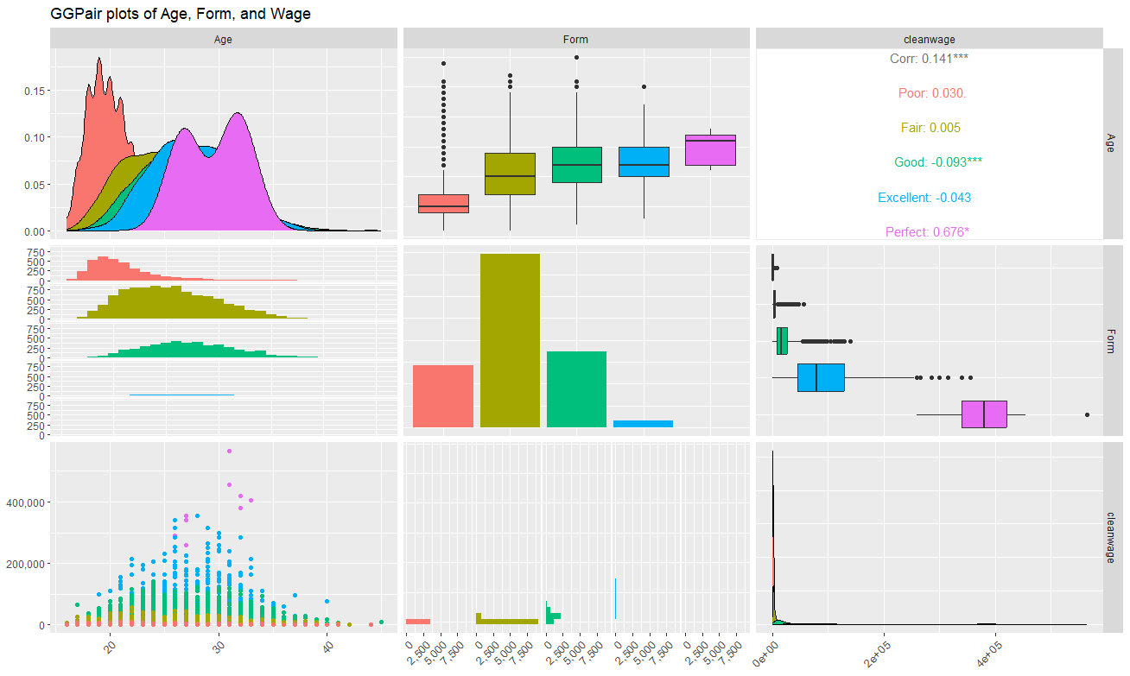
EDA - GGPair
Code:
fifa_new_form_wage %>%
select(Age, Form, cleanwage) %>%
ggpairs(aes(color = Form)) +
scale_y_continuous(labels = comma) +
theme(axis.text.x = element_text(angle = 45, hjust =1, vjust = 1, size = 10)) +
ggtitle("GGPair plots of Age, Form, and Wage")
Initial thoughts are that there are ALOT of players that have Poor Form
May have to pull in the “potential” category and look at the mean potential grouped by Age and Form
Players that have a “Perfect” Form Skew Pay Data, although they’re only a few of them
So few that they created a bimodal distribution of their ages
Pay discrepancies between the highest category and the lowest category is EXTREME
As Expected, the median age of each Player Form Category rises as the Form Level rises.
Question: Why are there so many “poor” form players? Is it because of their low “wage” or “potential” Likely some combination of both.

Slide 9
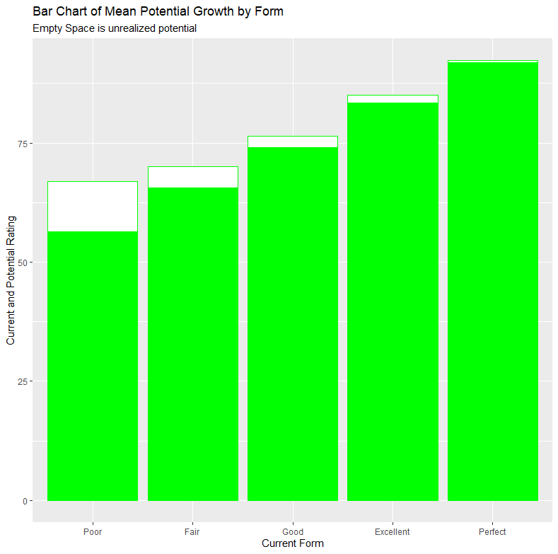
EDA - Bar Graph
Code:
meanpotential <- fifa_new_form_wage %>% group_by(Form) %>% summarise(mean_potential = mean(Potential), count = n())
fifa_new_form_wage %>% group_by(Form) %>% summarise(median_potential = median(Potential), count = n())
meanOverall <- fifa_new_form_wage %>% group_by(Form) %>% summarise(mean_overall = mean(Overall), count = n())
fifa_new_form_wage %>% group_by(Form) %>% summarise(median_overall = median(Overall), count = n())
mean_pot_ovr <- meanpotential %>%
mutate(mean_overall = meanOverall$mean_overall)
mean_pot_ovr %>% ggplot(aes(x = Form)) +
geom_bar(stat = "identity", aes(y = mean_potential), fill = "white", color = 'green') +
geom_bar(stat = "identity", aes(y = mean_overall), fill = "green") +
ggtitle("Bar Chart of Mean Potential Growth by Form", subtitle = "Empty Space is unrealized potential") +
ylab("Current and Potential Rating") +
xlab("Current Form")
Wanted to show that players with “Poor” form have strong potential, which is one of the stronger reasons why they are kept along with the relative age, I should’ve added another aesthetics and used fill for age to show that Poor more than likely has a younger average than the other positions.
As players age, they realize their potential and the empty space shrinks, which is why there are smaller windows of growth as the form increases.
What’s the relationship between age and potential

Slide 10
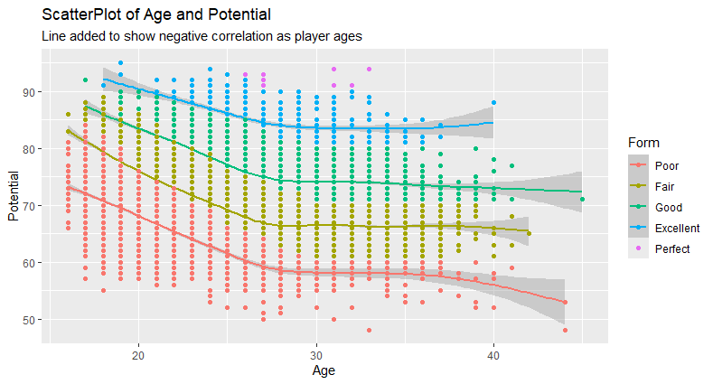
EDA - Scatter Plot
Code:
fifa_new_form_wage %>% ggplot(aes(x = Age, color = Form)) +
geom_smooth(aes(y = Potential)) +
geom_point(aes(y = Potential)) +
ggtitle("ScatterPlot of Age and Potential", subtitle = "Line added to show negative correlation as player ages")
Younger players trend towards a higher Overall Rating.
As they get older, players are likely to leave their current form and enter the form above their current one.
Players that have a low ceiling stay in their form as they grow older creating a negative correlation with age and potential.
If I had more time, I would make the potential variable into a categorical variable and try to determine if younger players are being paid more based of their potential or if it matches with their overall rating instead.

Slide 11
Takeaway - Questions
As I got further into my EDA, the more interesting it became.
I went down alot of other rabbit holes that are irrelevant towards the questions that I was following in the slide
During the t.test between LF and LM, when R did the test, it said that the df was 14.48. Even though the sample sizes were 15 and 1095, I figured that it would be 1108, but after looking into it, I went into the “Welch Two Sample T-Test” and got side tracked.

