Slide 1
FLS: Unit 4
Johnny Vogt
DS63036

Slide 2
Baltimore Restaurant Data
Code:
#Collecting, parsing, and knitting data together
balrestdata <-getURL("https://d396qusza40orc.cloudfront.net/getdata%2Fdata%2Frestaurants.xml")
brd_doc <- xmlParse(balrestdata)
brd_names <- xpathSApply(brd_doc,"//name",xmlValue)
brd_zipcode <- xpathSApply(brd_doc,"//zipcode",xmlValue)
brd_cd <- xpathSApply(brd_doc,"//councildistrict",xmlValue)
brd = data.frame(brd_names,brd_zipcode,brd_cd)
#How many Sushi Resteraunts are in Baltimore
grep("Sushi", brd$brd_names, ignore.case = TRUE, value = TRUE)
# How many sushi resteraunts are in CD11/DownTown?
brd_cd11 <- brd %>% filter(brd$brd_cd == 11)
grep("Sushi", brd_cd11$brd_names, ignore.case = TRUE, value = TRUE)
Q: How many Sushi Restaurants are in Baltimore?
A: There are at least 9 Sushi Restaurants, Since there are no Categories or Menus to parse through, we can only go off the title of each Restaurants.
Q:Are there any Sushi Restaurants in the Council District 11?
A: There is at least 1 Restaurant in District 11 based off of their Names.

Slide 3
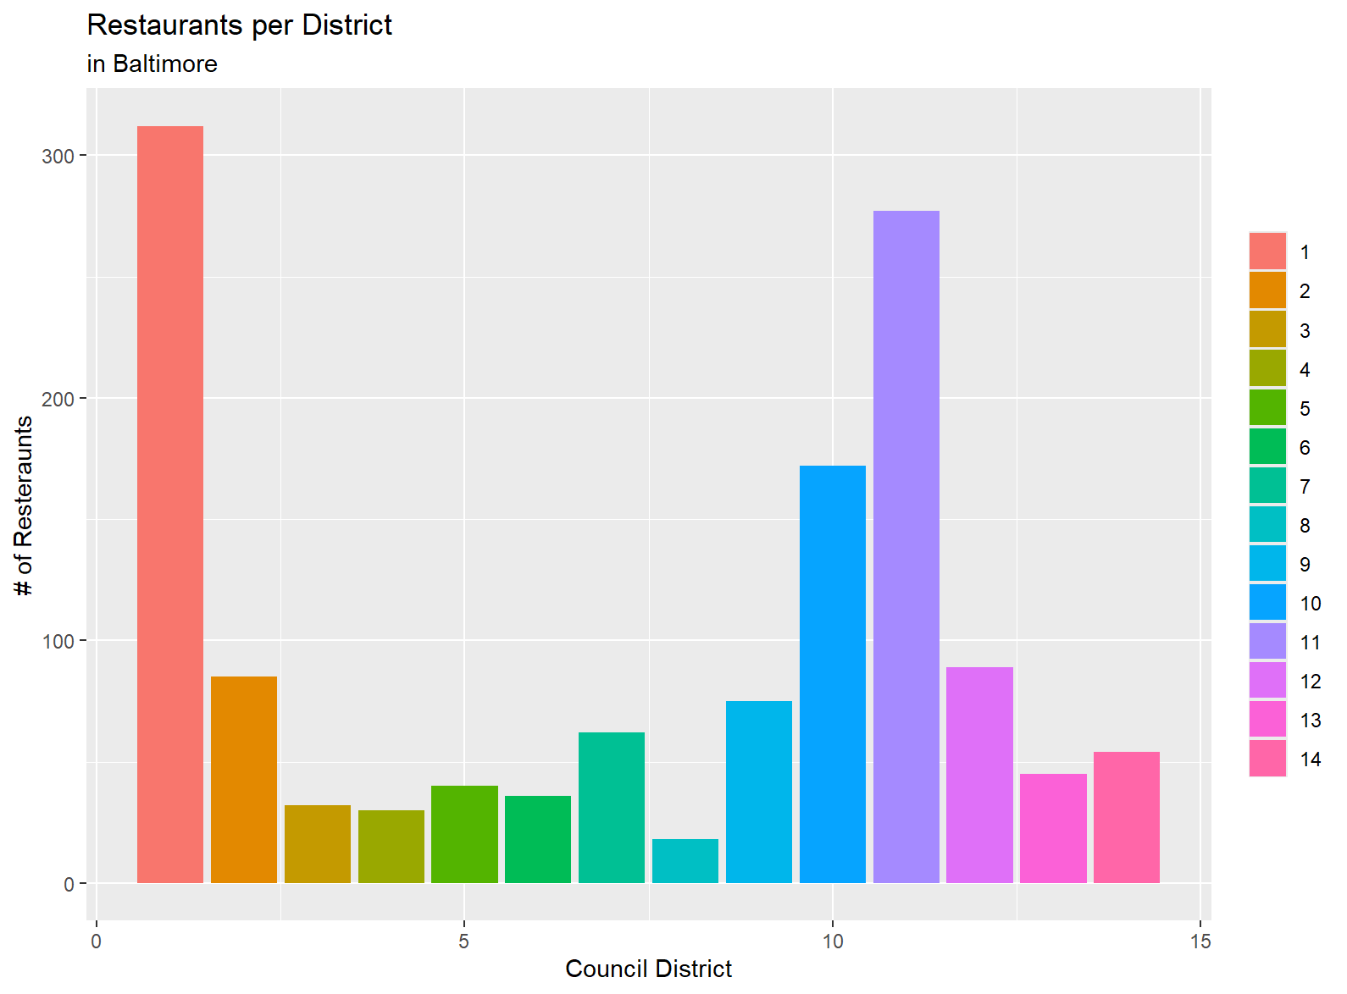
Baltimore Restaurant Bar Graph
Code:
#Make a Bar plot of Number of Resteraunts in each district
#Making brd_cd numeric to sort better
brd$brd_cd <- as.numeric(as.character(brd$brd_cd))
brd %>% arrange(desc(brd_cd)) %>% ggplot(aes(x = brd_cd, fill = factor(brd_cd))) +
geom_bar(stat = "count") +
ggtitle("Restaurants per District", subtitle = "in Baltimore") +
xlab("Council District") +
ylab("# of Resteraunts") +
theme(legend.title = element_blank())
There are 14 Districts with Districts 1 and 11 having the highest amount of restaurants. District 8 has the least amount of restaurants as well. I wonder if its close in proximity to 1 or 11.

Slide 4
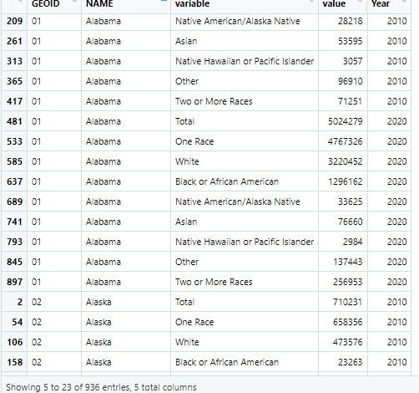
Census EDA
Johnny Vogt
I put this here to show my data was tidy annnnd cause I ran out of space everywhere else and there’s a 5 page limit

Slide 5
What is the Census and How does the API Work?
The Census is a Decennial Event where the Government tries to enumerate its own population
The latest Census took place 2020 and 2010 before that.
All of the data is Publicly Available
The 2020 Census costs roughly $13.7 Billion
Took 4 years of work to complete
More than just a simple “count”
Obtain a API Key from “api.census.gov”
Needs to request a key and sign up
In Rstudio
Install “TidyCensus” and import it to the library
Run “census_api_key(<API_Key>, Install = True)
Run “readRenviron("~/.Renviron")”
Places the API Key within its environment
TidyCensus has a number of “get” commands that can gather different kind of information
All of my Demographic Data comes from people who assigned themselves as “One Race”, aside from the “Two or More” Bar Graph
I’ll Put all of my code on the LAST Page

Slide 6
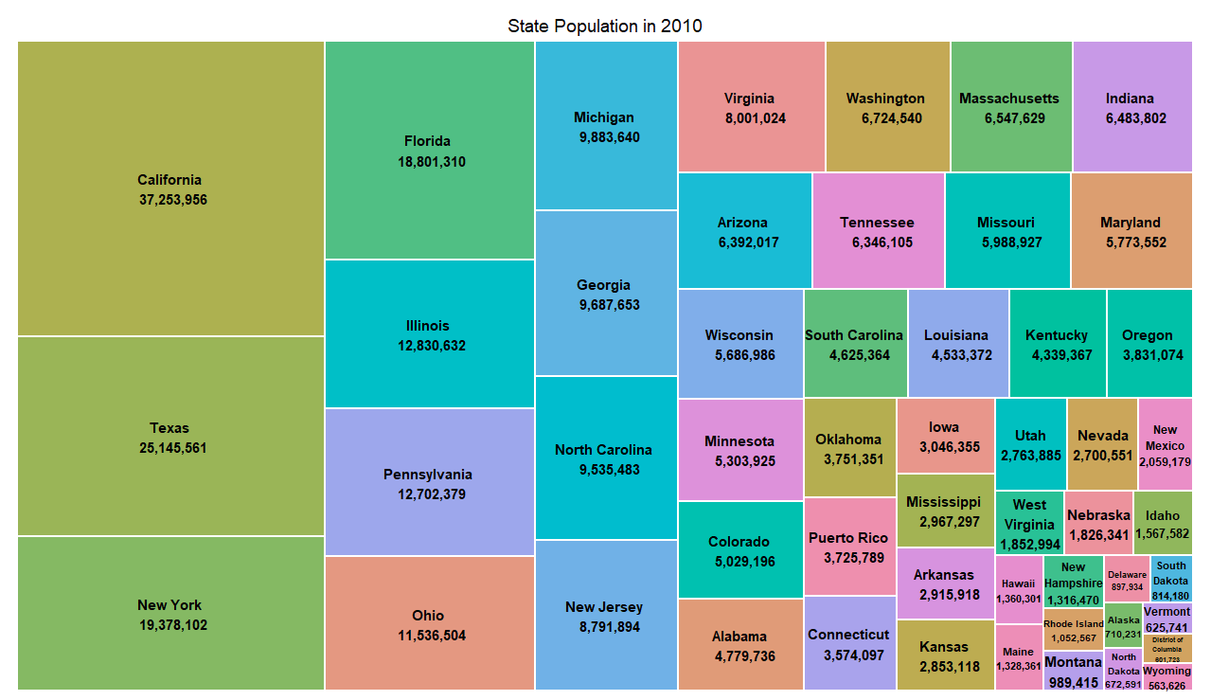
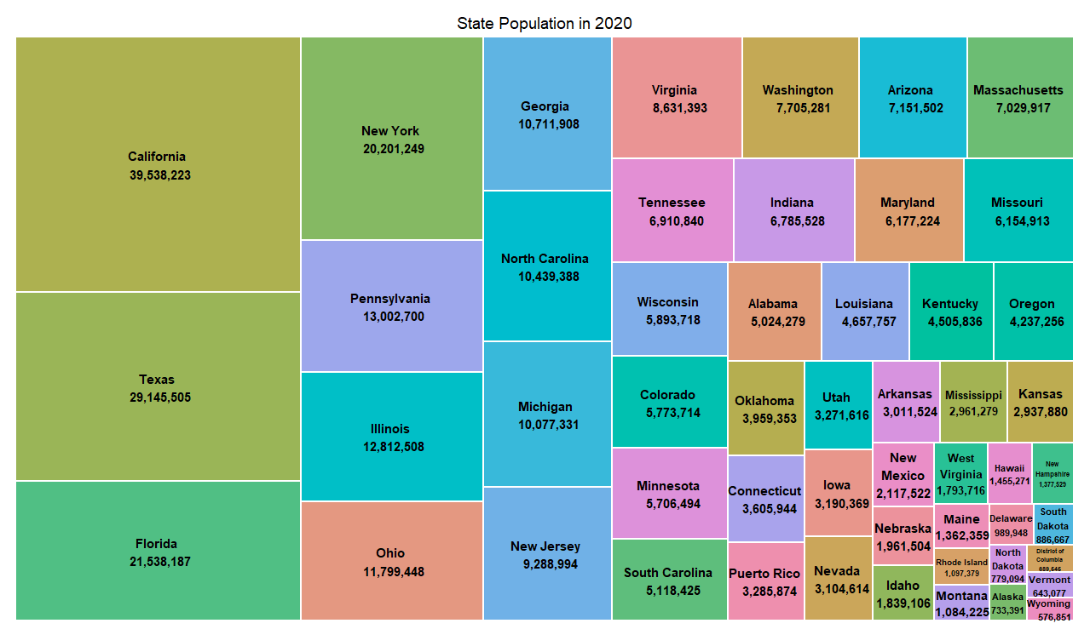
Tree Map of State Population
A Tree map is able to visually show how each state compares to each other
I’ve added the actual population to the Index, so we can see the difference between decades. I should’ve chosen another decade beside 2010 in order to show a larger visual change.

Slide 7
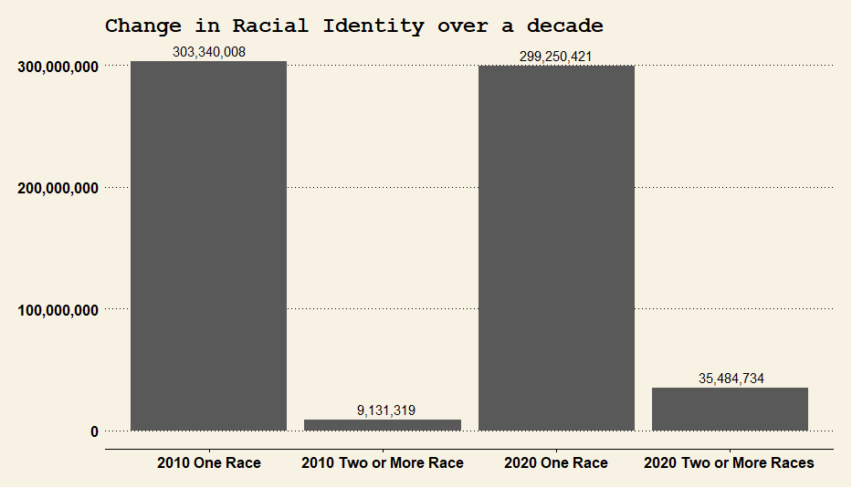
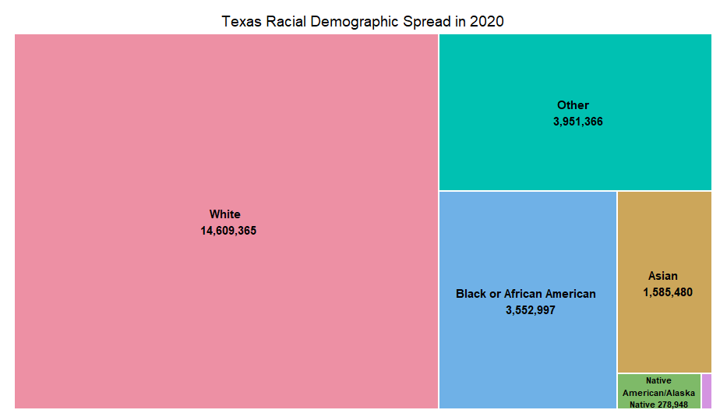
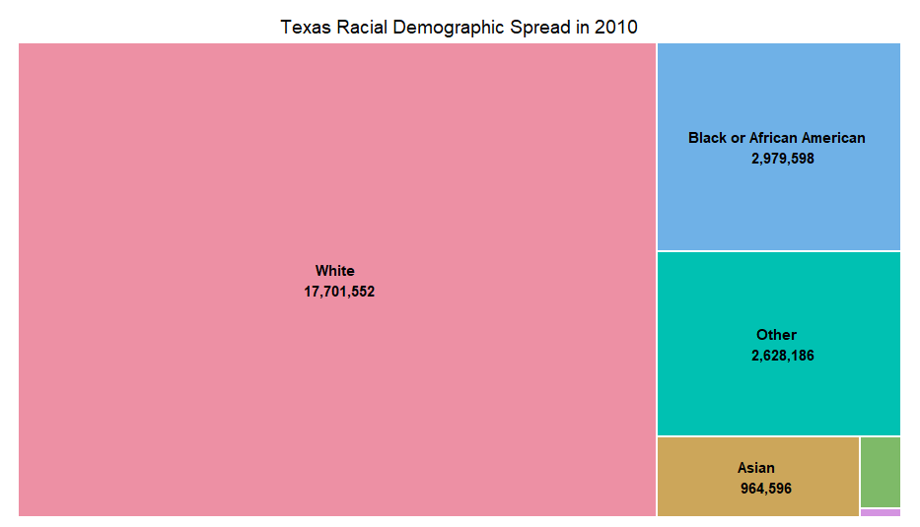
Racial Diveristy and Texas Racial Demographics
Texas’ White demographics have shrinked by 3 million, while every other race has increased dramatically
This information tagged along with the previous TreeMap with state population, poses an interesting question about how diverse Texas has grown over the past decade. Along with what had happened to the White demographic.
Over the decade, people who have identified as two or more races have increased by 26 Million People. While People who Identify as one race has decreased by 3 Million.
With further time and data, it should be simple to deduce whether that came from immigration, new births, or maybe people have changed their answers.

Slide 8
Code
#Grabbing Demographic Data
total_race_2010 <- get_decennial(geography = "state",
variables = c("P001001","P001002", "P001003", "P001004","P001005", "P001006", "P001007", "P001008", "P001009"),
year =2010,
sumfile = "pl")
total_race_2020 <- get_decennial(geography = "state",
variables = c("P1_001N", "P1_002N","P1_003N", "P1_004N", "P1_005N","P1_006N", "P1_007N", "P1_008N", "P1_009N"),
year =2020)
#Using total_race_2020 and 2010
#Need to translate Variables to corresponding race
total_race_2010 <- total_race_2010 %>% mutate(variable = recode(variable, 'P001001' = 'Total', 'P001002' = "One Race", 'P001003' = 'White','P001004' = 'Black or African American','P001005' = 'Native American/Alaska Native','P001006' = 'Asian','P001007' = 'Native Hawaiian or Pacific Islander','P001008' = 'Other','P001009' = 'Two or More Races'))
total_race_2020 <- total_race_2020 %>% mutate(variable = recode(variable, 'P1_001N' = 'Total', 'P1_002N' = 'One Race','P1_003N' = 'White', 'P1_004N' ='Black or African American', 'P1_005N' = 'Native American/Alaska Native','P1_006N' = 'Asian', 'P1_007N' = 'Native Hawaiian or Pacific Islander', 'P1_008N' = 'Other', 'P1_009N' = 'Two or More Races'))
total_race_2010 <- cbind(total_race_2010, Year = 2010)
total_race_2020 <- cbind(total_race_2020, Year = 2020)
total <- rbind(total_race_2010, total_race_2020)
#Mapping Treemaps
treemap_data <- total %>%
filter(Year == 2010, variable == "Total")
treemap_data$label <- paste(treemap_data$NAME, "\n", format(treemap_data$value, big.mark = ","))
treemap(treemap_data,
index = "label",
type = "index",
vSize = "value",
title = "State Population in 2010",
fontsize.title = 14,
border.col = "white",
format.legend = list(scientific = FALSE, big.mark = ","))
total %>% filter(total$variable == "Total") %>%
treemapify(aes(x = gg, y = "value")) +
geom_bar(stat = "identity")
treemap_data_2020 <- total %>%
filter(Year == 2020, variable == "Total")
treemap_data_2020$label <- paste(treemap_data_2020$NAME, "\n", format(treemap_data_2020$value, big.mark = ","))
treemap(treemap_data_2020,
index = "label",
type = "index",
vSize = "value",
title = "State Population in 2020",
fontsize.title = 14,
border.col = "white",
format.legend = list(scientific = FALSE, big.mark = ","))
treemap_texas_2010_race_data <- total %>%
filter(NAME == "Texas", Year == 2010, variable != "Total", variable != "One Race", variable != "Two or More Races")
treemap_texas_2010_race_data$label <- paste(treemap_texas_2010_race_data$variable, "\n", format(treemap_texas_2010_race_data$value, big.mark = ","))
treemap(treemap_texas_2010_race_data,
index = "label",
type = "index",
vSize = "value",
title = "Texas Racial Demographic Spread in 2010",
fontsize.title = 14,
border.col = "white",
format.legend = list(scientific = FALSE, big.mark = ","))
treemap_texas_2020_race_data <- total %>%
filter(NAME == "Texas", Year == 2020, variable != "Total", variable != "One Race", variable != "Two or More Races")
treemap_texas_2020_race_data$label <- paste(treemap_texas_2020_race_data$variable, "\n", format(treemap_texas_2020_race_data$value, big.mark = ","))
treemap(treemap_texas_2020_race_data,
index = "label",
type = "index",
vSize = "value",
title = "Texas Racial Demographic Spread in 2020",
fontsize.title = 14,
border.col = "white",
format.legend = list(scientific = FALSE, big.mark = ","))
Sorry for the tight fit and Crowded EDA
Each Square is a section of Code; Data Collection, Bar Graph, TreeMap
#BAR Graph
oner_2010_total <- total %>%
filter(variable == "One Race", Year == 2010)
twor_2010_total <- total %>%
filter(variable =="Two or More Races", Year == 2010)
oner_2020_total <- total %>%
filter(variable == "One Race", Year == 2020)
twor_2020_total <- total %>%
filter(variable =="Two or More Races", Year == 2020)
sum_of_race_pop <- c(sum(oner_2010_total$value), sum(twor_2010_total$value),sum(oner_2020_total$value),sum(twor_2020_total$value))
sum_title <- c("2010 One Race", "2010 Two or More Race", "2020 One Race", "2020 Two or More Races")
race_pop_decades <- data.frame(Title = sum_title, Population = sum_of_race_pop)
race_pop_decades$sum_of_race_pop <- as.numeric(race_pop_decades$sum_of_race_pop)
race_pop_decades <- race_pop_decades %>%
mutate(Population = format(Population, big.mark = ","))
race_pop_decades %>% ggplot(aes(x = sum_title, y = sum_of_race_pop)) +
geom_bar(stat = "identity") +
xlab("Categories") +
ylab("Population") +
ggtitle("Change in Racial Identity over a decade") +
scale_y_continuous(labels = scales::comma) +
geom_text(aes(label = Population), vjust = -0.5) +
theme_wsj() +
theme(plot.title = element_text(size = 18))

