Slide 1
FLS Unit 5
DS6306
Johnny Vogt

Slide 2
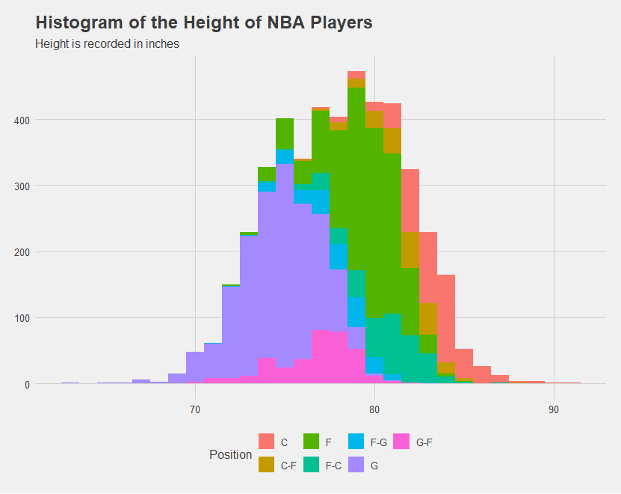
BBall Study - Conversion Foot/Inches to Total Inches
Code:
#Converting Feet/Inches to Total Inches
PlayersBBall <- PlayersBBall %>%
separate(col = height, into = c("feet", "inches"), sep = "-")
PlayersBBall$feet <- as.numeric(PlayersBBall$feet)
PlayersBBall$inches <- as.numeric(PlayersBBall$inches)
PlayersBBall$feet <- PlayersBBall$feet * 12
PlayersBBall$TotalInches <- PlayersBBall$feet + PlayersBBall$inches
#Plotting
PlayersBBall %>% ggplot(aes(x = TotalInches, fill = position)) +
geom_histogram(binwidth = 1) +
xlab("NBA Player's Height in Inches") +
ylab("Number of Players") +
ggtitle("Histogram of the Height of NBA Players") +
guides(fill = guide_legend((title = "Position"))) +
theme_fivethirtyeight()
I had created a conversion function that I had created in Unit 2, but I decided to forgo using it to manually convert them.
Created a Histogram with the converted data. Had to uses “binwidth = 1” in order to fix some spacing issue in the histogram.

Slide 3
FIFA Study
Code:
#Height
FIFA_Players <- FIFA_Players %>%
separate(col = Height, into = c("ht_ft", "ht_in", sep = "'"))
FIFA_Players$ht_ft <- as.numeric(FIFA_Players$ht_ft)
FIFA_Players$ht_in <- as.numeric(FIFA_Players$ht_in)
FIFA_Players$ht_ft <- FIFA_Players$ht_ft * 12
FIFA_Players$Height <- FIFA_Players$ht_ft + FIFA_Players$ht_in
#Weight
FIFA_Players$Weight = str_replace(FIFA_Players$Weight, "lbs", "")
FIFA_Players$Weight = as.numeric(FIFA_Players$Weight)
This code essentially converts both the Weight and Height into numerics and into characters that are easy to plot
The height conversion was almost word for word as the BBAll Study.

Slide 4
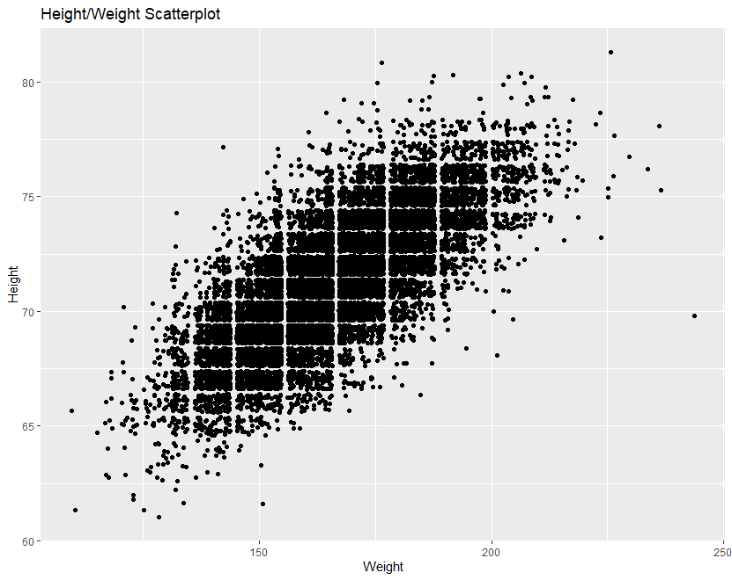
Player’s Height and Weight
Code:
FIFA_Players %>% ggplot(aes(x = Weight, y = Height)) +
geom_point(position = "jitter") +
ggtitle("Height/Weight Scatterplot" )
The most obvious relationship is the positive correlation of the Height and Weight.
As the Weight Increases, the Height increases.

Slide 5
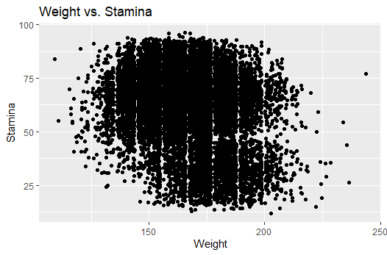
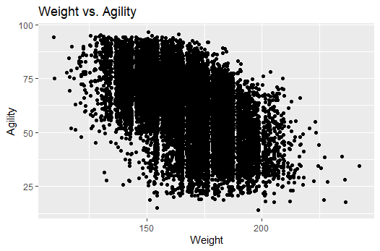
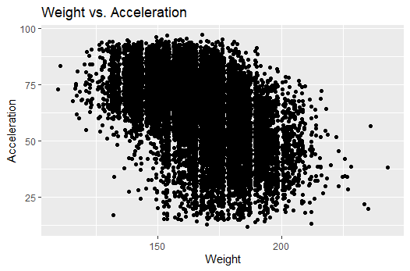
Weight’s effect on Skills
Code:
FIFA_Players %>% ggplot(aes(x = Weight, y = Acceleration)) +
geom_point(position = "jitter") +
ggtitle("Weight vs. Acceleration")
FIFA_Players %>% ggplot(aes(x = Weight, y = Agility)) +
geom_point(position = "jitter") +
ggtitle("Weight vs. Agility")
FIFA_Players %>% ggplot(aes(x = Weight, y = Stamina)) +
geom_point(position = "jitter") +
ggtitle("Weight vs. Stamina")
Wanted to see the effect that weigh thad on skills, specifically Speed-Related skills
In general from a visual perspective, I would say that there is a clear negative correlation, but with alot of variation.
Weight does play a factor in their speed, but doesn’t have a large effect on their Speed-Related Skills
There is no discernible effect on stamina

Slide 6
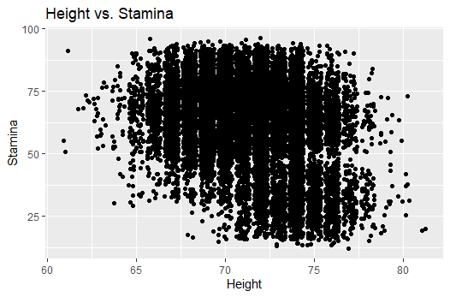
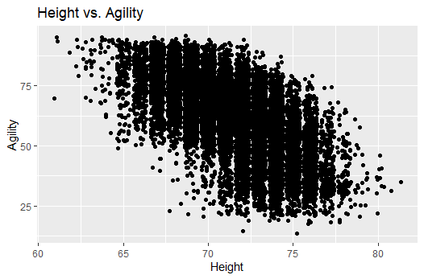
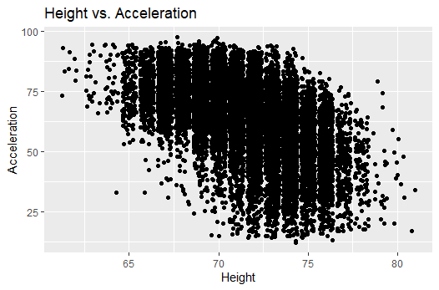
Heights effect on Skills
Code:
Same as last slide, replace W with H
It was only fair comparing the same skills with height and to see similar results.
As Players get taller, they also grow in weight, so the players on the right side of the distribution would be on average heavier
The data may look more orderly and show slightly clearer correlation than the weight, but its only because that there are less values in the range for height than there are in range for weight

Slide 7
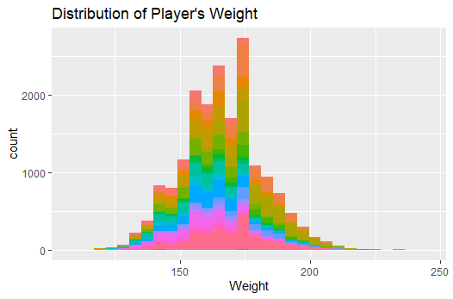
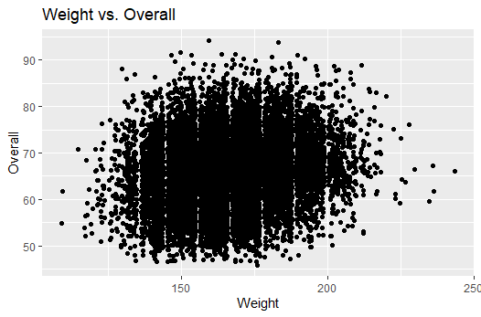
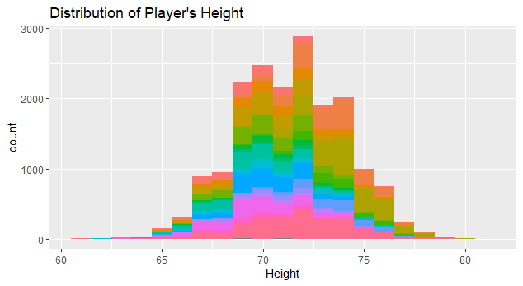
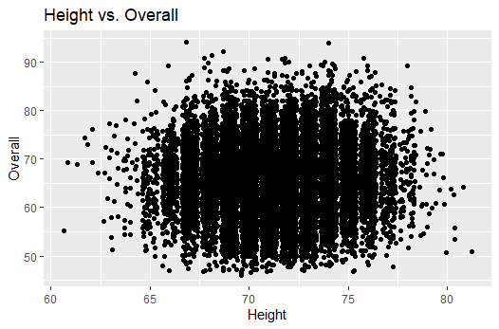
Height and Weight Distributions
The Distributions for both player’s weight and height seem fairly normal.
I would imagine the large spikes in certain weights are mainly because Teams may require certain players to weigh a certain amount creating a bias towards specific weights
Similar to the weight, the Height distribution seems to be fairly normal, with only a few spikes in certain heights.
The spikes are probably because scouts are looking for a specific height of players for a certain positions, thus creating a bias in the data.
Added 2 Plots comparing the overall to height and weight to leave off that at the end of the day, although the height and weight may seem to have an affect on some skills and that coaches may have biases on weight and height, At the end of the day, there doesn't seem to be strong evidence that these two factor into whether or not a player is “Good” or “Bad” at Soccer.

Slide 8
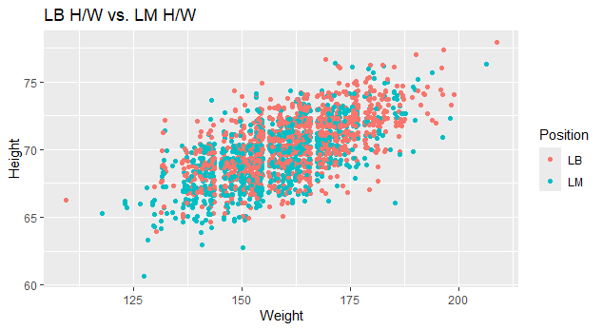
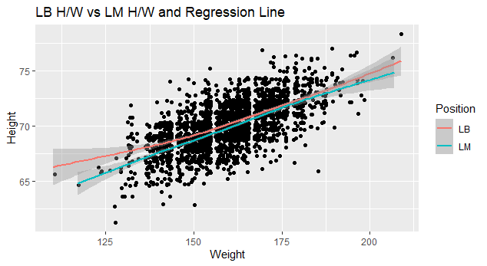
LB vs. LM
Code:
#Filtering out LB and LM Position and Plotting a scatter plot with posiiton color
FFPlayers_lb_lm <- FIFA_Players %>% filter(Position == "LB" | Position == "LM")
FFPlayers_lb_lm
str(FFPlayers_lb_lm)
FFPlayers_lb_lm %>%
ggplot(aes(x = Weight, y = Height, color = Position)) +
geom_point( position = "jitter")+
ggtitle("LB H/W vs. LM H/W")
FFPlayers_lb_lm %>%
ggplot(aes(x = Weight, y = Height)) +
geom_point( position = "jitter") +
geom_smooth(aes(color = Position)) +
ggtitle("LB H/W vs LM H/W and Regression Line")
Provided two plots one with a regression and one without
The plot without the regression line delineates between positon by color.
It’s hard to tell if there is any true difference between positions
The line with the regression line was added for that exact reason. Although it’s small difference, you can see that the players in the LB position are slightly bigger than LMs.

Slide 9
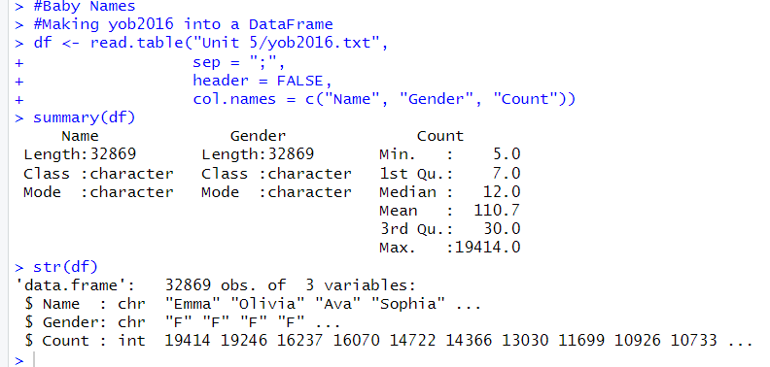
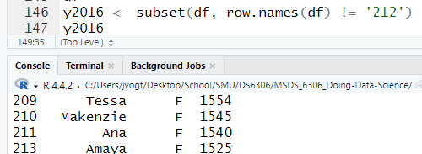
Baby Names
Had a hard time trying to get the data into a data.frame
Used readLines and read_csv, but it I couldn't get the data into a dataframe.
Everytime I removed “Fionayyy”, I would look back at the missing “212” that she had been at. Does that ever go away? Will there just be a void between 211 and 213?

Slide 10
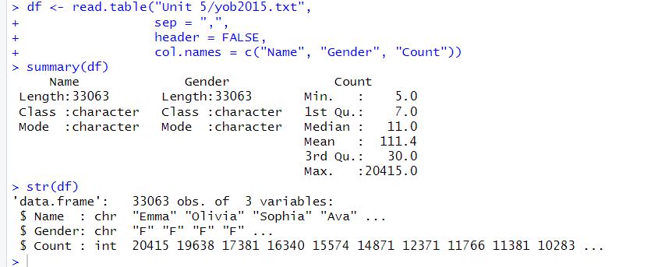
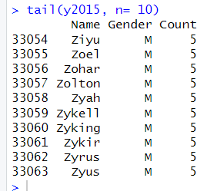
Baby Names Pt.2
Didnt have to do much here compared to the previous slide. Once you figure out how to do it once, it gets easier.
The last 10 observation in this set of data are all males and only goes down to 5. You would think there would be “Unique” Names that only 1 person would have.
Code that I used to merge:
final <- merge(x = y2015, y = y2016, by = "Name")
final$Total <- final$Count.x + final$Count.y
final <- final[order(final$Total, decreasing = TRUE),]

Slide 11
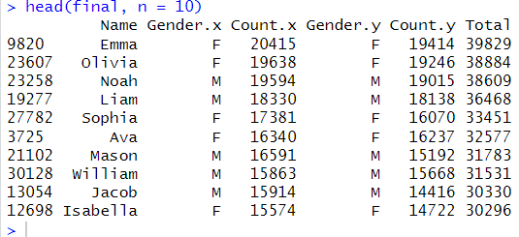
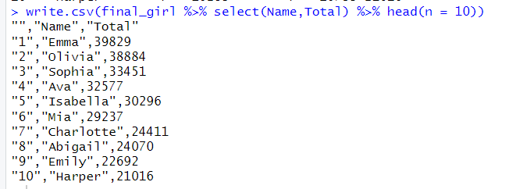
Top Ten Names
Code:
final <- final[order(final$Total, decreasing = TRUE),]
head(final, n = 10)
#Top Ten for Girls
final_girl <- final %>% filter(Gender.x == "F")
write.csv(final_girl %>% select(Name,Total) %>% head(n = 10))

Slide 12
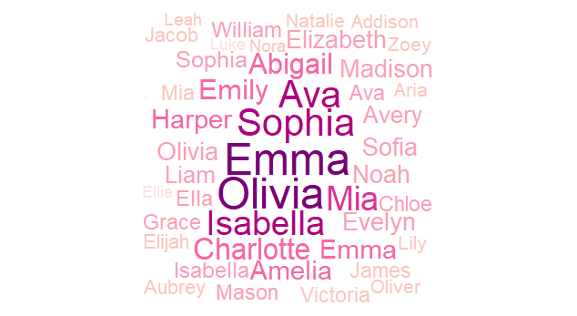
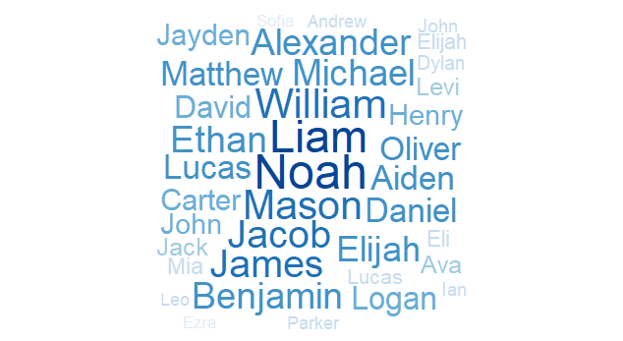
Baby Names Pt. 3
Code:
library(wordcloud)
wordcloud(words = final_girl$Name,
freq = final_girl$Total,
scale = c(3,0.5),
min.freq = 9000,
colors = brewer.pal(8, "RdPu"),
random.order = FALSE,
rot.per = 0)
wordcloud(words = final_boy$Name,
freq = final_boy$Total,
scale = c(3,0.5),
min.freq = 9000,
colors = brewer.pal(8, "Blues"),
random.order = FALSE,
rot.per = 0)
Created a Wordmap, Works similar to a heat map, but also Centers the most popular name and surrounds it with name in a descending fashion.
Thought it’d be cool.
Honestly tried something simple like a bar graph or pie chart that separated the top ten names vs. others, but I just couldn't get it working. So I googled cool ways to show names. If I was gonna struggle, might as well be something fun.

