Slide 1

Preliminary Results of Maintenance Planning Optimization
299 Alhambra Circle, Suite 403
Coral Gables, Florida 33134
(786) 388-098
info@bix-tech.com

Slide 2
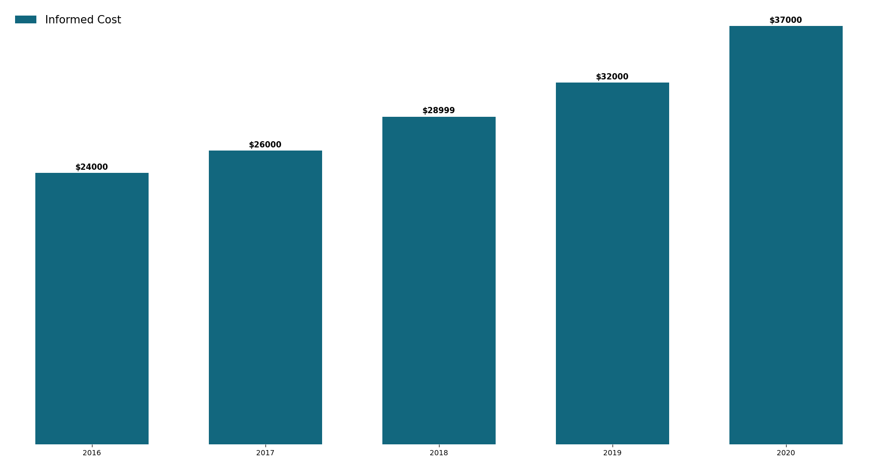
Overview
In the last 3 years it has been noticing a large increase in the expenses related to the maintenance of the air system of its vehicles, even though it has been keeping the size of its fleet relatively constant.

Slide 3
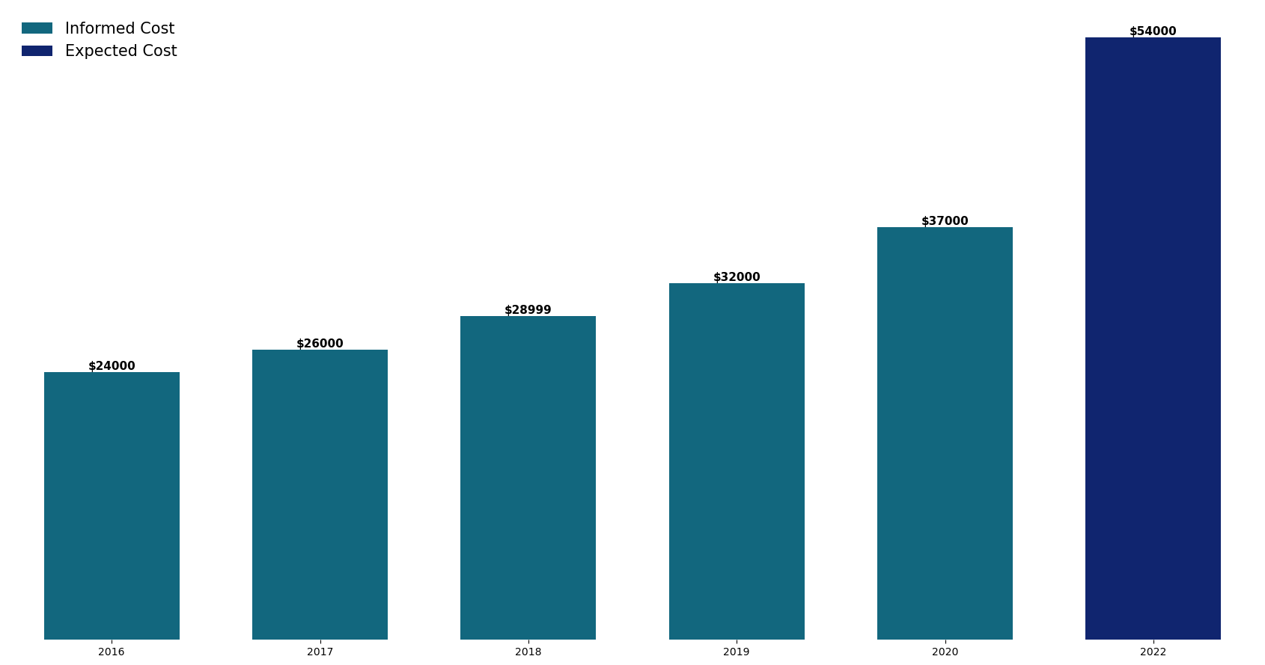
Direct cost of maintenance for 2022 using linear regression

Slide 4
Pipeline for our Solution
1. Problem Definition
2. Data Analysis and Preprocessing
3. Model Selection
4. Model Training
5. Model Evaluation

Slide 5
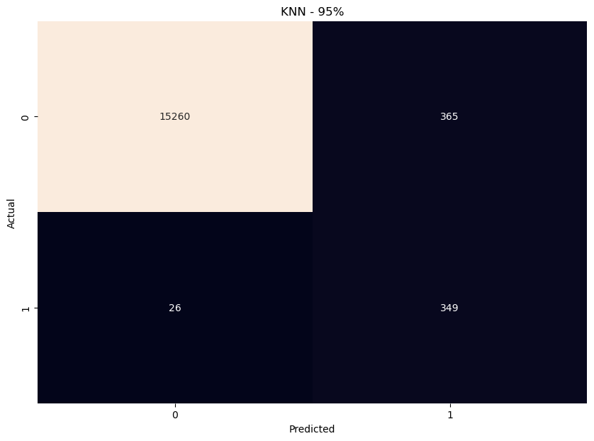
Result obtained by the Model
True Negative
False Positive
False Negative
True Positive

Slide 6
False Positive
True Positive
False Negative
Predicted Result: 365
Predicted Result: 349
Predicted Result: 26
Cost: $3650
Cost: $8725
Cost: $13000
Total Cost: $25.365

Slide 7
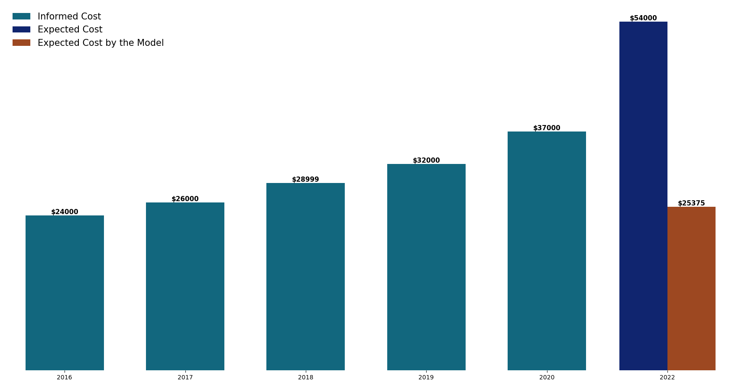
Direct cost of maintenance for 2022 was reduced in $28.625 (53%) (based in our expected cost)

Slide 8
Summary:
The expected cost was $54,000, which our model successfully reduced to $25,375.
Maintenance costs from six years ago (excluding inflation, taxes, and other factors).
Mitigation of potential indirect expenses, including accident-related costs, driver’s meals, lodging, delivery delays, and others.

Slide 9
Next Steps:
Implementation cost of the model.
Comprehensive comparative analysis between current costs (both direct and indirect) and the model's application.

Slide 10
| Thank you!

Slide 11
Any Questions?

