Slide 1
Playtest Results of 2020 Space Odyssey

Slide 2
Playtest Plan
Playtesting Goals
See people’s reaction to the modifier icons.
General feedback of the game. (dominant strategies, confusions, etc)
See people’s reactions to the modifiers themselves and balance them.
Preparation
Prepared a sheet with icons to note how players reacted to certain icons.
Prepared and tested a build of the game that was functional enough to playtest
Testing Methodology
Got the people to figure out the game on their own.
After a few minutes, asked about their understanding of different aspects

Slide 3
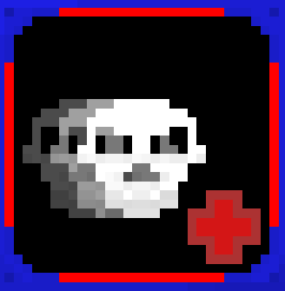
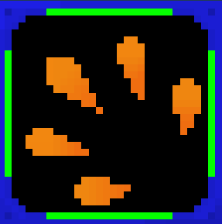
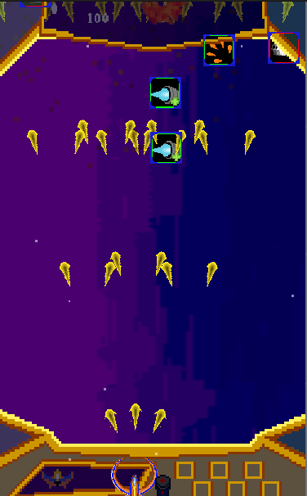
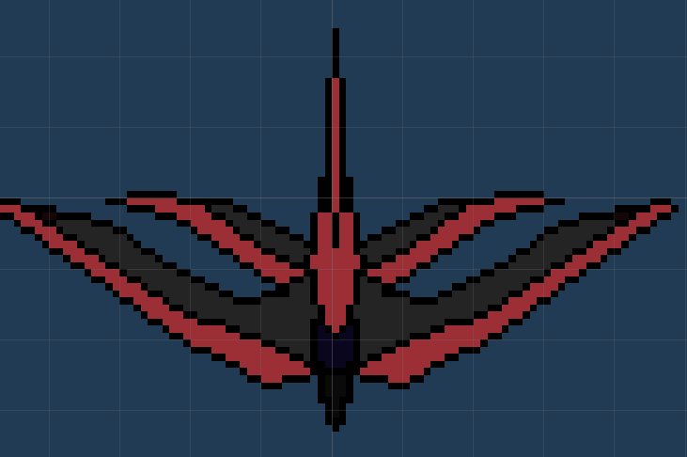
Design Insights
Icons
Lower rate of successful understanding than expected.
Didn’t understand which powerups were good or bad, just assumed that since it’s a powerup its good.
Dominant Strategies
Powerups need to be balanced. Dominant strategy emerged where player would become invincible with the correct powerups.
Scaling Difficulty
Enemies and waves need to get harder over time.
Enemies should spawn faster and with no gap between late game waves.
Shooter enemies take too long to fire, negating their effect.

Slide 4



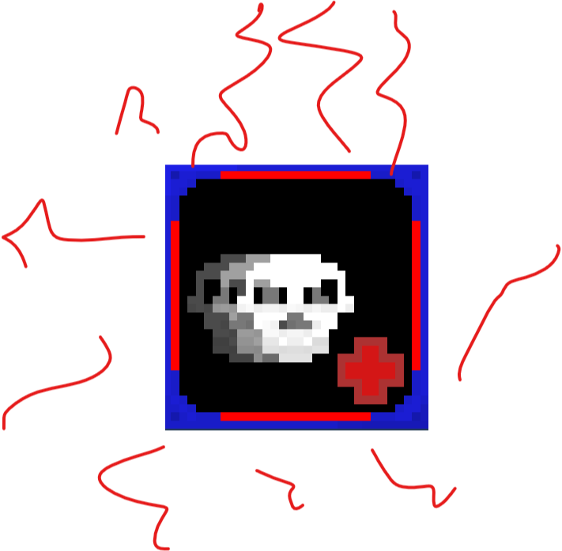
Solutions to Issues
Icons
Change the +/- to up/down arrows to avoid confusion with hit points.
Further iteration on icon designs
Ideas for further fixes
Further emphasize good or bad with particles surrounding the icon.
Increase the red/green highlights on the icon (risk of losing too much real estate)

Slide 5
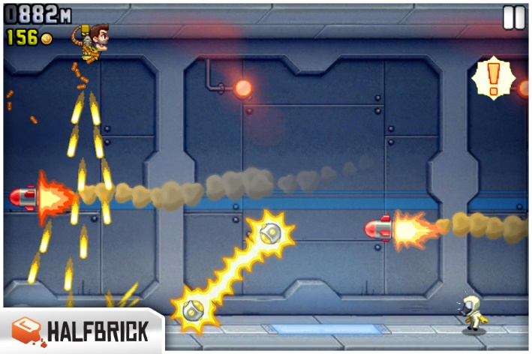
Solutions to Issues
Dominant Strategy
Prevent player from sitting still too long by increasing fire rate of shooter enemies
Prevent player from sitting still by firing missiles or other indestructible obstacles
Scaling Difficulty
Fix wave breaks and spawn rates at late game
Force player to move around more
Remove positive modifiers over time (?)

