Slide 1
STUDENT ATTENDANCE
MANAGEMENT SYSTEM
✓
Project Presentation
A VINESH | Roll No. 123456
ADITYA DIPLOMA COLLEGE • CSE • Academic Year 2026–2027
Guide / Supervisor
J V RAMA KRISHNA RAO
ADIKAVI NANNAYA UNIVERSITY

Slide 2
PROJECT OVERVIEW
A simple web-based system for secure and organized student attendance.
STUDENT
FACE VERIFICATION
ATTENDANCE
APPROVAL
Registers • Logs in • Submits attendance
Camera + OpenCV + DeepFace
Date recorded • Status = PENDING
Admin / Superadmin reviews record
KEY FEATURES
✓ Role-based access
✓ One registered face image
✓ Attendance history
✓ Email notification
Student Attendance Management System • Page 2

Slide 3
PROBLEM STATEMENT
Challenges in maintaining accurate, efficient and manageable attendance records.
Manual effort
Paper or manual records require repeated data entry and checking.
01
Identity verification
A reliable way to confirm the student's identity is needed before
attendance submission.
02
Approval tracking
Attendance records need a controlled approval or rejection process.
03
MANUAL RECORDS
Student access
Students need convenient access to their attendance history and
profile.
04
Student Attendance Management System • Page 3

Slide 4
PROJECT OBJECTIVES
The system is designed around a secure and simple attendance workflow.
01
Student Registration
02
Secure Login
03
Face Verification
Allow students to create an account and
register one face image.
Provide authenticated access according to
the user's role.
Verify the student's face before attendance
is submitted.
04
Attendance Record
05
Approval Workflow
06
Student History
Automatically create an attendance record
with the current date.
Allow authorized users to approve or reject
attendance.
Let students view attendance history and
profile information.
Student Attendance Management System • Page 4

Slide 5
SCOPE OF THE SYSTEM
The project covers the complete student attendance process from registration to approval.
INCLUDED
CURRENT LIMITS
✓ Student registration with personal details
✓ One registered face image per student
✓ Superadmin approval of student accounts
✓ Student login and role-based access
✓ Camera-based face verification
✓ Attendance creation with date and status
✓ Admin / Superadmin approval or rejection
✓ Attendance history and student profile
✓ Email notification for approved attendance
• No separate face training or encoding
• One student face at a time
• No Excel / CSV export
• No multiple classes or subjects
REGISTER
VERIFY
RECORD
APPROVE
Student Attendance Management System • Page 5

Slide 6
TECHNOLOGY STACK
The project combines web technologies, database management and face verification.
FRONTEND
BACKEND
DATABASE
FACE VERIFICATION
HTML • CSS • JavaScript • Bootstrap
Python • Django
MySQL • mysqlclient
DeepFace • TensorFlow
CAMERA PROCESSING
DEVELOPMENT
EMAIL
DEPLOYMENT / TOOLS
OpenCV
VS Code • Windows
SMTP Email
WhiteNoise • Gunicorn • Git & GitHub
Browser → Django → MySQL | Camera → OpenCV → DeepFace / TensorFlow
Student Attendance Management System • Page 6

Slide 7
SYSTEM ARCHITECTURE
A layered design connects the user interface, Django application, database and face verification.
USER LAYER
Student • Admin • Superadmin
WEB / UI LAYER
HTML • CSS • JavaScript • Bootstrap
APPLICATION LAYER
Django • Authentication • Role-based access
VERIFICATION LAYER
OpenCV → DeepFace → TensorFlow
DATA LAYER
MySQL • Student data • Attendance records
Attendance request → authentication → face verification → database record → approval
Student Attendance Management System • Page 7

Slide 8
USER ROLES & ACCESS
Role-based access keeps student and administrative functions clearly separated.
STUDENT
ADMIN
SUPERADMIN
• Registration
• Login
• Face verification
• Submit attendance
• View history & profile
• Login
• View attendance
• Approve attendance
• Reject attendance
• Login
• Approve students
• Approve attendance
• Reject attendance
STUDENT → SUBMIT → ADMIN / SUPERADMIN → APPROVE OR REJECT
Student Attendance Management System • Page 8

Slide 9
STUDENT REGISTRATION WORKFLOW
Registration collects student details and a face image before account approval.
01
02
03
04
05
ENTER DETAILS
ADD FACE IMAGE
ACCOUNT PENDING
APPROVAL
LOGIN
Student provides personal and
account information.
One registered face image is
uploaded.
The new account waits for
Superadmin approval.
Superadmin reviews and approves
the student.
Approved student can access the
system.
NEW STUDENT ACCOUNT → PENDING → SUPERADMIN APPROVAL → ACTIVE ACCESS
Student Attendance Management System • Page 9

Slide 10
FACE VERIFICATION
DeepFace verifies the student's live camera image against the registered face image.
CAPTURE
OpenCV captures the student's face.
COMPARE
DeepFace compares the live image with the registered image.
LIVE CAMERA INPUT
VERIFY
A successful match allows attendance submission.
One registered face image per student
No separate face training or encoding
OpenCV → DeepFace → TensorFlow → Verification
Student Attendance Management System • Page 10

Slide 11
ATTENDANCE WORKFLOW
From attendance submission to final approval, each step is recorded in the system.
1
2
3
4
5
6
7
START
CAMERA
VERIFY
CREATE
PENDING
REVIEW
FINAL
Student opens attendance
page
Face is captured using the
camera
DeepFace verifies the
registered face
Attendance record is
created with date
Record receives PENDING
status
Admin / Superadmin
Reviews the record
APPROVED or REJECTED
status is stored
PENDING → APPROVED / REJECTED
Student Attendance Management System • Page 11

Slide 12
DATABASE DESIGN
MySQL stores student information, attendance records and authentication-related data.
STUDENT / USER
ATTENDANCE
• Username & password
• First name & last name
• Email address
• Role
• Approval status
• Registered face image
1 → MANY
• Student reference
• Attendance date
• Status
• PENDING
• APPROVED / REJECTED
Django Authentication • Users • Groups • Permissions • Sessions
Student Attendance Management System • Page 12

Slide 13
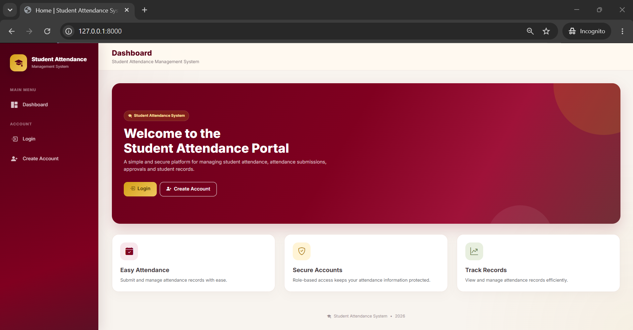
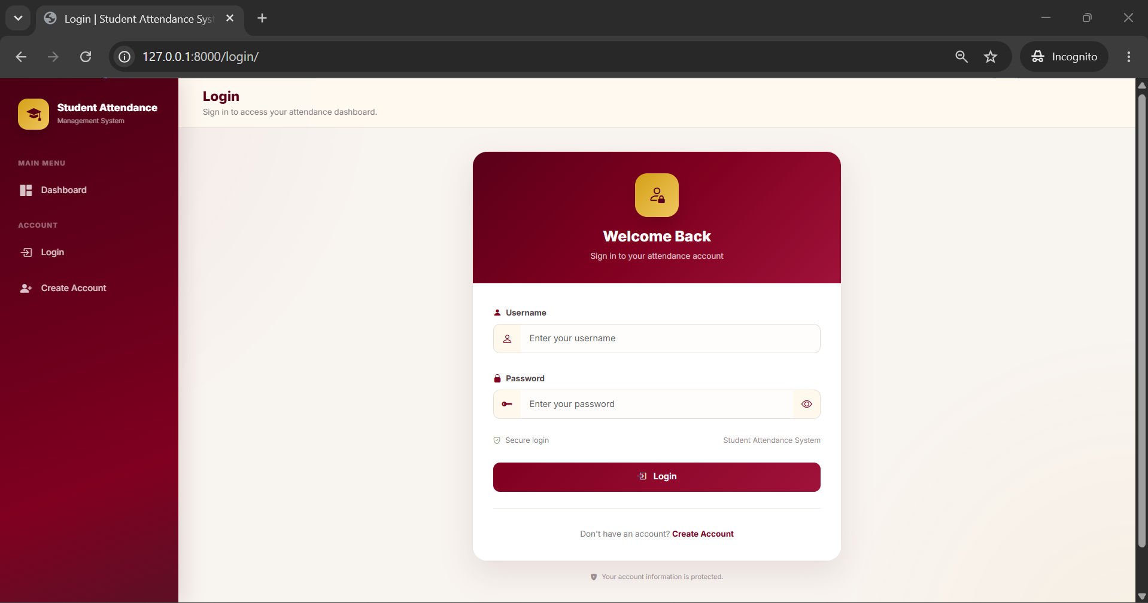
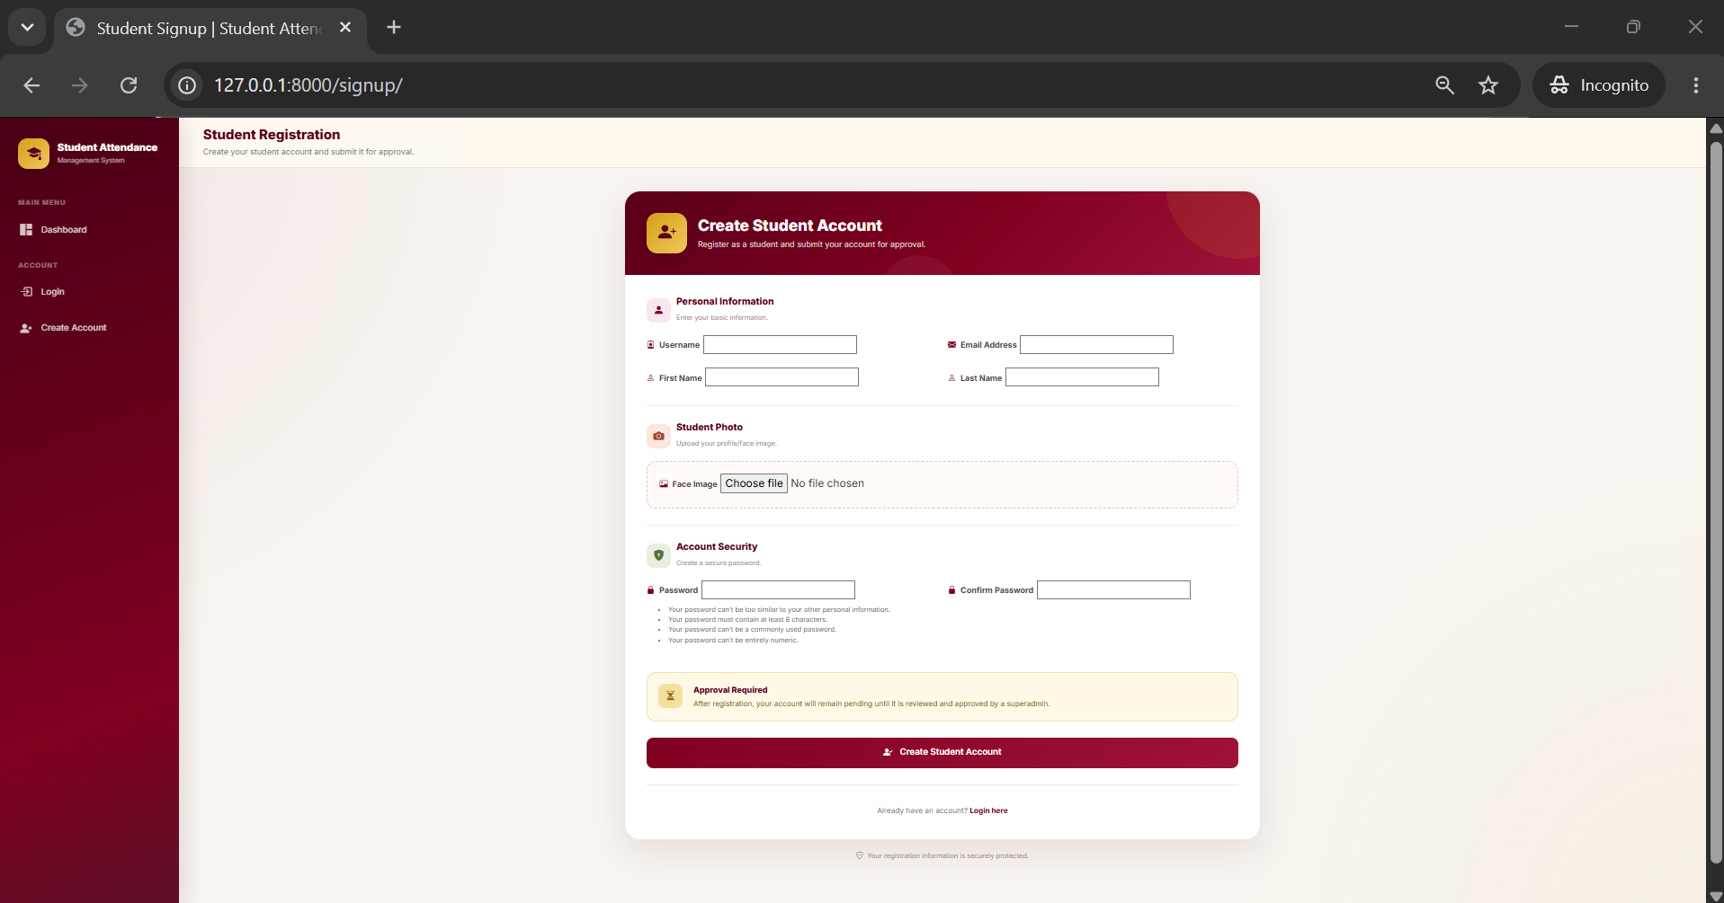
USER INTERFACE — REAL SYSTEM SCREENS
Actual project screenshots showing the public landing page, login and student registration.
Figure 13.1 Base / Home Page
Figure 13.2 Login Page
Figure 13.3 Student Registration Page
Student Attendance Management System • Page 13

Slide 14
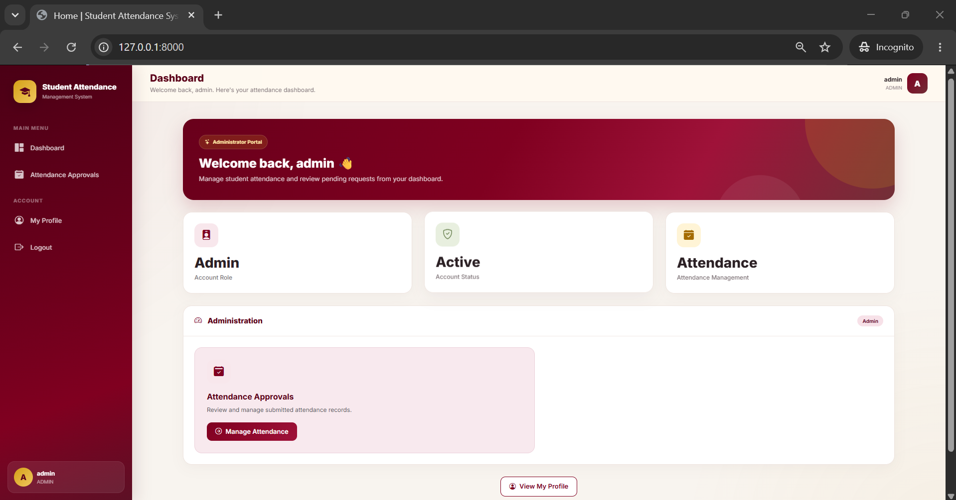
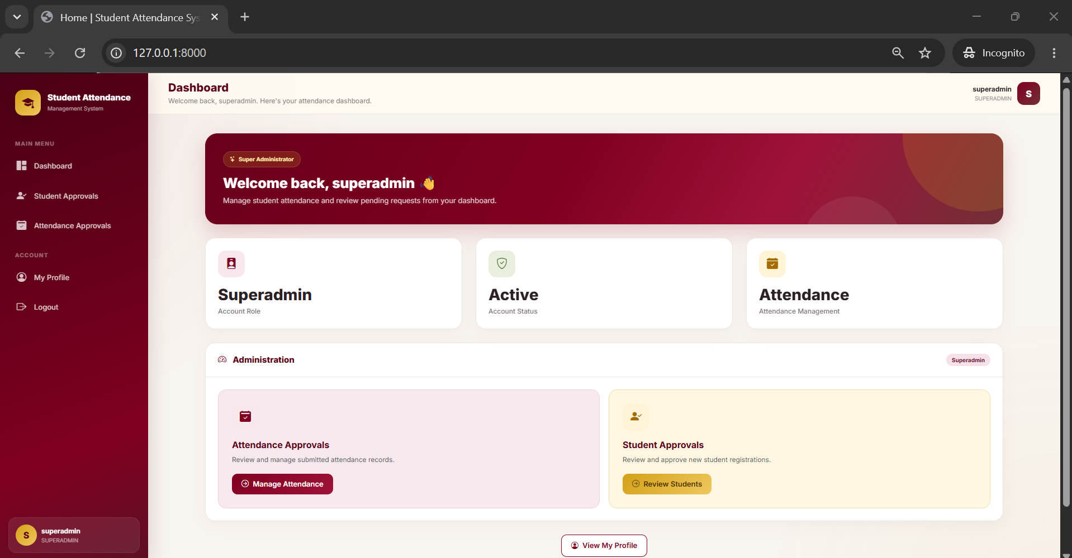
ADMINISTRATION DASHBOARDS — REAL SCREENS
Actual project screenshots showing the Admin and Superadmin dashboards.
Figure 14.1 Admin Dashboard
Figure 14.2 Superadmin Dashboard
ADMIN • Attendance Approvals
SUPERADMIN • Student + Attendance Approvals
Student Attendance Management System • Page 14

Slide 15
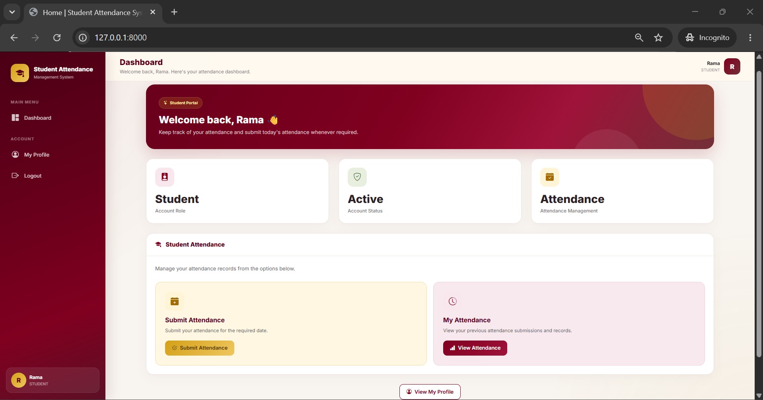
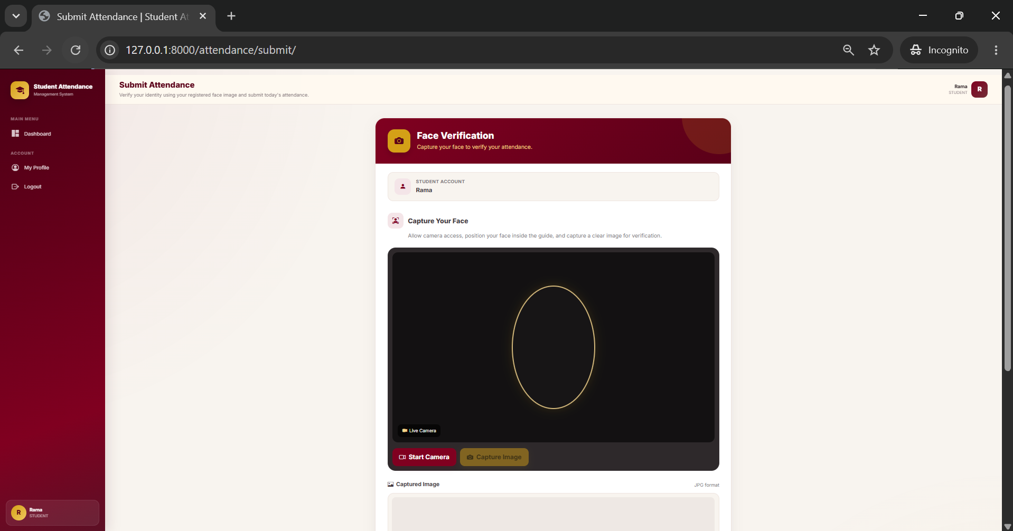
STUDENT DASHBOARD & ATTENDANCE
Real project screens showing student access and attendance history
Figure 15.1 Student Dashboard
Figure 15.2 Student Attendance History
STUDENT LOGIN → DASHBOARD → SUBMIT ATTENDANCE → VIEW RECORDS

Slide 16
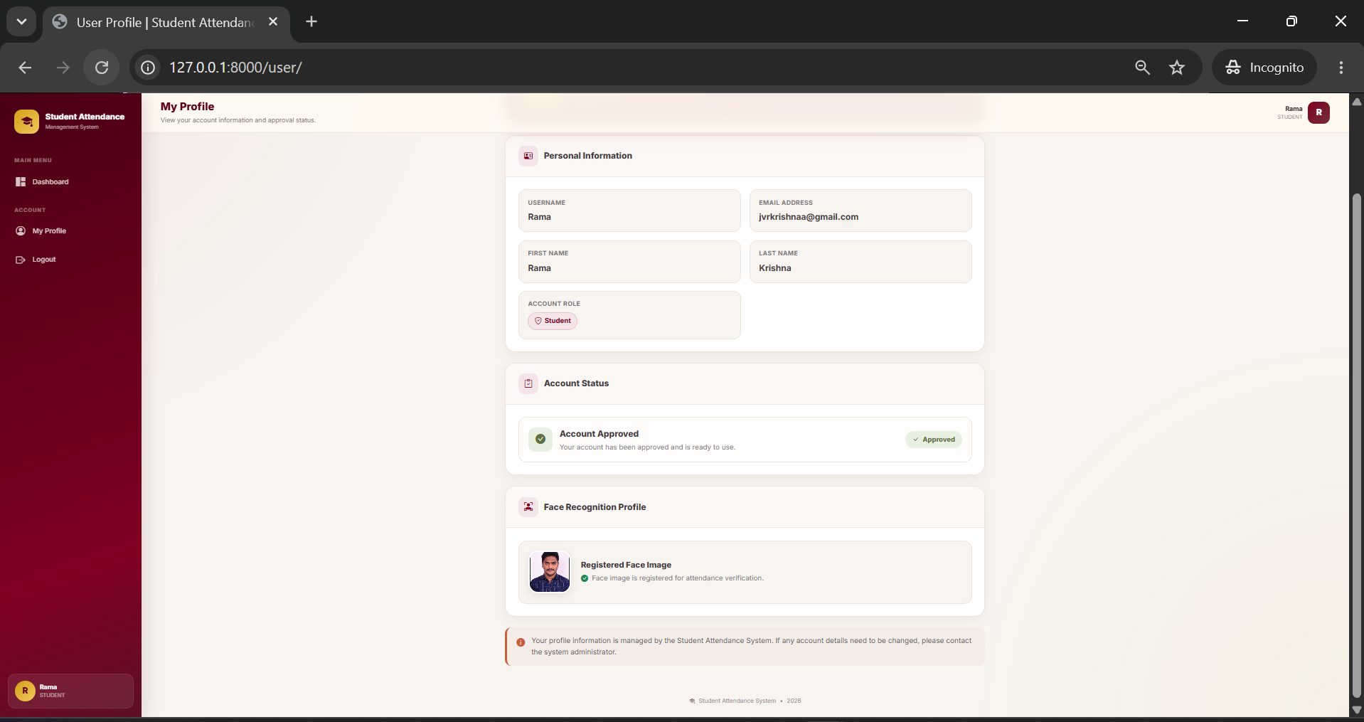
FACE VERIFICATION & STUDENT PROFILE
Real project screens for camera-based verification and student profile management
Figure 16.1 Face Verification / Attendance Submission
Figure 16.2 Student Profile
CAMERA CAPTURE → DEEPFACE VERIFICATION → ATTENDANCE RECORD → PROFILE STATUS

Slide 17
STUDENT USER PROFILE
Real project screen showing the student's account and profile information
PERSONAL DETAILS
Student account information is displayed in one profile
view.
ACCOUNT STATUS
Approval status and registered student information
can be checked.
PROFILE MANAGEMENT
The student can review their account details after login.
Figure 17.1 Student User Profile Screen
SECURE • ROLE-BASED • PROFILE ACCESS

Slide 18
ATTENDANCE SYSTEM WORKFLOW
Complete process from student registration to approved attendance
01
02
03
04
05
06
REGISTER
APPROVAL
LOGIN
VERIFY FACE
ATTENDANCE
DECISION
Student enters personal details
and uploads face image
Superadmin reviews
and approves account
Approved student
logs into the system
Camera captures face
and DeepFace verifies
Successful verification
creates PENDING record
Admin/Superadmin approves
or rejects attendance
APPROVED → ATTENDANCE STATUS = APPROVED → EMAIL NOTIFICATION

Slide 19
SYSTEM TESTING & RESULTS
Functional testing of the major Student Attendance Management System modules
TEST AREA
TEST CONDITION
EXPECTED RESULT
STATUS
Registration
Student submits details and face image
Account created and sent for approval
PASS
Login
Valid approved student credentials
Student dashboard opens
PASS
Face Verification
Camera captures registered student's face
Face verified and attendance submitted
PASS
Attendance Record
Successful verification
Date recorded with PENDING status
PASS
Approval
Admin/Superadmin reviews record
Record becomes APPROVED or REJECTED
PASS
Email Notification
Attendance is approved
Student receives notification email
PASS
Profile & History
Student opens profile/attendance pages
Correct account and attendance data shown
PASS
Coverage: Core workflows tested
Result: All listed tests PASS
Outcome: Attendance workflow operates as designed

Slide 20
CONCLUSION & FUTURE SCOPE
Summary of the implemented system and possible future enhancements
CONCLUSION
FUTURE SCOPE
• Automates student attendance using camera-based face verification.
• Uses Django with MySQL for secure web-based attendance management.
• Provides separate access for STUDENT, ADMIN and SUPERADMIN roles.
• Records attendance date and supports approval or rejection workflow.
• Provides attendance history, profile access and email notification.
• Add Excel/CSV attendance export.
• Support multiple classes, subjects and departments.
• Provide richer attendance reports and analytics.
• Improve face verification for wider environmental conditions.
• Add additional deployment and notification options.
STUDENT ATTENDANCE MANAGEMENT SYSTEM • 2026–2027

Slide 21
THANK YOU
Student Attendance Management System
A VINESH • Roll No: 123456
ADITYA DIPLOMA COLLEGE • CSE
ADIKAVI NANNAYA UNIVERSITY • Academic Year 2026–2027
Project Guide: J V RAMA KRISHNA RAO

