Slide 1
What has been the women contribution to mayor discoveries in science?

Slide 2
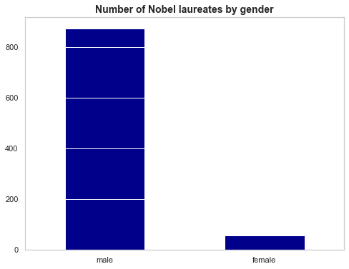
Historically, women are x15 less likely to win a Nobel price than men

Slide 3
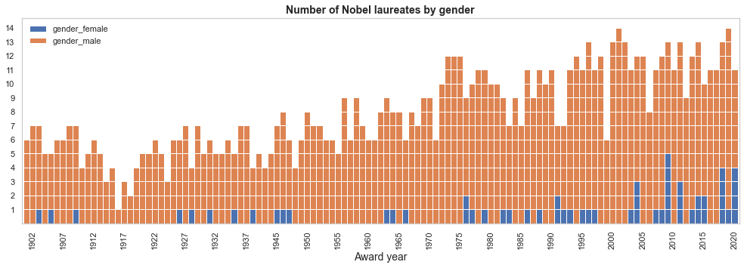
Has this proportion changed over time?

Slide 4

Since 2003 Nobel prizes are a bit more equitable

Slide 5
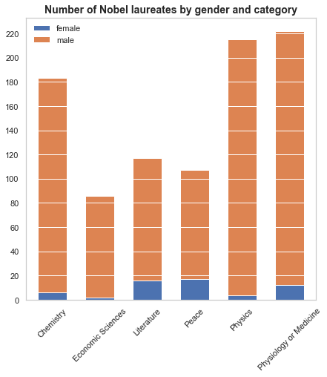
But not in research sciences…

Slide 6
But not in research sciences…

Slide 7
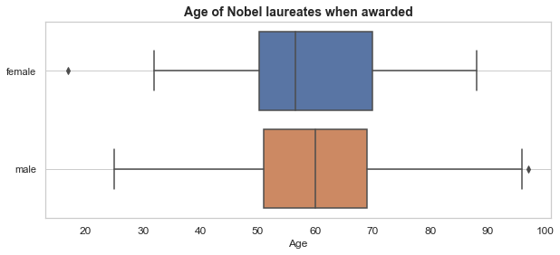
Women were on average younger when they receive the Nobel price

Slide 8
Women were on average
58 years old
when they earned their Nobel prize, whereas their male peers were
60 years old

Slide 9
How immigration has affected national science research?

Slide 10
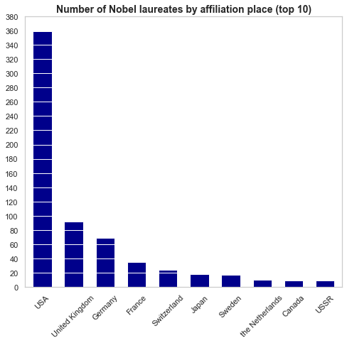

Slide 11
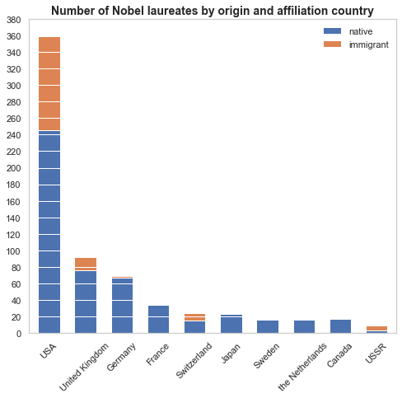

Slide 12
The USA has massively benefited from Scientifics immigration.

Slide 13
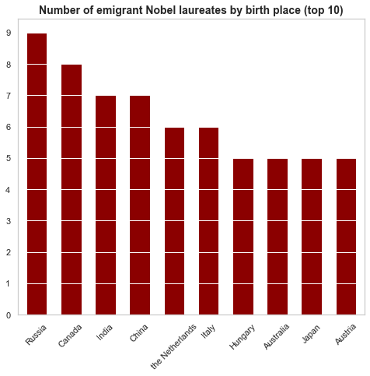
Where do all those immigrant scientists come from?

