Slide 1
Bitcoin Price Prediction using Neural Network
15CS303M- Multi Disciplinary Design
BATCH NO. XII CSE 3G
Guided by Mrs. Gowthamy.J Assistant Professor (O.G) Department of Computer Science and Engineering SRM Institute of Science and Technology Ramapuram Campus, Chennai | Presented By Paul Davis RA1711003020410 Sanjesh Chevanan RA1711003020438 John Vivin Samuel RA1711003020448 B.Tech, CSE, IIII YEAR , G Section SRM Institute of Science & Technology Ramapuram Campus, Chennai
15CS375 L MINOR PROJECT- I, CSE , SRM IST, RAMAPURAM CAMPUS , CHENNAI.

Slide 2
ABSTRACT
This paper aims at predicting the prices of bit coin using neural network.
This can be done accurately by taking into consideration various frameworks that affect the value of Bitcoin.
We aim to achieve this by understanding and identifying daily trends in the Bitcoin market while gaining insight into optimal features surrounding Bitcoin price.
Our data set consists of various features relating to the Bitcoin price and payment network over the course of five years, recorded daily.
Using the available information, we will signal the daily price change with maximum accuracy.

Slide 3
INTRODUCTION
Bitcoin is the worlds’ most valuable cryptocurrency and is traded on over 40 exchanges worldwide accepting over 30 different currencies.
It has a current market capitalization of 9 billion USD according to https://www.blockchain.info/ and sees over 250,000 transactions taking place per day.
Bitcoin is decentralized i.e. it is not owned by anyone. Transactions made by Bitcoins are easy as they are not tied to any country.
Bitcoins are stored in a digital wallet which is basically like a virtual bank account. The record of all the transactions, the timestamp data is stored in a place called Blockchain.
Each record in a blockchain is called a block. Each block contains a pointer to a previous block of data.
The data on blockchain is encrypted. During transactions the user’s name is not revealed, but only their wallet ID is made public.

Slide 4
EXISTING SYSTEM
The existing system uses a Non-linear autoregressive exogenous (NARX) model.
There are many applications for the NARX network. It can be used as a predictor, to predict the next value of the input signal.
It can also be used for nonlinear filtering, in which the target output is a noise-free version of the input signal.
The use of the NARX network is shown in another important application, the modeling of nonlinear dynamic systems.

Slide 5
PROPOSED SYSTEM
The proposed system uses a Multi-Layer Perceptron (MLP) model.
A perceptron is a neural network unit (an artificial neuron) that does certain computations to detect features or business intelligence in the input data.
A Perceptron is an algorithm for supervised learning of binary classifiers. This algorithm enables neurons to learn and processes elements in the training set one at a time.
Multilayer Perceptrons or feedforward neural networks with two or more layers have the greater processing power.
The Perceptron receives multiple input signals, and if the sum of the input signals exceeds a certain threshold, it either outputs a signal or does not return an output. In the context of supervised learning and classification, this can then be used to predict the class of a sample.

Slide 6
LITERATURE SURVEY
Predicting the Price of Bitcoin Using Machine Learning
Author: Sean McNally, 2018
The goal of this paper is to ascertain with what accuracy the direction of Bitcoin price in USD can be predicted. The price data is sourced from the Bitcoin Price Index. The task is achieved with varying degrees of success through the implementation of a Bayesian optimised recurrent neural network (RNN) and a Long Short Term Memory (LSTM) network.

Slide 7
Machine Learning Models Comparison for Bitcoin Price Prediction
Author: Thearasak Phaladisailoed, 2018
This research aims to discover the most efficient and highest accuracy model to predict Bitcoin prices from various machine learning algorithms.The best results showed that the Mean Squared Error (MSE) was as low as 0.00002 and the R-Square (R2) was as high as 99.2%.

Slide 8
Performance Comparison of Bitcoin Prediction in Big Data Environment
Author: Sumarsih C. Purbarani, 2018
In this paper, data processing simulation using machine learning algorithm of Linear Regression is conducted to learn from Bitcoin trading dataset. The simulation is carried out in Apache Spark cluster architecture and GPU. The simulation results show similar error performance between Apache Spark cluster and GPU. Yet, Apache Spark can run the simulation 2x faster than GPU.

Slide 9
Project Based Learning: Predicting Bitcoin Prices using Deep Learning
Author: S. Yogeshwaran, 2018This paper discusses the scheme and delivery of project based learning in computer science engineering as major project which adopts undergraduate creativities and emphasizes on real-world, open-ended
projects.

Slide 10
Systematic Erudition of Bitcoin Price Prediction using Machine Learning Techniques
Author: Prachi Vivek Rane, 2019 This paper discusses comparative analysis envisions to select optimal technique to forecast prices more precisely.

Slide 11
Bitcoin Concepts, Threats, and Machine-Learning Security Solutions
Author: MOHAMED RAHOUTI, 2018 This paper introduces an intensive study that explores the key security concerns. They first start by presenting a global overview of the Bitcoin protocol as well as its major components. Next, they detail the existing threats and weaknesses of the Bitcoin system and its main technologies including the blockchain protocol.

Slide 12
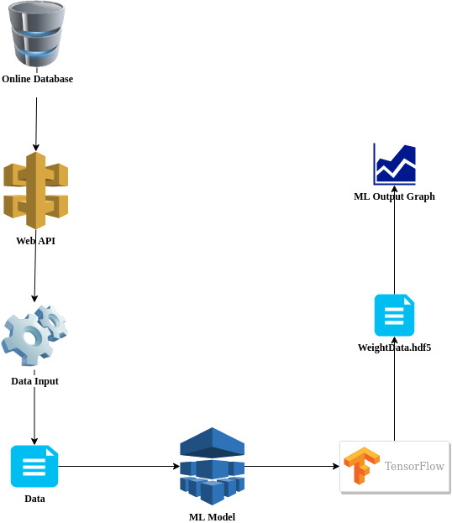
Architecture Diagram

Slide 13
MODULES
1. DATA COLLECTION
We collect the historical data from Binance API using an REST API call.
The API returns data from 2015 to the present day in time intervals of 5 mins and 2 hours. The collected data is then placed into a Data Frame.
2. DATA PREPROCESSING
The Data Frame would contain all the columns that were required as well as a few additional columns.
In order to feed relevant data into our model those extra columns will be removed and the filtered data is stored in to a CSV file.
The exported CSV file is later then called into difference parts of the overall program and filtered again to get relevant data. The rows of the data frame are stored in .h5py format.

Slide 14
MODULES
3. CONVOLUTIONAL NEURAL NETWORK
Convolutional Neural Networks (CNN) is a deep learning methodology used for classification.
However, here we tweak it to be used for prediction.
By setting up a one dimensional network instead of 2D or 3D, we can predict the output by feeding in a list of the close prices from our dataset.

Slide 15
SOFTWARE SPECIFICATIONS
This project built primarily on Python. Python is a high level programming language, which is very efficient when trying to build machine-learning algorithms.
Since it is an open source language, it has a lot of open source libraries built by third party institutions such as Google for example, which can facilitate in construction of complex programs and algorithms.
Complex programs can be written in shorter lines of code in python when compared to Java or other object-oriented programs due to python’s modular features. It can also be used to code across wide range of platforms.

Slide 16
Procurement of data from the Website
A. Urllib:
This python module is used for sending and receiving the HTTP request over the internet like GET,POST,DELETE etc. We are using the request function to send GET request to receive data as a json format which is the universal format for getting data over the HTTP we then send the data to the json module for converting to python processable format like dictionary
B. Json:
This module is used for converting the JSON data that is received from a HTTP GET Request or REST API to a python readable format like the dictionay which has similar syntax like the JSON format data Here we are using it to convert the raw JSON data from poloniex website to python fromat for processing
C. CSV:
The CSV is the abbrivation for "Comma Seperated Variables". The csv module used in python for reading CSV files or to write to a CSV file. Here we are using the csv module in python for storing the data from poloniex
D. Datetime:
The datetime module is used in python for dealing with the date and time. This module can be used for converting a timestamp to YYYY-MM-DD HH:MM:SS format for processing with the Neural Network

Slide 17
E. Binance:
This is a proprietary module which is used for getting the data from the binance website using their APIKey and the SecretKey. Here we are using as out backup data retriving for model testing purpose.
F. Binance API:
The Binance is a site that is facilitated for digital money trade that has given a stage to in excess of 100 cryptographic forms of money. From the start the binance organization constructed high recurrence exchanging framework for merchants. Around 2013 they joined the blockchain.info as a cryptographic money wallet's group. Presently it considered as one of the greatest digital currency trade on the planet as far as trading volume. We are utilizing their API to get access of the Bitcoin trade data that is going on and furthermore the price market of the Bitcoin which will be utilized to prepare the Neural Network Model that is foreseeing the end price of the Bitcoin the following day. The strategy by which Binance API works is that we have to make a profile for us and login with the certifications given and we have to produce an APIKey and a SecretKey which are should have been sent with other required data to get the Bitcoin price data. We are utilizing an extraordinary module in python for interfacing with API known as binance.client which will be utilized to send the APIKey and the SecretKey and recover the data.

Slide 18
Refinement of Data
A. Pandas:
The pandas library is used for data science and data processing. This uses the numpy objects as the inputing the data and matplotlib.pyplot for visualization of the data. This converts the numpy.ndarray into a pnadas.dataframe to process the data which given as the input
B. Numpy:
The Numpy is a mathematical library for creating and fast processing of n-dimention data. We have other mathematical prcessing library in python but we have chosen Numpy becoz it is compatible with most of the ML libraried and also it more faster to compute data in Numpy lib then the treditional list and array of the python
C. Sklearn:
The Sklearn is a ML library of its own but here we are using it for preprocessing of the data which means the data that we have here is in a broad range of data which is very hard for Neural Network to process so we bring down the range of the data to a certain constraint range ideally in between 0 and 1. We are using the Scaling function for converting the data to 0 to 1 range using the Sigmoid method

Slide 19
Incorporation of neural network
Tensorflow and Keras:
These are the modules that are used for creating and training the models that is used for predicting the price of the bitcoin closing price the next day. we are using LSTM (Long Short Term Memory Neurons) for predicting the data that is given to us.

Slide 20
RESULTS
In principle, RNN can monitor self-assertive long haul dependencies from the input. This implies if characteristic changes can be evacuated by utilizing the back-propagation technique. This can help produce a progressively exact training and prediction of the data.
We are utilizing LSTM neural network and MinMaxScaler(Sigmoid) where the base paper is really utilizing MLP as the significant network and utilizing various kinds of normalization work. We can accomplish around 76-78 % precision in the framework.

Slide 21
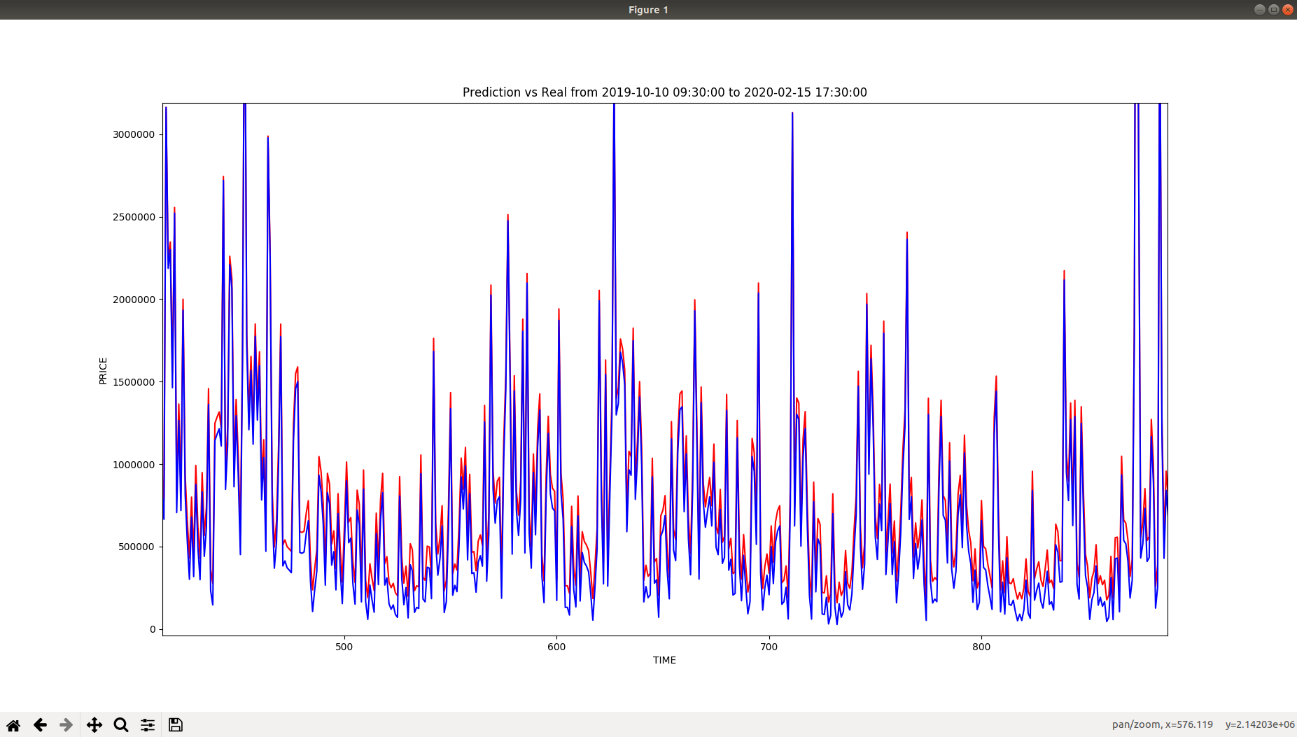
RESULT

Slide 22
SCREENSHOTS

Slide 23
SCREENSHOTS

Slide 24
SCREENSHOTS

Slide 25
SCREENSHOTS

Slide 26
REFERENCES
Sean McNally ; Jason Roche ; Simon Caton: Predicting the Price of Bitcoin Using Machine Learning 2018[1]
Thearasak Phaladisailoed ; Thanisa Numnonda: Machine Learning Models Comparison for Bitcoin Price Prediction 2018[2]
Siddhi Velankar ; Sakshi Valecha ; Shreya Maji Bitcoin price prediction using machine learning 2018[3]
Aslı Demir ; Beyza Nur Akılotu ; Zehra Kadiroğlu ; Abdulkadir Şengür Bitcoin Price Prediction Using Machine Learning Methods 2020[4]
Prachi Vivek Rane ; Sudhir N. Dhage Systematic Erudition of Bitcoin Price Prediction using Machine Learning Techniques 2019[5]
S. Yogeshwaran ; Maninder Jeet Kaur ; Piyush Maheshwari Project Based Learning: Predicting Bitcoin Prices using Deep Learning 2019[6]
Karunya Rathan ; Somarouthu Venkat Sai ; Tubati Sai Manikanta Crypto-Currency price prediction using Decision Tree and Regression techniques 2019[7]
Vineet Shrivastava ; Suresh Kumar Utilizing Block Chain Technology in Various Application Areas of Machine Learning 2019[8]

