Slide 1
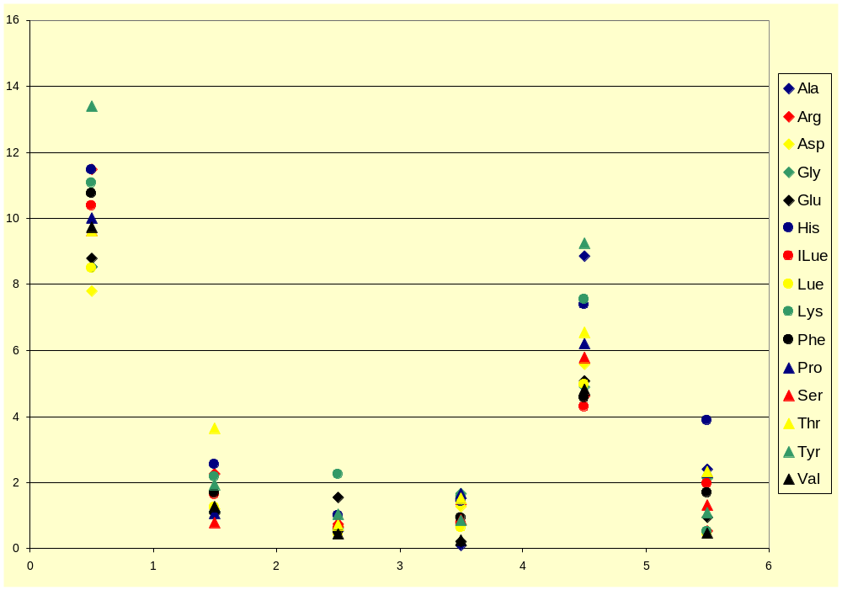
Precision (RSD, %)
(Based on DDGS hydrolysate triplicate)
HPLC-POS
LCMSMS-PRE
Precision (RSD %)
Lab 1
Lab 2
Lab 3
Lab 4
Lab 5
Lab 6

Slide 2
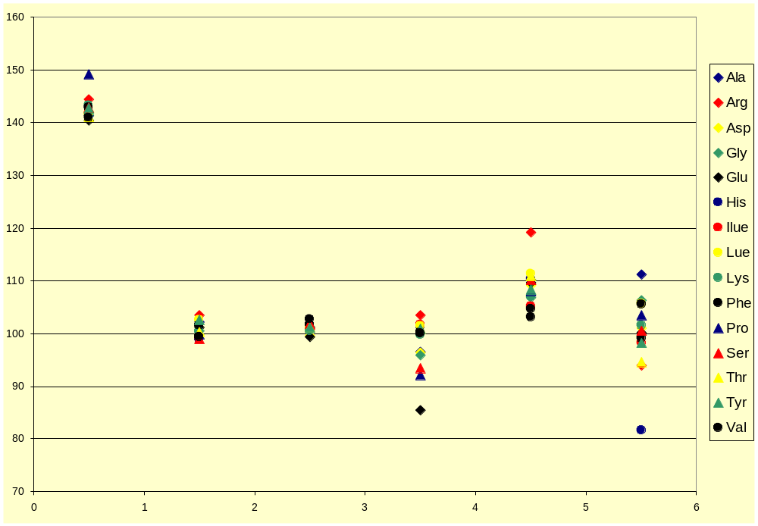
Accuracy (Recovery, %)
(Based on Sigma amino acid hydrolysate standard)
HPLC-POS
LCMSMS-PRE
% Recovery
Lab 1
Lab 2
Lab 3
Lab 4
Lab 5
Lab 6

Slide 3
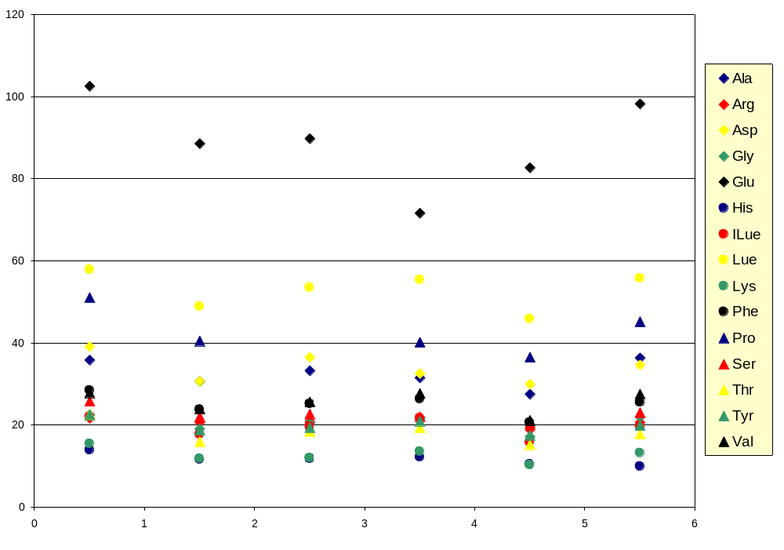
Amino Acid Content in DDGS Hydrolysates
HPLC-POS
LCMSMS-PRE
Amino acid content in DDGS hydrolysate (μg/ml)
Lab 1
Lab 2
Lab 3
Lab 4
Lab 5
Lab 6

Slide 4
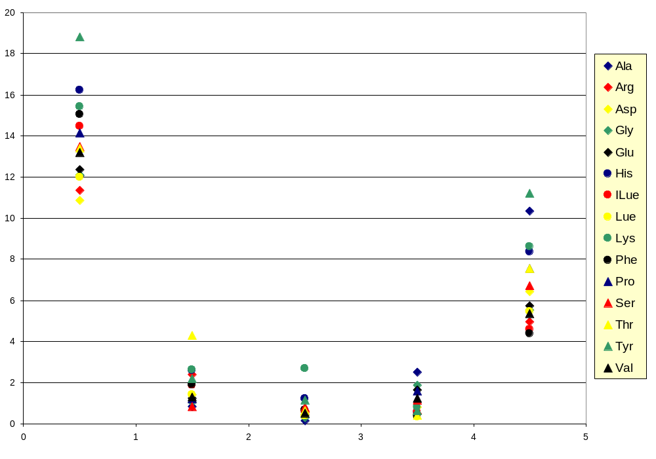
Precision (RSD, %)
(DDGS sample, tested in 5-week period)
Precision (RSD %)
Lab 1
Lab 2
Lab 3
Lab 4
Lab 5

