Slide 1
AI CONCLAVE HACKATHON 2026 • HEALTHCARE
AroggyaGram
A Community-Powered Healthcare Platform
Patient
↔
Family / Caretaker
↔
Volunteer
↔
Local Healthcare
💊
🚨
🤝
🤖
Medicine Management
Emergency SOS
Community Volunteers
AI Health Assistant
JUSTIN JOE MATHEW [TEAM LEAD]
KRISHNAJITH H | JERIN JOMY | JOEL BINOY
1 / 8

Slide 2
THE PROBLEM
Everyday Healthcare Needs, Scattered Across People and Places
💊
Missed Medications
Keeping track of medicine intake and remaining stock is easy to lose control of.
👪
Caregiver Gap
Family members are not always physically nearby when help is needed.
🤝
Lack of Local Support
Patients often need simple, local, everyday assistance.
🚨
Emergency Communication
Emergencies demand fast communication with the right people.
📋
Health Information
Health records and doctor details end up scattered across places.
🏥
Healthcare Discovery
Finding nearby clinics or hospitals and their contacts takes time.
AroggyaGram brings these needs together in one community-based platform.
2 / 8

Slide 3
FEATURES
One Platform, Eight Core Capabilities
💊
🚨
🤝
📋
Medicine Management
SOS Emergency
Community Volunteers
Health Records
Intake tracking
Stock tracking
Alerts to responsible people
One-tap SOS
Alerts family/volunteers
Emergency-help guidance
Locals register as volunteers
Help nearby patients
Points & badges
Store health records
Doctor details
🤖
🏥
📰
👤
AI Health Assistant
Nearby Healthcare
Health News
Two User Roles
Gemini-powered chatbot
Health-related guidance
Nearby clinics & hospitals
Directions
Contact details
Latest Health Updates
Awareness & Prevention Tips
Relevant Health News
Patient
Volunteer
3 / 8

Slide 4
HOW IT WORKS
Two Journeys, One Connected Platform
PATIENT JOURNEY
VOLUNTEER JOURNEY
1
Log in as Patient
1
Log in as Volunteer
↓
Manage medicines + health records
↓
Set local assistance availability
2
2
↓
Receive intake / stock alerts
↓
See nearby assistance requests
3
3
↓
Find nearby healthcare services
↓
Provide permitted non-medical help
4
4
↓
Ask the AI Health Assistant
↓
Complete the task
5
5
↓
Press SOS when emergency help is needed
↓
Earn points / badges
6
6
↓
Responsible family / volunteers are alerted
7
AroggyaGram connects patients who need help with people in their community who can provide it.
4 / 8

Slide 5
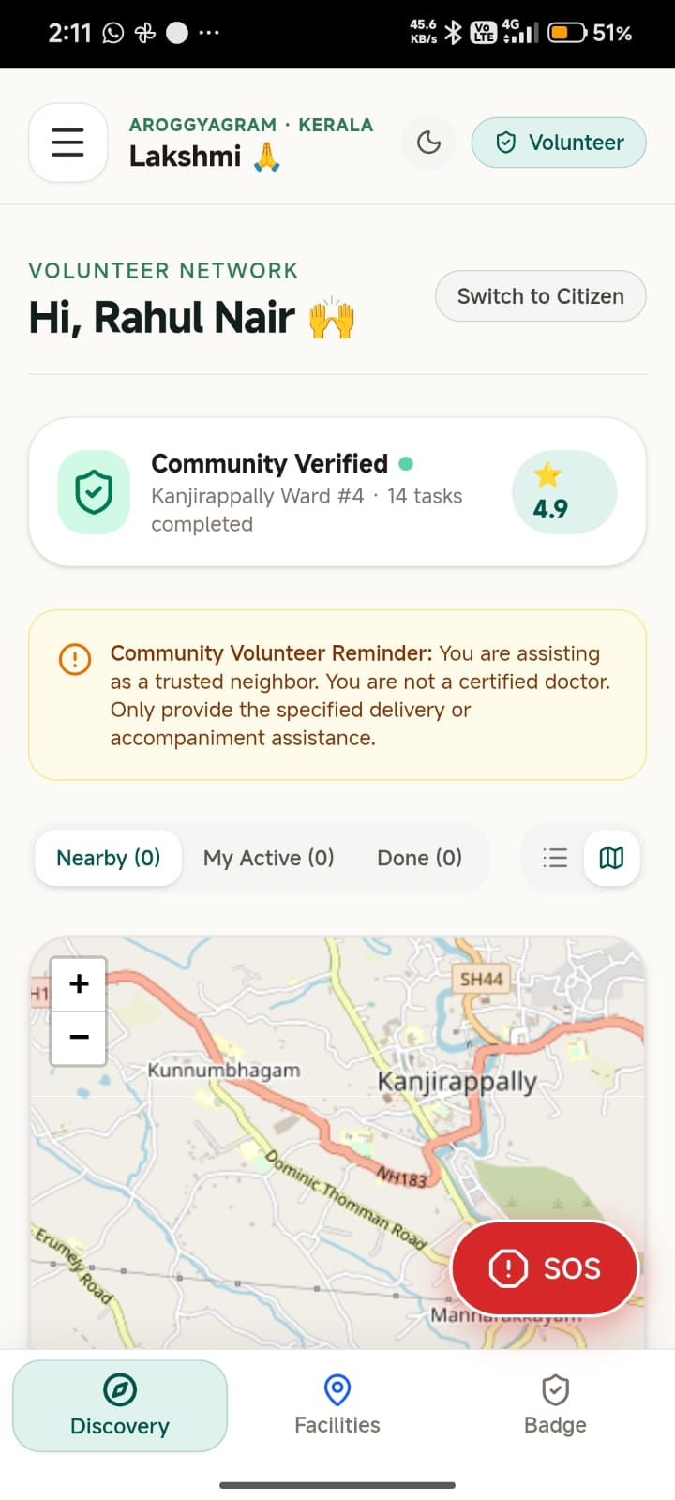
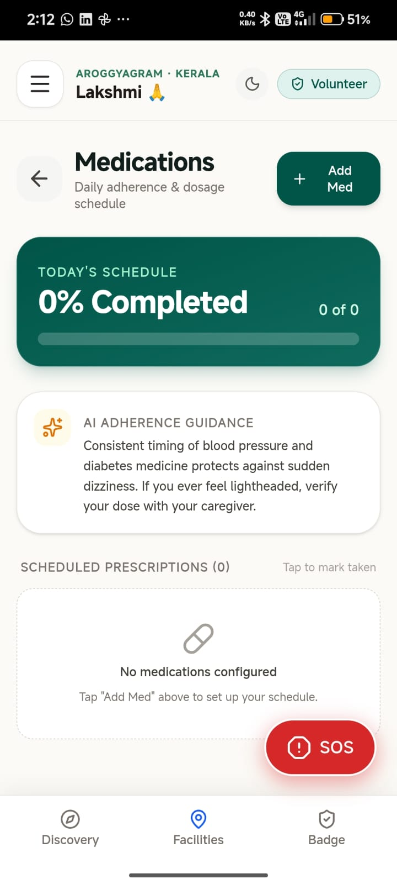
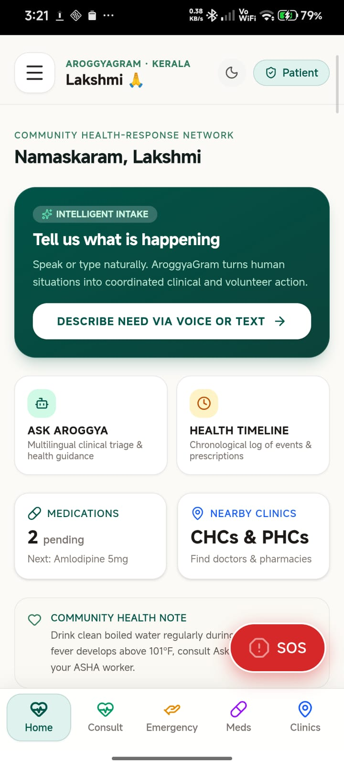
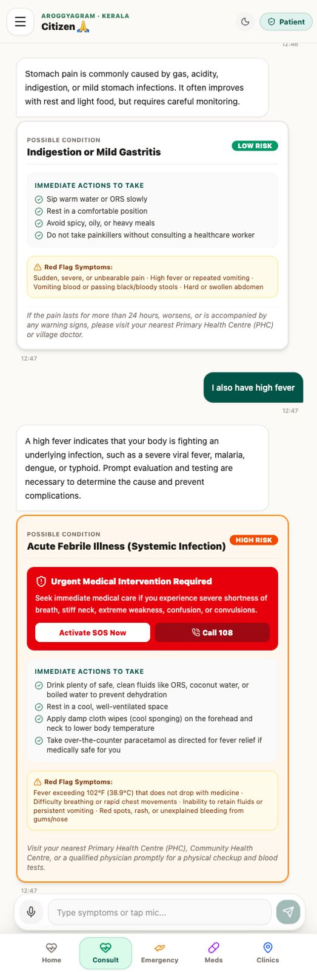
PATIENT SIDE
VOLUNTEER SIDE
5 / 8

Slide 6
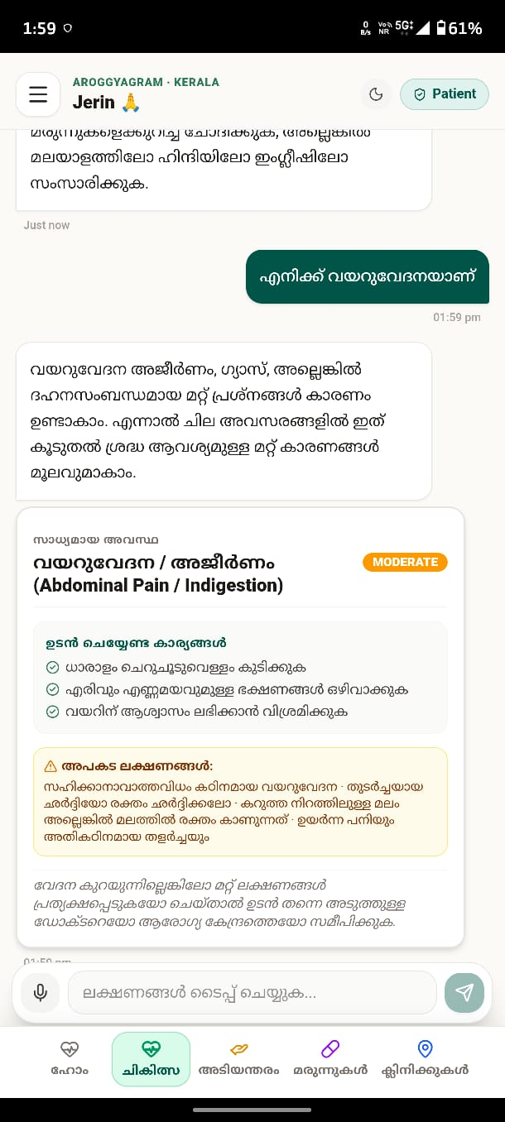
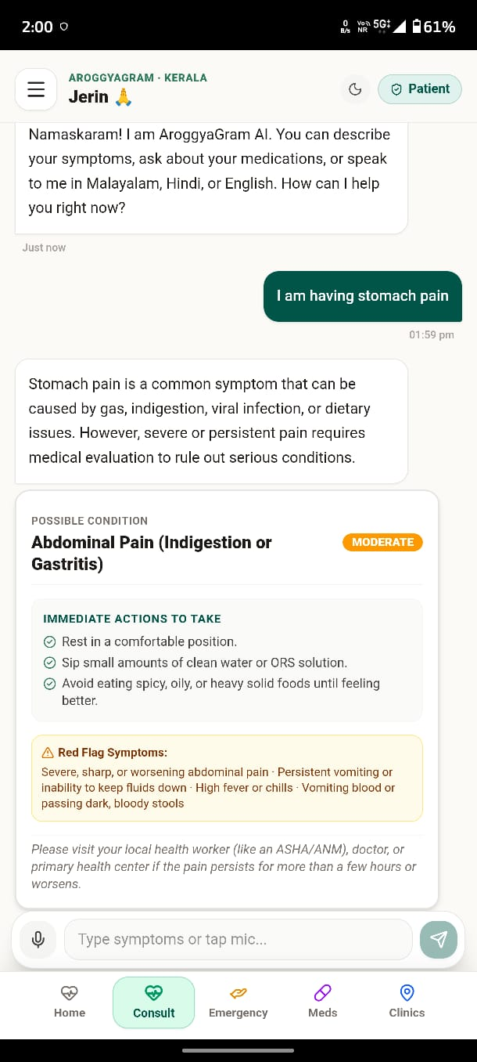
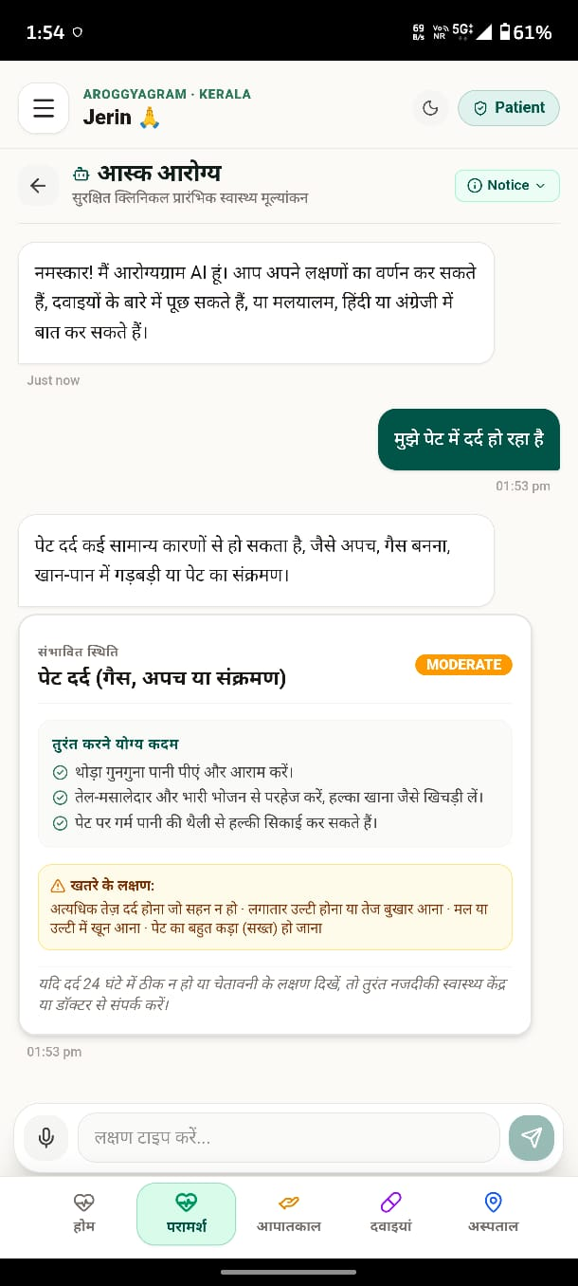
VOICE RECONGTION
5 / 8

Slide 7
TECHNOLOGY & ARCHITECTURE
How AroggyaGram Is Actually Built
AroggyaGram
TECHNOLOGY STACK
Frontend
Patient
Volunteer
AI Assistant
React, TypeScript, Vite
Styling
Backend / Database
Tailwind CSS
Backend & Data
Supabase (PostgreSQL)
Health Records
Medicine Tracking
SOS Alerts
AI Assistant
Gemini 3.5 Flash
Maps / Location Services
Maps
Leaflet / OpenStreetMap
App Packaging
Capacitor / Android
6 / 8

Slide 8
FEASIBILITY & VIABILITY
Practical Beyond the Prototype
Technical Feasibility
Operational Feasibility
Existing web/mobile technologies
Cloud database & authentication
AI API integration
Maps / location services
Simple patient/volunteer roles
Local volunteer network
Responsible-contact alerts
Non-medical assistance model
Scalability
Sustainability / Viability
Start with one locality
Expand to panchayat level
Grow to district level
Wider community deployment
Healthcare/community partnerships (future)
Local pharmacy/clinic participation (future)
NGO/community deployment (future)
Institutional support (future)
7 / 8

Slide 9
IMPACT & BENEFITS
Who Benefits from AroggyaGram
🧑‍⚕️
👪
🤝
🏥
Patients
Family / Caretakers
Volunteers
Local Healthcare Ecosystem
Easier medicine management
Faster access to local assistance
Emergency communication
Centralized health information
Nearby healthcare discovery
Receive medicine & SOS alerts
Better awareness of patient needs
Support even when far away
Meaningful local contribution
Discover nearby assistance needs
Points & badges for participation
Better connection between people and nearby healthcare resources
Connecting people, care and community — when it matters.
8 / 8

Slide 10
CLOSING
“No patient should have to face a healthcare need alone.”
PATIENT
VOLUNTEER
Medicine
→
Health Records
→
AI Assistant
→
Healthcare
→
SOS
Nearby Need
→
Accept
→
Assist
→
Earn Badge
ROADMAP
NOW
NEXT
FUTURE
Working patient + volunteer platform
Expand local healthcare/community participation
Scale from locality → panchayat → district
github.com/jvstin47/AroggyaGram-3
9 / 8

