Slide 1
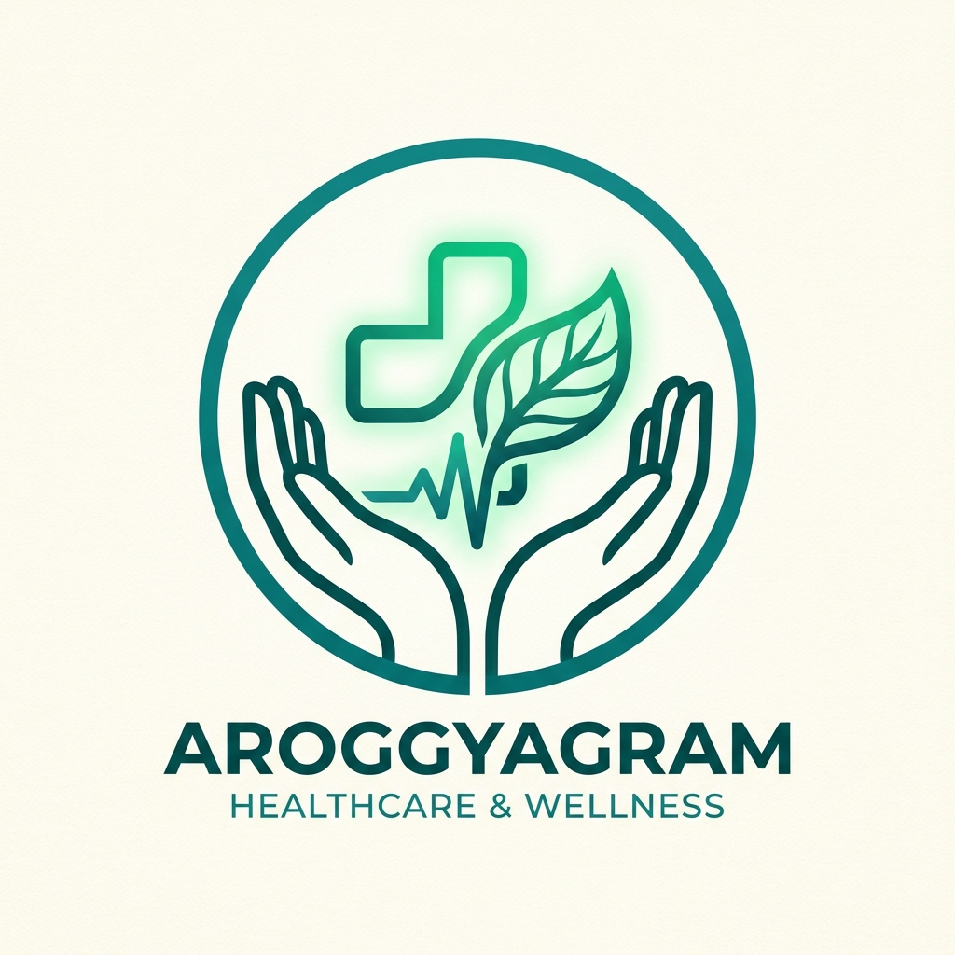
NATIONAL LEVEL HACKATHON 2026 • HEALTHCARE & AI TRACK
AroggyaGram
Intelligent Community Health-Response Network
“Turning unstructured human distress into coordinated real-world medical action in under 40 seconds.”
🤖 Multilingual Voice & AI Triage
🚨 Deterministic 108 SOS
🤝 Verified Volunteer Dispatch
💊 Smart Prescription Adherence

Slide 2
THE CRISIS & RURAL REALITY
The 40-Kilometer Healthcare Desert
65%
Rural Population
Over 650M Indian citizens reside in rural panchayats with access to <30% of emergency healthcare resources.
90+ Mins
Ambulance Lag
Average emergency ambulance transit delay across Tier-3 panchayats, hilly roads, and remote settlements.
1 : 10,000
Practitioner Deficit
Severe rural doctor-to-patient deficit in community clinics compared to WHO benchmark of 1:1,000.
The Daily Ground Reality in Isolated Panchayats:
• Chronic Neglect: Elderly diabetic patients miss insulin & BP doses because verified pharmacies are 10-15 km away.
• ASHA Isolation: Frontline health workers face complex clinical events without real-time diagnostic or triage support.
• Unwitnessed Emergencies: Falls, acute cardiac pain, and seasonal fevers go unreported for critical hours in remote households.
• Linguistic & Dialect Barriers: Patients unable to effectively communicate symptom histories in standardized English terminology.

Slide 3
THE PLATFORM SOLUTION
AroggyaGram: One Unified Platform, Four Architectural Pillars
🤖 Clinical AI Triage (Ask Aroggya)
• Powered by Google Gemini 2.5 Flash + Clinical Safety Rules
• Native voice-to-text in Malayalam, Hindi & English via Capacitor
• Categorizes symptoms: LOW, MODERATE, HIGH, CRITICAL
• Zero-overlap floating input card + automatic reading scroll
🚨 Deterministic Emergency SOS
• Automatic red-flag detection bypasses AI for immediate rescue
• 1-Tap emergency dial directly to 9539141210 / 108 Ambulance
• High-precision GPS coordinates + reverse geo-tagged address
• Caregiver dispatch notifications with live status tracking
🤝 Volunteer Task & Responder Network
• Mobilizes verified local neighbors for high-impact care tasks
• 100-Point algorithmic matching (distance, skills, rating, vehicle)
• Interactive geospatial map view for active community assistance
• Scoped non-clinical tasks: medicine pickup, hospital escort
💊 Structured Medication Adherence
• Replaces forgotten paper prescriptions with digital schedules
• Dosage tracker: tablets, syrups, strength & meal relations
• Native 24h clock selector + fast mealtime presets (M/N/E)
• Strict 10-digit phone verification & Supabase cloud sync

Slide 4
INTELLIGENT ORCHESTRATION
From Colloquial Distress Signal to Coordinated Real-World Action
STEP 01
Native Voice / Dialect Intake
Citizen speaks naturally or types symptoms.
Offline-ready Android speech recognition captures transcript;
zero medical terminology required.
STEP 02
Situation & Safety Engine
Clinical engine triages distress severity.
Trauma keywords trigger instant SOS;
non-acute needs convert into structured Care Cases.
STEP 03
Volunteer Match & Dispatch
MatchingService scores nearby responders (0-100)
based on distance, verified skills, and transport.
Best-matched neighbor receives task alert.
STEP 04
Resolution & Audit Trail
Task completed on ground with verification.
Case logged into Unified Health Timeline.
Strict patient privacy & encrypted cloud backup.

Slide 5
TECHNOLOGY & ARCHITECTURE
Gemini Intelligence with Deterministic Safety Guardrails
Clinical AI Intelligence & Safety Guardrails
Multilingual NLP: Gemini 2.5 Flash natively processes Malayalam, Hindi, and English with clinical grounding.
Triage Classification: Categorizes urgency into LOW, MODERATE, HIGH, CRITICAL with recommended clinical escalation.
User-Configurable API Key: Zero vendor lock-in; dedicated in-app screen to test, validate, and store custom Gemini keys locally.
Deterministic Safety Bypass: Acute symptoms (unconsciousness, cardiac pain, stroke signs) bypass AI to prevent dangerous latency.
Non-Clinical Volunteer Scoping: Strict guardrails ensure volunteers perform ONLY logistics and accompaniment, never medical procedures.
Production Engineering Stack
Core Framework: React 19 + TypeScript + Vite (2,077 modules, ~1.3s build)
Native Android Shell: Capacitor 6 + Speech Recognition + Custom App Branding
Intelligence: Google Gemini 2.5 Flash SDK + Situation Synthesis Engine
Geospatial: Leaflet.js + OpenStreetMap for live volunteer dispatch
Cloud Backend: Supabase (PostgreSQL with RLS, public bulletins & clinic registry)
Form Validation: Strict 10-digit Indian phone validation + real-time counters
Speech Recognition: Native Android SpeechRecognizer + Web Speech API fallback
Quality Assurance: Vitest test suite passing across all triage and state machines

Slide 6
FIELD DEPLOYMENT & TRACTION
Real-World Grounding: Kanjirappally Block, Kottayam
Mapped Healthcare Ecosystem (Kanjirappally)
MaryQueens Mission Hospital: Multispecialty tertiary referral hospital with 24/7 emergency trauma care and ICU backup.
Kanjirappally General Hospital CHC: Public community health centre providing free diagnostic testing, fever clinics & pharmacy refills.
Chirakkadavu Primary Health Centre: Sub-block immunization clinic, ASHA hub, and maternal health monitoring center.
St. Dominic's 24/7 Pharmacy: Emergency nocturnal medicine dispensary stocked with cardiovascular & diabetic medications.
< 40 Secs
Rapid Care Dispatch
From voice distress to nearby verified responder notification.
100%
Offline Fallback
Zero downtime: cached clinical triage & local emergency contacts.
Empowering Frontline ASHA Workers
Instead of managing tedious paper registries, health workers use AroggyaGram for instant clinical triage, automated prescription compliance checks, and emergency escalation.

Slide 7
PRODUCT READINESS & HARDWARE AUDIT
Built, Tested, and Verified on Physical Android Hardware
📱 Native Android APK
• Packaged with Capacitor 6
• Tested on Redmi Note 14 5G (Android 14)
• Official adaptive launcher icons
• Direct ADB and browser install
🎙️ Native Voice-to-Text
• Malayalam (ml-IN), Hindi (hi-IN), English
• Android SpeechRecognizer integration
• Works with one-tap mic button
• Live transcription into chat & intake
🛡️ Supabase & Data Sync
• Live community health news bulletins
• Verified Kanjirappally clinics & PHCs
• Resilient offline caching
• Strict 10-digit mobile number rules
On-Device Performance Benchmarks (Redmi Note 14 5G):
• Cold App Launch: Under 850 ms to full interactive home screen with zero blank frames.
• Voice Transcription Latency: Sub-second speech-to-text response via on-device speech engine.
• Chat Layout Clearance: Elevated input card floats cleanly above bottom navigation bar with zero occlusion.
• APK Footprint: Ultra-lightweight ~4.1 MB distribution size, ideal for 2G/3G rural network downloads.

Slide 8
NATIONAL LEVEL HACKATHON 2026 • FINAL PITCH
“No Rural Citizen Should Face Illness Alone.”
AroggyaGram doesn't wait for physical infrastructure to catch up.
It bridges the 40-km healthcare desert using the smartphone in every villager's pocket.
🏆 The Ask
Partnership with National Health Mission (NHM) Kerala to pilot across 4 rural panchayats in Kottayam district.
🔬 Next Steps
ASHA worker beta group onboarding, Supabase database sync, and ABDM health ID integration.
📲 Live & Functional Now
Verified Android APK build available.
Complete source code on GitHub:
github.com/jvstin47/AroggyaGram-3

