Slide 1






SMART INDIA HACKATHON 2026
HARDWARE EDITION | POWERED BY ARDUINO UNO Q (QUALCOMM INC.)
PROJECT PHOENIX X
SAR UAV
Arduino UNO Q Dual-Brain Edge-AI Scout for Zero-Infrastructure Disaster Reconnaissance
PROBLEM STATEMENT ID
THEME
SIH26177
Robotics and Drones
PROBLEM STATEMENT TITLE
A deployable AI-powered autonomous drone that aids search-and-rescue operations by detecting people and hazards, thereby improving responder safety and reducing victim discovery time.
SPONSORING ORGANIZATION
CATEGORY
Qualcomm Inc.
Hardware
Arduino UNO Q Dual-Brain SBC
TEAM NAME
TEAM ID
Phoenix X
141943
QRB2210 Linux + STM32U5 RTOS
Dual 1080p + Thermal Fusion
WEB DEMO
VIDEO
3-5 km LoRa Telemetry
IEEE Anti-Drift VIO Navigation

Slide 2


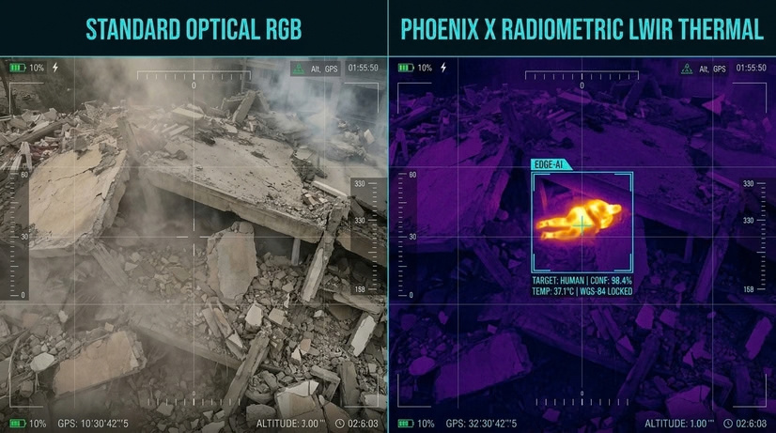



Disaster Reconnaissance & Emergency Survivor Triage
PROBLEM STATEMENT
PROPOSED SOLUTION
CRITICAL DISASTER BARRIERS — FOUR OPERATIONAL FAILURES:
01 — TOTAL COMMS BLACKOUT: Cellular and Wi-Fi networks down; cloud-reliant commercial drones fail immediately.
02 — ZERO OPTICAL VISIBILITY: Darkness, dense smoke, and debris dust blind conventional visible-light RGB cameras.
03 — UNLOCALIZED CASUALTIES: Visual spotting lacks coordinates; rescue teams dig blindly without actionable GPS fixes.
04 — SECONDARY RESCUER HAZARDS: Live electrical lines, shifting rubble piles, and gas voids endanger ground rescue crews.
PROJECT PHOENIX: ARDUINO UNO Q DUAL-BRAIN ARCHITECTURE
ARDUINO UNO Q DUAL-BRAIN: QRB2210 MPU performs INT8 edge-AI on Linux; STM32U585 MCU runs deterministic 250 Hz flight loop on Zephyr.
1080P + THERMAL FUSION: Fuses 1080p optical with 8–14μm LWIR to detect human heat signatures in darkness, smoke & debris.
CONTINUOUS GEOREFERENCING: Synchronized GNSS, attitude, camera geometry & ToF altitude georeference victims in real time without hovering.
OFFLINE RESCUE ROUTING: Prioritizes triage on-chip; broadcasts 17-byte LoRa packets to chart Dijkstra corridors avoiding hazards [1, 3].
INNOVATION / UNIQUENESS
Dual-Brain Architecture
5W Edge YOLO
Ray-Cast Geolocation
ROS-LoRa P2P Bridge
Anti-Compass Drift VIO
ARDUINO UNO Q SBC (4GB/32GB): Qualcomm Dragonwing QRB2210 MPU + STM32U585 MCU on a single 42g board.
SUB-5W HETEROGENEOUS AI: QRB2210 CPU/GPU/DSP executes INT8 YOLO inference, preserving battery for flight.
REAL-TIME GEOREFERENCING: Tait-Bryan ray projection calculates ground WGS-84 coordinates on the fly without hovering.
17-BYTE LORA TELEMETRY: Off-grid bit-packed triage stream reaches 3–5+ km in complete cellular blackouts [3].
ANTI-DRIFT VIO NAVIGATION: Visual-Inertial Odometry overrides compromised magnetometers in metallic rubble environments.
TRADITIONAL DISASTER SEARCH
(Current Approach)
Manual Foot Sweeps
Blind Rubble Digging
Stalled at Sunset (Darkness)
High Responder Casualty Risk
Critical Hours Lost
PHOENIX AUTONOMOUS SAR
(Our Approach)
Autonomous Aerial Sweep
24/7 Thermal Night Vision
Instant Survivor GPS Raycasting
Zero-Drop LoRa Telemetry
Safe Responder Path Routing
PROJECT PHOENIX: Autonomous Multi-Spectral Edge-AI UAV | SIH26177 (Qualcomm Inc.)
2
Notes:
1.7.2013
2
‹#›

Slide 3

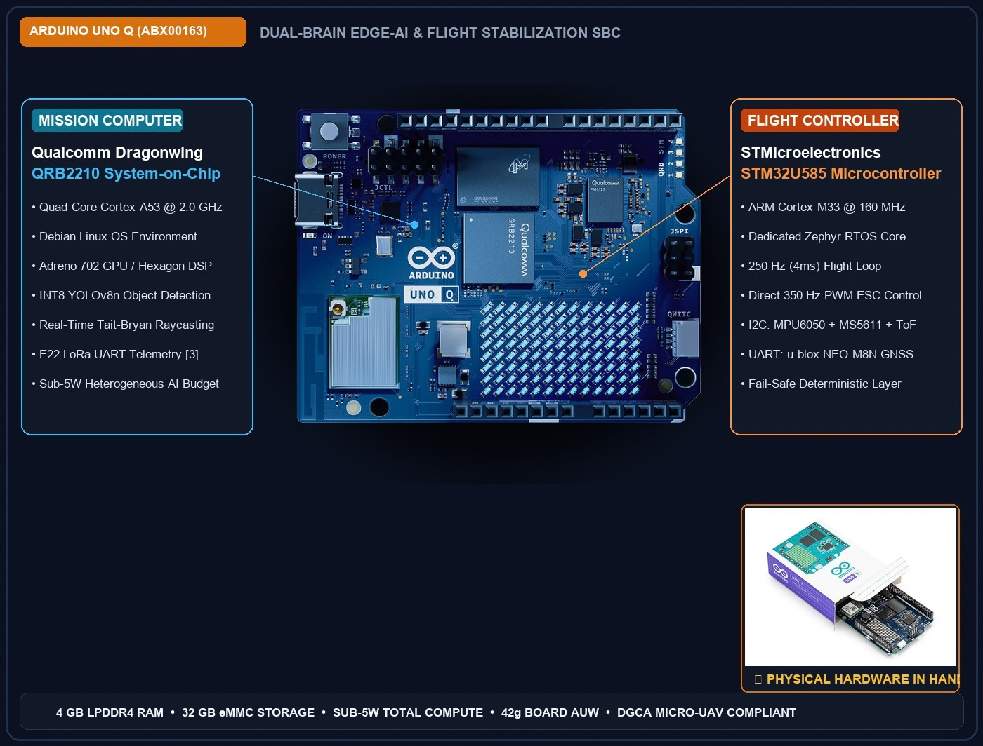
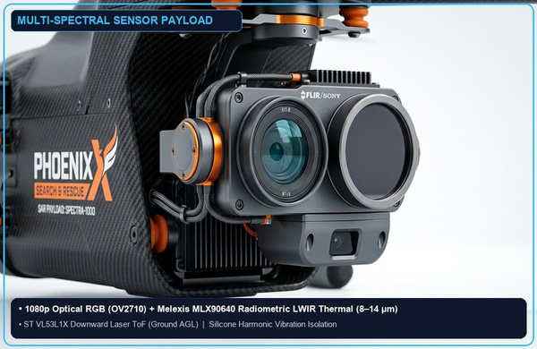

TECHNICAL APPROACH
Dual-Brain Architecture & Workflow
IMPLEMENTATION WORKFLOW
1
Sector Partition & Launch
OFFLINE SECTOR SETUP: Operator defines 2 km² search polygon on tactical tablet; autonomous launch in < 3 minutes.
2
Autonomous Grid Sweep
TERRAIN-FOLLOWING GRID: Boustrophedon sweep with 60% sidelap; downward ToF altimeter maintains constant GSD over sloped terrain.
3
Multi-Spectral Perception
1080P + THERMAL FUSION: Dual 1080p RGB + LWIR thermal fusion; edge YOLO detects survivor heat anomalies in darkness, smoke & debris.
4
Ray-Cast Geolocation
INSTANT GEOREFERENCING: Synchronized GNSS, attitude, camera geometry & ToF altitude georeference victims on the fly without hovering.
TECH STACK
5
Binary LoRa Packet Burst
Flight Stack
Zephyr RTOS, YMFC-32 Core, PX4 Autopilot
17-BYTE LORA BURST: Onboard edge triage scores urgency and broadcasts compact binary frame over 868 MHz UART LoRa [3].
Edge AI & Vision
YOLOv8n INT8 (Detection & Avoidance), SNPE SDK, ONNX, OpenCV
Robotics Middleware
ROS2 Humble, MAVLink v2, micro-ROS
6
GCS Triage & Route Planning
Long-Range RF Comms
Ebyte E22-900T22S LoRa (868 MHz UART)
DYNAMIC SAFE ROUTING: Tactical GCS runs Dijkstra graph search [1] to generate hazard-free ground ingress corridors for first responders.
Tactical GCS
React, Leaflet, Tailwind CSS, WebSockets
Security
HMAC-SHA256 Telemetry Packet Signatures
PROJECT PHOENIX: Autonomous Multi-Spectral Edge-AI UAV | SIH26177 (Qualcomm Inc.)
3
Notes:
1.7.2013
3
‹#›

Slide 4






FEASIBILITY AND VIABILITY
Feasibility, Challenges-to-Strategies & Market Viability
FEASIBILITY
VIABILITY
CHALLENGES → STRATEGIES
TECHNICAL FEASIBILITY
ECONOMIC VIABILITY
Prototype cost: <40,000₹
1
Comms Blackout in Canyons
    THRUST HEADROOM: 2.23:1 maximum thrust-to-weight ratio provides substantial control authority in wind gusts.
    SUB-5W COMPUTE: Arduino UNO Q heterogeneous AI consumes <4% of power, reserving energy for rotor flight.
868 MHZ LORA BRIDGE: Sustains NLoS micro-telemetry packet link [2] without cellular towers (DOI: 10.1109/ACCESS.2026.3731317).
Enterprise Drone Disruption costs:
2
Smoke, Mud Slush & Darkness
DJI Matrice 30T
₹10+ Lakhs
Phoenix
₹1.2 Lakh
LWIR THERMAL DETECTION: 8–14μm radiometric array isolates 37°C casualties through smoke, dust, and debris [1] (Siotia, IEEE Access 2026).
OPERATIONAL FEASIBILITY
    RAPID SETUP: < 3 minutes from rugged backpack unboxing to active search flight.
    CONTINUOUS SORTIES: Dual-pack quick-swap batteries support rolling 100% duty-cycle rescue sweeps.
    FLEET SCALABILITY: NDRF battalions can deploy a 10-drone swarm for the acquisition cost of 1 imported drone.
3
Rubble Steel Magnetometer Distortion
ANTI-DRIFT VIO NAVIGATION: Visual-Inertial Odometry overrides compromised magnetometers in collapsed steel rubble (IEEE standard).
AIR-GAPPED TACTICAL RESILIENCE
    100% OFFLINE DATA PRIVACY: Zero cloud dependencies; all sensor feeds and victim GPS fixes remain strictly local with first responders.
4
Propeller Vibration Sensor Noise
FINANCIAL FEASIBILITY
HARMONIC NOTCH FILTERING: Silicone damping mounts + software notch filtering eliminate ESC/motor noise on 250Hz EKF loop.
    PROTOTYPE BUILD (₹37,400): Genuine Arduino UNO Q 4GB/32GB build for full hardware evaluation.
    PRODUCTION BOM (₹1.2 LAKH): Enterprise-grade SAR UAV at 1/10th the cost of imported commercial drones.
DEPLOYMENT ECOSYSTEM
    FIELD-READY INTEGRATION: Native protocol compatibility with NDRF, SDRF, and civil disaster response command units.
5
Actuator Saturation in Gusts
ANTI-WINDUP PID CLAMPING: Dynamic integrator clamping prevents control surface saturation during aggressive gusts.
PROJECT PHOENIX: Autonomous Multi-Spectral Edge-AI UAV | SIH26177 (Qualcomm Inc.)
4
Notes:
1.7.2013
4
‹#›

Slide 5






IMPACT AND BENEFITS
Mission Impact & Multi-Stakeholder Benefits
IMPACT PIPELINE
1 DEPLOY
2 SEARCH
3 LOCATE
4 RESPOND
5 OUTCOME
PHOENIX DOES
BACKPACK DEPLOY: Unbox to autonomous flight in < 3 minutes
BOUSTROPHEDON SWEEP: Autonomous dual 1080p + thermal grid coverage
INSTANT GEOREFERENCING: Tait-Bryan projection calculates exact ground GPS
TRIAGE & HAZARD ROUTE: Ranks casualties & computes Dijkstra safe corridors [1]
FLEET ECONOMICS: Full autonomous capability at 1/10th enterprise cost
IMPACT
ZERO INFRASTRUCTURE: Search begins immediately upon arrival
ALL-WEATHER SCAN: Continuous search in smoke, dust & darkness
ZERO SEARCH DELAY: Rescuers proceed straight to survivor coordinates
CREW PROTECTION: Rescuers avoid live power cables & gas hazards
LIVES SAVED: Accelerates extraction within the Golden 72 hours
MEASURE
< 3 min
2 km²
0 cell towers
Ranked queue
₹1.2 Lakh
unboxing to flight
search sector
needed to report locations
+ safe rescue route
vs ₹12-14 Lakhs
TRAPPED VICTIMS
NDRF / SDRF TEAMS
DISASTER AUTHORITIES
DISTRICT GOVERNANCE
    GOLDEN 72H WINDOW: Rapid discovery within critical survival timeframe
    DEBRIS & SMOKE SENSING: Thermal lock in zero-light and smoky collapse voids
    TRIAGE PRIORITIZATION: Instant medical urgency rating streamed to rescue teams
    SURVIVAL MULTIPLIER: Dramatically cuts time-to-extraction under rubble
    ADVANCE HAZARD MAPPING: Flags live high-voltage cables, gas leaks & floodwaters
    SAFE ROUTE NAVIGATION: Dynamic Dijkstra corridor guides rescuers around hazards [1]
    TACTICAL AWARENESS: Crews proceed straight to verified survivor coordinates
    FATIGUE REDUCTION: Replaces blind shovel digs with targeted extraction
    UNIFIED COMMON PICTURE: Real-time casualty mapping with micro-telemetry tracking
    DYNAMIC SECTOR LOGS: Autonomous coverage tracking ensures no sector is missed
    17-BYTE LORA STREAM: Ultra-compact bit-packed alerts arrive in under 3 seconds [3]
    TARGETED RESOURCE DROPS: Prioritized airlift and medical kits based on triage data
    AFFORDABLE PROCUREMENT: Deploy 10 Phoenix drones for the price of 1 enterprise UAV
    SCALABLE STOCKPILING: Standardized COTS electronics enable rapid state-wide rollout
PROJECT PHOENIX: Autonomous Multi-Spectral Edge-AI UAV | SIH26177 (Qualcomm Inc.)
5
Notes:
1.7.2013
5
‹#›

Slide 6






RESEARCH AND REFERENCES
Academic Research Foundations & Prototype Verification
RESEARCH & REFERENCES
PROTOTYPE PROOF
01
IIT Jodhpur & Manipal Univ. (IEEE Access, Sept 2026) [1]
OPEN-SOURCE REPOSITORY & VERIFICATION ASSETS
    • 'SwarmSAR-FW: Drone-Based Swarm Search and Rescue in Fire and Water Disasters'
• HAZARD-AWARE DIJKSTRA ROUTING: Validates safe ingress routing (98.7% triage accuracy, 4.1s) avoiding debris & power lines.
DOI: 10.1109/ACCESS.2026.3730315 (Direct IEEE Document Link)
Video link: SIH Grand Finale Submission Portal
Presentation Video:
02
UPC Spain & Souli et al. (IEEE Access 2026 / Elsevier 2024) [2, 3]
Web Demo:
Github Repo:
    • 'Long-Range BLE via Drone LoRa Relays' [2] & 'Mission-Critical ROS-LoRa Architecture' [3]
• 868 MHZ LORA & 17-BYTE TELEMETRY: Validates off-grid NLoS canyon relay and 17-byte bit-packed triage frames during blackouts.
DOIs: 10.1109/ACCESS.2026.3731317 [2] | 10.1016/j.comcom.2024.04.015 [3]
phoenix-sar-uav.vercel.app
github.com/jvstin47/Phoenix-SIH26177-SAR-UAV
Documented Subsystems:
03
TalTech Estonia (IEEE Access, July 2023) [4]
1. docs/research_papers_synthesis_2026.md
2. docs/prototype_bom_and_financial_viability.md
3. docs/ros_lora_mission_critical_uav_swarm_research.md
4. docs/hardware_viva_defense_guide.md
    • 'Applying RIS-Based Communication for Collaborative Computing in a Swarm of Drones'
• DECENTRALIZED EDGE COMPUTE: Validates autonomous on-device computing (-32% energy, -18% latency) with zero cloud reliance.
DOI: 10.1109/ACCESS.2023.3293737 (Direct IEEE Document Link)
Prototype Architecture Deliverables:
IEEE Trans. Geoscience & Remote Sensing (IEEE TGRS 2023) [5, 6]
Live Web GCS Tactical Dashboard (React + Leaflet)
04
Multi-Spectral Dual Stream (RGB + LWIR Thermal HUD)
    • 'Unregistered RGB-T Salient Detection' [5] & 'Monocular VIO in GNSS-Denied Zone' [6]
• MULTI-SPECTRAL AI & VIO SLAM: Validates 1080p RGB + LWIR thermal fusion and anti-drift VIO state estimation in metallic rubble.
DOIs: 10.1109/TGRS.2023.3332179 [5] | 10.1109/TGRS.2023.3323519 [6]
LoRa 17-Byte Binary Bit-Packing Serialization Module
Ray-Casting Geolocation Python Engine
PROJECT PHOENIX: Autonomous Multi-Spectral Edge-AI UAV | SIH26177 (Qualcomm Inc.)
6
Notes:
1.7.2013
6
‹#›

