Slide 1
PHOENIX X · HARDWARE PRESENTATION GRAPHIC MASTER PACK
Self-Explanatory Aerospace Infographics & Drone Renders
A complete visual asset library for SIH26177: 3D product callouts, in-flight dual-beam perception, and NDRF tactical tablet routing.
SLIDE 2: HARDWARE SCHEMATIC
Avionics & Compute Partition
3D Studio render with 6 interactive numbered beacon pins.
SLIDE 3: FEASIBILITY & SIZING
Buildability & Legal Viability
DGCA 1.58 kg AUW, Bouabdallah β ≥ 2.0 sizing, sub-5W compute.
SLIDE 4: IN-FLIGHT DUAL-BEAM
Optical + Radiometric LWIR
Hero in-action render: Cyan optical + orange 37°C thermal lock.
SLIDE 5: 5-MINUTE SORTIE PIPELINE
Autonomous Mission Flow
Horizontal 5-step chevron from unboxing to safe route.
SLIDE 6: FIRST RESPONDER GCS
NDRF Tactical Tablet Field Action
Hazard-aware Dijkstra safe rescue route around 11kV wires.
SLIDE 7: PARADIGM COMPARISON
Foot Search vs. Phoenix X
High-contrast split comparison proving operational disruption.

Slide 2
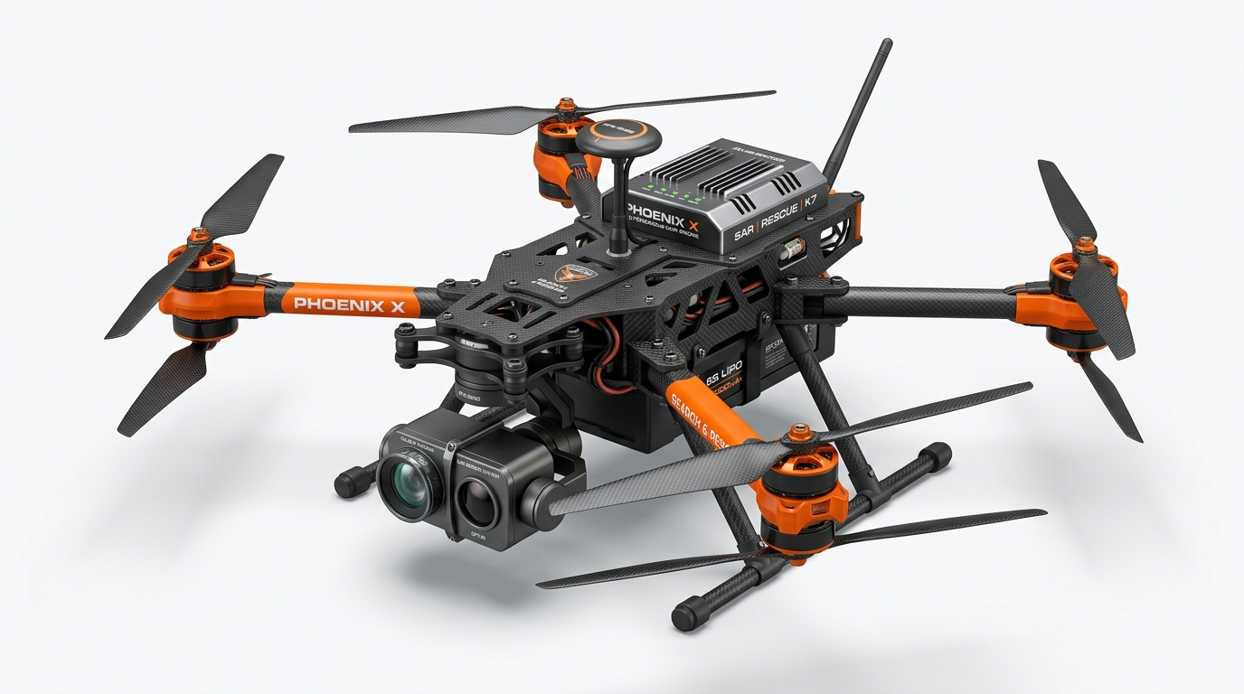
PHOENIX X · SIH26177
TECHNICAL APPROACH · DUAL-BRAIN AVIONICS ARCHITECTURE
AVIONICS & PAYLOAD
Hardware Subsystem Mapping on the Phoenix X Airframe
1
Dual-Spectral Vision Gimbal
2
SX1262 LoRa RF Telemetry
TACTICAL RECONNAISSANCE AIRFRAME · 3D PRODUCT SCHEMATIC
1080p Optical + 8-14μm Radiometric LWIR
868 MHz P2P Sub-GHz Link · +22 dBm
Fuses visual contours with thermal emissivity (37.0°C biological lock). Rejects solar heat false positives.
Transmits Souli et al. (Elsevier 2024) 17-byte encrypted binary packets over 3–5 km without cellular towers.
2
4
3
3
STM32U585 Flight Core (MCU)
4
Qualcomm QRB2210 Mission MPU
5
Zephyr RTOS @ 250 Hz Loop · 350 Hz PWM
Quad-Core Linux + Hexagon NPU (< 5W)
1
6
Deterministic 4ms PID motor loop. Completely isolated from AI workload to guarantee zero flight jitter.
Runs INT8-quantized YOLO object detection and 6-DOF Tait-Bryan ray-casting geodetics in under 60 ms.
5
1D ToF Laser + 3S Power Tray
6
Propulsion & Power Dynamics
AUW MASS BUDGET
1.58 kg
DGCA Micro Category
DUAL-BRAIN CHIPS
QRB2210 + STM32
Linux NPU + Zephyr RTOS
OFF-GRID TELEMETRY
868 MHz LoRa
17-byte P2P (3–5 km)
VL53L1X Laser Ranging + 4500mAh LiPo
4× 2212/2216 BLDC + 1045 Carbon Props
Measures true AGL ground clearance for terrain-following and ray-casting. Quick-swap battery rail.
Delivers 2.4 kg peak thrust. Adheres to Bouabdallah sizing laws for stable hover in gusty disaster winds.

Slide 3
PHOENIX X · SIH26177
FEASIBILITY & VIABILITY · COMPLIANCE & SIZING LAWS
DGCA MICRO-DRONE CLASS
Why the Airframe Is Structurally Sized, Legal & Scalable
1
Modular Quick-Release Gimbal
2
Indian WPC De-Licensed Band
TACTICAL RECONNAISSANCE AIRFRAME · 3D PRODUCT SCHEMATIC
Vibration-Damped Payload Bay
865–867 MHz Compliant (GSR 564(E))
Houses dual sensors inside strict weight limits. Silicone dampers eliminate high-frequency motor vibration.
100% legal for disaster operations in India. Bypasses jammed 433 MHz and severed 4G/5G mobile towers.
2
4
3
3
Sub-5W Ultra-Low Power Draw
4
Bouabdallah Dynamic Stability
5
Qualcomm Dragonwing Energy Budget
Thrust-to-Weight Ratio β ≥ 1.65 – 2.0
1
6
Preserves >90% of total electrical power for rotor lift, achieving 28–32 minutes search sortie endurance.
Sized via EPFL thesis laws. Anti-windup integrator clamping prevents motor saturation during heavy wind gusts.
5
All-Up-Weight: 1.58 kg Total
6
Disruptive Unit Economics
AUW MASS BUDGET
1.58 kg
DGCA Micro Category
DUAL-BRAIN CHIPS
QRB2210 + STM32
Linux NPU + Zephyr RTOS
OFF-GRID TELEMETRY
868 MHz LoRa
17-byte P2P (3–5 km)
Safely under DGCA 2.0 kg Micro Limit
₹35.8k Prototype ➔ ₹1.2L Production
Requires no complex enterprise flight licensing for disaster response drills. Deploys from backpack in <3 minutes.
Delivers tactical thermal SAR at 1/10th the cost of commercial enterprise imports (₹14 Lakh DJI Matrice 30T).

Slide 4
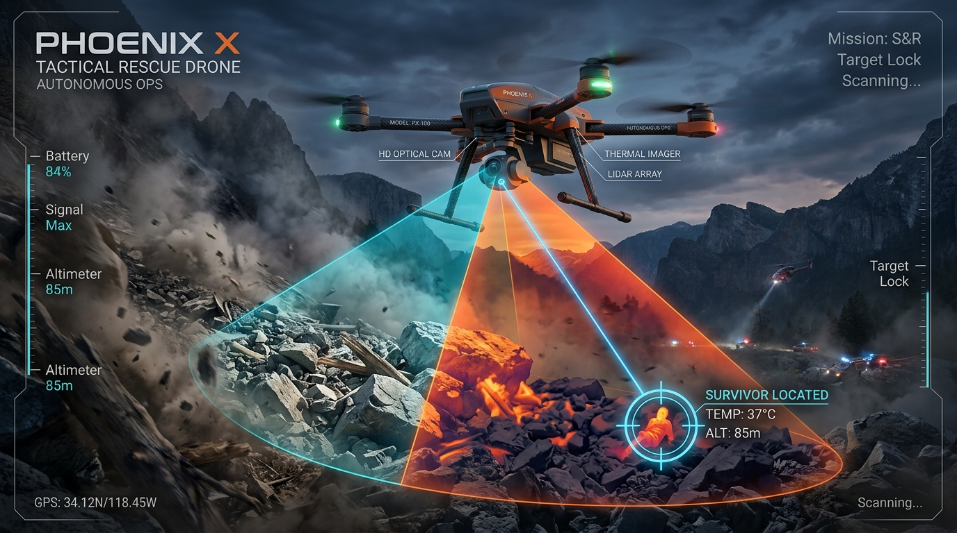
PHOENIX X · SIH26177
MULTI-SPECTRAL PERCEPTION · REAL-TIME TARGET ACQUISITION
DUAL-BEAM TACTICAL HUD
How Phoenix X Detects Living Survivors Through Dense Smoke & Debris
1. DUAL-SPECTRAL CONICAL SENSING
Cyan Beam: 1080p Optical Geometry
Orange Beam: 8–14μm Radiometric LWIR
Standard RGB cameras blind at dusk and in smoke plumes. Phoenix X projects co-registered optical and thermal fields-of-view, continuously scanning rubble crevices for human infrared emissions.
2. RADIOMETRIC CORE HEAT FILTER
Gated Detection: 36.5°C to 37.5°C
Noise Equivalent Temp Diff: NETD < 50 mK
Solar radiation heats tin roofs, wet mud, and rocks to over 45°C. Phoenix X isolates true biological core temperature profiles, instantly discarding thermal false alarms before passing tensors to the NPU.
3. 6-DOF TAIT-BRYAN RAY-CASTING
Optical-to-Ground Vector Projection
Accuracy: WGS-84 within ±2.1m SEP
Hovering overhead puts drones at risk of collision. The drone flies at an oblique standoff angle; its onboard NPU projects camera bounding-box pixels directly onto a local DEM elevation grid in < 60 ms.

Slide 5
PHOENIX X · SIH26177
OPERATIONAL PIPELINE · ZERO-CONNECTIVITY RECONNAISSANCE
RAPID SORTIE PIPELINE
End-to-End Autonomous Reconnaissance & Survivor Extraction Flow
1. RAPID SORTIE LAUNCH
< 3 Minutes Deployment
Operator outlines 2 km² search polygon on offline tablet. UAV unboxes from rugged backpack and auto-launches.
2. BOUSTROPHEDON SWEEP
STM32U5 @ 250 Hz Loop
Autonomous lawnmower search trajectory at 25-30m AGL. 1D ToF laser altimeter maintains terrain contour following.
3. 37°C THERMAL LOCK
Qualcomm NPU (< 5W)
Quantized INT8 YOLO model fuses daylight contours with radiometric 8-14μm body heat, spotting trapped survivors.
4. 17-BYTE LORA BURST
Souli et al. (Elsevier 2024)
Tait-Bryan ray-caster projects pixel to WGS-84 pin. Lat/Long/Temp compressed into 17-byte HMAC-SHA256 packet.
5. SAFE ROUTE EXTRACTION
Hazard-Aware Dijkstra
Offline Ground Station instantly charts safe walking corridor bypassing 11kV wires directly to casualty.
01
02
03
04
05

Slide 6
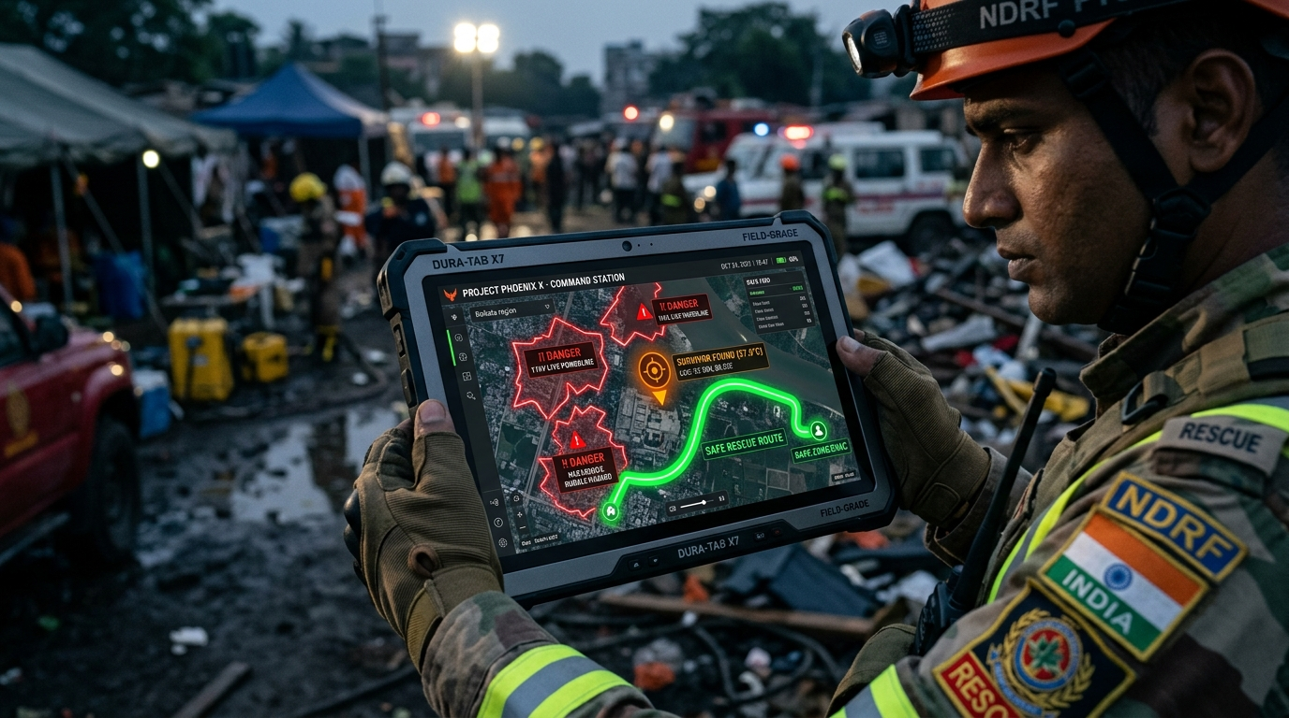
PHOENIX X · SIH26177
INCIDENT COMMAND & GIS ROUTING · FIRST RESPONDER INTEGRATION
TACTICAL RESCUE GCS
From Airborne Detection to Boots-on-Ground Extraction in < 5 Minutes
1. 17-BYTE LORA PACKET INGESTION
Zero Cloud / Zero Internet Architecture
Air-Gapped Local Tactical Mesh (868 MHz)
Incoming telemetry packets unpack victim coordinates, biological body temperature (37.0°C), and triage status directly into the offline Leaflet GIS dashboard in milliseconds without commercial cellular service.
2. HAZARD-AWARE DIJKSTRA ROUTING
Dynamic Obstacle & Danger Buffers
Avoids: 11kV Severed Wires, Landslides, Fires
Rescuers walking blindly into disaster zones suffer secondary casualties. Phoenix X plots an automated, hazard-weighted pedestrian extraction path navigating safely around verified hazards.
3. 5-MINUTE TACTICAL CYCLE
Golden 72 Hours Response Compression
Instant Triage Priority for NDRF / SDRF
What traditionally takes hours of agonizing, dangerous foot searches across square kilometers of debris is compressed into a rapid sub-5-minute autonomous sortie from unboxing to casualty recovery.

Slide 7
PHOENIX X · SIH26177
TACTICAL PARADIGM SHIFT · FIRST RESPONDER RESILIENCE
OPERATIONAL IMPACT
Traditional Foot Search vs. Project Phoenix X Autonomous Triage
TRADITIONAL DISASTER RECONNAISSANCE
Manual Foot Sweeps & Standard Visual Cameras
❌ Blind Foot Patrols: Rescuers sweep unstable terrain on foot across square kilometers; takes 4 to 8 hours per sector.
❌ Darkness & Smoke Blockade: Operations halt at sunset; dust and thick smoke plumes completely blind standard optical cameras.
❌ Rescuer Secondary Casualties: Crews step blindly into severed 11kV live powerlines, gas leaks, and secondary mudslide slip planes.
❌ Cellular Infrastructure Collapse: Drones relying on 4G/5G mobile towers or Wi-Fi stream fail instantly when towers collapse.
PROJECT PHOENIX X AUTONOMOUS TRIAGE
Dual-Brain Tactical Edge AI & Long-Range Telemetry
✓ Rapid Aerial Grid Sweep: Covers 2.0 km² in <15 minutes. Launches from backpack in under 3 minutes without infrastructure.
✓ 24/7 Radiometric Thermal Lock: Penetrates fog and darkness; locks living 37°C body heat through crevices using NETD < 50 mK LWIR.
✓ Automated Safe-Path Routing: Hazard-aware Dijkstra pathfinding calculates pedestrian extraction route avoiding live 11kV lines.
✓ 100% Offline 868 MHz LoRa Link: Souli et al. (Elsevier 2024) 17-byte binary bit-packing beams coordinates across 3–5 km reliably.

