Slide 1
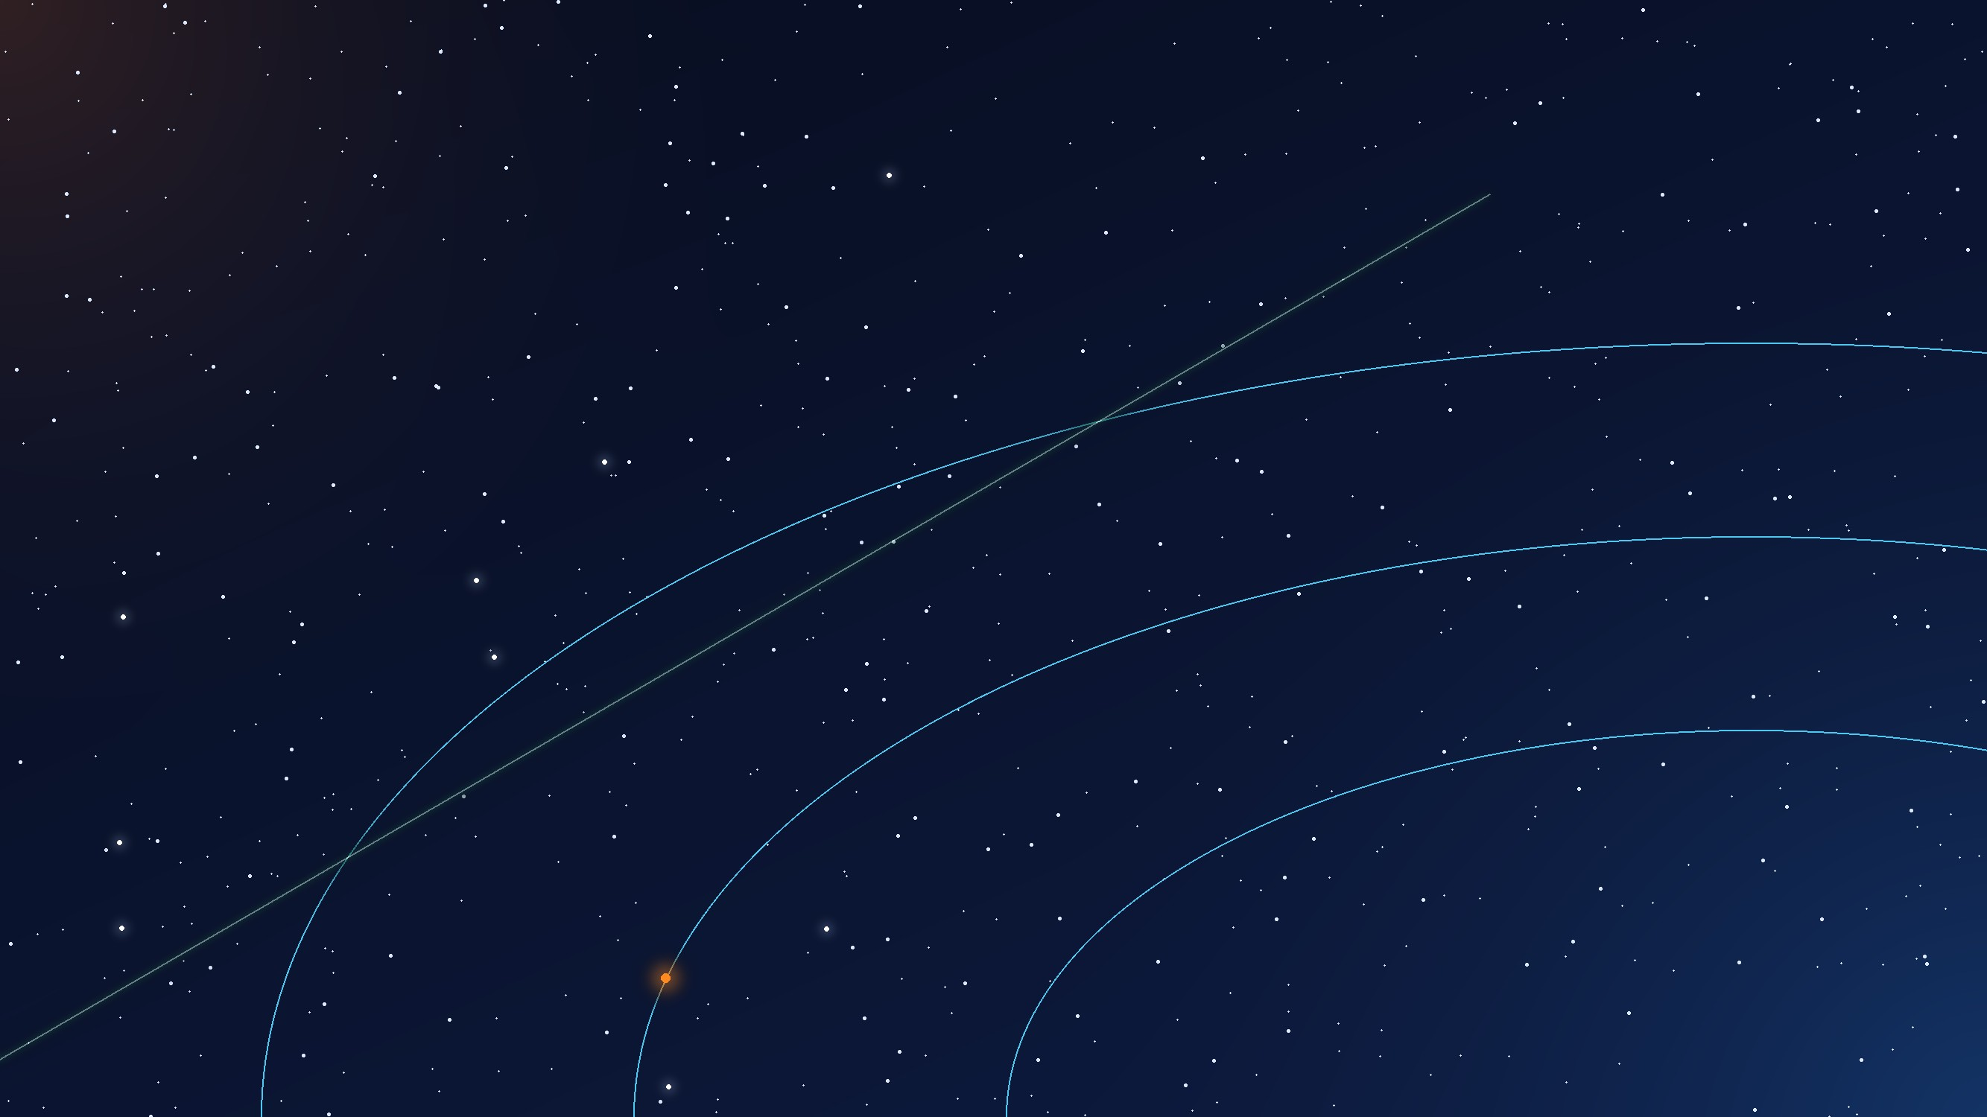

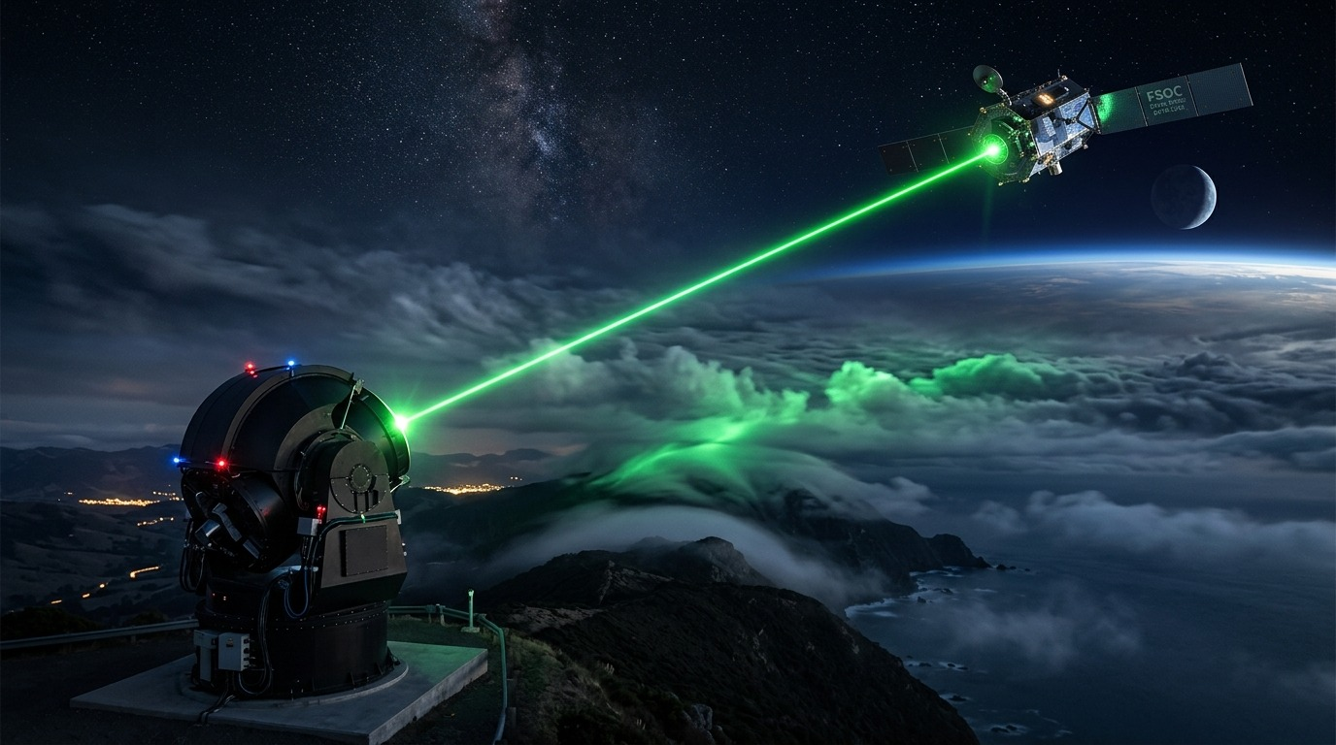

SPACE TECHNOLOGY & SMART AUTOMATION | ISRO / SPACE APPLICATIONS CENTRE
PROJECT PHOENIX
FSOC TRACKER
Software-in-the-Loop (SIL) Testbed for Coarse Tracking & Reacquisition in Mobile FSOC Terminals
PROBLEM STATEMENT ID
THEME
SIH26169
Space Technology & Smart Automation
97%
32%
<0.2 px
PROBLEM STATEMENT TITLE
faster re-lock
lag cut, τ 0–200 ms
centroid RMSE
Development of an AI-Based Virtual Camera Tracking System for Coarse Alignment of Mobile Free Space Optical Communication (FSOC) Terminals
HEADLINE CAPABILITIES
Scale: 109.1 μrad/px (4°×3° FOV) · handover ≤ 10 px (≈ 1.09 mrad)
SPONSORING ORGANIZATION
CATEGORY
Primary: Uncertainty-Guided Elliptical Reacquisition (up to 97% faster re-lock)
ISRO / Space Applications Centre
Software
Secondary: Latency-Aware Forward State Prediction (up to 32% lag cut)
TEAM NAME
TEAM ID
Perception: Top-Hat Morphology + Subpixel IWC (< 0.2 px RMSE, ~10–25% S&P)
Phoenix X
141943
Evaluator: Dual Mode (Synthetic SIL + Offline MP4 Bypass with CSV Audit)

Slide 2
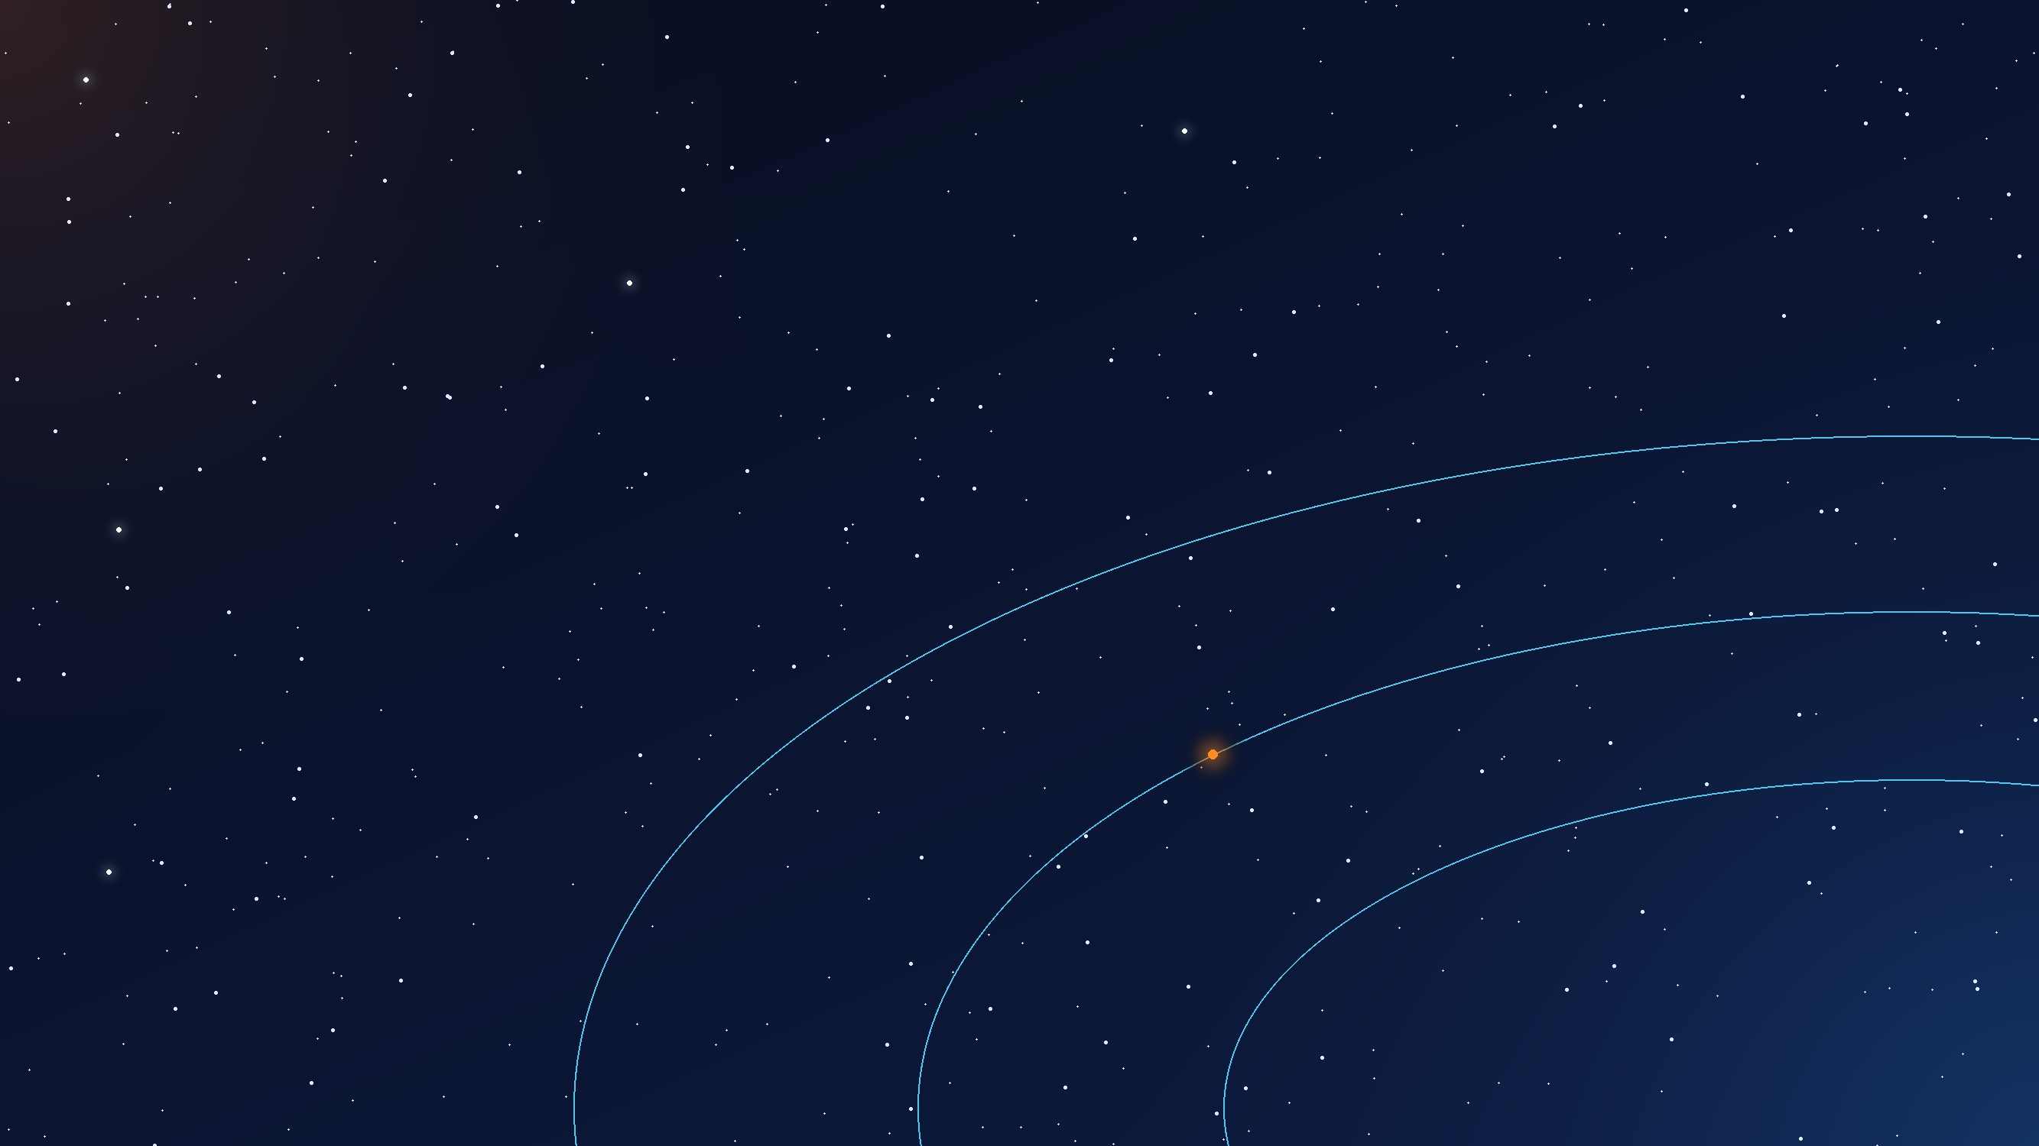
Phoenix X
PROPOSED SOLUTION
PROJECT PHOENIX: AI-Based Virtual Camera Tracking for Mobile FSOC | SIH26169 (ISRO / SAC)
PROBLEM
Current operational limitations
SOLUTION ARCHITECTURE
INNOVATION & UNIQUENESS
Uncertainty blindness: blind spirals ignore error covariance, prolonging link outages.
Uncompensated latency: exposure, compute and gimbal delay cause lag and overshoot.
Impulsive noise & fog: PS ~10% salt-and-pepper and haze corrupt naive centroids.
Gimbal inertia: unconstrained commands violate 5–10°/s slew limits.
₹50L+ physical testbed: vacuum chambers and piezo steering benches.
TIER 1
Kinematics & Virtual Gimbal
1
Uncertainty-guided search
Scale: 2000×2000 px world at 109.1 μrad/px (22.5″/px, 4°×3° FOV).
Maneuvers: Singer walk, Lemniscate (x²+y²)² = 2a²(x²−y²), ±20 px jitter.
Virtual pinhole FPA: matrix K crops 640×480, motor rate limit 5.0°/s.
Covariance P_k grows during outages; the scan follows the uncertainty ellipse (σa, σb, φ) and re-locks up to 97% faster than blind spirals.
2
Latency compensation (H1)
Forward projection x̂(t+τ) = Fᵏ x̂(t) absorbs frame, compute and servo delay (0–200 ms): up to 32% less tracking lag.
TIER 2
Optical Physics & Atmospheric Channel
Airy optics: I(θ) = I₀[2J₁(u)/u]², spot 5×5 to 20×20 px.
Beer–Lambert: I = I₀exp(−γR) with dynamic fog and scintillation.
Disturbances: Poisson shot noise, PS ~10% S&P (stress to 25%).
Top-Hat morphology + IWC
3
OUR SOLUTION
Autonomous software tracking
Background suppression + subpixel centroiding: < 0.2 px RMSE through ~10% S&P (25% stress), no heavy YOLO.
Coarse PAT handover: beacon into ≤ 10 px (≈ 1.09 mrad) cone for FSM takeover.
Uncertainty-guided search: covariance-driven elliptical scan, up to 97% faster.
Latency-compensated pointing: forward Kalman projection, τ ∈ [0, 200] ms, up to 32% lag cut.
Adaptive localization: Top-Hat + subpixel IWC rejects ~10% S&P (stress 25%).
Dual-mode evaluator: closed-loop SIL or external .mp4 with CSV audit.
TIER 3
Edge AI Perception & IMM-Kalman Control
4
Dual-mode SIL / MP4 engine
Stage 1: Top-Hat + subpixel IWC, I = A·exp(−r²/2σ²), RMSE < 0.2 px.
Stage 2: forward projection x̂(t+τ) = Fᵏ x̂(t) over loop delay τ.
Stage 3: covariance reacquisition scans growing ellipse (σa, σb, φ).
Stage 4: anti-windup PID + feedforward, clamped ≤ 5.0°/s.
One testbed ingests synthetic physics or external camera video, verified by ground-truth CSV error audits.
5
Defined coarse PAT scope
Bounded to coarse PAT (109.1 μrad/px); ≤ 10 px (≈ 1.09 mrad) capture for hand-over to 10 kHz FSM fine pointing.
@SIH Idea submission- Template
2

Slide 3
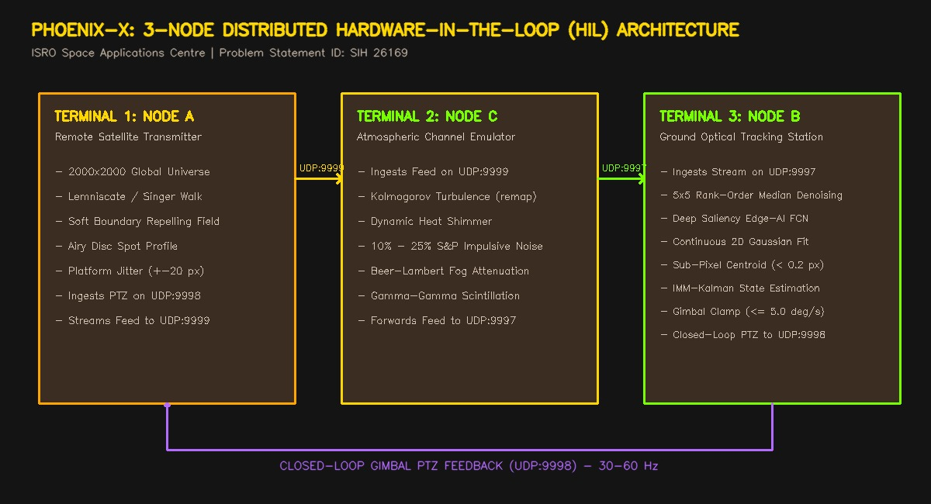
Phoenix X
TECHNICAL APPROACH
PROJECT PHOENIX: AI-Based Virtual Camera Tracking for Mobile FSOC | SIH26169 (ISRO / SAC)
IMPLEMENTATION WORKFLOW & CONTROL PIPELINE
FULL-STACK TECHNOLOGY ECOSYSTEM
1
Global Universe Kinematics
2
Platform Jitter & Dynamics
2000×2000 universe at 109.1 μrad/px (22.5″/px, 4°×3° FOV), propagating Lemniscate and Singer walks.
Enforces 5.0°/s slew limit and multi-harmonic vibration θ_jit(t) = Σ A_k sin(2π f_k t + φ_k).
WORLD
DYNAMICS
3
Optical & Atmospheric Degradation
4
Sensor Windowing & Latency Queue
Airy PSF I(θ) = I₀[2J₁(u)/u]², Beer–Lambert fog, Poisson noise and PS ~10% S&P (to 25%).
Pinhole matrix K crops a 640×480 FPA; LatencyQueue models cumulative delay τ ∈ [0, 200] ms.
State estimation (H1)
Latency-compensated Kalman filter projecting x̂(t+τ) across loop delay τ (up to 32% lag cut).
CHANNEL
SENSOR
Reacquisition (H2)
Uncertainty-guided covariance-ellipse search cutting link recovery time by up to 97%.
5
Denoising & Sub-Pixel Centroiding
6
Predictive Pointing & Reacquisition
Coarse handover SLA
Holds line-of-sight inside ≤ 10 px (≈ 1.09 mrad) for the downstream FSM / QPD stage.
Top-Hat background suppression + intensity-weighted centroiding: < 0.2 px RMSE, no heavy YOLO.
Latency-compensated projection (H1: 32% lag cut) + covariance-ellipse search on loss (H2: 97% faster re-lock).
PERCEPTION
CONTROL
Evaluator engine
Real-time SIL simulator + offline .mp4 benchmark bypass with CSV audit.
@SIH Idea submission- Template
3

Slide 4
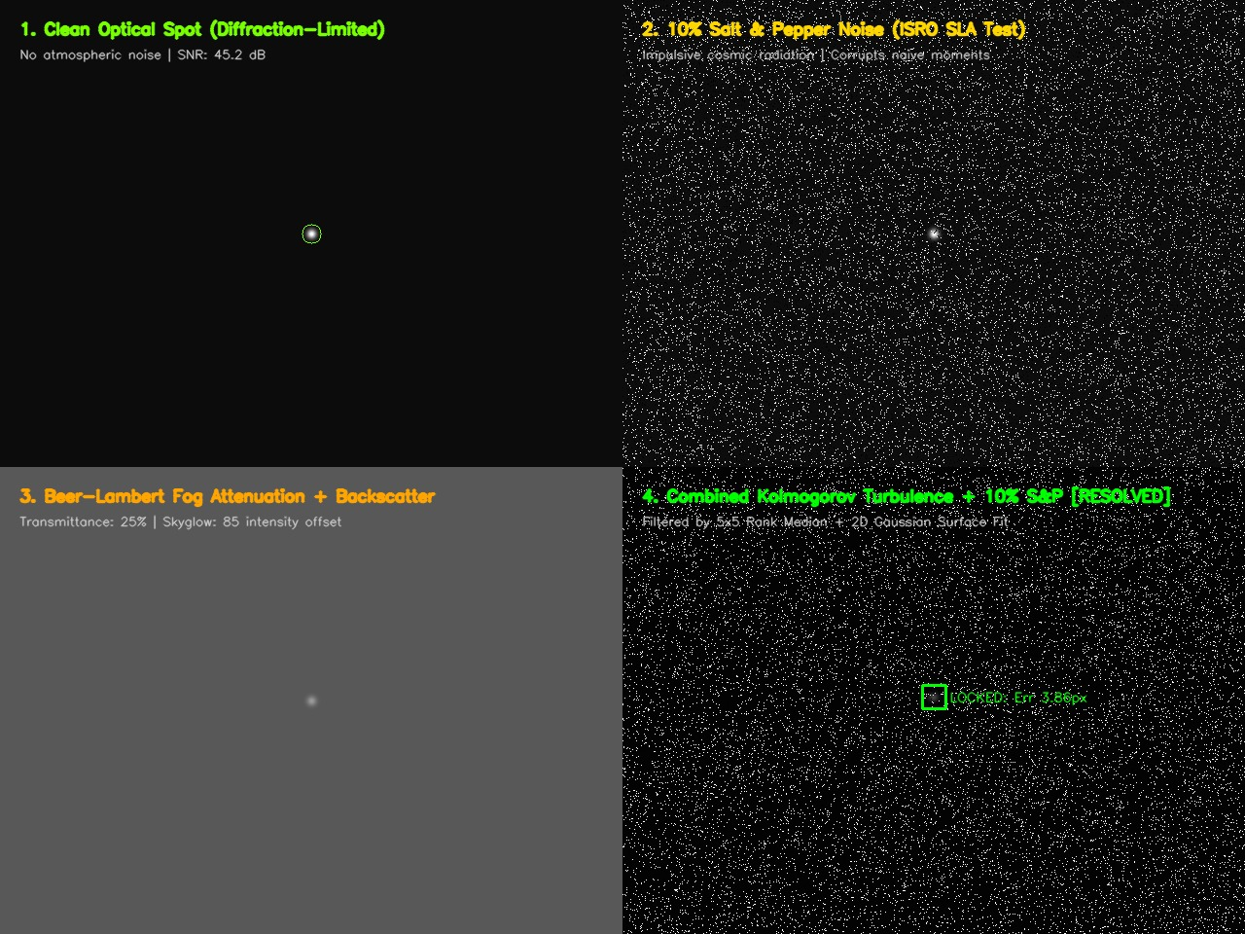
Phoenix X
FEASIBILITY AND VIABILITY
PROJECT PHOENIX: AI-Based Virtual Camera Tracking for Mobile FSOC | SIH26169 (ISRO / SAC)
FEASIBILITY ANALYSIS
VIABILITY & DEPLOYMENT
CHALLENGES → STRATEGIES
Technical feasibility · frame latency budget (33.3 ms ceiling)
ECONOMIC DISRUPTION
1
PS-specified ~10% S&P noise (stress 25%)
₹50+ Lakhs
₹0
Vectorized rank-order median + Top-Hat strip impulsive noise in 0.8 ms, keeping < 0.2 px centroid accuracy.
Physical FSOC testbed
Phoenix SIL (open source)
2
Loop latency & actuator delay (0–200 ms)
Parallel multi-team algorithm development without equipment bottlenecks.
Forward projection (H1) compensates frame, compute and motor delay: up to 32% less steady-state lag.
AIR-GAPPED DATA RESILIENCE
100% offline: zero cloud dependency; telemetry, logs and AI weights stay local.
Compliance: meets DRDO/ISRO cyber-security and air-gapped lab mandates.
3
Gimbal dynamics & slew limits (5–10°/s)
= 19.9 ms total
≥ 45 FPS on dual-core CPU, zero discrete GPU needed
Anti-windup saturated velocity PID (θ̇ ≤ 5.0°/s) prevents torque saturation and models gimbal inertia.
OPERATIONAL FEASIBILITY
4
Visibility outages & cloud/fog drops
Rapid setup: < 1 min zero-config launch (1-click binaries).
Benchmark bypass: external .mp4 + ground-truth CSV.
Repeatable: deterministic PRNG seeds for jury audits.
Uncertainty-guided reacquisition (H2) scans the growing covariance ellipse, re-locking up to 97% faster.
FINANCIAL FEASIBILITY
5
Independent evaluator verification
₹0 hardware capex: no ₹50L+ gimbal or vacuum chamber.
Open access: universities and space research labs.
MP4 bypass ingests external real/synthetic video; 1-click macOS DMG (61 MB) & Windows EXE for jury testing.
Optical channel validation: Airy · 10% S&P · fog · combined turbulence
@SIH Idea submission- Template
4

Slide 5




Phoenix X
IMPACT AND BENEFITS
PROJECT PHOENIX: AI-Based Virtual Camera Tracking for Mobile FSOC | SIH26169 (ISRO / SAC)
ISRO / SAC FLIGHT TEAMS
NATIONAL SPACE DEFENSE
DEEP SPACE & OISL MISSIONS
INDIAN ACADEMIA & STARTUPS
Accelerated development: cuts PAT validation cycles from 6 months to 48 hours.
Risk-free validation: verifies coarse tracking before hardware fabrication.
Automated logging: timestamped error audits matching ISRO criteria.
Jam-proof comms: accelerates optical links immune to RF EW.
QKD readiness: coarse-tracking foundation for satellite quantum key distribution.
Airborne FSOC: UAV-to-ground high-bandwidth disaster and defense links.
Inter-satellite crosslinks: tracking algorithms for LEO mega-constellations.
Lunar & planetary probes: validates coarse alignment for deep-space laser transceivers.
Adaptive simulation: models space scintillation and reaction-wheel jitter.
Democratized research: zero-capex platform for university FSOC labs.
Repeatable benchmarking: lowers the barrier for spacetech startups.
Open standards: clean modular codebase fostering indigenous space-comms innovation.
PHOENIX IMPACT PIPELINE — MEASURABLE PERFORMANCE BREAKTHROUGHS
1 DEPLOY
2 SIMULATE
3 ACQUIRE
4 TRACK
5 AUDIT
1-Click Native Runtime
Empirical SIL Testbed
Latency-Compensated Lock
Sub-Pixel Coarse Centroiding
Empirical Benchmark Engine
Standalone app (macOS 61 MB DMG / Windows EXE) runs 100% offline in < 30 s.
Models 109.1 μrad/px scale, loop latency (0–200 ms), PS ~10% S&P and platform motion.
Autonomous acquisition in ≤ 0.8 s (SLA ≤ 2.0 s); forward projection cuts lag by up to 32%.
Holds lock at RMSE ≤ 1.5 px nominal; all evaluated trials stayed inside the PS ≤ 10 px cone.
Auto-exports timestamped CSV compliance audits; verifies H1 (latency) & H2 (reacquisition).
100% Offline
109.1 μrad/px
≤ 0.8 s
< 1.5 px
+97% / +32%
macOS & Windows native
Default 4°×3° FOV
SLA: ≤ 2 s
PS cone: ≤ 10 px
H1 & H2 empirical gains
@SIH Idea submission- Template
5

Slide 6

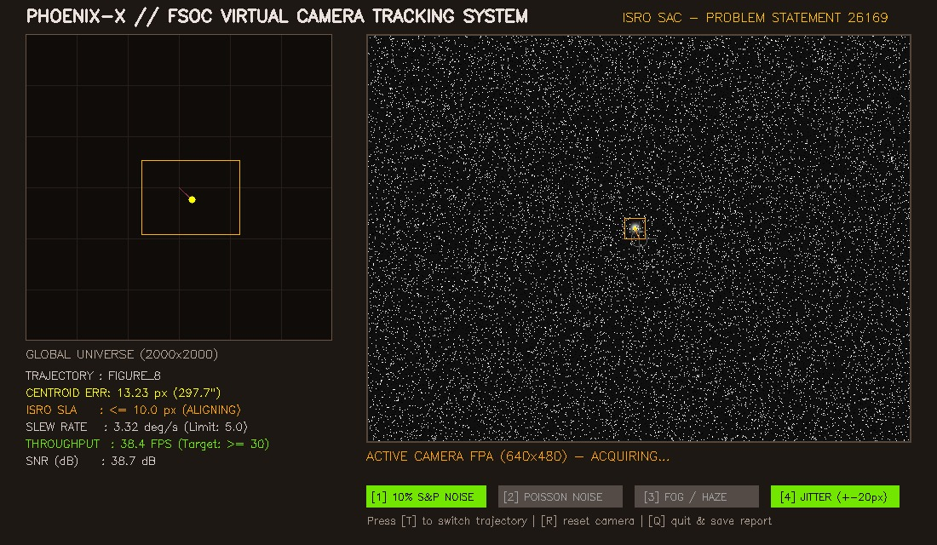
Phoenix X
RESEARCH AND REFERENCES
PROJECT PHOENIX: AI-Based Virtual Camera Tracking for Mobile FSOC | SIH26169 (ISRO / SAC)
PEER-REVIEWED RESEARCH CITATIONS (2023–2025)
PROTOTYPE PROOF & VERIFICATION
01
Liu et al. (IEEE ICSOS, 2025)
02
Sun, Wang, Wu & Liu (MDPI Photonics, 2024)
Open-source GitHub repository
PAT for Optical Satellite Communications: The ALIGN UK Mission
High-Precision Tracking of FSO Communication System on Mobile Platforms
github.com/jvstin47/Phoenix-X-AI-Based-Virtual-
Camera-Tracking-System-SIH26169
Satellite PAT handover: coarse-to-fine transition dynamics and ≤ 2 s acquisition SLA.
Mobile platform dynamics: multi-axis jitter rejection (±20 px/frame).
SCOPE BOUNDARY & ENGINEERING DELIVERABLES
DOI: 10.1109/icsos66026.2025.11443125
DOI: 10.3390/photonics11100900
Scope boundary: coarse PAT & reacquisition (109.1 μrad/px). Fine pointing (FSM, QPD, BER, link budget) is handled at hand-over.
Scientific engine: src/experiments/scientific_benchmark.py (SNR, latency H1, reacquisition H2, maneuver sweeps).
Standalone releases: native macOS 61 MB DMG (arm64) + Windows 1-click CI/CD binaries.
03
Saha, Qin, Li, Ye & Jayasuriya (CVPR, 2024)
04
Qin, Saha, Chung, Jayasuriya, Ye & Li (ECCV, 2024)
Turb-Seg-Res: Segment-then-Restore for Dynamic Videos with Atmospheric Turbulence
Unsupervised Moving Object Segmentation with Atmospheric Turbulence
Spatio-temporal segmentation under refractive shimmer.
Separates faint moving beacons under haze, fog and scintillation.
DOI: 10.1109/CVPR52733.2024.02389
DOI: 10.1007/978-3-031-72658-3_2
05
Yang, Xie, Liu, Mo & Zeng (MDPI Remote Sensing, 2023)
06
Kaushal & Kaddoum (IEEE COMST, 2017)
Centroid Extraction of Laser Spots Captured by Infrared Detectors Combining Observation Data
Optical Communication in Space: Challenges and Mitigation Techniques
Sub-pixel Gaussian diffusion: < 0.2 px centroid accuracy under noise.
Foundational survey for Beer–Lambert extinction and scintillation channels.
DOI: 10.3390/rs15082129
DOI: 10.1109/COMST.2016.2603518
Operational software cockpit (main.py)
@SIH Idea submission- Template
6

