Slide 1


ROBOTICS AND DRONES | MINISTRY OF DEFENCE / DEFENCE SERVICES STAFF COLLEGE
PROJECT PHOENIX-X
C-UAS TRAINER
AI-enabled drone & counter-drone threat simulation trainer for unit-level defence force readiness
HEADLINE CAPABILITIES
PROBLEM STATEMENT ID
THEME
SIH26247
Robotics and Drones
Procedural, Seed-Reproducible Scenarios
PROBLEM STATEMENT TITLE
Zero-Install, Fully Offline PWA
AI-Enabled Drone & Counter-Drone Threat Simulation Trainer
Multi-Sensor Radar / EO / Thermal Feeds
(Ministry of Defence / Defence Services Staff College)
SPONSORING ORGANIZATION
CATEGORY
Deterministic AAR & Skill Analytics
Ministry of Defence
Software
Runs on Standard COTS Laptops
TEAM NAME
TEAM ID
Phoenix X
141943

Slide 2





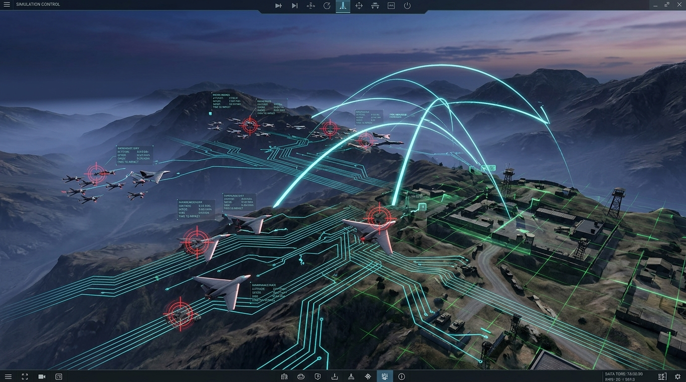
PROPOSED SOLUTION
Phoenix X
PROJECT PHOENIX-X: AI Drone & Counter-Drone Threat Simulator | SIH26247 (MoD / DSSC)
Core Concept
How It Solves the Problem
Procedural Scenario DNA
A lightweight, software-based simulation platform engineered for unit-level deployment to train defence personnel in detecting, classifying, and responding to drone and swarm threats across varied environments.
Replaces expensive, weather-dependent, and infrequent live-fire drills with high-repetition synthetic practice running on standard military-issue laptops without requiring specialized hardware or cloud dependencies.
Seed-reproducible generation of tactical environments across Day/Night, Urban/Rural/Open terrains, degraded sensor conditions (atmospheric noise, low visibility, sensor health degradation), and diverse threat profiles.
Decision-Tree Cognitive Evaluation
After-Action Review (AAR) & Analytics
Scores operators deterministically on detection reaction latency, multi-class classification accuracy (Benign / Unknown / Unusual), confidence calibration, and abstract engagement decisions (Monitor / Escalate / Resolve).
Delivers millisecond-accurate timeline event replays, automated strengths/mistakes coaching diagnostics, and longitudinal unit-level skill retention tracking across repeated sessions to eliminate rote learning.

Slide 3

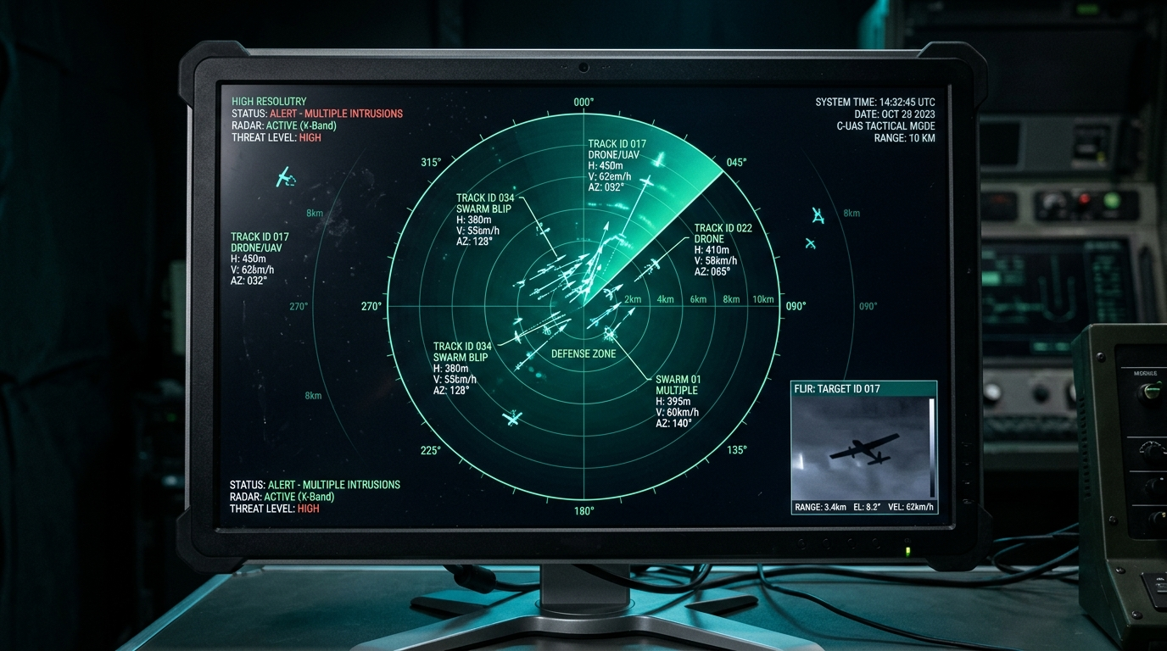




TECHNICAL APPROACH
Phoenix X
PROJECT PHOENIX-X: AI Drone & Counter-Drone Threat Simulator | SIH26247 (MoD / DSSC)
SYSTEM ARCHITECTURE & IMPLEMENTATION
System Architecture & Stack
Local-first modular architecture combining a deterministic fixed-step simulation engine, client-side React 19/TypeScript cockpit, Babylon.js 3D/2D tactical viewport, and optional Python 1-click launcher.
Multi-Sensor Threat Perception Suite
Simulates simultaneous feeds including 3D Radar PPI Scope (range, bearing, velocity vectors), Electro-Optical (EO) daylight/night surveillance, and Thermal-like LWIR contrast feeds with synthetic noise degradation.
Kinematic Modeling & Swarm Trajectories
Physics-grounded 3D path generation modeling individual Micro/Mini drones, fast loitering targets, and multi-agent swarm formations with dynamic speed, altitude, and bearing variations.
Anti-Cheat Ground-Truth Hard Boundary
Simulation ground truth is strictly sealed in the engine; trainee classifications and confidence inputs can never overwrite actual entity states, guaranteeing 100% auditable scoring integrity.
Offline Persistence & Zero-Dependency Execution
Local IndexedDB / Dexie client-side persistence and single-file canvas companion enabling instant zero-install execution on forward-deployed hardware without internet connectivity.

Slide 4
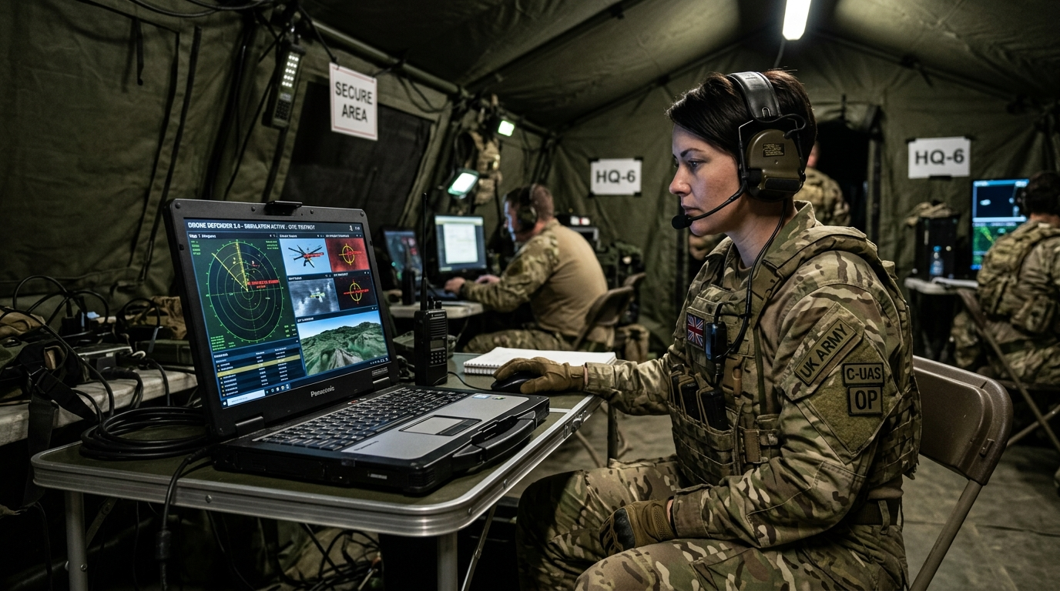

FEASIBILITY AND VIABILITY
Phoenix X
PROJECT PHOENIX-X: AI Drone & Counter-Drone Threat Simulator | SIH26247 (MoD / DSSC)
Feasibility Analysis (Unit-Level Usability)
Operational Viability
Engineered specifically for low-overhead execution. Runs smoothly on standard COTS laptops (integrated graphics, 4GB RAM) with zero dependency on expensive external GPU rigs, physical radar hardware, or VR headsets.
Immediately adoptable by training establishments (such as the Defence Services Staff College) for tactical officer decision-making drills before conducting costly live-fire range exercises.
TOP RISKS → ENGINEERED MITIGATIONS
1
Rote Learning & Predictability
2
Connectivity & Field Environment Outages
3
Complex Deployment Overhead
Risk: Trainees memorize fixed drone paths.
Risk: Forward bases have zero internet access.
Risk: Defence units cannot troubleshoot complex installation scripts.
→ Pseudorandom Seeded Scenario DNA alters approach vectors, spawn times, environmental visibility, and noise in every run while remaining fully reproducible for instructor evaluation.
→ Fully local-first Progressive Web App (PWA) with self-contained assets and bundled evidence clips ensuring 100% offline mission readiness.
→ Provided with a 1-click Python launcher (python3 launch_demo.py) and a standalone zero-dependency mobile/desktop preview.

Slide 5





IMPACT AND BENEFITS
Phoenix X
PROJECT PHOENIX-X: AI Drone & Counter-Drone Threat Simulator | SIH26247 (MoD / DSSC)
Dramatic Cost Reduction & Resource Optimization
High-Repetition Cognitive Muscle Memory
All-Weather & 24/7 Training Availability
Objective Data-Driven Readiness Auditing
Strategic Alignment with Atmanirbhar Bharat
Eliminates the immense recurring expense of expending target drones, fuel, and specialized range safety infrastructure. Delivers unlimited virtual training repetitions at zero per-drill consumable cost.
Enables soldiers and officers to experience 50+ diverse swarm and single-drone threat scenarios per week, building rapid decision reflexes under time pressure and degraded visibility.
Training schedules are no longer canceled due to adverse weather, airspace restrictions, or range scheduling conflicts, ensuring continuous training readiness across all defence units.
Automated After-Action Review (AAR) provides command staff with empirical metrics on unit reaction speed, classification error trends, and engagement judgment over time.
100% indigenous, sovereign training software designed to fortify India's counter-drone operational doctrine against evolving unmanned aerial threats along borders and vital installations.

Slide 6
RESEARCH AND REFERENCES
Phoenix X
PROJECT PHOENIX-X: AI Drone & Counter-Drone Threat Simulator | SIH26247 (MoD / DSSC)
VERIFIED PEER-REVIEWED RESEARCH FOUNDATIONS
01
Radar Drone Detection & Micro-Doppler Signatures
J. Drozdowicz et al. — IEEE Radar Conference
'35 GHz FMCW radar for drone detection and tracking'
Modeling radar cross-section (RCS) fluctuations and range-bearing tracking vectors.
DOI: 10.1109/RADAR.2016.7485122
02
Adverse Weather Optical Drone Classification
S. S. A. Ghaffar et al. — IEEE Sensors Journal
'Optical Drone Detection and Classification Under Adverse Weather Conditions'
Grounding synthetic visual degradation, contrast loss, and atmospheric extinction.
DOI: 10.1109/JSEN.2020.3025211
03
Autonomous Swarm Dynamics & Flocking Models
C. W. Reynolds — ACM SIGGRAPH
'Flocks, herds and schools: A distributed behavioral model'
Implementing coordinated multi-agent separation, cohesion, and alignment dynamics for realistic swarm attacks.
DOI: 10.1145/37402.37406
04
Multi-Sensor Fusion in Counter-UAS Systems
M. Ezuma et al. — IEEE Aerospace and Electronic Systems
'Micro-UAV Detection and Classification Using Machine Learning Techniques'
Structuring multi-channel radar, EO, and RF track association.
DOI: 10.1109/MAES.2019.2955959
05
Intelligent Tutoring Systems & Simulation AAR
R. S. Sottilare et al. — Springer
'Design Recommendations for Adaptive Intelligent Tutoring Systems'
Formulating deterministic decision-tree scoring, confidence calibration, and after-action review feedback loops.
DOI: 10.1007/978-3-319-07227-2

