Slide 1
FORESIGHT RM
The bank already knows. It has never told anyone.
Julius Baer · Wealth Intelligence
Foresight Labs · SingHacks 2026
20 clients · 6 agents · 12 data files · 28 RM notes
Notes:
Open on the thesis: the information already exists inside the bank. It is held in systems that do not speak to each other.

Slide 2
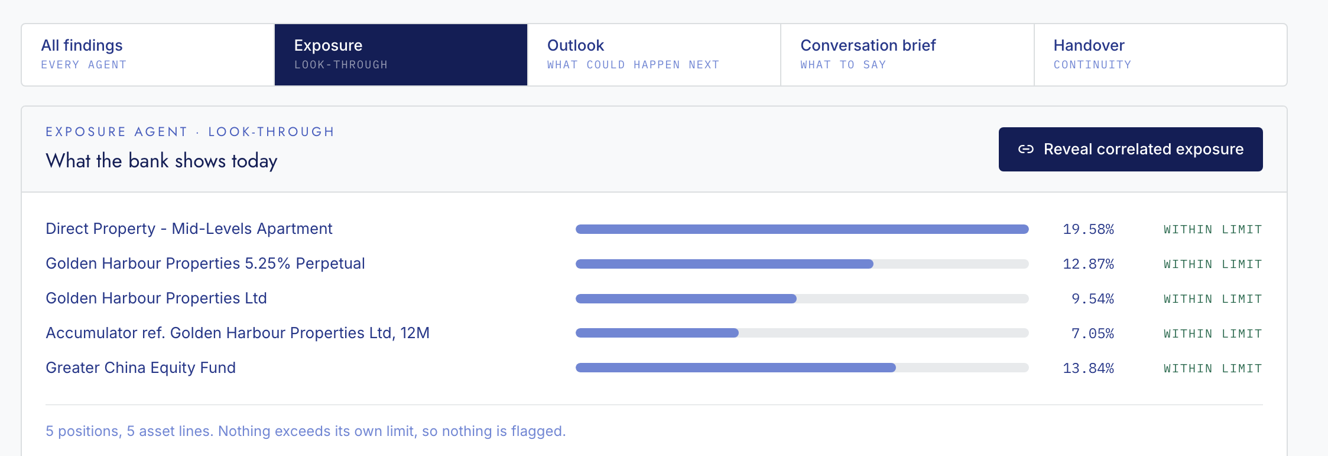
THE PROBLEM
SIX HOLDINGS. EVERY ONE INSIDE ITS LIMIT.
Lau Chi Ming holds an apartment, a share, a bond and a derivative.
The bank shows six tidy rows. Nothing is flagged, because nothing
individually breaks a rule.
This is what every wealth platform shows today.
Screen: Client 360 → Exposure, before the reveal
Notes:
Six positions, each within its own limit, nothing flagged. This is what a wealth platform shows today. Pause here before the next slide.

Slide 3
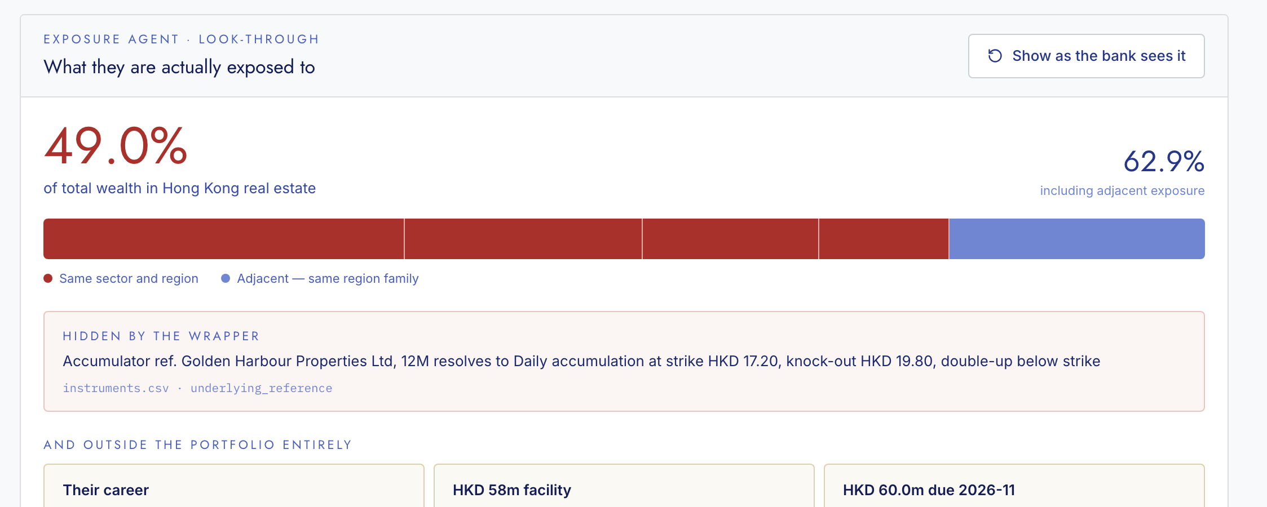
ONE CLICK LATER
49.0%
of his wealth is one Hong Kong property bet
A structured product hid the exposure behind a wrapper.
His loan is secured on the same asset.
His career is Hong Kong property development.
He owes HKD 60m to a project in November.
Three positions already breach the 12% single-position limit — and no mandate rule measures the other 49%
Notes:
One click resolves the six positions into a single correlated bet. His mandate is Balanced, so the single-position limit is 12% (mandates.csv, BAL) — and three positions already breach it: the Mid-Levels apartment at 19.58%, a Pacific Rim Bank perpetual at 17.57%, and the Golden Harbour perpetual at 12.87%. The 49% is the aggregate across four correlated positions, which no mandate rule measures at all. That gap is the point. Pause after the limit figure.

Slide 4



WHY NOBODY SAW IT
THREE SYSTEMS THAT NEVER SPEAK
PORTFOLIO SYSTEM
CREDIT SYSTEM
CRM NOTES
Six separate holdings
One loan, well covered
A note nobody queries
“All fine”
“All fine”
never read
And the Relationship Manager had already worked it out.
“the perpetual, the shares, the accumulator and his own development business are all the same bet.
He said that is why he is confident.”
rm_notes.json · N-018 · 5 March 2026 · P. Ong — typed, filed, and never read against the numbers
Notes:
Three systems each report no problem. The Relationship Manager had already identified the correlation herself and recorded it on 5 March. Nothing read that note against the portfolio.

Slide 5





WHAT WE BUILT
SIX AGENTS READ ALL TWELVE FILES TOGETHER
01 MONITOR
02 EXPOSURE
03 RESILIENCE
04 OPPORTUNITY
05 SUITABILITY
06 RELATIONSHIP
what changed
what they really hold
what breaks first
what is unclaimed
breach or authorised
how to say it
Detectors compute. Agents narrate. No agent originates a number.
Notes:
Six agents read all twelve source files together. Every figure is computed in Python; the model narrates and translates but never originates a number.

Slide 6

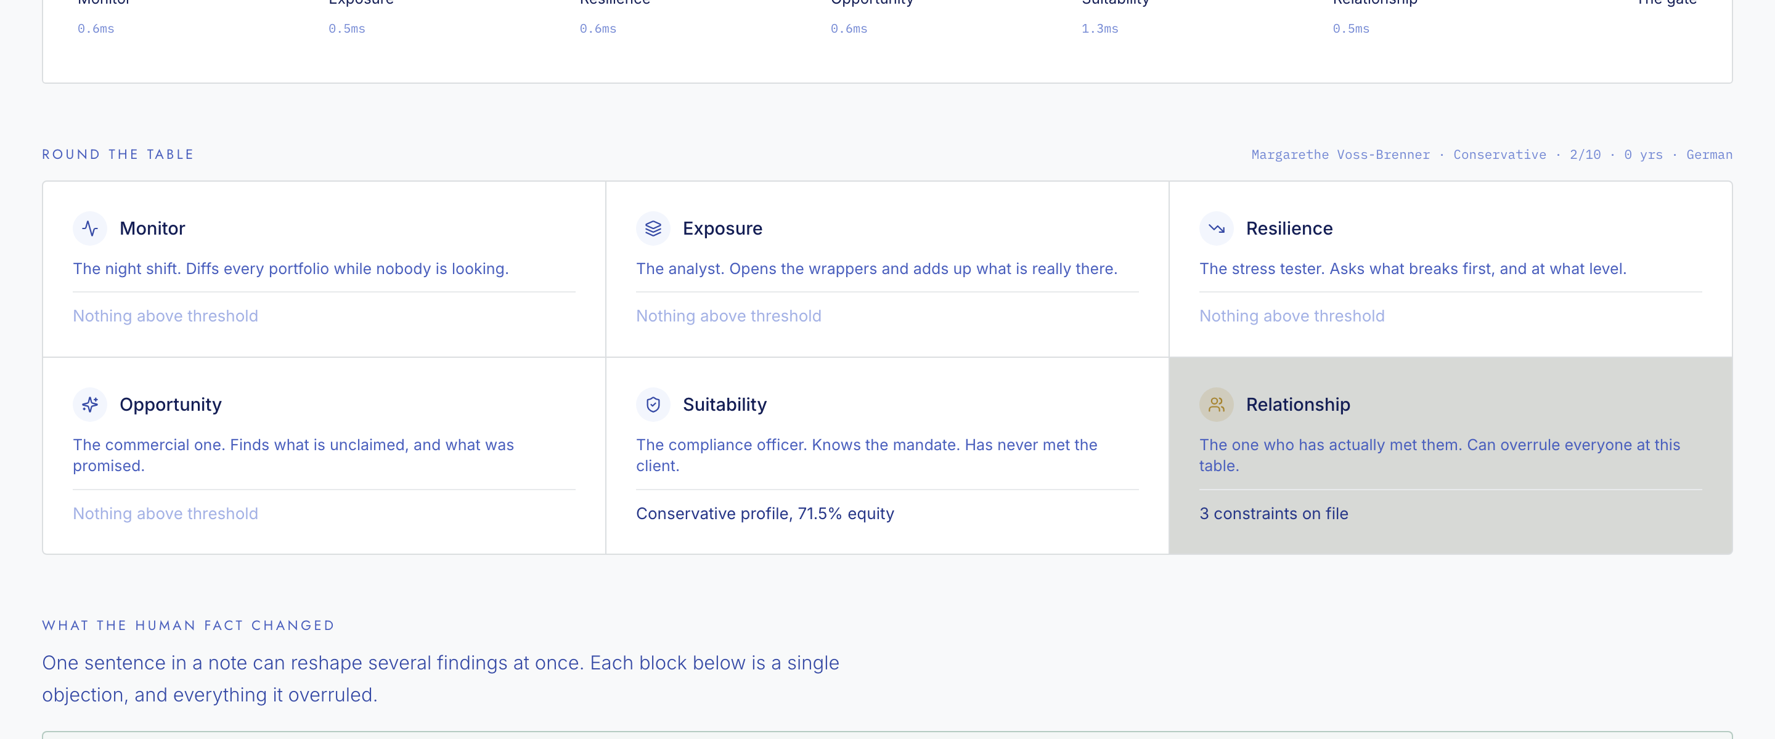
THE DIFFERENTIATOR
OUR AI OVERRULES ITSELF
Suitability calls Margarethe a critical breach: 71.46% equity against a 10–30% band. It is right. Relationship objects — she was widowed six months ago and asked that nothing be changed. The gate holds the finding, and gives the RM a different door in.
Screen: The Desk — every objection is extracted from a dated, attributed RM note
Notes:
Suitability correctly identifies a critical breach. The Relationship agent objects on a dated client instruction, and the gate holds the finding with a reason and a dated note. Only some holds carry a revisit date; this one does not, because the instruction was open-ended. The system can overrule its own analysis when a human fact requires it.

Slide 7
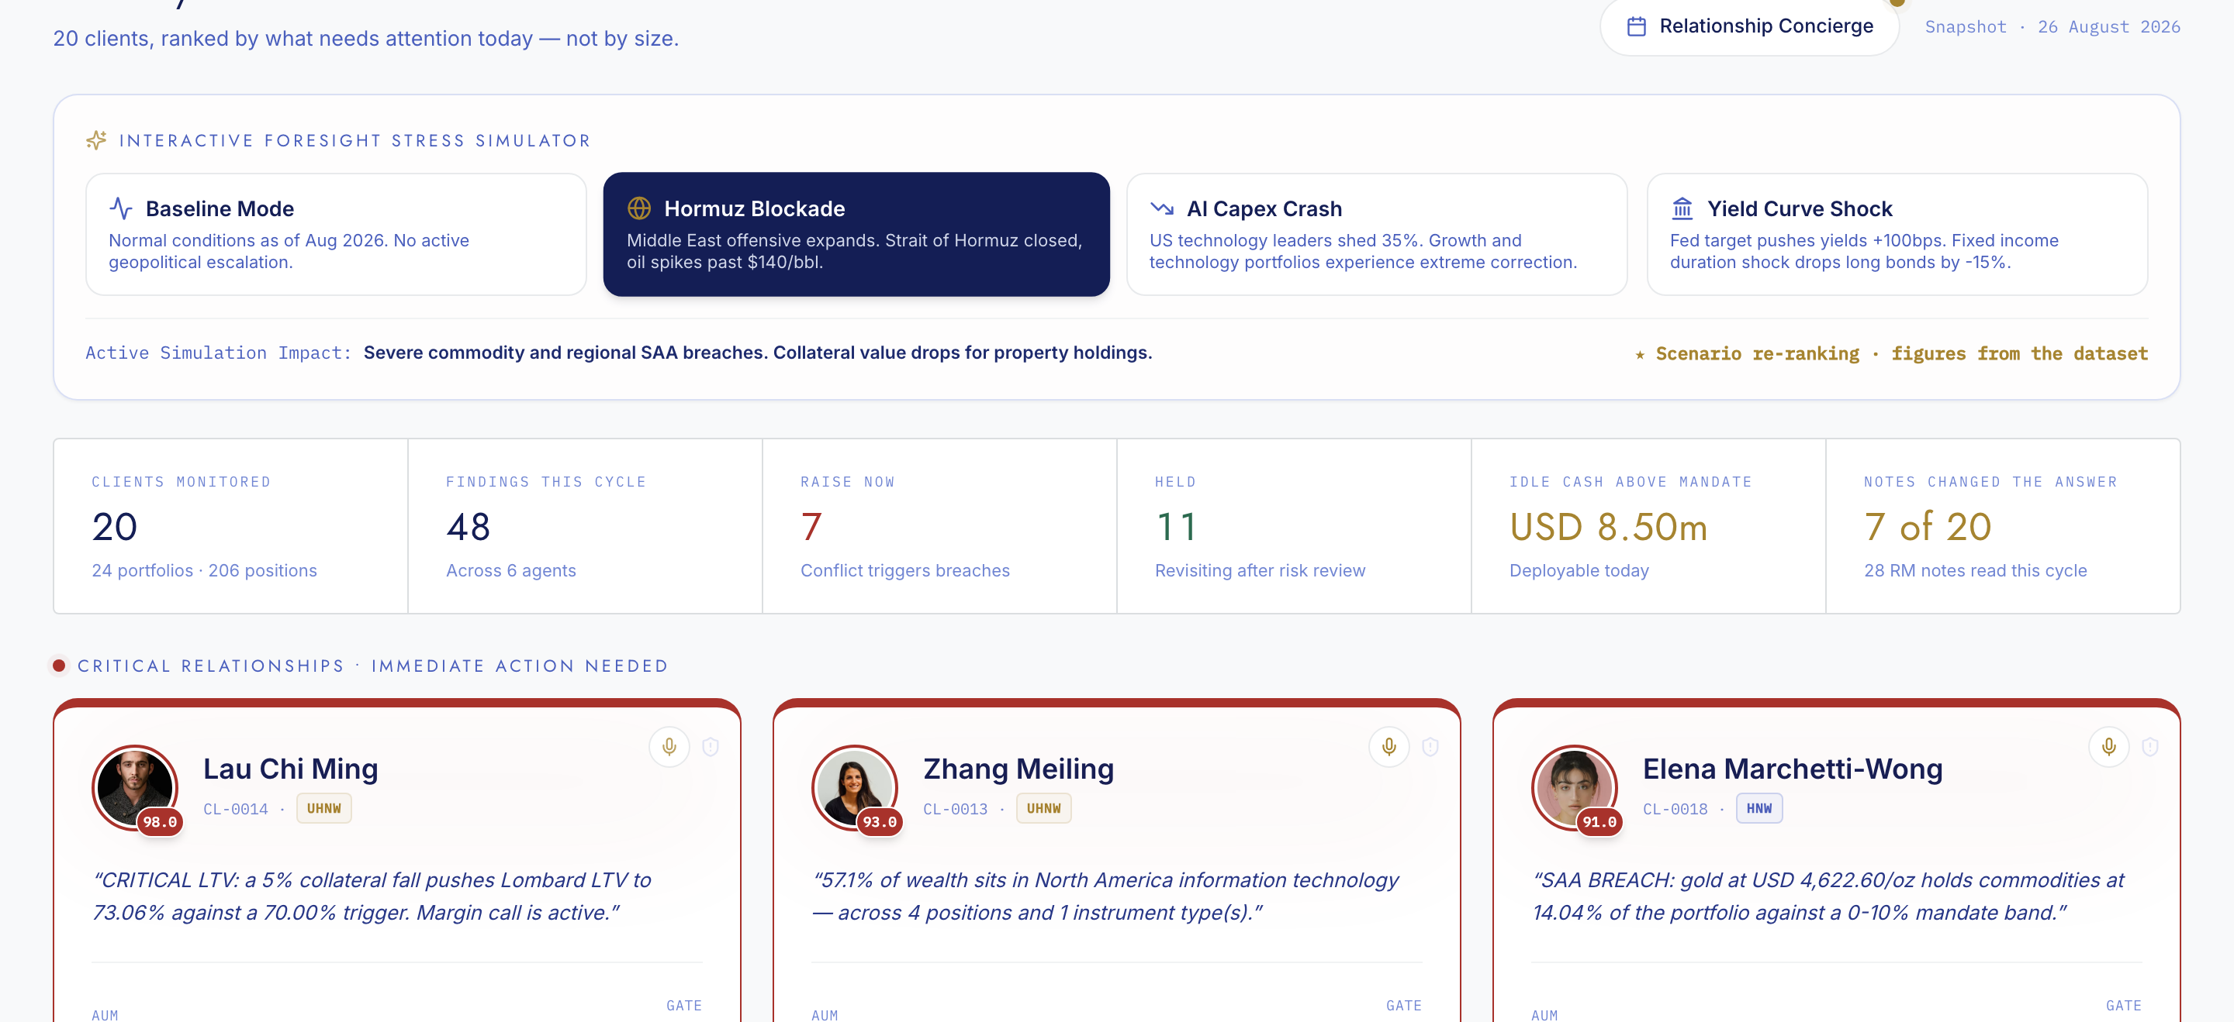
WHAT COULD HAPPEN NEXT
ONE CLIENT, AND THE WHOLE BOOK
Lau’s loan is secured on the very thing he is concentrated in,
so selling to raise cash makes the ratio worse, not better.
COMPUTED FROM HIS CREDIT FILE
Today
69.41%
−5%
73.06%
margin call
−10%
77.12%
margin call
AND THE SAME SHOCK ACROSS ALL TWENTY
86.76%
Four macro scenarios re-rank the book in place. Selecting a Middle East oil shock moves Lau to the top of Priscilla’s list, and Elena with him on commodities.
−20%
margin call
Left: loan-to-value computed from the credit facility under collateral shocks. Right: scenario definitions are ours; every figure quoted inside them is read from the dataset
Notes:
The brief asks what could happen next, and the answer works at two scales. Per client, the loan-to-value figures are computed from the actual credit facility under collateral shocks. Across the book, four macro scenarios re-rank all twenty clients in place — a Middle East oil shock moves Lau to the top of the list. If asked: the scenario definitions are ours, and every figure quoted inside them is read from the dataset.

Slide 8





THE OTHER HALF OF THE JOB
NOT EVERY REASON TO CALL IS A RISK
A risk engine only ever tells her something is wrong. Much of an RM’s job is the opposite — a relationship reason to call when no finding is outstanding: months of silence, a review falling due, a holiday in the client’s own jurisdiction.
180 days
since anyone spoke to Grace Adeyemi-Lim — USD 19.1m, and no finding is above threshold
5 days
until Tan Boon Huat’s review falls due, on the anniversary of a 23-year relationship
Mid-Autumn
a public holiday in the Hong Kong booking centre — greeting drafted, the RM chooses who receives it
Screen: Relationship Concierge — contact gaps and compliance dates are computed from the data; greetings are drafted for the RM to choose
Notes:
Contact gaps and compliance dates are computed from the data. Greetings are drafted for the RM to select; the system does not assume a client observes any particular occasion.

Slide 9
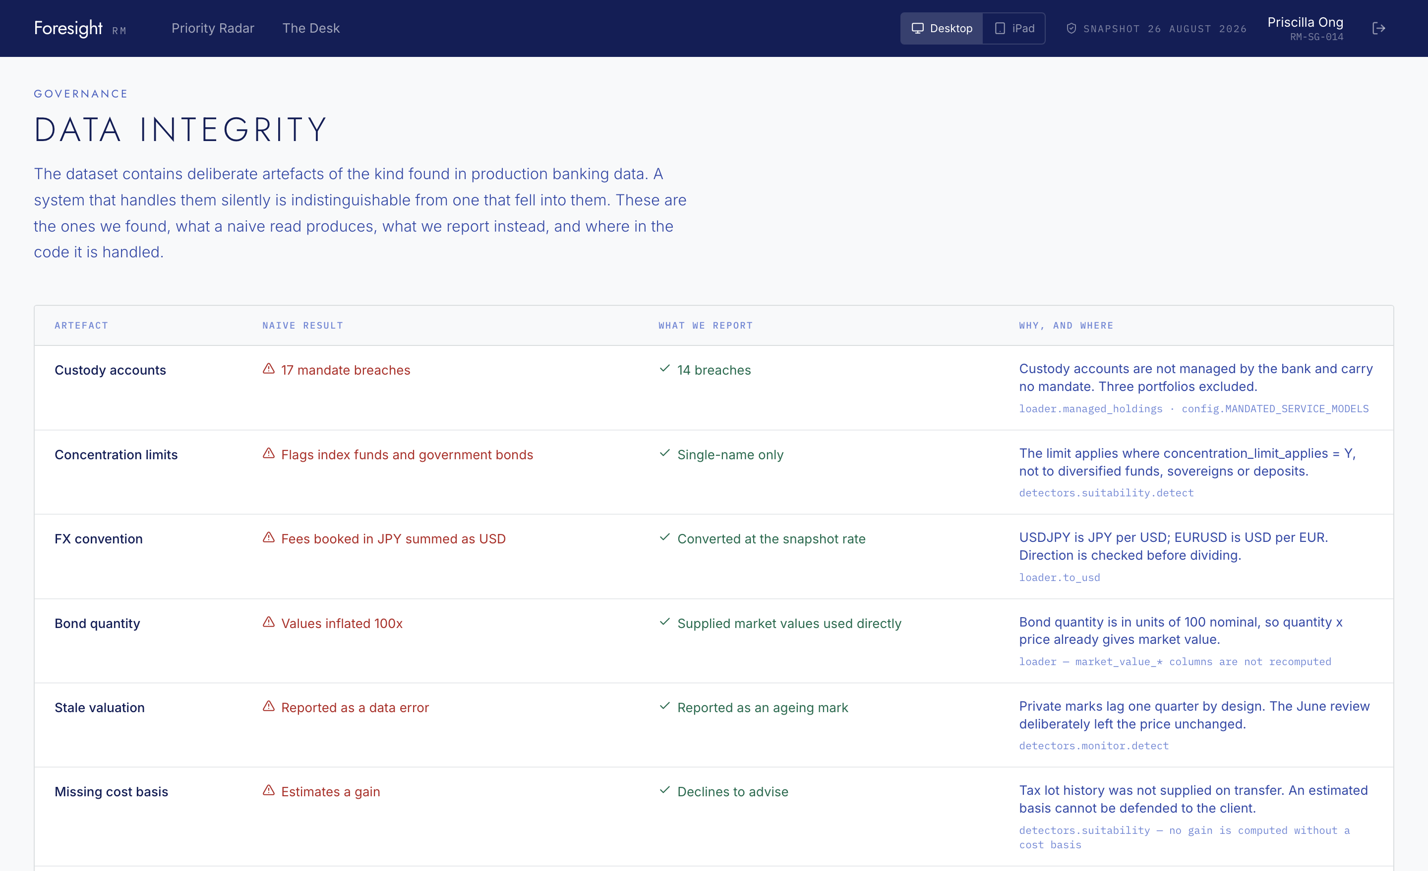
WHY A BANK COULD RUN THIS
EVERY NUMBER IS CHECKABLE
8
deliberate data traps in the dataset, each handled in named code
48
findings, every one carrying its file, row and dated note
1
command — python backend/verify.py — prints every claim with its source rows
Custody accounts carry no mandate. A documented waiver is not a breach. Missing cost basis means we decline to quote a gain.
Notes:
The dataset contains deliberate production artefacts. Each is handled in named code, and a single command reproduces every headline figure with its source rows.

Slide 10
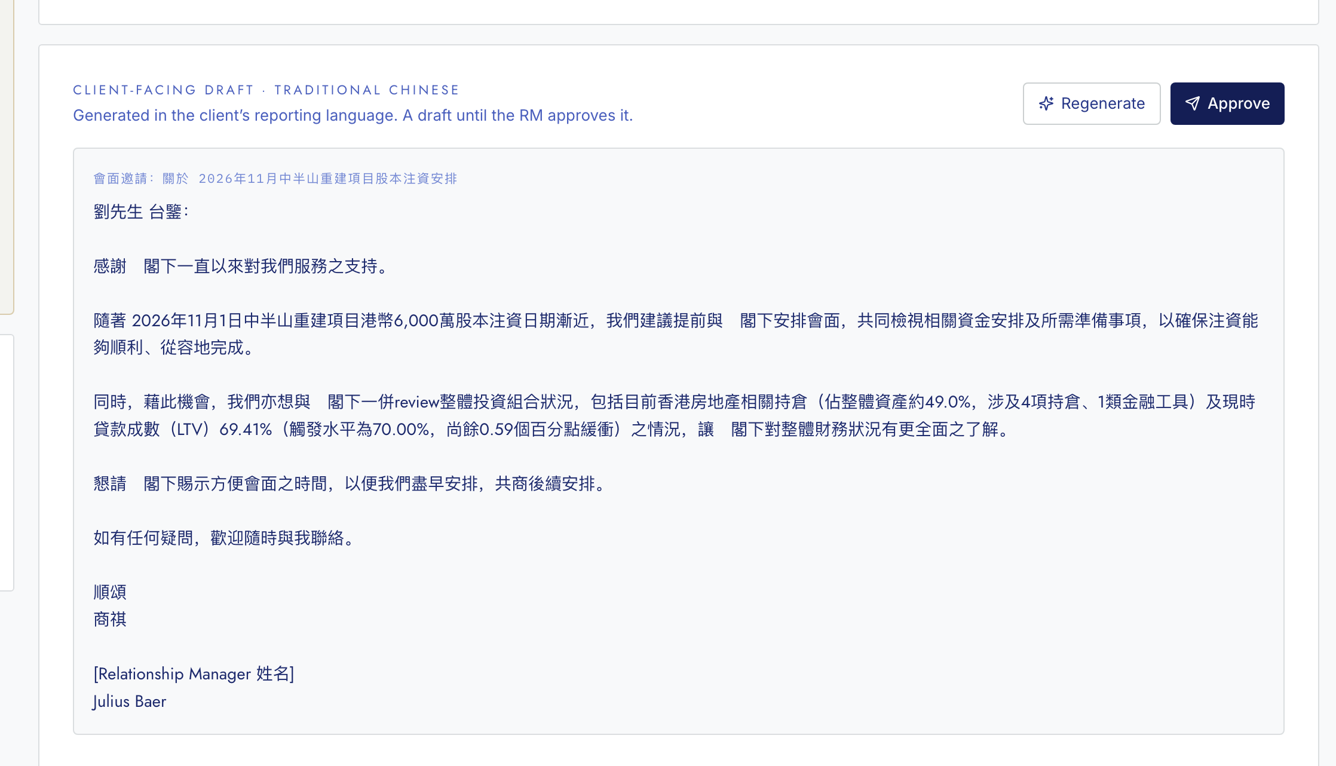
STRATEGIC IMPACT
THE RM STAYS AT THE CENTRE
Nothing reaches a client without her approval.
Drafts are written in the client’s own reporting language.
Every approval is stored with the original AI draft beside it.
If she leaves, 23 years of relationship does not leave with her.
Relationship is the only agent that can veto another. A financial finding can be suppressed by a human fact — never the reverse.
Screen: the client-facing draft in Traditional Chinese — every figure in it was computed, and it stays a draft until the RM approves
Notes:
Preserving the central role of the Relationship Manager is a rubric criterion. Here it is architectural: the Relationship agent is the only one able to veto another, and no client communication is sent without RM approval.

Slide 11

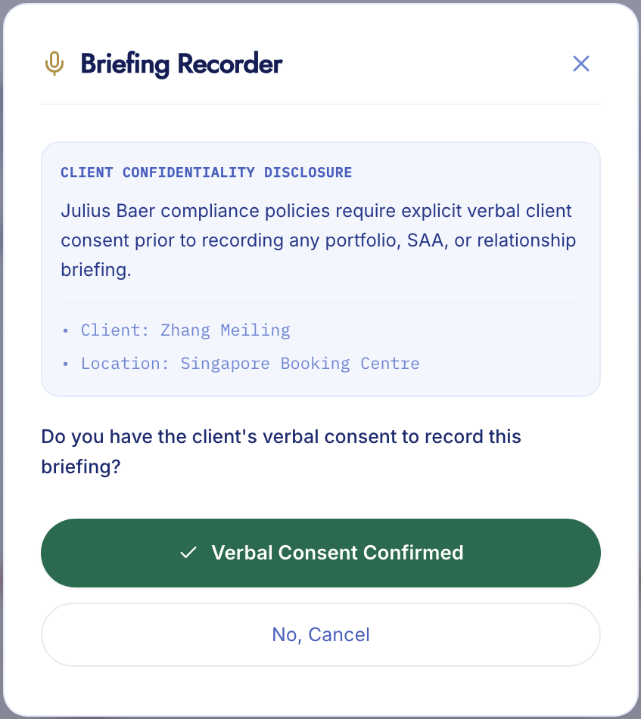
WHERE THIS GOES NEXT
CLOSING THE LOOP
Every other tool summarises the meeting and files a note. Ours feeds what was said back into what may be said next.
BUILT TODAY · CONSENT BEFORE RECORDING
LIVE TODAY · FROM THE 28 WRITTEN RM NOTES
“Speak with respect for his entrepreneurial conviction but be direct and grounded in numbers, gently challenging the concentration risk without dismissing his market view.”
NEXT · FROM A CONSENTED TRANSCRIPT
Consent captured before anything records.
Tone and concerns extracted from the meeting.
Those become constraints — so the gate holds a recommendation the client is not ready to hear.
The tone analysis runs live on the written notes. No transcript exists in the supplied dataset, so none was fabricated
Notes:
The same relationship agent currently runs on written RM notes; a consented transcript is the next input channel. Consent capture is built. No transcript exists in the supplied dataset, so none was fabricated.

Slide 12
FORESIGHT RM
Lau’s flat, shares, bond, derivative, job and loan are one bet —
and no system in the bank could see it.
Priscilla worked it out in March and typed it into a note.
Nothing read it.
We read the notes with the numbers — and we know when the
right answer is still the wrong thing to say.
7 of 20
6
48
USD 8.50m
Clients where an RM note changed the answer
Findings held, each with a reason and a dated RM note
Findings this cycle, produced by six agents
Idle cash above mandate, deployable today
github.com/jvvinoth/Foresight-RM
Notes:
Close on the three sentences, then let the four numbers sit on screen through questions. Every one of them is read from the run, not asserted: seven of twenty clients had an RM note change the answer, six findings were held with a reason and a dated RM note, forty-eight findings came from six agents, and USD 8.50m of idle cash sits above mandate.

