Slide 1
Bitcoin: A Peer-to-Peer Electronic Cash System Satoshi Nakamoto, 2008
Jungwoo Pyo
21st Jul, 2017

Slide 2
Index
1. Introduction
2. Contents
Transactions and blocks
Proof-of-work(distributed timestamp server based on P2P)
Network
Incentive: how to maintain the network
Reclaiming disk space
Security
3. Conclusion

Slide 3
1. Introduction
Bitcoin system is decentralized-P2P online payment system based on cryptographic proof
Faced problem in online payment is that trusted third-party is still required when using digital signature: especially double-spending
A solution to the double-spending using a P2P network : any two willing parties can transact directly without the need for a trusted third party

Slide 4
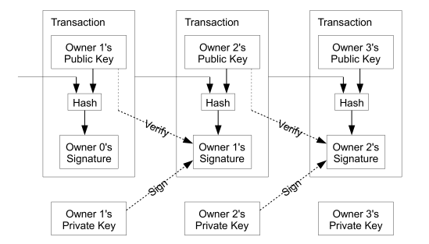
2. Contents- transactions and blocks
How the transaction is composed of?
In present transaction:
hash(Next owner’s public key + prev transaction) = prev owner’s sign
If prev owner sign with private key, the coin is transferred to next owner.

Slide 5
2. Contents- transactions and blocks
How can we guarantee the owner did not double-spend?
In present transaction:
hash(Next owner’s public key + prev transaction) = prev owner’s sign
Prev transaction is regarded as reliable one, don’t care about double-spend

Slide 6
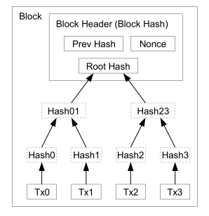
2. Contents- transactions and blocks
The relation between transactions and Blocks
Block header = [prev_hash + mkrl_root + time + bits + nonce ]
In the process of finding the hash value of the block header is called mining
The first person to find the hash value is given a certain amount of coin as reward. That is recorded in Tx0.

Slide 7
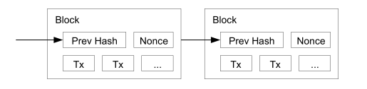
2. Contents- Proof-of-work
To connect the next block, we need to find the hash value of previous block
To find the required hash value, we continually increment the constant value so-called nonce.

Slide 8
2. Contents- Proof-of-work
If hash(previous block header) is under condition( It is a matter of finding a hash value that starts with several zero), that block is accepted.
These accepted blocks are connected like chains.

Slide 9
2. Contents- Proof-of-work
Proof-of-work also solves the majority decision making : 1-CPU-1-vote
We only regard the longest chain as trusted ledger.

Slide 10

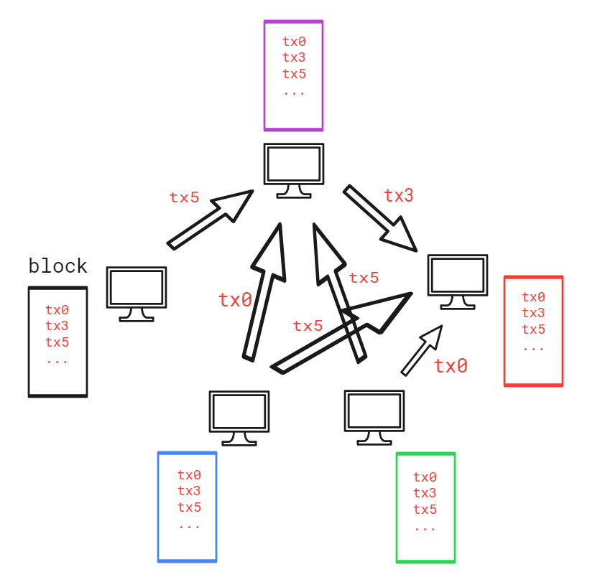
2. Contents- Network

Slide 11
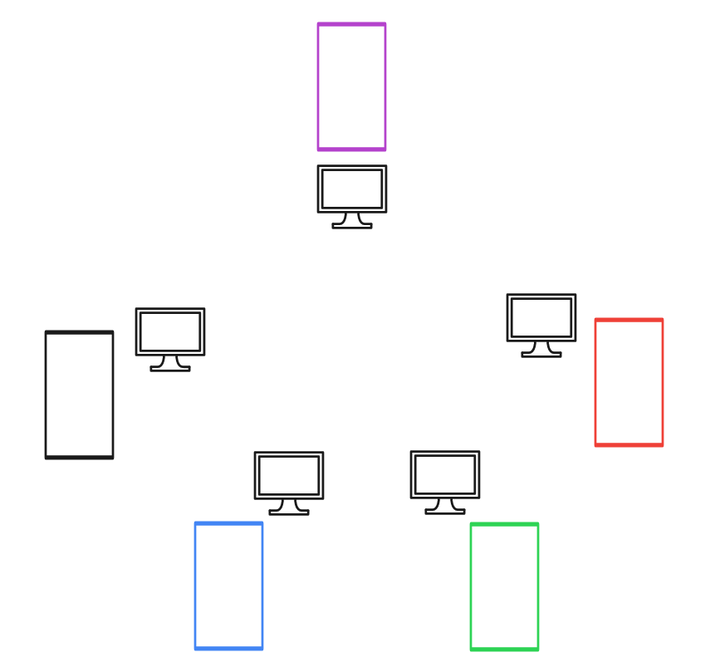
2. Contents- Network

Slide 12
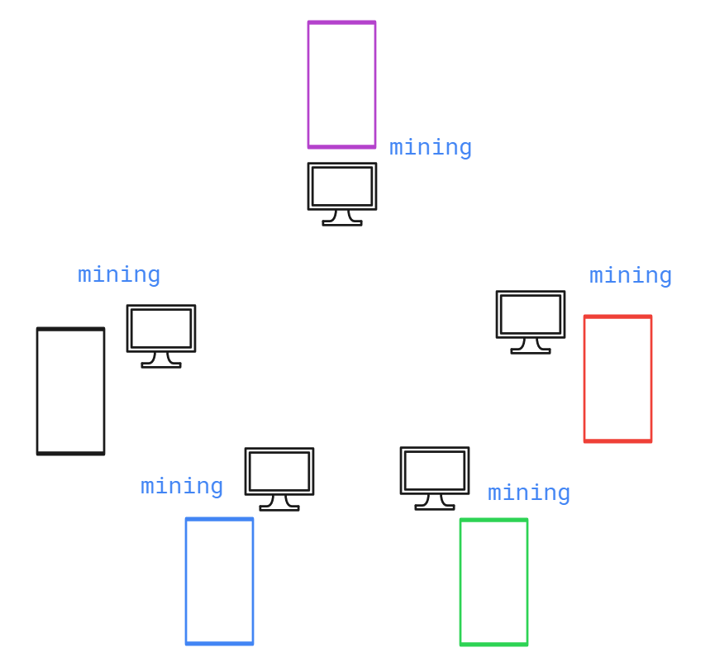
2. Contents- Network

Slide 13
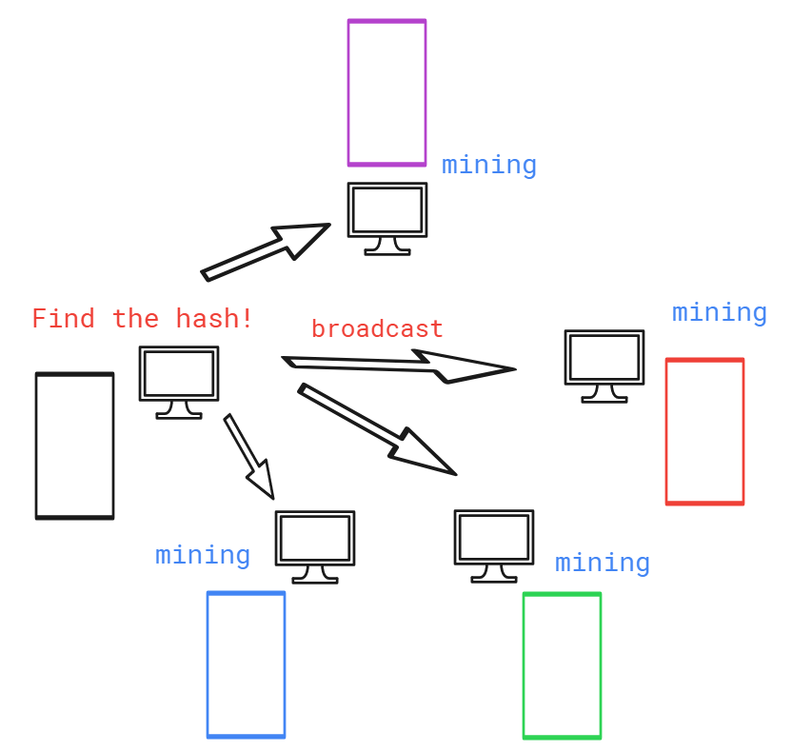
2. Contents- Network

Slide 14
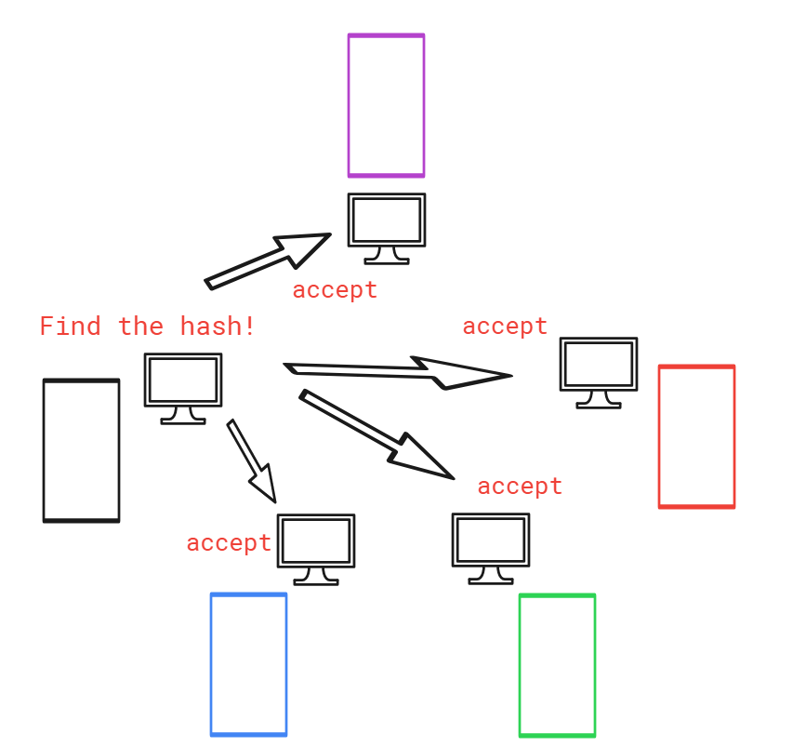
2. Contents- Network

Slide 15
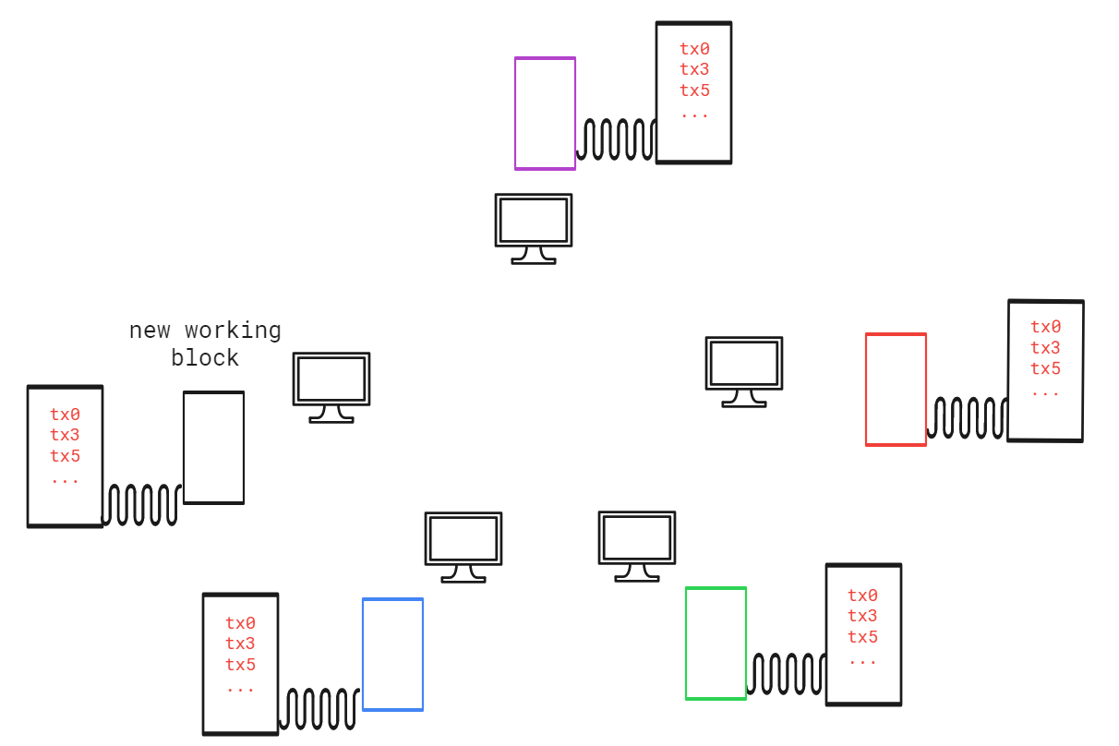
2. Contents- Network

Slide 16
2. Contents- Incentive: how to maintain the network
Mining is the process which is finding the hash of block.
In the process of mining, all nodes are participating in maintaining network.
They want to be compensated for network maintenance.
The first person who find the hash is getting rewarded certain amount of coins(About 50 BTC. It reduces by half every four years) + transaction fee
That is the motivation of maintaining networks!

Slide 17
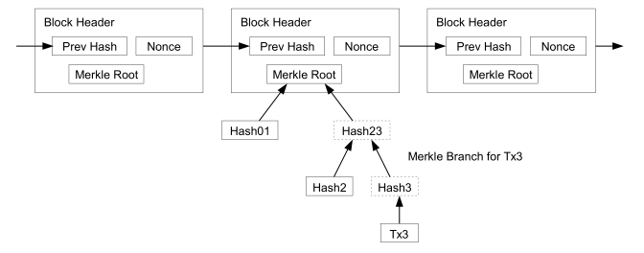
2. Contents- Reclaiming the disk space
Every nodes has entire blockchain which takes up quite a lot of capacity
It can occur capacity issues in saving entire blockchain in storage
Every node don’t need to be full node – can transact with having only chain of block header(not entire block)

Slide 18
2. Contents- Reclaiming the disk space
the block header size is 80 byte, 1 block is created per 10 minutes
80 bytes * 6 * 24 * 365 = 4.2MB per year
Most of the node can afford to store the whole blockchain!

Slide 19
2. Contents- Security
There is a possible cases that manipulate the blockchain: 51% attack
If the malicious attacker has more than half of the computing power to take part in network, they can make the longest chain.
Bitcoin system is 1-CPU-1-vote, which means the majority is the one who has more than half of the computing power.

Slide 20
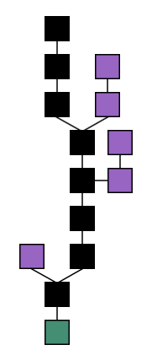
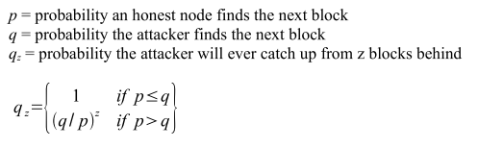
2. Contents- Security
But it is impossible as time goes by…
Honest chain
Attacker’s chain

Slide 21


2. Contents- Security
The probability that attackers catch up the honest chain is
It is almost impossible if q is small and z is large!

Slide 22
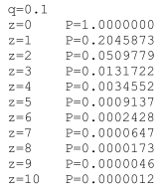
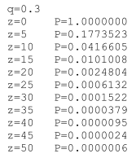
2. Contents- Security
we can see the probability drop off exponentially with z
Bitcoin network is proved quite reliable and secure to attack by hackers

Slide 23
Conclusion
It proposed a Peer-to-Peer network using proof-of-work to recode a public history of transactions, which can prevent double-spending
Some rules and incentives can be enforced with this consensus mechanism

Slide 24
Thanks!

