Slide 1
Proba
A High-Performance, Low-Traffic Probabilistic
Spatial Memory Streaming Prefetcher
Yinting Huang · Jacky Wong · Sam Ainsworth
Huawei Newton Research Centre · Imperial College London · University of Edinburgh

Slide 2

L1$
Notes:
SMS prefetcher has also made its way to production core. Arm Neoverse V2, which powers systems including NVIDIA Grace and AWS Graviton4, uses SMS at both cache levels: SMS at L1 and global SMS at L2. SMS is able to work alongside other prefetchers in the cache hierarchy like stride, best offset and correlated miss cache because it captures spatial access patterns that other predictors can miss. It makes a distinct contribution to the processor’s ability to bring data in before it is needed. Therefore, improving SMS has practical relevance for the commercial architecture.

Slide 3

L1$
Stride
Page
SMS
SIP
Notes:
SMS prefetcher has also made its way to production core. Arm Neoverse V2, which powers systems including NVIDIA Grace and AWS Graviton4, uses SMS at both cache levels: SMS at L1 and global SMS at L2. SMS is able to work alongside other prefetchers in the cache hierarchy like stride, best offset and correlated miss cache because it captures spatial access patterns that other predictors can miss. It makes a distinct contribution to the processor’s ability to bring data in before it is needed. Therefore, improving SMS has practical relevance for the commercial architecture.

Slide 4
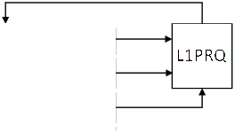
L1$
Stride
L1PRQ
Page
SMS
SIP
Notes:
SMS prefetcher has also made its way to production core. Arm Neoverse V2, which powers systems including NVIDIA Grace and AWS Graviton4, uses SMS at both cache levels: SMS at L1 and global SMS at L2. SMS is able to work alongside other prefetchers in the cache hierarchy like stride, best offset and correlated miss cache because it captures spatial access patterns that other predictors can miss. It makes a distinct contribution to the processor’s ability to bring data in before it is needed. Therefore, improving SMS has practical relevance for the commercial architecture.

Slide 5
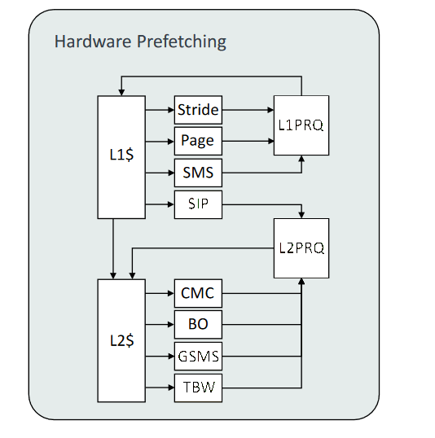
Spatial Memory Streaming is Important
Arm Neoverse V2
- NVIDIA Grace
L1$
Stride
L1PRQ
- AWS Graviton4
Page
SMS
SMS
SIP
L2PRQ
L2$
CMC
BO
GSMS
GSMS (Global)
TBW
Notes:
SMS prefetcher has also made its way to production core. Arm Neoverse V2, which powers systems including NVIDIA Grace and AWS Graviton4, uses SMS at both cache levels: SMS at L1 and global SMS at L2. SMS is able to work alongside other prefetchers in the cache hierarchy like stride, best offset and correlated miss cache because it captures spatial access patterns that other predictors can miss. It makes a distinct contribution to the processor’s ability to bring data in before it is needed. Therefore, improving SMS has practical relevance for the commercial architecture.

Slide 6
SMS: exploiting spatial correlation across fix-sized regions
Region A
Trigger PC1
Eviction
First access identifies the context
PC1:
+1
+2
+3
+4
+5
+6
+7
+8
+9
+10
+11
+12
+13
+14
+15
+16
First eviction completes the training
Prefetch
B+1 B+3 B+5 B+7 B+8 B+9 B+11 B+12 B+13
Region B
Trigger PC1
PC1:
+1
+2
+3
+4
+5
+6
+7
+8
+9
+10
+11
+12
+13
+14
+15
+16

Slide 7
Problem: What pattern should the prefetcher remember?
Same Trigger Context
Stored Pattern
Replace?
New Observation

Slide 8
Problem: What pattern should the prefetcher remember?
Same Trigger Context
Stored Pattern
Replace?
New Observation

Slide 9
Problem: What pattern should the prefetcher remember?
Same Trigger Context
Stored Pattern
Replace?
New Observation

Slide 10
Problem: What pattern should the prefetcher remember?
Same Trigger Context
Stored Pattern
Replace?
New Observation

Slide 11
Problem: What pattern should the prefetcher remember?
Can we do better?
Same Trigger Context
Stored Pattern
Replace?
New Observation
Limitation: Simple replacement discards all historical behaviour…

Slide 12

Problem: What pattern should the prefetcher remember?
What we want:
We want a storage-efficient representation for these patterns.
We want to remove bad patterns overtime.
We want to keep good patterns overtime.
Genetic Algorithms: “Survival of the Fittest”
If patterns appear frequently enough
Those are the patterns worth remembering
Using a Probabilistic Approach!

Slide 13
Core Idea: Probabilistic Pattern Update
Treat the update of a stored pattern with a new observation as a stochastic process.
Store only a single bit pattern per entry.
STEP 1: INTERSECTION
New Observation
Stored Pattern
Updated Pattern

Slide 14
Core Idea: Probabilistic Pattern Update
Treat the update of a stored pattern with a new observation as a stochastic process.
Store only a single bit pattern per entry.
STEP 2: Probabilistic Insertion
New Observation
Stored Pattern
Insertion Probability p
Updated Pattern

Slide 15
Core Idea: Probabilistic Pattern Update
Treat the update of a stored pattern with a new observation as a stochastic process.
Store only a single bit pattern per entry.
STEP 3: Probabilistic Deletion
New Observation
Stored Pattern
Deletion Probability q
Updated Pattern
How do we control p and q (to control aggression)?

Slide 16
Prior Methods: Dual Spatial Pattern Prefetcher (DSPatch)
Can we do better?
Maintain two patterns: accuracy-biased and coverage-biased.
Issue one pattern based on current bandwidth utilization.
Stored Pattern
OR
Updated Patterns
New Observation
AND
Limitation:
(Since it is not probabilistic) You need to store two patterns!
Only support two aggression modes, limiting fine-grain control.

Slide 17
Dynamic Decision-making
Accuracy
< Threshold
State --
State ++
Yes
No
Accuracy Seeking
Coverage Seeking
State | 0 | 1 | 2 | 3 | 4 | 5 | 6 | 7
Insertion Probability (p) | 0.01 | 0.05 | 0.10 | 0.40 | 1.00 | 1.00 | 1.00 | 1.00
Deletion Probability (q) | 1.00 | 1.00 | 1.00 | 1.00 | 1.00 | 0.60 | 0.40 | 0.20
Accuracy Feedback Decides How Aggressive Proba Should Be

Slide 18
Marginal Accuracy: What is the best context to use?
Proba uses multiple trigger contexts to improve coverage
Overlapping contexts can lead to overprediction.
Absolute
Accuracy
Marginal
Accuracy
New Observation
PC 0x1234
100%
100%
Offset 7
75%
0%
The offset context adds only one new incorrect prediction

Slide 19
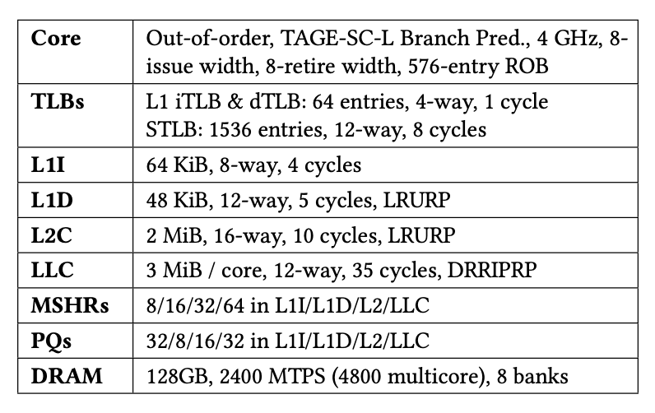

Evaluation
Evaluated on ChampSim.
Baseline: Stride prefetcher at L1.
Evaluated SMS-based prefetchers:
Run at L2 cache
Track 4 KiB spatial regions
Use an iso-storage budget of roughly 10 KiB
Code and Artifact available @ GitHub!

Slide 20
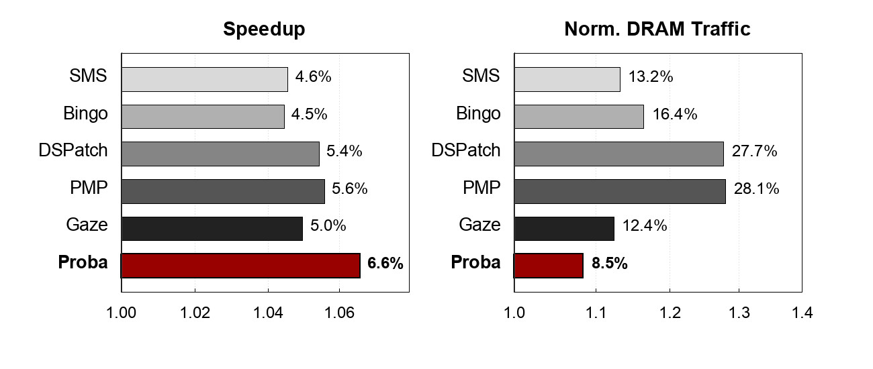
SPECspeed 2017: Speedup and DRAM Traffic
Proba delivers a 6.6% geomean speedup with only 8.5% additional DRAM traffic.
Higher is Better ⟶
⟵ Lower is Better

Slide 21
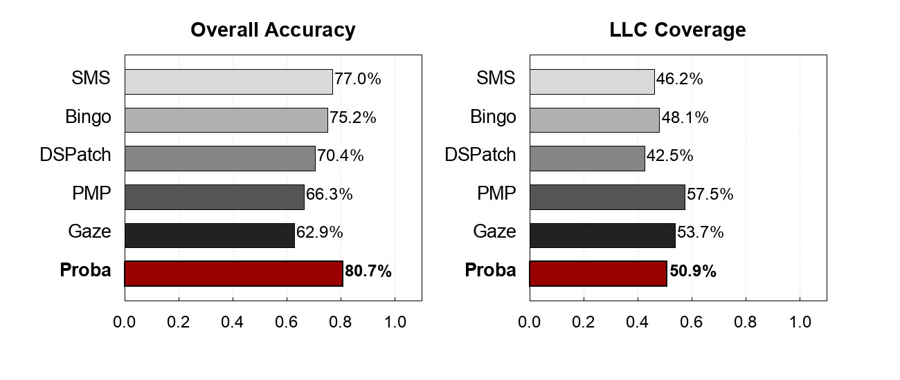
SPECspeed 2017: Accuracy and Coverage
Proba achieves the highest overall prefetch accuracy.
LLC coverage can be lower for workloads that are poorly suited to SMS.
Higher is Better ⟶
Higher is Better ⟶

Slide 22
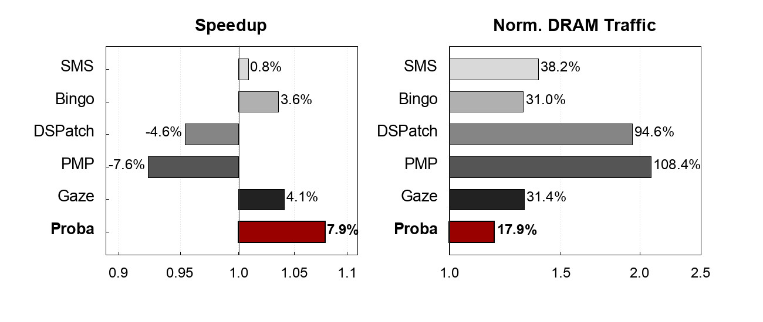
4-Core CloudSuite: Speedup and DRAM Traffic
Proba’s advantage is more evident as contention rises.
On CloudSuite, Proba achieves a 7.9% geomean speedup, nearly twice the nearest contender Gaze.
Higher is Better ⟶
⟵ Lower is Better

Slide 23
For More: Read Our Paper!
More Benchmarks
DRAM Sensitivity
Homogeneous Multicore
Ablation Study
And More!

Slide 24
Takeaways
We Present Proba: a practical SMS-based prefetcher for next-gen processor.
Probabilistic updates provide a powerful alternative to storage-heavy counters and dual-pattern schemes.
Update probabilities control how quickly the prefetcher learns and forgets.
Accuracy feedback adjusts aggression level with fine-grain control.
Marginal accuracy assesses the unique contribution of overlapping contexts.
More questions? Contact: yh653@cam.ac.uk

Slide 25
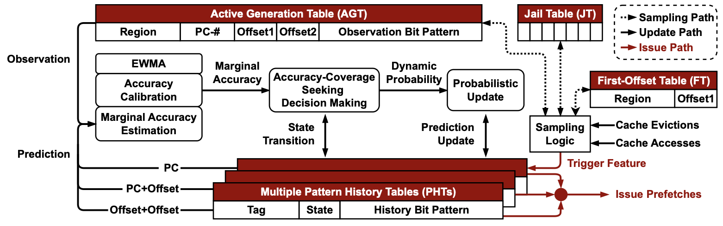
Proba
Design Overview

Slide 26
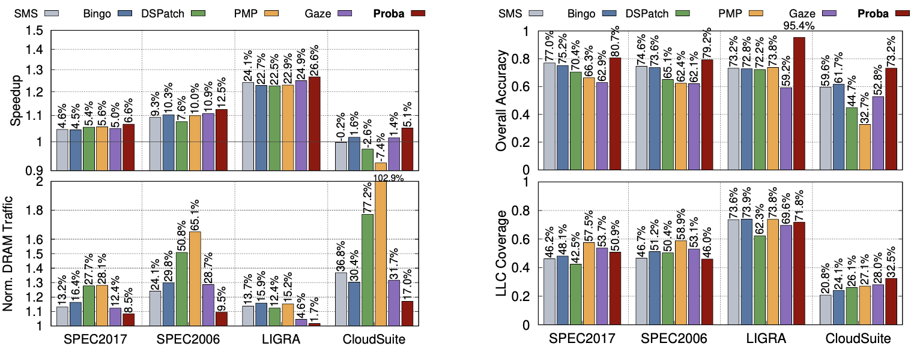
Evaluation
Single Core Performance Analysis

Slide 27
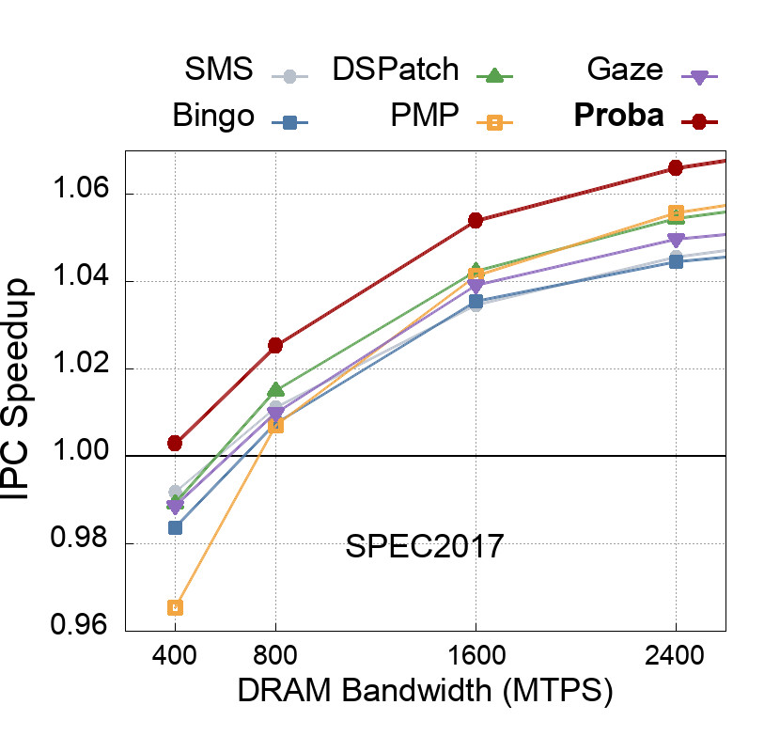
Evaluation
Performance vs. Bandwidth

Slide 28
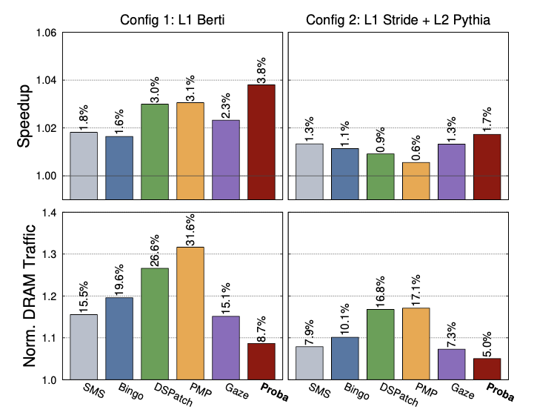
Evaluation
Multi-Prefetcher Stack

Slide 29
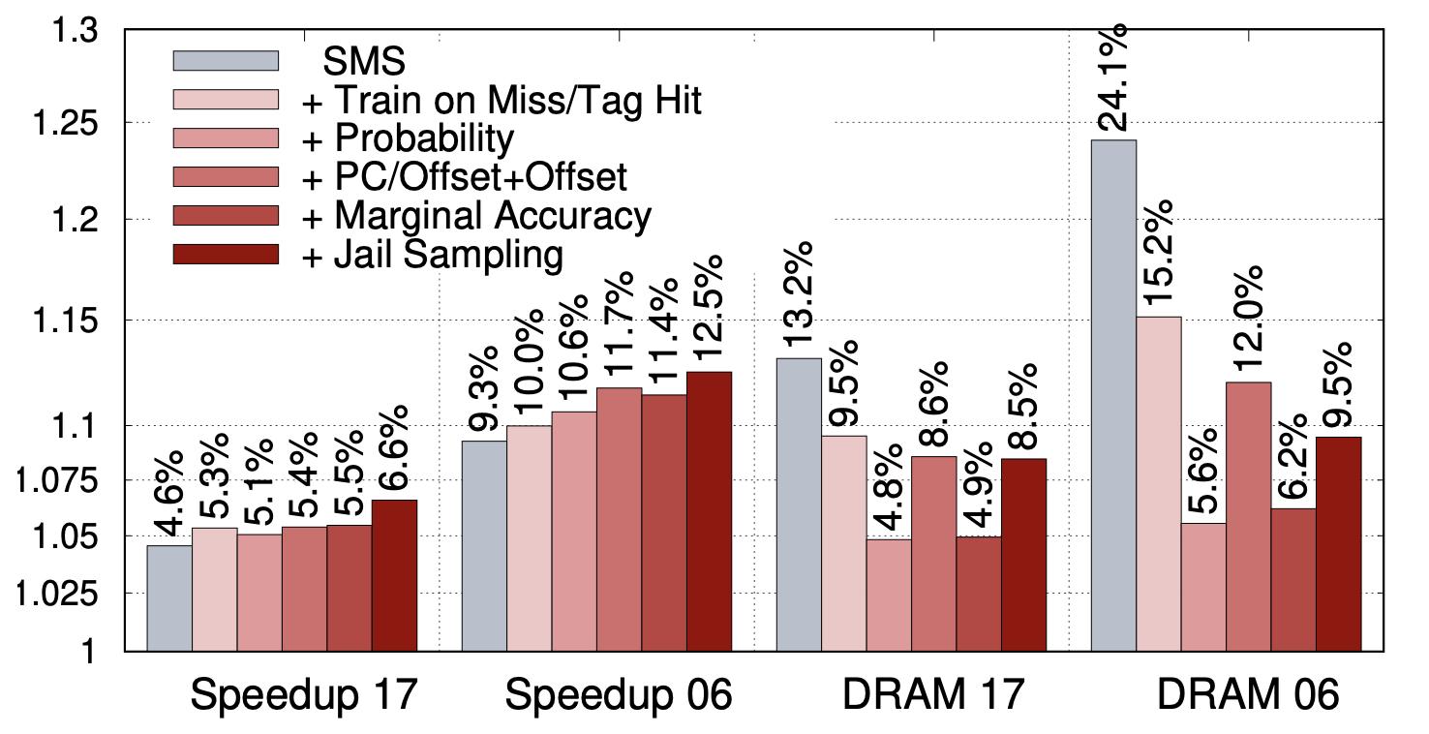
Evaluation
Ablation Study

