Slide 1
Caerus:
Prefetching by Thinking Globally and Acting Locally
Jacky Wong ¹, Jacob Alexandrou ¹, YinTing Huang ², Luke Panayi ¹,
Lev Mukhanov ³, Sam Ainsworth ³, Paul H J Kelly ¹
¹ Imperial College London ² University of Cambridge ³ IMEC

Slide 2
Data Prefetching is a Big Deal!

Slide 3


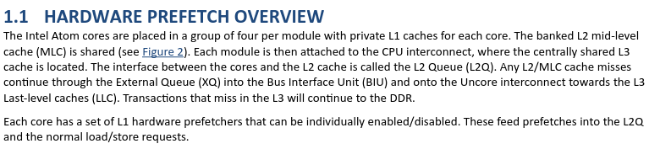
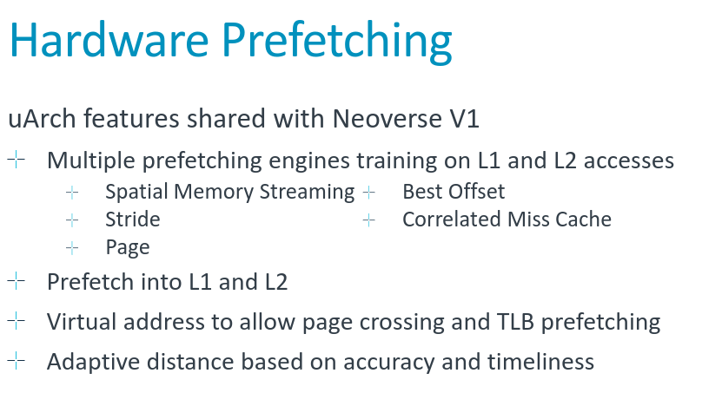

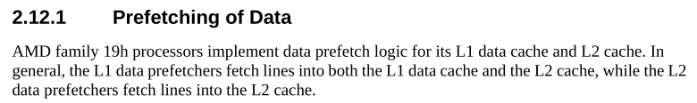

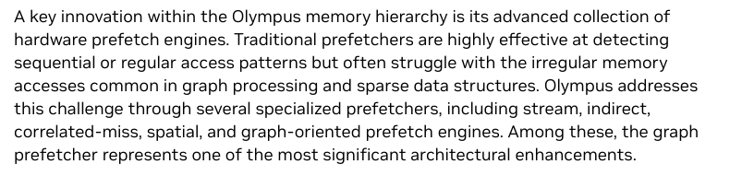



Prefetching is a Hot Topic Again!
From: Hardware Prefetch Controls for Intel® Atom® Cores
From: Software Optimization Guide for AMD EPYC™7003 Processors
From: Arm Neoverse V2 platform: Leadership Performance
and Power Efficiency for Next Generation Cloud Computing, ML and HPC Workloads
And Everyone Else…
From: NVIDIA Vera CPU Architecture

Slide 4


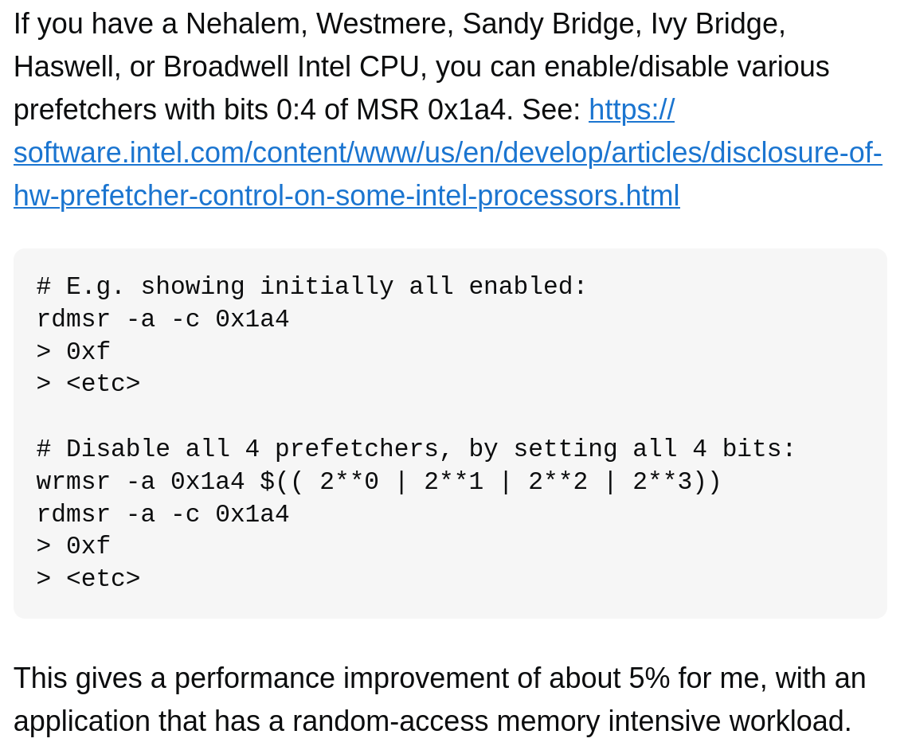
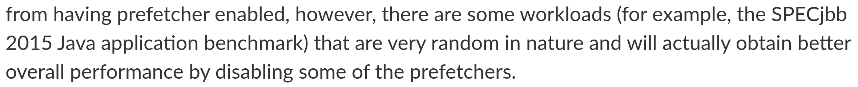

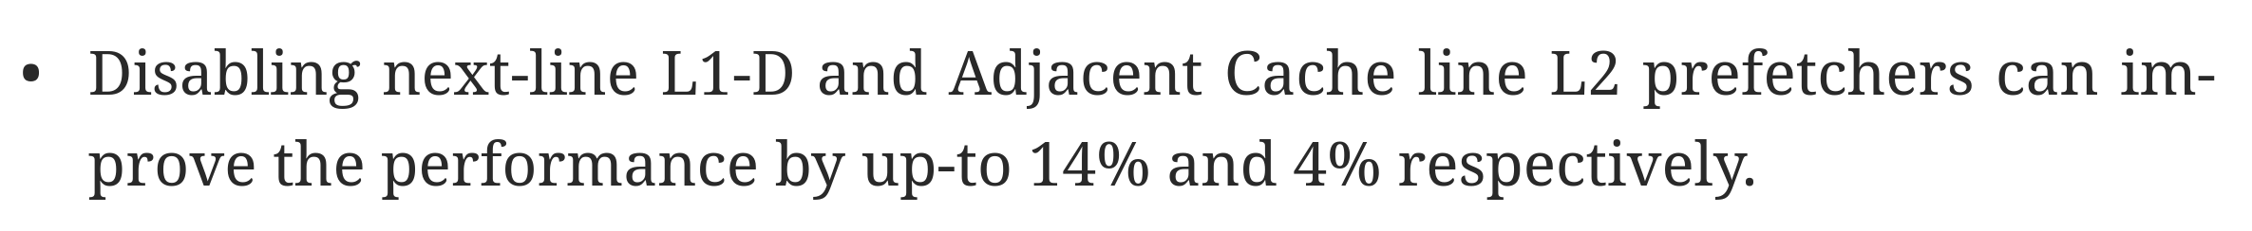

But People Keep Turning Them Off…
Contention due to
DRAM Traffic!

Slide 5

Approach
Prefetchers have great performance potential!
How do we completely
redesign our prefetchers around filtering to get the maximum performance?
Prefetchers need to control their excess traffic
We can control excess traffic by filtering
Once we have control over our excess traffic…

Slide 6
KEY IDEA
Our answer is Caerus: a prefetcher people won’t turn off.
Caerus Thinks Globally and Acts Locally
High Accuracy & Coverage
Prefetches
Powerful
Training
Max Coverage
Prefetches
Diligent
Filtering
Accesses
Multiple
Global
Overlap-Resistant
offsets
Filtered by PC context

Slide 7
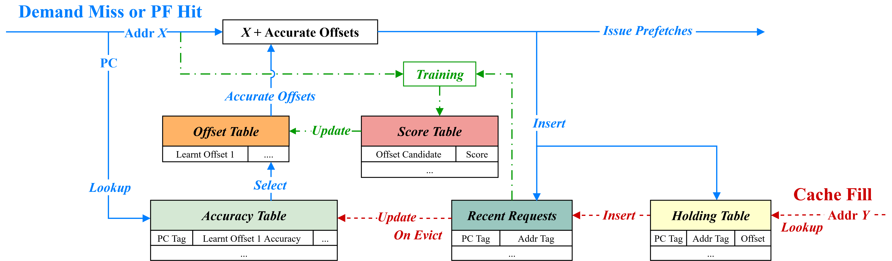
KEY IDEA
Our answer is Caerus: a prefetcher people won’t turn off.
Caerus Thinks Globally and Acts Locally
Global Training
Issuing Prefetches
PC-Local Filtering
Maintaining History and Timeliness

Slide 8
KEY IDEA
In one sentence:
Caerus is an offset prefetcher that employs
PC-local filtering on
multiple,
non-overlapping,
globally derived offsets.

Slide 9
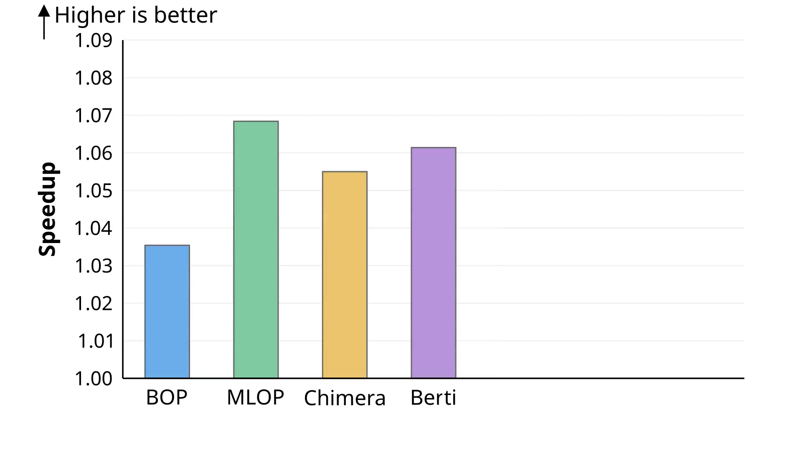
Evaluation on SPECspeed 2017
Evaluated in ChampSim, no-prefetching baseline, prefetchers placed in the L1D Cache.

Slide 10
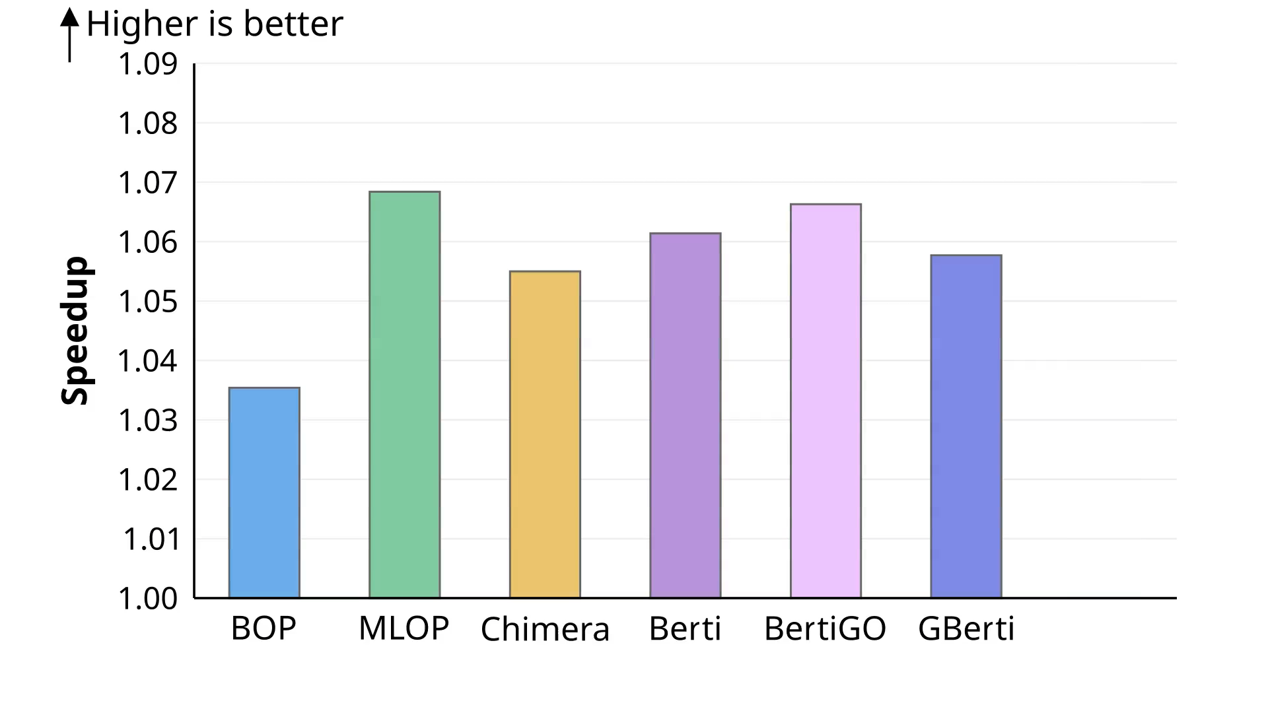
Evaluation on SPECspeed 2017
Evaluated in ChampSim, no-prefetching baseline, prefetchers placed in the L1D Cache.

Slide 11
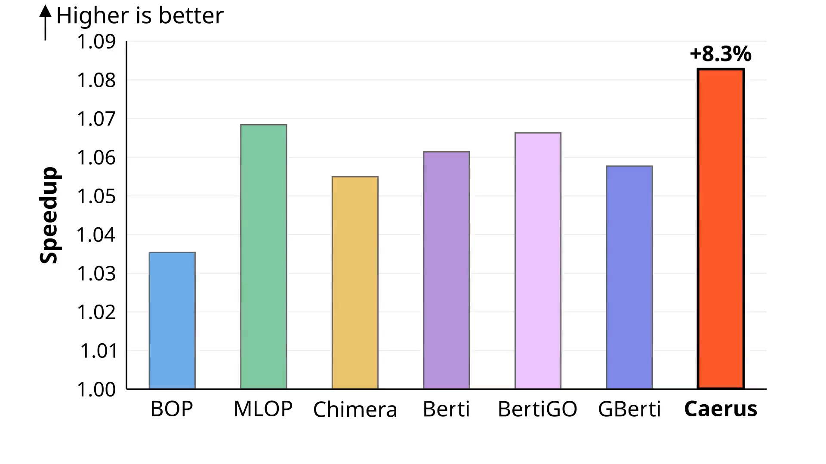
Evaluation on SPECspeed 2017
Evaluated in ChampSim, no-prefetching baseline, prefetchers placed in the L1D Cache.

Slide 12
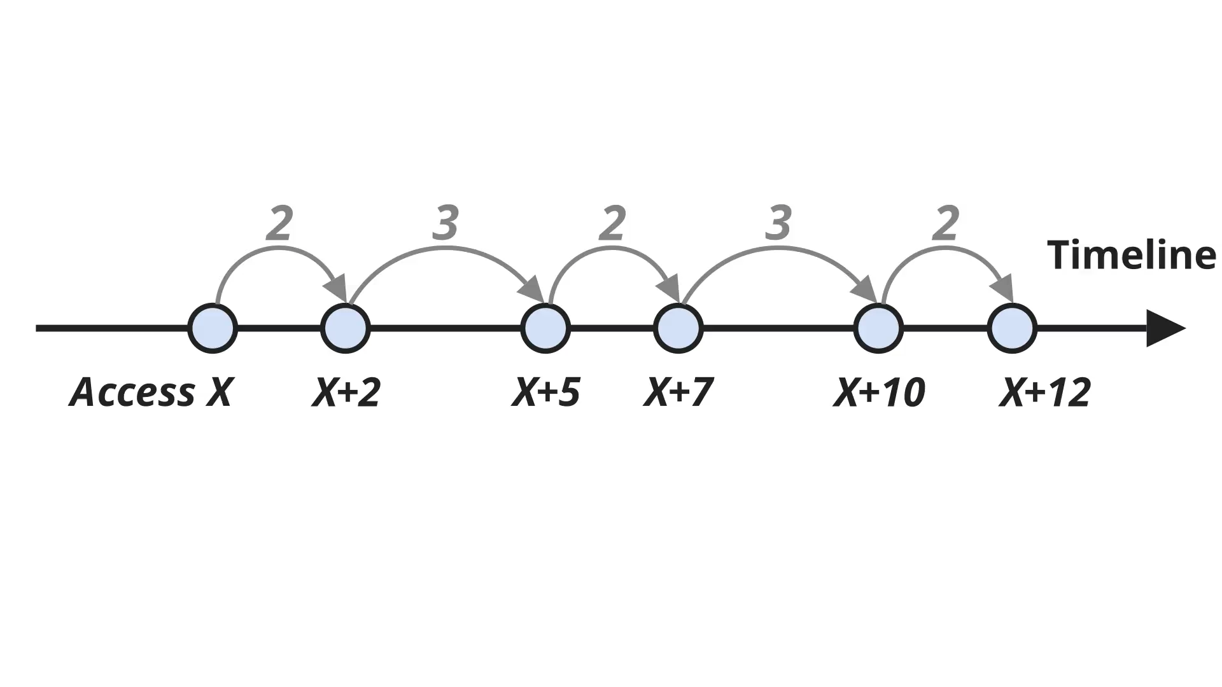
What is Offset Prefetching?

Slide 13
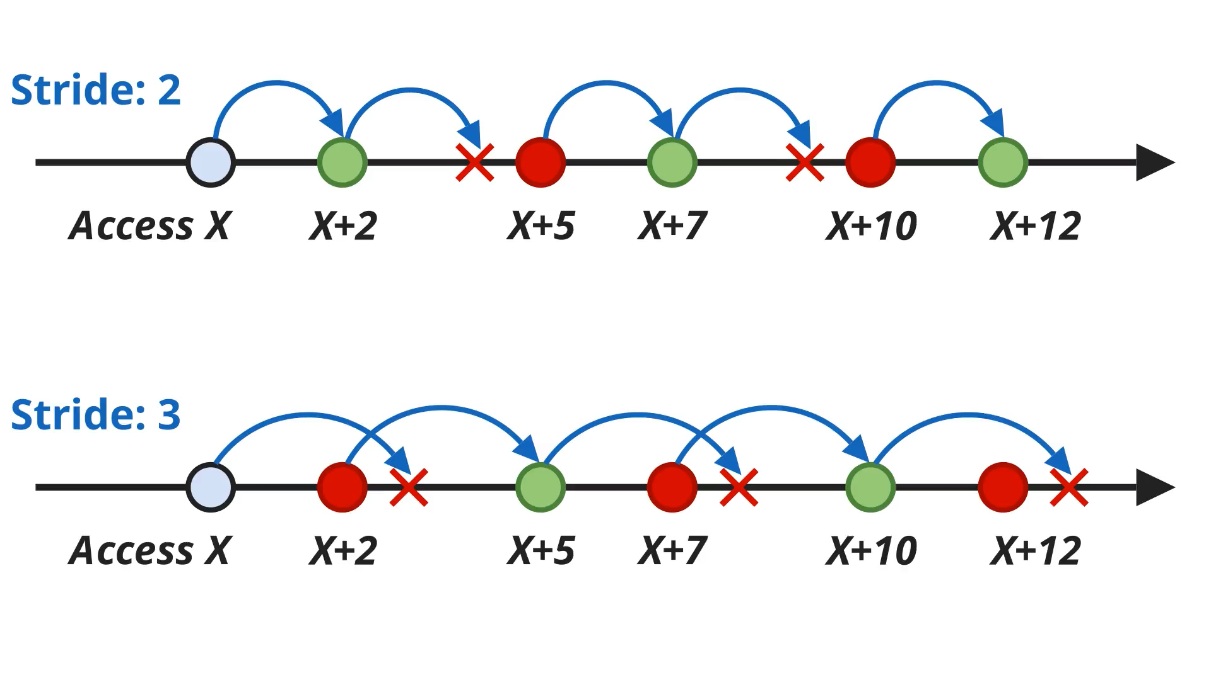
What is Offset Prefetching?

Slide 14
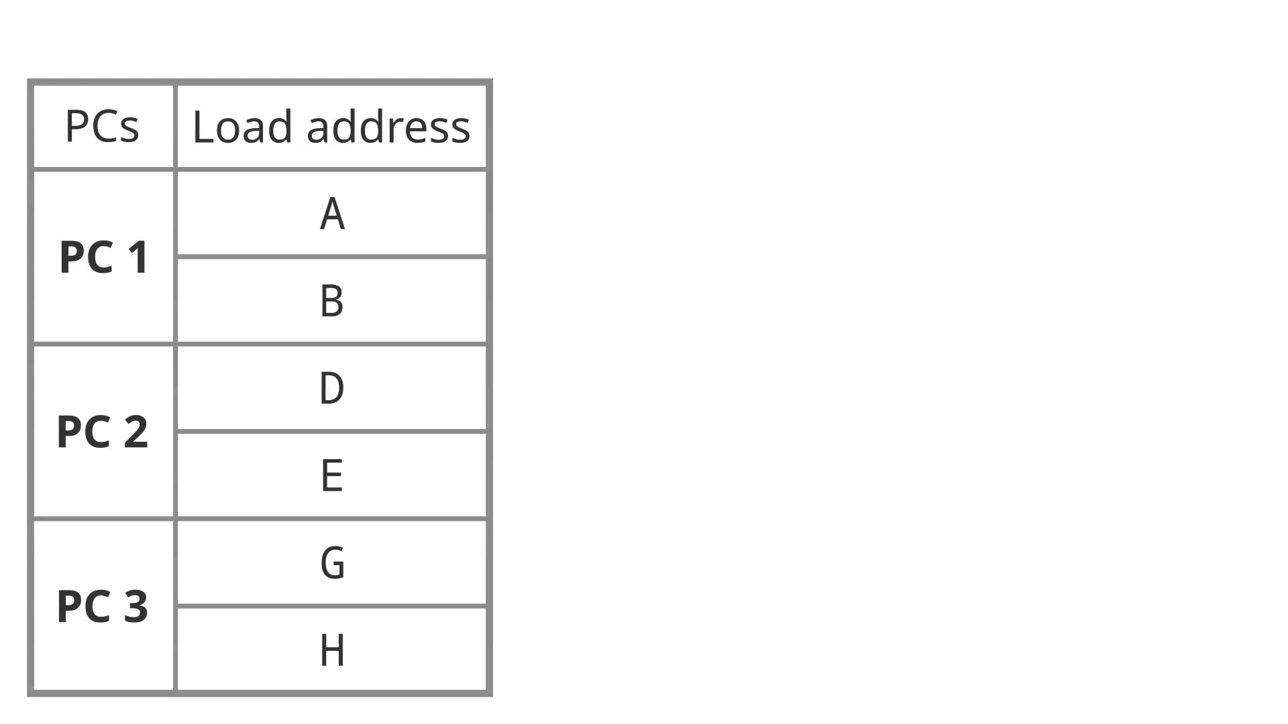
What is “Global”?
Global means that all loads are evaluated without considering the Program Counter (PC) context of the load instruction.

Slide 15
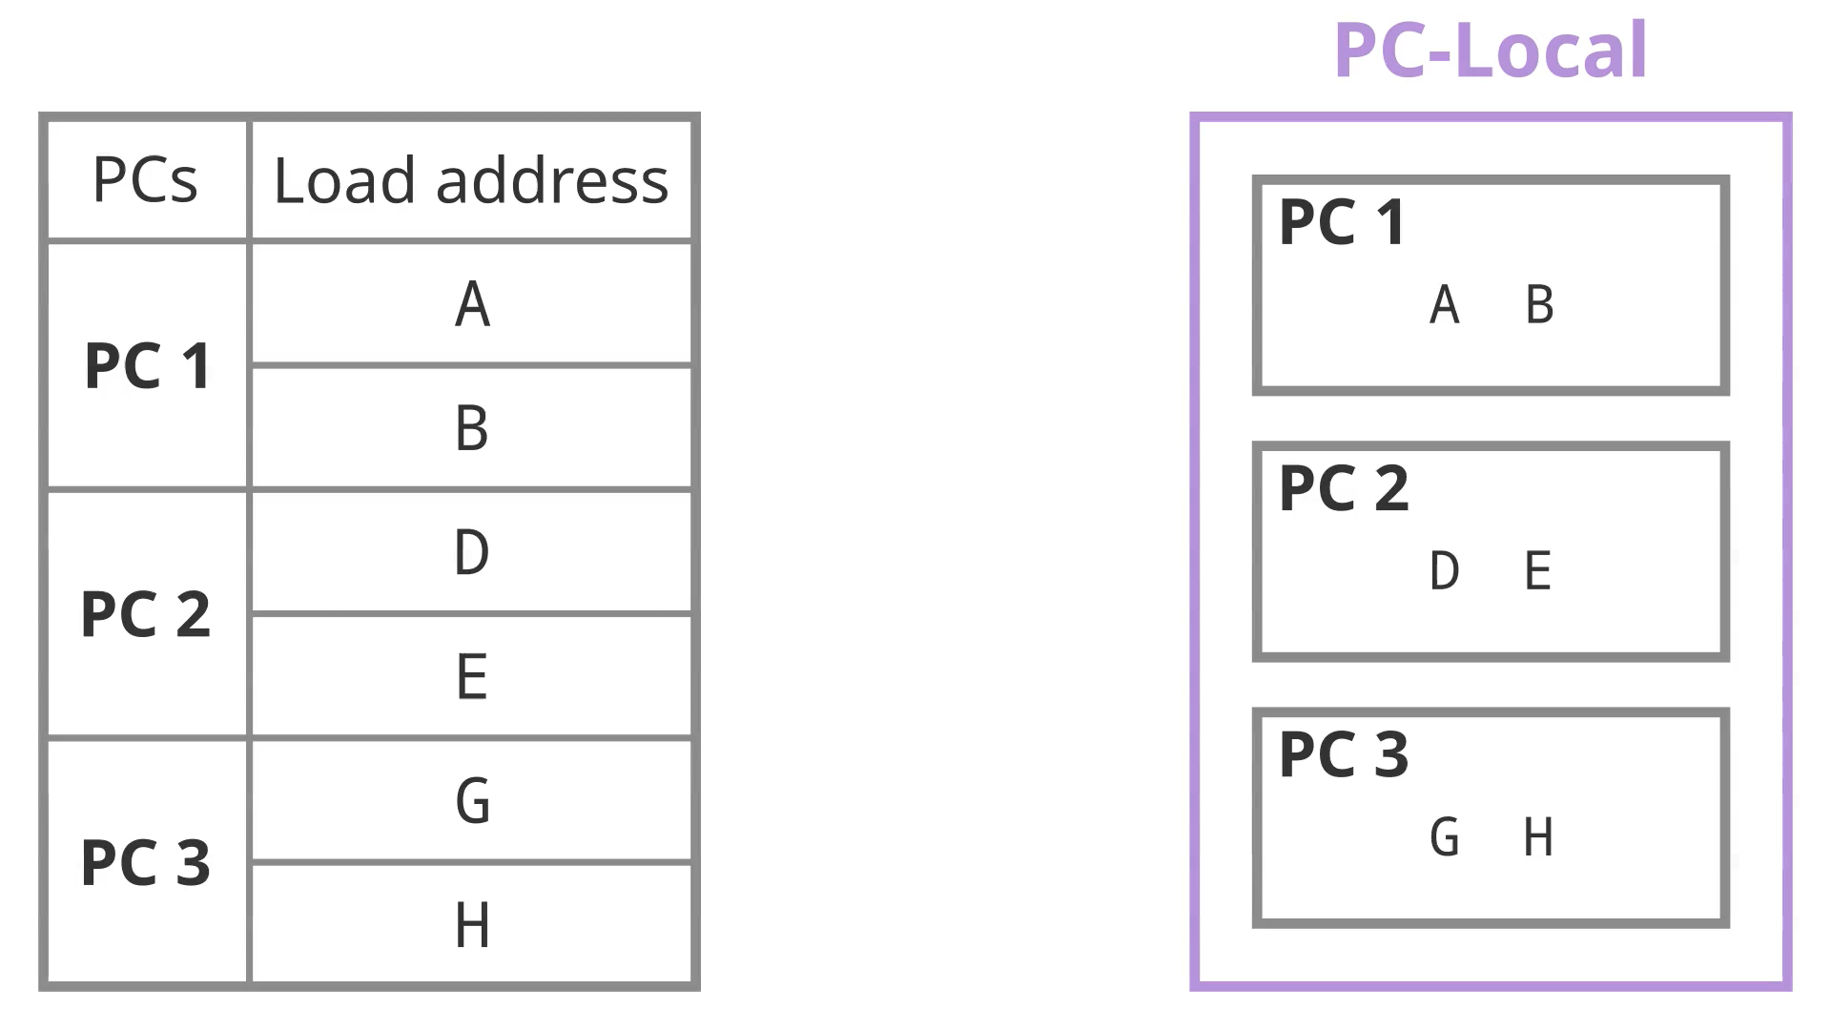
What is “Global”?
Global means that all loads are evaluated without considering the Program Counter (PC) context of the load instruction.
Why?
To enable Cross-PC Prefetching

Slide 16

Illustration of Cross-PC Prefetching
Cross-PC Prefetching means that prefetches from one PC can target accesses of another PC.
Example: We are traversing an array of pointers to structs. In each struct, we access elements A, C, and F in order.

Slide 17
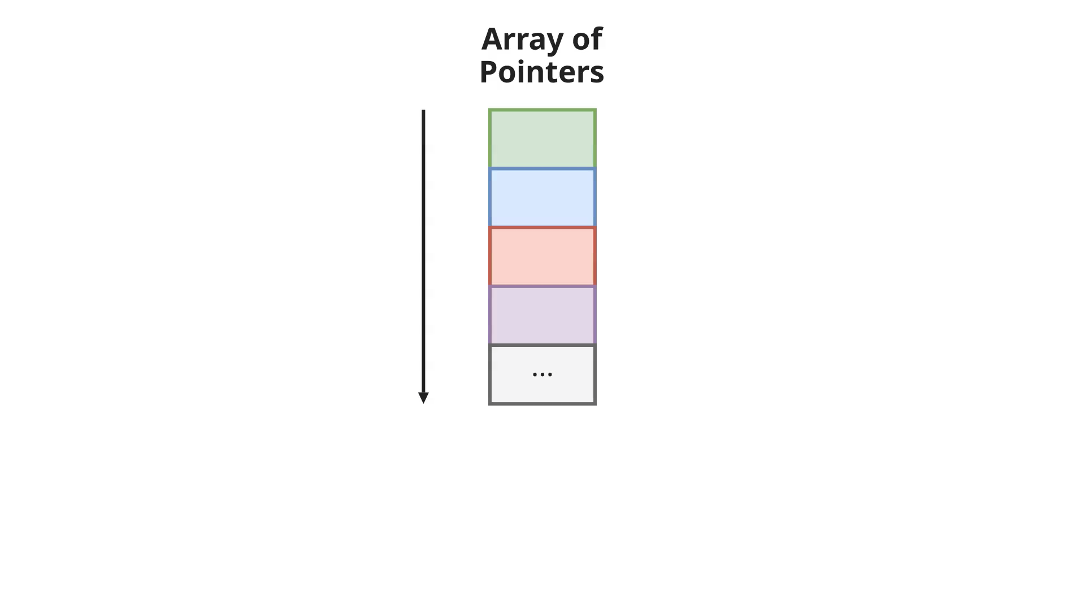
Illustration of Cross-PC Prefetching
Cross-PC Prefetching means that prefetches from one PC can target accesses of another PC.
Example: We are traversing an array of pointers to structs. In each struct, we access elements A, C, and F in order.

Slide 18
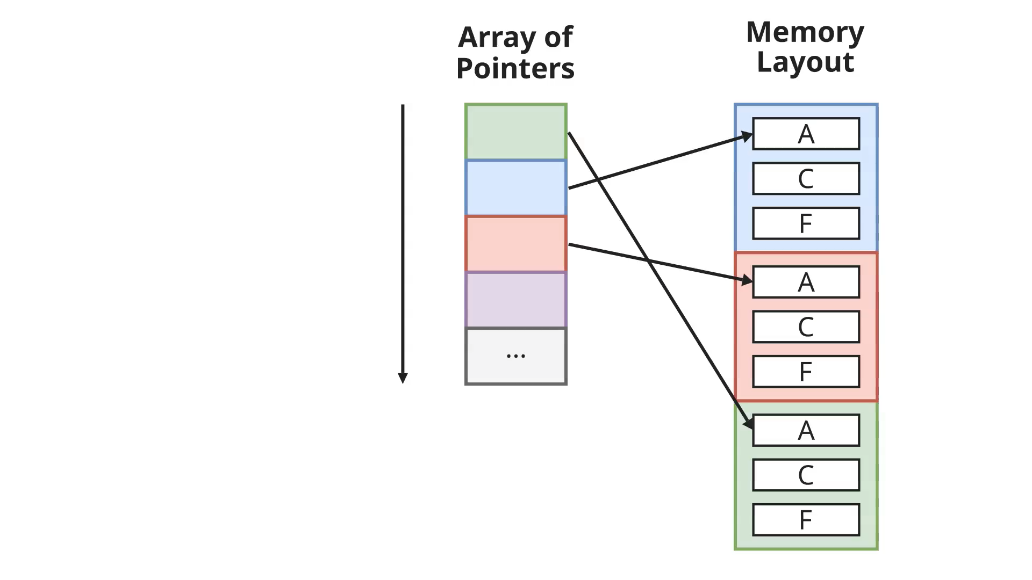
Illustration of Cross-PC Prefetching
Cross-PC Prefetching means that prefetches from one PC can target accesses of another PC.
Example: We are traversing an array of pointers to structs. In each struct, we access elements A, C, and F in order.

Slide 19
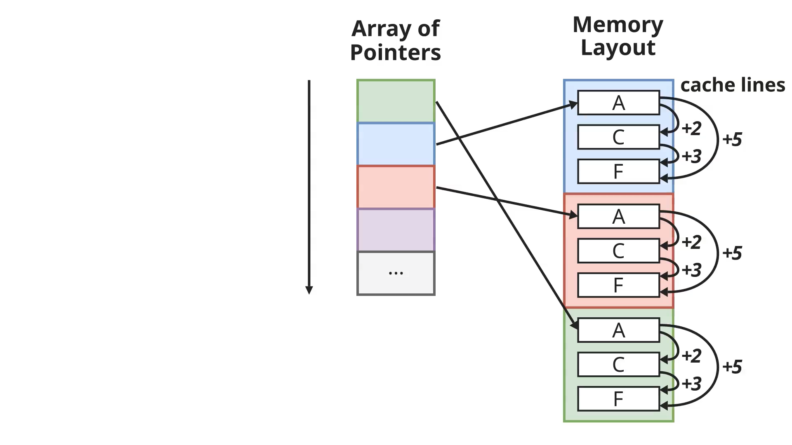
#1 Global Extraction of Offsets
A separate load instruction loads A, C, and F.
From a PC-local point of view, there is no apparent offset pattern. (due to placement in memory)

Slide 20
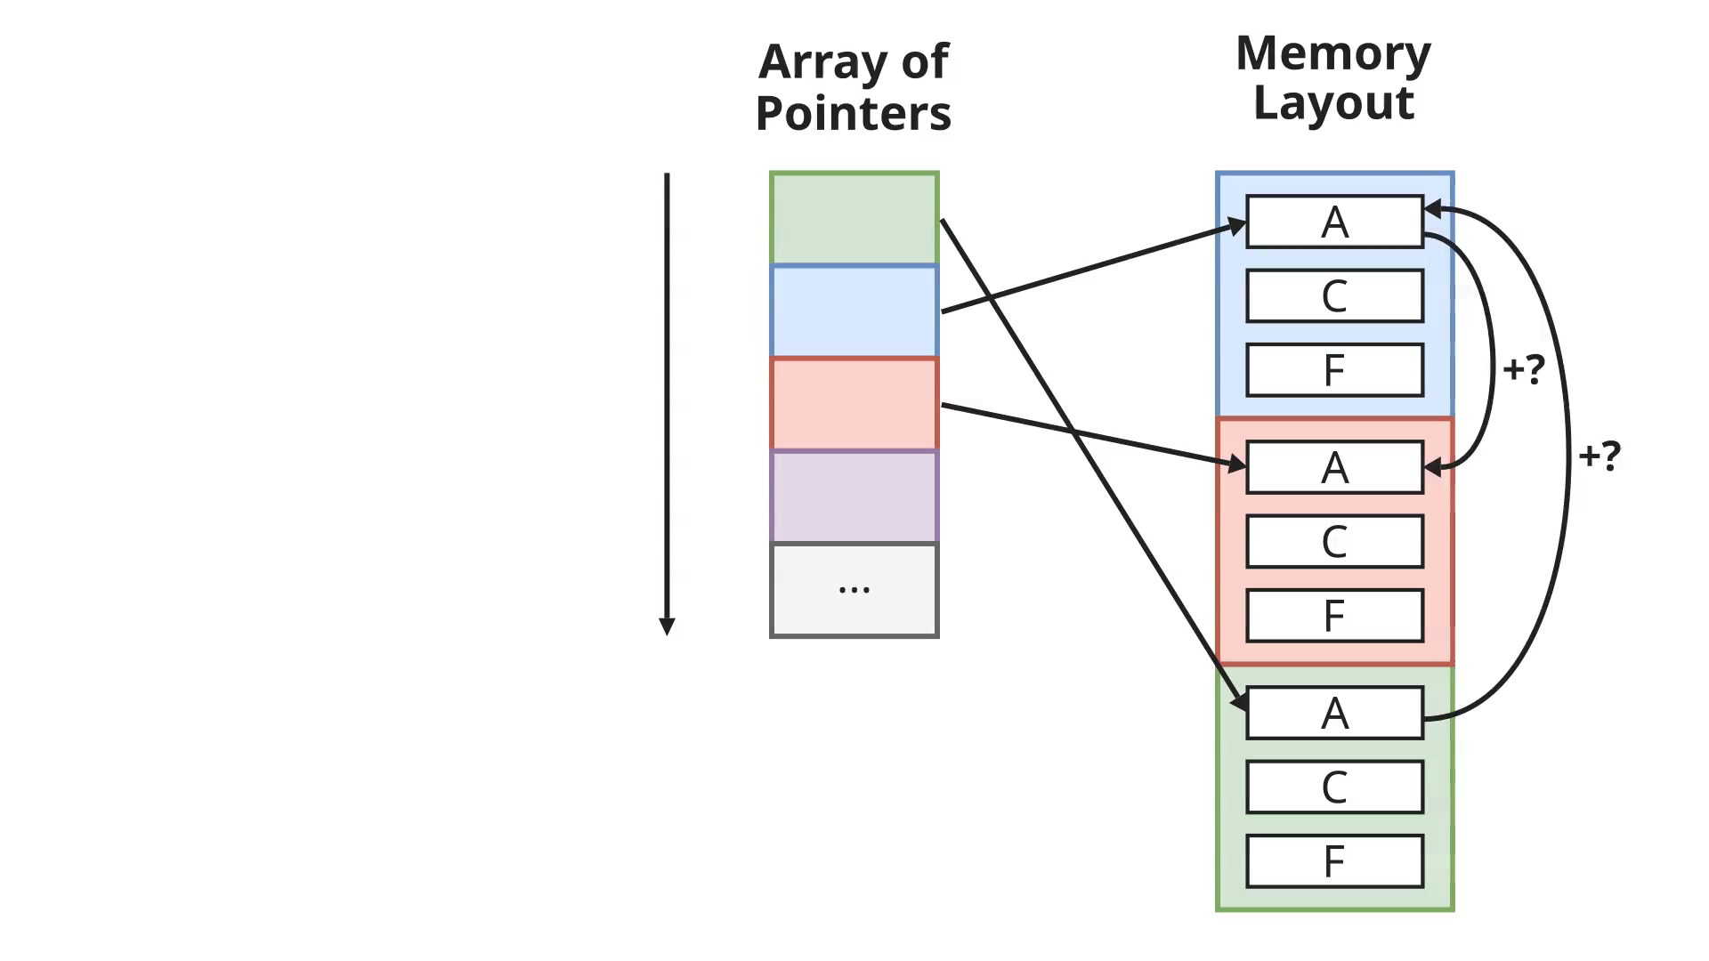
#1 Global Extraction of Offsets
From a global point of view, we know that when field A is accessed, field C and F will also be accessed.

Slide 21
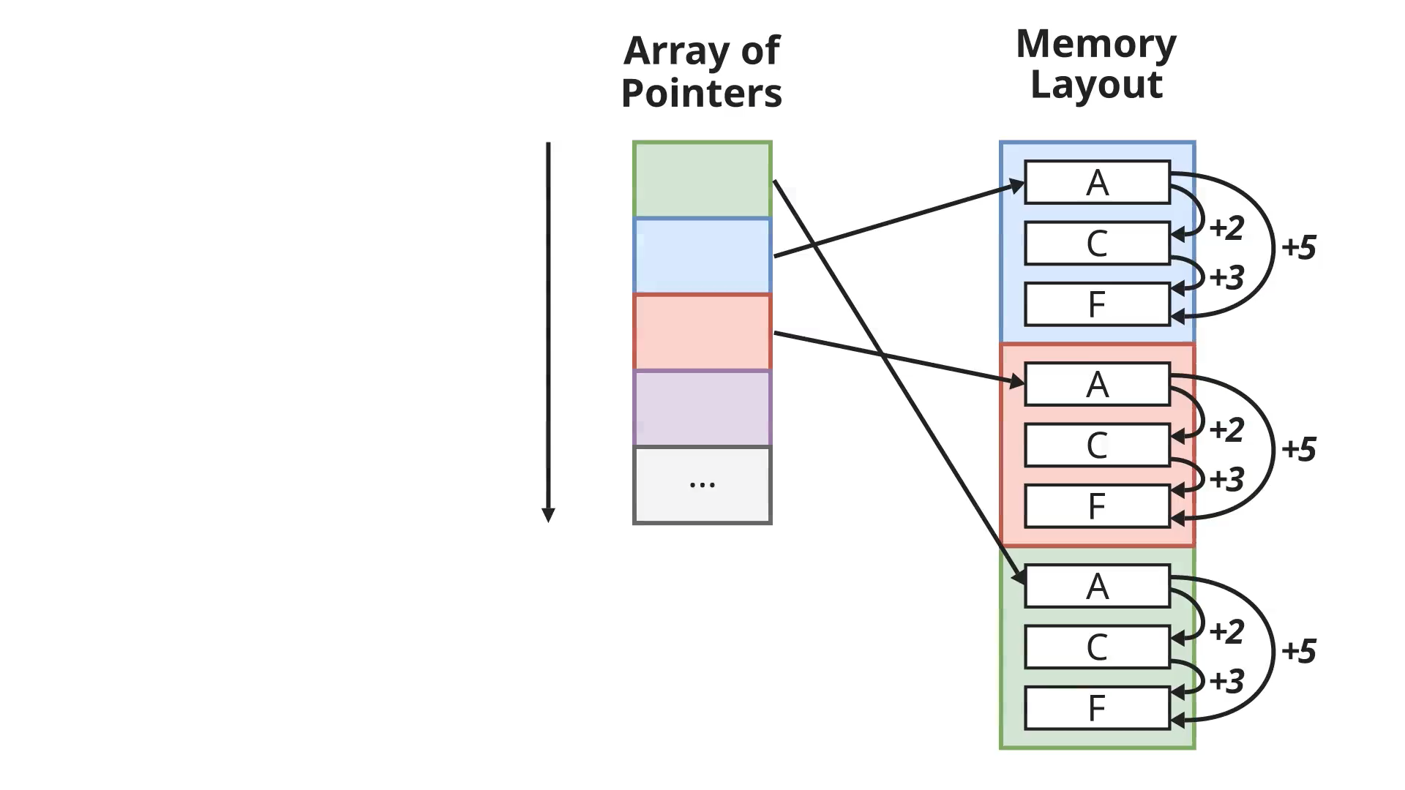
#2 Extracting Multiple Offsets
We want to extract multiple recurring offsets to cover diverse memory access patterns.

Slide 22
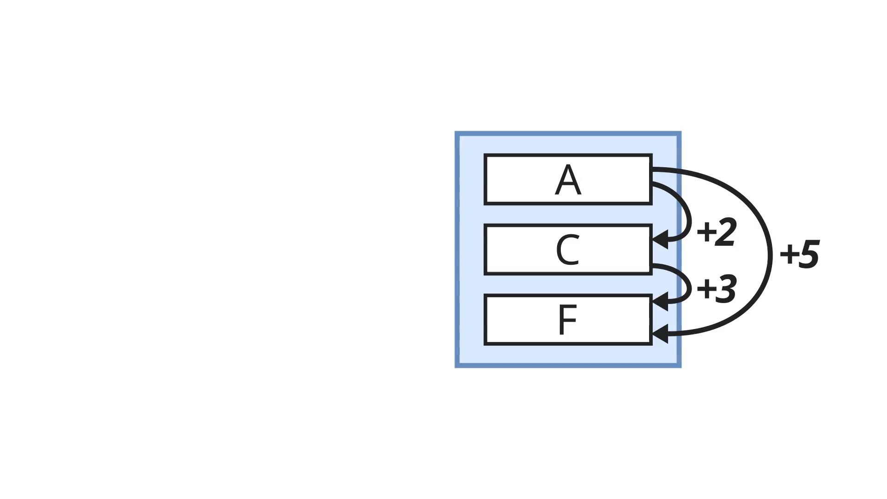
#3 Discouraging Overlap
Overlap prevents us from finding better offsets, hurting coverage.
This requires Caerus to find the next-best offset to maximize coverage. (given the offsets already being prefetched)

Slide 23
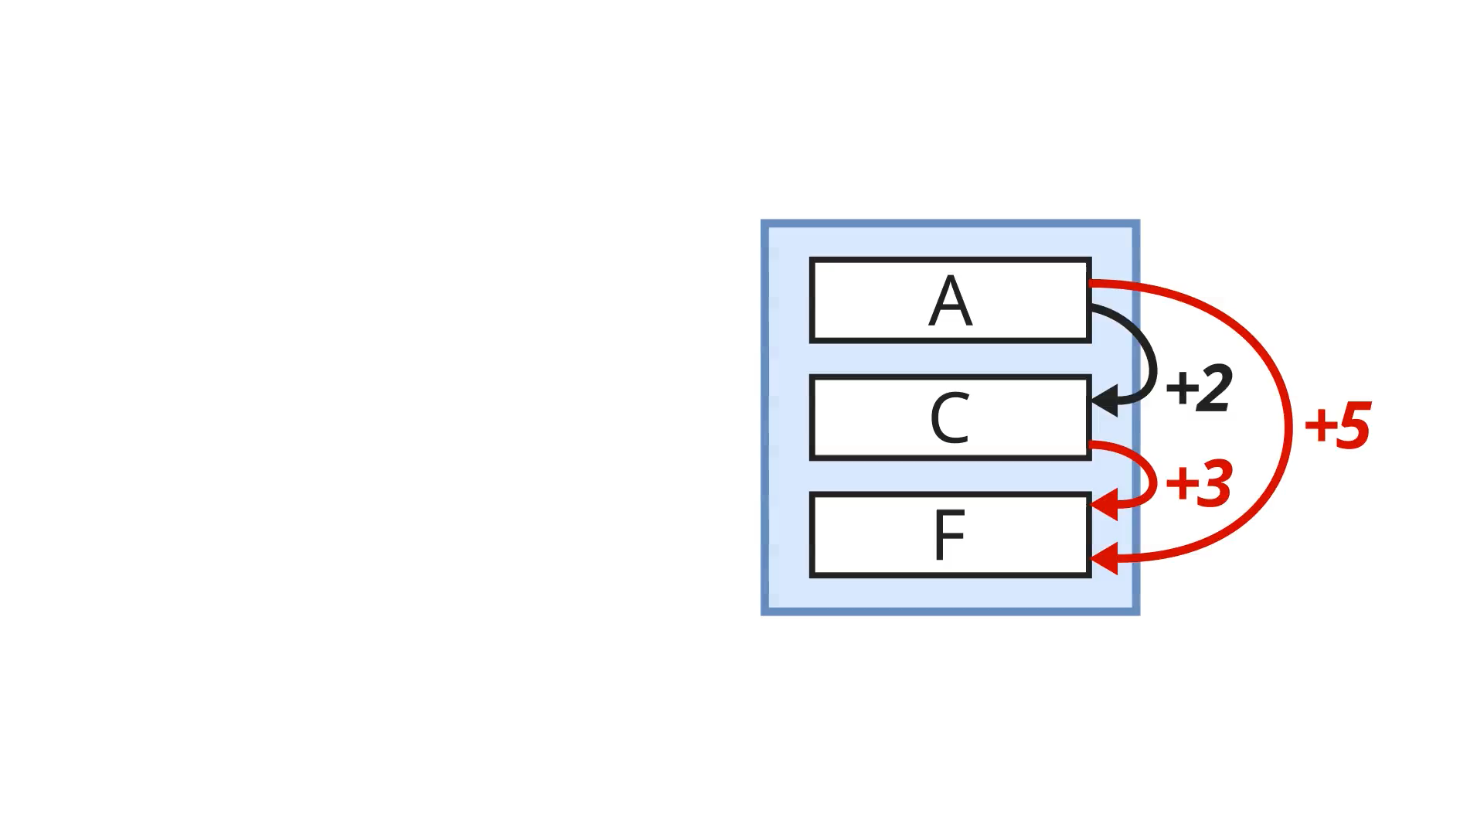
#4 PC-Local Filtering of Offsets
We filter the globally-derived offsets based on their accuracy by their PC context.
Prefetches from one PC can target accesses of another PC as long as they are accurate. This means we filter based on the source PC.

Slide 24
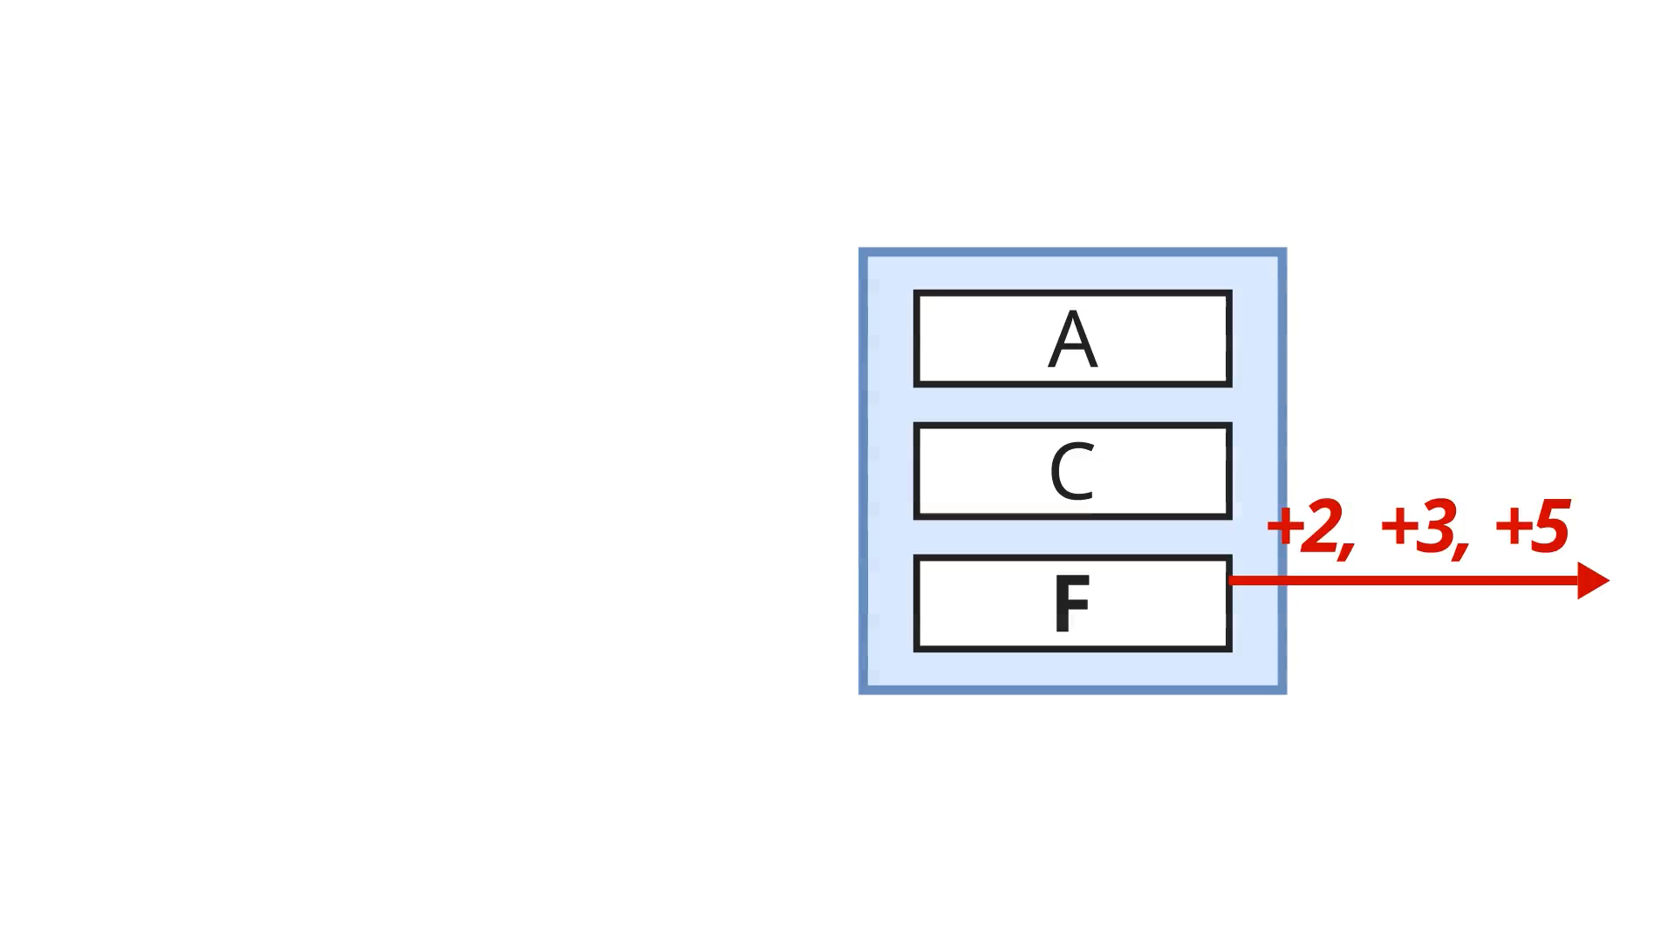
#4 PC-Local Filtering of Offsets
We filter the globally-derived offsets based on their accuracy by their PC context.
Prefetches from one PC can target accesses of another PC as long as they are accurate. This means we filter based on the source PC.

Slide 25
Key Takeaways
We know filtering matters. How do we completely redesign our prefetchers around diligent filtering?
Our answer is Caerus: a prefetcher that people won’t turn off.
Given that we can control DRAM traffic with PC-Local Filtering, we liberate the training engine to derive more adventerous offsets, gathering Multiple Overlap-Resistant Global offsets.

Slide 26

For More: Read Our Paper!
We’re just scratching the surface, the paper contains:
Maintaining history and timeliness,
Retraining offsets without losing coverage,
Caerus as an L2 prefetcher,
Caerus doesn’t make things worse!
Caerus is also open-source, code and artifact available @ GitHub
If you have more questions, you can find me at jkw20@ic.ac.uk
Additional acknowledgements to David Schall, Nicolas Fry, Justine Giroux, and Shinjeong Kim.

Slide 27
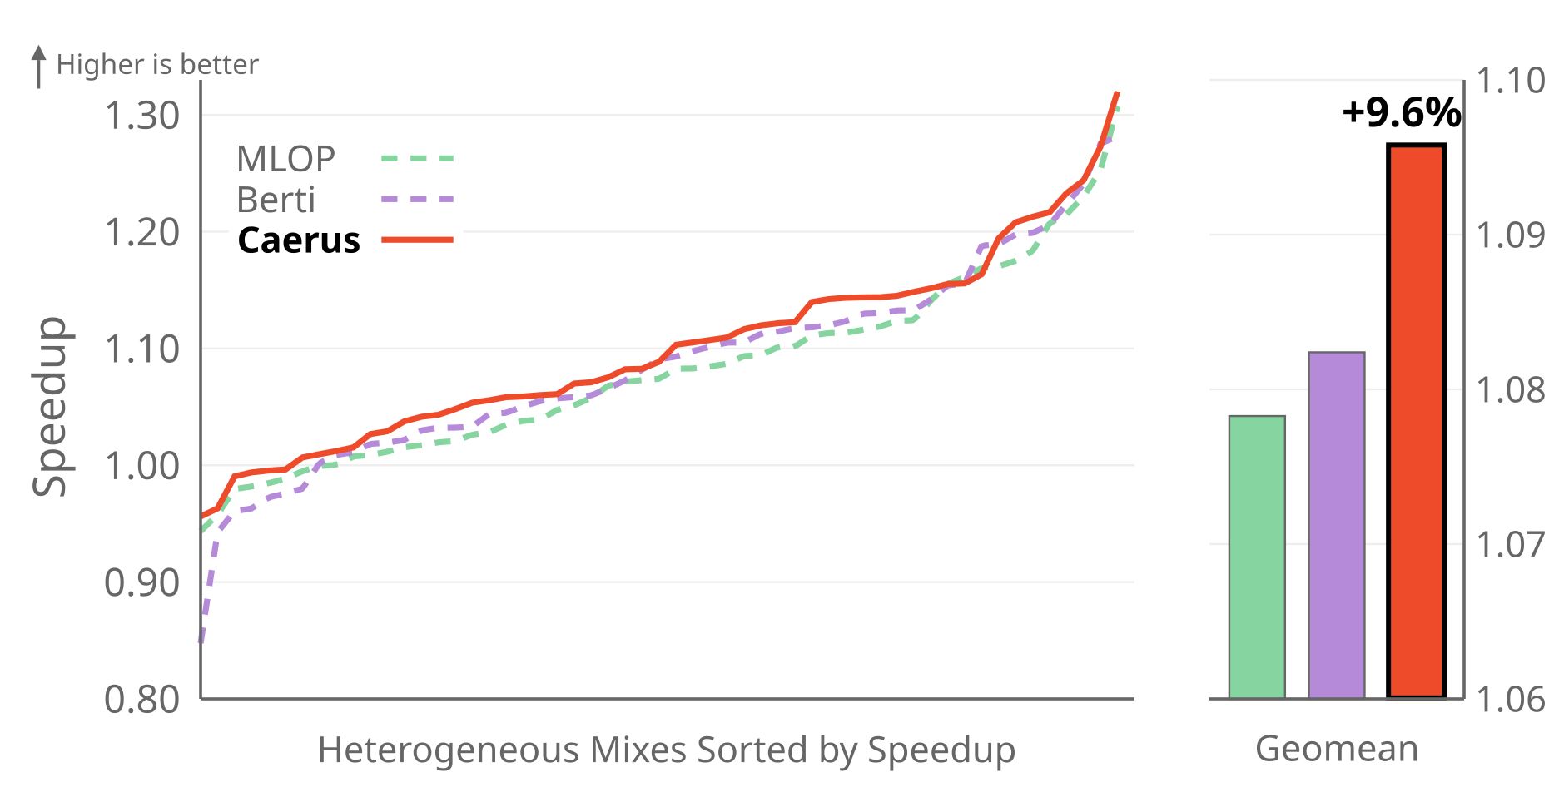
Heterogeneous Multi-Core Evaluation
* Random 8-core mixes from SPECspeed 2017, SPEC CPU2006, Ligra, and Parsec, with private L1, L2, and shared LLC.

Slide 28
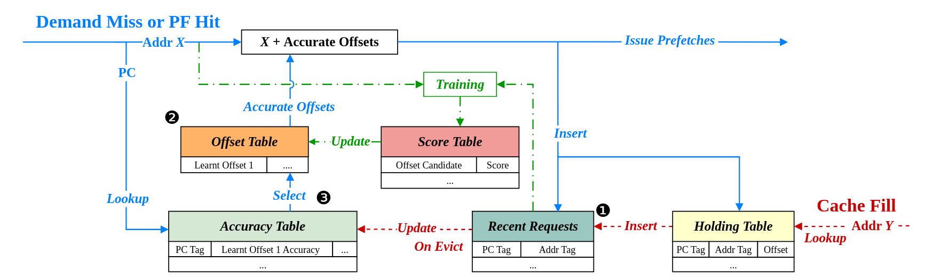
Organisation of Caerus

Slide 29
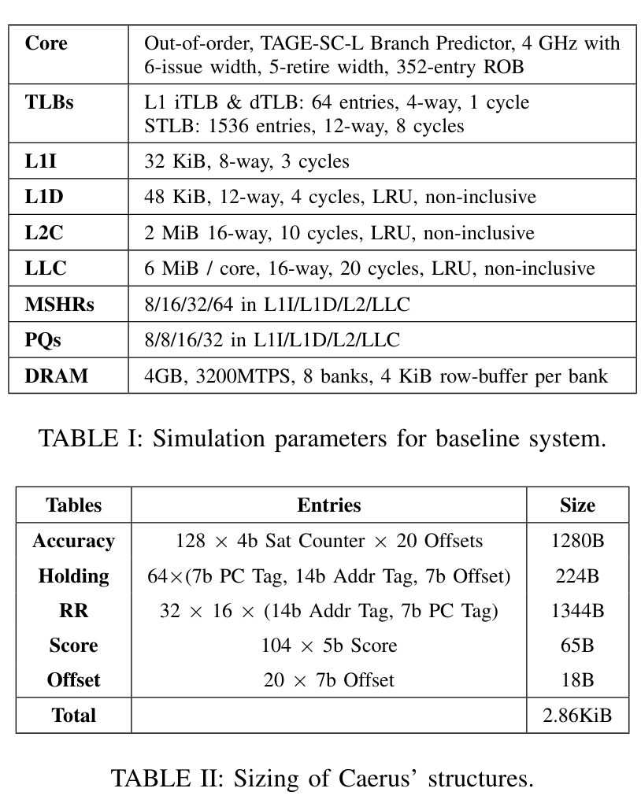
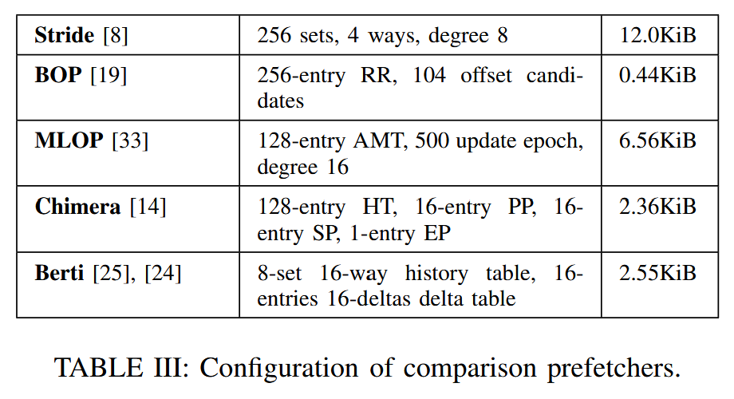
Configuration

Slide 30
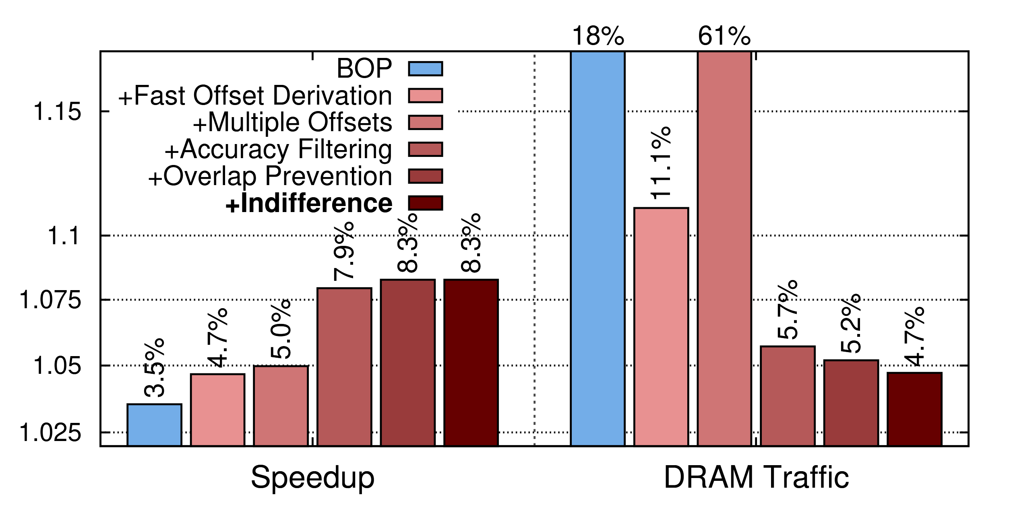
Ablation Study

Slide 31
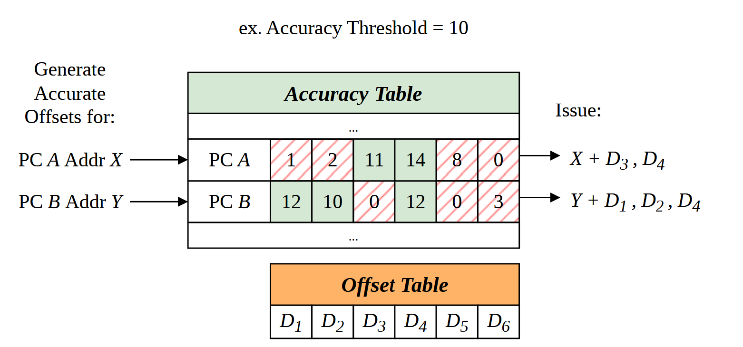
Issuing Prefetches

Slide 32
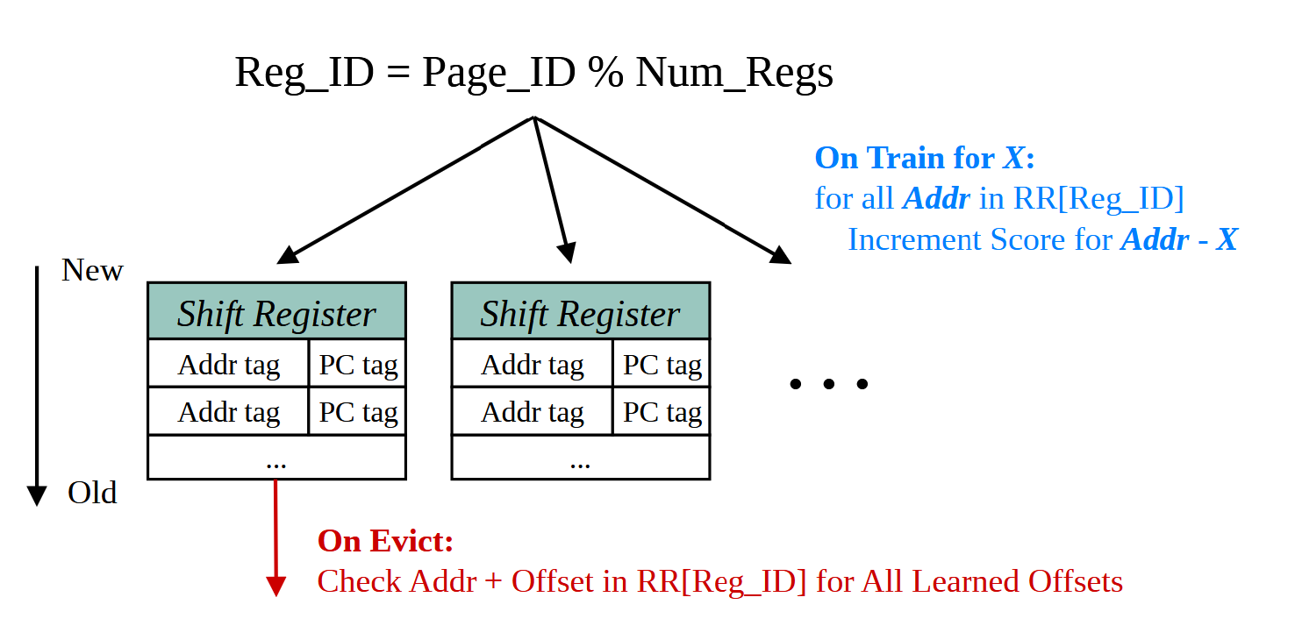
Recording History

Slide 33
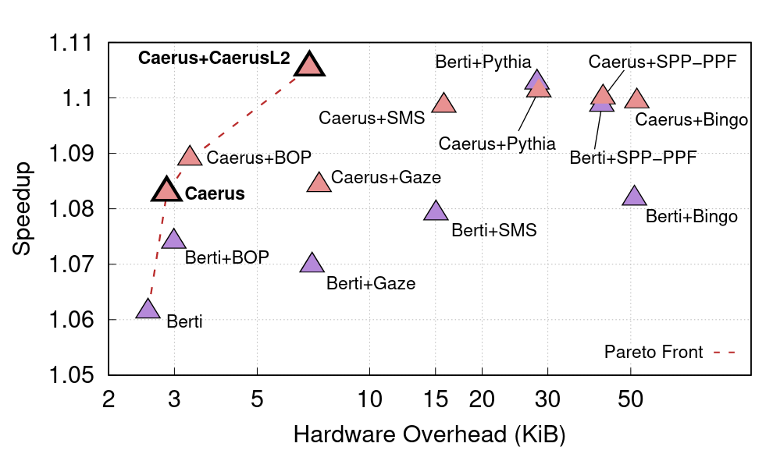
L2 Performance vs. Storage

Slide 34
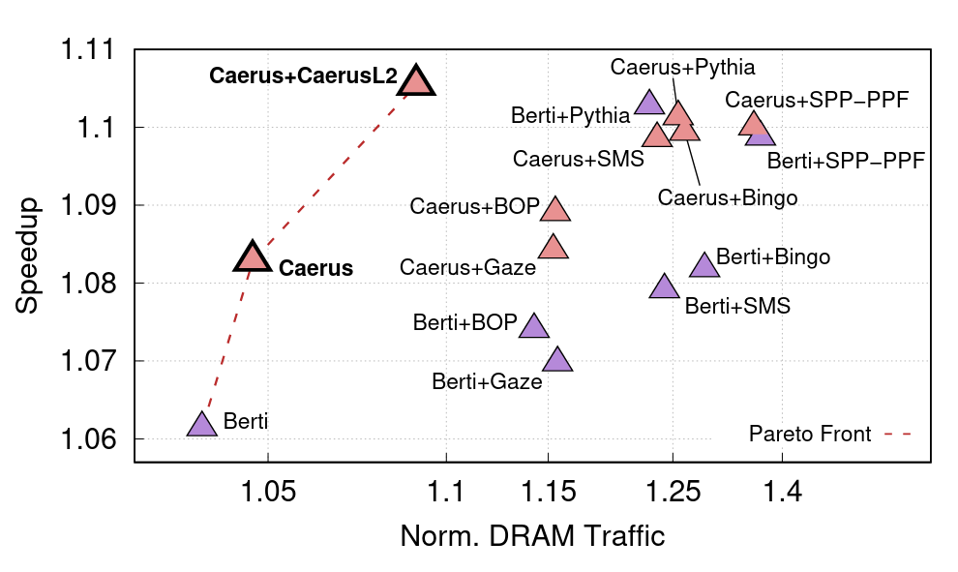
L2 Performance vs. DRAM Traffic

Slide 35
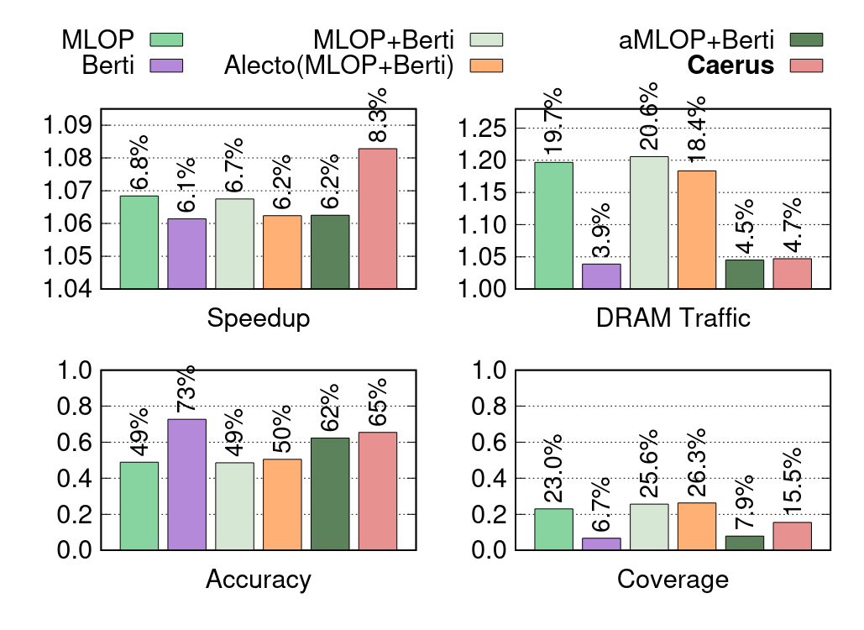
Caerus vs. Composite Global-PC-Local Prefetchers

Slide 36
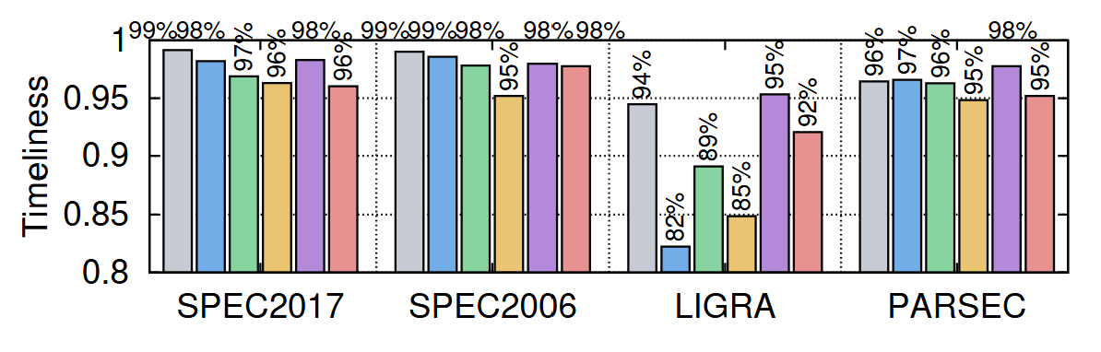
Timeliness

