Slide 1
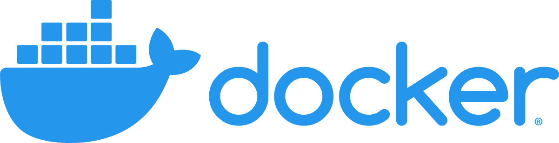
in 60 minutes
KOM KWT 2022 / Workshop
Docker logo from https://www.docker.com/wp-content/uploads/2022/03/horizontal-logo-monochromatic-white.png
The authors of this presentation are not not affiliated, associated, authorized, endorsed by, or in any way officially connected with Docker, Inc.

Slide 2
WHY?
..and how?

Slide 3
What is Docker?
“ Docker is an open platform for developing, shipping, and running applications.” https://docs.docker.com/get-started/overview/
Main idea
Put applications into lightweight containers
Use containers in all stages: development, testing and production
Hardware-independent deployment (target only needs docker)
Orchestration and scaling of modular applications
Points based on https://docs.docker.com/get-started/overview/

Slide 4
Why should you care?
As an independent developer
Specify your whole setup at one place
Build once, run anywhere (local machine, VM…)
Containerized performance nearly identical to native* (also for ML workloads with GPUs)
As a researcher
Isolated and safe environment for executing apps
Use exactly the same setup between collaborators
Boost reproducibility of your research
Most arguments are taken from https://pointful.github.io/docker-intro/
* depending on your workloads, see e.g. https://ieeexplore.ieee.org/document/7095802

Slide 5
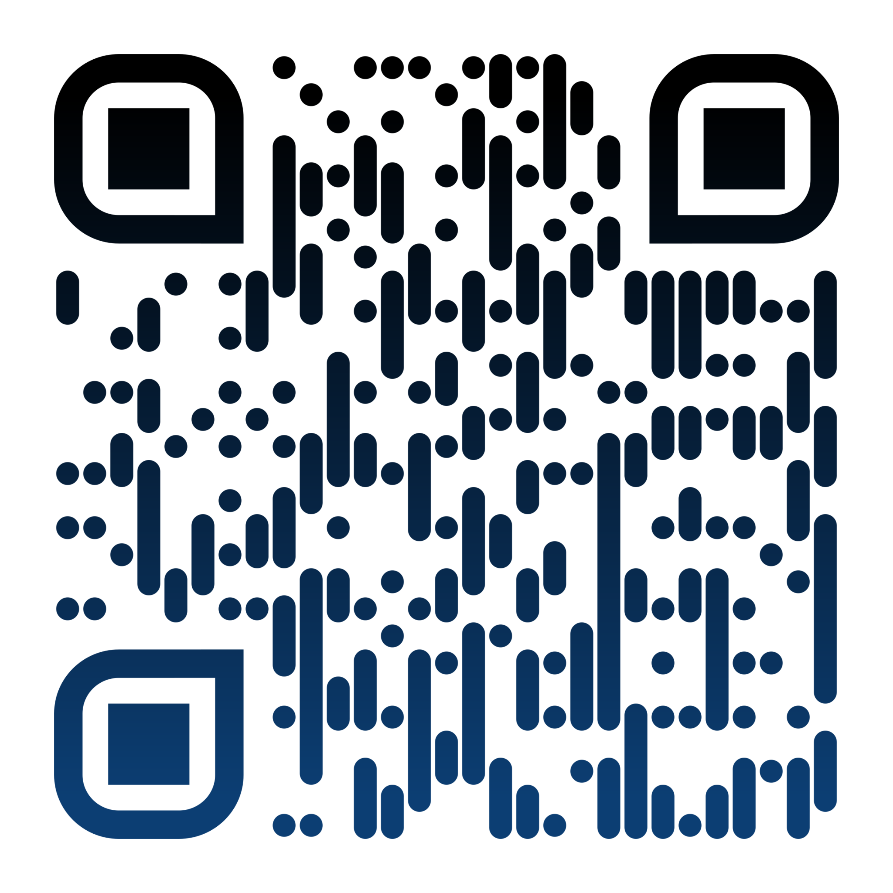
This Workshop on GitHub
git clone https://github.com/jw3il/kwt22-docker
QR code generated with https://www.qrcode-monkey.com/

Slide 6
What you will learn in the next ~ 55 minutes..
Concepts required for (basically) all projects
Basic Concepts
Dockerfile Basics
Development
Production
Run
Hello World
Create | Modify | Deploy
Python Web Application Example
Notes:
Minute 5

Slide 7
Basic Concepts
Images
Containers
Volumes

Slide 8
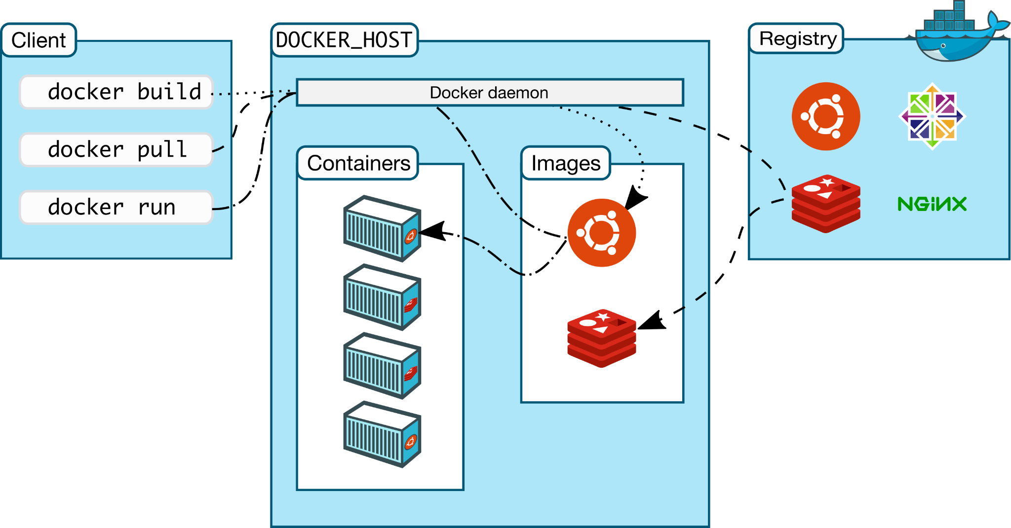
Volumes
Architecture image from https://docs.docker.com/engine/images/architecture.svg (modification: added volumes)
Notes:
Icons: ubuntu, redis, nginx, centos
Default registry: docker hub. Worth to mention: GitLab can have own registry for each repository => build and host images with CI
Minute 7-10 (the earlier the better)

Slide 9
🧑‍💻 Hands-On Session 👩‍💻
Complete step 1 (see README.md in the git repository)
Notes:
Minute 15 (MAX 17)

Slide 10
Dockerfile Basics
A recipe to build and run your application!

Slide 11
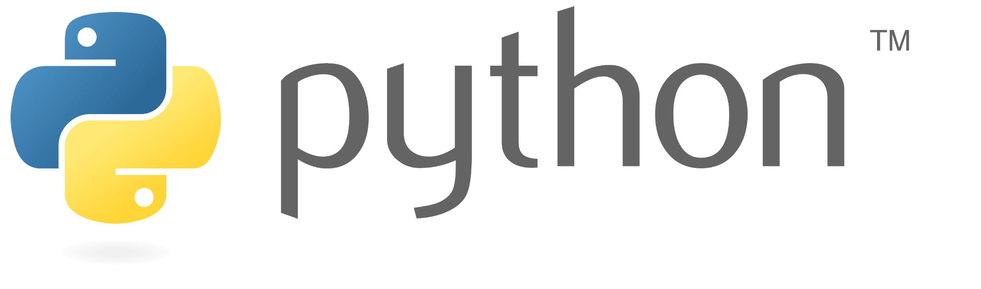
Dockerfile Basics
FROM python:3.9-slim-bullseye
# set the work dir in the image to /app
WORKDIR /app
# install requirements
RUN pip install --no-cache-dir flask
# copy files from local system to /app
COPY ./app ./
# set path to flask app and enable development mode
ENV FLASK_APP=app.py
ENV FLASK_DEBUG=1
# start flask when running containers based on this image
ENTRYPOINT [ "flask", "run" ]
CMD ["--host", "0.0.0.0", "--port", "5000"]
base image name:tag
(on debian bullseye)
We build an image with a Dockerfile
Docker creates layers after each statement
Each layer is an intermediate image based on the previous image
Allows for caching & faster downloads of modified images
But: each layer increases the size of the image (like a git commit)
install requirements & remove garbage
run command and default args
Logo from https://www.python.org/static/community_logos/python-logo-generic.svg
Notes:
Minute 20

Slide 12
Complete step 2
Notes:
Minute 30

Slide 13
Development
How to use docker for development

Slide 14
Development with Docker
We need persistent storage for our code..
Volumes | Bind Mounts
Let docker manage storage Isolated storage units Mount in multiple containers https://docs.docker.com/storage/volumes/ | Mount local filesystem Easy to use Do not use in production https://docs.docker.com/storage/volumes/

Slide 15
Development with Docker - Bind Mounts
local filesystem
Mount the directory /$(pwd)/app as /app
docker filesystem
$ docker run --rm --name kwt22-container -v "/$(pwd)/app":"/app" -p 8080:5000 kwt22-image
Alternatively, you can also use –mount, which is more verbose (see https://docs.docker.com/storage/bind-mounts/ for further details and options)
Notes:
Minute 35

Slide 16
Work on step 3
Notes:
Minute 45

Slide 17
Production
Create different development and production images

Slide 18
Getting ready for production
Goal: create a (small) image to run your application
Main options
Create multiple Dockerfiles (e.g. development, production)
Create multi-stage builds with a single Dockerfile

Slide 19
Multi-Stage Builds by Example
# development image
FROM base-image as dev
# ... do some stuff
ENTRYPOINT ...
CMD ...
# production image
FROM dev as prod
# ... do some stuff
ENTRYPOINT ...
CMD ...
Stage 1: –-target dev
Like our previous image
Keyword as defines build target name
Base stage could e.g. be slim build target with all common and installed dependencies
In our case: development target (we have no unnecessary dependencies)
Stage 2: –-target prod
Defines own build target
Can be based on previous (dev) or different image
We could also copy files from previous stages like
COPY --from=dev DEV_PATH PROD_PATH
Note that an arbitrary number of stages can be defined according to your needs
More info at https://docs.docker.com/develop/develop-images/multistage-build/
Notes:
Minute 50

Slide 20
Complete step 4
Notes:
Minute 60

Slide 21
Congratulations!
You are ready to use docker in your own projects

