Slide 1
Introduction Myself
Jing Wang

Slide 2
Biographical Information
Date of birth: 11/10/1988
Country: China
Department: Civil and environmental engineering
Program: Ph.D.
Graduation date: 12/2024
Quarto enables you to weave together content and executable code into a finished presentation. To learn more about Quarto presentations see https://quarto.org/docs/presentations/.

Slide 3

Favorite Animal
My Favorite Animal

Slide 4
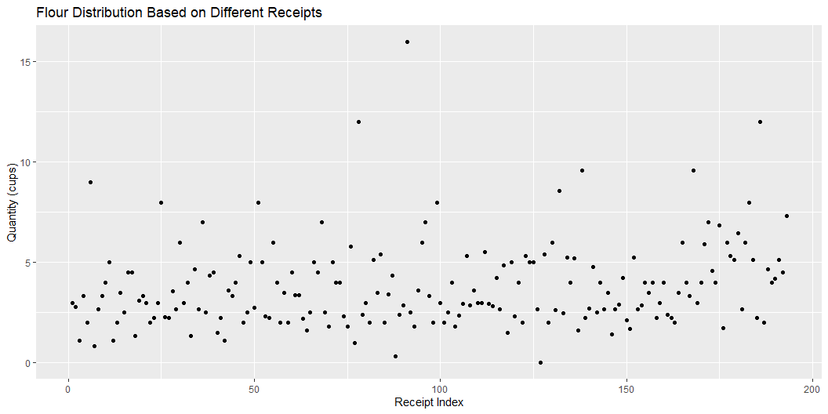
Plot

Slide 5
CV Link
[CV Link](CV.pdf)

