Slide 1


2024년 2월 2일 Study Meeting전 중간 결과 보고
ChatGPT 실험
Can GhatGPT distinguish Logical Fallacy?
정지$원$
성균관대학교 인공지능학과
석사과정
jwjw9603@g.skku.edu

Slide 2
Logical Fallacy with Knowledge graph and LLM
Contents
01
Progress
진행 내용 Overview
Experiment Setting and Method
Prompt
Data Distribution
Result
Result(Table)

Slide 3
Progress
진행 내용 Overview
실험 진행
Zero-shot, 2-shot
Multi class classification with no fallacy
LM with KG
논문 리뷰
How to??
Notes:
c

Slide 4
Progress
실험 세팅 및 방법
지식 그래프가 활용이 되면 도움이 될 것 같다고 판단한 클래스에 대해서 분류를 진행 함.
총 4개의 벤치마크 데이터셋에 대해서 실험을 진행 함.
Argotario : Hasty Generalization, Irrelevant Authority
LOGIC : Faulty Generalization, False Causality, Fallacy of Credibility
COVID-19 : Cherry picking, False Causality, Hasty Generalization, False Authority, Post Hoc
CLIMATE : Cherry picking, False Causality, Hasty Generalization, False Authority, Post Hoc
Gpt-3.5-turbo(Chatgpt) 모델을 사용하고, 모델의 성능을 평가하기 위해 zero-shot, 2-shot learning으로 진행 함
Argotario, COVID-19, CLIMATE 데이터셋은 No Fallacy 클래스가 있지만 LOGIC 데이터는 없음
LOGIC데이터는 총 13개의 클래스가 있으며 나머지 10개의 클래스를 No Fallacy 클래스로 지칭 함.
No Fallacy 클래스를 추가했을 때의 prompt는 크게 바뀐게 없으며(class label만 추가), LOGIC데이터셋에서의 prompt만 바뀜(다음 페이지)

Slide 5
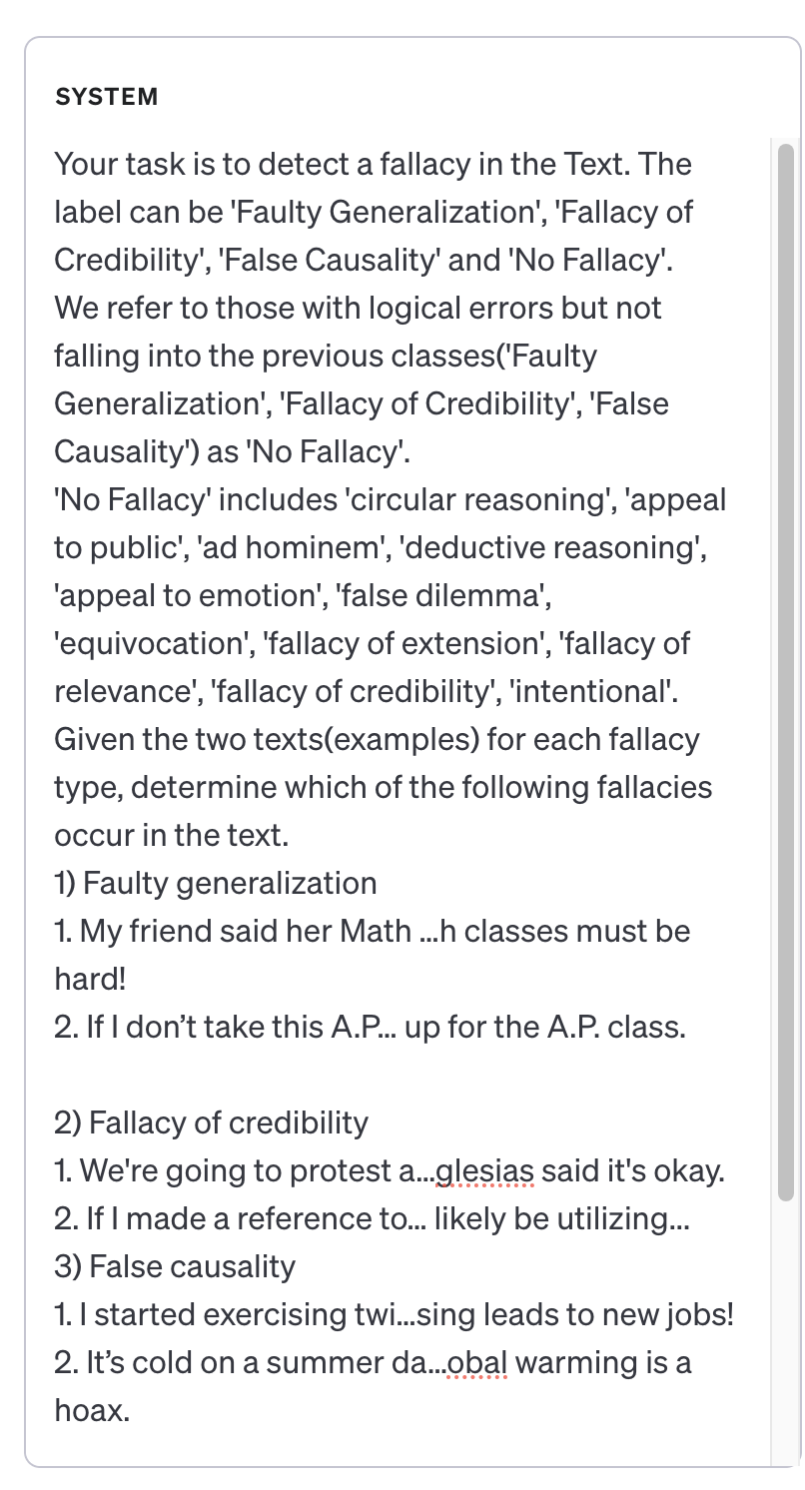
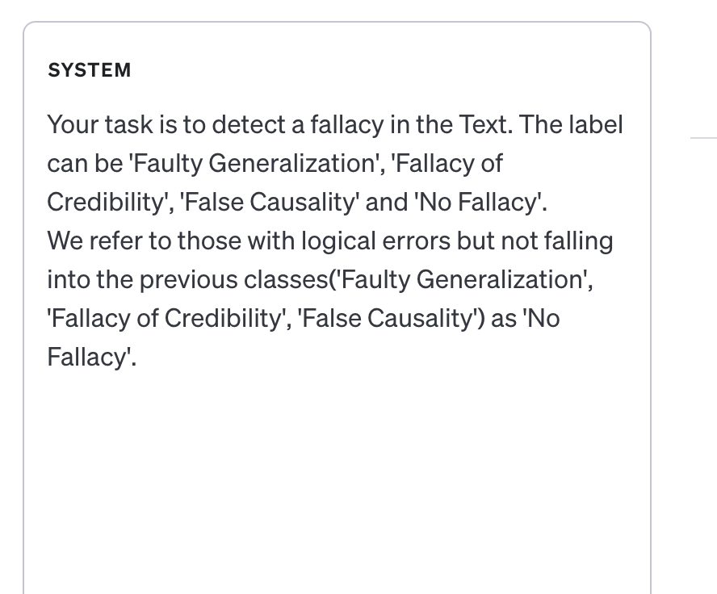
Progress
Prompting(LOGIC)
Notes:
c

Slide 6
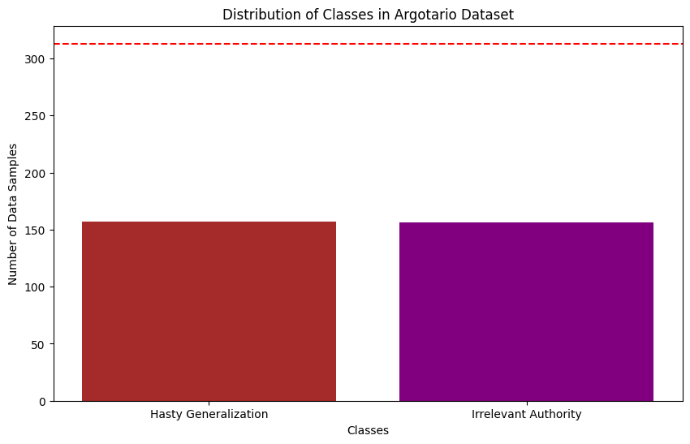
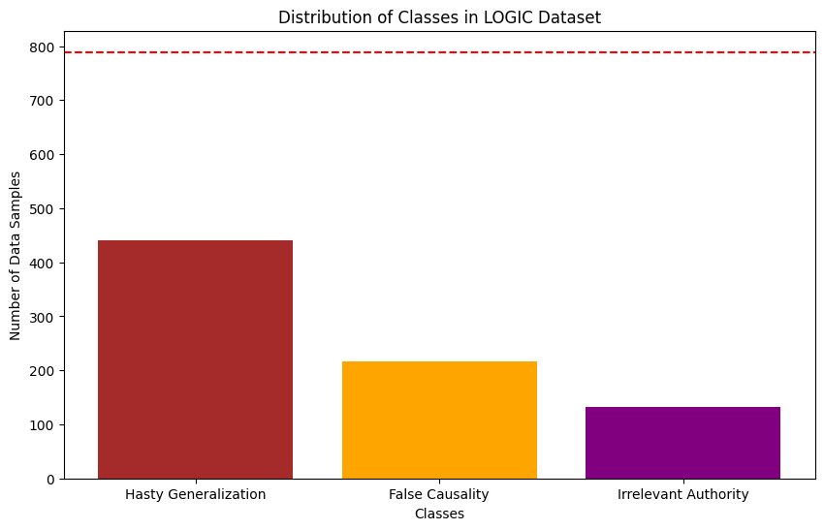
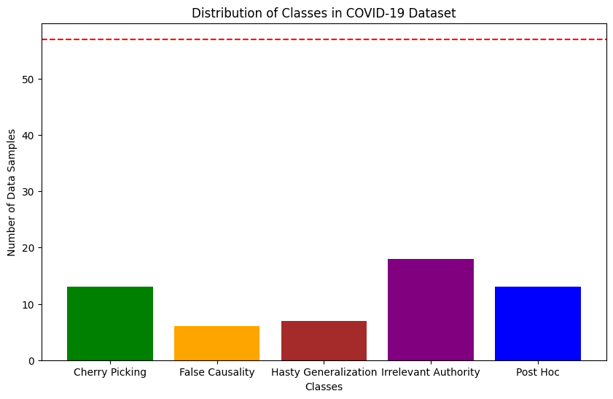
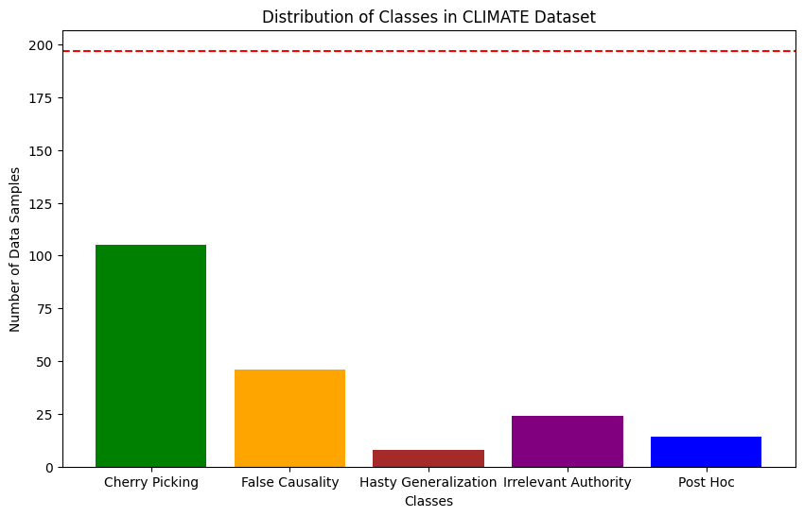
Progress
데이터 분포(only Fallacy)
Notes:
c

Slide 7
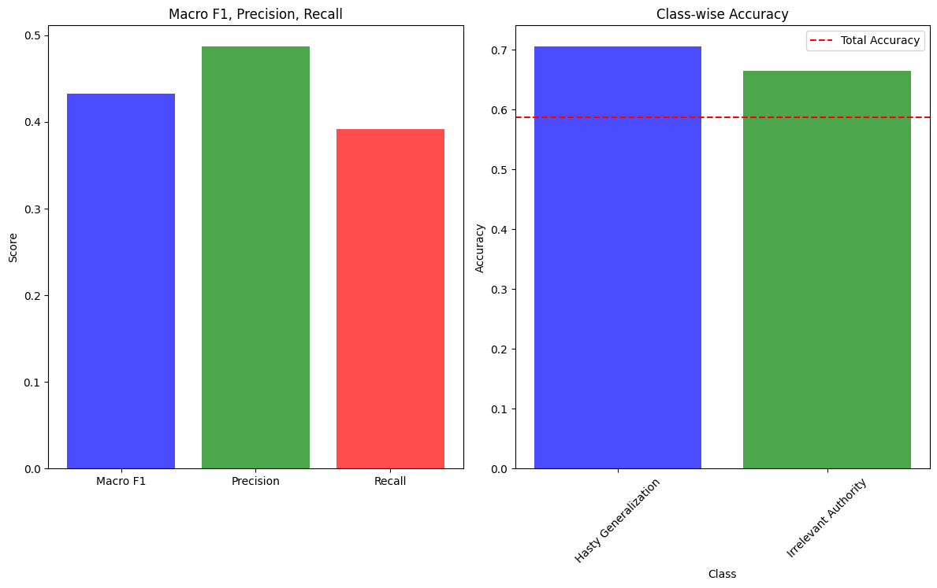
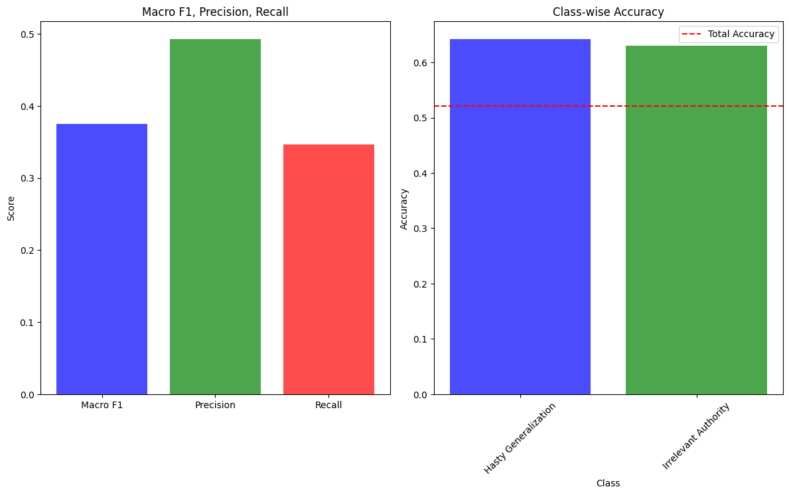
Progress
결과(Argotario)
Zero-Shot
Two-Shot
Notes:
c

Slide 8
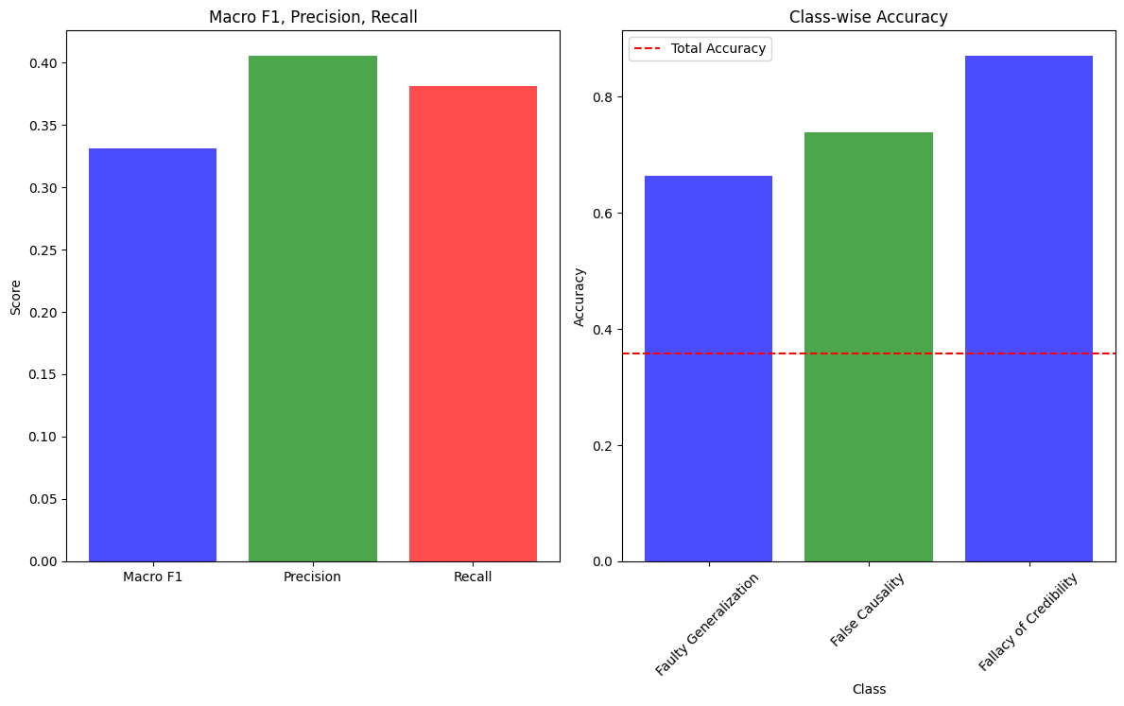
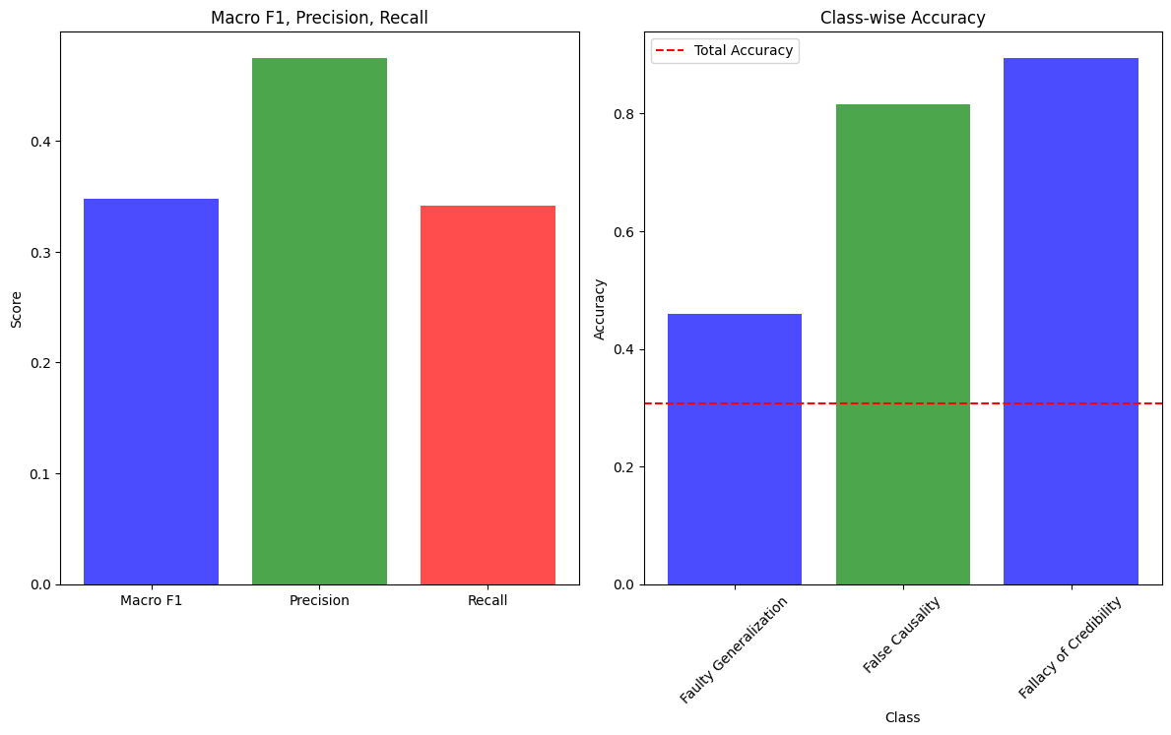
Progress
결과(LOGIC)
Zero-Shot
Two-Shot
Notes:
c

Slide 9
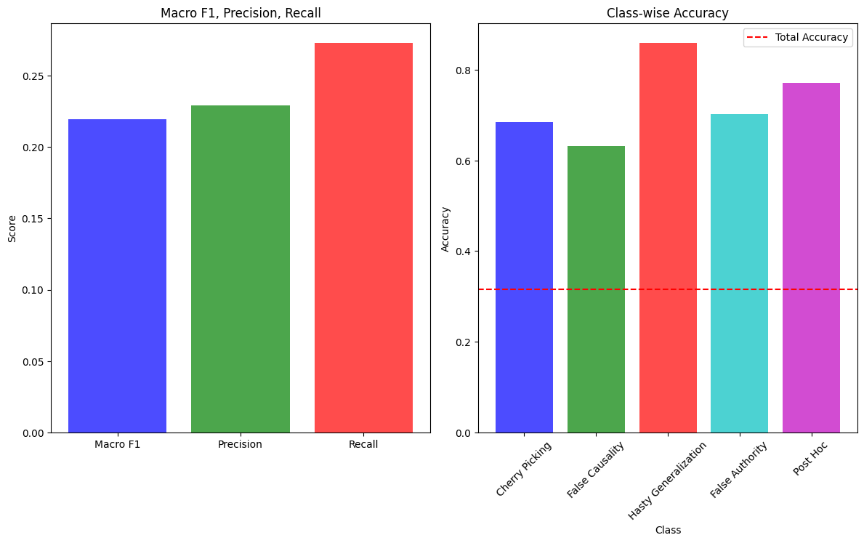
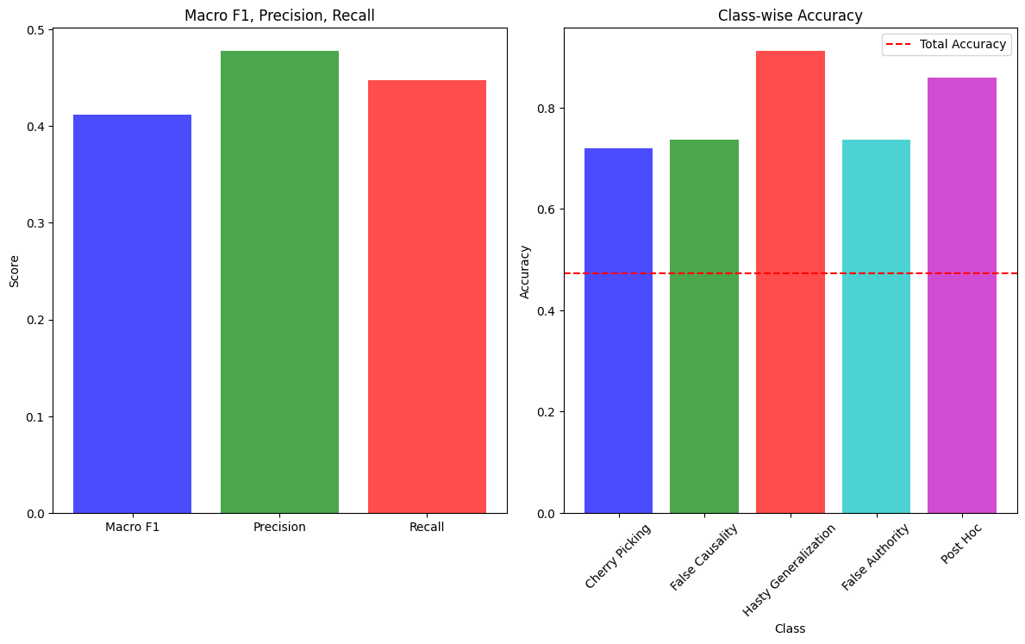
Progress
결과(COVID-19)
Zero-Shot
Two-Shot
Notes:
c

Slide 10
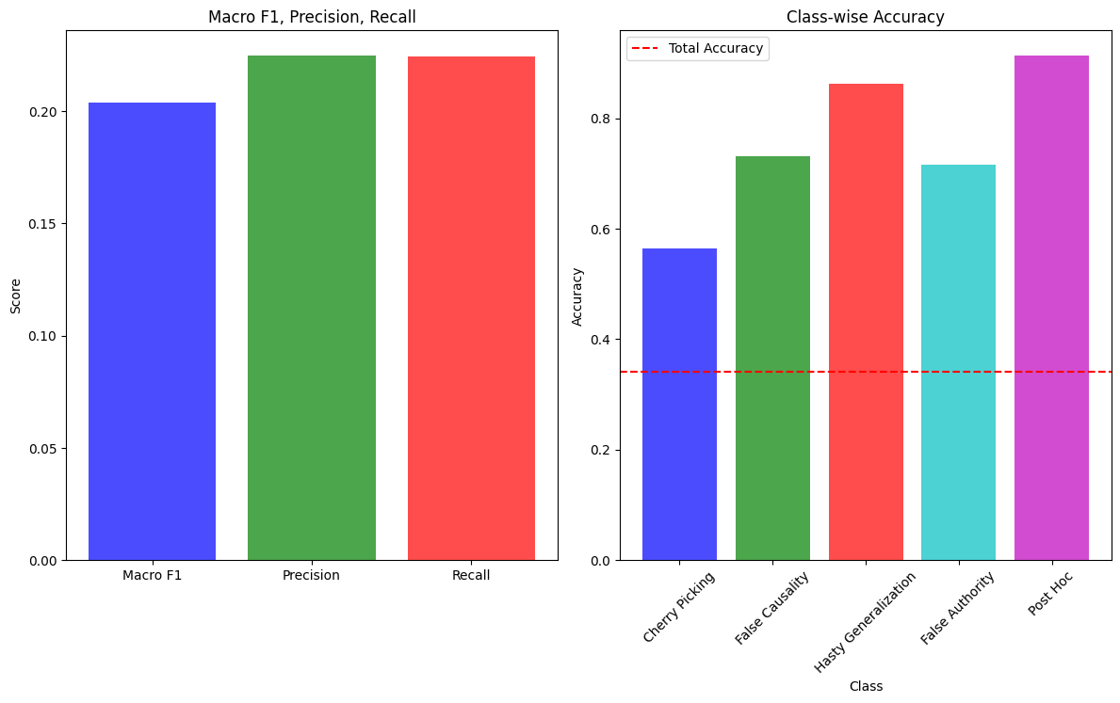
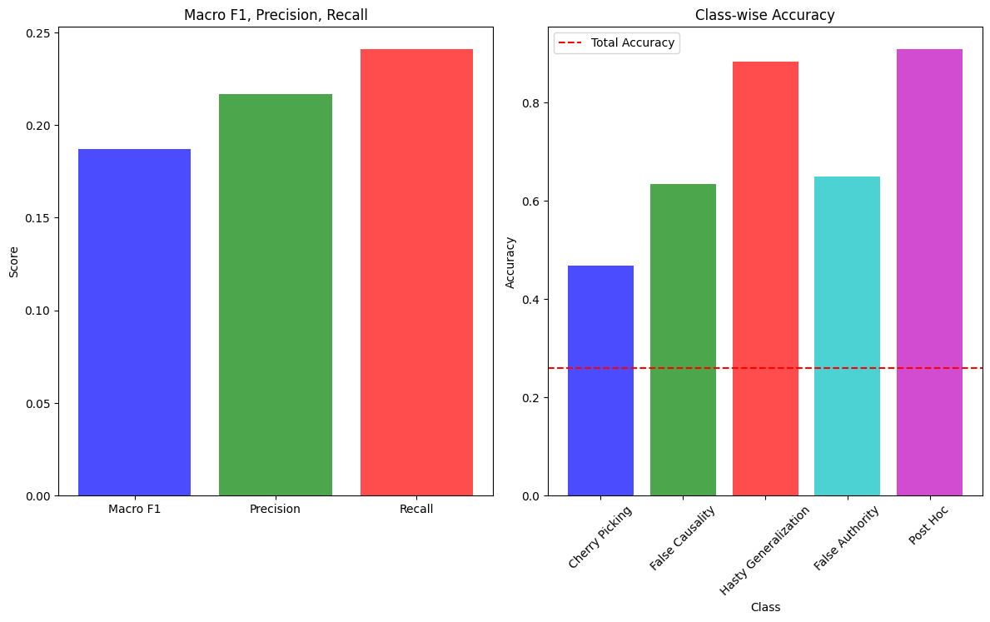
Progress
결과(CLIMATE)
Zero-Shot
Two-Shot
Notes:
c

Slide 11
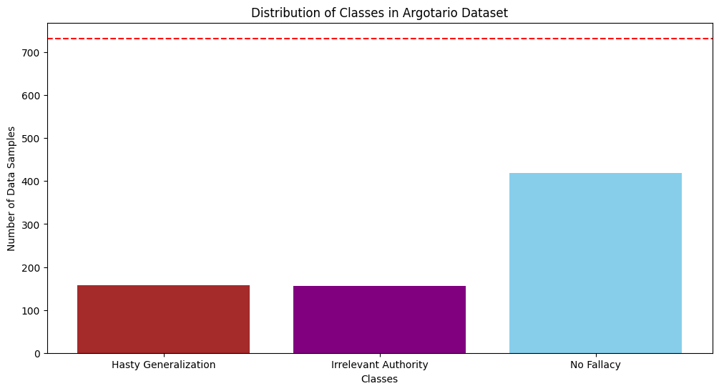
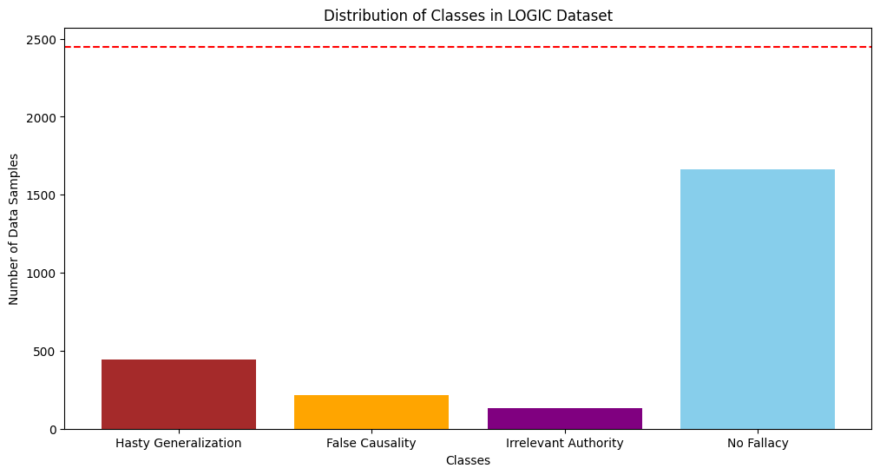
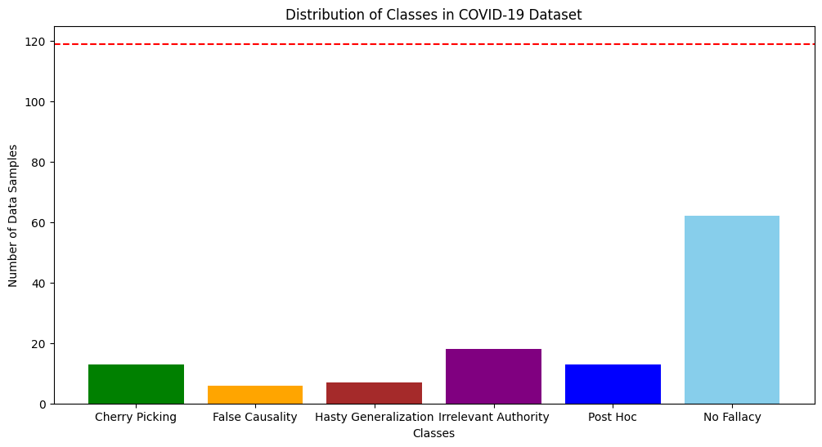
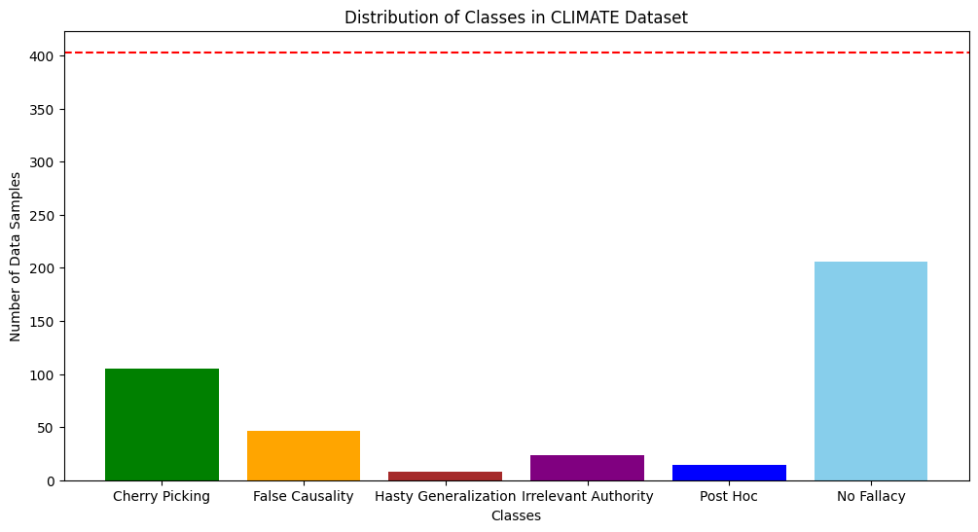
Progress
데이터 분포(with No Fallacy)
Notes:
c

Slide 12
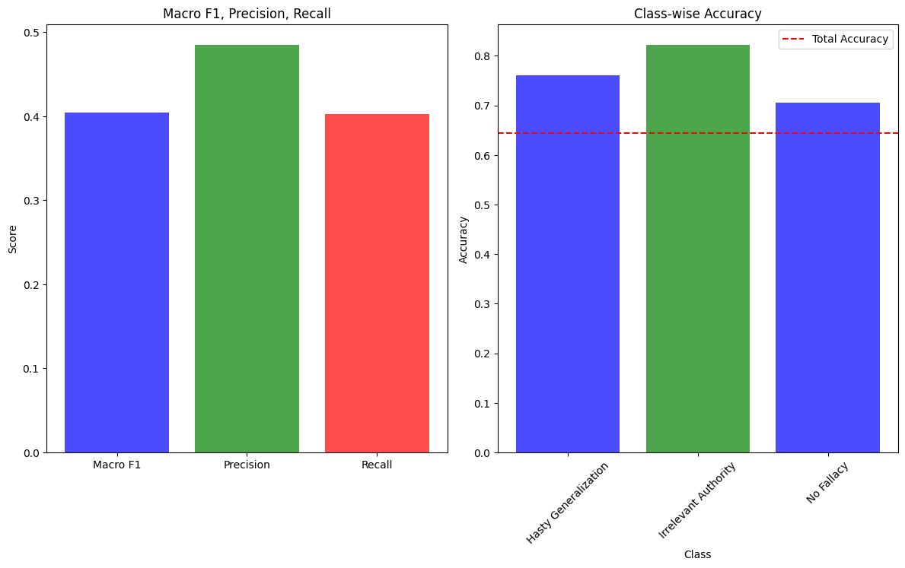
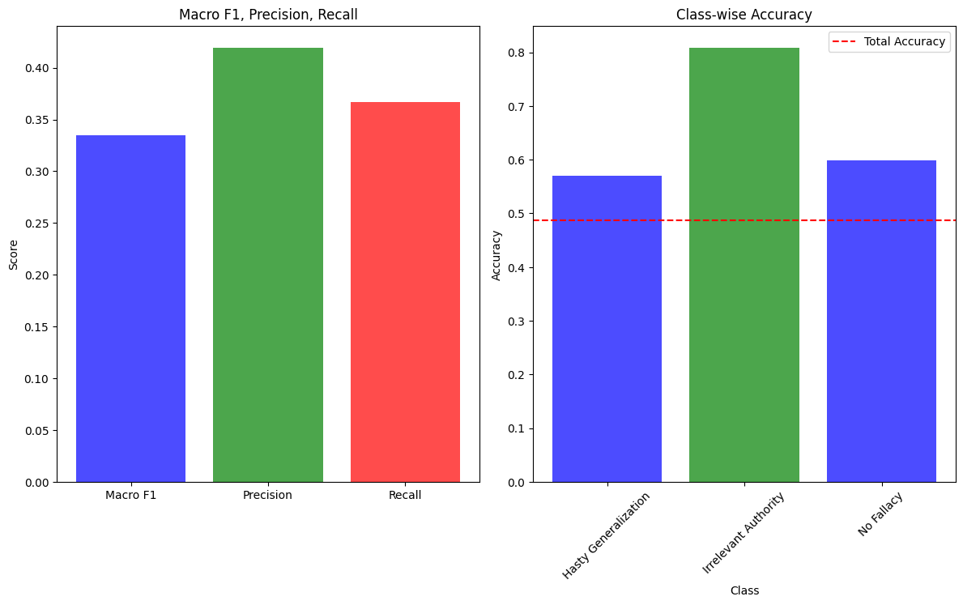
Progress
결과(Argotario)
Zero-Shot
Two-Shot
Notes:
c

Slide 13
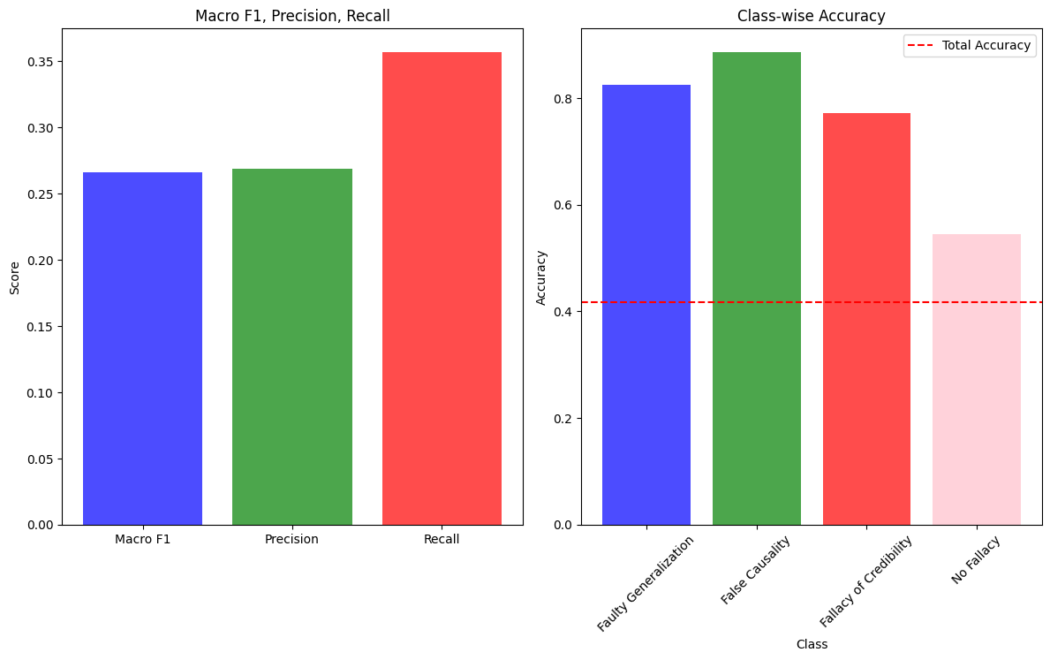
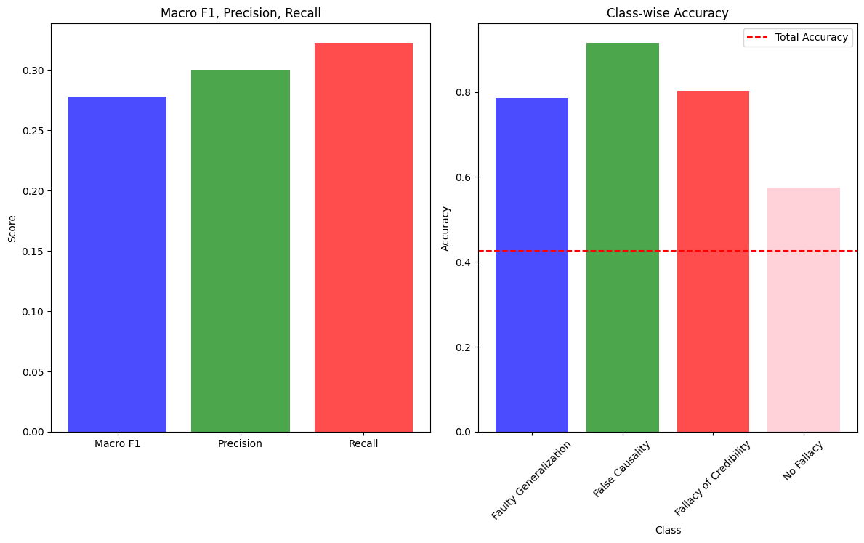
Progress
결과(LOGIC)
Zero-Shot
Two-Shot
Notes:
c

Slide 14
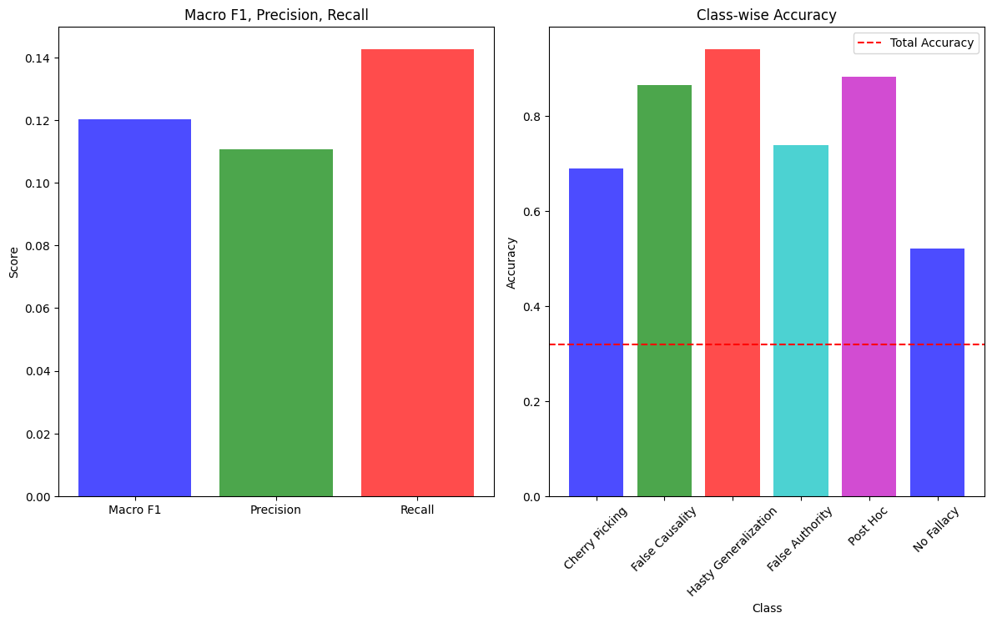
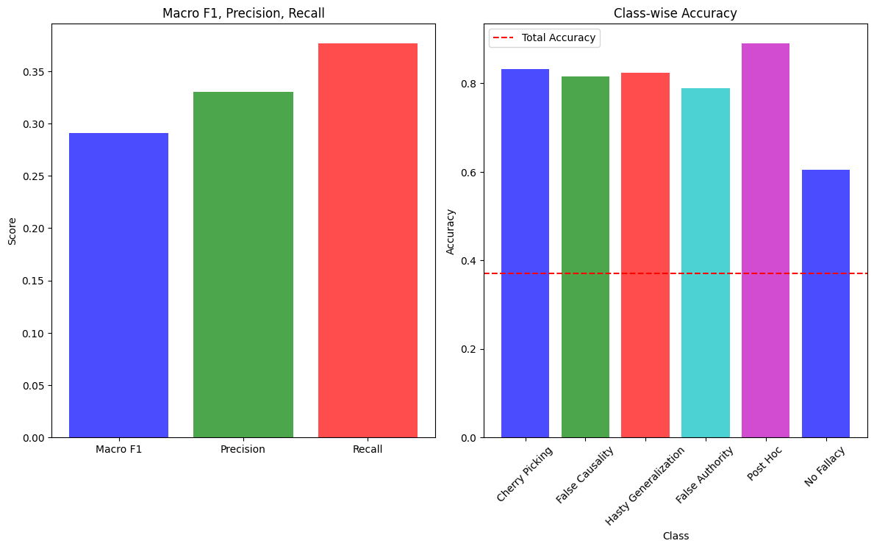
Progress
결과(COVID-19)
Zero-Shot
Two-Shot
Notes:
c

Slide 15
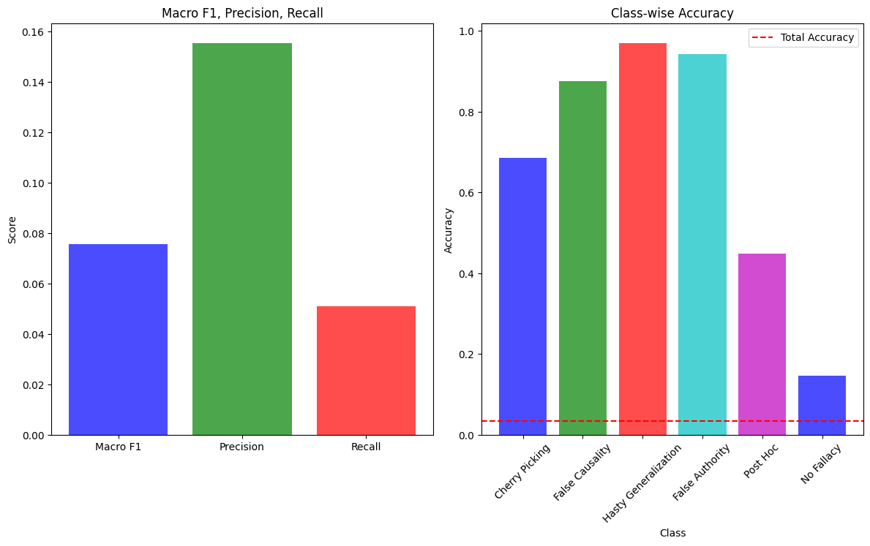
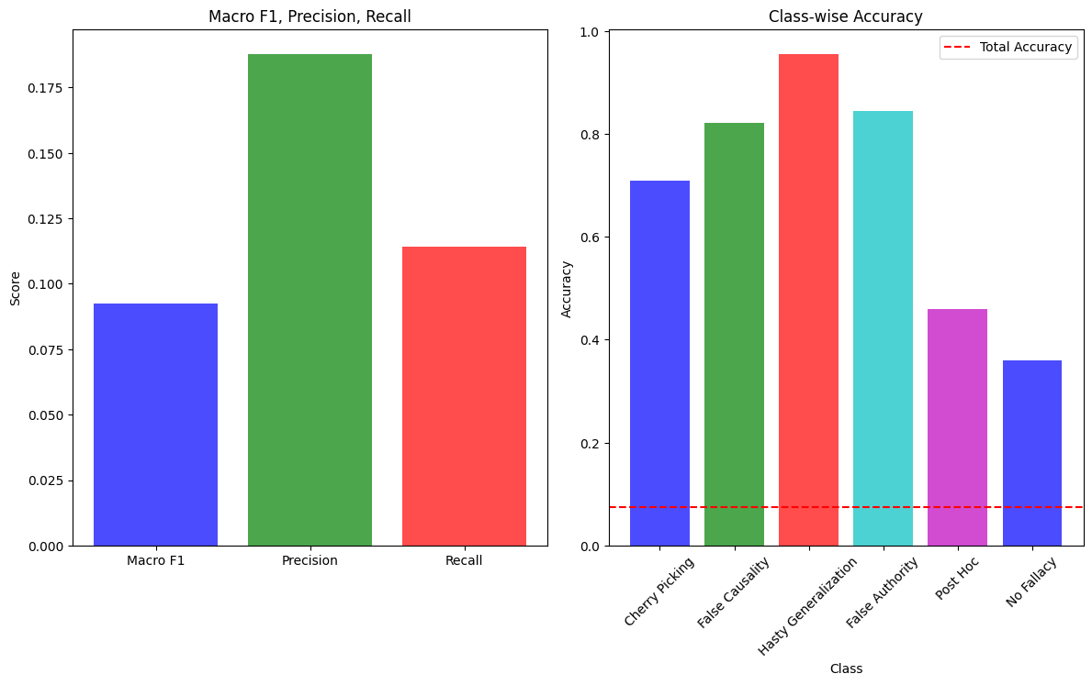
Progress
결과(CLIMATE)
Zero-Shot
Two-Shot
Notes:
c

Slide 16
Progress
결과(Table)-without No Fallacy
Dataset | Total Accuracy | Precision | Recall | Macro-F1
Argotario (Zero-Shot) | 0.5879 | 0.4871 | 0.3917 | 0.4324
Argotario (Two-Shot) | 0.5208 | 0.4929 | 0.3467 | 0.3751
LOGIC (Zero-Shot) | 0.3574 | 0.4053 | 0.3807 | 0.3311
LOGIC (Two-Shot) | 0.3067 | 0.4749 | 0.3414 | 0.3481
COVID-19 (Zero-Shot) | 0.3158 | 0.2290 | 0.2731 | 0.2196
COVID-19 (Two-Shot) | 0.4737 | 0.4779 | 0.4474 | 0.4119
CLIMATE (Zero-Shot) | 0.3401 | 0.2249 | 0.2245 | 0.2037
CLIMATE (Two-Shot) | 0.2589 | 02167 | 0.2412 | 0.1869
AVG(Zero-Shot) | 0.3902 | 0.3519 | 0.3099 | 0.2969
AVG(Two-Shot) | 0.3964 | 0.4174 | 0.3415 | 0.3313
2-shot 평균이 높은 이유는 COVID데이터 때문
Notes:
c

Slide 17
Progress
결과(Table)-without No Fallacy
Class | Zero-Shot Accuracy | Two-Shot Accuracy
Faulty Generalization (441) | 0.6641 | 0.4601
False Causality (216) | 0.7389 | 0.8150
Irrelevant Authority (132) | 0.8707 | 0.8948
Total (789) | 0.3574 | 0.3067
Class | Zero-Shot Accuracy | Two-Shot Accuracy
Cherry Picking (105) | 0.5635 | 0.4670
False Cause (46) | 0.7310 | 0.6345
Hasty Generalization (8) | 0.8629 | 0.8832
False Authority (24) | 0.7157 | 0.6497
Post Hoc (14) | 0.9137 | 0.9086
Total (197) | 0.3401 | 0.2589
LOGIC
Class | Zero-Shot Accuracy | Two-Shot Accuracy
Cherry Picking (13) | 0.6842 | 0.7193
False Causality (6) | 0.6316 | 0.7368
Hasty Generalization (7) | 0.8596 | 0.9123
False Authority (18) | 0.7018 | 0.7368
Post Hoc (13) | 0.7719 | 0.8596
Total (57) | 0.3158 | 0.4737
CLIMATE
Class | Zero-Shot Accuracy | Two-Shot Accuracy
Hasty Generalization (157) | 0.7061 | 0.6422
Irrelevant Authority (156) | 0.6645 | 0.6294
Total (313) | 0.5879 | 0.5208
Argotario
COVID-19
Notes:
c

Slide 18
Progress
결과(Table)-with No Fallacy
Dataset | Total Accuracy | Precision | Recall | Macro-F1
Argotario (Zero-Shot) | 0.6434 | 0.4851 | 0.4029 | 0.4039
Argotario (Two-Shot) | 0.4877 | 0.4194 | 0.3667 | 0.3348
LOGIC (Zero-Shot) | 0.4173 | 0.2688 | 0.3570 | 0.2661
LOGIC (Two-Shot) | 0.4263 | 0.2999 | 0.3225 | 0.2776
COVID-19 (Zero-Shot) | 0.3193 | 0.1108 | 0.1427 | 0.1203
COVID-19 (Two-Shot) | 0.3697 | 0.3302 | 0.3769 | 0.2908
CLIMATE (Zero-Shot) | 0.0347 | 0.1555 | 0.0510 | 0.0756
CLIMATE (Two-Shot) | 0.0744 | 0.1878 | 0.1142 | 0.0923
AVG(Zero-Shot) | 0.3537 | 0.2551 | 0.2384 | 0.2165
AVG(Two-Shot) | 0.3395 | 0.3093 | 0.2951 | 0.2489
2-shot 평균이 높은 이유는 COVID데이터 때문
Notes:
c

Slide 19
Progress
결과(Table)-with No Fallacy
Class | Zero-Shot Accuracy | Two-Shot Accuracy
Cherry Picking (105) | 0.6849 | 0.7097
False Cause (46) | 0.8759 | 0.8213
Hasty Generalization (8) | 0.9702 | 0.9553
False Authority (24) | 0.9429 | 0.8437
Post Hoc (14) | 0.4491 | 0.4591
No Fallacy (206) | 0.1464 | 0.3598
Total (197) | 0.0347 | 0.0744
Class | Zero-Shot Accuracy | Two-Shot Accuracy
Faulty Generalization (441) | 0.8248 | 0.7852
False Causality (216) | 0.8865 | 0.9163
Irrelevant Authority (132) | 0.7722 | 0.8024
No Fallacy (1660) | 0.5439 | 0.5741
Total (789) | 0.4173 | 0.4263
LOGIC
Class | Zero-Shot Accuracy | Two-Shot Accuracy
Cherry Picking (13) | 0.6891 | 0.8319
False Causality (6) | 0.8655 | 0.8151
Hasty Generalization (7) | 0.9412 | 0.8235
False Authority (18) | 0.7395 | 0.7899
Post Hoc (13) | 0.8824 | 0.8908
No Fallacy (62) | 0.5210 | 0.6050
Total (57) | 0.3193 | 0.3697
CLIMATE
Class | Zero-Shot Accuracy | Two-Shot Accuracy
Hasty Generalization (157) | 0.7609 | 0.5697
Irrelevant Authority (156) | 0.8224 | 0.8087
No Fallacy (419) | 0.7049 | 0.5984
Total (732) | 0.6434 | 0.4877
COVID-19
Argotario
Notes:
c

