Slide 1
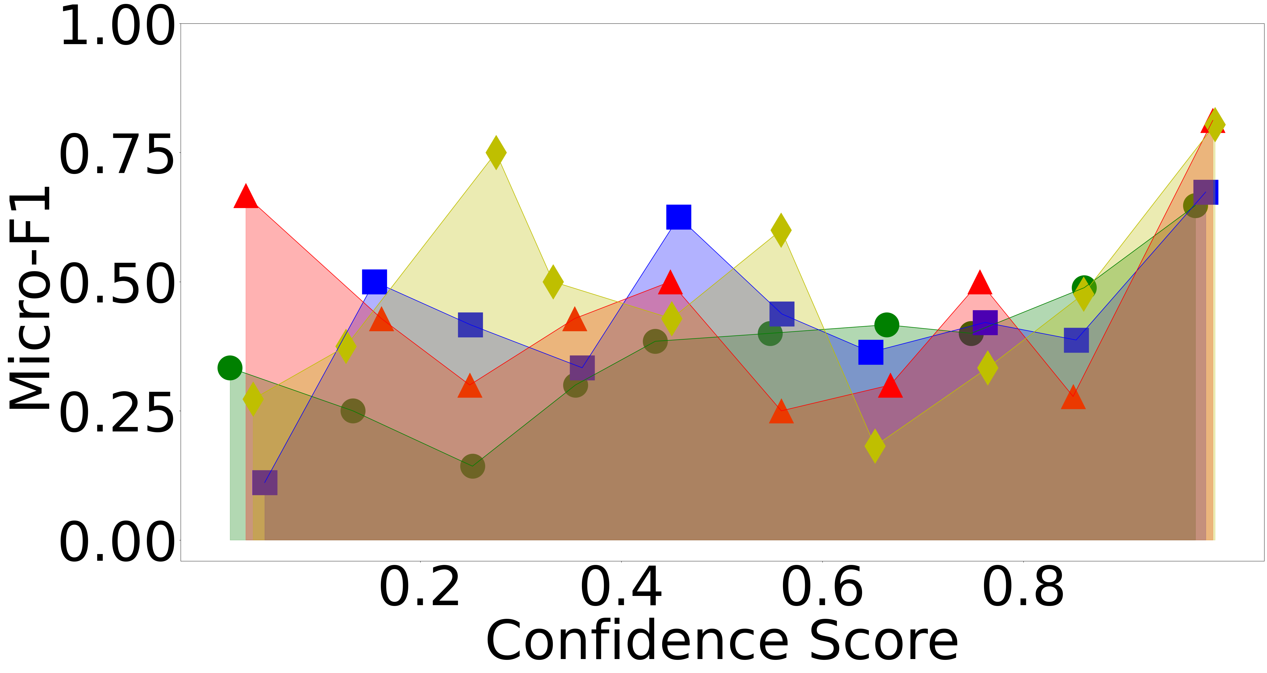
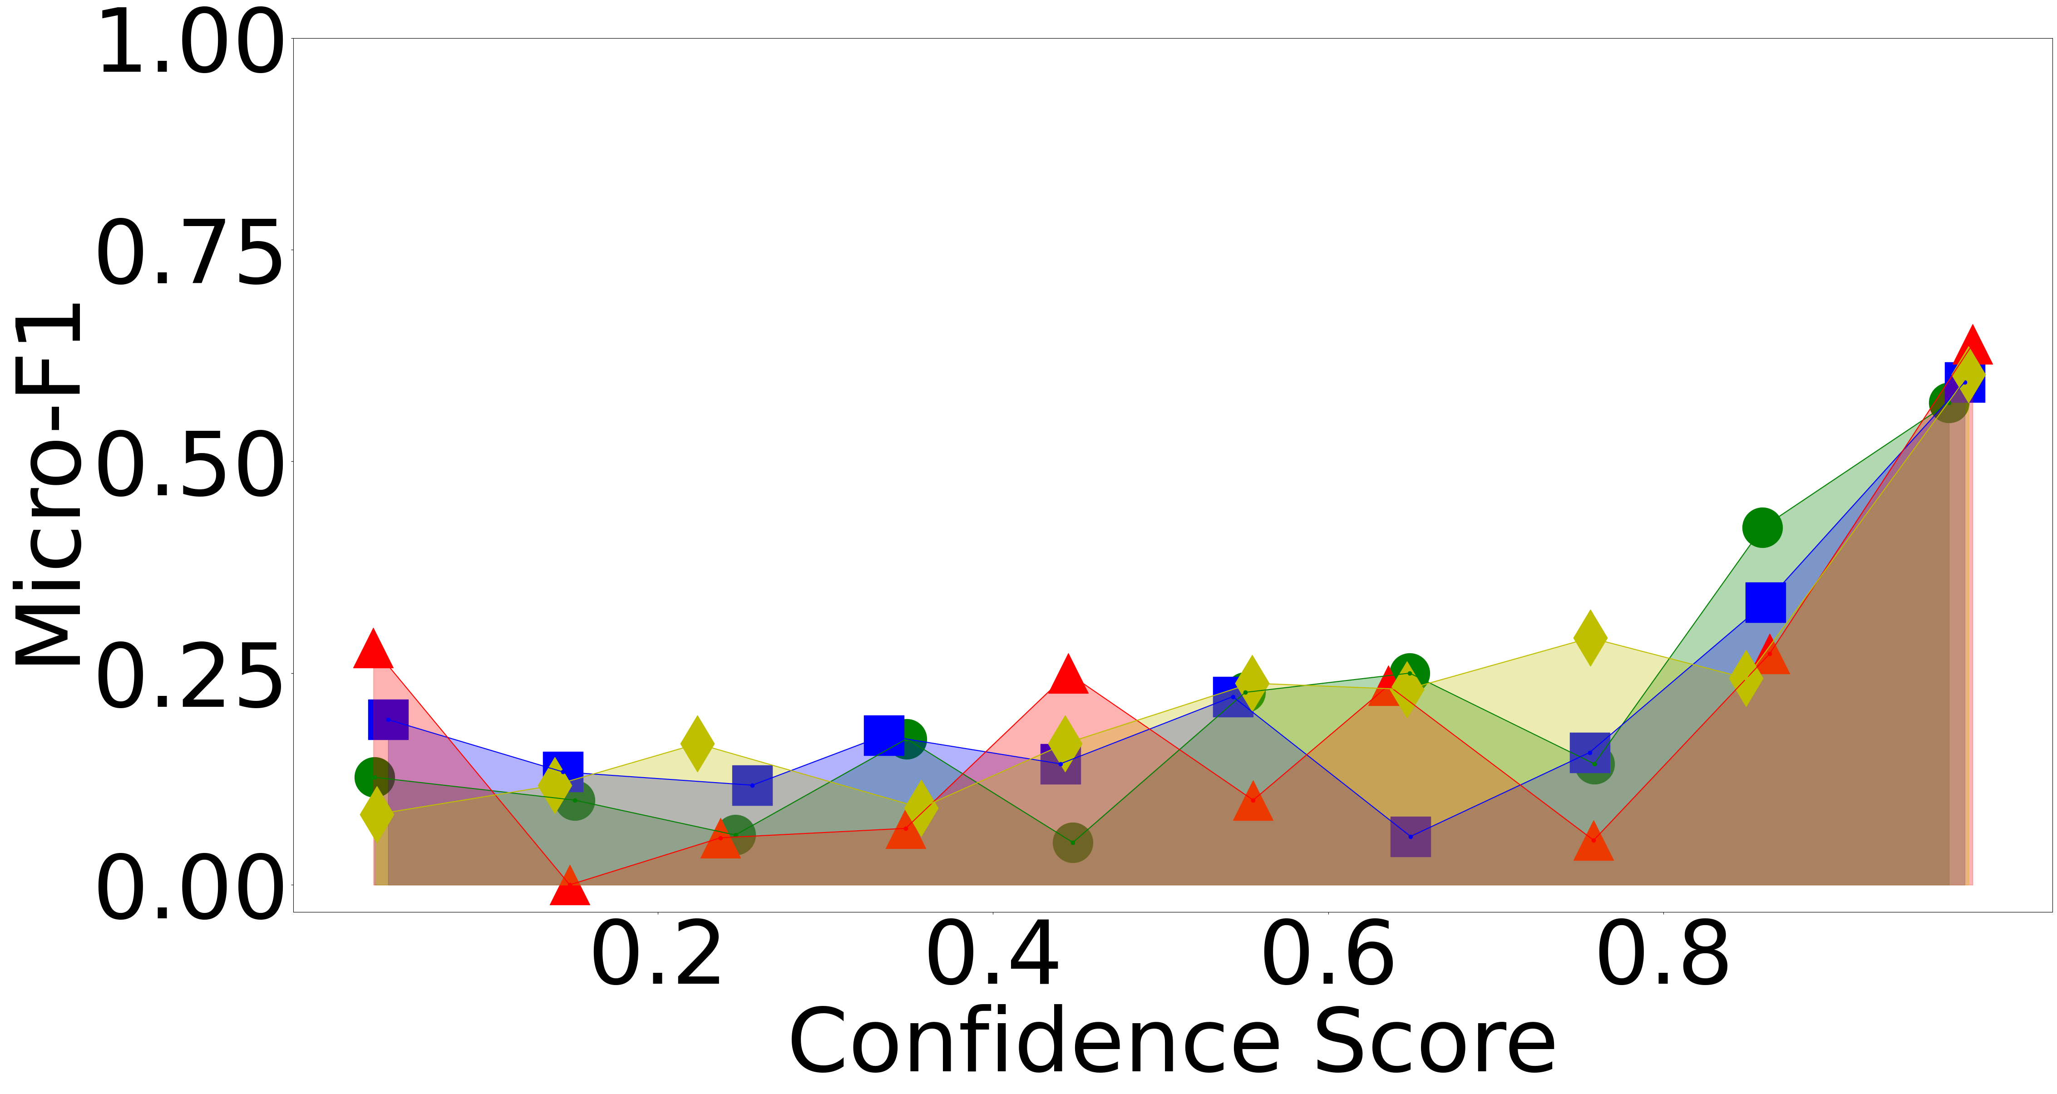
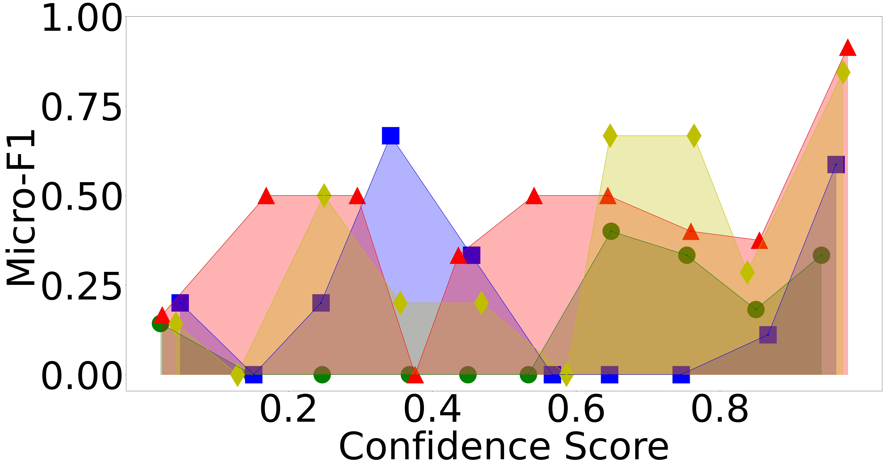
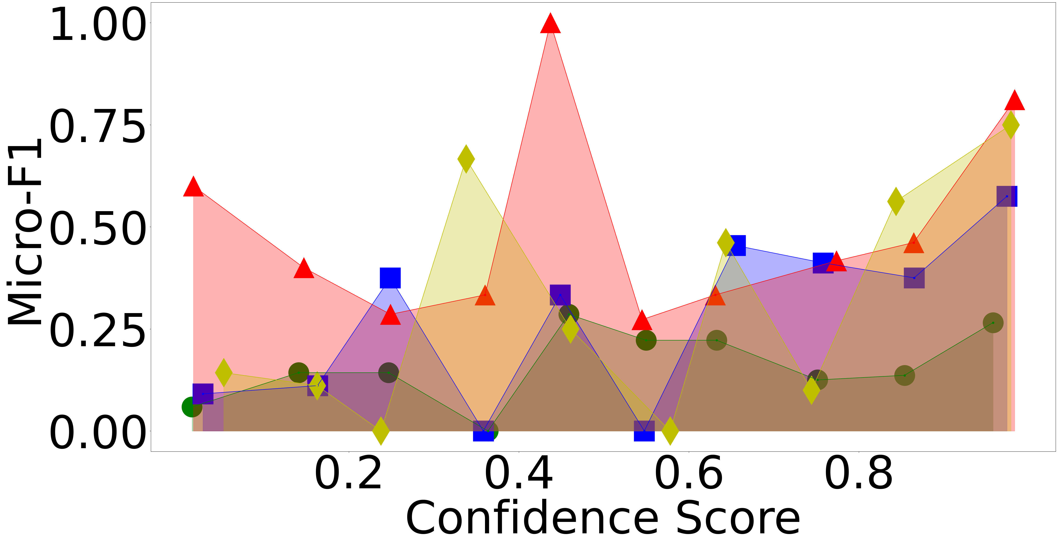
Progress
Confidence Score(Query Validation 재실험)
초록 : base, 파랑 : cg, 빨강 : ex, 노랑 : go
ARGOTARIO
LOGIC
COVID-19
CLIMATE

Slide 2
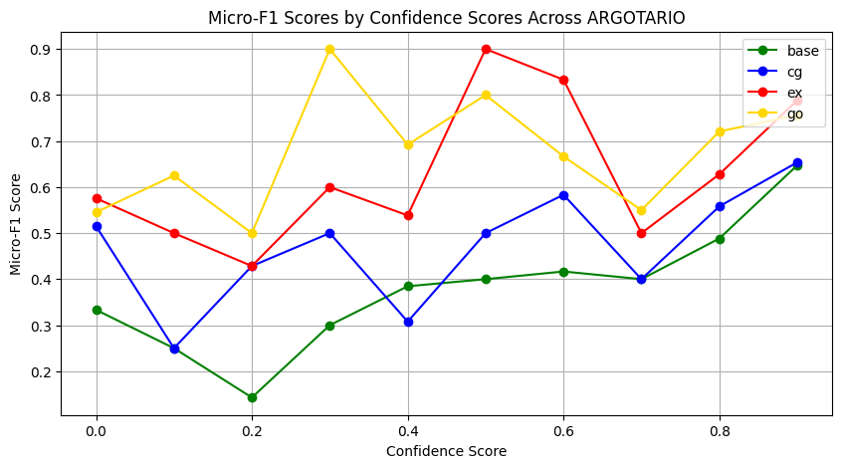
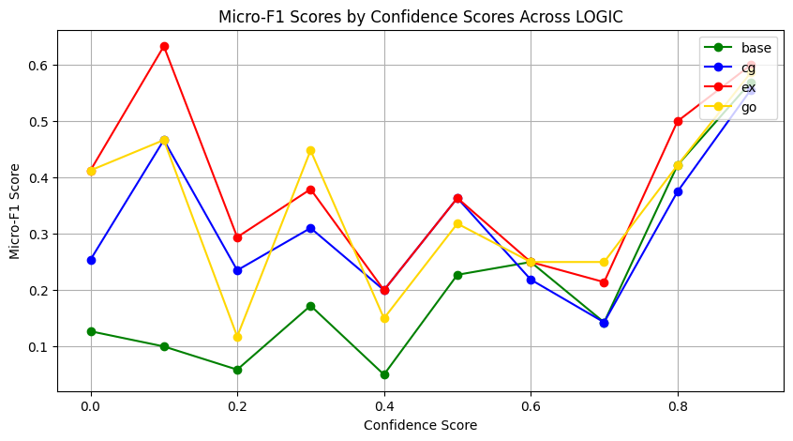
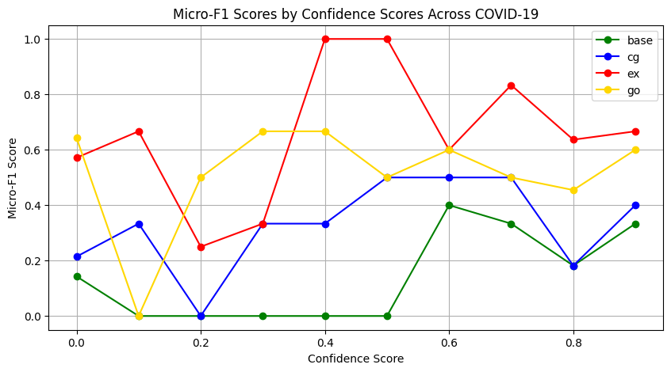
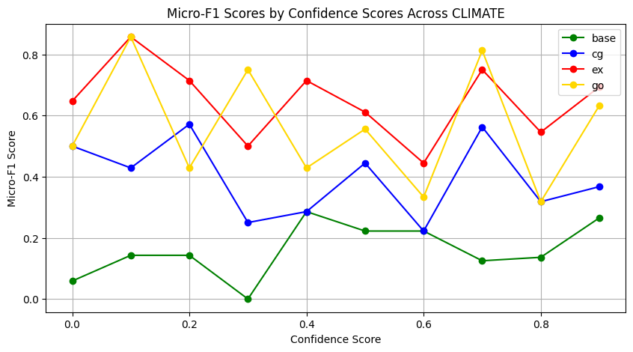
Progress
Confidence score 추가실험
Notes:
c

Slide 3
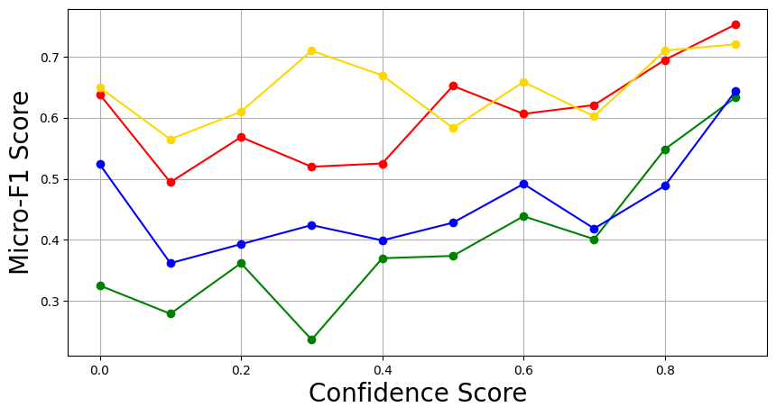
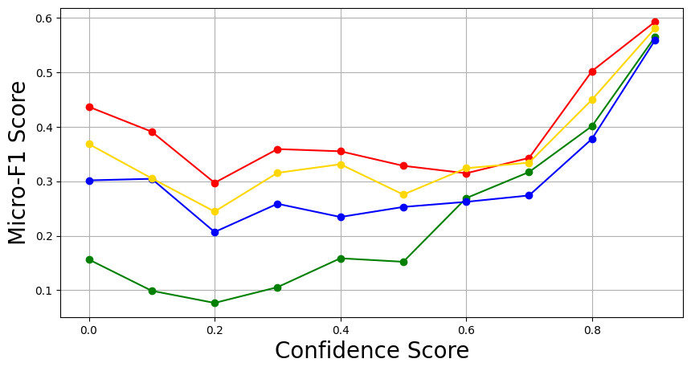
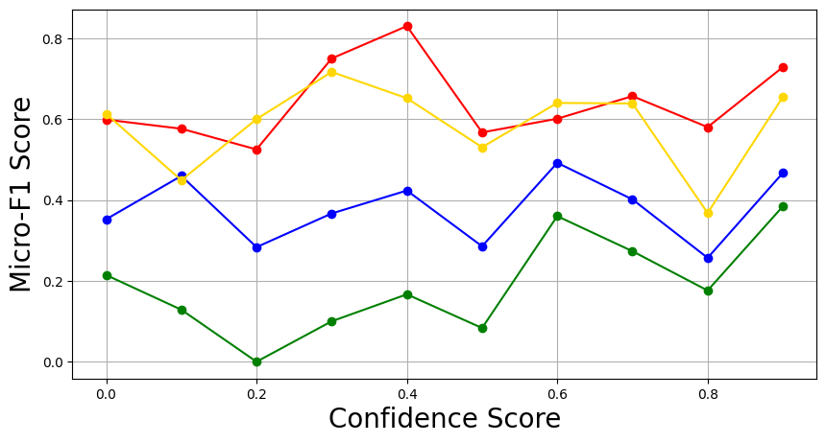
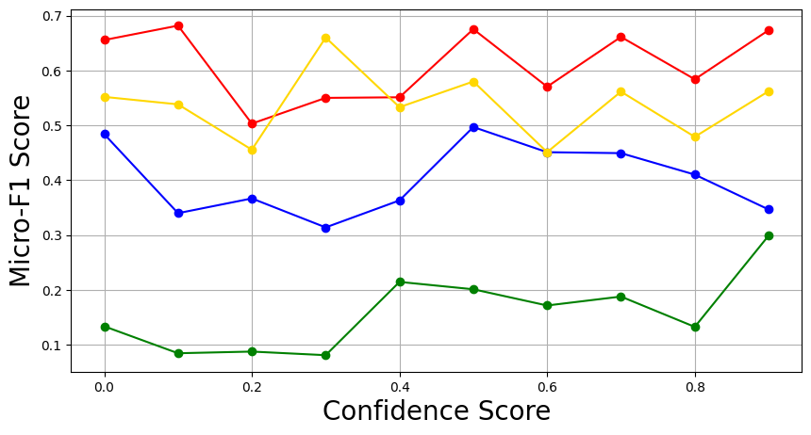
Progress
Confidence score 추가실험
Notes:
c

Slide 4
Progress
Confidence score 추가실험(10회 평균)
LOGIC
ARGOTARIO
CLIMATE
COVID-19
Notes:
c

Slide 5
Progress
Confidence score 추가실험(비교)
Notes:
c

Slide 6
Progress
Confidence score 추가실험(비교)
Notes:
c

