Slide 1


2023년 8월 11일 Study Meeting
상식 기반 QA 모델에서의 그래프 순환 구조의 영향
Influence of Graph Cyclic structure on Common Sense - based QA models
정지$원$
성균관대학교 인공지능학과
석사과정
jwjw9603@g.skku.edu

Slide 2
Influence of Graph Cyclic structure
Contents
01
Progress
지난 내용
진행 상황

Slide 3
지난 내용
Weekly Plan
Relation(Edge) to Text 과정에서 어떻게 바꿀지를 생각해보자.
Node_list를 추출 후 Cycle Passage를 만들어보자.
Notes:
c

Slide 4
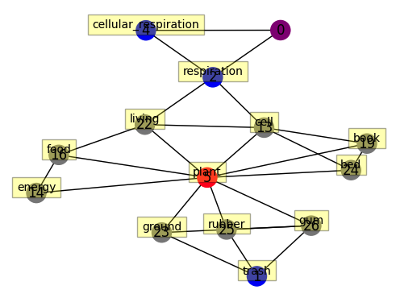
지난 내용
Method Review
Q. “Cellular respiration’s trash is”
A. a bug’s treasure B. a cow’s treasure C. a plant’s treasure D. everyone’s trash
+ Noun chunk node
Noun chunk node to make more cycle
Noun chunk can help to reason QA task
…
…
Cellular respiration's trash
a plant’s treasure
Ablation Study
Notes:
c

Slide 5
지난 내용
Make template(text) about Cycles
respiration – causes - living
living – related to - cell
CP1
cell – related to - respiration
여기까지 진행
…
…
Cellular respiration's trash
a plant’s treasure
Passage from BM25
cp1
…
https://github.com/dorianbrown/rank_bm25
cp2
cpN
Passage from DPR
https://dl.fbaipublicfiles.com/dpr/
cp1
cp2
…
cpN
+
QA context
Cellular respiration’s trash is a plant’s treasure.
It is used for Query
Notes:
c

Slide 6
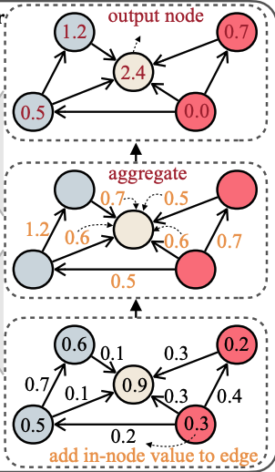
지난 내용
Passage from BM25
# N개의 Cycle Passage
https://github.com/dorianbrown/rank_bm25
…
Cross Encoder
cp1
cp2
cpN
Passage from DPR
# N개의 Cycle Passage
https://dl.fbaipublicfiles.com/dpr/
…
cp1
cp2
cpN
https://github.com/microsoft/MSMARCO-Passage-Ranking
+
Reranking
QA context
Cellular respiration’s trash is a plant’s treasure.
Cycle Passage 1
Cycle Passage 5
Top-K Cycle passage
GSC
…
Cycle Passage K
Graph Pruning Based Cycle Passage
Top-k개 속하지 않는 or 하위 K개의 사이클에 속한 에지들을 자른다면??
MLP/ attention
MLP는 질문 노드와 답변 노드간의 path를 단순히 MLP에 넣기
Notes:
c

Slide 7
진행상황
Code Level 지난 내용 및 진행 상황
Model.py
Model.py를 작동시키면 미니배치만큼 modeling_{model}.py에 인풋 데이터가 들어감
인풋 데이터는 LM_{model}_dataLoader 클래스를 통해 만들어지며 미니 배치만큼 데이터 분할은 MultiGPUSparseAdjDataBatchGenerator 클래스가 함
CSQA는 문제당 5개의 subgraph, OBQA는 문제당 4개의 subgraph가 생성되며 미니 배치가 4개라면 edge_index, edge_type, concept_ids에 20개의 문제+정답의 subgraph가 들어감
MultiGPUSparseAdjDataBatchGenerator의 시간 복잡도는 O(문제수/미니배치)이며 이 반복문 안에 사이클 트리플을 찾고 저장하는 코드를 대입하고자 함
LinkedList와 DFS를 사용하여 O(#E)의 알고리즘을 완성함
1.14초 -> 0.10초 -> 0.0001초
Triple을 찾고 텍스트화 코딩을 진행중
텍스트 화 코딩 완료 후 전체 데이터에 적용 완료
이는 전처리로 진행하기 위해 pickle파일로 저장함
Modeling_{model}.py에서 BM25, DPR, 을 대입할 예정
Reranking도 마찬가지로 대입할 예정
사전학습된 SentenceBERT 사용
미니 배치만큼 학습 반복
LM_{model}_dataLoader
MultiGPUSparseAdjDataBatchGenerator
Modeling_{model}.py
modeling_encoder.py
Notes:
c

Slide 8
진행상황
Cycle Passage
[[0, 0, 2, 2, 36, 3, 3, 19, 0], [0, 0, 3, 3, 17, 2, 2, 19, 0], [1, 36, 5, 5, 26, 9, 9, 17, 1], [1, 36, 5, 5, 26, 9, 9, 9, 1], [1, 36, 6, 6, 36, 9, 9, 17, 1], [1, 36, 6, 6, 36, 9, 9, 9, 1], [1, 17, 6, 6, 36, 9, 9, 17, 1], [1, 17, 6, 6, 36, 9, 9, 9, 1], [1, 17, 7, 7, 36, 8, 8, 17, 1], [1, 17, 7, 7, 26, 9, 9, 17, 1], [1, 17, 7, 7, 26, 9, 9, 9, 1], [1, 36, 8, 8, 17, 7, 7, 36, 1], [1, 36, 8, 8, 17, 9, 9, 17, 1], [1, 36, 8, 8, 17, 9, 9, 9, 1], [1, 36, 9, 9, 7, 5, 5, 17, 1], [1, 28, 9, 9, 7, 5, 5, 17, 1], [1, 36, 9, 9, 17, 6, 6, 36, 1], [1, 36, 9, 9, 17, 6, 6, 17, 1], [1, 28, 9, 9, 17, 6, 6, 36, 1], [1, 28, 9, 9, 17, 6, 6, 17, 1], [1, 36, 9, 9, 7, 7, 7, 36, 1], [1, 28, 9, 9, 7, 7, 7, 36, 1], [1, 36, 9, 9, 36, 8, 8, 17, 1], [1, 28, 9, 9, 36, 8, 8, 17, 1], [2, 36, 3, 3, 12, 4, 4, 36, 2], [2, 36, 3, 3, 29, 10, 10, 36, 2], [2, 17, 4, 4, 31, 3, 3, 17, 2], [2, 7, 5, 5, 26, 9, 9, 36, 2], [2, 17, 5, 5, 26, 9, 9, 36, 2], [2, 17, 6, 6, 36, 9, 9, 36, 2], [2, 17, 7, 7, 26, 9, 9, 36, 2], [2, 7, 7, 7, 26, 9, 9, 36, 2], [2, 17, 7, 7, 17, 10, 10, 36, 2], [2, 7, 7, 7, 17, 10, 10, 36, 2], [2, 17, 9, 9, 7, 5, 5, 36, 2], [2, 17, 9, 9, 7, 5, 5, 26, 2], [2, 17, 9, 9, 17, 6, 6, 36, 2], [2, 17, 9, 9, 7, 7, 7, 36, 2], [2, 17, 9, 9, 7, 7, 7, 26, 2], [2, 17, 10, 10, 10, 3, 3, 17, 2], [2, 17, 10, 10, 36, 7, 7, 36, 2], [2, 17, 10, 10, 36, 7, 7, 26, 2], [3, 4, 8, 8, 17, 10, 10, 10, 3], [3, 29, 10, 10, 36, 8, 8, 23, 3], [7, 36, 8, 8, 17, 9, 9, 7, 7], [7, 36, 8, 8, 17, 10, 10, 36, 7], [7, 26, 9, 9, 36, 8, 8, 17, 7], [7, 17, 10, 10, 36, 8, 8, 17, 7]]
[[0, 2, 3], [0, 3, 2], [1, 5, 9], [1, 6, 9], [1, 7, 8], [1, 7, 9], [1, 8, 7], [1, 8, 9], [1, 9, 5], [1, 9, 6], [1, 9, 7], [1, 9, 8], [2, 3, 4], [2, 3, 10], [2, 4, 3], [2, 5, 9], [2, 6, 9], [2, 7, 9], [2, 7, 10], [2, 9, 5], [2, 9, 6], [2, 9, 7], [2, 10, 3], [2, 10, 7], [3, 8, 10], [3, 10, 8], [7, 8, 9], [7, 8, 10], [7, 9, 8], [7, 10, 8]]
문제가 끝날 때마다 <EOS>, 1개의 subgraph가 끝날때마다 <SEP>가 대입됨
Notes:
c

Slide 9
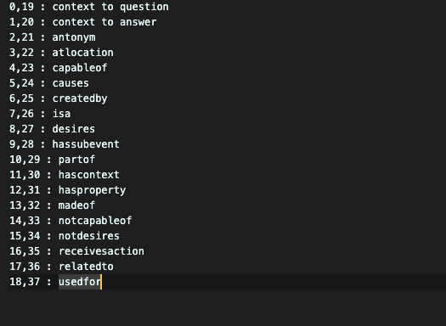
진행상황
Relation to Text
0,19 : context to question | “is context and that is question “ | “is question and that is context” 1,20 : context to answer | “is context and that is answer” | “is answer and that is context”
2,21 : antonym | “is the antonym of” | “is the antonym of”
3,22 : atlocation | “is at location of “ | “ is considered as the location of “
4,23 : capableof | “is capable of” | “is capable of being” -> “is used to make”
5,24 : causes | “causes” | “is caused by”
6,25 : createdby | “is created by” | “creates”
7,26 : isa | “is a” | “is a”| “is a”
8,27 : desires | “desires” | “desires”
9,28 : hassubevent | “has subevent” | “is the subevent of “
10,29 : partof | “is part of” | “includes”
11,30 : hascontext | “has context” | “is the context of “
12,31 : hasproperty | “has property” | “is the property of”
13,32 : madeof | “is made of” | “is the material of” -> “is used to make”
14,33 : notcapableof | “is not capable of” | “is not capable of being”
15,34 : notdesires | “does not desire” | “does not desire”
16,35 : receivesaction | “is” | “is”
17,36 : relatedto | “is related to” | “is related to“
18,37 : usedfor | “is used for” | uses
Notes:
c

Slide 10
진행상황
Relation to Text
Book is made of paper <-> Paper is the material of book -> Paper used to make book
Computer is made of silicons <-> Silicon is the material of computer -> silicon makes computer
Book is capable of teaching a person to sing <-> Teaching a person to sing can make it from book
A tree is capable of being grow <-> growing can make it from a tree
A miner is capable of mining coal <-> mining coal can make it from a miner
A sailor is capable of captaining a ship <-> captaining a ship can make it from a sailor
A kite is capable of flying <-> flying can make it from a kite
Notes:
c

Slide 11
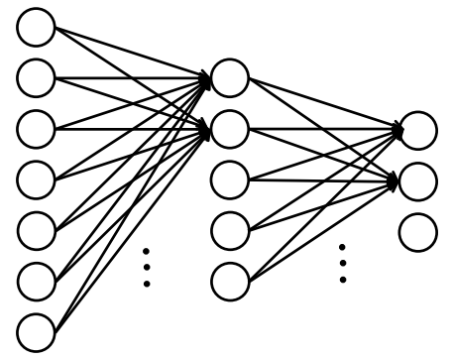
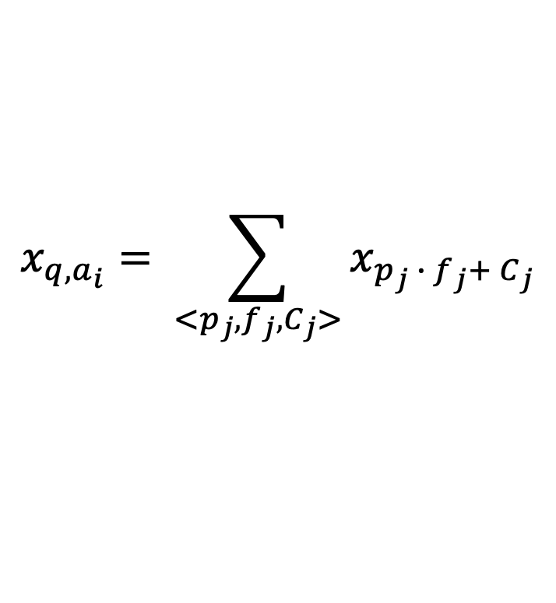




진행상황
Path based MLP
$p=\{t_{v_{1}}, cycle count feature, r_{1}, t_{v_{2}}, r_{2}, …, r_{k−1}, t_{v_{k}}\}$,
Each value represents one-hot feature,
Cycle count feature indicates the number of cycles of each node between paths, and handles only nodes belonging to the top-k cycle passage,
$$x_{v}=MLP_{2}(MLP_{1}\left(v_{p}\right))$$
Cp count
Frequency
Relation Paths
MLP
1
2
0
1
…
3
1
2
1
…
$$x_{1}$$
$$x_{2}$$
$$x_{3}$$
$$x_{4}$$
…
…
$$x_{q,a_{i}}= \sum_{<p_{j},f_{j}, C_{j}>}{x_{p_{j} ∙ f_{j}+ C_{j}}}$$
Notes:
c₩1

Slide 12
감사합니다
발표 경청해 주셔서 감사합니다
정지원 성균관대학교 인공지능학과 석사 과정
jwjw9603@g.skku.edu

