Slide 1

00
Study Meeting
LearnData Lab
LearnData Lab @SKKU
1월 20일 연구 미팅
Natural Language Processing and Commonsense Reasoning for the Next of QnA System
정지원

Slide 2
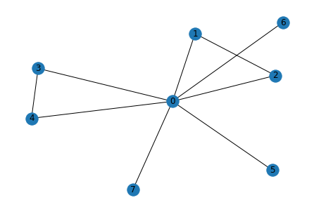
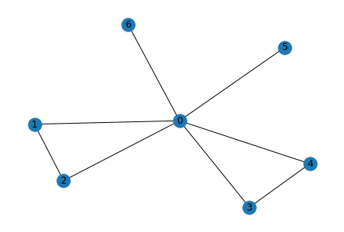
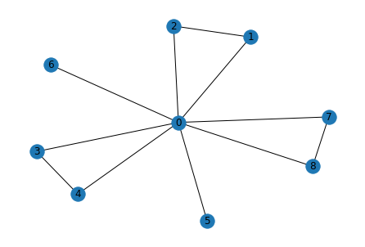
01
Study Meeting
LearnData Lab
LearnData Lab @SKKU
이 문제는 순전히 LM의 힘이 큼
Graph score& final 크기순서
1.Cycle encoder
D > B> A -> B > D > A
2. GSC
D > B > A -> A > B > D
Cycle 개수 순위
D > B = A
진행 상황
Q. What might have a drop of flood on their fingertip?
A. needle B. person C. clock D. test tube E. battlefield
person_might
needle
fingertip
drop
might
test
drop
flood
fingertip
drop
test_tube
flood
may
may
tube
might
fingertip
may
person
flood
might
Cycle Encoder(B)
GSC(A)
Highest graph score(D)

Slide 3
Message Passing 2-layer을 지난 후 + MLP 의 임베딩 값 in Cycle encoder
02
Study Meeting
LearnData Lab
LearnData Lab @SKKU
A
B
C
D
E
[[-1.2988],
[-1.4188],
[-1.4188],
[-1.3865],
[-1.3865],
[-1.4421],
[-1.4361],
[-1.4486],
[-1.4486],
[-1.4486],
[-1.4486],
[-1.4486],
[-1.4486],
[-1.4486],
[-1.4486],
[-1.4486],
[-1.4486],
[-1.4486],
[-1.4486],
[-1.4486],
[-1.4486],
[-1.4486],
[-1.4486],
[-1.4486],
[-1.4486],
[-1.4486],
[-1.4486],
[-1.4486],
[-1.4486],
[-1.4486],
[-1.4486],
[-1.4486]],
[[-1.2824],
[-1.4238],
[-1.4238],
[-1.3936],
[-1.3936],
[-1.4449],
[-1.4449],
[-1.4396],
[-1.4486],
[-1.4486],
[-1.4486],
[-1.4486],
[-1.4486],
[-1.4486],
[-1.4486],
[-1.4486],
[-1.4486],
[-1.4486],
[-1.4486],
[-1.4486],
[-1.4486],
[-1.4486],
[-1.4486],
[-1.4486],
[-1.4486],
[-1.4486],
[-1.4486],
[-1.4486],
[-1.4486],
[-1.4486],
[-1.4486],
[-1.4486]],
[[-1.2988],
[-1.4188],
[-1.4188],
[-1.3865],
[-1.3865],
[-1.4421],
[-1.4361],
[-1.4486],
[-1.4486],
[-1.4486],
[-1.4486],
[-1.4486],
[-1.4486],
[-1.4486],
[-1.4486],
[-1.4486],
[-1.4486],
[-1.4486],
[-1.4486],
[-1.4486],
[-1.4486],
[-1.4486],
[-1.4486],
[-1.4486],
[-1.4486],
[-1.4486],
[-1.4486],
[-1.4486],
[-1.4486],
[-1.4486],
[-1.4486],
[-1.4486]],
[[-1.1909],
[-1.3969],
[-1.3969],
[-1.3597],
[-1.3597],
[-1.4267],
[-1.4180],
[-1.3953],
[-1.3953],
[-1.4486],
[-1.4486],
[-1.4486],
[-1.4486],
[-1.4486],
[-1.4486],
[-1.4486],
[-1.4486],
[-1.4486],
[-1.4486],
[-1.4486],
[-1.4486],
[-1.4486],
[-1.4486],
[-1.4486],
[-1.4486],
[-1.4486],
[-1.4486],
[-1.4486],
[-1.4486],
[-1.4486],
[-1.4486],
[-1.4486]]
[[-1.2988],
[-1.4188],
[-1.4188],
[-1.3865],
[-1.3865],
[-1.4421],
[-1.4361],
[-1.4486],
[-1.4486],
[-1.4486],
[-1.4486],
[-1.4486],
[-1.4486],
[-1.4486],
[-1.4486],
[-1.4486],
[-1.4486],
[-1.4486],
[-1.4486],
[-1.4486],
[-1.4486],
[-1.4486],
[-1.4486],
[-1.4486],
[-1.4486],
[-1.4486],
[-1.4486],
[-1.4486],
[-1.4486],
[-1.4486],
[-1.4486],
[-1.4486]],

Slide 4
B in Cycle Encoder
6
Study Meeting
LearnData Lab
LM의 값(context score)과 더한 최종 값
LearnData Lab @SKKU
Graph score
[-1.2988],A
[-1.2824],B
[-1.2988],C
[-1.1909],D
[-1.2988],E
[-3.1120,A
-2.3809,B
-7.8380,C
-5.3621,D
-5.7331]E

Slide 5
Message Passing 2-layer을 지난 후 + MLP 의 임베딩 값 in GSC
6
Study Meeting
LearnData Lab
LearnData Lab @SKKU
A
B
C
D
E
[[-1.2627],
[-1.3414],
[-1.3414],
[-1.3088],
[-1.3088],
[-1.4054],
[-1.3970],
[-1.5911],
[-1.5911],
[-1.5911],
[-1.5911],
[-1.5911],
[-1.5911],
[-1.5911],
[-1.5911],
[-1.5911],
[-1.5911],
[-1.5911],
[-1.5911],
[-1.5911],
[-1.5911],
[-1.5911],
[-1.5911],
[-1.5911],
[-1.5911],
[-1.5911],
[-1.5911],
[-1.5911],
[-1.5911],
[-1.5911],
[-1.5911],
[-1.5911]],
[[-1.2461],
[-1.3269],
[-1.3269],
[-1.2942],
[-1.2942],
[-1.3911],
[-1.3911],
[-1.3826],
[-1.5911],
[-1.5911],
[-1.5911],
[-1.5911],
[-1.5911],
[-1.5911],
[-1.5911],
[-1.5911],
[-1.5911],
[-1.5911],
[-1.5911],
[-1.5911],
[-1.5911],
[-1.5911],
[-1.5911],
[-1.5911],
[-1.5911],
[-1.5911],
[-1.5911],
[-1.5911],
[-1.5911],
[-1.5911],
[-1.5911],
[-1.5911]]
[[-1.2627],
[-1.3414],
[-1.3414],
[-1.3088],
[-1.3088],
[-1.4054],
[-1.3970],
[-1.5911],
[-1.5911],
[-1.5911],
[-1.5911],
[-1.5911],
[-1.5911],
[-1.5911],
[-1.5911],
[-1.5911],
[-1.5911],
[-1.5911],
[-1.5911],
[-1.5911],
[-1.5911],
[-1.5911],
[-1.5911],
[-1.5911],
[-1.5911],
[-1.5911],
[-1.5911],
[-1.5911],
[-1.5911],
[-1.5911],
[-1.5911],
[-1.5911]]
[[-0.9912],
[-1.1010],
[-1.1010],
[-1.0677],
[-1.0677],
[-1.1668],
[-1.1581],
[-1.1390],
[-1.1390],
[-1.5911],
[-1.5911],
[-1.5911],
[-1.5911],
[-1.5911],
[-1.5911],
[-1.5911],
[-1.5911],
[-1.5911],
[-1.5911],
[-1.5911],
[-1.5911],
[-1.5911],
[-1.5911],
[-1.5911],
[-1.5911],
[-1.5911],
[-1.5911],
[-1.5911],
[-1.5911],
[-1.5911],
[-1.5911],
[-1.5911]],
[[-1.2627],
[-1.3414],
[-1.3414],
[-1.3088],
[-1.3088],
[-1.4054],
[-1.3970],
[-1.5911],
[-1.5911],
[-1.5911],
[-1.5911],
[-1.5911],
[-1.5911],
[-1.5911],
[-1.5911],
[-1.5911],
[-1.5911],
[-1.5911],
[-1.5911],
[-1.5911],
[-1.5911],
[-1.5911],
[-1.5911],
[-1.5911],
[-1.5911],
[-1.5911],
[-1.5911],
[-1.5911],
[-1.5911],
[-1.5911],
[-1.5911],
[-1.5911]]

Slide 6
A in GSC
6
Study Meeting
LearnData Lab
LM의 값(context score)과 더한 최종 값
LearnData Lab @SKKU
Graph score
[-1.2627],A
[-1.2461],B
[-1.2627],C
[-0.9912],D
[-1.2627]E
[0.5817,A
-0.5477,B
-3.0673,C
-0.5820,D
-2.1919],E

Slide 7
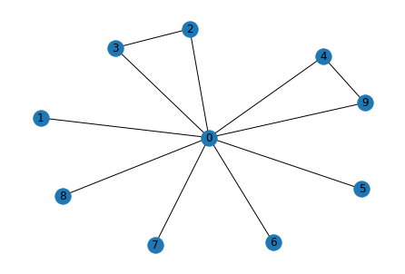
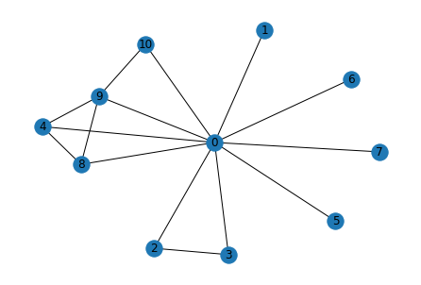
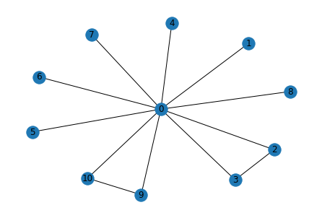
03
Study Meeting
LearnData Lab
파란색 원의 크기 비교
Cycle encoder
D > E > C
GSC
D > C > E
LearnData Lab @SKKU
Graph score& final 크기순서
1.Cycle encoder
D > C > E -> E > C > D
2. GSC
D > C > E -> D > E > C
Cycle 개수 순위
D > E = C
진행 상황
Q. What would a person do if they saw a bully make a person cry but they wanted no trouble?
A. courageous B. set up C. keep walking D. cross street E. do nothing
cry
bully
person_crying
person
person_crying
street
trouble
bully
nothing
see
bully
cross_street
see
person_crying
keep
cross
trouble
saw
cry
do_nothing
saw
saw
walking
person
trouble
see
cry
person
walk
Cycle Encoder(E)
GSC(D)
High graph score(C)

Slide 8
Message Passing 2-layer을 지난 후 + MLP 의 임베딩 값 in Cycle encoder
6
Study Meeting
LearnData Lab
LearnData Lab @SKKU
A
B
C
D
E
[[-1.3688],
[-1.4533],
[-1.4471],
[-1.4471],
[-1.4533],
[-1.4533],
[-1.4533],
[-1.4533],
[-1.4505],
[-1.4486],
[-1.4486],
[-1.4486],
[-1.4486],
[-1.4486],
[-1.4486],
[-1.4486],
[-1.4486],
[-1.4486],
[-1.4486],
[-1.4486],
[-1.4486],
[-1.4486],
[-1.4486],
[-1.4486],
[-1.4486],
[-1.4486],
[-1.4486],
[-1.4486],
[-1.4486],
[-1.4486],
[-1.4486],
[-1.4486]],
[[-1.3238],
[-1.4522],
[-1.4451],
[-1.4451],
[-1.4522],
[-1.4522],
[-1.4522],
[-1.4522],
[-1.4489],
[-1.4489],
[-1.4486],
[-1.4486],
[-1.4486],
[-1.4486],
[-1.4486],
[-1.4486],
[-1.4486],
[-1.4486],
[-1.4486],
[-1.4486],
[-1.4486],
[-1.4486],
[-1.4486],
[-1.4486],
[-1.4486],
[-1.4486],
[-1.4486],
[-1.4486],
[-1.4486],
[-1.4486],
[-1.4486],
[-1.4486]],
[[-1.2007],
[-1.4453],
[-1.4331],
[-1.4331],
[-1.4453],
[-1.4453],
[-1.4453],
[-1.4453],
[-1.4400],
[-1.4220],
[-1.4220],
[-1.4486],
[-1.4486],
[-1.4486],
[-1.4486],
[-1.4486],
[-1.4486],
[-1.4486],
[-1.4486],
[-1.4486],
[-1.4486],
[-1.4486],
[-1.4486],
[-1.4486],
[-1.4486],
[-1.4486],
[-1.4486],
[-1.4486],
[-1.4486],
[-1.4486],
[-1.4486],
[-1.4486]],
[[ 1.4064],
[-1.4371],
[-1.4257],
[-1.4257],
[ 1.3850],
[-1.4371],
[-1.4371],
[-1.4371],
[ 1.3850],
[ 1.3891],
[ 0.7101],
[-1.4486],
[-1.4486],
[-1.4486],
[-1.4486],
[-1.4486],
[-1.4486],
[-1.4486],
[-1.4486],
[-1.4486],
[-1.4486],
[-1.4486],
[-1.4486],
[-1.4486],
[-1.4486],
[-1.4486],
[-1.4486],
[-1.4486],
[-1.4486],
[-1.4486],
[-1.4486],
[-1.4486]]
[[-1.2350],
[-1.4473],
[-1.4361],
[-1.4361],
[-1.4212],
[-1.4473],
[-1.4473],
[-1.4473],
[-1.4425],
[-1.4212],
[-1.4486],
[-1.4486],
[-1.4486],
[-1.4486],
[-1.4486],
[-1.4486],
[-1.4486],
[-1.4486],
[-1.4486],
[-1.4486],
[-1.4486],
[-1.4486],
[-1.4486],
[-1.4486],
[-1.4486],
[-1.4486],
[-1.4486],
[-1.4486],
[-1.4486],
[-1.4486],
[-1.4486],
[-1.4486]]

Slide 9
E in Cycle Encoder
6
Study Meeting
LearnData Lab
LM의 값(context score)과 더한 최종 값
LearnData Lab @SKKU
Graph score
[-1.3688],A
[-1.3238],B
[-1.2007],C
[ 1.4064],D
[-1.2350],E
[-5.4172e+00,A
-6.9877e-01,B
1.2792e+00,C
1.0475e+00,D
1.6209e+00]E

Slide 10
Message Passing 2-layer을 지난 후 + MLP 의 임베딩 값 in GSC
6
Study Meeting
LearnData Lab
LearnData Lab @SKKU
A
B
C
D
E
[[-1.3239],
[-1.3768],
[-1.3439],
[-1.3439],
[-1.3768],
[-1.3768],
[-1.3768],
[-1.3768],
[-1.3682],
[-1.5911],
[-1.5911],
[-1.5911],
[-1.5911],
[-1.5911],
[-1.5911],
[-1.5911],
[-1.5911],
[-1.5911],
[-1.5911],
[-1.5911],
[-1.5911],
[-1.5911],
[-1.5911],
[-1.5911],
[-1.5911],
[-1.5911],
[-1.5911],
[-1.5911],
[-1.5911],
[-1.5911],
[-1.5911],
[-1.5911]],
[[-1.1935],
[-1.2578],
[-1.2244],
[-1.2244],
[-1.2578],
[-1.2578],
[-1.2578],
[-1.2578],
[-1.2492],
[-1.2492],
[-1.5911],
[-1.5911],
[-1.5911],
[-1.5911],
[-1.5911],
[-1.5911],
[-1.5911],
[-1.5911],
[-1.5911],
[-1.5911],
[-1.5911],
[-1.5911],
[-1.5911],
[-1.5911],
[-1.5911],
[-1.5911],
[-1.5911],
[-1.5911],
[-1.5911],
[-1.5911],
[-1.5911],
[-1.5911]],
[[-1.0529],
[-1.1372],
[-1.1036],
[-1.1036],
[-1.1372],
[-1.1372],
[-1.1372],
[-1.1372],
[-1.1285],
[-1.1090],
[-1.1090],
[-1.5911],
[-1.5911],
[-1.5911],
[-1.5911],
[-1.5911],
[-1.5911],
[-1.5911],
[-1.5911],
[-1.5911],
[-1.5911],
[-1.5911],
[-1.5911],
[-1.5911],
[-1.5911],
[-1.5911],
[-1.5911],
[-1.5911],
[-1.5911],
[-1.5911],
[-1.5911],
[-1.5911]],
[[ 2.2336],
[-1.1372],
[-1.1036],
[-1.1036],
[ 2.2310],
[-1.1372],
[-1.1372],
[-1.1372],
[ 2.2310],
[ 2.2317],
[ 1.6962],
[-1.5911],
[-1.5911],
[-1.5911],
[-1.5911],
[-1.5911],
[-1.5911],
[-1.5911],
[-1.5911],
[-1.5911],
[-1.5911],
[-1.5911],
[-1.5911],
[-1.5911],
[-1.5911],
[-1.5911],
[-1.5911],
[-1.5911],
[-1.5911],
[-1.5911],
[-1.5911],
[-1.5911]],
[[-1.1203],
[-1.2578],
[-1.2244],
[-1.2244],
[-1.1744],
[-1.2578],
[-1.2578],
[-1.2578],
[-1.2492],
[-1.1744],
[-1.5911],
[-1.5911],
[-1.5911],
[-1.5911],
[-1.5911],
[-1.5911],
[-1.5911],
[-1.5911],
[-1.5911],
[-1.5911],
[-1.5911],
[-1.5911],
[-1.5911],
[-1.5911],
[-1.5911],
[-1.5911],
[-1.5911],
[-1.5911],
[-1.5911],
[-1.5911],
[-1.5911],
[-1.5911]],

Slide 11
A in GSC
6
Study Meeting
LearnData Lab
LM의 값(context score)과 더한 최종 값
LearnData Lab @SKKU
Graph score
[-1.3239],A
[-1.1935],B
[-1.0529],C
[ 2.2336],D
[-1.1203],E
[-2.7829,
1.6273,
5.4622,
5.9611,
5.6303],

Slide 12
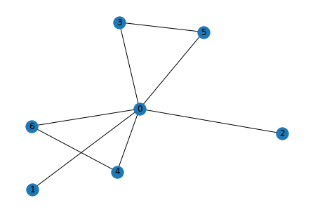
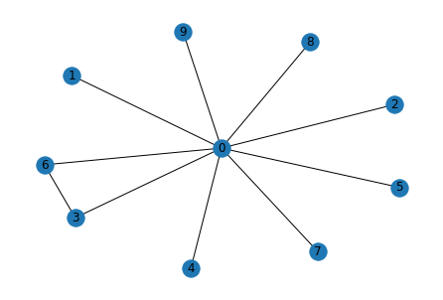
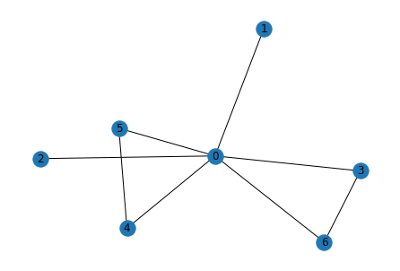
03
Study Meeting
LearnData Lab
파란색 원의 크기 비교
Cycle encoder
C > B > D
GSC
D > B = C
LearnData Lab @SKKU
Graph score& final 크기순서
1.Cycle encoder
C > D > B -> B > D > C
2. GSC
D > C > B -> D > B > C
Cycle 개수 순위
C > B > A = D
진행 상황
Q. What could a solicitor do that would gain revenue?
A. buy house B. claim compensation C. write letter D. charge according to time E. go to court
solicitor
claim_compensation
time
charge_according_to_time
gain
gain
revenue
write
compensation
according_to
solicitor
revenue
according
revenue
claim
solicitor
gain
accord
charge
letter
write_letter
Cycle Encoder(B)
GSC(D)
High graph score(C)

Slide 13
Message Passing 2-layer을 지난 후 + MLP 의 임베딩 값 in Cycle encoder
6
Study Meeting
LearnData Lab
LearnData Lab @SKKU
A
B
C
D
E
[ 1.3643],
[-1.4409],
[-1.4409],
[ 1.3356],
[-1.4347],
[-1.4347],
[ 1.3356],
[-1.4486],
[-1.4486],
[-1.4486],
[-1.4486],
[-1.4486],
[-1.4486],
[-1.4486],
[-1.4486],
[-1.4486],
[-1.4486],
[-1.4486],
[-1.4486],
[-1.4486],
[-1.4486],
[-1.4486],
[-1.4486],
[-1.4486],
[-1.4486],
[-1.4486],
[-1.4486],
[-1.4486],
[-1.4486],
[-1.4486],
[-1.4486],
[-1.4486]]
[[ 1.3717],
[-1.4320],
[-1.4320],
[ 1.3425],
[-1.3991],
[ 1.3425],
[-1.3991],
[-1.4486],
[-1.4486],
[-1.4486],
[-1.4486],
[-1.4486],
[-1.4486],
[-1.4486],
[-1.4486],
[-1.4486],
[-1.4486],
[-1.4486],
[-1.4486],
[-1.4486],
[-1.4486],
[-1.4486],
[-1.4486],
[-1.4486],
[-1.4486],
[-1.4486],
[-1.4486],
[-1.4486],
[-1.4486],
[-1.4486],
[-1.4486],
[-1.4486]],
[[ 1.4115],
[-1.4289],
[-1.4289],
[ 1.3438],
[-1.0495],
[-0.6854],
[ 1.3438],
[-1.4486],
[-1.4486],
[-1.4486],
[-1.4486],
[-1.4486],
[-1.4486],
[-1.4486],
[-1.4486],
[-1.4486],
[-1.4486],
[-1.4486],
[-1.4486],
[-1.4486],
[-1.4486],
[-1.4486],
[-1.4486],
[-1.4486],
[-1.4486],
[-1.4486],
[-1.4486],
[-1.4486],
[-1.4486],
[-1.4486],
[-1.4486],
[-1.4486]],
[[ 1.3933],
[-1.4323],
[-1.4323],
[ 1.3415],
[-1.4245],
[-1.4245],
[ 1.3415],
[-1.4245],
[-1.4245],
[-1.4245],
[-1.4486],
[-1.4486],
[-1.4486],
[-1.4486],
[-1.4486],
[-1.4486],
[-1.4486],
[-1.4486],
[-1.4486],
[-1.4486],
[-1.4486],
[-1.4486],
[-1.4486],
[-1.4486],
[-1.4486],
[-1.4486],
[-1.4486],
[-1.4486],
[-1.4486],
[-1.4486],
[-1.4486],
[-1.4486]],
[[-1.3812],
[-1.4458],
[-1.4458],
[-1.4458],
[-1.4406],
[-1.4406],
[-1.4406],
[-1.4406],
[-1.4486],
[-1.4486],
[-1.4486],
[-1.4486],
[-1.4486],
[-1.4486],
[-1.4486],
[-1.4486],
[-1.4486],
[-1.4486],
[-1.4486],
[-1.4486],
[-1.4486],
[-1.4486],
[-1.4486],
[-1.4486],
[-1.4486],
[-1.4486],
[-1.4486],
[-1.4486],
[-1.4486],
[-1.4486],
[-1.4486],
[-1.4486]],

Slide 14
B in Cycle Encoder
6
Study Meeting
LearnData Lab
LM의 값(context score)과 더한 최종 값
LearnData Lab @SKKU
Graph score
[[ 1.3643],
[ 1.3717],
[ 1.4115],
[ 1.3933],
[-1.3812],
[[-5.2472,
0.7141,
-1.1701,
0.5443,
-5.1809],

Slide 15
Message Passing 2-layer을 지난 후 + MLP 의 임베딩 값 in GSC
6
Study Meeting
LearnData Lab
LearnData Lab @SKKU
A
B
C
D
E
[ 2.1724],
[-1.1963],
[-1.1963],
[ 2.1710],
[-1.1876],
[-1.1876],
[ 2.1710],
[-1.5911],
[-1.5911],
[-1.5911],
[-1.5911],
[-1.5911],
[-1.5911],
[-1.5911],
[-1.5911],
[-1.5911],
[-1.5911],
[-1.5911],
[-1.5911],
[-1.5911],
[-1.5911],
[-1.5911],
[-1.5911],
[-1.5911],
[-1.5911],
[-1.5911],
[-1.5911],
[-1.5911],
[-1.5911],
[-1.5911],
[-1.5911],
[-1.5911]]
[[ 2.1729],
[-1.1963],
[-1.1963],
[ 2.1710],
[-1.1681],
[ 2.1710],
[-1.1681],
[-1.5911],
[-1.5911],
[-1.5911],
[-1.5911],
[-1.5911],
[-1.5911],
[-1.5911],
[-1.5911],
[-1.5911],
[-1.5911],
[-1.5911],
[-1.5911],
[-1.5911],
[-1.5911],
[-1.5911],
[-1.5911],
[-1.5911],
[-1.5911],
[-1.5911],
[-1.5911],
[-1.5911],
[-1.5911],
[-1.5911],
[-1.5911],
[-1.5911]]
[[ 2.1782],
[-1.1963],
[-1.1963],
[ 2.1710],
[-0.9758],
[-1.0473],
[ 2.1710],
[-1.5911],
[-1.5911],
[-1.5911],
[-1.5911],
[-1.5911],
[-1.5911],
[-1.5911],
[-1.5911],
[-1.5911],
[-1.5911],
[-1.5911],
[-1.5911],
[-1.5911],
[-1.5911],
[-1.5911],
[-1.5911],
[-1.5911],
[-1.5911],
[-1.5911],
[-1.5911],
[-1.5911],
[-1.5911],
[-1.5911],
[-1.5911],
[-1.5911]],
[[ 2.1938],
[-0.8335],
[-0.8335],
[ 2.1908],
[-0.8249],
[-0.8249],
[ 2.1908],
[-0.8249],
[-0.8249],
[-0.8249],
[-1.5911],
[-1.5911],
[-1.5911],
[-1.5911],
[-1.5911],
[-1.5911],
[-1.5911],
[-1.5911],
[-1.5911],
[-1.5911],
[-1.5911],
[-1.5911],
[-1.5911],
[-1.5911],
[-1.5911],
[-1.5911],
[-1.5911],
[-1.5911],
[-1.5911],
[-1.5911],
[-1.5911],
[-1.5911]],
[[-1.0285],
[-1.0753],
[-1.0753],
[-1.0753],
[-1.0665],
[-1.0665],
[-1.0665],
[-1.0665],
[-1.5911],
[-1.5911],
[-1.5911],
[-1.5911],
[-1.5911],
[-1.5911],
[-1.5911],
[-1.5911],
[-1.5911],
[-1.5911],
[-1.5911],
[-1.5911],
[-1.5911],
[-1.5911],
[-1.5911],
[-1.5911],
[-1.5911],
[-1.5911],
[-1.5911],
[-1.5911],
[-1.5911],
[-1.5911],
[-1.5911],
[-1.5911]],

Slide 16
D in GSC
6
Study Meeting
LearnData Lab
LM의 값(context score)과 더한 최종 값
LearnData Lab @SKKU
Graph score
[[ 2.1724],A
[ 2.1729],B
[ 2.1782],C
[ 2.1938],D
[-1.0285],E
[[-1.9449,A
3.6465,B
1.7990,C
3.7890,D
-2.5564],E

Slide 17
81
Study Meeting
LearnData Lab
LearnData Lab @SKKU
결과
Current Works
Cycle이 많으면 graph score가 큼(Cycle encoder, GSC 둘 다 그럼)
Subgraph의 노드 개수가 많은 경우에 graph score가 큼
Cycle encoder은 GSC에 비해 정답을 구성하는 사이클에 속한 노드들의 중요도가 크게 나타남(정답 추적?)
Cycle encoder은 GSC에 비해 정답을 도출하는데 중요한 노드의 중요도를 크게 봄

Slide 18
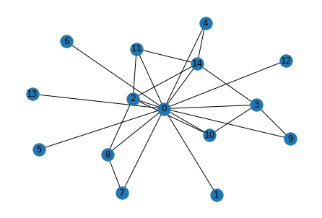
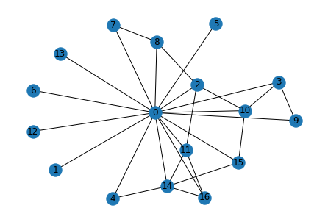
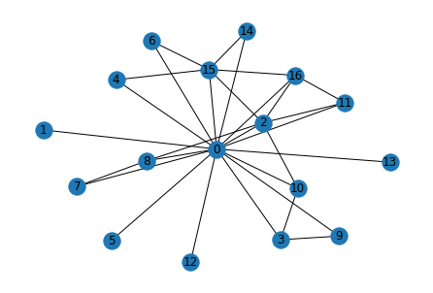
03
Study Meeting
LearnData Lab
파란색 원의 크기 비교
Cycle encoder
GSC
LearnData Lab @SKKU
Graph score& final 크기순서
1.Cycle encoder
D > C > B -> B > C > A
2. GSC
D > C > B -> C > B > A
Cycle 개수 순위
D > C > B > A
진행 상황
Question_concept : toy ballon
Q. Where can I go to see a really big toy ballon floating at the top of a dome?
A. parade B. circus C. amusement park D. birthday party E. magic show
dome
go
float
floating
birthday
floating
top
toy_ballon
really
toy
birthday_party
party
circus
big_toy
top
floating
big
big
big_toy
toy_ballon
see
ballon
really_big
really
toy_ballon
see
toy
top
go
see
really_big
float
really
amusement_park
ballon
amusement
float
big_toy
really_big
go
ballon
dome
park
toy
Cycle Encoder(B)
GSC(D)
High graph score(C)

Slide 19
Message Passing 2-layer을 지난 후 + MLP 의 임베딩 값 in Cycle encoder
6
Study Meeting
LearnData Lab
LearnData Lab @SKKU
A
B
C
D
E
[[ 1.3999],
[-1.4459],
[ 0.7111],
[-1.4207],
[-1.4459],
[-1.4459],
[-1.4459],
[ 0.7247],
[-1.3965],
[-1.4335],
[-1.4058],
[ 1.3642],
[-1.4459],
[-1.4459],
[ 1.3633],
[-1.4486],
[-1.4486],
[-1.4486],
[-1.4486],
[-1.4486],
[-1.4486],
[-1.4486],
[-1.4486],
[-1.4486],
[-1.4486],
[-1.4486],
[-1.4486],
[-1.4486],
[-1.4486],
[-1.4486],
[-1.4486],
[-1.4486]],
[[ 1.5932],
[-1.4486],
[ 1.5874],
[ 1.3874],
[ 1.3766],
[-1.4486],
[-1.4486],
[-1.4410],
[ 0.6654],
[-1.4139],
[ 0.7350],
[ 1.5868],
[-1.4486],
[-1.4486],
[ 1.5904],
[-1.4486],
[-1.4486],
[-1.4486],
[-1.4486],
[-1.4486],
[-1.4486],
[-1.4486],
[-1.4486],
[-1.4486],
[-1.4486],
[-1.4486],
[-1.4486],
[-1.4486],
[-1.4486],
[-1.4486],
[-1.4486],
[-1.4486]],
[[ 1.5949],
[-1.4335],
[ 1.3744],
[-1.3812],
[ 0.7890],
[-1.4335],
[-1.4335],
[-1.4171],
[-1.3949],
[-1.4171],
[-1.3372],
[ 1.5881],
[-1.4335],
[-1.4335],
[ 1.5895],
[ 0.8228],
[ 1.5872],
[-1.4486],
[-1.4486],
[-1.4486],
[-1.4486],
[-1.4486],
[-1.4486],
[-1.4486],
[-1.4486],
[-1.4486],
[-1.4486],
[-1.4486],
[-1.4486],
[-1.4486],
[-1.4486],
[-1.4486]],
[[ 1.6105],
[-1.4414],
[ 1.6379],
[-1.4205],
[-0.0782],
[-1.4414],
[-0.0782],
[-1.4335],
[ 0.6780],
[-1.4272],
[ 0.6909],
[ 1.5840],
[-1.4414],
[-1.4414],
[ 1.4632],
[ 1.5853],
[ 1.6254],
[-1.4486],
[-1.4486],
[-1.4486],
[-1.4486],
[-1.4486],
[-1.4486],
[-1.4486],
[-1.4486],
[-1.4486],
[-1.4486],
[-1.4486],
[-1.4486],
[-1.4486],
[-1.4486],
[-1.4486]],
[[ 1.0806],
[-1.4385],
[-1.3874],
[-1.4071],
[-1.4385],
[ 1.1276],
[-1.4385],
[-1.4234],
[-1.4000],
[-1.4226],
[-1.3919],
[-1.4173],
[-1.4385],
[-1.4385],
[ 1.4015],
[-1.4318],
[-1.4318],
[-1.4486],
[-1.4486],
[-1.4486],
[-1.4486],
[-1.4486],
[-1.4486],
[-1.4486],
[-1.4486],
[-1.4486],
[-1.4486],
[-1.4486],
[-1.4486],
[-1.4486],
[-1.4486],
[-1.4486]],

Slide 20
B in Cycle Encoder
6
Study Meeting
LearnData Lab
LM의 값(context score)과 더한 최종 값
LearnData Lab @SKKU
Graph score
[[ 1.3999],
[ 1.5932],
[ 1.5949],
[ 1.6105],
[ 1.0806],
[[-2.3578,
1.5251,
1.4653,
-5.9485,
-4.4003]

Slide 21
Message Passing 2-layer을 지난 후 + MLP 의 임베딩 값 in GSC
6
Study Meeting
LearnData Lab
LearnData Lab @SKKU
A
B
C
D
E
[[ 2.2289],
[-1.2898],
[ 1.7460],
[-1.2074],
[-1.2898],
[-1.2898],
[-1.2898],
[ 1.6858],
[-1.1666],
[-1.2408],
[-1.1770],
[ 2.2210],
[-1.2898],
[-1.2898],
[ 2.2208],
[-1.5911],
[-1.5911],
[-1.5911],
[-1.5911],
[-1.5911],
[-1.5911],
[-1.5911],
[-1.5911],
[-1.5911],
[-1.5911],
[-1.5911],
[-1.5911],
[-1.5911],
[-1.5911],
[-1.5911],
[-1.5911],
[-1.5911]]
[[ 2.4464],
[-1.2898],
[ 2.4448],
[ 2.2171],
[ 2.2132],
[-1.2898],
[-1.2898],
[-1.2408],
[ 1.7400],
[-1.1934],
[ 1.7512],
[ 2.4442],
[-1.2898],
[-1.2898],
[ 2.4454],
[-1.5911],
[-1.5911],
[-1.5911],
[-1.5911],
[-1.5911],
[-1.5911],
[-1.5911],
[-1.5911],
[-1.5911],
[-1.5911],
[-1.5911],
[-1.5911],
[-1.5911],
[-1.5911],
[-1.5911],
[-1.5911],
[-1.5911]],
[[ 2.4480],
[-1.0484],
[ 2.2470],
[-0.9389],
[ 1.7397],
[-1.0484],
[-1.0484],
[-0.9988],
[-0.9506],
[-0.9989],
[-0.8476],
[ 2.4456],
[-1.0484],
[-1.0484],
[ 2.4461],
[ 1.7524],
[ 2.4452],
[-1.5911],
[-1.5911],
[-1.5911],
[-1.5911],
[-1.5911],
[-1.5911],
[-1.5911],
[-1.5911],
[-1.5911],
[-1.5911],
[-1.5911],
[-1.5911],
[-1.5911],
[-1.5911],
[-1.5911]],
[[ 2.4520],
[-1.0484],
[ 2.5042],
[-0.9652],
[-0.6205],
[-1.0484],
[-0.6205],
[-0.9988],
[ 1.7839],
[-0.9989],
[ 1.7865],
[ 2.4446],
[-1.0484],
[-1.0484],
[ 0.4720],
[ 2.3987],
[ 2.4841],
[-1.5911],
[-1.5911],
[-1.5911],
[-1.5911],
[-1.5911],
[-1.5911],
[-1.5911],
[-1.5911],
[-1.5911],
[-1.5911],
[-1.5911],
[-1.5911],
[-1.5911],
[-1.5911],
[-1.5911]]
[[ 0.6163],
[-1.0484],
[-0.9167],
[-0.9652],
[-1.0484],
[ 1.2148],
[-1.0484],
[-0.9988],
[-0.9506],
[-0.9989],
[-0.9348],
[-0.9839],
[-1.0484],
[-1.0484],
[ 0.6404],
[-1.0397],
[-1.0397],
[-1.5911],
[-1.5911],
[-1.5911],
[-1.5911],
[-1.5911],
[-1.5911],
[-1.5911],
[-1.5911],
[-1.5911],
[-1.5911],
[-1.5911],
[-1.5911],
[-1.5911],
[-1.5911],
[-1.5911]]

Slide 22
C in GSC
6
Study Meeting
LearnData Lab
LM의 값(context score)과 더한 최종 값
LearnData Lab @SKKU
Graph score
[[ 2.2289],
[ 2.4464],
[ 2.4480],
[ 2.4520],
[ 0.6163],
[[ 1.2488e+00,
5.9446e+00,
6.7553e+00,
-1.7830e+00,
-1.0700e+00],

Slide 23
20
Study Meeting
LearnData Lab
LearnData Lab @SKKU
Thank you!

