Slide 1

00
Study Meeting
LearnData Lab
LearnData Lab @SKKU
1월 27일 연구 미팅
Natural Language Processing and Commonsense Reasoning for the Next of QnA System
정지원

Slide 2
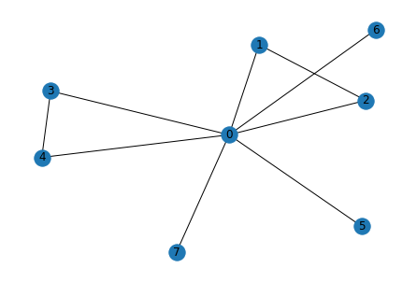
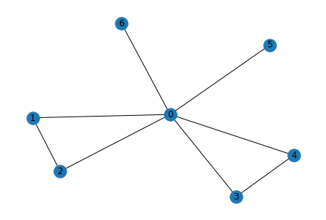
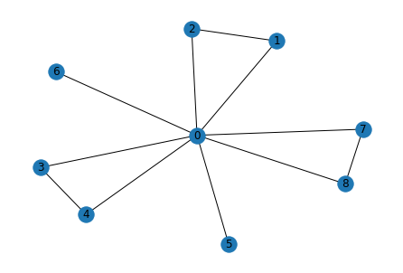
01
Study Meeting
LearnData Lab
LearnData Lab @SKKU
이 문제는 순전히 LM의 힘이 큼
Graph score& final 크기순서
1.Cycle encoder
D > B> A -> B > D > A
2. GSC
D > B > A -> A > B > D
Cycle 개수 순위
D > B = A
진행 상황
Q. What might have a drop of flood on their fingertip?
A. needle B. person C. clock D. test tube E. battlefield
person_might
needle
fingertip
drop
might
test
drop
flood
fingertip
drop
test_tube
flood
may
may
tube
might
fingertip
may
person
flood
might
Cycle Encoder(B)
GSC(A)
Highest graph score(D)

Slide 3
Message Passing 2-layer을 지난 후 + MLP 의 임베딩 값 in Cycle encoder
02
Study Meeting
LearnData Lab
LearnData Lab @SKKU
A
B
C
D
E
[[-1.2988],
[-1.4188],
[-1.4188],
[-1.3865],
[-1.3865],
[-1.4421],
[-1.4361],
[-1.4486],
[-1.4486],
[-1.4486],
[-1.4486],
[-1.4486],
[-1.4486],
[-1.4486],
[-1.4486],
[-1.4486],
[-1.4486],
[-1.4486],
[-1.4486],
[-1.4486],
[-1.4486],
[-1.4486],
[-1.4486],
[-1.4486],
[-1.4486],
[-1.4486],
[-1.4486],
[-1.4486],
[-1.4486],
[-1.4486],
[-1.4486],
[-1.4486]],
[[-1.2824],
[-1.4238],
[-1.4238],
[-1.3936],
[-1.3936],
[-1.4449],
[-1.4449],
[-1.4396],
[-1.4486],
[-1.4486],
[-1.4486],
[-1.4486],
[-1.4486],
[-1.4486],
[-1.4486],
[-1.4486],
[-1.4486],
[-1.4486],
[-1.4486],
[-1.4486],
[-1.4486],
[-1.4486],
[-1.4486],
[-1.4486],
[-1.4486],
[-1.4486],
[-1.4486],
[-1.4486],
[-1.4486],
[-1.4486],
[-1.4486],
[-1.4486]],
[[-1.2988],
[-1.4188],
[-1.4188],
[-1.3865],
[-1.3865],
[-1.4421],
[-1.4361],
[-1.4486],
[-1.4486],
[-1.4486],
[-1.4486],
[-1.4486],
[-1.4486],
[-1.4486],
[-1.4486],
[-1.4486],
[-1.4486],
[-1.4486],
[-1.4486],
[-1.4486],
[-1.4486],
[-1.4486],
[-1.4486],
[-1.4486],
[-1.4486],
[-1.4486],
[-1.4486],
[-1.4486],
[-1.4486],
[-1.4486],
[-1.4486],
[-1.4486]],
[[-1.1909],
[-1.3969],
[-1.3969],
[-1.3597],
[-1.3597],
[-1.4267],
[-1.4180],
[-1.3953],
[-1.3953],
[-1.4486],
[-1.4486],
[-1.4486],
[-1.4486],
[-1.4486],
[-1.4486],
[-1.4486],
[-1.4486],
[-1.4486],
[-1.4486],
[-1.4486],
[-1.4486],
[-1.4486],
[-1.4486],
[-1.4486],
[-1.4486],
[-1.4486],
[-1.4486],
[-1.4486],
[-1.4486],
[-1.4486],
[-1.4486],
[-1.4486]]
[[-1.2988],
[-1.4188],
[-1.4188],
[-1.3865],
[-1.3865],
[-1.4421],
[-1.4361],
[-1.4486],
[-1.4486],
[-1.4486],
[-1.4486],
[-1.4486],
[-1.4486],
[-1.4486],
[-1.4486],
[-1.4486],
[-1.4486],
[-1.4486],
[-1.4486],
[-1.4486],
[-1.4486],
[-1.4486],
[-1.4486],
[-1.4486],
[-1.4486],
[-1.4486],
[-1.4486],
[-1.4486],
[-1.4486],
[-1.4486],
[-1.4486],
[-1.4486]],

Slide 4
B in Cycle Encoder
6
Study Meeting
LearnData Lab
LM의 값(context score)과 더한 최종 값
LearnData Lab @SKKU
Graph score
[-1.2988],A
[-1.2824],B
[-1.2988],C
[-1.1909],D
[-1.2988],E
[-3.1120,A
-2.3809,B
-7.8380,C
-5.3621,D
-5.7331]E

Slide 5
Message Passing 2-layer을 지난 후 + MLP 의 임베딩 값 in GSC
6
Study Meeting
LearnData Lab
LearnData Lab @SKKU
A
B
C
D
E
[[-1.2627],
[-1.3414],
[-1.3414],
[-1.3088],
[-1.3088],
[-1.4054],
[-1.3970],
[-1.5911],
[-1.5911],
[-1.5911],
[-1.5911],
[-1.5911],
[-1.5911],
[-1.5911],
[-1.5911],
[-1.5911],
[-1.5911],
[-1.5911],
[-1.5911],
[-1.5911],
[-1.5911],
[-1.5911],
[-1.5911],
[-1.5911],
[-1.5911],
[-1.5911],
[-1.5911],
[-1.5911],
[-1.5911],
[-1.5911],
[-1.5911],
[-1.5911]],
[[-1.2461],
[-1.3269],
[-1.3269],
[-1.2942],
[-1.2942],
[-1.3911],
[-1.3911],
[-1.3826],
[-1.5911],
[-1.5911],
[-1.5911],
[-1.5911],
[-1.5911],
[-1.5911],
[-1.5911],
[-1.5911],
[-1.5911],
[-1.5911],
[-1.5911],
[-1.5911],
[-1.5911],
[-1.5911],
[-1.5911],
[-1.5911],
[-1.5911],
[-1.5911],
[-1.5911],
[-1.5911],
[-1.5911],
[-1.5911],
[-1.5911],
[-1.5911]]
[[-1.2627],
[-1.3414],
[-1.3414],
[-1.3088],
[-1.3088],
[-1.4054],
[-1.3970],
[-1.5911],
[-1.5911],
[-1.5911],
[-1.5911],
[-1.5911],
[-1.5911],
[-1.5911],
[-1.5911],
[-1.5911],
[-1.5911],
[-1.5911],
[-1.5911],
[-1.5911],
[-1.5911],
[-1.5911],
[-1.5911],
[-1.5911],
[-1.5911],
[-1.5911],
[-1.5911],
[-1.5911],
[-1.5911],
[-1.5911],
[-1.5911],
[-1.5911]]
[[-0.9912],
[-1.1010],
[-1.1010],
[-1.0677],
[-1.0677],
[-1.1668],
[-1.1581],
[-1.1390],
[-1.1390],
[-1.5911],
[-1.5911],
[-1.5911],
[-1.5911],
[-1.5911],
[-1.5911],
[-1.5911],
[-1.5911],
[-1.5911],
[-1.5911],
[-1.5911],
[-1.5911],
[-1.5911],
[-1.5911],
[-1.5911],
[-1.5911],
[-1.5911],
[-1.5911],
[-1.5911],
[-1.5911],
[-1.5911],
[-1.5911],
[-1.5911]],
[[-1.2627],
[-1.3414],
[-1.3414],
[-1.3088],
[-1.3088],
[-1.4054],
[-1.3970],
[-1.5911],
[-1.5911],
[-1.5911],
[-1.5911],
[-1.5911],
[-1.5911],
[-1.5911],
[-1.5911],
[-1.5911],
[-1.5911],
[-1.5911],
[-1.5911],
[-1.5911],
[-1.5911],
[-1.5911],
[-1.5911],
[-1.5911],
[-1.5911],
[-1.5911],
[-1.5911],
[-1.5911],
[-1.5911],
[-1.5911],
[-1.5911],
[-1.5911]]

Slide 6
A in GSC
6
Study Meeting
LearnData Lab
LM의 값(context score)과 더한 최종 값
LearnData Lab @SKKU
Graph score
[-1.2627],A
[-1.2461],B
[-1.2627],C
[-0.9912],D
[-1.2627]E
[0.5817,A
-0.5477,B
-3.0673,C
-0.5820,D
-2.1919],E

Slide 7
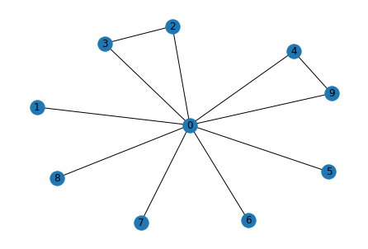
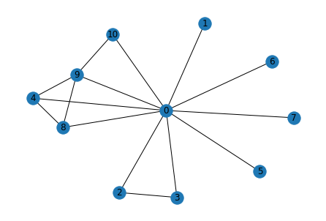
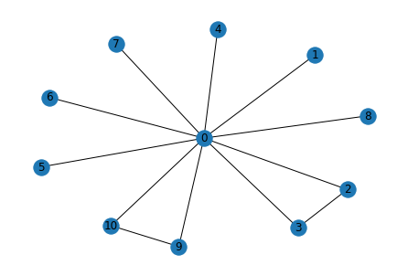
03
Study Meeting
LearnData Lab
파란색 원의 크기 비교
Cycle encoder
D > E > C
GSC
D > C > E
LearnData Lab @SKKU
Graph score& final 크기순서
1.Cycle encoder
D > C > E -> E > C > D
2. GSC
D > C > E -> D > E > C
Cycle 개수 순위
D > E = C
진행 상황
Q. What would a person do if they saw a bully make a person cry but they wanted no trouble?
A. courageous B. set up C. keep walking D. cross street E. do nothing
cry
bully
person_crying
person
person_crying
street
trouble
bully
nothing
see
bully
cross_street
see
person_crying
keep
cross
trouble
saw
cry
do_nothing
saw
saw
walking
person
trouble
see
cry
person
walk
Cycle Encoder(E)
GSC(D)
High graph score(C)

Slide 8
Message Passing 2-layer을 지난 후 + MLP 의 임베딩 값 in Cycle encoder
6
Study Meeting
LearnData Lab
LearnData Lab @SKKU
A
B
C
D
E
[[-1.3688],
[-1.4533],
[-1.4471],
[-1.4471],
[-1.4533],
[-1.4533],
[-1.4533],
[-1.4533],
[-1.4505],
[-1.4486],
[-1.4486],
[-1.4486],
[-1.4486],
[-1.4486],
[-1.4486],
[-1.4486],
[-1.4486],
[-1.4486],
[-1.4486],
[-1.4486],
[-1.4486],
[-1.4486],
[-1.4486],
[-1.4486],
[-1.4486],
[-1.4486],
[-1.4486],
[-1.4486],
[-1.4486],
[-1.4486],
[-1.4486],
[-1.4486]],
[[-1.3238],
[-1.4522],
[-1.4451],
[-1.4451],
[-1.4522],
[-1.4522],
[-1.4522],
[-1.4522],
[-1.4489],
[-1.4489],
[-1.4486],
[-1.4486],
[-1.4486],
[-1.4486],
[-1.4486],
[-1.4486],
[-1.4486],
[-1.4486],
[-1.4486],
[-1.4486],
[-1.4486],
[-1.4486],
[-1.4486],
[-1.4486],
[-1.4486],
[-1.4486],
[-1.4486],
[-1.4486],
[-1.4486],
[-1.4486],
[-1.4486],
[-1.4486]],
[[-1.2007],
[-1.4453],
[-1.4331],
[-1.4331],
[-1.4453],
[-1.4453],
[-1.4453],
[-1.4453],
[-1.4400],
[-1.4220],
[-1.4220],
[-1.4486],
[-1.4486],
[-1.4486],
[-1.4486],
[-1.4486],
[-1.4486],
[-1.4486],
[-1.4486],
[-1.4486],
[-1.4486],
[-1.4486],
[-1.4486],
[-1.4486],
[-1.4486],
[-1.4486],
[-1.4486],
[-1.4486],
[-1.4486],
[-1.4486],
[-1.4486],
[-1.4486]],
[[ 1.4064],
[-1.4371],
[-1.4257],
[-1.4257],
[ 1.3850],
[-1.4371],
[-1.4371],
[-1.4371],
[ 1.3850],
[ 1.3891],
[ 0.7101],
[-1.4486],
[-1.4486],
[-1.4486],
[-1.4486],
[-1.4486],
[-1.4486],
[-1.4486],
[-1.4486],
[-1.4486],
[-1.4486],
[-1.4486],
[-1.4486],
[-1.4486],
[-1.4486],
[-1.4486],
[-1.4486],
[-1.4486],
[-1.4486],
[-1.4486],
[-1.4486],
[-1.4486]]
[[-1.2350],
[-1.4473],
[-1.4361],
[-1.4361],
[-1.4212],
[-1.4473],
[-1.4473],
[-1.4473],
[-1.4425],
[-1.4212],
[-1.4486],
[-1.4486],
[-1.4486],
[-1.4486],
[-1.4486],
[-1.4486],
[-1.4486],
[-1.4486],
[-1.4486],
[-1.4486],
[-1.4486],
[-1.4486],
[-1.4486],
[-1.4486],
[-1.4486],
[-1.4486],
[-1.4486],
[-1.4486],
[-1.4486],
[-1.4486],
[-1.4486],
[-1.4486]]

Slide 9
E in Cycle Encoder
6
Study Meeting
LearnData Lab
LM의 값(context score)과 더한 최종 값
LearnData Lab @SKKU
Graph score
[-1.3688],A
[-1.3238],B
[-1.2007],C
[ 1.4064],D
[-1.2350],E
[-5.4172e+00,A
-6.9877e-01,B
1.2792e+00,C
1.0475e+00,D
1.6209e+00]E

Slide 10
Message Passing 2-layer을 지난 후 + MLP 의 임베딩 값 in GSC
6
Study Meeting
LearnData Lab
LearnData Lab @SKKU
A
B
C
D
E
[[-1.3239],
[-1.3768],
[-1.3439],
[-1.3439],
[-1.3768],
[-1.3768],
[-1.3768],
[-1.3768],
[-1.3682],
[-1.5911],
[-1.5911],
[-1.5911],
[-1.5911],
[-1.5911],
[-1.5911],
[-1.5911],
[-1.5911],
[-1.5911],
[-1.5911],
[-1.5911],
[-1.5911],
[-1.5911],
[-1.5911],
[-1.5911],
[-1.5911],
[-1.5911],
[-1.5911],
[-1.5911],
[-1.5911],
[-1.5911],
[-1.5911],
[-1.5911]],
[[-1.1935],
[-1.2578],
[-1.2244],
[-1.2244],
[-1.2578],
[-1.2578],
[-1.2578],
[-1.2578],
[-1.2492],
[-1.2492],
[-1.5911],
[-1.5911],
[-1.5911],
[-1.5911],
[-1.5911],
[-1.5911],
[-1.5911],
[-1.5911],
[-1.5911],
[-1.5911],
[-1.5911],
[-1.5911],
[-1.5911],
[-1.5911],
[-1.5911],
[-1.5911],
[-1.5911],
[-1.5911],
[-1.5911],
[-1.5911],
[-1.5911],
[-1.5911]],
[[-1.0529],
[-1.1372],
[-1.1036],
[-1.1036],
[-1.1372],
[-1.1372],
[-1.1372],
[-1.1372],
[-1.1285],
[-1.1090],
[-1.1090],
[-1.5911],
[-1.5911],
[-1.5911],
[-1.5911],
[-1.5911],
[-1.5911],
[-1.5911],
[-1.5911],
[-1.5911],
[-1.5911],
[-1.5911],
[-1.5911],
[-1.5911],
[-1.5911],
[-1.5911],
[-1.5911],
[-1.5911],
[-1.5911],
[-1.5911],
[-1.5911],
[-1.5911]],
[[ 2.2336],
[-1.1372],
[-1.1036],
[-1.1036],
[ 2.2310],
[-1.1372],
[-1.1372],
[-1.1372],
[ 2.2310],
[ 2.2317],
[ 1.6962],
[-1.5911],
[-1.5911],
[-1.5911],
[-1.5911],
[-1.5911],
[-1.5911],
[-1.5911],
[-1.5911],
[-1.5911],
[-1.5911],
[-1.5911],
[-1.5911],
[-1.5911],
[-1.5911],
[-1.5911],
[-1.5911],
[-1.5911],
[-1.5911],
[-1.5911],
[-1.5911],
[-1.5911]],
[[-1.1203],
[-1.2578],
[-1.2244],
[-1.2244],
[-1.1744],
[-1.2578],
[-1.2578],
[-1.2578],
[-1.2492],
[-1.1744],
[-1.5911],
[-1.5911],
[-1.5911],
[-1.5911],
[-1.5911],
[-1.5911],
[-1.5911],
[-1.5911],
[-1.5911],
[-1.5911],
[-1.5911],
[-1.5911],
[-1.5911],
[-1.5911],
[-1.5911],
[-1.5911],
[-1.5911],
[-1.5911],
[-1.5911],
[-1.5911],
[-1.5911],
[-1.5911]],

Slide 11
A in GSC
6
Study Meeting
LearnData Lab
LM의 값(context score)과 더한 최종 값
LearnData Lab @SKKU
Graph score
[-1.3239],A
[-1.1935],B
[-1.0529],C
[ 2.2336],D
[-1.1203],E
[-2.7829,
1.6273,
5.4622,
5.9611,
5.6303],

Slide 12
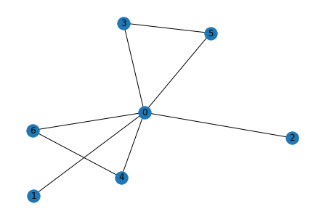
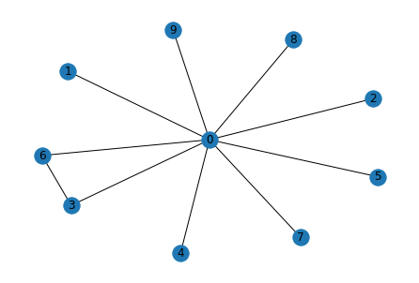
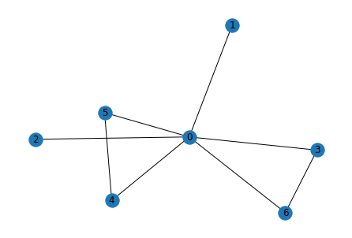
03
Study Meeting
LearnData Lab
파란색 원의 크기 비교
Cycle encoder
C > B > D
GSC
D > B = C
LearnData Lab @SKKU
Graph score& final 크기순서
1.Cycle encoder
C > D > B -> B > D > C
2. GSC
D > C > B -> D > B > C
Cycle 개수 순위
C > B > A = D
진행 상황
Q. What could a solicitor do that would gain revenue?
A. buy house B. claim compensation C. write letter D. charge according to time E. go to court
solicitor
claim_compensation
time
charge_according_to_time
gain
gain
revenue
write
compensation
according_to
solicitor
revenue
according
revenue
claim
solicitor
gain
accord
charge
letter
write_letter
Cycle Encoder(B)
GSC(D)
High graph score(C)

Slide 13
Message Passing 2-layer을 지난 후 + MLP 의 임베딩 값 in Cycle encoder
6
Study Meeting
LearnData Lab
LearnData Lab @SKKU
A
B
C
D
E
[ 1.3643],
[-1.4409],
[-1.4409],
[ 1.3356],
[-1.4347],
[-1.4347],
[ 1.3356],
[-1.4486],
[-1.4486],
[-1.4486],
[-1.4486],
[-1.4486],
[-1.4486],
[-1.4486],
[-1.4486],
[-1.4486],
[-1.4486],
[-1.4486],
[-1.4486],
[-1.4486],
[-1.4486],
[-1.4486],
[-1.4486],
[-1.4486],
[-1.4486],
[-1.4486],
[-1.4486],
[-1.4486],
[-1.4486],
[-1.4486],
[-1.4486],
[-1.4486]]
[[ 1.3717],
[-1.4320],
[-1.4320],
[ 1.3425],
[-1.3991],
[ 1.3425],
[-1.3991],
[-1.4486],
[-1.4486],
[-1.4486],
[-1.4486],
[-1.4486],
[-1.4486],
[-1.4486],
[-1.4486],
[-1.4486],
[-1.4486],
[-1.4486],
[-1.4486],
[-1.4486],
[-1.4486],
[-1.4486],
[-1.4486],
[-1.4486],
[-1.4486],
[-1.4486],
[-1.4486],
[-1.4486],
[-1.4486],
[-1.4486],
[-1.4486],
[-1.4486]],
[[ 1.4115],
[-1.4289],
[-1.4289],
[ 1.3438],
[-1.0495],
[-0.6854],
[ 1.3438],
[-1.4486],
[-1.4486],
[-1.4486],
[-1.4486],
[-1.4486],
[-1.4486],
[-1.4486],
[-1.4486],
[-1.4486],
[-1.4486],
[-1.4486],
[-1.4486],
[-1.4486],
[-1.4486],
[-1.4486],
[-1.4486],
[-1.4486],
[-1.4486],
[-1.4486],
[-1.4486],
[-1.4486],
[-1.4486],
[-1.4486],
[-1.4486],
[-1.4486]],
[[ 1.3933],
[-1.4323],
[-1.4323],
[ 1.3415],
[-1.4245],
[-1.4245],
[ 1.3415],
[-1.4245],
[-1.4245],
[-1.4245],
[-1.4486],
[-1.4486],
[-1.4486],
[-1.4486],
[-1.4486],
[-1.4486],
[-1.4486],
[-1.4486],
[-1.4486],
[-1.4486],
[-1.4486],
[-1.4486],
[-1.4486],
[-1.4486],
[-1.4486],
[-1.4486],
[-1.4486],
[-1.4486],
[-1.4486],
[-1.4486],
[-1.4486],
[-1.4486]],
[[-1.3812],
[-1.4458],
[-1.4458],
[-1.4458],
[-1.4406],
[-1.4406],
[-1.4406],
[-1.4406],
[-1.4486],
[-1.4486],
[-1.4486],
[-1.4486],
[-1.4486],
[-1.4486],
[-1.4486],
[-1.4486],
[-1.4486],
[-1.4486],
[-1.4486],
[-1.4486],
[-1.4486],
[-1.4486],
[-1.4486],
[-1.4486],
[-1.4486],
[-1.4486],
[-1.4486],
[-1.4486],
[-1.4486],
[-1.4486],
[-1.4486],
[-1.4486]],

Slide 14
B in Cycle Encoder
6
Study Meeting
LearnData Lab
LM의 값(context score)과 더한 최종 값
LearnData Lab @SKKU
Graph score
[[ 1.3643],
[ 1.3717],
[ 1.4115],
[ 1.3933],
[-1.3812],
[[-5.2472,
0.7141,
-1.1701,
0.5443,
-5.1809],

Slide 15
Message Passing 2-layer을 지난 후 + MLP 의 임베딩 값 in GSC
6
Study Meeting
LearnData Lab
LearnData Lab @SKKU
A
B
C
D
E
[ 2.1724],
[-1.1963],
[-1.1963],
[ 2.1710],
[-1.1876],
[-1.1876],
[ 2.1710],
[-1.5911],
[-1.5911],
[-1.5911],
[-1.5911],
[-1.5911],
[-1.5911],
[-1.5911],
[-1.5911],
[-1.5911],
[-1.5911],
[-1.5911],
[-1.5911],
[-1.5911],
[-1.5911],
[-1.5911],
[-1.5911],
[-1.5911],
[-1.5911],
[-1.5911],
[-1.5911],
[-1.5911],
[-1.5911],
[-1.5911],
[-1.5911],
[-1.5911]]
[[ 2.1729],
[-1.1963],
[-1.1963],
[ 2.1710],
[-1.1681],
[ 2.1710],
[-1.1681],
[-1.5911],
[-1.5911],
[-1.5911],
[-1.5911],
[-1.5911],
[-1.5911],
[-1.5911],
[-1.5911],
[-1.5911],
[-1.5911],
[-1.5911],
[-1.5911],
[-1.5911],
[-1.5911],
[-1.5911],
[-1.5911],
[-1.5911],
[-1.5911],
[-1.5911],
[-1.5911],
[-1.5911],
[-1.5911],
[-1.5911],
[-1.5911],
[-1.5911]]
[[ 2.1782],
[-1.1963],
[-1.1963],
[ 2.1710],
[-0.9758],
[-1.0473],
[ 2.1710],
[-1.5911],
[-1.5911],
[-1.5911],
[-1.5911],
[-1.5911],
[-1.5911],
[-1.5911],
[-1.5911],
[-1.5911],
[-1.5911],
[-1.5911],
[-1.5911],
[-1.5911],
[-1.5911],
[-1.5911],
[-1.5911],
[-1.5911],
[-1.5911],
[-1.5911],
[-1.5911],
[-1.5911],
[-1.5911],
[-1.5911],
[-1.5911],
[-1.5911]],
[[ 2.1938],
[-0.8335],
[-0.8335],
[ 2.1908],
[-0.8249],
[-0.8249],
[ 2.1908],
[-0.8249],
[-0.8249],
[-0.8249],
[-1.5911],
[-1.5911],
[-1.5911],
[-1.5911],
[-1.5911],
[-1.5911],
[-1.5911],
[-1.5911],
[-1.5911],
[-1.5911],
[-1.5911],
[-1.5911],
[-1.5911],
[-1.5911],
[-1.5911],
[-1.5911],
[-1.5911],
[-1.5911],
[-1.5911],
[-1.5911],
[-1.5911],
[-1.5911]],
[[-1.0285],
[-1.0753],
[-1.0753],
[-1.0753],
[-1.0665],
[-1.0665],
[-1.0665],
[-1.0665],
[-1.5911],
[-1.5911],
[-1.5911],
[-1.5911],
[-1.5911],
[-1.5911],
[-1.5911],
[-1.5911],
[-1.5911],
[-1.5911],
[-1.5911],
[-1.5911],
[-1.5911],
[-1.5911],
[-1.5911],
[-1.5911],
[-1.5911],
[-1.5911],
[-1.5911],
[-1.5911],
[-1.5911],
[-1.5911],
[-1.5911],
[-1.5911]],

Slide 16
D in GSC
6
Study Meeting
LearnData Lab
LM의 값(context score)과 더한 최종 값
LearnData Lab @SKKU
Graph score
[[ 2.1724],A
[ 2.1729],B
[ 2.1782],C
[ 2.1938],D
[-1.0285],E
[[-1.9449,A
3.6465,B
1.7990,C
3.7890,D
-2.5564],E

Slide 17
81
Study Meeting
LearnData Lab
LearnData Lab @SKKU
결과
Current Works
Cycle이 많으면 graph score가 큼(Cycle encoder, GSC 둘 다 그럼)
Subgraph의 노드 개수가 많은 경우에 graph score가 큼
Cycle encoder은 GSC에 비해 정답을 구성하는 사이클에 속한 노드들의 중요도가 크게 나타남(정답 추적?)
Cycle encoder은 GSC에 비해 정답을 도출하는데 중요한 노드의 중요도를 크게 봄

Slide 18
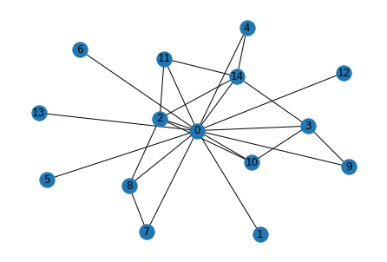
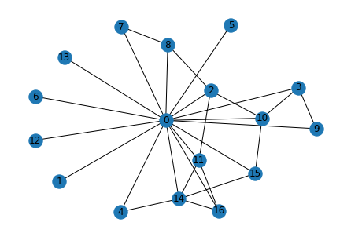
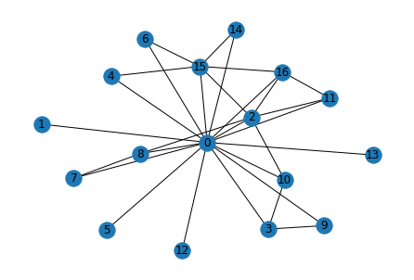
03
Study Meeting
LearnData Lab
파란색 원의 크기 비교
Cycle encoder
D > C > B
GSC
D > C > B
LearnData Lab @SKKU
Graph score& final 크기순서
1.Cycle encoder
D > C > B -> B > C > A
2. GSC
D > C > B -> C > B > A
Cycle 개수 순위
D > C > B > A
진행 상황
Question_concept : toy ballon
Q. Where can I go to see a really big toy ballon floating at the top of a dome?
A. parade B. circus C. amusement park D. birthday party E. magic show
dome
go
float
floating
birthday
floating
top
toy_ballon
really
toy
birthday_party
party
circus
big_toy
top
floating
big
big
big_toy
big
toy_ballon
see
ballon
really_big
really
toy_ballon
see
toy
top
go
see
really_big
float
really
amusement_park
ballon
amusement
float
big_toy
really_big
go
ballon
dome
park
toy
Cycle Encoder(B)
GSC(D)
High graph score(C)

Slide 19
Message Passing 2-layer을 지난 후 + MLP 의 임베딩 값 in Cycle encoder
6
Study Meeting
LearnData Lab
LearnData Lab @SKKU
A
B
C
D
E
[[ 1.3999],
[-1.4459],
[ 0.7111],
[-1.4207],
[-1.4459],
[-1.4459],
[-1.4459],
[ 0.7247],
[-1.3965],
[-1.4335],
[-1.4058],
[ 1.3642],
[-1.4459],
[-1.4459],
[ 1.3633],
[-1.4486],
[-1.4486],
[-1.4486],
[-1.4486],
[-1.4486],
[-1.4486],
[-1.4486],
[-1.4486],
[-1.4486],
[-1.4486],
[-1.4486],
[-1.4486],
[-1.4486],
[-1.4486],
[-1.4486],
[-1.4486],
[-1.4486]],
[[ 1.5932],
[-1.4486],
[ 1.5874],
[ 1.3874],
[ 1.3766],
[-1.4486],
[-1.4486],
[-1.4410],
[ 0.6654],
[-1.4139],
[ 0.7350],
[ 1.5868],
[-1.4486],
[-1.4486],
[ 1.5904],
[-1.4486],
[-1.4486],
[-1.4486],
[-1.4486],
[-1.4486],
[-1.4486],
[-1.4486],
[-1.4486],
[-1.4486],
[-1.4486],
[-1.4486],
[-1.4486],
[-1.4486],
[-1.4486],
[-1.4486],
[-1.4486],
[-1.4486]],
[[ 1.5949],
[-1.4335],
[ 1.3744],
[-1.3812],
[ 0.7890],
[-1.4335],
[-1.4335],
[-1.4171],
[-1.3949],
[-1.4171],
[-1.3372],
[ 1.5881],
[-1.4335],
[-1.4335],
[ 1.5895],
[ 0.8228],
[ 1.5872],
[-1.4486],
[-1.4486],
[-1.4486],
[-1.4486],
[-1.4486],
[-1.4486],
[-1.4486],
[-1.4486],
[-1.4486],
[-1.4486],
[-1.4486],
[-1.4486],
[-1.4486],
[-1.4486],
[-1.4486]],
[[ 1.6105],
[-1.4414],
[ 1.6379],
[-1.4205],
[-0.0782],
[-1.4414],
[-0.0782],
[-1.4335],
[ 0.6780],
[-1.4272],
[ 0.6909],
[ 1.5840],
[-1.4414],
[-1.4414],
[ 1.4632],
[ 1.5853],
[ 1.6254],
[-1.4486],
[-1.4486],
[-1.4486],
[-1.4486],
[-1.4486],
[-1.4486],
[-1.4486],
[-1.4486],
[-1.4486],
[-1.4486],
[-1.4486],
[-1.4486],
[-1.4486],
[-1.4486],
[-1.4486]],
[[ 1.0806],
[-1.4385],
[-1.3874],
[-1.4071],
[-1.4385],
[ 1.1276],
[-1.4385],
[-1.4234],
[-1.4000],
[-1.4226],
[-1.3919],
[-1.4173],
[-1.4385],
[-1.4385],
[ 1.4015],
[-1.4318],
[-1.4318],
[-1.4486],
[-1.4486],
[-1.4486],
[-1.4486],
[-1.4486],
[-1.4486],
[-1.4486],
[-1.4486],
[-1.4486],
[-1.4486],
[-1.4486],
[-1.4486],
[-1.4486],
[-1.4486],
[-1.4486]],

Slide 20
B in Cycle Encoder
6
Study Meeting
LearnData Lab
LM의 값(context score)과 더한 최종 값
LearnData Lab @SKKU
Graph score
[[ 1.3999],
[ 1.5932],
[ 1.5949],
[ 1.6105],
[ 1.0806],
[[-2.3578,
1.5251,
1.4653,
-5.9485,
-4.4003]

Slide 21
Message Passing 2-layer을 지난 후 + MLP 의 임베딩 값 in GSC
6
Study Meeting
LearnData Lab
LearnData Lab @SKKU
A
B
C
D
E
[[ 2.2289],
[-1.2898],
[ 1.7460],
[-1.2074],
[-1.2898],
[-1.2898],
[-1.2898],
[ 1.6858],
[-1.1666],
[-1.2408],
[-1.1770],
[ 2.2210],
[-1.2898],
[-1.2898],
[ 2.2208],
[-1.5911],
[-1.5911],
[-1.5911],
[-1.5911],
[-1.5911],
[-1.5911],
[-1.5911],
[-1.5911],
[-1.5911],
[-1.5911],
[-1.5911],
[-1.5911],
[-1.5911],
[-1.5911],
[-1.5911],
[-1.5911],
[-1.5911]]
[[ 2.4464],
[-1.2898],
[ 2.4448],
[ 2.2171],
[ 2.2132],
[-1.2898],
[-1.2898],
[-1.2408],
[ 1.7400],
[-1.1934],
[ 1.7512],
[ 2.4442],
[-1.2898],
[-1.2898],
[ 2.4454],
[-1.5911],
[-1.5911],
[-1.5911],
[-1.5911],
[-1.5911],
[-1.5911],
[-1.5911],
[-1.5911],
[-1.5911],
[-1.5911],
[-1.5911],
[-1.5911],
[-1.5911],
[-1.5911],
[-1.5911],
[-1.5911],
[-1.5911]],
[[ 2.4480],
[-1.0484],
[ 2.2470],
[-0.9389],
[ 1.7397],
[-1.0484],
[-1.0484],
[-0.9988],
[-0.9506],
[-0.9989],
[-0.8476],
[ 2.4456],
[-1.0484],
[-1.0484],
[ 2.4461],
[ 1.7524],
[ 2.4452],
[-1.5911],
[-1.5911],
[-1.5911],
[-1.5911],
[-1.5911],
[-1.5911],
[-1.5911],
[-1.5911],
[-1.5911],
[-1.5911],
[-1.5911],
[-1.5911],
[-1.5911],
[-1.5911],
[-1.5911]],
[[ 2.4520],
[-1.0484],
[ 2.5042],
[-0.9652],
[-0.6205],
[-1.0484],
[-0.6205],
[-0.9988],
[ 1.7839],
[-0.9989],
[ 1.7865],
[ 2.4446],
[-1.0484],
[-1.0484],
[ 0.4720],
[ 2.3987],
[ 2.4841],
[-1.5911],
[-1.5911],
[-1.5911],
[-1.5911],
[-1.5911],
[-1.5911],
[-1.5911],
[-1.5911],
[-1.5911],
[-1.5911],
[-1.5911],
[-1.5911],
[-1.5911],
[-1.5911],
[-1.5911]]
[[ 0.6163],
[-1.0484],
[-0.9167],
[-0.9652],
[-1.0484],
[ 1.2148],
[-1.0484],
[-0.9988],
[-0.9506],
[-0.9989],
[-0.9348],
[-0.9839],
[-1.0484],
[-1.0484],
[ 0.6404],
[-1.0397],
[-1.0397],
[-1.5911],
[-1.5911],
[-1.5911],
[-1.5911],
[-1.5911],
[-1.5911],
[-1.5911],
[-1.5911],
[-1.5911],
[-1.5911],
[-1.5911],
[-1.5911],
[-1.5911],
[-1.5911],
[-1.5911]]

Slide 22
C in GSC
6
Study Meeting
LearnData Lab
LM의 값(context score)과 더한 최종 값
LearnData Lab @SKKU
Graph score
[[ 2.2289],
[ 2.4464],
[ 2.4480],
[ 2.4520],
[ 0.6163],
[[ 1.2488e+00,
5.9446e+00,
6.7553e+00,
-1.7830e+00,
-1.0700e+00],

Slide 23
81
Study Meeting
LearnData Lab
LearnData Lab @SKKU
이 문제의 결과
Current Works
이 문제의 유일한 차이점은 B-subgraph에서 Cycle encoder은 top노드의 중요도가 circus보다 컸다.
하지만 GSC는 circus 노드의 중요도가 top보다 컸다.
질문(question)에서 가장 중요한 부분은 “top of dome”의 top이다.
“top of a dome에서 big toy ballon을 볼 수 있는 곳은 어디야?”라는 질문이다.

Slide 24
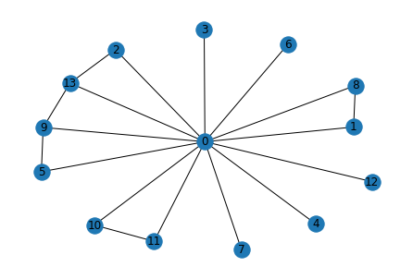
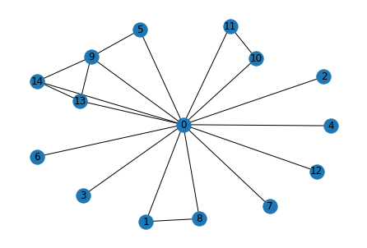
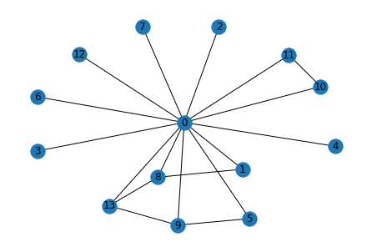
03
Study Meeting
LearnData Lab
파란색 원의 크기 비교
Cycle encoder
B > D > E
GSC
B > D > E
LearnData Lab @SKKU
Graph score& final 크기순서
1.Cycle encoder
B > D > E -> D > B > C
2. GSC
B > D > E -> B > D > C
Cycle 개수 순위
B > C = D = E
진행 상황
Question_concept : movies
Q. Movies which contain unusual or unexpected events which are lightherated in tone are trying to be what?
A. clever B. entertaining C. watched by people D. funny E. excellent
events
unexpected_event
tone
event
event
movies
movie
trying
unusual
unexpected_event
try
unexpected
funny
event
entertaining
movies
unexpected
trying
contain
entertain
lightherated
lightherated
movie
events
contain
unusual
movies
try
unusual
unexpected
lightherated
events
excellent
tone
tone
movie
unexpected_event
contain
try
trying
Cycle Encoder(D)
GSC(B)
High graph score(E)

Slide 25
Message Passing 2-layer을 지난 후 + MLP 의 임베딩 값 in Cycle encoder
6
Study Meeting
LearnData Lab
LearnData Lab @SKKU
A
B
C
D
E
[[-1.1503],
[-1.4459],
[-1.4523],
[-1.4523],
[-1.4523],
[-1.3506],
[-1.4523],
[-1.4523],
[-1.4459],
[-1.3674],
[-1.4459],
[-1.4459],
[-1.4523],
[-1.4490],
[-1.4486],
[-1.4486],
[-1.4486],
[-1.4486],
[-1.4486],
[-1.4486],
[-1.4486],
[-1.4486],
[-1.4486],
[-1.4486],
[-1.4486],
[-1.4486],
[-1.4486],
[-1.4486],
[-1.4486],
[-1.4486],
[-1.4486],
[-1.4486]],
[[ 1.4336],
[-1.4492],
[-1.4530],
[-1.4530],
[-1.4530],
[ 0.7835],
[-1.4530],
[-1.4530],
[-1.4492],
[ 1.5186],
[-1.4492],
[-1.4492],
[-1.4530],
[ 1.6123],
[ 1.5672],
[-1.4486],
[-1.4486],
[-1.4486],
[-1.4486],
[-1.4486],
[-1.4486],
[-1.4486],
[-1.4486],
[-1.4486],
[-1.4486],
[-1.4486],
[-1.4486],
[-1.4486],
[-1.4486],
[-1.4486],
[-1.4486],
[-1.4486]],
[[ 0.9808],
[-1.4270],
[-1.4367],
[-1.4367],
[-1.4367],
[ 1.3710],
[-1.4367],
[-1.4367],
[-1.4270],
[ 0.8878],
[-1.4270],
[-1.4270],
[-1.4367],
[-1.4296],
[-1.2797],
[-1.3880],
[ 0.6832],
[-1.4486],
[-1.4486],
[-1.4486],
[-1.4486],
[-1.4486],
[-1.4486],
[-1.4486],
[-1.4486],
[-1.4486],
[-1.4486],
[-1.4486],
[-1.4486],
[-1.4486],
[-1.4486],
[-1.4486]],
[[ 1.2346],
[-1.4398],
[ 0.6713],
[-1.4470],
[-1.4470],
[ 0.7644],
[-1.4470],
[-1.4470],
[-1.4398],
[ 1.1819],
[-1.4398],
[-1.4398],
[-1.4470],
[ 1.1719],
[-1.4486],
[-1.4486],
[-1.4486],
[-1.4486],
[-1.4486],
[-1.4486],
[-1.4486],
[-1.4486],
[-1.4486],
[-1.4486],
[-1.4486],
[-1.4486],
[-1.4486],
[-1.4486],
[-1.4486],
[-1.4486],
[-1.4486],
[-1.4486]],
[[ 1.2154],
[-1.4335],
[-1.4490],
[-1.4490],
[-1.4490],
[ 0.7558],
[-1.4490],
[-1.4490],
[ 0.6323],
[ 1.1700],
[-1.4426],
[-1.4426],
[-1.4490],
[ 1.1467],
[-1.4486],
[-1.4486],
[-1.4486],
[-1.4486],
[-1.4486],
[-1.4486],
[-1.4486],
[-1.4486],
[-1.4486],
[-1.4486],
[-1.4486],
[-1.4486],
[-1.4486],
[-1.4486],
[-1.4486],
[-1.4486],
[-1.4486],
[-1.4486]],

Slide 26
D in Cycle Encoder
6
Study Meeting
LearnData Lab
LM의 값(context score)과 더한 최종 값
LearnData Lab @SKKU
Graph score
[-1.1503],
[ 1.4336],
[ 0.9808],
[ 1.2346],
[ 1.2154]
[-2.3804,
3.9794,
-1.9295,
4.4991,
-4.4918],

Slide 27
Message Passing 2-layer을 지난 후 + MLP 의 임베딩 값 in GSC
6
Study Meeting
LearnData Lab
LearnData Lab @SKKU
A
B
C
D
E
[[-0.9756],
[-1.2712],
[-1.3044],
[-1.3044],
[-1.3044],
[-0.9925],
[-1.3044],
[-1.3044],
[-1.2712],
[-0.9079],
[-1.2712],
[-1.2712],
[-1.3044],
[-1.2958],
[-1.5911],
[-1.5911],
[-1.5911],
[-1.5911],
[-1.5911],
[-1.5911],
[-1.5911],
[-1.5911],
[-1.5911],
[-1.5911],
[-1.5911],
[-1.5911],
[-1.5911],
[-1.5911],
[-1.5911],
[-1.5911],
[-1.5911],
[-1.5911]]
[[ 1.9329],
[-1.1507],
[-1.1843],
[-1.1843],
[-1.1843],
[ 1.5149],
[-1.1843],
[-1.1843],
[-1.1507],
[ 1.9728],
[-1.1507],
[-1.1507],
[-1.1843],
[ 2.3912],
[ 1.9674],
[-1.5911],
[-1.5911],
[-1.5911],
[-1.5911],
[-1.5911],
[-1.5911],
[-1.5911],
[-1.5911],
[-1.5911],
[-1.5911],
[-1.5911],
[-1.5911],
[-1.5911],
[-1.5911],
[-1.5911],
[-1.5911],
[-1.5911]],
[[ 1.0671],
[-0.9085],
[-0.9421],
[-0.9421],
[-0.9421],
[-0.1182],
[-0.9421],
[-0.9421],
[-0.9085],
[ 1.0565],
[-0.9085],
[-0.9085],
[-0.9421],
[-0.9333],
[-0.6006],
[-0.8043],
[ 0.8637],
[-1.5911],
[-1.5911],
[-1.5911],
[-1.5911],
[-1.5911],
[-1.5911],
[-1.5911],
[-1.5911],
[-1.5911],
[-1.5911],
[-1.5911],
[-1.5911],
[-1.5911],
[-1.5911],
[-1.5911]],
[[ 1.8548],
[-1.2712],
[ 1.3616],
[-1.3044],
[-1.3044],
[ 1.4536],
[-1.3044],
[-1.3044],
[-1.2712],
[ 1.8592],
[-1.2712],
[-1.2712],
[-1.3044],
[ 1.8189],
[-1.5911],
[-1.5911],
[-1.5911],
[-1.5911],
[-1.5911],
[-1.5911],
[-1.5911],
[-1.5911],
[-1.5911],
[-1.5911],
[-1.5911],
[-1.5911],
[-1.5911],
[-1.5911],
[-1.5911],
[-1.5911],
[-1.5911],
[-1.5911]],
[[ 1.8426],
[-1.2451],
[-1.3044],
[-1.3044],
[-1.3044],
[ 1.4536],
[-1.3044],
[-1.3044],
[ 1.3455],
[ 1.8501],
[-1.2712],
[-1.2712],
[-1.3044],
[ 1.8082],
[-1.5911],
[-1.5911],
[-1.5911],
[-1.5911],
[-1.5911],
[-1.5911],
[-1.5911],
[-1.5911],
[-1.5911],
[-1.5911],
[-1.5911],
[-1.5911],
[-1.5911],
[-1.5911],
[-1.5911],
[-1.5911],
[-1.5911],
[-1.5911]],

Slide 28
B in GSC
6
Study Meeting
LearnData Lab
LM의 값(context score)과 더한 최종 값
LearnData Lab @SKKU
Graph score
[-0.9756],
[ 1.9329],
[ 1.0671],
[ 1.8548],
[ 1.8426],
[ 0.9668,
10.0426,
1.5509,
9.3283,
-1.0042]

Slide 29
81
Study Meeting
LearnData Lab
LearnData Lab @SKKU
이 문제의 결과
Current Works
이 문제는 경향성의 차이가 없음…
오로지 LM의 영향

Slide 30
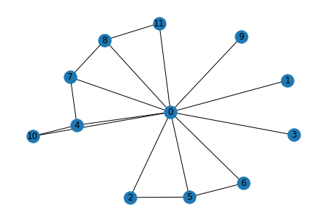
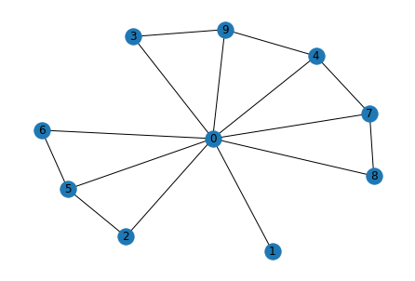
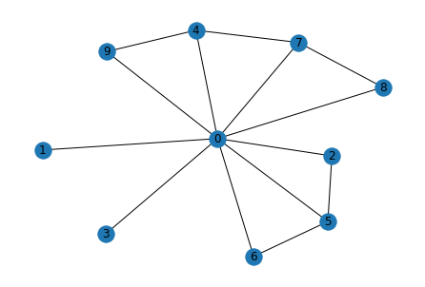
03
Study Meeting
LearnData Lab
LearnData Lab @SKKU
Graph score& final 크기순서
1.Cycle encoder
D > E > A > C
2. GSC
D > E = A > C
Cycle 개수 순위
B > A = D = E
진행 상황
Question_Concept : wound
Q. Where might a person go if they need urgent care for a wound?
A. body B. injury C. patient D. emergency room E. hospital
파란색 원을 보면 D-subgraph는 wound와 room이 연결되어 있음
정답을 도출하기 위해선 Key question node와 key answer node는 연결되어야 함
Cycle encoder는 정답노드의 score가 높음
room
wound
may
injury
might
urgent
emergency
might
hospital
urgent
care
person
urgent
wound
might
care
go
emergency_room
may
need
wound
person
need
go
need
go
care
may
person
0 > 4 > 10 > 7
0 > 4 > 10 > 7
9 > 4 > 0
4 > 9 > 0
0 > 9 > 4 > 3 > 7
0 > 4 > 9 > 7 > 3
Cycle Encoder(D)
GSC(B)
High graph score(E)

Slide 31
Message Passing 2-layer을 지난 후 + MLP 의 임베딩 값 in Cycle encoder
6
Study Meeting
LearnData Lab
LearnData Lab @SKKU
A
B
C
D
E
[[ 1.3935],
[-1.4373],
[-1.4120],
[-1.4373],
[ 1.5309],
[-1.3788],
[-1.3745],
[ 0.7211],
[-1.4213],
[ 1.5293],
[-1.4486],
[-1.4486],
[-1.4486],
[-1.4486],
[-1.4486],
[-1.4486],
[-1.4486],
[-1.4486],
[-1.4486],
[-1.4486],
[-1.4486],
[-1.4486],
[-1.4486],
[-1.4486],
[-1.4486],
[-1.4486],
[-1.4486],
[-1.4486],
[-1.4486],
[-1.4486],
[-1.4486],
[-1.4486]],
[[-0.8957],
[-1.4416],
[-1.4198],
[-1.4416],
[-0.1239],
[-1.3915],
[-1.3866],
[-1.2905],
[-1.4312],
[-0.0341 ],
[-1.4486],
[-1.4486],
[-1.4486],
[-1.4486],
[-1.4486],
[-1.4486],
[-1.4486],
[-1.4486],
[-1.4486],
[-1.4486],
[-1.4486],
[-1.4486],
[-1.4486],
[-1.4486],
[-1.4486],
[-1.4486],
[-1.4486],
[-1.4486],
[-1.4486],
[-1.4486],
[-1.4486],
[-1.4486]],
[[ 1.3873],
[-1.4379],
[-1.4122],
[-1.4379],
[ 1.3634],
[-1.3766],
[-1.3735],
[ 0.6906],
[-1.4205],
[ 1.3569],
[-1.4486],
[-1.4486],
[-1.4486],
[-1.4486],
[-1.4486],
[-1.4486],
[-1.4486],
[-1.4486],
[-1.4486],
[-1.4486],
[-1.4486],
[-1.4486],
[-1.4486],
[-1.4486],
[-1.4486],
[-1.4486],
[-1.4486],
[-1.4486],
[-1.4486],
[-1.4486],
[-1.4486],
[-1.4486]],
[[ 1.4174],
[-1.4248],
[-1.3929],
[-1.4248],
[ 1.3703],
[-1.3532],
[-1.3482],
[ 0.7801],
[-1.2914],
[-1.4158],
[ 1.3637],
[-1.3259],
[-1.4486],
[-1.4486],
[-1.4486],
[-1.4486],
[-1.4486],
[-1.4486],
[-1.4486],
[-1.4486],
[-1.4486],
[-1.4486],
[-1.4486],
[-1.4486],
[-1.4486],
[-1.4486],
[-1.4486],
[-1.4486],
[-1.4486],
[-1.4486],
[-1.4486],
[-1.4486]],
[[ 1.3938],
[-1.4318],
[-1.4035],
[ 0.7242],
[ 1.3699],
[-1.3672],
[-1.3626],
[ 0.7084],
[-1.4127],
[ 1.3705],
[-1.4486],
[-1.4486],
[-1.4486],
[-1.4486],
[-1.4486],
[-1.4486],
[-1.4486],
[-1.4486],
[-1.4486],
[-1.4486],
[-1.4486],
[-1.4486],
[-1.4486],
[-1.4486],
[-1.4486],
[-1.4486],
[-1.4486],
[-1.4486],
[-1.4486],
[-1.4486],
[-1.4486],
[-1.4486]],

Slide 32
D in Cycle Encoder
6
Study Meeting
LearnData Lab
LM의 값(context score)과 더한 최종 값
LearnData Lab @SKKU
Graph score
[ 1.3935],
[-0.8957],
[ 1.3873],
[ 1.4174],
[ 1.3938]
[ -3.8736,
-5.2579,
-2.1974,
7.0199,
6.9767],

Slide 33
Message Passing 2-layer을 지난 후 + MLP 의 임베딩 값 in GSC
6
Study Meeting
LearnData Lab
LearnData Lab @SKKU
A
B
C
D
E
[[ 2.2237],
[-1.3624],
[-1.2983],
[-1.3624],
[ 2.3715],
[-1.2317],
[-1.2336],
[ 1.7258],
[-1.3139],
[ 2.3765],
[-1.5911],
[-1.5911],
[-1.5911],
[-1.5911],
[-1.5911],
[-1.5911],
[-1.5911],
[-1.5911],
[-1.5911],
[-1.5911],
[-1.5911],
[-1.5911],
[-1.5911],
[-1.5911],
[-1.5911],
[-1.5911],
[-1.5911],
[-1.5911],
[-1.5911],
[-1.5911],
[-1.5911],
[-1.5911]],
[[-0.7492],
[-1.3624],
[-1.2983],
[-1.3624],
[-0.0827],
[-1.2317],
[-1.2336],
[-1.1365],
[-1.3139],
[-0.3884],
[-1.5911],
[-1.5911],
[-1.5911],
[-1.5911],
[-1.5911],
[-1.5911],
[-1.5911],
[-1.5911],
[-1.5911],
[-1.5911],
[-1.5911],
[-1.5911],
[-1.5911],
[-1.5911],
[-1.5911],
[-1.5911],
[-1.5911],
[-1.5911],
[-1.5911],
[-1.5911],
[-1.5911],
[-1.5911]]
[[ 2.2204],
[-1.3624],
[-1.2983],
[-1.3624],
[ 2.2147],
[-1.2317],
[-1.2336],
[ 1.7210],
[-1.3139],
[ 2.2131],
[-1.5911],
[-1.5911],
[-1.5911],
[-1.5911],
[-1.5911],
[-1.5911],
[-1.5911],
[-1.5911],
[-1.5911],
[-1.5911],
[-1.5911],
[-1.5911],
[-1.5911],
[-1.5911],
[-1.5911],
[-1.5911],
[-1.5911],
[-1.5911],
[-1.5911],
[-1.5911],
[-1.5911],
[-1.5911]],
[[ 2.2390],
[-1.1225],
[-1.0570],
[-1.1225],
[ 2.2258],
[-0.9896],
[-0.9916],
[ 1.7722],
[-0.9040],
[-1.1137],
[ 2.2243],
[-0.9376],
[-1.5911],
[-1.5911],
[-1.5911],
[-1.5911],
[-1.5911],
[-1.5911],
[-1.5911],
[-1.5911],
[-1.5911],
[-1.5911],
[-1.5911],
[-1.5911],
[-1.5911],
[-1.5911],
[-1.5911],
[-1.5911],
[-1.5911],
[-1.5911],
[-1.5911],
[-1.5911]],
[[ 2.2237],
[-1.3624],
[-1.2983],
[ 1.6610],
[ 2.2169],
[-1.2317],
[-1.2336],
[ 1.7210],
[-1.3139],
[ 2.2166],
[-1.5911],
[-1.5911],
[-1.5911],
[-1.5911],
[-1.5911],
[-1.5911],
[-1.5911],
[-1.5911],
[-1.5911],
[-1.5911],
[-1.5911],
[-1.5911],
[-1.5911],
[-1.5911],
[-1.5911],
[-1.5911],
[-1.5911],
[-1.5911],
[-1.5911],
[-1.5911],
[-1.5911],
[-1.5911]],

Slide 34
E in GSC
6
Study Meeting
LearnData Lab
LM의 값(context score)과 더한 최종 값
LearnData Lab @SKKU
Graph score
[ 2.2237],
[-0.7492],
[ 2.2204],
[ 2.2390],
[ 2.2237],
[ -1.7211,
-2.8685,
1.4000,
10.9253,
10.9578]

Slide 35
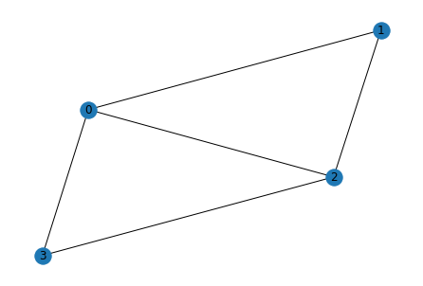
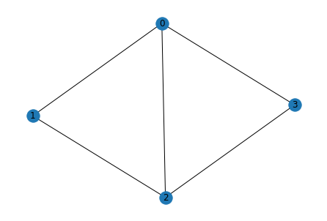
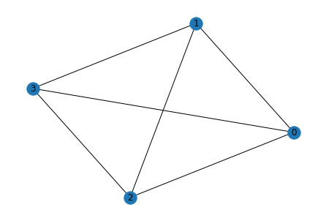
03
Study Meeting
LearnData Lab
LearnData Lab @SKKU
Graph score& final 크기순서
1.Cycle encoder
C > E > A -> A > E > B
2. GSC
C > E > A -> E > A > C
Cycle 개수 순위
E > C > A > B > D
진행 상황
Question_Concept : river
Q. A tributary of a river is a?
A. creek B. pond C. lake D. inlet E. stream
Tributary : 다른 강이나 개울에 합류하면서도 바다로 직접적으로 흐르지 않는 물줄기를 가리킨다.
이 문제는 나도 정답이 뭔지…(chatGPT도 구분 못함)
이 문제 역시 X
river
river
stream
creek
river
tributary
tributary
tributary
lake
3 > 2 > 0 > 1
3 > 2 > 0 > 1
2 > 3 > 0=1
3 > 2 > 0=1
2 > 3 > 0 > 1
3 > 2 > 0 > 1
Cycle Encoder(A)
GSC(E)
High graph score(C)

Slide 36
Message Passing 2-layer을 지난 후 + MLP 의 임베딩 값 in Cycle encoder
6
Study Meeting
LearnData Lab
LearnData Lab @SKKU
A
B
C
D
E
[[ 1.3645],
[ 0.6837],
[ 1.5874],
[ 1.5878],
[-1.4486],
[-1.4486],
[-1.4486],
[-1.4486],
[-1.4486],
[-1.4486],
[-1.4486],
[-1.4486],
[-1.4486],
[-1.4486],
[-1.4486],
[-1.4486],
[-1.4486],
[-1.4486],
[-1.4486],
[-1.4486],
[-1.4486],
[-1.4486],
[-1.4486],
[-1.4486],
[-1.4486],
[-1.4486],
[-1.4486],
[-1.4486],
[-1.4486],
[-1.4486],
[-1.4486],
[-1.4486]],
[[ 1.3482],
[ 0.6301],
[ 1.5202],
[ 1.5173],
[-1.4486],
[-1.4486],
[-1.4486],
[-1.4486],
[-1.4486],
[-1.4486],
[-1.4486],
[-1.4486],
[-1.4486],
[-1.4486],
[-1.4486],
[-1.4486],
[-1.4486],
[-1.4486],
[-1.4486],
[-1.4486],
[-1.4486],
[-1.4486],
[-1.4486],
[-1.4486],
[-1.4486],
[-1.4486],
[-1.4486],
[-1.4486],
[-1.4486],
[-1.4486],
[-1.4486],
[-1.4486]],
[[ 1.3989],
[ 0.7439],
[ 1.6238],
[ 1.6222],
[-1.4486],
[-1.4486],
[-1.4486],
[-1.4486],
[-1.4486],
[-1.4486],
[-1.4486],
[-1.4486],
[-1.4486],
[-1.4486],
[-1.4486],
[-1.4486],
[-1.4486],
[-1.4486],
[-1.4486],
[-1.4486],
[-1.4486],
[-1.4486],
[-1.4486],
[-1.4486],
[-1.4486],
[-1.4486],
[-1.4486],
[-1.4486],
[-1.4486],
[-1.4486],
[-1.4486],
[-1.4486]],
[[-1.4112],
[-1.4309],
[-1.4309],
[-1.4369],
[-1.4486],
[-1.4486],
[-1.4486],
[-1.4486],
[-1.4486],
[-1.4486],
[-1.4486],
[-1.4486],
[-1.4486],
[-1.4486],
[-1.4486],
[-1.4486],
[-1.4486],
[-1.4486],
[-1.4486],
[-1.4486],
[-1.4486],
[-1.4486],
[-1.4486],
[-1.4486],
[-1.4486],
[-1.4486],
[-1.4486],
[-1.4486],
[-1.4486],
[-1.4486],
[-1.4486],
[-1.4486]],
[[ 1.3787],
[ 1.3787],
[ 1.6205],
[ 1.6187],
[-1.4486],
[-1.4486],
[-1.4486],
[-1.4486],
[-1.4486],
[-1.4486],
[-1.4486],
[-1.4486],
[-1.4486],
[-1.4486],
[-1.4486],
[-1.4486],
[-1.4486],
[-1.4486],
[-1.4486],
[-1.4486],
[-1.4486],
[-1.4486],
[-1.4486],
[-1.4486],
[-1.4486],
[-1.4486],
[-1.4486],
[-1.4486],
[-1.4486],
[-1.4486],
[-1.4486],
[-1.4486]],

Slide 37
D in Cycle Encoder
6
Study Meeting
LearnData Lab
LM의 값(context score)과 더한 최종 값
LearnData Lab @SKKU
Graph score
[ 1.3645],
[ 1.3482],
[ 1.3989],
[-1.4112],
[ 1.3787]
[ 7.8585,
0.2091,
-0.4403,
-3.4991,
7.3520]

Slide 38
Message Passing 2-layer을 지난 후 + MLP 의 임베딩 값 in GSC
6
Study Meeting
LearnData Lab
LearnData Lab @SKKU
A
B
C
D
E
[[ 1.9384],
[ 1.4709],
[ 2.2754],
[ 2.3721],
[-1.5911],
[-1.5911],
[-1.5911],
[-1.5911],
[-1.5911],
[-1.5911],
[-1.5911],
[-1.5911],
[-1.5911],
[-1.5911],
[-1.5911],
[-1.5911],
[-1.5911],
[-1.5911],
[-1.5911],
[-1.5911],
[-1.5911],
[-1.5911],
[-1.5911],
[-1.5911],
[-1.5911],
[-1.5911],
[-1.5911],
[-1.5911],
[-1.5911],
[-1.5911],
[-1.5911],
[-1.5911]],
[[ 1.9194],
[ 1.4579],
[ 2.1402],
[ 2.2414],
[-1.5911],
[-1.5911],
[-1.5911],
[-1.5911],
[-1.5911],
[-1.5911],
[-1.5911],
[-1.5911],
[-1.5911],
[-1.5911],
[-1.5911],
[-1.5911],
[-1.5911],
[-1.5911],
[-1.5911],
[-1.5911],
[-1.5911],
[-1.5911],
[-1.5911],
[-1.5911],
[-1.5911],
[-1.5911],
[-1.5911],
[-1.5911],
[-1.5911],
[-1.5911],
[-1.5911],
[-1.5911]],
[[ 1.9889],
[ 1.5182],
[ 2.3733],
[ 2.4431],
[-1.5911],
[-1.5911],
[-1.5911],
[-1.5911],
[-1.5911],
[-1.5911],
[-1.5911],
[-1.5911],
[-1.5911],
[-1.5911],
[-1.5911],
[-1.5911],
[-1.5911],
[-1.5911],
[-1.5911],
[-1.5911],
[-1.5911],
[-1.5911],
[-1.5911],
[-1.5911],
[-1.5911],
[-1.5911],
[-1.5911],
[-1.5911],
[-1.5911],
[-1.5911],
[-1.5911],
[-1.5911]],
[[-1.4055],
[-1.4158],
[-1.4158],
[-1.4397],
[-1.5911],
[-1.5911],
[-1.5911],
[-1.5911],
[-1.5911],
[-1.5911],
[-1.5911],
[-1.5911],
[-1.5911],
[-1.5911],
[-1.5911],
[-1.5911],
[-1.5911],
[-1.5911],
[-1.5911],
[-1.5911],
[-1.5911],
[-1.5911],
[-1.5911],
[-1.5911],
[-1.5911],
[-1.5911],
[-1.5911],
[-1.5911],
[-1.5911],
[-1.5911],
[-1.5911],
[-1.5911]],
[[ 1.9678],
[ 1.9678],
[ 2.3624],
[ 2.4386],
[-1.5911],
[-1.5911],
[-1.5911],
[-1.5911],
[-1.5911],
[-1.5911],
[-1.5911],
[-1.5911],
[-1.5911],
[-1.5911],
[-1.5911],
[-1.5911],
[-1.5911],
[-1.5911],
[-1.5911],
[-1.5911],
[-1.5911],
[-1.5911],
[-1.5911],
[-1.5911],
[-1.5911],
[-1.5911],
[-1.5911],
[-1.5911],
[-1.5911],
[-1.5911],
[-1.5911],
[-1.5911]]

Slide 39
E in GSC
6
Study Meeting
LearnData Lab
LM의 값(context score)과 더한 최종 값
LearnData Lab @SKKU
Graph score
[ 1.9384],
[ 1.9194],
[ 1.9889],
[-1.4055],
[ 1.9678]
[ 9.8152,
3.4319,
4.3040,
-0.7054,
10.1222],

Slide 40
03
Study Meeting
LearnData Lab
LearnData Lab @SKKU
Graph score& final 크기순서
1.Cycle encoder
B > A=C=D > E -> D > B > C > A > E
2. GSC
B > A=C=D > E -> B > D > C > A > E
Cycle 개수 순위
B > A = C = D > E
진행 상황
Question_Concept : excavation
Q. What will be created after an excavation is finished?
A. montana B. work area C. city D. quarry E. trunk
이 문제 역시 X
0 > 4 = 6
0 > 4 = 6
0 > 4 = 7
0 > 4 = 7
0 > 4 = 6
0 > 4 = 6
Cycle Encoder(D)
GSC(B)
High graph score(C)

Slide 41
Message Passing 2-layer을 지난 후 + MLP 의 임베딩 값 in Cycle encoder
6
Study Meeting
LearnData Lab
LearnData Lab @SKKU
A
B
C
D
E
[[ 1.3802],
[-1.3732],
[-1.4192],
[-1.4192],
[ 1.3575],
[-1.3732],
[ 1.3575],
[-1.4486],
[-1.4486],
[-1.4486],
[-1.4486],
[-1.4486],
[-1.4486],
[-1.4486],
[-1.4486],
[-1.4486],
[-1.4486],
[-1.4486],
[-1.4486],
[-1.4486],
[-1.4486],
[-1.4486],
[-1.4486],
[-1.4486],
[-1.4486],
[-1.4486],
[-1.4486],
[-1.4486],
[-1.4486],
[-1.4486],
[-1.4486],
[-1.4486]]
[[ 1.4118],
[-1.2072],
[-1.4063],
[-1.4063],
[ 1.3626],
[-1.1950],
[-1.2839],
[ 1.3626],
[-1.4122],
[-1.4486],
[-1.4486],
[-1.4486],
[-1.4486],
[-1.4486],
[-1.4486],
[-1.4486],
[-1.4486],
[-1.4486],
[-1.4486],
[-1.4486],
[-1.4486],
[-1.4486],
[-1.4486],
[-1.4486],
[-1.4486],
[-1.4486],
[-1.4486],
[-1.4486],
[-1.4486],
[-1.4486],
[-1.4486],
[-1.4486]]
[[ 1.3802],
[-1.3732],
[-1.4192],
[-1.4192],
[ 1.3575],
[-1.3732],
[ 1.3575],
[-1.4486],
[-1.4486],
[-1.4486],
[-1.4486],
[-1.4486],
[-1.4486],
[-1.4486],
[-1.4486],
[-1.4486],
[-1.4486],
[-1.4486],
[-1.4486],
[-1.4486],
[-1.4486],
[-1.4486],
[-1.4486],
[-1.4486],
[-1.4486],
[-1.4486],
[-1.4486],
[-1.4486],
[-1.4486],
[-1.4486],
[-1.4486],
[-1.4486]]
[[ 1.3802],
[-1.3732],
[-1.4192],
[-1.4192],
[ 1.3575],
[-1.3732],
[ 1.3575],
[-1.4486],
[-1.4486],
[-1.4486],
[-1.4486],
[-1.4486],
[-1.4486],
[-1.4486],
[-1.4486],
[-1.4486],
[-1.4486],
[-1.4486],
[-1.4486],
[-1.4486],
[-1.4486],
[-1.4486],
[-1.4486],
[-1.4486],
[-1.4486],
[-1.4486],
[-1.4486],
[-1.4486],
[-1.4486],
[-1.4486],
[-1.4486],
[-1.4486]]
[[-1.3228],
[-1.3865],
[-1.4292],
[-1.4292],
[-1.4421],
[-1.3865],
[-1.4361],
[-1.4486],
[-1.4486],
[-1.4486],
[-1.4486],
[-1.4486],
[-1.4486],
[-1.4486],
[-1.4486],
[-1.4486],
[-1.4486],
[-1.4486],
[-1.4486],
[-1.4486],
[-1.4486],
[-1.4486],
[-1.4486],
[-1.4486],
[-1.4486],
[-1.4486],
[-1.4486],
[-1.4486],
[-1.4486],
[-1.4486],
[-1.4486],
[-1.4486]]

Slide 42
D in Cycle Encoder
6
Study Meeting
LearnData Lab
LM의 값(context score)과 더한 최종 값
LearnData Lab @SKKU
Graph score
[ 1.3802],
[ 1.4118],
[ 1.3802],
[ 1.3802],
[-1.3228]]
[ -4.3993,
1.3767,
0.0656,
4.1706,
-7.7021]

Slide 43
Message Passing 2-layer을 지난 후 + MLP 의 임베딩 값 in GSC
6
Study Meeting
LearnData Lab
LearnData Lab @SKKU
A
B
C
D
E
[[ 2.2151],
[-1.3088],
[-1.3728],
[-1.3728],
[ 2.2102],
[-1.3088],
[ 2.2102],
[-1.5911],
[-1.5911],
[-1.5911],
[-1.5911],
[-1.5911],
[-1.5911],
[-1.5911],
[-1.5911],
[-1.5911],
[-1.5911],
[-1.5911],
[-1.5911],
[-1.5911],
[-1.5911],
[-1.5911],
[-1.5911],
[-1.5911],
[-1.5911],
[-1.5911],
[-1.5911],
[-1.5911],
[-1.5911],
[-1.5911],
[-1.5911],
[-1.5911]
[[ 2.2363],
[-0.8489],
[-1.1332],
[-1.1332],
[ 2.2216],
[-1.0086],
[-0.9158],
[ 2.2216],
[-1.1581],
[-1.5911],
[-1.5911],
[-1.5911],
[-1.5911],
[-1.5911],
[-1.5911],
[-1.5911],
[-1.5911],
[-1.5911],
[-1.5911],
[-1.5911],
[-1.5911],
[-1.5911],
[-1.5911],
[-1.5911],
[-1.5911],
[-1.5911],
[-1.5911],
[-1.5911],
[-1.5911],
[-1.5911],
[-1.5911],
[-1.5911]
[[ 2.2151],
[-1.3088],
[-1.3728],
[-1.3728],
[ 2.2102],
[-1.3088],
[ 2.2102],
[-1.5911],
[-1.5911],
[-1.5911],
[-1.5911],
[-1.5911],
[-1.5911],
[-1.5911],
[-1.5911],
[-1.5911],
[-1.5911],
[-1.5911],
[-1.5911],
[-1.5911],
[-1.5911],
[-1.5911],
[-1.5911],
[-1.5911],
[-1.5911],
[-1.5911],
[-1.5911],
[-1.5911],
[-1.5911],
[-1.5911],
[-1.5911],
[-1.5911]
[[ 2.2151],
[-1.3088],
[-1.3728],
[-1.3728],
[ 2.2102],
[-1.3088],
[ 2.2102],
[-1.5911],
[-1.5911],
[-1.5911],
[-1.5911],
[-1.5911],
[-1.5911],
[-1.5911],
[-1.5911],
[-1.5911],
[-1.5911],
[-1.5911],
[-1.5911],
[-1.5911],
[-1.5911],
[-1.5911],
[-1.5911],
[-1.5911],
[-1.5911],
[-1.5911],
[-1.5911],
[-1.5911],
[-1.5911],
[-1.5911],
[-1.5911],
[-1.5911]]
[[-1.2944],
[-1.3088],
[-1.3728],
[-1.3728],
[-1.4054],
[-1.3088],
[-1.3970],
[-1.5911],
[-1.5911],
[-1.5911],
[-1.5911],
[-1.5911],
[-1.5911],
[-1.5911],
[-1.5911],
[-1.5911],
[-1.5911],
[-1.5911],
[-1.5911],
[-1.5911],
[-1.5911],
[-1.5911],
[-1.5911],
[-1.5911],
[-1.5911],
[-1.5911],
[-1.5911],
[-1.5911],
[-1.5911],
[-1.5911],
[-1.5911],
[-1.5911]

Slide 44
B in GSC
6
Study Meeting
LearnData Lab
LM의 값(context score)과 더한 최종 값
LearnData Lab @SKKU
Graph score
[ 2.2151],
[ 2.2363],
[ 2.2151],
[ 2.2151],
[-1.2944]
[ 1.0229,
7.8472,
5.0574,
7.5733,
-1.6549]

Slide 45
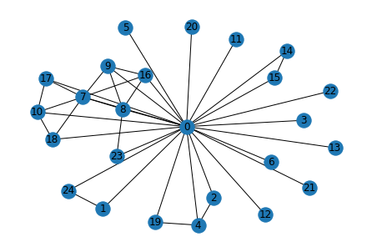
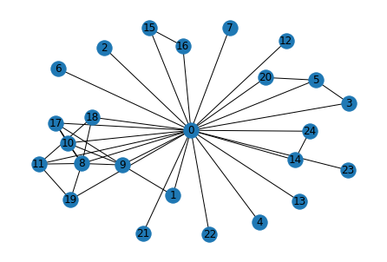
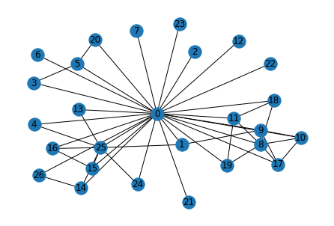
03
Study Meeting
LearnData Lab
LearnData Lab @SKKU
Graph score& final 크기순서
1.Cycle encoder
D > B > C > A -> A > C > D
2. GSC
D > B > C > A -> C > A > B
Cycle 개수 순위
D > B > A = C = E
진행 상황
Question_Concept : excavation
Q. He spent all summer in his room playing video games, because of this it wasn’t surprising for Mother to find a stack of dirty dishes in her what?
A. son’s room B. party C. dishwasher D. restaurant kitchen E. shoes
Graph score는 a-subgraph가 낮았지만 LM으로 인해 가장 높아짐…
이 문제 역시 의미 X
Cycle Encoder(A)
GSC(C)
High graph score(D)

Slide 46
Message Passing 2-layer을 지난 후 + MLP 의 임베딩 값 in Cycle encoder
6
Study Meeting
LearnData Lab
LearnData Lab @SKKU
A
B
C
D
E
[[-0.8771],
[-1.3495],
[-1.4418],
[-1.4563],
[-1.4360],
[-1.4563],
[-1.4563],
[-1.1944],
[-1.3843],
[-1.3996],
[-1.4361],
[-1.4563],
[-1.4563],
[-1.4563],
[-1.4551],
[-1.4551],
[-1.4309],
[-1.4514],
[-1.4514],
[-1.4526],
[-1.4563],
[-1.4563],
[-1.4563],
[-1.4505],
[-1.3433],
[-1.4486],
[-1.4486],
[-1.4486],
[-1.4486],
[-1.4486],
[-1.4486],
[-1.4486]],
[[ 1.5952],
[ 1.3587],
[-1.4558],
[-1.4498],
[-1.4558],
[-1.4458],
[-1.4558],
[-1.4558],
[ 1.5442],
[ 0.7939],
[ 0.7513],
[-1.4334],
[-1.4558],
[-1.4558],
[ 1.5172],
[-1.4564],
[-1.4564],
[ 1.6175],
[-1.4541],
[-1.4541],
[-1.4558],
[-1.4558],
[-1.4558],
[-1.4558],
[ 1.6157],
[-1.4486],
[-1.4486],
[-1.4486],
[-1.4486],
[-1.4486],
[-1.4486],
[-1.4486]]
[[ 1.4033],
[-1.4562],
[-1.4563],
[-1.4467],
[-1.4563],
[-1.4420],
[-1.4563],
[-1.4563],
[-1.2646],
[-1.4176],
[-1.4167],
[-1.4421],
[-1.4563],
[-1.4563],
[ 1.5172],
[-1.4562],
[-1.4562],
[-1.4414],
[-1.4540],
[-1.4540],
[-1.4548],
[-1.4563],
[-1.4563],
[-1.4563],
[ 1.5149],
[-1.4486],
[-1.4486],
[-1.4486],
[-1.4486],
[-1.4486],
[-1.4486],
[-1.4486]],
[[ 1.6632],
[ 1.6716],
[-1.4542],
[-1.4307],
[ 1.6165],
[-1.4230],
[-1.4542],
[-1.4542],
[-1.2216],
[ 0.7370],
[-1.3898],
[-1.4231],
[-1.4542],
[ 1.6317],
[ 1.6488],
[ 1.6419],
[ 1.6419],
[-1.4245],
[-1.4446],
[-1.4446],
[-1.4466],
[-1.4542],
[-1.4542],
[-1.4542],
[ 1.6192],
[ 1.6659],
[ 1.5151],
[-1.4486],
[-1.4486],
[-1.4486],
[-1.4486],
[-1.4486]],
[[-1.0254],
[-1.4552],
[-1.4563],
[-1.4422],
[-1.4404],
[-1.4365],
[-1.4563],
[-1.4563],
[-1.2426],
[-1.4082],
[-1.4071],
[-1.4366],
[-1.4563],
[-1.4563],
[-1.4563],
[-1.4552],
[-1.4552],
[-1.4356],
[-1.4516],
[-1.4516],
[-1.4528],
[-1.4563],
[-1.4563],
[-1.4563],
[-1.4490],
[-1.4292],
[-1.4486],
[-1.4486],
[-1.4486],
[-1.4486],
[-1.4486],
[-1.4486]],

Slide 47
D in Cycle Encoder
6
Study Meeting
LearnData Lab
LM의 값(context score)과 더한 최종 값
LearnData Lab @SKKU
Graph score
[-0.8771],
[ 1.5952],
[ 1.4033],
[ 1.6632],
[-1.0254]
[3.4933,
-4.3885,
3.1625,
-2.6731,
-11.3106],

Slide 48
Message Passing 2-layer을 지난 후 + MLP 의 임베딩 값 in GSC
6
Study Meeting
LearnData Lab
LearnData Lab @SKKU
A
B
C
D
E
[[ 0.0646],
[-0.6312],
[-0.8865],
[-1.0364],
[-0.8688],
[-1.0364],
[-1.0364],
[ 0.1274],
[-0.0151],
[-0.0623],
[-0.1648],
[-1.0364],
[-1.0364],
[-1.0364],
[-1.0027],
[-1.0027],
[-0.5201],
[-0.6688],
[-0.6688],
[-0.9201],
[-1.0364],
[-1.0364],
[-1.0364],
[-0.8747],
[-0.7207],
[-1.5911],
[-1.5911],
[-1.5911],
[-1.5911],
[-1.5911],
[-1.5911],
[-1.5911]],
[[ 2.4540],
[ 2.2273],
[-1.1428],
[-0.9927],
[-1.1428],
[-0.9749],
[-1.1428],
[-1.1428],
[ 2.3983],
[ 1.9279],
[ 1.9199],
[-0.1883],
[-1.1428],
[-1.1428],
[ 2.3771],
[-1.1091],
[-1.1091],
[ 2.4834],
[-0.7469],
[-0.7469],
[-1.0264],
[-1.1428],
[-1.1428],
[-1.1428],
[ 2.4850],
[-1.5911],
[-1.5911],
[-1.5911],
[-1.5911],
[-1.5911],
[-1.5911],
[-1.5911]],
[[ 2.2610],
[-1.0310],
[-1.1428],
[-0.9927],
[-1.1428],
[-0.9749],
[-1.1428],
[-1.1428],
[ 0.0196],
[-0.1452],
[-0.1604],
[-0.2571],
[-1.1428],
[-1.1428],
[ 2.3729],
[-1.1091],
[-1.1091],
[-0.6314],
[-0.7727],
[-0.7727],
[-1.0264],
[-1.1428],
[-1.1428],
[-1.1428],
[ 2.3785],
[-1.5911],
[-1.5911],
[-1.5911],
[-1.5911],
[-1.5911],
[-1.5911],
[-1.5911]],
[[ 2.5525],
[ 2.5695],
[-0.9006],
[-0.7522],
[ 2.4651],
[-0.7347],
[-0.9006],
[-0.9006],
[ 0.2061],
[ 1.8071],
[ 0.0393],
[-0.0507],
[-0.9006],
[ 2.4939],
[ 2.5251],
[ 2.5128],
[ 2.5128],
[-0.4033],
[-0.5386],
[-0.5386],
[-0.7853],
[-0.9006],
[-0.9006],
[-0.9006],
[ 2.4652],
[ 2.5576],
[ 2.3822],
[-1.5911],
[-1.5911],
[-1.5911],
[-1.5911],
[-1.5911]],
[[-0.0534],
[-0.9100],
[-1.0216],
[-0.8718],
[-0.9049],
[-0.8542],
[-1.0216],
[-1.0216],
[ 0.1147],
[-0.0441],
[-0.0587],
[-0.1521],
[-1.0216],
[-1.0216],
[-1.0216],
[-0.9879],
[-0.9879],
[-0.5160],
[-0.6545],
[-0.6545],
[-0.9054],
[-1.0216],
[-1.0216],
[-1.0216],
[-0.9317],
[-0.8907],
[-1.5911],
[-1.5911],
[-1.5911],
[-1.5911],
[-1.5911],
[-1.5911]],

Slide 49
B in GSC
6
Study Meeting
LearnData Lab
LM의 값(context score)과 더한 최종 값
LearnData Lab @SKKU
Graph score
[ 0.0646],
[ 2.4540],
[ 2.2610],
[ 2.5525],
[-0.0534]
[ 7.1018,
-1.5493,
8.3646,
-2.2254,
-8.8209]

Slide 50
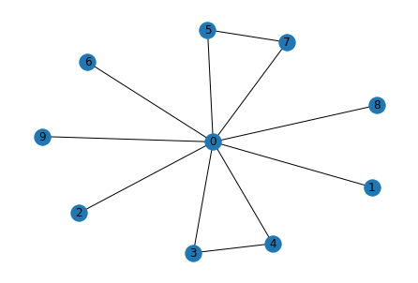
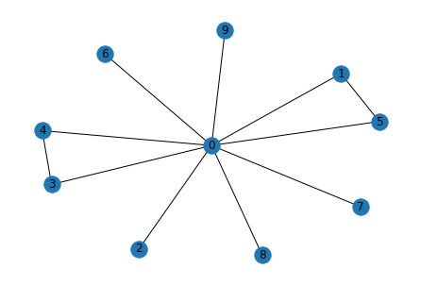
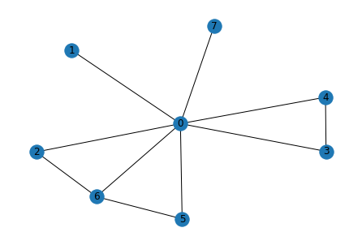
03
Study Meeting
LearnData Lab
LearnData Lab @SKKU
Graph score& final 크기순서
1.Cycle encoder
D > C > A -> D > A > C
2. GSC
D > A > C -> A > C > D
Cycle 개수 순위
C > D > A > B = E
진행 상황
Question_Concept : having food
Q. What happens after having food too much?
A. being full B. laziness C. weight gain D. getting fat E. will not starve
Cycle encoder은 happen(C)에 초점을 가졌고, GSC는 food(A)에 초점을 가짐
C-subgraph는 사이클이 많음, Cycle encoder은 Cycle개수를 중요시함
Cycle은 중요한 역할 -> 중요한 의미를 가지는 노드들은 사이클을 형성, 서로 relevant한 의미를 가지기 때문
fat
were_full
weight_gain
get_fat
full
get
food
food
getting
much
much
being_full
getting_fat
happen
food
happens
happens
happen
is_full
weight
happens
much
happen
gain
was_full
Cycle Encoder(D)
GSC(A)
High graph score(C)

Slide 51
Message Passing 2-layer을 지난 후 + MLP 의 임베딩 값 in Cycle encoder
6
Study Meeting
LearnData Lab
LearnData Lab @SKKU
A
B
C
D
E

Slide 52
D in Cycle Encoder
6
Study Meeting
LearnData Lab
LM의 값(context score)과 더한 최종 값
LearnData Lab @SKKU
Graph score
[[-0.9546],
[-1.3961],
[-0.8247],
[ 0.4045],
[-1.3113],
[ 1.3523, -5.9579, 1.3423, 2.4420, -5.5775],

Slide 53
Message Passing 2-layer을 지난 후 + MLP 의 임베딩 값 in GSC
6
Study Meeting
LearnData Lab
LearnData Lab @SKKU
A
B
C
D
E

Slide 54
B in GSC
6
Study Meeting
LearnData Lab
LM의 값(context score)과 더한 최종 값
LearnData Lab @SKKU
Graph score
[[-0.6932],
[-1.3730],
[-0.8732],
[-0.5047],
[-1.1120],
[ 8.2756,
0.5685,
6.5134,
6.3173,
0.6794],

Slide 55
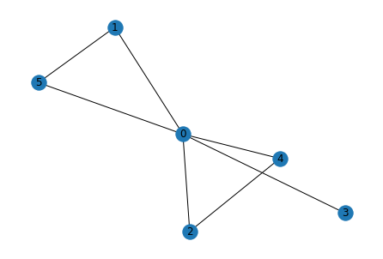
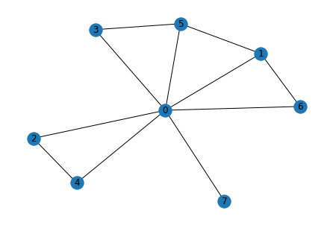
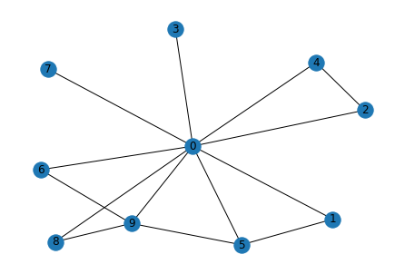
03
Study Meeting
LearnData Lab
LearnData Lab @SKKU
Graph score& final 크기순서
1.Cycle encoder
E > C > D -> C > E > A
2. GSC
E > C > D -> E > C > A
Cycle 개수 순위
D > E > C > A = B
진행 상황
Question_Concept : plumbing
Q. Where is plumbing likely to be clogged by food?
A. Bathroom B. wall C. kitchen D. oil refineries E. water park
E-subgraph의 graph score가 가장 높다. Graph score가 높은 경우는 확실히
중요한 question node와 중요한 answer node들이 사이클로 연결이 되어야함
clog
park
food
food
clog
oil_refinery
plumb
kitchen
clogged
water
oil_refineries
clogged
plumb
food
clog
clogged
plumb
refinery
water_park
refineries
oil
Cycle Encoder(C)
GSC(E)
High graph score(D)

Slide 56
Message Passing 2-layer을 지난 후 + MLP 의 임베딩 값 in Cycle encoder
6
Study Meeting
LearnData Lab
LearnData Lab @SKKU
A
B
C
D
E
[[-1.3961],
[-1.4480],
[-1.4385],
[-1.4480],
[-1.4385],
[-1.4434],
[-1.4486],
[-1.4486],
[-1.4486],
[-1.4486],
[-1.4486],
[-1.4486],
[-1.4486],
[-1.4486],
[-1.4486],
[-1.4486],
[-1.4486],
[-1.4486],
[-1.4486],
[-1.4486],
[-1.4486],
[-1.4486],
[-1.4486],
[-1.4486],
[-1.4486],
[-1.4486],
[-1.4486],
[-1.4486],
[-1.4486],
[-1.4486],
[-1.4486],
[-1.4486]],

Slide 57
D in Cycle Encoder
6
Study Meeting
LearnData Lab
LM의 값(context score)과 더한 최종 값
LearnData Lab @SKKU
Graph score
[-1.3961],
[-1.3961],
[ 1.3806],
[-1.0600],
[ 1.4354]
[ -2.0554,
-6.4231,
2.9738,
-3.9654,
1.4863],

Slide 58
Message Passing 2-layer을 지난 후 + MLP 의 임베딩 값 in GSC
6
Study Meeting
LearnData Lab
LearnData Lab @SKKU
A
B
C
D
E

Slide 59
B in GSC
6
Study Meeting
LearnData Lab
LM의 값(context score)과 더한 최종 값
LearnData Lab @SKKU
Graph score
[-1.3730],
[-1.3730],
[ 2.2148],
[-0.6594],
[ 2.2521]
[ 1.8548,
-3.5387,
6.3755,
-0.5656,
7.0562],

Slide 60
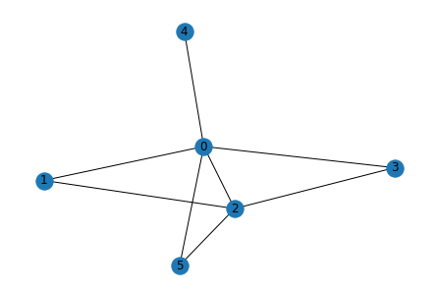
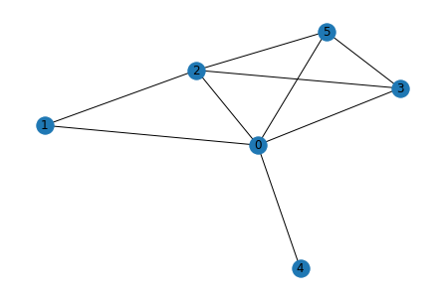
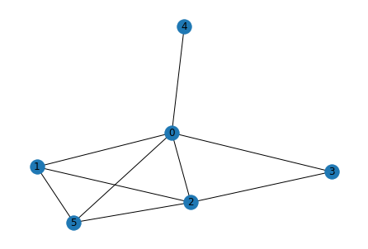
03
Study Meeting
LearnData Lab
LearnData Lab @SKKU
Graph score& final 크기순서
1.Cycle encoder
D > E > A -> E > A > D
2. GSC
E > D > A -> D > A > E
Cycle 개수 순위
D > E > A > B = C
진행 상황
Question_Concept : river
Q. What feature can a river flow through?
A. valley B. wisconsin C. wilderness D. bridge E. waterfall
Cycle encoder은 사이클이 높은 경우를 큰 의미가 있다 생각하여 graph score가 높아진다.
그렇다면 사이클이 무조건 좋은거야??
오답 subgraph의 사이클도 높아지잔아?? >> cycle encoder가 이것까지는 구분하지 못함..
bridge
river_flow
river_flow
flow
river
feature
feature
feature
river
flow
river
river_flow
flow
valley
waterfall
Cycle Encoder(A)
GSC(D)
High graph score(E)

Slide 61
Message Passing 2-layer을 지난 후 + MLP 의 임베딩 값 in Cycle encoder
6
Study Meeting
LearnData Lab
LearnData Lab @SKKU
A
B
C
D
E

Slide 62
D in Cycle Encoder
6
Study Meeting
LearnData Lab
LM의 값(context score)과 더한 최종 값
LearnData Lab @SKKU
Graph score
[ 1.3898],
[ 1.3751],
[ 1.3751],
[ 1.4350],
[ 1.5289]
[ 3.8358e+00,
-6.0571e+00,
-2.9666e+00,
3.1986e+00,
3.3958e+00]

Slide 63
Message Passing 2-layer을 지난 후 + MLP 의 임베딩 값 in GSC
6
Study Meeting
LearnData Lab
LearnData Lab @SKKU
A
B
C
D
E

Slide 64
B in GSC
6
Study Meeting
LearnData Lab
LM의 값(context score)과 더한 최종 값
LearnData Lab @SKKU
Graph score
[ 2.2250],
[ 2.2143],
[ 2.2143],
[ 2.2453],
[ 2.2778],
[ 7.8617,
-1.4460,
1.5659,
8.6832,
7.7614],

Slide 65
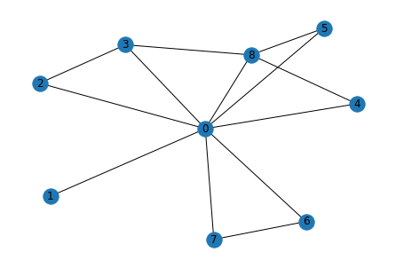
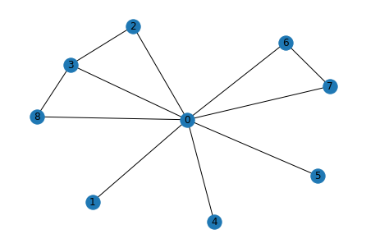
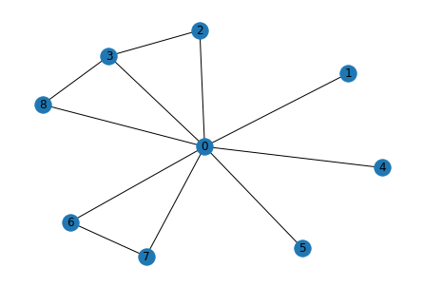
03
Study Meeting
LearnData Lab
LearnData Lab @SKKU
Graph score& final 크기순서
1.Cycle encoder
A > D > B =E -> B > E > D
2. GSC
A > D > B=E -> E > B > D
Cycle 개수 순위
A > D > B = E > C
진행 상황
Question_Concept : french restaurant
Q. Balthazar is a popular french restaurant located where?
A. wine B. manhattan C. underwater D. quebec E. montreal
french
french_restaurant
located
popular
french
wine
french_restaurant
french_restaurant
balthazar
french
restaurant
locate
montreal
manhattan
=
locate
balthazar
located
popular
balthazar
popular
locate
restaurant
located
restaurant
Cycle Encoder(B)
GSC(E)
High graph score(A)

Slide 66
Message Passing 2-layer을 지난 후 + MLP 의 임베딩 값 in Cycle encoder
6
Study Meeting
LearnData Lab
LearnData Lab @SKKU
A
B
C
D
E

Slide 67
D in Cycle Encoder
6
Study Meeting
LearnData Lab
LM의 값(context score)과 더한 최종 값
LearnData Lab @SKKU
Graph score
[ 1.3993],
[ 1.3831],
[-1.3241],
[ 1.3864],
[ 1.3831],
[ -5.5233,
4.4776,
-5.7496,
2.4021,
4.3576],

Slide 68
Message Passing 2-layer을 지난 후 + MLP 의 임베딩 값 in GSC
6
Study Meeting
LearnData Lab
LearnData Lab @SKKU
A
B
C
D
E

Slide 69
B in GSC
6
Study Meeting
LearnData Lab
LM의 값(context score)과 더한 최종 값
LearnData Lab @SKKU
Graph score
[ 2.2258],
[ 2.2151],
[-1.2936],
[ 2.2186],
[ 2.2151],
[-1.2553,
7.7638,
-1.9054,
5.6557,
8.5870],

Slide 70
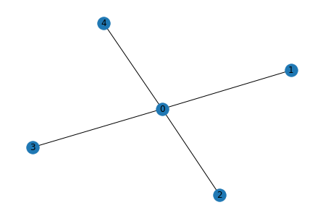
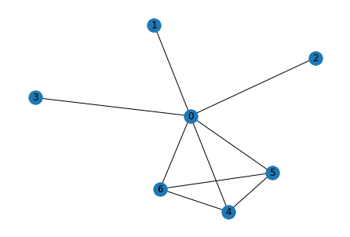
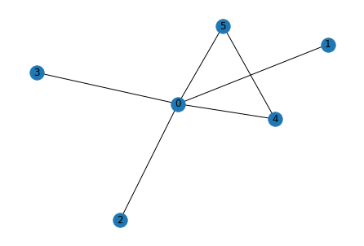
03
Study Meeting
LearnData Lab
LearnData Lab @SKKU
Graph score& final 크기순서
1.Cycle encoder
A > D > B = C = E -> C > B > D > A > E
2. GSC
D > A > B = C = E -> D > C > B > A > E
Cycle 개수 순위
D > A > B = E = C
진행 상황
Question_Concept : most
Q. Who will be voted as the most likely to be successful?
A. bitterest B. representative C. cleverest D. bunny rabbit E. corrupt
clever
successful
bitterest
successful
successful
vote
voted
voted
bitter
voted
bunny_rabbit
rabbit
vote
bunny
vote
Cycle Encoder(C)
GSC(D)
High graph score(A)

Slide 71
Message Passing 2-layer을 지난 후 + MLP 의 임베딩 값 in Cycle encoder
6
Study Meeting
LearnData Lab
LearnData Lab @SKKU
A
B
C
D
E

Slide 72
D in Cycle Encoder
6
Study Meeting
LearnData Lab
LM의 값(context score)과 더한 최종 값
LearnData Lab @SKKU
Graph score
[-1.3778],
[-1.4390],
[-1.4390],
[-1.4334],
[-1.4390],
[ -7.9694,
-4.4465,
-3.6202,
-4.8129,
-14.4877],

Slide 73
Message Passing 2-layer을 지난 후 + MLP 의 임베딩 값 in GSC
6
Study Meeting
LearnData Lab
LearnData Lab @SKKU
A
B
C
D
E

Slide 74
B in GSC
6
Study Meeting
LearnData Lab
LM의 값(context score)과 더한 최종 값
LearnData Lab @SKKU
Graph score
[-1.2826],
[-1.4199],
[-1.4199],
[-1.0997],
[-1.4199]
[ -3.6104,
-1.4352,
0.6657,
0.9848,
-8.0380],

Slide 75
89
Study Meeting
LearnData Lab
LearnData Lab @SKKU
Cycle encoder, GSC 두 모델에서 경향성의 차이점이 없다…
Cycle encoder은 노드 임베딩 값들을 smoothing하게 해준다.
Smoothing 역할을 하였기 때문에 정답과 오답의 graph score차이가 적어서 정답을 잘 맞춘 것
Cycle encoder나 GSC의 graph score의 크기 변화는 없었다. (graph score의 경향성)
E,.g. cycle encoder가 a 정답을 선택한다면, GSC도 a를 선택하는 경향
3번의 뜻은 그만큼 Language Model의 중요도가 크다.
Question text에 올바른 답을 선택하기 위해 중요한 question node와 많은 연결을 한 answer node가 있으면 그 그래프의 score(graph score)가 높아지는 경향이 있다. >> 이래서 Language model이 중요, 오답 subgraph의 score가 높아질 수 있기 때문
보통 정답 노드를 선택하기 위해 필요한(중요한) 질문 노드가 사이클을 형성하는데 이는 우리가 가정했던 순환 논법이 발생하는 것은 아닌 것 같다. -> 이는 좀 더 분석이 필요함 -> 20문제 확인 결과 아닌것 같다.
정답을 도출하는데 필요하지 않은 노드들은 사이클을 형성하지 않는다.
순환 논법이 발생한 것이 아니라 사이클이 있는 것은 사이클을 이루는 노드들이 그만큼 관련성이 높고 중요하다는 것을 의미함 -> relevant한 관계가 아니면 사이클을 형성하지 않는다.
CommonsenseQA 결과 in GSC

Slide 76
81
Study Meeting
LearnData Lab
LearnData Lab @SKKU
결과
그렇다면 graph score가 높을 경우는 뭘까?
20문제를 살펴봄
Cycle이 많으면 graph score가 큼(Cycle encoder, GSC 둘 다 그럼)
하지만 Cycle encoder은 의미 없는 cycle일경우에는 아닌 경우도 있음
의미 없는 사이클은 두 개의 단어로 이루어진 노드가 각각 하나의 단어로 된 노드들과 사이클을 형성하는 경우, 진짜 의미 없는 사이클일 경우
Cycle encoder은 유의미한 Cycle을 detect함
Subgraph의 노드 개수가 많은 경우에 graph score가 큼
Cycle encoder은 GSC에 비해 정답을 구성하는 사이클에 속한 노드들의 중요도가 크게 나타남( 정답 추적/flag역할)
Cycle encoder로 인해 기존 문제의 graph score가 낮아서 못풀던 문제를 풀린 경우는 없음
단지, 값들의 편차를 줄여서 LM score을 통해 역전하는 경우가 다분함

Slide 77
81
Study Meeting
LearnData Lab
LearnData Lab @SKKU
결과
Subgraph의 사이클이 많은 경우는 언제야?
20문제를 살펴봄
텍스트가 길 때
질문(Question)이 길 때
정답 후보(5개의 answer)들이 여러 단어(하나 이상의 단어)로 이루어 질 때
Question node와 Answer node의 관련성이 높을 때 -> 이것은 모든 문제들이 당연히 정답을 맞추기 위해서 이래야 하는데 question node끼리, answer node끼리 형성하는 경우가 있음 -> 이런 경우는 의미 없는 Cycle(정답을 도출하는데 중요하지 않은 집합들)

Slide 78
81
Study Meeting
LearnData Lab
LearnData Lab @SKKU
결과
그래서 Cycle encoder은 사이클에 어떻게 반응을 하는거지?
사이클은 노드간의 관련성이 높아서 형성된다.
Cycle encoder은 사이클로 인해 증가하는 값(node value)을 smoothing해준다. 이는 결국 graph score에도 영향을 미친다.
Cycle encoder은 사이클이 많은 경우를 큰 의미가 있다 생각하여 graph score가 높아지게 하는 역할을 한다. ->
이것이 오답일지라도 의미 연결이 되면 score가 증가함
그래도 비교적 유의미한 cycle을 detect함
부정적 영향을 미칠수도 있음
예를 들어 오답이지만 정말 말이 되는 문제의 경우도 많음 -> 사이클 형성(하지만 이것은 정답이 아님) -> 이것의 graph score 증가(예시 : 65p,

Slide 79
81
Study Meeting
LearnData Lab
LearnData Lab @SKKU
한마디로 요약해보자면
Cycle은 순환 논법이 아니라 노드들의 관련성을 의미하는 것임
Cycle이 높을수록 graph score가 높은 편이다. 무조건은 아님
Cycle encoder은 노드값을 smoothing하게 해주는 역할을 가짐
Cycle encoder은 유의미한 cycle을 detect함, 하지만 이것으로 확실하게 정답을 찾아주지는 못함, 왜냐하면 그런 유의미한 사이클이 해당 문제에서는 정답이 아닐지라도 의미 연결이 맞는 경우…

Slide 80
81
Study Meeting
LearnData Lab
LearnData Lab @SKKU
그렇다면 앞으로 해야할 것은?
OpenBookQA in GSC
CSQA in QA-GNN
OBQA in QA-GNN

Slide 81
81
Study Meeting
LearnData Lab
LearnData Lab @SKKU
그렇다면?
OpenBookQA를 분석해보자
사이클은 노드간의 관련성이

Slide 82
20
Study Meeting
LearnData Lab
LearnData Lab @SKKU
Thank you!

