Slide 1


2024년 1월 17일 Study Meeting
지식 그래프를 사용해서 논리 오류 텍스트를 어떻게 해결할까
How to inject Knowledge with fallacy text using Knowledge Graph
정지$원$
성균관대학교 인공지능학과
석사과정
jwjw9603@g.skku.edu

Slide 2
Influence of Graph Cyclic structure
Contents
01
Progress
진행 내용 Overview
Paper Summary
Prompting for Insight
Result analysis
Data check
My Method
Summary
References

Slide 3
Progress
진행 내용 Overview
5개의 fallacy 벤치마크 데이터셋을 검토하자.
지식 그래프가 어떻게 활용이 될 지?
지식 그래프를 활용한다면 해결될 fallacious text가 무엇이 있을지?
주제 direction
기존 데이터셋을 대상으로 지식 그래프를 활용해서 발전
지식 그래프를 사용한다면 더 잘 풀릴 fallacy text dataset 만들기
Notes:
c

Slide 4
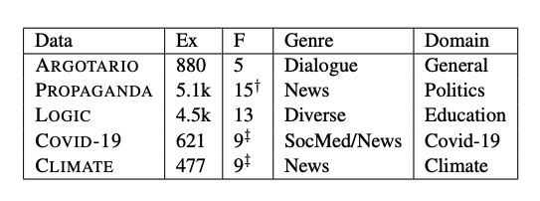
Progress
Multitask Instruction-based Prompting for Fallacy Recognition
기존의 논리 오류 데이터셋들은 단일 데이터셋을 모델에 학습시켜서 평가하는 방식으로 진행했다.
Fallacy detection 작업을 발전시키기 위해, 데이터셋 간의 형태, 도메인, 레이블링 정의 차이를 여러 작업으로 접근하고 T5모델을 기반으로 한 멀티 태스크 설정에서 모델을 학습시켰다. 그 결과 단일 데이터셋으로 학습시킨 모델보다 성능이 좋았다.
https://arxiv.org/pdf/2301.09992.pdf
Notes:
c

Slide 5
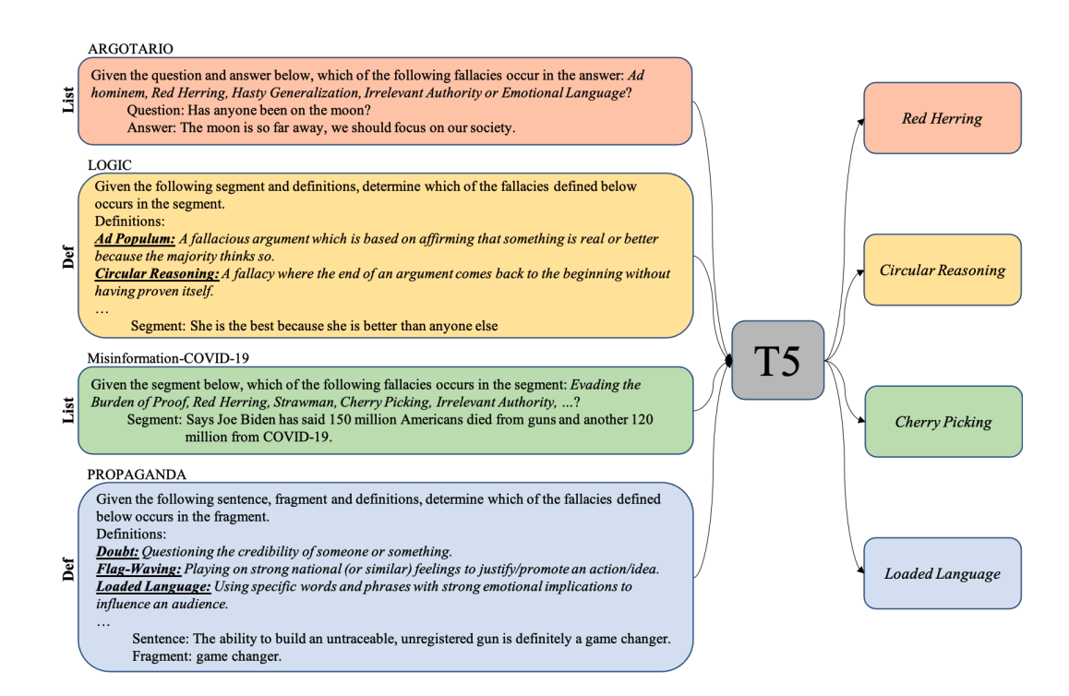
Progress
Multitask Instruction-based Prompting for Fallacy Recognition
https://arxiv.org/pdf/2301.09992.pdf
Notes:
c

Slide 6
Progress
Multitask Instruction-based Prompting for Fallacy Recognition
https://arxiv.org/pdf/2301.09992.pdf
Notes:
c

Slide 7
Progress
벤치마크별 지식 그래프의 영향성 선별하기
지식 그래프가 데이터별로 fallacy type마다 어떻게 영향을 줄지 생각해본다.
직관적으로 아이디어를 얻기 위해 우선 ChatGPT(4.0)에 프롬프팅을 해서 정보를 얻어본다.
지식 그래프의 원리와 개념을 파악한다.
여러 데이터셋에 대해서 진행하므로 공통되는 fallacy가 있을 것이다.
Recency Bias방지를 위해 데이터마다 New Chat으로 진행함
ChatGPT를 통해 얻은 정보와 fallacy type definition & 예시를 확인해서 비교한다.
Notes:
c

Slide 8
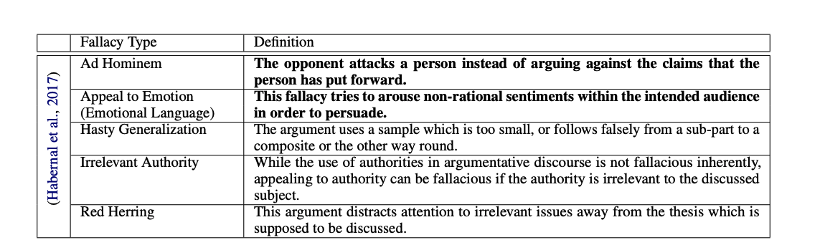
Progress
Data1(Argotario)
위 데이터셋은 게임 설정에서 참여자 간 대화에서 다섯 가지의 오류로 이루어져 있다.
Question(Topic)-Answer(text) pair가 주어지고 이 pair의 fallacy 를 분류하는 태스크로 이루어져 있다.
Ad Hominem, Appeal to Emotion, Red Herring, Hasty Generalization, Irrelevant Authority
이러한 유형들은 논쟁적인 대화에서 흔하게 나타나며 서로 구별되며 서로 다른 난이도 수준을 가지고 있기 때문에 선택되었다.
Notes:
c

Slide 9
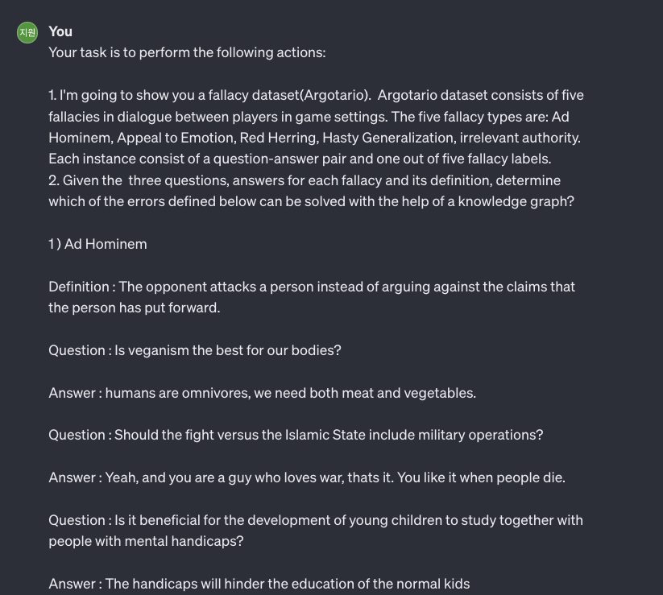
Progress
Prompting(Argotario)
Notes:
c

Slide 10
Progress
Based on these evaluations, knowledge graphs would be most effective in addressing the Hasty Generalization and Irrelevant Authority fallacies. These fallacies rely on the kind of factual and relational information that knowledge graphs are particularly good at processing and providing.
Prompting(Argotario)-result
Ad Hominem: This fallacy involves attacking the person rather than addressing the argument. Knowledge graphs are less effective here because this fallacy is more about the speaker's intent and less about the factual content of the argument.
Appeal to Emotion: These arguments use emotions rather than facts to persuade. Knowledge graphs might provide factual counterpoints to emotional claims but are less effective in directly addressing the emotional aspect of the argument.
Red Herring: This fallacy involves diverting the argument to irrelevant issues. Knowledge graphs can help by identifying the core topics and facts of an argument, potentially highlighting when a red herring is being used.
Hasty Generalization: This fallacy involves drawing broad conclusions from inadequate evidence. Knowledge graphs could be very useful here, as they can provide additional data and examples that either support or refute the generalization, thus informing whether the generalization is valid.
Irrelevant Authority: This fallacy involves citing an authority who is not an expert in the field being discussed. Knowledge graphs are particularly well-suited to address this fallacy, as they can store information about individuals' areas of expertise and whether they are credible sources on a particular topic.
Notes:
c

Slide 11
Progress
Data2(LOGIC)
LOGIC데이터는 Quizziz, study.com, ProProfs와 같은 fallacy에 관한 교육 웹사이트에서 논리 오류 예제를 수집했다.
Wikipedia3(https://en.wikipedia.org/wiki/List_of_fallacies)를 참고로 사용하여 데이터셋에서 13가지 유형의 fallacy를 분류했다.
텍스트 형태는 문장이나 대화 형태로 이뤄져있다.
Notes:
c

Slide 12
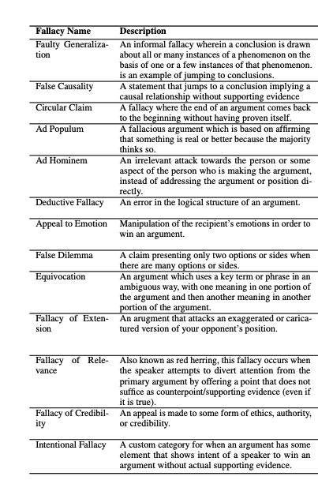
Progress
Data2(LOGIC)
Notes:
c

Slide 13
Progress
Prompting(LOGIC)
Your task is to perform the following actions:
I'm going to show you a fallacy dataset(LOGIC). Logic collected examples of logical fallacies from educational websites on fallacies such as Quizziz, study.com and ProProfs. They identified 13 types of fallacies in the dataset using Wikipedia3 as a reference. The fallacy types are: Faulty Generalization, False Causality, Circular Claim, Ad Populum, Ad Hominem, Deductive Fallacy, Appeal to Emotion, False Dilemma, Equivocation, Fallacy of Extension, Fallacy of Relevance, Fallacy of Credibility and Intentional Fallacy. Each training instance consists of a text segment (e.g. dialogue, sentence) and one of thirteen fallacy labels.
Given the three texts(examples) for each fallacy and its definition, determine which of the errors defined below can be solved with the help of a knowledge graph the most?
Notes:
c

Slide 14
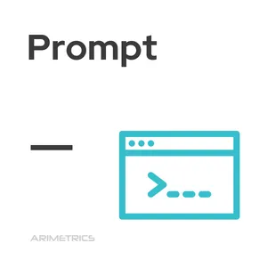

Progress
Prompting(LOGIC)-result
Based on these considerations, knowledge graphs would be most effective in addressing Faulty Generalization, False Causality, and Fallacy of Credibility, as they rely heavily on factual correctness and verification of data or expertise.
Notes:
c

Slide 15
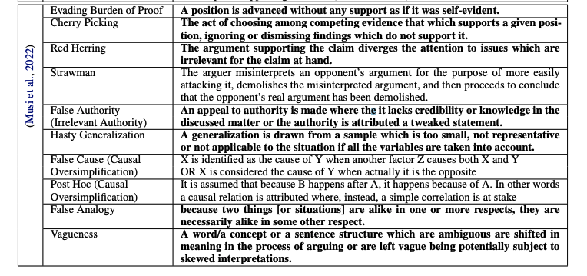
Progress
Data3(COVID-19)
COVID-19 데이터셋은 사실 확인(fact-checked)된 소셜 미디어 게시물과 뉴스를 분석하여 10가지의 오류를 확인하였다.
Evading the Burden of Proof, Cherry Picking, Strawman, Red Herring, False Authority, Hasty Generalization, False Cause, Post Hoc, False Analogy, Vagueness
Notes:
c

Slide 16
Progress
Prompting(COVID-19)
Your task is to perform the following actions:
I'm going to show you a fallacy dataset(COVID-19). It is about fact-checked content around Covid-19. The authors identify 10 fallacies (Evading the Burden of Proof, Cherry Picking, Red Herring, Strawman, False Authority, Hasty Generalization, Post Hoc, False Cause, False Analogy, Vagueness) through analysis of fact-checked social media posts and news by considering fallacies as indicators of misinformation.
Given the three texts(examples) for each fallacy and its definition, determine which of the errors defined below can be solved with the help of a knowledge graph the most?
Notes:
c

Slide 17
Progress
Prompting(COVID-19)-result
In summary, knowledge graphs are most effective in addressing fallacies that involve the misuse or misinterpretation of data and relationships, such as Hasty Generalization, False Cause, Post Hoc, and potentially Cherry Picking and False Authority. They are less effective against fallacies that involve more abstract or rhetorical manipulations, such as Evading the Burden of Proof, Red Herring, Strawman, False Analogy, and Vagueness.
Notes:
c

Slide 18
Progress
결과 분석
ChatGPT-4에 prompting 결과 공통적으로 발견되는 fallacy들이 있다.
Argotario : Hasty generalization, Irrelevant Authority
LOGIC : Hasty generalization, Irrelevant Authority, False Causality(Causal oversimplification)
COVID-19 : Cherry Picking, Hasty generalization, False Cause(Causal Oversimplification), Post HOC(Causal Oversimplification), False
위 세 가지 데이터에 대해서 ChatGPT4.0이 선택한 fallacy들은 공통적으로 문장내에서 주장의 퀄리티, 인과관계, 증거 부족으로 인해서 생기는 문제들이다.
The knowledge graph acts as a source of factual, contextual, and expert information that can be used to evaluate and potentially refute the fallacies present in the texts.
데이터의 예시를 확인해보자.
Notes:
c

Slide 19
Progress
Hasty Generalization
Definition(Argotario) : The argument uses a sample which is too small, or follows falsely from a sub-part to a composite or the other way round.
Definition(LOGIC) : An informal fallacy wherein a conclusion is drawn about all or many instances of a phenomenon on the basis of one or a few instances of that phenomenon is an example of jumping to conclusions.
Definition(COVID-19) : A generalization is drawn from a sample which is too small, not representative or not applicable to the situation if all the variables are taken into account.
Notes:
c

Slide 20
Progress
Argotario(Hasty Generalization)
Q. “Do we need a global environment task force?”
Answer. The global taskforce for human rights is doing a good job. Thats why we need one for environment, too.
Q. “Is there a good reason for the American war on terror?”
Answer. If you fight once you will never stop fighting. Never start!
Q. “Is Plastic surgery an important field of medicine?”
Answer. Some people need plastic surgery after horrific accidents. Therefore, all forms of plastic surgery are good and plastic surgery is an important field of medicine.
Notes:
c

Slide 21
Progress
LOGIC(Hasty Generalization)
"Annie must like Starbucks because all white girls like Starbucks."
“Birds can fly; therefore, penguins can fly.”
Teenagers are too immature and self-absorbed to understand anything about global issues.
I met a rude person from France yesterday. I guess all French people are rude.
Notes:
c

Slide 22
Progress
COVID-19(Hasty Generalization)
The Pfizer vaccine contains syncytin-1 which is vital for the formation of human placenta, so could lead to infertility.
화이자 백신에는 인간 태반 형성에 필수적인 신시틴-1이 포함되어 있어 불임으로 이어질 수 있습니다.
The Covid-19 spike protein which the Pfizer vaccine causes an immune response against also trains the body to attack syncytin-1, a protein in the placenta, which could lead to infertility in women.
화이자 백신이 면역 반응을 일으키는 코로나19 스파이크 단백질은 또한 태반의 단백질인 신시틴-1을 공격하도록 신체를 훈련시켜 여성 불임을 유발할 수 있습니다.
Covid vaccines contain aborted babies.
Notes:
c

Slide 23
Progress
Irrelevant Authority
Definition(Argotario) : While the use of authorities in argumentative discourse is not fallacious inherently, appealing to authority can be fallacious if the authority is irrelevant to the discussed subject.
Definition(LOGIC) : An appeal is made to some form of ethics, authority, or credibility.
Definition(COVID-19) : An appeal to authority is made where the it lacks credibility or knowledge in the discussed matter or the authority is attributed a tweaked statement.
Notes:
c

Slide 24
Progress
Irrelevant Authority
Q. “Has anyone been on the moon?”
Answer. No, i saw a video from a guy on youtube. Therein he presents, that the landing is completely faked. The state seems to have organized this in order to beat the russians.
A book argues that global warming is not actually happening, and cites the research of one environmental scientist who has been studying climate change for several years.
The Mental Health Act will be used to section people who refuse to have the Covid-19 vaccine so they can be forced to have it.
Notes:
c

Slide 25
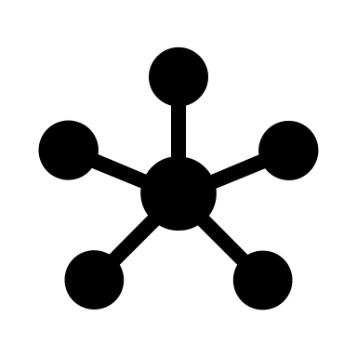


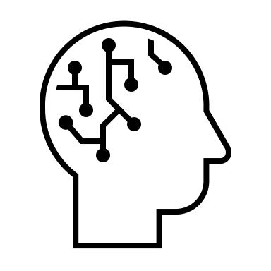


Progress
My Method1
Dynamic KG
Knowledge injection
A text(query)
which is to be used in knowledge graph
Original text
LM
Notes:
c

Slide 26
Progress
My Method2
Original text
Dynamic KG
Knowledge injection
LM

Slide 27
Progress
Summary
지식 그래프가 영향을 줄 수 있는 fallacy type은 추가적인 증거, 정보를 주어서 해결될 수 있는 오류들이다.
A Knowledge graph is a structured model of data that captures relationships between entities and concepts in a domain, providing context and meaning to these entities.
이것들에 해당하는 fallacy는 일반화의 오류, 인과 간계의 단순화, 잘못된 인과관계 등이 있다.
주제내에 두 가지 contribution을 만들 수 있지 않을까?
지식 그래프를 사용하면 더 잘 풀릴 수 있는 데이터셋 만들기
지식 그래프를 활용해서 fallacy detection(classification) 성능 올리기(Method1&Methd2)

Slide 28
Progress
Reference
JIANG, Xuhui, et al. On the Evolution of Knowledge Graphs: A Survey and Perspective. arXiv preprint arXiv:2310.04835, 2023.
ALHINDI, Tariq, et al. Multitask Instruction-based Prompting for Fallacy Recognition. arXiv preprint arXiv:2301.09992, 2023.
ChatGPT 4.0

