Slide 1

00
Study Meeting
LearnData Lab
LearnData Lab @SKKU
6월 17일 연구 미팅
Natural Language Processing and Commonsense Reasoning for the Next of QnA System
정지원

Slide 2
01
Study Meeting
LearnData Lab
LearnData Lab @SKKU
Content
ID-GNN Algorithm
ID-GNN-Fast
Preliminaries
Our Algorithm

Slide 3
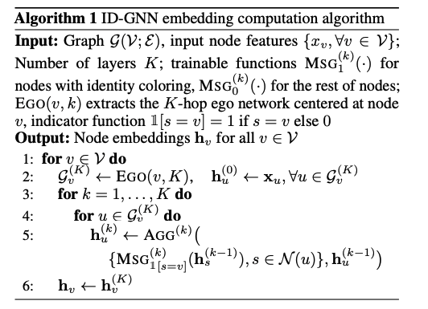
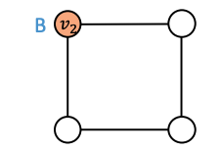

02
Study Meeting
LearnData Lab
LearnData Lab @SKKU
ID-GNN Algorithm
We extract the ego network for each node, and initialize node embeddings by raw node features
2-hop ego network
2-layer GNN
$$v_{2}$$
We apply a K-layer ID-GNN to each node in the ego network
Ego network can be used to determine the GNN computational graph for a node
We compute node embeddings for all the nodes in the ego network
We only keep the final embedding for the center node
Other node embeddings are only used to facilitate the computation

Slide 4
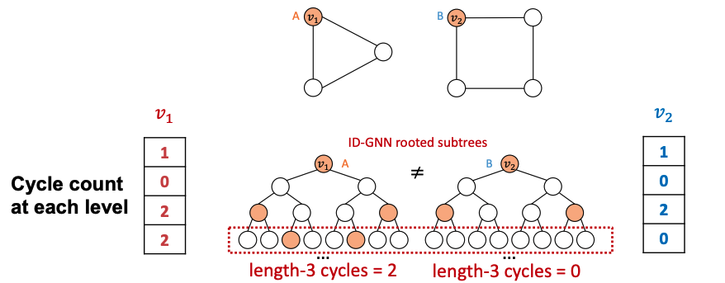
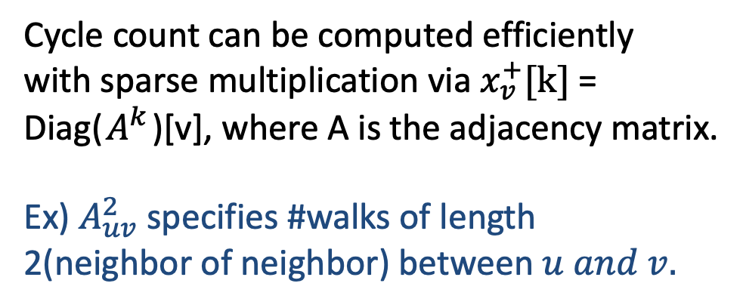
03
Study Meeting
LearnData Lab
LearnData Lab @SKKU
ID-GNN-Fast
Simplified Version : ID-GNN-Fast
- Based on the intuition, They propose ID-GNN-Fast
- Use cycle counts in each layer as additional node features
- Include identity information as an augmented node feature
(no need to do heterogeneous message passing)
Cycle count can be computed efficiently with sparse multiplication via $x_{v}^{+}[k]$ = Diag($A^{k}$)[v], where A is the adjacency matrix.
Ex) $A_{uv}^{2}$ specifies #walks of length 2(neighbor of neighbor) between $u and v.$

Slide 5
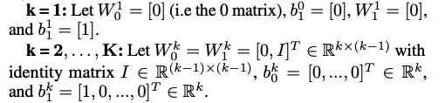


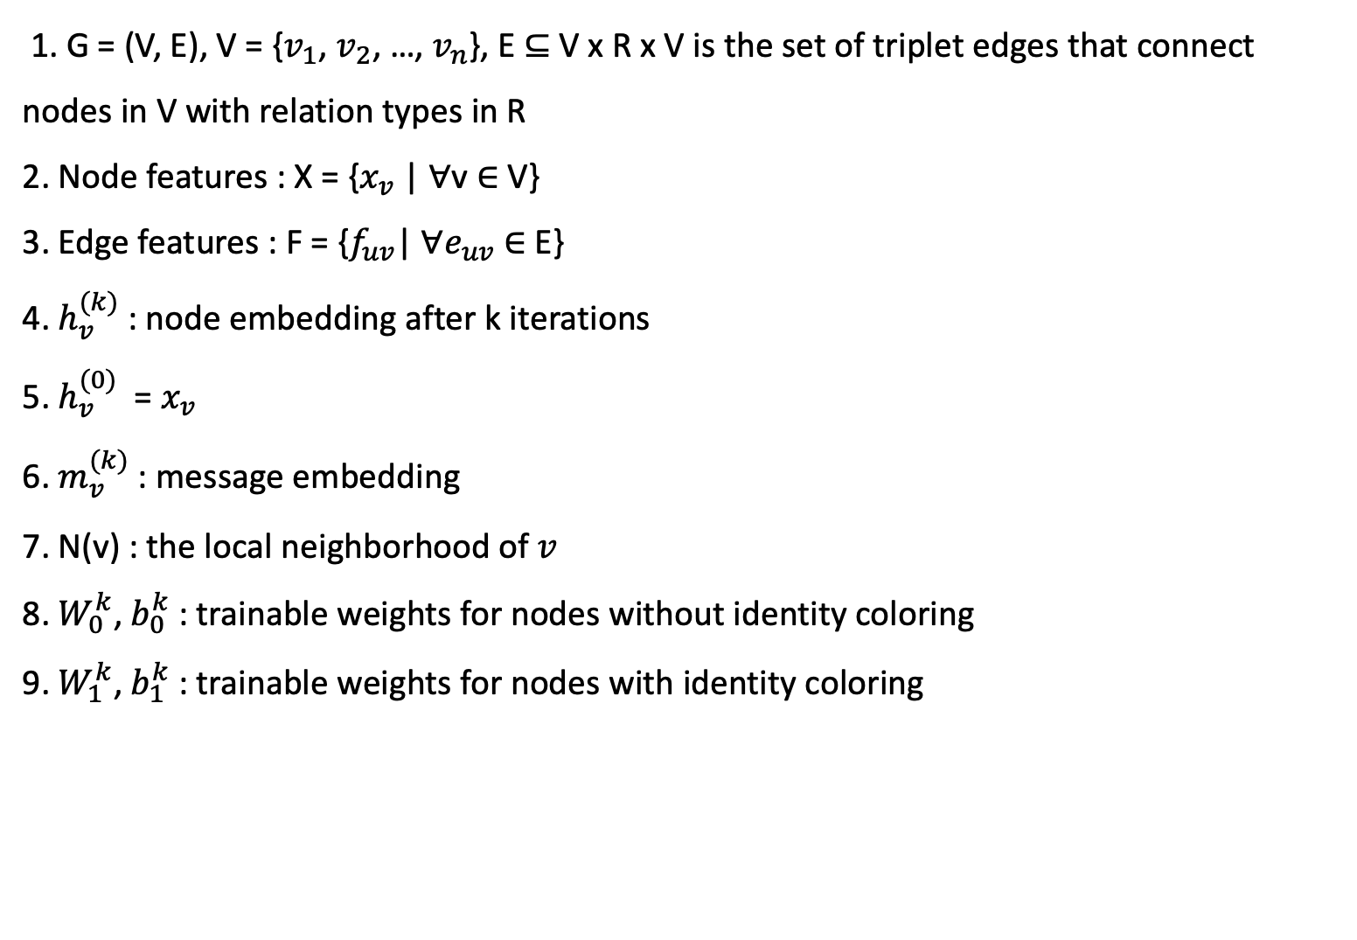
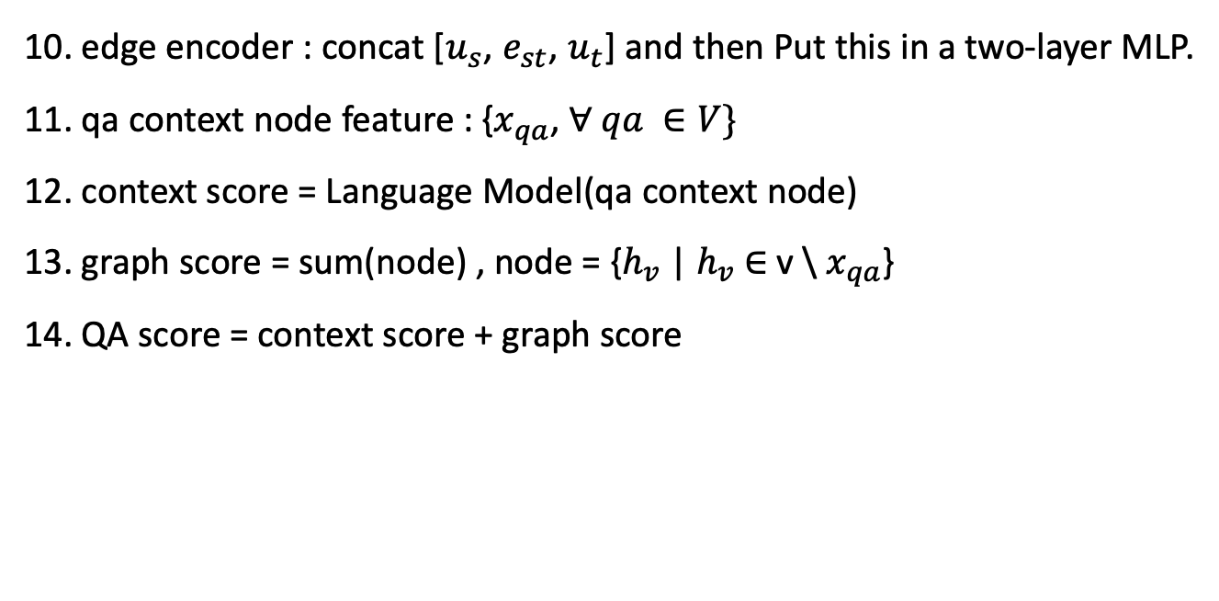
04
Study Meeting
LearnData Lab
LearnData Lab @SKKU
Preliminaries
Settings
1. G = (V, E), V = {$v_{1}$, $v_{2}$, …, $v_{n}$}, E $⊆$ V x R x V is the set of triplet edges that connect nodes in V with relation types in R
2. Node features : X = {$x_{v}$ | $∀$v $∈$ V}
3. Edge features : F = {$f_{uv}$| $∀e_{uv}$ $∈$ E}
4. $h_{v}^{(k)}$ : node embedding after k iterations
5. $h_{v}^{(0)}$ = $x_{v}$
6. $m_{v}^{(k)}$ : message embedding
7. N(v) : the local neighborhood of $v$
8. $W_{0}^{k}$, $b_{0}^{k}$ : trainable weights for nodes without identity coloring
9. $W_{1}^{k}$, $b_{1}^{k}$ : trainable weights for nodes with identity coloring
10. edge encoder : concat [$u_{s}$, $e_{st}$, $u_{t}$] and then Put this in a two-layer MLP.
11. qa context node feature : {$x_{qa}$, $∀ qa ∈V\}$
12. context score = Language Model(qa context node)
13. graph score = sum(node) , node = {$h_{v}$ | $h_{v}$ $∈$ v \ $x_{qa}$}
14. QA score = context score + graph score
initialization
1. $x_{u}$ = [1], $∀$u $∈$ V

Slide 6
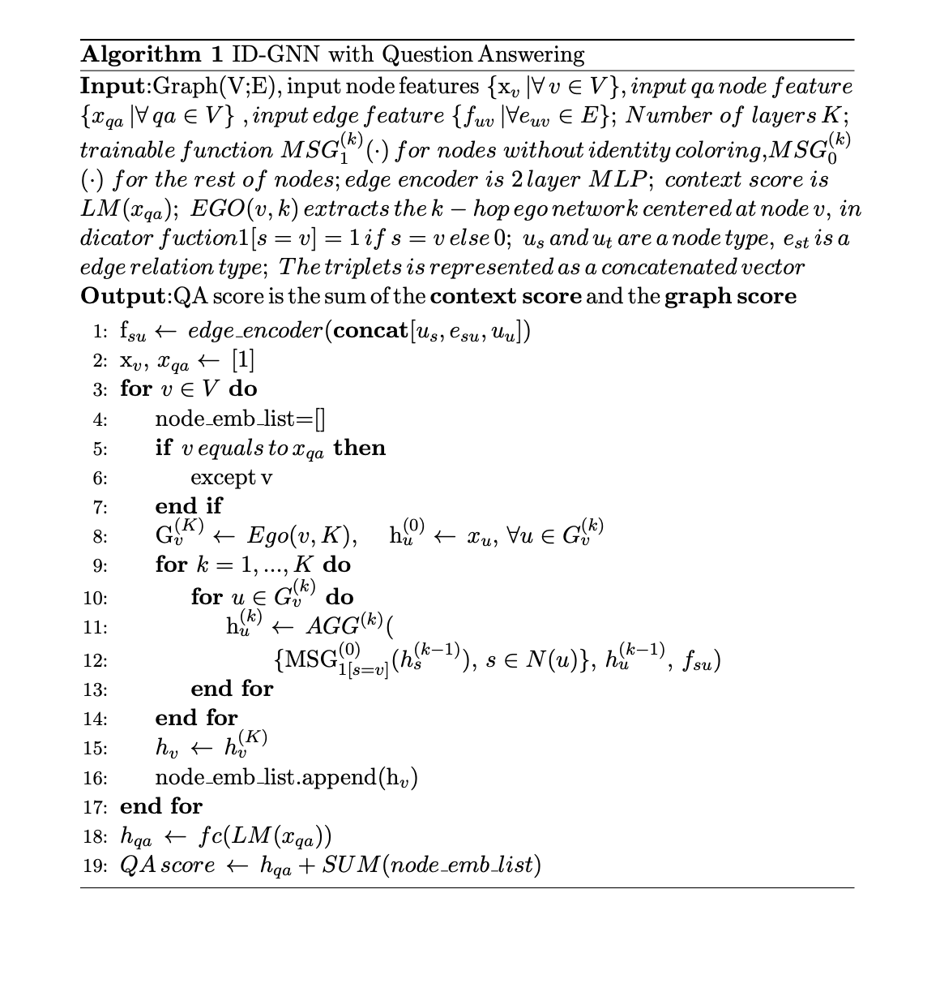
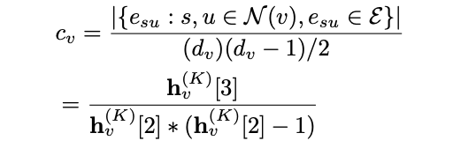
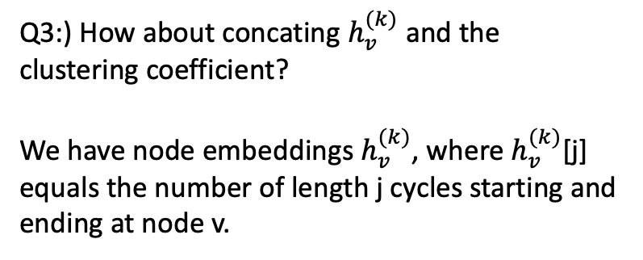
05
Study Meeting
LearnData Lab
LearnData Lab @SKKU
Algorithm
Q1:) Would it be better to designate the context node as ego of ego network?
Q2:) Fast or full, which is better?
- In real dataset(Cora, CiteSeer) -> ID-GNN full better
In predicting the clustering coefficient -> ID-GNN fast
better
IDGNN fast가 clustering coefficient를 예측하는데 성능이 좋았다. 그러면 IDGNN fast를 써야하나?
하지만 fast는 cycle count를 직접적으로 사용하였기 때문에 좋았을 수도 있다.
그래서 real data에서 성능이 좋았던 IDGNN full을 사용함
Q3:) How about concating $h_{v}^{(k)}$ and the clustering coefficient?
We have node embeddings $h_{v}^{(k)}$, where $h_{v}^{(k)}$[j] equals the number of length j cycles starting and ending at node v.

Slide 7
06
Paper Review
LearnData Lab
LearnData Lab @SKKU
Thank you!

