Slide 1
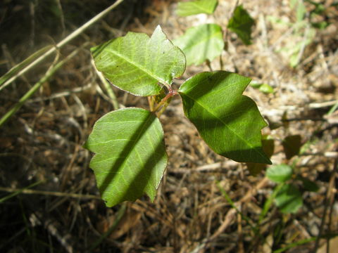
Toxicodendron radicans
Jesi Weed

Slide 2
Scientific Classification:
Domain: Eukarya
Kingdom: Plantae
Phylum: Magnoliophyta
Class: Magnoliopsida
Order: Sapindales
Family: Anacardiacae
Genus: Toxicodendron
Species: Toxicodendron radicans
Common Name: Poison Ivy

Slide 3
Order: Sapindales
Defined by:
Dicots
Flowering plants
Pinnately compound leaves
Dioecious (“two houses”)

Slide 4
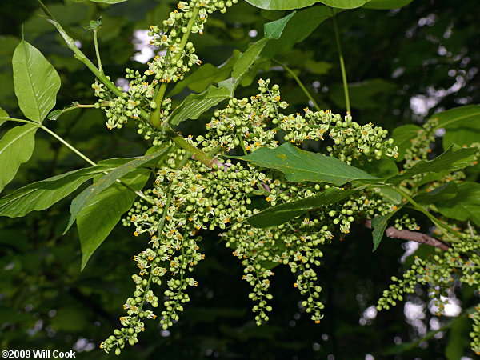
Family: Anacardiaceae
Inconspicuous flowers
Highly poisonous
Sometimes have foul-smelling sap
http://www.carolinanature.com/trees/tora.html

Slide 5
Characteristics of the Plant
Dicots
Pinnate, compound consisting of 3 leaflets
Alternate
Flowers: 5 petals, form in clusters
Dioecious
Small, white berries
Each berry contains 1 seed
Perennial
Tend to grow as an herb, foil, shrub, or vine

Slide 6
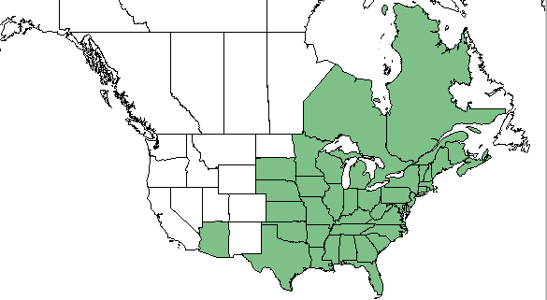
Habitat
Generally found in woodlands and wetlands
Native to Canada and the U.S.- range from Canada to South America (also prevalent in other parts of the world)
Tend to live at around 1,900 m above sea level

Slide 7
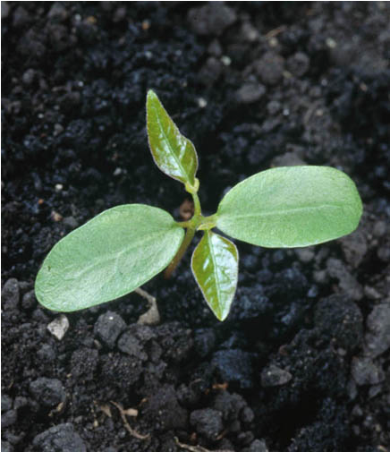
Reproduction
Seed dispersal by wind and animals
Drop their seeds
Can spread by rhizomes
Stems can form roots and develop new shoots

Slide 8
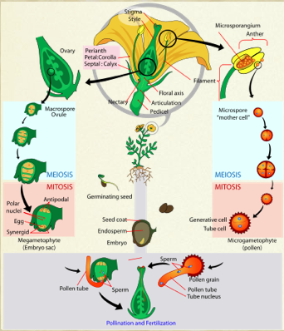
Life Cycle
Double fertilization
Alternation of generations
Dominant sporophyte

Slide 9
Gas Exchange & Waste Removal
Primarily producers
Photosynthetic: have chloroplasts in their leaves
Produces O2 as a waste product
Vascular tissue: transportation of nutrients
Roots take up nutrients from the soil

Slide 10
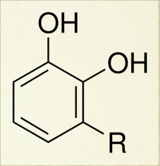
Interactions with other organisms - Humans
Humans are the only organism that show an allergic reaction to poison ivy
Urushiol is an oil in the sap of the plant
Rhus Dermatitis is the allergic reaction
¼ oz to infect everyone on the planet

Slide 11
Interactions with other Organisms
Important food source for a variety of species- leaves, stems, berries
Use larger trees for growth
Virginia Pine, Willow Oak, American Sycamore
Will also grow with other vines

Slide 12
Questions?

Slide 13
Citations
Cook, Will. "Eastern Poison-Ivy (Toxicodendron Radicans)." Carolina Nature. N.p., 4 Apr. 2013. Web. 02 May 2015.
Jason Sharp, ed. "Toxicodendron radicans subsp. radicans." Encyclopedia of Life, available from http://eol.org/pages/460427. 01 May 2015.
"Ohio Perennial and Biennial Weed Guide." Ohio Perennial and Biennial Weed Guide. Ohio State Univeristy, n.d. Web. 03 May 2015.
"Plants Profile for Toxicodendron Radicans (eastern Poison Ivy)." United States Department of Agriculture: Natural Resources Conservation Service. NRCS, n.d. Web. 01 May 2015.
Porter, Duncan M. "Sapindales: Plant Order: Characteristic Morphological Features." Encyclopedia Britannica Online. Encyclopedia Britannica, 09 Feb. 2009. Web. 02 May 2015.

