Slide 1
Formalizing Software Bugs
Irena Bojanova
UMUC, NIST
12/08/2014

Slide 2
Software Bugs
“Software bug” – a concept that applies to:
CWE – Common Weakness Enumeration
CVE – Common Vulnerabilities and Exposures
CAPEC – Common Attack Pattern Enumeration and Classification.
Related, but different:
Weakness – a static presence in software – might never cause problems;
only when an attacker finds the weakness and exploits it
the vulnerability of this software is exposed.
CWE & CVE + CAPEC:
Considerable efforts, providing foundational knowledge
However, not sufficient, accurate, and precise enough.
Notes:
Knowing what makes a software systems vulnerable to attacks is critical, as software vulnerabilities hurt security, reliability, and availability of the system as a whole. In addition, understanding how an adversary operates is essential to effective cyber security.
The “software bugs” concept applies to the Common Weakness Enumeration (CWE), the Common Vulnerabilities and Exposures (CVE), and the Common Attack Pattern Enumeration and Classification (CAPEC).
Note: These are important concepts that are related but different. A weakness is a static presence existing in software systems -- it might stay in software and never cause any problems until it is exploited by an attacker, and when the attacker finds out the weakness (es) and exploit it (them), the vulnerability of this software is exposed.
CWE, CVE, and CAPEC are considerable efforts, providing foundational knowledge about software weaknesses, vulnerabilities, and attacks. However they are not sufficient, accurate, and precise enough to serve as common measuring sticks and provide common base for software developers and security practitioners. There is luck of precise descriptions of attacks that lead to realization of vulnerabilities, exposed by software weaknesses.

Slide 3
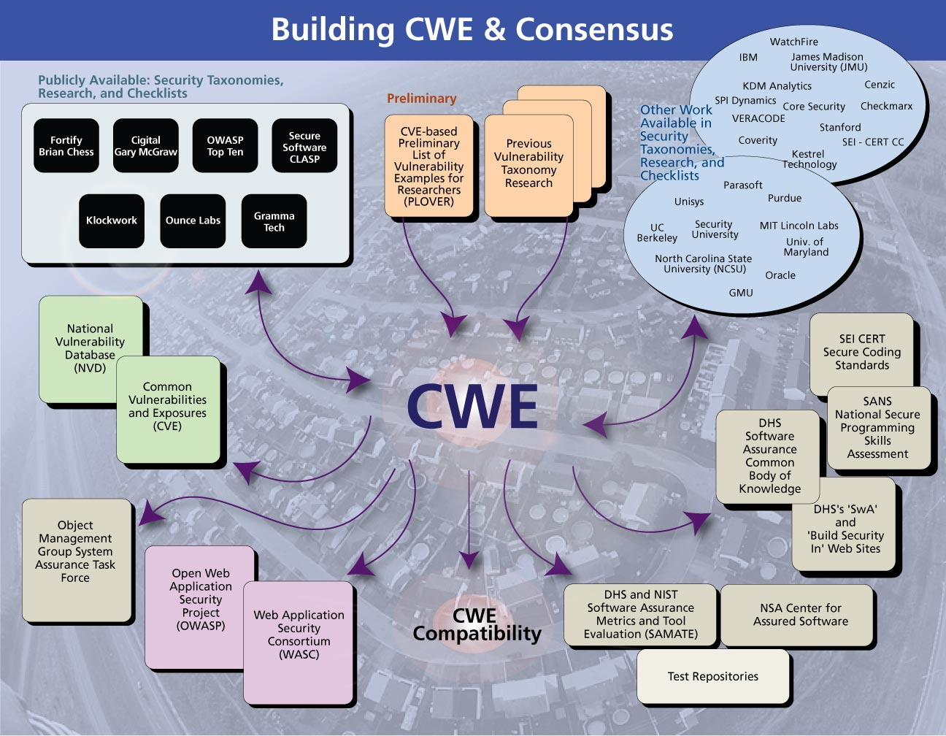
Notes:
CWE & CVE
We bring also CAPEC into the picture.

Slide 4
Problems with CWE, CVE, & CAPEC
CWE:
Not orthogonal, just an enumeration
Ambiguous definitions
Do not match well with classes reported by test tools.
Example: CWE-119:
Improper Restriction of Operations within the Bounds of a Memory Buffer
“The software performs operations on a memory buffer, but it can read from or write to a memory location that is outside of the intended boundary of the buffer.”
Notes:
CWE, CVE, and CAPEC are considerable efforts, providing foundational knowledge about software weaknesses, vulnerabilities, and attacks. However they are not sufficient, accurate, and precise enough to serve as common measuring sticks and provide common base for software developers and security practitioners. There is luck of precise descriptions of attacks that lead to realization of vulnerabilities, exposed by software weaknesses.
CWE is not orthogonal, it is just an enumeration. The definitions have ambiguities, entangle phases, and do not match well with the classes reported by test tools. For example, the description summary of CWE-119 includes text such as “intended boundary”, which is too vague. It does not indicate that it is the boundary given by the formal semantics.
CWE-119: Improper Restriction of Operations within the Bounds of a Memory Buffer
“The software performs operations on a memory buffer, but it can read from or write to a memory location that is outside of the intended boundary of the buffer.”
While, to mitigate the vagueness of the definition as much as possible, our tentative definition of CWE-119 is: The software can access through a buffer a memory location not allocated to that buffer [ref ].

Slide 5
Problems CWE, CVE, & CAPEC (cont.)
CVE:
Ambiguous definitions
Do not fully and precisely describe involved CWEs.
Example: CVE-160: Heartbleed.
“The (1) TLS and (2) DTLS implementations in OpenSSL 1.0.1 before 1.0.1g do not properly handle Heartbeat Extension packets, which allows remote attackers to obtain sensitive information from process memory via crafted packets that trigger a buffer over-read, as demonstrated by reading private keys, related to d1_both.c and t1_lib.c, aka the Heartbleed bug.”
“Technical Details: Buffer Errors (CWE-119)”
Actual exploited is CWE-126, while only parent CWE-119 is listed.
CWE-130 is in CWE-126, but CWE-20 also can precede CWE-126.
Notes:
CVE definitions need to unambiguously and fully describe the involved weakness (es) exposure. For example, CVE-160 description and Related Weaknesses parts do not provide information on the actual exploited weakness and the chains of weaknesses that possibly lead to the vulnerability realization. The actual exploited weakness is CWE-126, while only its parent CWE-119 is listed. CWE-130 is listed in CWE-126, but other CWEs such as CWE-20 also can precede CWE-126.
CVE-160: Heartbleed “The (1) TLS and (2) DTLS implementations in OpenSSL 1.0.1 before 1.0.1g do not properly handle Heartbeat Extension packets, which allows remote attackers to obtain sensitive information from process memory via crafted packets that trigger a buffer over-read, as demonstrated by reading private keys, related to d1_both.c and t1_lib.c, aka the Heartbleed bug.”

Slide 6
Problems CWE, CVE, & CAPEC (cont.)
CAPEC:
Do not fully show dynamics of activities leading to realization of attack
CVE, CWE, CAPEC links could be confusing.
Example: Heartbleed – which CAPEC and CWEs? From attack to weakness:
Heartbleed exploits Buffer Overread (CWE-126) -> attack should be CAPEC 540: Overread Buffers
CAPEC 540, “Related Weakness” is CWE-125, parent of CWE-126, lists CVE-160 (Heartbleed).
Form weakness to attack:
CVE-160 (Heartbleed), “Technical Details”— CWE-119.
CWE-119, “Related Attack Patterns” – no CAPEC 540, closest CAPEC-47.
It is a fact that CVE-160 is listed in CAPEC 540, but not in CAPEC-47.
Notes:
Apparently, serious confusion could be reached depending on how information is retrieved from CWE, CVE, and CAPEC: from bottom up or from top down. For example, if exploring which CAPEC corresponds to Heartbleed and which CWEs are involved:
Exploring form weakness to attack: If we start from CVE-2014-0160 (Heartbleed), the “Technical Details” section mentions only CWE-119. Then in CWE-119, in section “Related Attack Patterns” CAPEC-47 would be identified as suitable, because the payload is expanded by the server.
Going from attack to weakness: However, if we are initially aware that the Heartbleed vulnerability is result of exploitation of CWE-126 Buffer Over-read, and start exploring from above, it becomes apparent that we need CAPEC 540 and not CAPEC-47. From CAPEC 540, we find that related weakness is CWE-125, which is parent of the proper for Heartbleed CWE-126. It is a fact that CVE-0160 is listed in CAPEC 540, but not in CAPEC-47. The link between CAPEC 540 and CWE-125 (which is a parent of CWE-126) is mentioned also here: https://capec.mitre.org/news/
Later we found the Security Standards Help Stop Heartbleed blog post. Where CVE-160 is related to CWE-130 and CWE-125, as well as CAPEC 540.
==> This is one more strong example of why CWEs, CVEs, and CAPECs need to be formalized and reclassified.

Slide 7
Need For
Precise descriptions of attacks (CAPECs) that lead to realization of vulnerabilities (CVEs), exposed by software weaknesses (CWEs.
Research to explore formalization of CWEs, CVEs, & CAPECs.

Slide 8
CAPEC 540 – CAPEC 47
CAPEC-540: Overread Buffers
“An adversary attacks a target by providing input that causes an application to read beyond the boundary of a defined buffer. This typically occurs when a value influencing where to start or stop reading is set to reflect positions outside of the valid memory location of the buffer. This type of attack may result in exposure of sensitive information, a system crash, or arbitrary code execution.”
CAPEC-47: Buffer Overflow via Parameter Expansion
“In this attack, the target software is given input that the attacker knows will be modified and expanded in size during processing. This attack relies on the target software failing to anticipate that the expanded data may exceed some internal limit, thereby creating a buffer overflow.”

Slide 9
Previous Related Work
Semantic Templates – Yan Wu’s Dissertation
Classify
Extract commonalities
Reorganize information into four groups:
1) Software faults that lead to a weakness
2) Resources that a weakness affects
3) Weakness characteristics
4) Consequences/failures resulting from the weakness.
Support by vulnerabilities and feedback to annotate vulnerabilities
Software Fault Patterns – KDM Analytics
Classify
Identify patterns
Test cases generator.
Notes:
Yan Wu, “Using Semantic Templates to Study Vulnerabilities Recorded in Large Software Repositories”, Dissertation, October 2011, Omaha, Nebraska.
A Semantic Template is a human and machine understandable representation that contains the following four elements [5]:
1) Software faults that lead to a weakness
2) Resources that a weakness affects
3) Weakness characteristics
4) Consequences/failures resulting from the weakness.
KDM Analytics
Software Fault Patterns (SFPs) was developed by KDM Analytics Inc. By identifying and developing white box definitions for SFPs as a formalization process, they could be integrated into a standards-based tool analysis approach, benefiting both real-time embedded and enterprise software assurance systems. Those identified SFPs will be common to more than one CWE and can be used to further define CWEs.

Slide 10
Buffer Overflow Semantic Template
Notes:
A Semantic Template is a human and machine understandable representation that contains the following four elements [5]:
1) Software faults that lead to a weakness
2) Resources that a weakness affects
3) Weakness characteristics
4) Consequences/failures resulting from the weakness.

Slide 11
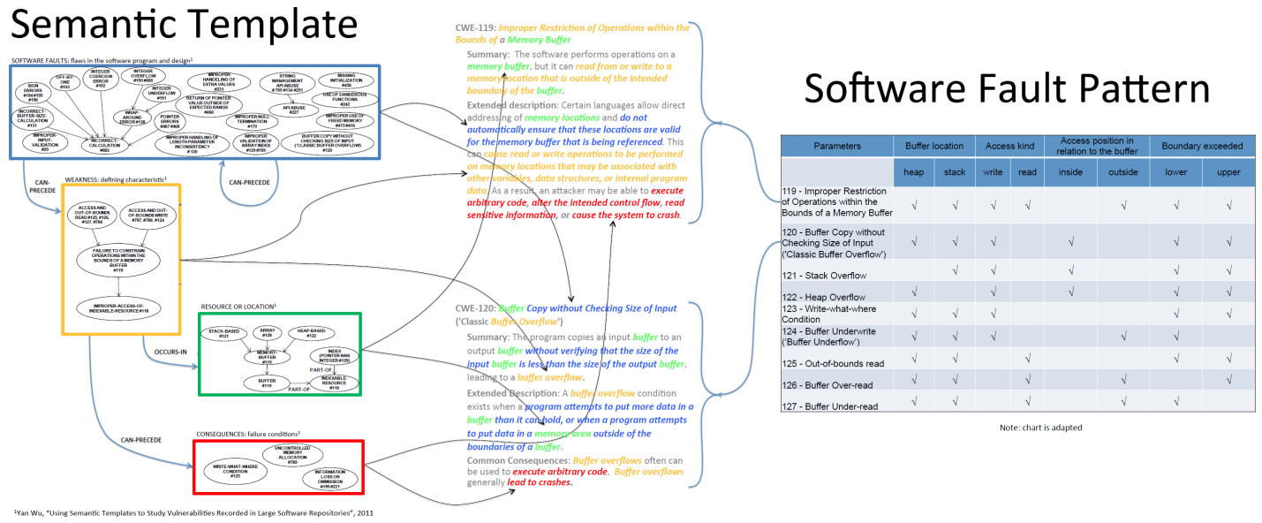
Previous Related Work
Tried to formally describe :
Vulnerabilities as chains of exploited weaknesses
Involved CWEs utilizing the corresponding SFPs.
Failed midway – realized need to specify also the dynamic aspect of the attack.
Notes:
So, one idea is to utilize Semantic Templates and Software Fault Patterns.
For example, this Figure demonstrates how the Buffer Overflow Semantic Template helps separate the distinct phases of software faults, weakness, resource/location, and consequence between which “can precede” and “occurs in” relationship exist. In addition the figure contains how the Buffer Overflow SFP can be used to factor out parameters, such as resource and location.
Using this schema, we tried to accomplish the following tasks:
Task 1: Formally describe the vulnerabilities as chains of exploited weaknesses, corresponding to Yan Wu’s Buffer Overflow and Injection Semantic Templates [4].
Task 2: Formally describe the involved CWEs utilizing the corresponding SFPs.

Slide 12
Formalization of CWE, CVE & CAPEC
Formalization of CWEs will:
Clarify their definitions
Remove ambiguities among them.
As a result, reclassification of CWEs will be possible.
Same reasoning applies to CVEs and CAPECs formalization.
Important:
Base of CVEs are CWEs. Each CVE is a result of CAPEC(s) exploiting software CWEs.
Each CWE is a static software property.
Each CVE is a dynamic software property that occurs as a result of some CAPEC (s).
Notes:
Formalization of CWEs will clarify their definitions and remove ambiguities among them. As a result, reclassification of CWEs will be possible. Same reasoning applies to CVEs and CAPECs formalization.
Base of CVEs are CWEs. In fact, each CVE is a result of a CAPEC (s) exploiting some software CWEs. Each CWE is a static software property. Each CVE is a dynamic software property that occurs as a result of some CAPEC (or CAPECs).

Slide 13
Considered Notations
Static software properties: formal software specification models, languages, notations, and tools.
Z notation - standardized by ISO.
Dynamic software properties – those used for process specification: process algebra, Petri nets, and state machines.
CSP – Communicating Sequential Processes
UML & OCL – Unified Modeling Language with Object Constraint Language.
__________________
Z notation and CSP – strongly based on the mathematical notation without introducing strange constructions
UML – provides good visual representation.
Notes:
Appropriate notations for formal description of static software properties are formal software specification models, languages, notations, and tools. Such a notation is Z notation, which is standardized by ISO.
Appropriate notations for dynamic software properties are those used for process specification, such as process algebra, Petri nets, and state machines. Most suitable is Communicating Sequential Processes (CSP) as originally defined by Hoar. Its abstraction level is just over the platforms and programming languages, but without details such as timings. The Unified Modeling Language (UML) with Object Constraint Language (OCL) is also a good option, as it is better accepted by software developers.
Both Z notation and CSP are strongly based on the mathematical notation without introducing strange constructions for well-known mathematical concepts. On the other hand, UML provides good visual representation

Slide 14
CWEs “Mental Models” (Step 1)
CWE & CVE databases – represented in XML
CWEs & CVEs text presentations – verbose and hardly navigable.
First Research Step:
Formal graph representation of these databases
“Mental models” of base CWEs – UML class diagrams:
CWEs – classes
Relationships between CWEs – associations
➔Later incorporate an OCL specification for each CWE.
Notes:
The CWE and CVE databases are represented in XML format, which is not suitable to be read and interpreted by humans (researchers and developers). The CWEs and CVEs text and HTML presentations are verbose and hardly navigable. Limited efforts on providing graph representations exist, but these are not suitable for detailed research.
The first step must be to represent these databases in graph formats as diagrams. Suitable representation is offered by the UML class diagrams. These diagrams combined with OCL could be used for CWEs formal representation. There is a need of a tool to automatically generate for each entity its “mental model” that is human readable. The Semantic Templates idea can be used for these representations. The UML class diagrams can be specialized with profiles for the CWEs and CVEs representations. A good tool having all the needed features is IBM Rational Software Architect (RSA). MS Vision can also be explored. However, without a tool for mental models generation, the mental models have to be handwritten.
Research in this step can be further extended to presentations mobility, user’s views, database modifications, and representations conversion to different formal models.

Slide 15
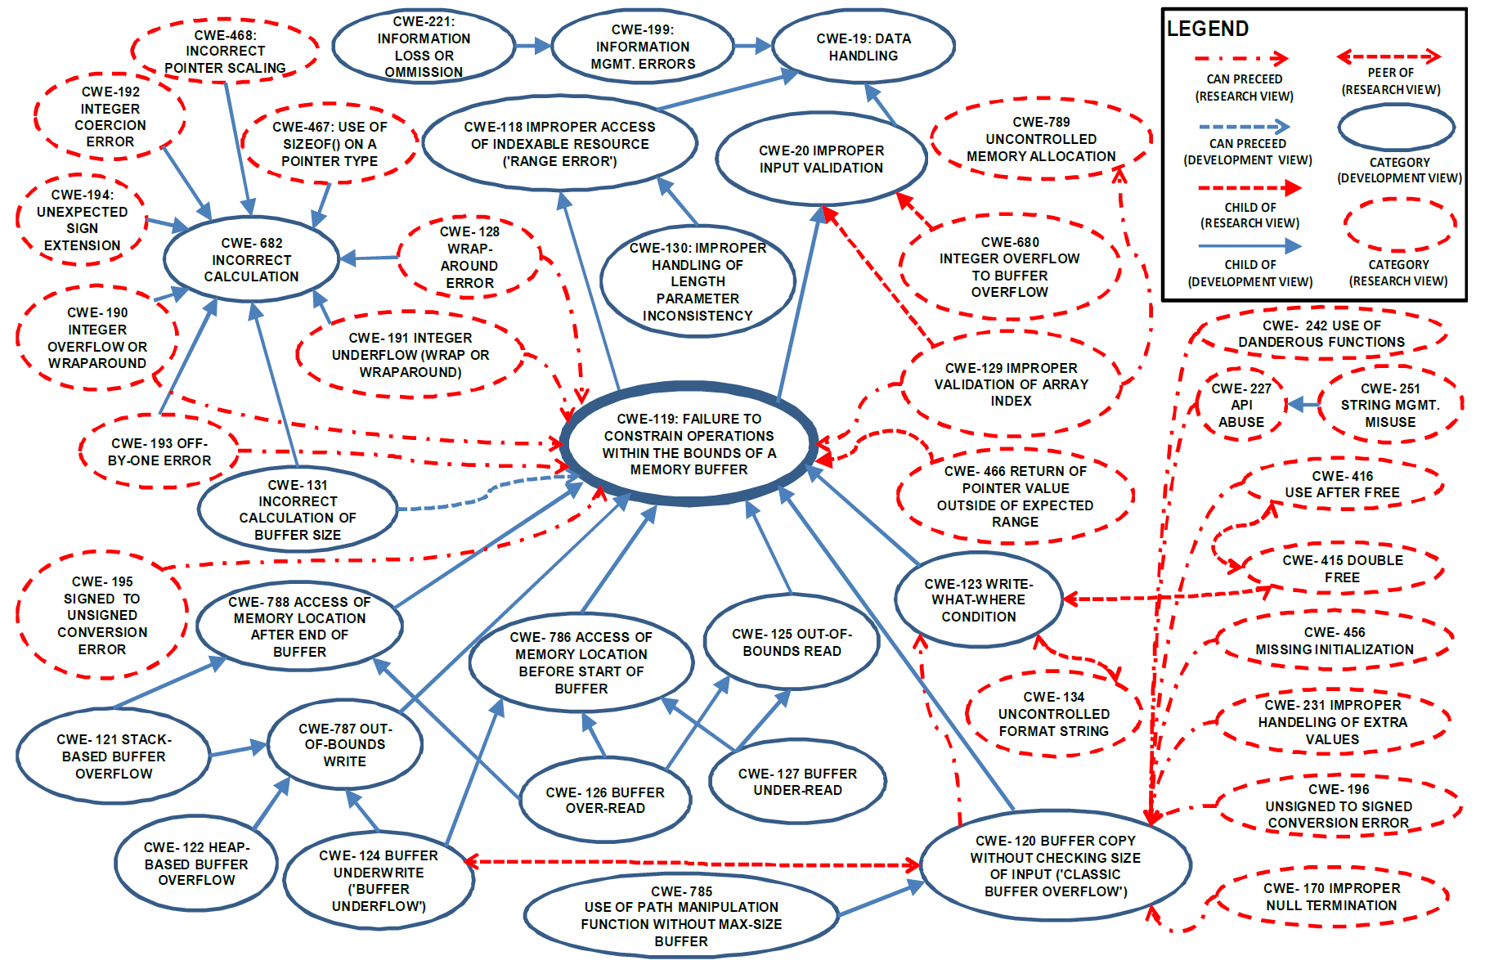
Buffer Overflow-related CWEs Extracted in the Preparation and Collection Phase (Figure 5 from Yan Wu’s dissertation)
Notes:
Following Yan’s idea, we have focused first on the creation of “mental models” for each base CWE showing the relationships it has with other CWEs. The idea on identifying base/primary vs. secondary CWEs (invariant core and variation points) is from SFP – we have to develop it).
The easiest and most attractive way is to create a class diagram, in which the weaknesses are classes and the relationships between them are presented as associations. We have decided first to explore the CWE-119’s environment following Yan’s strategy, starting with Figure 5 from her dissertation -- see the Figure here.

Slide 16
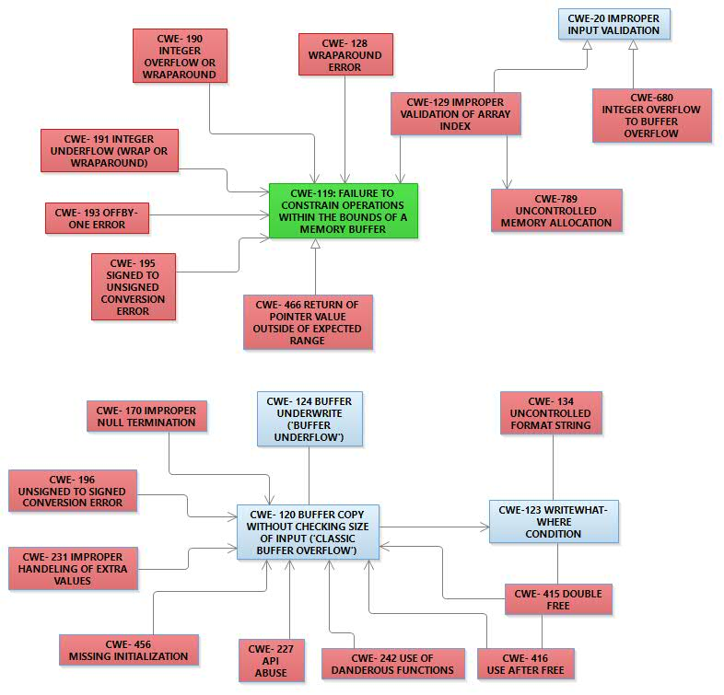
CWE-119 Research View – Inheritance and Precedence Relationships
Notes:
Following Yan’s idea, we have focused first on the creation of “mental models” for each base CWE showing the relationships it has with other CWEs. The idea on identifying base/primary vs. secondary CWEs (invariant core and variation points) is from SFP – we have to develop it).
The easiest and most attractive way is to create a class diagram, in which the weaknesses are classes and the relationships between them are presented as associations. We have decided first to explore the CWE-119’s environment following Yan’s strategy, starting with Figure 5 from her dissertation.
This and next two diagrams for are extracted from Yan’s Figure 5. The idea is to separate “the mental model“ of the original diagram into two views: research view and development view.
CWE-1000 (Research Concepts) supports research, using a fixed perspective that focuses exclusively on weaknesses and the different relationships between them. It is a novel approach to weakness classification that also has certain benefits to the CWE Content Team with respect to content management.

Slide 17
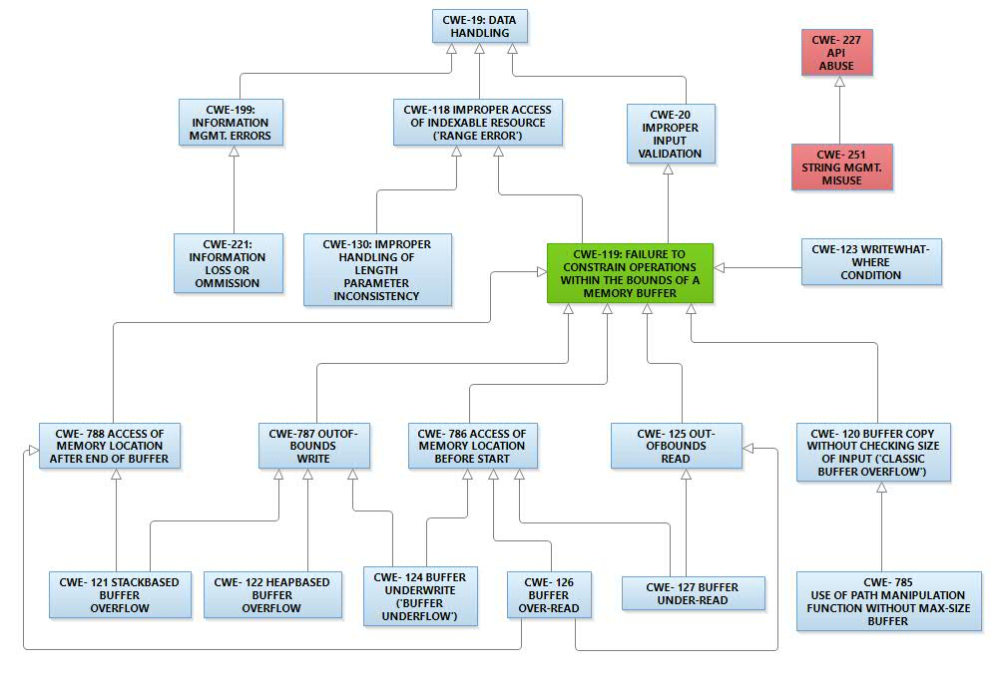
CWE-119 Development View – Inheritance Relationships
Notes:
CWE-699 (Development Concepts) supports developers and tool vendors, offering flexible navigation from different perspectives. It borrows from previous taxonomy efforts, so it will be familiar with many consumers. Much of the structure has been used since the beginning of CWE.

Slide 18
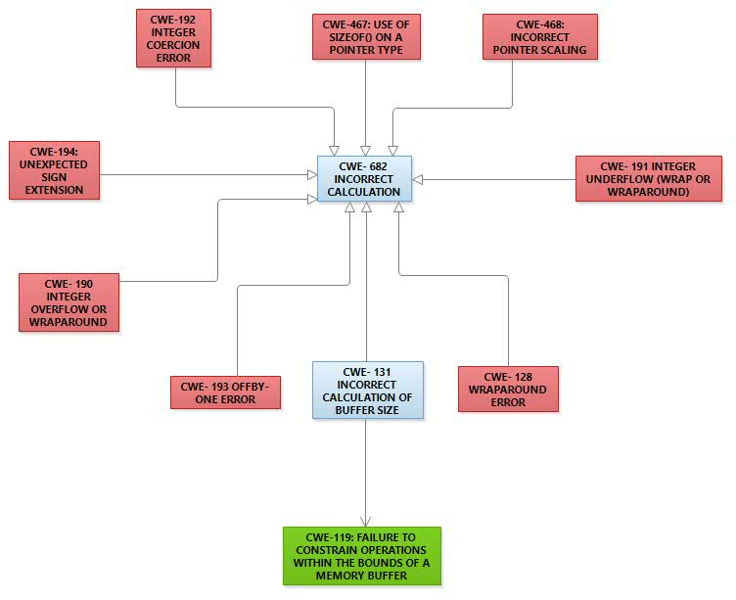
CWE-119 Development View – Precedence Relationships

Slide 19
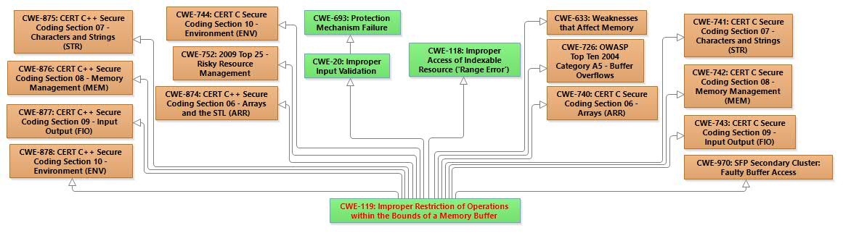
CWE-119 Mental Model
CWE-119 Relationships - not complete yet (extracted from CWE database XML representation)
Notes:
Note that Figure 5 from Yan’s dissertation is extracted from CWE, but this is not a trivial task. That is why we started with Yan’s work. Currently we are working on the complete mental model for CWE-119, retrieving data directly the XML representation of the CWE database. We extract the data following by hand the links provided in the CWE database. Each CWE that is accessible via some path of links starting from CWE-119 has to be presented in the diagram. A problem is how to position on the diagram the CWEs that have different roles in some clear and readable way, but we hope to develop suitable recommendations for that. Figure 7 presents the current, still not complete, diagram of the CWE-119 relationships mental model.
(!!!)The mental models will be useful for reading the database contents -- querying for mental models by particular characteristics. At the first step they will help us understand how CWE is currently organized. They will clearly show which CWEs are related and which are not, the possible chains (using the info from the CWE website, describe what can happen after what), and will be useful to follow the links among CWEs. Last but not least, the mental models will be useful to clear the CWEs definitions and eventually reclassify/ reorganize CWE. Formalization of CWEs will help.
The mental models and the Semantic Templates provide a good way for structuring the available information (parents/children, research/developer views). If going towards Artificial Intellect, they will help with the creation of a knowledgebase (structured in such a way, annotated in such a way). However, they will not give all the information needed to restructure the CWE and CVE. In addition, it is impossible to generate from the mental model test or verification code. The Semantic Templates are at knowledge base level and do not impose further pragmatic exploration of the descriptions.

Slide 20
CWEs Formal Specification (Step 2)
Second Research Step :
CWEs formalization in Z notation → will remove ambiguities in their definitions → can lead to CWEs reclassification.
Conversion of these Z notations in OCL specifications.
UML representations – could be source to industry tools for code verification and tests generation (RSA, MS Visio).
However, humans will not be able to use efficiently OCL, because of its complexity.
Formalization in Z notation – open to theorem solvers and eventually to analyzers (e.g Alloy Analyzer).
Z Word can be used for specification purposes and Z/Eves for verification.
Notes:
The second step is the CWEs formalization in Z notation. Total formalization of CWEs will remove ambiguities in their definitions and can lead to CWEs reclassification. An additional research option of this step can be conversion of these CWEs specifications in UML class diagrams with OCL specifications. The UML representations could be a source to industry tools for code verification and tests generation (RSA, MS Visio). However, humans will not be able to use efficiently OCL, because of its complexity. Formalization in Z notation is open to theorem solvers and eventually to analyzers (e.g Alloy Analyzer). Z Word can be used for specification purposes and Z/Eves for verification.

Slide 21
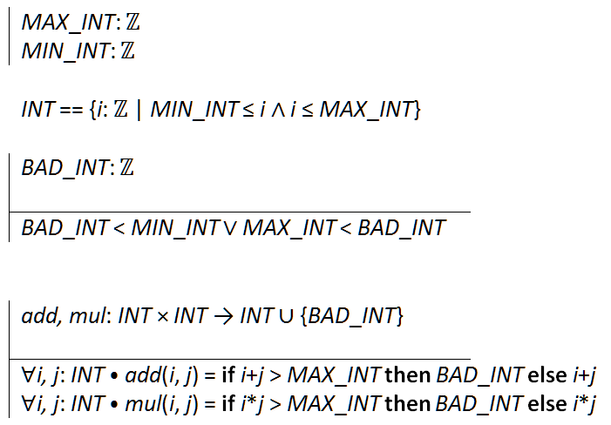
CWE-128 in Z notation
CWE-128: Wrap-around Error: “Wrap around errors occur whenever a value is incremented past the maximum value for its type and therefore "wraps around" to a very small, negative, or undefined value.”
Notes:
This following is an attempt for specification of CWE-128 in Z notation.
CWE-128: Wrap-around Error “Wrap around errors occur whenever a value is incremented past the maximum value for its type and therefore "wraps around" to a very small, negative, or undefined value.”
Note that the definition of CWE-128 is very contradictive and not complete. No types are mentioned and only the increment operation is mentioned. After checking the inheritance hierarchy and the siblings, we decided to specify it for integer types.
MAX_INT: ℤ
MIN_INT: ℤ
INT == {i: ℤ | MIN_INT ≤ i ∧ i ≤ MAX_INT}
BAD_INT: ℤ
BAD_INT < MIN_INT ∨ MAX_INT < BAD_INT
add, mul: INT × INT → INT ∪ {BAD_INT}
∀i, j: INT ⦁ add(i, j) = if i+j > MAX_INT then BAD_INT else i+j
∀i, j: INT ⦁ mul(i, j) = if i*j > MAX_INT then BAD_INT else i*j
Note that in this example, we specified also multiplication for illustration. It can be easily extended for all numeric types and generic schemas can be used. What is important is that this example is very clear. Here only one bad value is used, but the example can be extended with a set of bad values.
(!!!) Having in mind the Heartbleed example, this specification gives an idea about the Payload.size that has to be checked in the source code for CWE-126.
(!!!) Our conclusion from this exercise is that all CWEs must be formally specified in Z notation. This is a proper way to remove contradictions. And then, the related vulnerabilities and attacks can be considered.

Slide 22
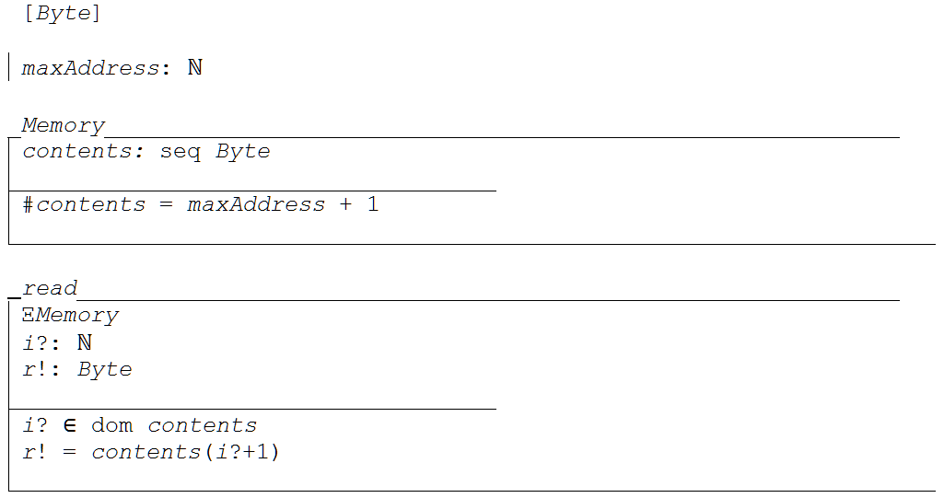
CWE-119 in Z notation
CWE-119: Improper Restriction of Operations within the Bounds of a Memory Buffer: “The software performs operations on a memory buffer, but it can read from or write to a memory location that is outside of the intended boundary of the buffer.”
Notes:
The memory is a sequence of bytes. The basic type is the byte.
The memory address space starts from 0 and ends at some max address.
The memory is a finite sequence of bytes – possibly the empty sequence. The finite sequences elements in Z notation are numbered starting from 1, but the computer memory bytes are indexed starting from 0. Note that ⟨a₁, . . . , a_{n}⟩ is a shorthand for the set {1 |→ a₁, . . . , n |→ a_{n} },so dom is 1..n
There are two operations with the memory: read and write that a program can perform.
The first operation is read -- it operates on the Memory without changing its state (Ξ).
The second operation is write -- it operates on the Memory and changes its state (Δ).
A program performs in memory on a buffer. The buffer is specified with its address space.
Every program run performs on a given buffer. The property bad run is CWE-119, i.e. read or write outside the buffer.

Slide 23
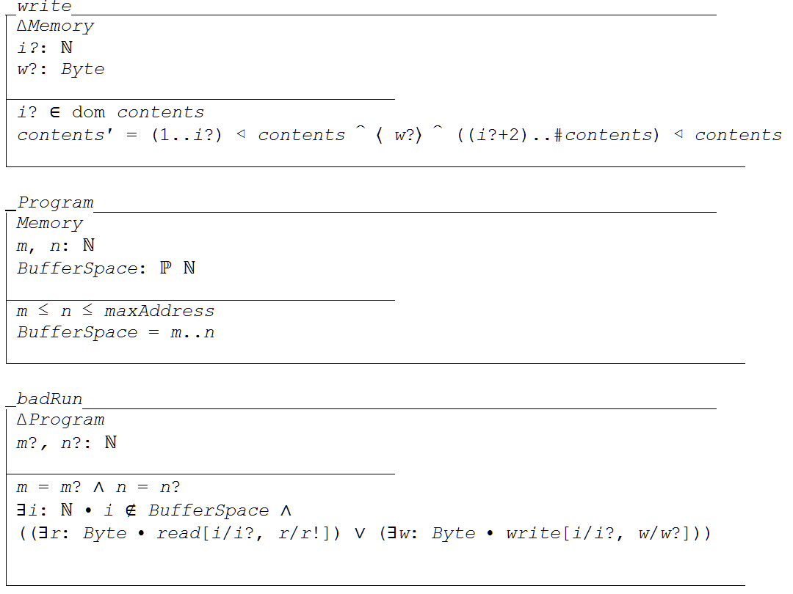

Slide 24
CVE/ CAPECs Formal Specification (Step 3)
Third Research Step:
CVEs/CAPECs specification in CSP.
CVEs/CAPECs specification in UML activity diagrams or BPPMN diagrams
will remove ambiguities in CVEs definitions
can lead to CWEs reclassification
CAPECs could be assembled on higher levels.
Humans accept UML and BPMN diagrams better
But UML and BPMN diagrams could be not too precise, as they are open to many platforms and programming languages.
UML activity diagrams with OCL or to BPMN diagrams can be used for tests code generation.
Z notation and CSP specifications can be used in theorem solvers for verification of dynamic software properties.
Notes:
The third step is CVEs (CAPECs) formalization in CSP. Humans would better accept CVEs and CAPECs specified in UML activity diagrams or Business Process Model and Notation (BPPMN) diagrams. CAPECs in reality are business processes. UML activity diagrams and BPMN diagrams could be not too precise, because they are open to many platforms and programming languages. CSP has very precise and formal semantics. It is abstract enough to represent all needed concepts without introducing additional constructs. CSP models can be verified. Good verification tool is PAT (Process Analysis Toolkit).
This step can remove ambiguities in CVEs definitions and could lead to their reclassification. CAPECs could be assembled on higher levels using the same notation. The formalized CVEs can be converted to UML activity diagrams with OCL or to BPMN diagrams for tests code generation.
Both Z notation and CSP specifications can be used in theorem solvers for verification of dynamic software properties.

Slide 25
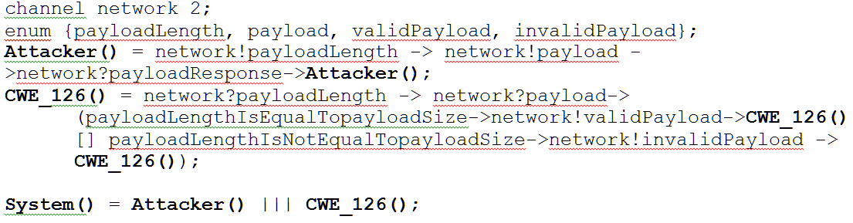
CVE-2014-160/CAPEC-540 in CSP
Notes:
The following is an attempt to specify the Heartbleed bug in pure CSP, taking into consideration that CWE-126 is the actual exploited weakness.
It can be reworked in PAT dialect, sent an array, check for its size, etc. There is a need also to add an assert that the network!invalidPayload state is reached, but it will ruin the clean specification.

Slide 26
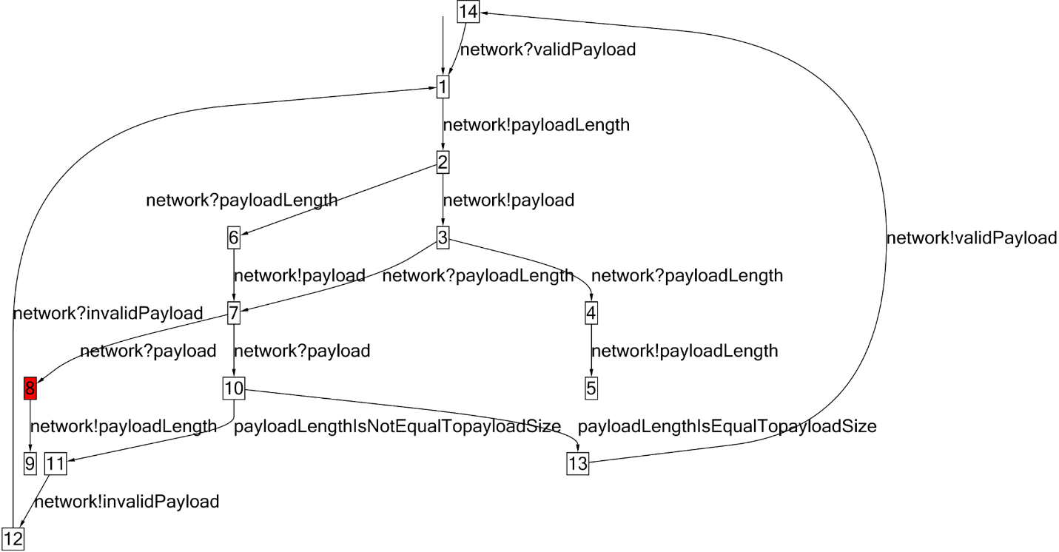
CVE-160/ CAPEC 540 SCP Simulation
Notes:
The following is a screen-shot from the simulation in PAT (Process Analysis Toolkit).
A more detailed specification of Heartbleed can be given in CSP, but so detailed has to be – at C language level. So, why not such attacks to be described directly in their programming language.
???See how to use the NIST source code database -- SARD???

Slide 27


CVE 160/CAPEC 540 in UML & OCL
First, the two signals for a “heart beat” are defined in a class diagram.
The attribute types are not defined, because nowhere in corresponding CWEs or CVEs and CAPECs is mentioned anything about their types. They have to be C types as follows, independently of the attacker software:
Notes:
First, the two signals for a “heart beat” are defined in a class diagram.
The attribute types are not defined, because nowhere in corresponding CWEs or CVEs and CAPECs is mentioned anything about their types. They have to be C types as follows, independently of the attacker software:

Slide 28
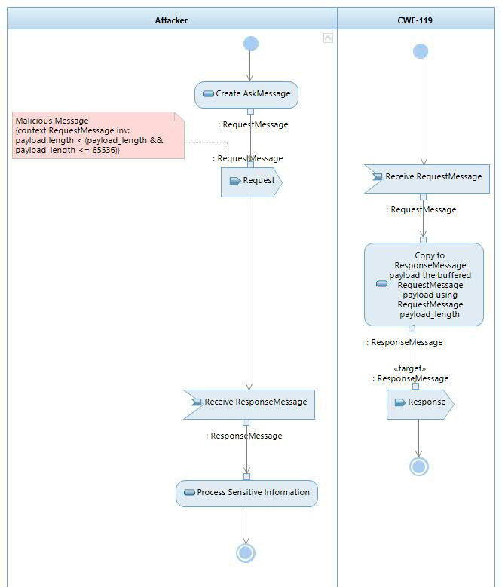
Notes:
The attack is specified with an activity diagram as follows.
<< correct to: context RequestMessage inv: (payload.length < payload_length && payload_length <= 65536)>>
The Attacker process and the Server with CWE-119 process are running independently. The Attacker creates its RequestMessage and sends it to the CWE-119 process. The server process receives the Attacker message via the Receive signal event that triggers its execution. The action “send RequestMessage ” and the trigger “receive RequestMessage ” are hidden in the corresponding activities as properties. In addition, for the RequestMessage to be an Attacker message, an OCL constraint is put on the RequestMessage signal such specifying that the payload length must be less than payload_length.
The server expands the Payload parameter, creates Response message, and answer back to the Attacker. In the “Expand parameter” action (which for now is spelling the constraint “Copy …”) and OCL constraint can be added specifying that the payload of ResponseMessage has RequestMessage payload_length and that it contains the payload.
(!!!) Furthermore, the model can be converted to C++ project and code generated. IBM RSA allows a UML model project to be imported in a development project (e.g. C++, Java project), which can be used for test code generation. The import preserves all source model constraints including those in OCL and they are reflected in the code generation.

Slide 29
Final Notes
Pending:
Explore how OCL specifications can be used to connect the CWE Z-specification to the UML class diagram and the UML activity diagrams. → converting Z specifications into OCL.
Demonstrate how chains of CWEs can be specified with CAPECs in UML.
There are industry efforts on legacy code reengineering. Their target are UML code representation for reuse and integration. UML is the point where CWEs, CVEs and CAPECs specifications can meet.
Notes:
For now the plan is:
Explore how OCL specifications can be used to connect the CWE Z-specification to the UML class diagram and the UML activity diagrams. The problem here is how to convert a Z specification to a OCL one. What exactly have to be converted and how this should be done? Theoretically it is possible.
Demonstrate how chains of CWEs (Task1 from 3.1.) can be specified with CAPECs in UML.
There are industry efforts on legacy code reengineering. Their target are UML code representation for reuse and integration. UML is the point where CWEs, CVEs and CAPECs specifications can meet.

