Slide 1
Towards a “Periodic Table” of Bugs
Irena Bojanova, Paul E. Black, Yaacov Yesha, Yan Wu NIST, BGSU
April 9, 2015

Slide 2
Agenda
Our Vision (Why Use the Term "periodic table“)
Taxonomy and (Formal) Meanings
Examples on Applying Our Approach (Techniques)
Next Steps
Conclusion

Slide 3
I. Our Vision (Why Use the Term "periodic table“)
Our vision is a “natural” organization of a catalog or dictionary or taxonomy to describe software weaknesses and vulnerabilities. Such an organization will help the community to:
a) more closely explain the nature of vulnerabilities (e.g. Heartbleed, Shellshock, Ghost, Chrome WebCore, etc.) and eventually detect, mitigate, or prevent them
b) more closely describe the classes of weaknesses that tools warnings cover (e.g. buffer overflow, injection, etc.)
c) eliminate the need for an exhaustive Cartesian product of weakness classes as in CWEs [1].
It may also help:
d) predict new classes of weaknesses and vulnerabilities
e) improve existing classifications.

Slide 4
Definition: Vulnerability
According to NIST Special Publication 800-27 A:
A vulnerability is “a weakness in system security requirements, design, implementation, or operation that could be accidentally triggered or intentionally exploited and result in a security failure” [2].

Slide 5
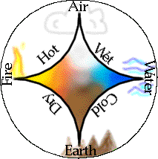
Towards Mendeleev’s Periodic Table
We use the term “periodic table” by analogy.
However obvious it seems today, it required extensive thought and investigation:
Greeks used element and atom to name differences between materials and smallest parts of matter.
In 330 BC, Aristotle proposed that everything is a mixture of “root elements”: Earth, Fire, Air, Water.
In the Middle Ages, alchemists made lists of materials, such as alcohol, sulfur, mercury, and salt.
Lavoisier created a list of 33 elements – e.g. oxygen, nitrogen, hydrogen, phosphorus, mercury, zinc, sulfur, light, and caloric, and distinguished metals from non-metals.
Dalton realized “atoms of same element are identical in all respects, particularly weight."
Source: Reich Chemistry, http://reich-chemistry.wikispaces.com/Ancient%20Time%20LG

Slide 6
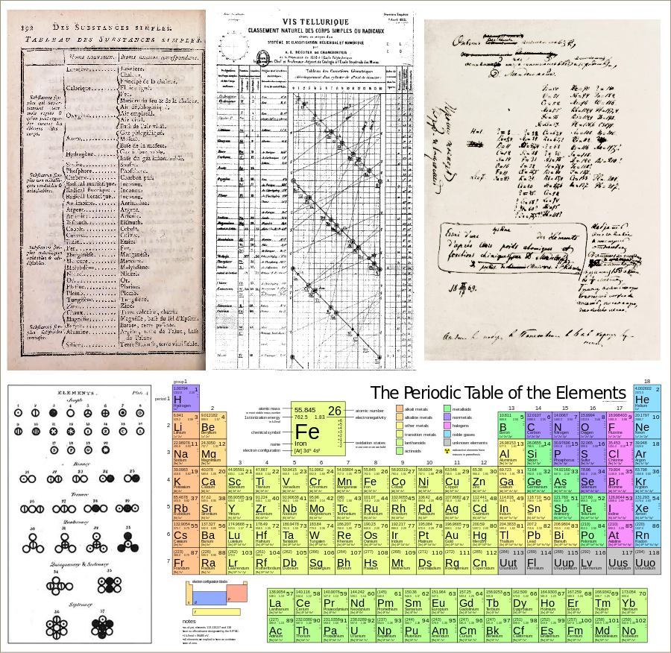
Mendeleev’s Periodic Table
Several tables of elements were developed in the 1800s (Fig. 1).
De Chancourtois first noticed periodicity of elements. When ordered by their atomic weights, similar elements occur at regular intervals.
Mendeleev’s Periodic Table in 1869 and his forecast of properties of missing elements reflected the century of growth in knowledge that reflects atomic structure.
Columns correspond to the number of electrons in the outer shell and the fundamental chemical properties
Rows correspond to the number of electron shells.
Figure 1. Historic development documents of modern periodic table (clockwise from top left) - Lavoisier's 'Table of Simple substances'; de Chancourtois' 'Vis Tellurique'; Mendeleev's hand-written periodic table; a modern periodic table; John Dalton's list of atomic weights & symbols (Source: The History of the Periodic Table, http://allperiodictables.com/ClientPages/AAEpages/aaeHistory.html).

Slide 7
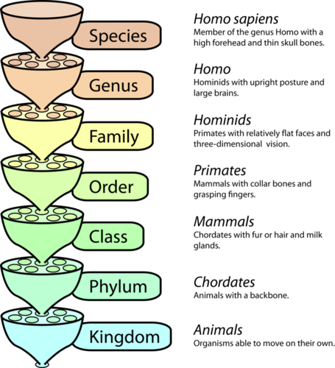
Other Organizational Structures in Science
Carl von Linné
http://www.linnaeus.uu.se/online
Science has developed many different organizational structures:
Linnaeus’ Taxonomy – Categorizes living things into a hierarchy of: Domain (added recently), Kingdom, Phylum, Class, Order, Family, Genus, Species.
Figure 2. Applying Linnaean system to classify our own species, Homo sapiens. (Source: c-K12, http://www.ck12.org/book/CK-12-Life-Science-For-Middle-School/section/2.3/ )
Notes:
Linnaeus’ taxonomy allows comprehension of the diversity of life forms and understanding that some animals are close in their evolutionary history.
Linnaeus also developed binomial nomenclature for naming species.

Slide 8
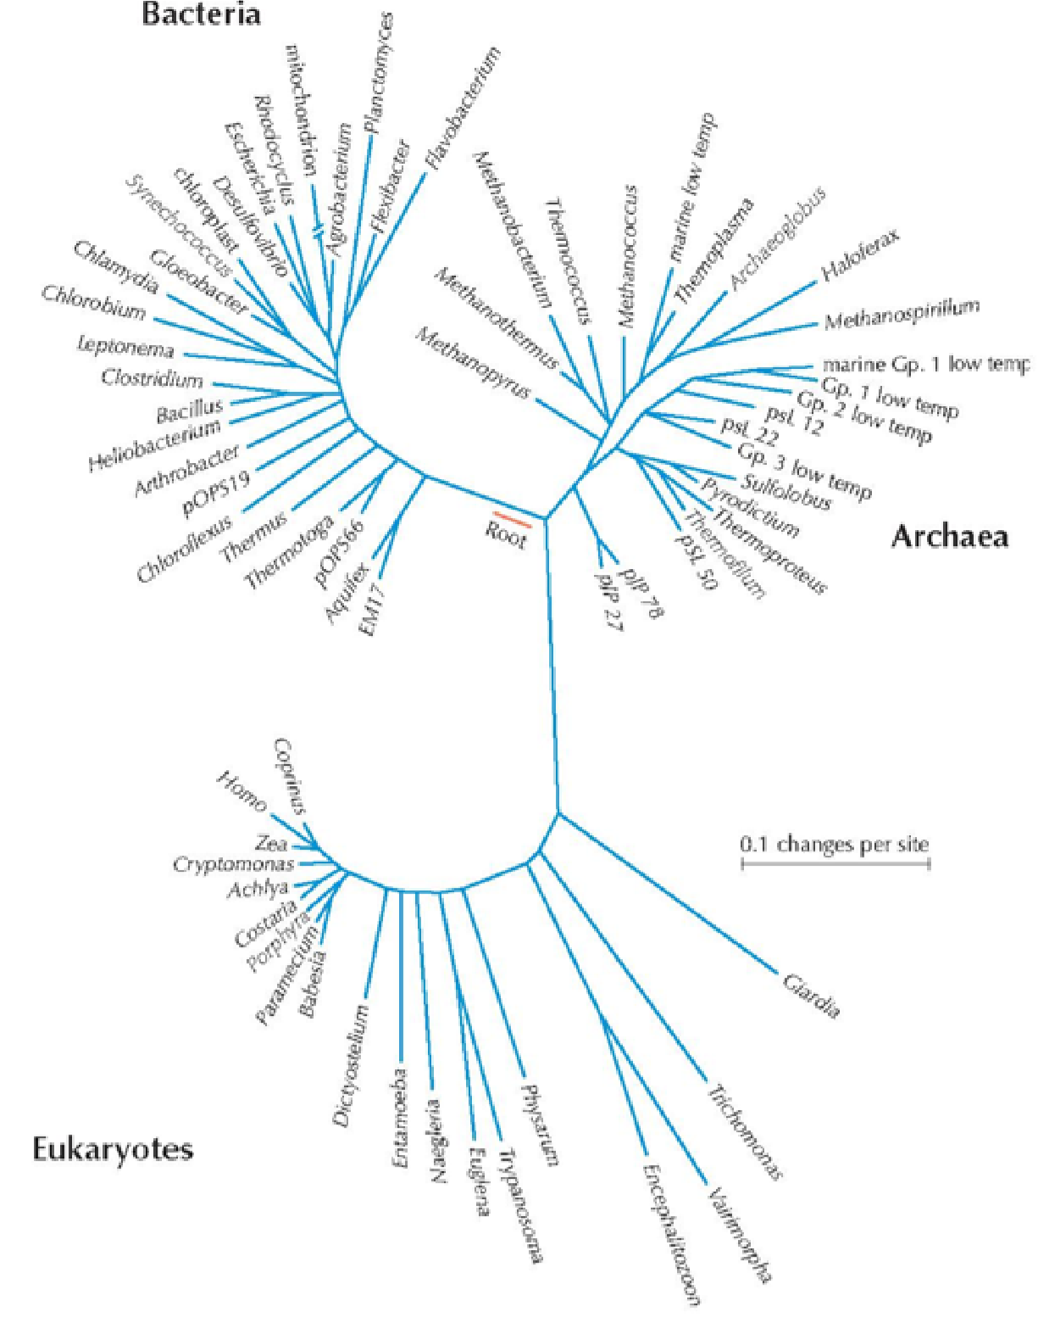
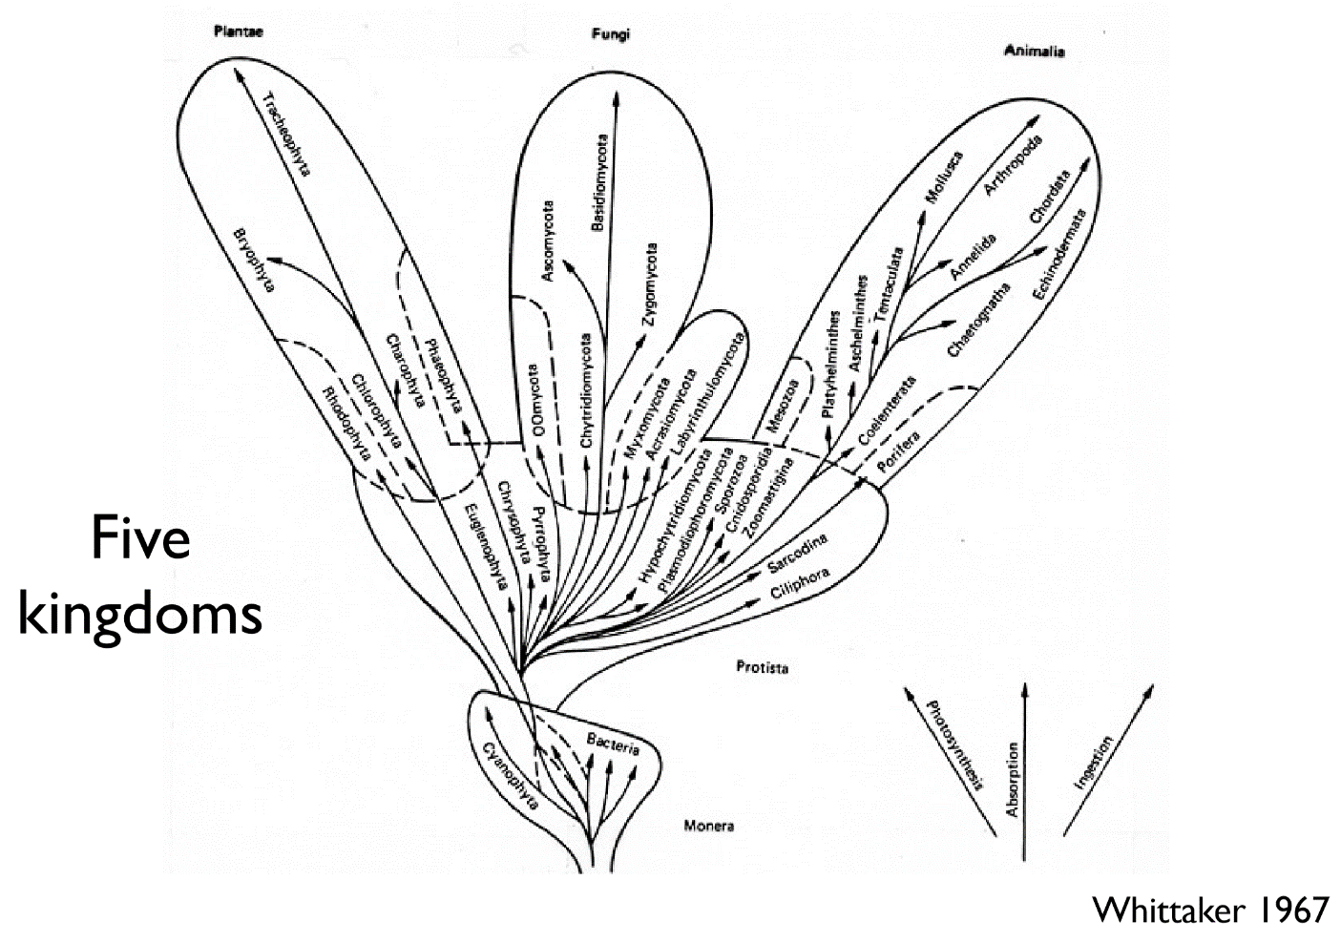
Other Organizational Structures in Science (Cont.)
Tree of Life – Division of life into three domains: Bacteria, Archaea, and Eukaryotes.
Phylogenetic tree, based on analysis of sequences of small-subunit rRNA molecules and supported by analyses of many other characteristics.
Three domains

Slide 9
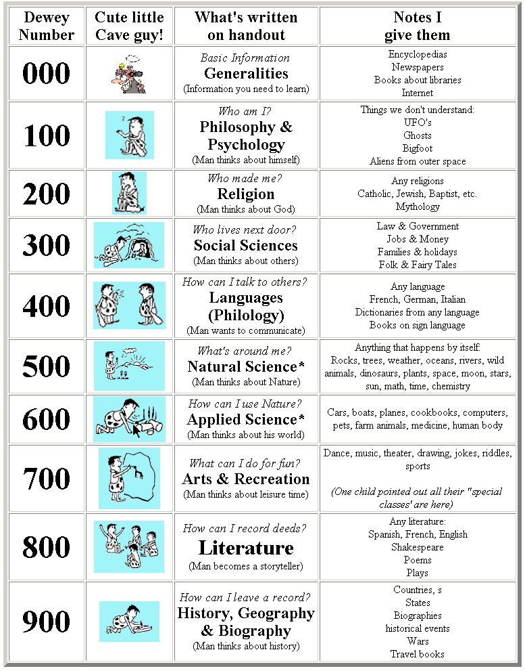
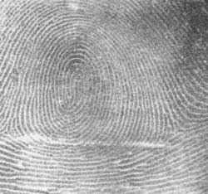
Other Organizational Structures in Science (Cont.)
Dewey Decimal Classification system – Allows new books and whole new subjects to be placed in reasonable locations in a library, for easy retrieval based on subject (Fig. 3).
Fingerprints are classified and retrieved using: loops, whorls, and arches as basic patterns.
Source: Wikipedia, https://en.wikipedia.org/?title=Fingerprint
Figure 3. Categories of Dewey Decimal Classification System. (Source: AIS, http://www.ais.up.ac.za/vet/infomania/infomania14/dewey14.htm)

Slide 10
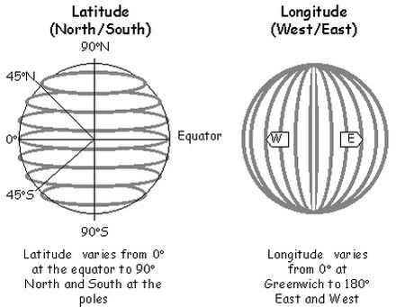
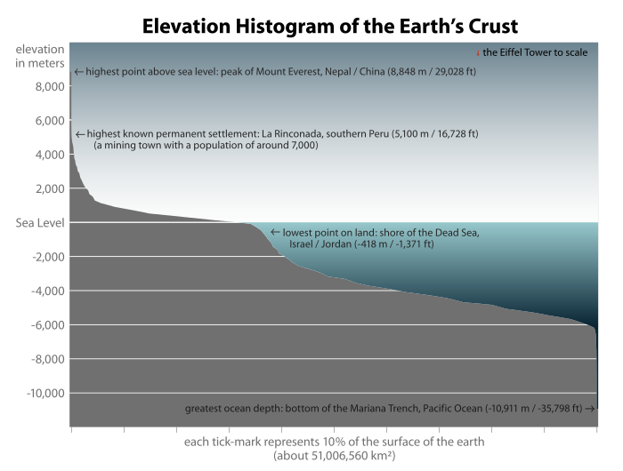
Other Organizational Structures in Science (Cont.)
Geographic Coordinate System – Specifies any location on Earth using: Latitude, Longitude, and Elevation.(Fig.4).
Figure 4. Longitude lines are perpendicular and latitude lines are parallel to the equator. (Sources: Wikipedia, http://en.wikipedia.org/wiki/Geographic_coordinate_system ; http://en.wikipedia.org/wiki/Elevation )

Slide 11
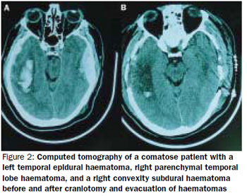
Other Organizational Structures in Science (Cont.)
Medical professionals have extension vocabulary to name all muscles, bones, and organs, and conditions and diseases, so they can communicate clearly.
For instance, the image caption uses some obscure/precise medical terminology.
They are not trying to obfuscate.
They are "painting a picture" (adding arrows and circles) with words.
(Source: http://i.stack.imgur.com/uLH9P.jpg)

Slide 12
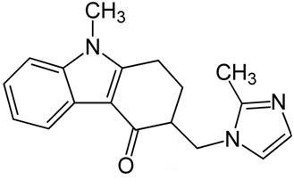
Other Organizational Structures in Science (Cont.)
Chemists have a detailed system beyond the periodic table to describe chemicals. For instance, Zofran ODT is:
C₁₈H₁₉N₃O or (±) 1, 2, 3, 9-tetrahydro-9-methyl-3-[(2-methyl-
1H-imidazol-1-yl)methyl]-4H-carbazol-4-one.
Analogously, we seek to: Factor software weaknesses into their constituent components.

Slide 13
Problem: Existing Classifications Must Be Improved
Common Weakness Enumerations (CWE) [1] are:
not orthogonal
coarse-grained.
Software Fault Patterns (SFP) [3] don’t include:
attacks, upstream influences, or consequences
Semantic Templates (ST) [4] are:
only general interactions.
Figure 5. Buffer Overflow ST. (Source: Yan Wu’s dissertation.)

Slide 14
Solution: A Formal Orthogonal “Periodic Table” of Bugs
A “natural” organization of a catalog or dictionary or taxonomy to describe software weaknesses and vulnerabilities. It will help the community to:
a) more closely explain the nature of vulnerabilities (e.g. Heartbleed, Shellshock, Ghost, Chrome WebCore, etc.) and eventually detect, mitigate, or prevent them
b) more closely describe the classes of weaknesses that tools warnings cover (e.g. buffer overflow, injection, etc.)
c) eliminate the need for an exhaustive Cartesian product of weakness classes as in CWEs [1].
It may also help:
d) predict new classes of weaknesses and vulnerabilities
e) improve existing classifications.

Slide 15
II. Taxonomy and (Formal) Meanings
We refined and extended the structures based on:
Common Weaknesses Enumeration (CWEs) & the notions of chains and composites
Software Fault Patterns (SFPs)
Semantic Templates.

Slide 16
Focus First On: Buffer Overflow
CWE-119: Improper Restriction of Operations within the Bounds of a Memory Buffer: The software performs operations on a memory buffer, but it can read from or write to a memory location that is outside of the intended boundary of the buffer. → “Read from or write to a memory location” is not tied to the buffer. Our definition clarifies that access is through the same buffer to which the intended boundary pertains. Our definition also accurately, precisely, and concisely describes violation of memory safety.
Our Definition: The software can access through a buffer a memory location that is not allocated to that buffer.

Slide 17
Buffer Overflow: Attributes
Segment (memory area):
Heap, Stack, BSS (uninitialized data), Data (initialized), Code (text) [5,6,3].
Access:
Read, Write. [5,3].
Side:
Below (before or under), Above (after or over) [5].
Method:
Indexed, (bare) Pointer [5,3].
Magnitude (how far outside):
Minimal (just barely outside), Moderate, Far (e.g. 4000) [5].
Data Size (base may be inside, but large chunk of data extends outside).
Note: Any of these attributes may be “Unknown”, “Any”, or “Don’t Care”.
Notes:
What does this add beyond SFPs? Nothing much.
All attributes can also be “either/any/don’t care/unknown”.

Slide 18
Buffer Overflow: Causes
Causes
Buffer Overflow
Attributes:
Access:
Read, Write.
Side:
Below (before or under), Above (after or over)
Segment (memory area):
Heap, Stack, BSS (uninitialized data), Data (initialized), Code (text)
Method:
Indexed, (bare) Pointer.
Magnitude (how far outside):
Minimal (just barely), Moderate, Far (e.g. 4000).
Data Size (base may be inside, but large chunk of data extends outside).
User Input Not Checked Properly
Missing Factor
Destination Too Small
Incorrect Argument
Integer Coercion
Integer Overflow Wrap-around
No NULL Termination
Integer Underflow
Incorrect Calculation
Data Too Big
Off By One
Incorrect Conversion
Wrong Index / Pointer Out of Range
There are only 3 proximate causes of buffer overflows:
Destination is too small
Data is too big
Wrong index / pointer out of range.
Some of the preceding causes that may lead to those.
means “is-a”
means “can precede”.
Notes:
Integer Overflow Wrap-around is CWE 128 and CWE 190
Incorrect Argument subsumes CWE-467 Using sizeof() on Pointer (i.e., sizeof(p) instead of sizeof(*p) ).

Slide 19
Buffer Overflow: Consequences
Consequences
Buffer Overflow
Attributes:
Access:
Read, Write.
Side:
Below (before or under), Above (after or over)
Segment (memory area):
Heap, Stack, BSS (uninitialized data), Data (initialized), Code (text)
Method:
Indexed, (bare) Pointer.
Magnitude (how far outside):
Minimal (just barely), Moderate, Far (e.g. 4000).
Data Size (base may be inside, but large chunk of data extends outside).
Information Exposure
Information Loss
Program Crash
Denial Of Service
System Crash
Resource Exhaustion (Memory/CPU)
Arbitrary Code Execution
Notes:
Integer Overflow Wrap-around is CWE 128 and CWE 190
Incorrect Argument subsumes CWE-467 Using sizeof() on Pointer (i.e., sizeof(p) instead of sizeof(*p) ).

Slide 20
Buffer Overflow: Attributes, Causes & Consequences
Consequences
Causes
Buffer Overflow
Attributes:
Access:
Read, Write.
Side:
Below (before or under), Above (after or over)
Segment (memory area):
Heap, Stack, BSS (uninitialized data), Data (initialized), Code (text)
Method:
Indexed, (bare) Pointer.
Magnitude (how far outside):
Minimal (just barely), Moderate, Far (e.g. 4000).
Data Size (base may be inside, but large chunk of data extends outside).
User Input Not Checked Properly
Information Exposure
Missing Factor
Destination Too Small
Information Loss
Incorrect Argument
Integer Coercion
Program Crash
Integer Overflow Wrap-around
No NULL Termination
System Crash
Denial Of Service
Integer Underflow
Incorrect Calculation
Data Too Big
Resource Exhaustion (Memory/CPU)
Off By One
Incorrect Conversion
Wrong Index / Pointer Out of Range
Arbitrary Code Execution
The graph of causes shows:
There are only 3 proximate causes of buffer overflows:
Destination is too small
Data is too big
Wrong index / pointer out of range.
Some of the preceding causes that may lead to those.
Note: In the graph of causes:
means “is-a”
means “can precede”.
Notes:
Integer Overflow Wrap-around is CWE 128 and CWE 190
Incorrect Argument subsumes CWE-467 Using sizeof() on Pointer (i.e., sizeof(p) instead of sizeof(*p) ).

Slide 21
III. Examples on Applying Our Techniques
CVE (Common Vulnerabilities and Exposures,) is a dictionary of security vulnerabilities. → We will demonstrate the use of our techniques for describing some CVEs.
CppCheck is a static analysis tool [7] → We will demonstrate the use of our techniques for analysis of cppCheck warning classes.
We will also demonstrate characterization of buffer overflow CWEs.

Slide 22
Example 1: Ghost (CVE-2015-0235)
CVE-2015-0235 is “Heap-based buffer overflow in the __nss_hostname_digits_dots function in glibc 2.2, and other 2.x versions before 2.18, allows context-dependent attackers to execute arbitrary code via vectors related to the (1) gethostbyname or (2) gethostbyname2 function, aka "GHOST."” [8,9].
Applying our techniques, we obtain:
Ghost — glibc gethostbyname buffer overflow is
caused by a Destination Too Small
because of an Incorrect Calculation specifically Missing Factor
where there was a Write that was After the end by a Moderate number of bytes
of a buffer in the Heap
which may be exploited for Arbitrary Code Execution.

Slide 23
Example 2: Chrome WebCore (CVE-2010-1773)
CVE-2010-1773 is “Off-by-one error in the toAlphabetic function in rendering/RenderListMarker.cpp in WebCore in WebKit before r59950, as used in Google Chrome before 5.0.375.70, allows remote attackers to obtain sensitive information, cause a denial of service (memory corruption and application crash), or possibly execute arbitrary code via vectors related to list markers for HTML lists, aka rdar problem 8009118.” [10]
Applying our techniques, we obtain:
Chrome WebCore — to Alphabetic render buffer overflow is
caused by a Wrong Index
because of an Incorrect Calculation specifically Off by One
where there was a Read that was Below the start by a Minimal amount
of a buffer in the Heap
which leads to use of User Input Not Checked Properly
which may be exploited for Information Exposure, Arbitrary Code Execution, or Program Crash leading to Denial of Service.

Slide 24
Example 3: Heartbleed (CVE-2014-0160)
CVE-2014-0160 is: “The (1) TLS and (2) DTLS implementations in OpenSSL 1.0.1 before 1.0.1g do not properly handle Heartbeat Extension packets, which allows remote attackers to obtain sensitive information from process memory via crafted packets that trigger a buffer over-read, as demonstrated by reading private keys, related to d1_both.c and t1_lib.c, aka the Heartbleed bug.”[11].
Applying our techniques, we obtain:
Heartbleed buffer overflow is:
caused by Data Too Big
because of User Input not Checked Properly
where there was a Read that was After the End that was Far Outside
of a buffer in the Heap
which may be exploited for Information Exposure

Slide 25
Example 3: Heartbleed (CVE-2014-0160) (cont.)
Information Exposure is also enabled by CWE-244: Improper Clearing of Heap Memory Before Release [14], and CWE-908: Use of Uninitialized Resource [15].

Slide 26
Example 4: cppCheck Warning Classes
CppCheck is a static analysis tool [7]. Table 1 provides descriptions of its warning classes.
Table 1. Analysis of cppCheck warning classes.
Warning\Attribute | Access | Side | Indexed | Size | Magnitude
array Index Out Of Bounds | - | - | Yes | - | -
buffer Access Out Of Bounds | - | - | - | - | -
out Of Bounds | - | - | - | - | -
negative Index | - | Below | Yes | - | -
insecure Cmd Line Args | - | - | - | - | -
write Outside Buffer Size | Write | - | - | - | -
invalid Scanf | Write | Above | - | Variable | Moderately outside

Slide 27
Example 5: Refactoring CWEs
Applying our definition and attributes, Buffer Overflow CWEs can be categorized as follows.
Buffer Overflow CWEs:
CWE 120: Write beyond buffer end.
CWE 121: Write outside buffer that is on stack.
CWE 122: Write outside buffer that is on heap.
CWE 123: Write outside buffer.
CWE 124: Write before start of buffer.
CWE 125: Read outside buffer.
CWE 126: Read after end of buffer.
CWE 127: Read before start of buffer.
CWE 786: Access before start of buffer.
CWE 787: Write outside buffer.
CWE 788: Access after end of buffer.
Table 2. Buffer Overflow CWEs Attributes.
 | before | after | either end | stack | heap
read | 127 | 126 | 125
write | 124 | 120 | 123, 787 | 121 | 122
either r/w | 786 | 788
Where:
access = either read/write
outside = either before/below start or after/above

Slide 28
IV. Next Steps
Provide more examples of applying our techniques
Define more “vocabulary” – add terms, more formal, refine
Focus on other CWEs – for example:
Improper Restriction of Excessive Authentication Attempts (CWE-307)
OS Command Injection (CWE-78 Improper Neutralization of Special Elements used in an OS Command).

Slide 29
Focus On: Injection
CWE-78: Improper Neutralization of Special Elements used in an OS Command ('OS Command Injection'): The software constructs all or part of an OS command using externally-influenced input from an upstream component, but it does not neutralize or incorrectly neutralizes special elements that could modify the intended OS command when it is sent to a downstream component. → “Using input”, “intended command”, and “correctly neutralizing” are imprecise. Our definition precisely defines “using input” and “intended command”. We do not include “correctly neutralizing”, because it simply means that intended OS command cannot be modified.
Our Definition: For a common trusted input and two untrusted inputs, the sub-sequences of code symbols in the output program differ in a way that is not included in a description of a given syntax of allowed different sequences.

Slide 30
Focus On: Authentication
CWE-307: Improper Restriction of Excessive Authentication Attempts: The software does not implement sufficient measures to prevent multiple failed authentication attempts within in a short time frame, making it more susceptible to brute force attacks.
→ “Multiple” and “short” are vague. Our definition recognizes that CWE-307 actually represents a set of weaknesses, each of which satisfies particular institution-specific definitions of “multiple” and “short”.
Our Definition: The software does not limit the number of failed authentication attempts or may allow more than a specified number of failed authentication attempts within a specified time period.

Slide 31
V. Conclusion
This presentation outlined the progress we have made towards better understanding of software weaknesses and their:
definitions
causes
consequences.
We hope that such progress will result in being able to:
write more secure software
improve tools that find weaknesses in code.

Slide 32
References
[1] The MITRE Corporation, CWE Common Weakness Enumeration, https://cwe.mitre.org/, viewed 2 April 2015.
[2] Stoneburner, G. et al., “Engineering Principles for Information Systems Security (A Baseline for Achieving Security)”, Revision A, NIST Special Publication 800-27 Rev A, June 2004.
[3] Nikolai Mansourov, DoD Software Fault Patterns, https://buildsecurityin.us-cert.gov/sites/default/files/Mansourov-SoftwareFaultPatterns.pdf viewed on June 3, 2015, listed in CWE, Common Weakness Enumeration, Sources, https://cwe.mitre.org/about/sources.html viewed on June 3, 2015.
[4] Yan Wu, Robin A Gandhi, and Harvey Siy, “Using semantic templates to study vulnerabilities recorded in large software repositories”, Proc. 2010 ICSE Workshop on Software Engineering for Secure Systems, pp 22-28.
[5] Kendra Kratkiewicz and Richard Lippmann, Using a Diagnostic Corpus of C Programs to Evaluate Buffer Overflow Detection by Static Analysis Tools. 2005 Workshop on the Evaluation of Software Defect Detection Tools 2005,June 12, Chicago, IL. https://www.cs.umd.edu/ ~pugh/BugWorkshop05/papers/62-kratkiewicz.pdf viewed on April 23, 2015

Slide 33
References (cont.)
[6] WIKIPEDIA, The Free Encyclopedia, Data segment https://en.wikipedia.org/wiki/Data_segment viewed on April 27, 2015
[7] ccpcheck.xml, SAMATE, NIST.
[8] CVE-2015-0235, MITRE, CVE, Common Vulnerabilities and Exposures, https://cve.mitre.org/cgi-bin/cvename.cgi?name=CVE-2015-0235 accessed April 23, 2015.
[9] Qualys Security Advisory, Qualys Security Advisory CVE-2015-0235 - GHOST: glibc gethostbyname buffer overflow, Openwall, bringing security into open environments, http://www.openwall.com/lists/oss-security/2015/01/27/9, viewed 9 April 2015.
[10] CVE-2010-1773, MITRE, CVE, Common Vulnerabilities and Exposures, http://cve.mitre.org/cgi-bin/cvename.cgi?name=CVE-2010-1773 accessed April 27, 2015.

Slide 34
References (cont.)
[11] CVE-2014-0160, MITRE, Common Vulnerabilities and Exposures, https://cve.mitre.org/cgi-bin/cvename.cgi?name=CVE-2014-0160 viewed on July 16, 2015.
[12] Kupsch & Miller https://continuousassurance.org/swamp/SWAMP-Heartbleed.pdf viewed on July 16, 2015.
[13] http://securityintelligence.com/heartbleed-openssl-vulnerability-what-to-do-protect/#.VagHQXbD-fA viewed on July 16, 2015.
[14] https://cwe.mitre.org/data/definitions/244.html viewed on July 20, 2015
[15] https://cwe.mitre.org/data/definitions/908.html viewed on July 20, 2015

