Slide 1
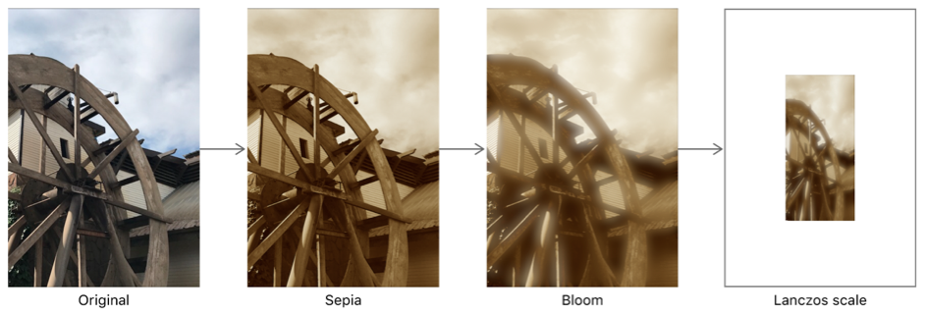
Implementation of various
Filtering Techniques on a
Noisy Image
Name : BADAM JWALA SRI HARI
Roll no : B18CS003
Branch : Computer Science and Engineering
Section : CSE-1
Year : 2020-2021
Counsellor : Dr. P. Niranjan Reddy

Slide 2
Abstract
Now a days many things going around the image processing because there are lot application based on image . In image processing after taking the image as input the first and foremost step is pre-processing. The main objectives of pre-processing is to remove noises from the image . In the perceptive of medical field converting the image in gray image also adds in pre-processing step. Removal of noise in the image is done by using filtering techniques. Filtering techniques changes the image based on shape, size, color, depth, etc. There are varies types of noises like salt pepper noises, Blurness ,Gaussian noises, periodic noises, etc. This noises are removed by varies filtering like mean filters , Median filters, Weiner filters and many smoothing techniques. This project is to implement filtering techniques on a noisy image

Slide 3
Introduction
What is filter and where we will use it?
What is image processing?
In image processing at what phase filters are used?

Slide 4
Steps in image processing
Input
Feature Extraction
Classification
Pre-processing
Image segmentation

Slide 5
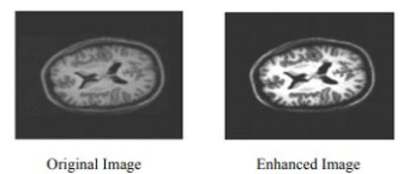
Pre-Processing involves processes like conversion to grey scale image, Enhancing, noise removal.
Filtering is the process of modifying and enhancing an image.
Pre-processing

Slide 6
Filtering Techniques
Image enhancement filters
Spatial domain filters
Frequency domain filters
Smoothing filters
Smoothing filters
Sharpening filters
Sharpening filters

Slide 7
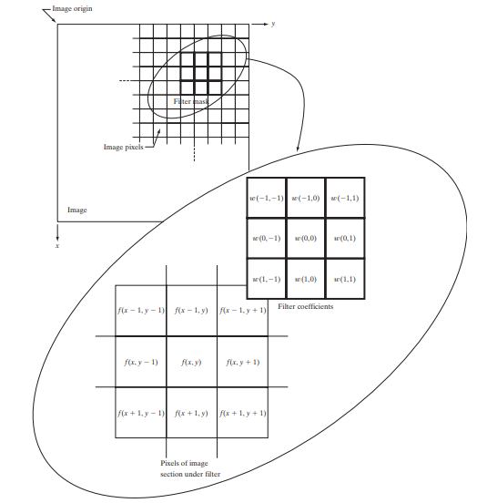
Spatial domain filter
Spatial filtering performs operations on the neighbourhood of every pixel in an image.
Kernel: kernel is the matrix which moves on the image and performs operations based on the filter.
Correlation: the process of applying kernel on an image.
Convolution: rotating kernel by 180⁰ and applying.

Slide 8
Smoothing: In order to smoothing an image, we apply blur to the image.
Ex: mean(averaging filter), Gaussian(weighted average filter),median, min, max
Sharpening: Sharping means highlighting the edges.
Ex: Laplacian, Roberts, Sobel
Linear filter: A linear spatial filter performs a sum of products operation between an input image and kernel.
Non-linear filter: A non-linear spatial filters whose response is based on ordering the pixels contained in the region encompassed by the filter.

Slide 9
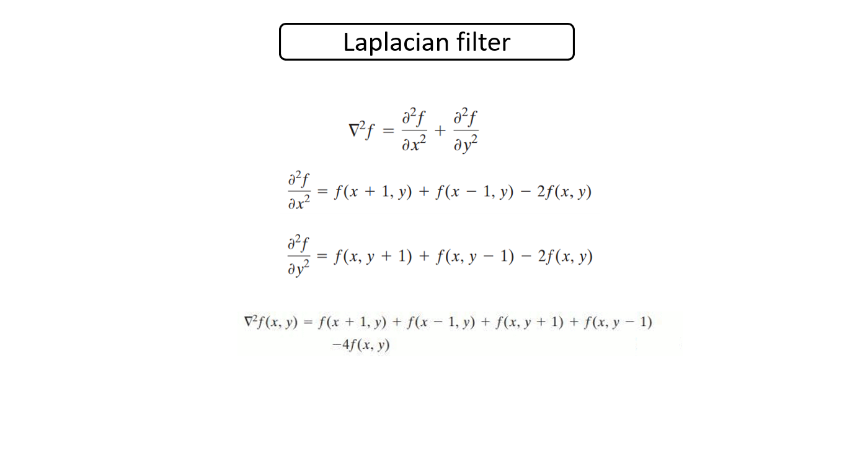
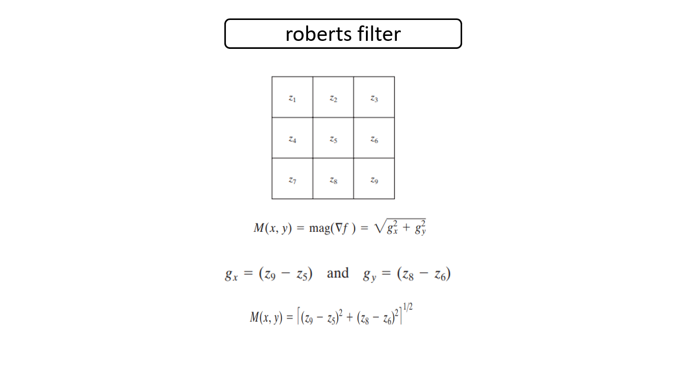
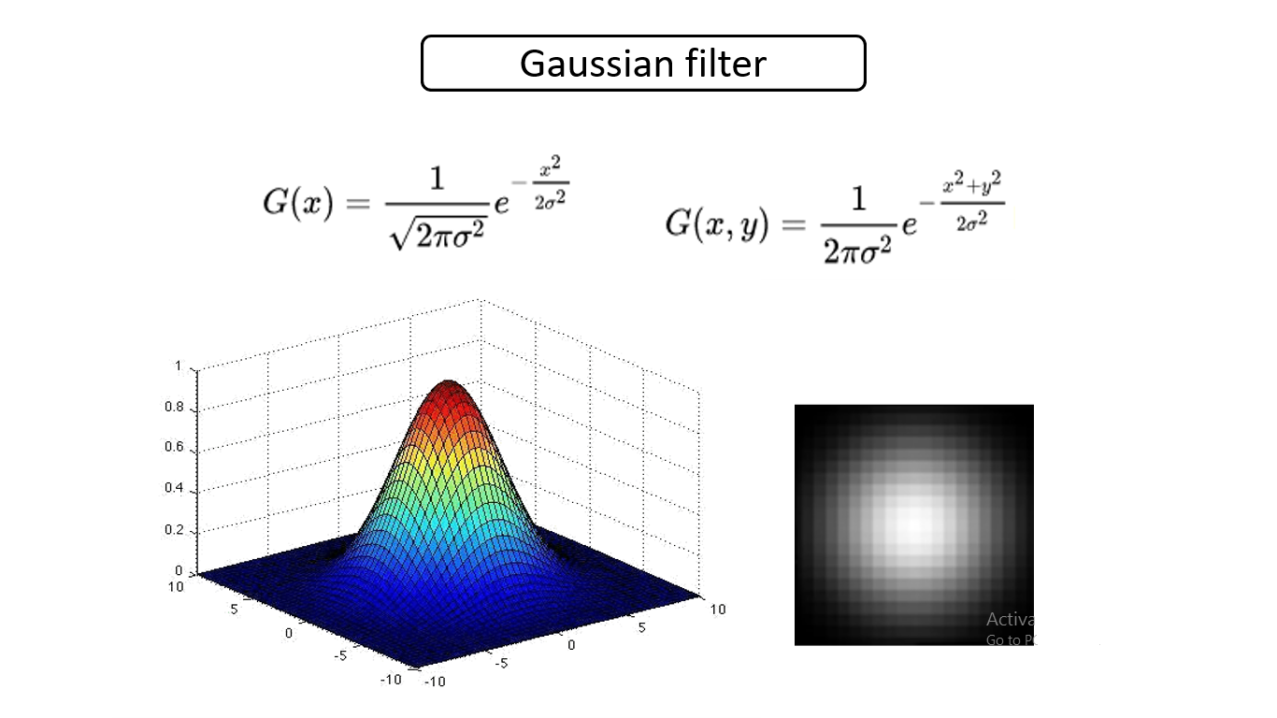
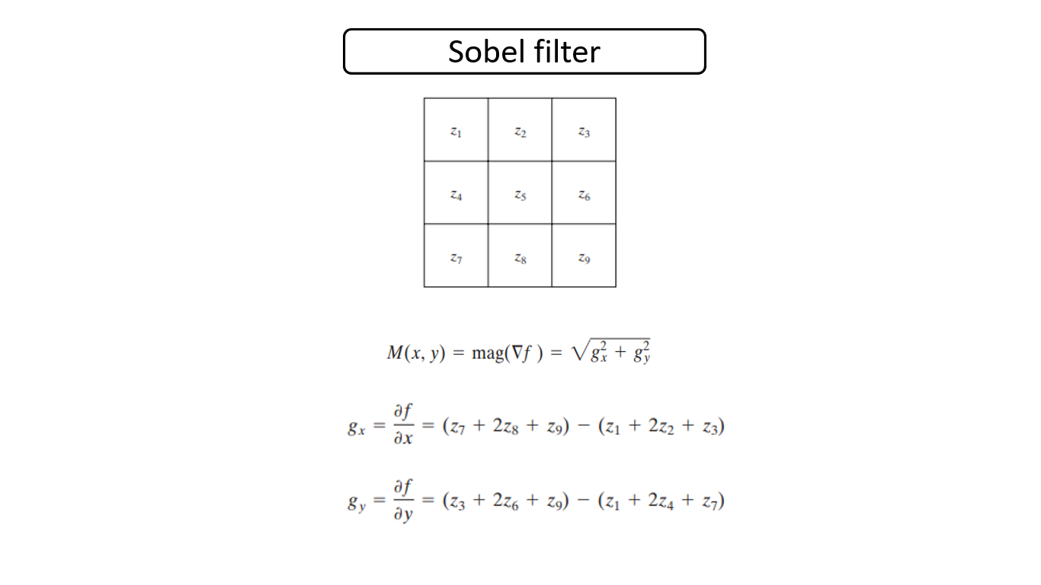
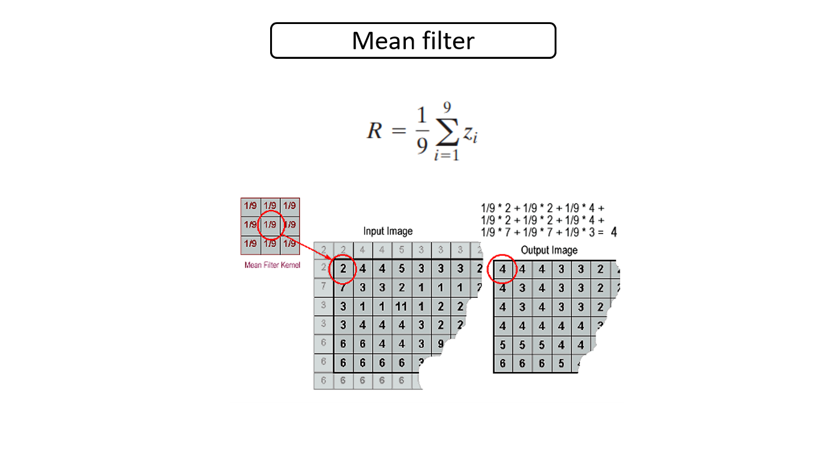







Filter | kernel
Mean
Gaussian
Laplacian
Roberts
Sobel

Slide 10
- | - | -
- | 10 | -
- | - | -
Min
Sorted list
10
Input Window
20
30
50 | 10 | 20
30 | 70 | 90
40 | 60 | 80
40
- | - | -
- | 50 | -
- | - | -
Median
50
60
70
80
90
- | - | -
- | 90 | -
- | - | -
Max

Slide 11
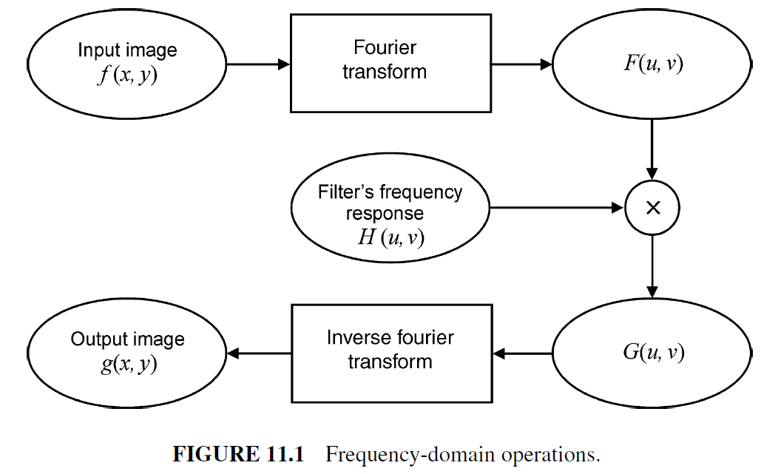
Frequency domain filter
In frequency domain filters operations on the image are performed on the transformed image
Transformation of the image is done by Fourier transform, discrete wavelet transform, discrete cosine transform
Usually, Fourier transformation is used

Slide 12
Differences
Spatial filter
Frequency filter
h(x, y)
H(u , v)
f(x , y)
g(x , y)
F(u , v)
G(u , v)
g(x , y)= f(x , y) * h(x , y)
G(u , v)= F(u , v) * H(u , v)
g(x , y)=F⁻¹ (F(u , v) H(u , v))

Slide 13
Ideal low pass
Smoothing
Butterworth low pass
Gaussian low pass
Frequency filter
Ideal high pass
Sharpening
Butterworth high filter
Gaussian high pass

Slide 14
Advantages:
Filtering techniques improves accuracy of the models.
By using filtering techniques, we can extra features easily.
Disadvantages:
Filters are subjective.
In order to reduces noise, sometimes image can be degraded.

Slide 15
Conclusions
In this we have discussed various spatial and frequency domain filtering techniques to enhance the quality of images which will help to get better results in medical, astronomy, surveillance areas.

Slide 16
References
Swati Dewangan and Anup Sharma, “Image Smoothening and Sharpening using Frequency Domain Filtering Technique “, IJETER Volume 5, Issue 4, April (2017)
Utkarsh Kushwaha and Shivam Jha, “Image Filtering -Techniques, Algorithm and Applications”, GIS SCIENCE JOURNAL, VOLUME 7, ISSUE 11(2020).
https://www.keyence.com/ss/products/vision/visionbasics/basic/filter/
https://www.geeksforgeeks.org/spatial-filtering-and-its-types/

Slide 17

Thank you!!!

