Slide 1
Gulf of Mexico – Current State and Looking forward
Wilson Aliaga

Slide 2
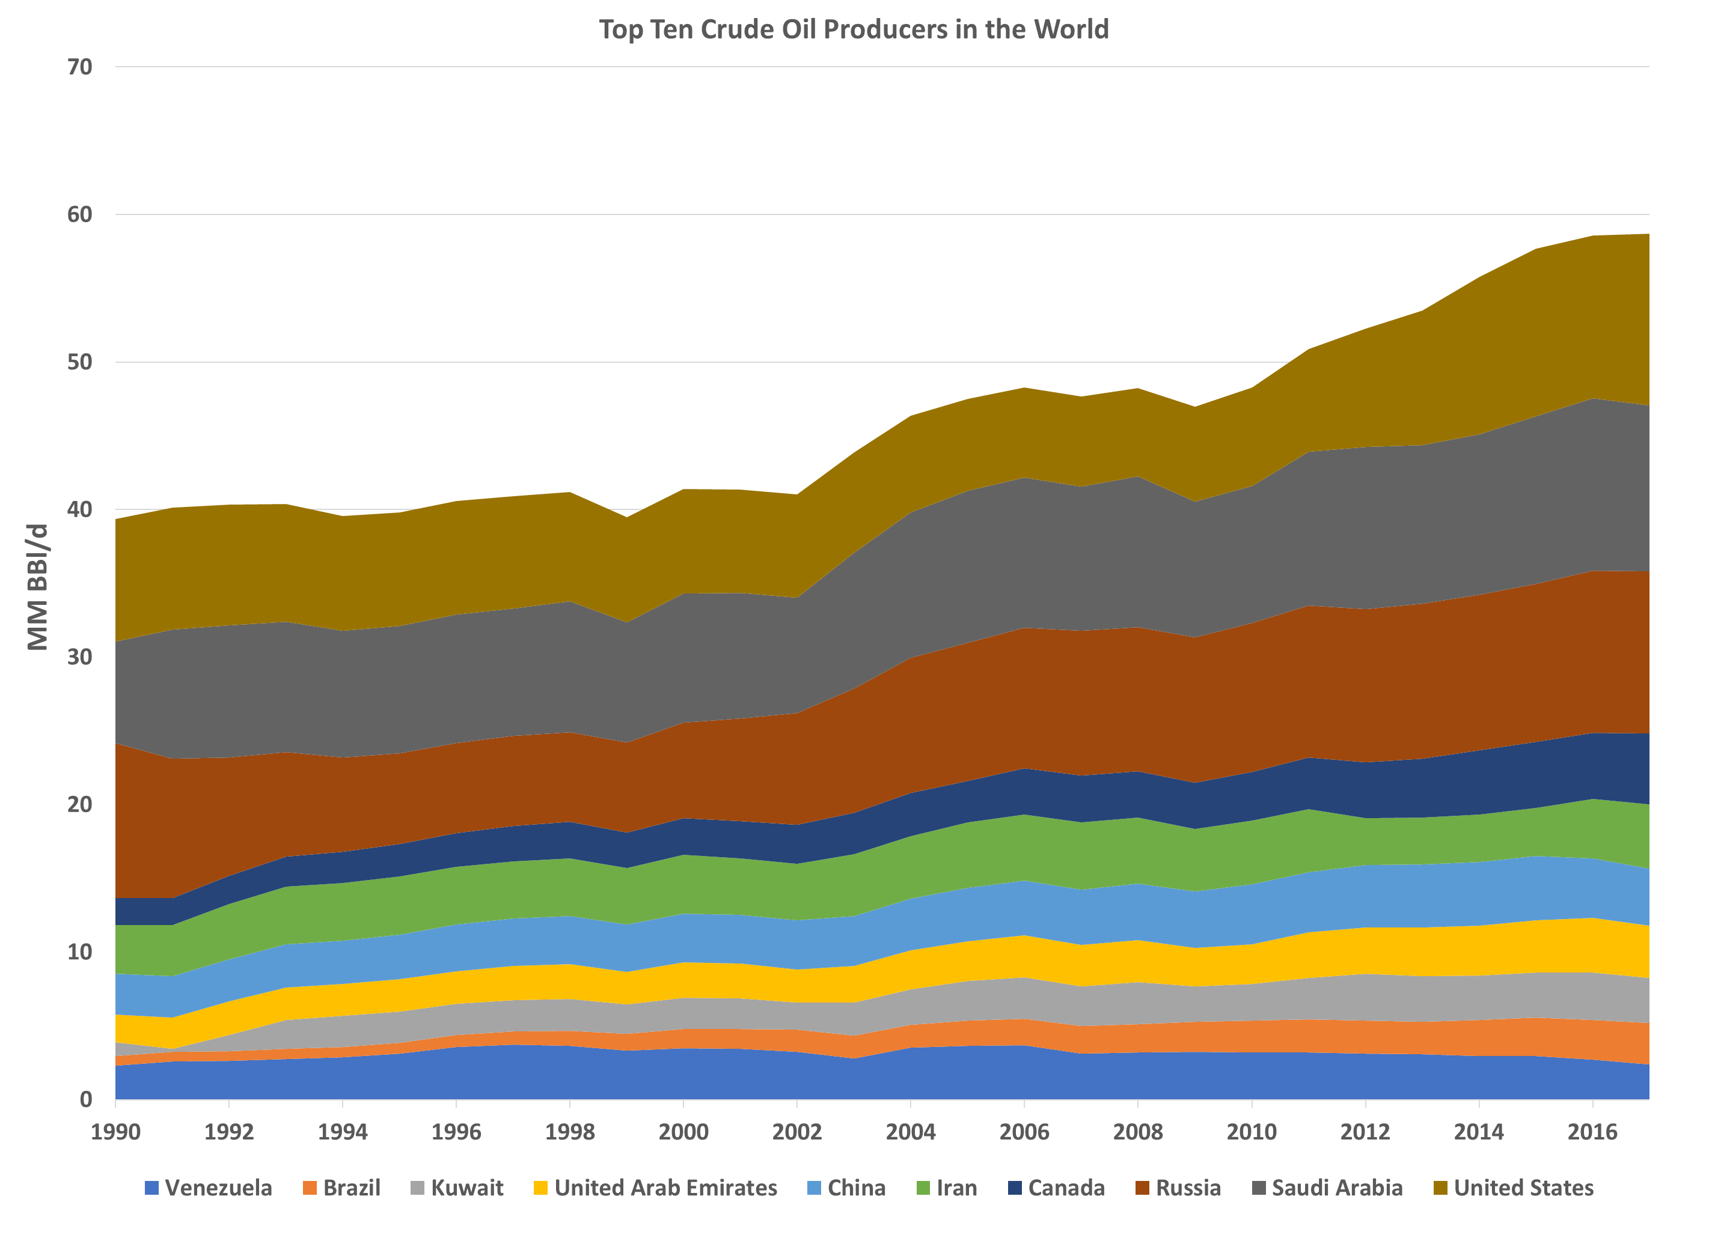
Top Crude Oil Producers
https://yearbook.enerdata.net/

Slide 3
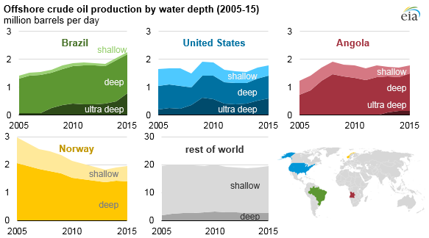
Offshore Crude Oil Production

Slide 4
Global Petroleum Survey – Fraser Institute

Slide 5
Global Petroleum Survey – Fraser Institute

Slide 6
Deepwater Project Economics
  Recoverable Volume
  Prices
  Water Depth
  Availability and Quality of Infrastructure
  Geological Database
  Fiscal terms and
  Taxation in General
  Legal environment

Slide 7
Crude Oil Production and Reserves
US Total ~ 12 million Bbl/d
GoM ~ 1.9 million Bbl/d
US Total ~ 39 Billion Bbl
GoM ~ 4.7 Billion bbl

Slide 8
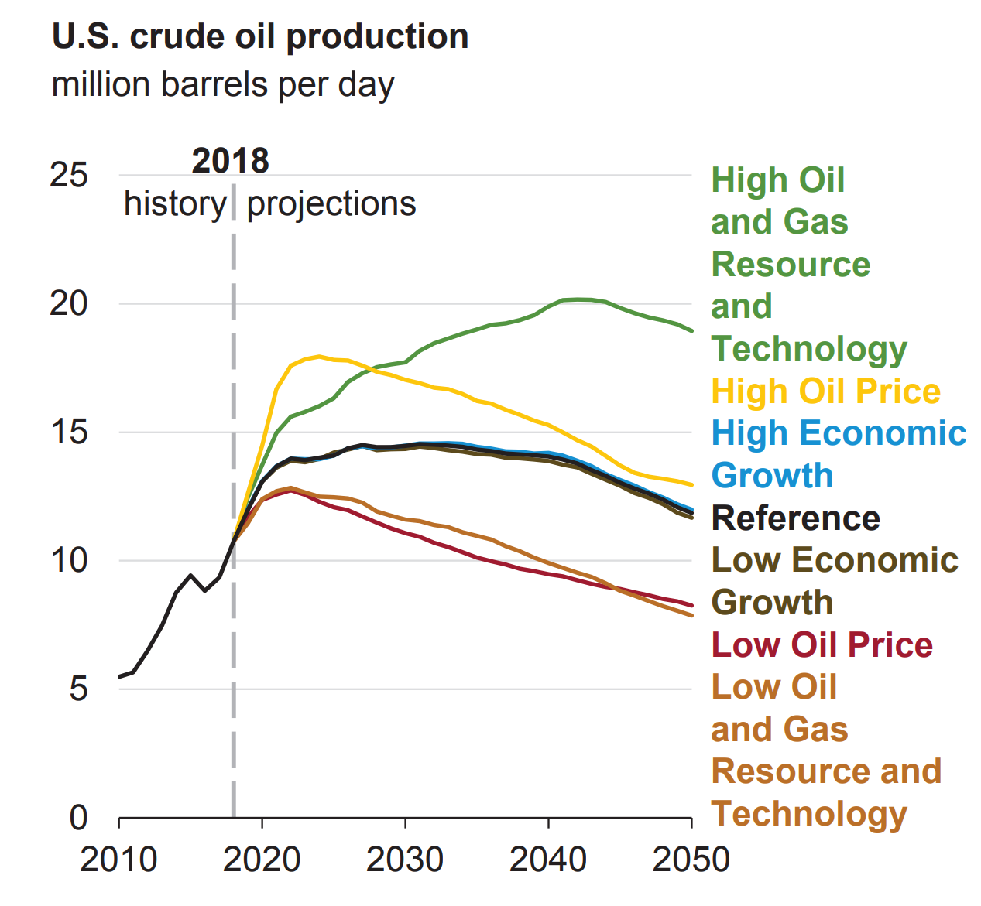
US Crude Oil Production Forecast
If the contribution of the GoM is still 16%, then the GoM crude oil production for 2025 and 2030 will be around 2.32 MM Bbl/d for the reference scenario
https://www.eia.gov/outlooks/aeo/pdf/aeo2019.pdf

Slide 9
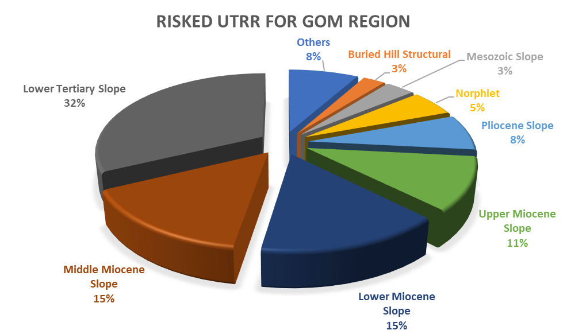
2016 Gulf of Mexico Risked Undiscovered Technically Recoverable Crude Oil Resources
GoM ~ 48 Billion bbl
https://www.boem.gov/2016a-National-Assessment-of-Undiscovered-Oil-and-Gas-Resources

Slide 10
Deepwater Oil Reservoir Properties
https://www.ogj.com/articles/print/volume-103/issue-24/exploration-development/gulf-of-mexico-reservoir-properties-are-helpful-parameters-for-explorers.html

Slide 11
Deepwater Oil Reservoir Properties
https://www.ogj.com/articles/print/volume-103/issue-24/exploration-development/gulf-of-mexico-reservoir-properties-are-helpful-parameters-for-explorers.html

Slide 12
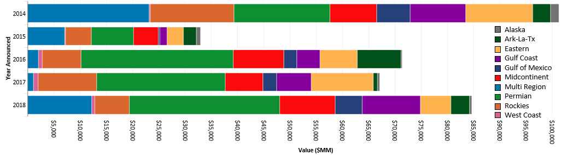
M&A Activity
https://www.jdsupra.com/legalnews/a-look-back-at-2018-oil-gas-m-a-deal-11280/

Slide 13
Gulf of Mexico M&A Activity
  Oxy acquired Anadarko: ~53 Billion dollar
  Oxy sells to Total former Anardarko assets in Africa: 8.8 Billion Dollar
  Oxy can potentially divest former Anardarko assets in GoM – Talos interested
  Murphy and Petrobras JV : ~1 Billion dollar
  Murphy acquired LLOG ‘s asset in GoM: ~1.4 Billion dollar
  ExxonMobil considers divestment of its GoM assets
  Shell to sell its interest in Caesar-Tonga yo Delek CT Investment LLC: ~ 1 Billion dollar
  Kosmos acquired Deep Gulf Energy for 1.225 Billion dollar

Slide 14
Gulf of Mexico M&A Considerations
Pause in M&A activity after 2014 when oil price crashed
  Financial restrictions
  Lack of consensus for future prices caused Bid/ask spread to dramatically increase
  Difficult to obtain fair valuation of asset that works for sellers and buyers
Optimization in operations and cost discipline (reduction of sector’s cash flow breakeven) allow some extra cash to come back to exploration or pursue M&A transactions
Oil price improvements in 2016 help market to reach a consensus on future crude prices. Therefore, the bid/ask spread narrowed and deals started to flow again.
Main operators will consider divesting to concentrate in their core assets.
Companies with high ownership in capital-intense projects might divest for portfolio optimization (risk spread) or deb payment

Slide 15
Gulf of Mexico M&A Considerations
M&A transactions is an opportunity for small companies to grow
Private equity either to get into or to leave (investment close to maturation) the GoM
Companies might acquire assets to compensate the lack of exploratory investment in the recent years where they only focus on incremental economics
Main operators or NOCS with little or no exposure to GoM could entry or increase their presence.
Existence of a market: sellers and buyers with aligned interests
Consensus about future crude oil prices

Slide 16
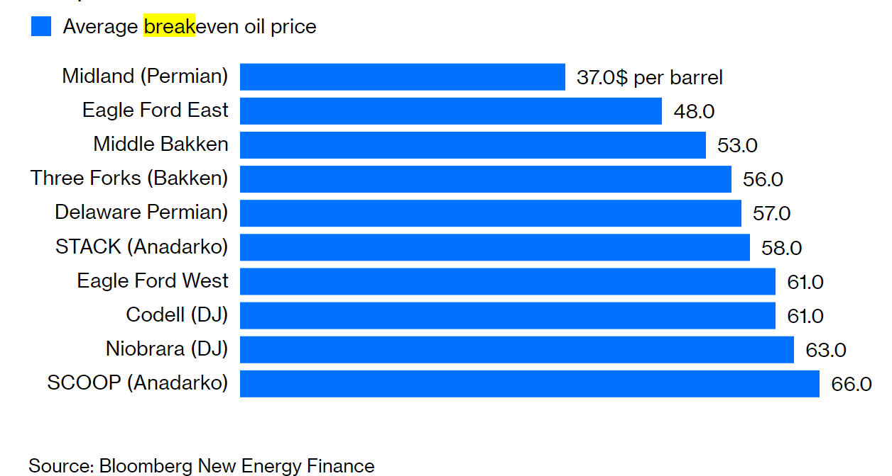
Deepwater vs Tight Oil
Deepwater is getting leaner and improving project economics: simplified project designs, cheaper wells and smaller facilities.
Tight oil faces inflation cost
Optimized developments dragged breakeven prices down:
~ $30/bbl – Kaikias Project
Brazil: Libra – breakeven of 35 US$/bbl

