Slide 1
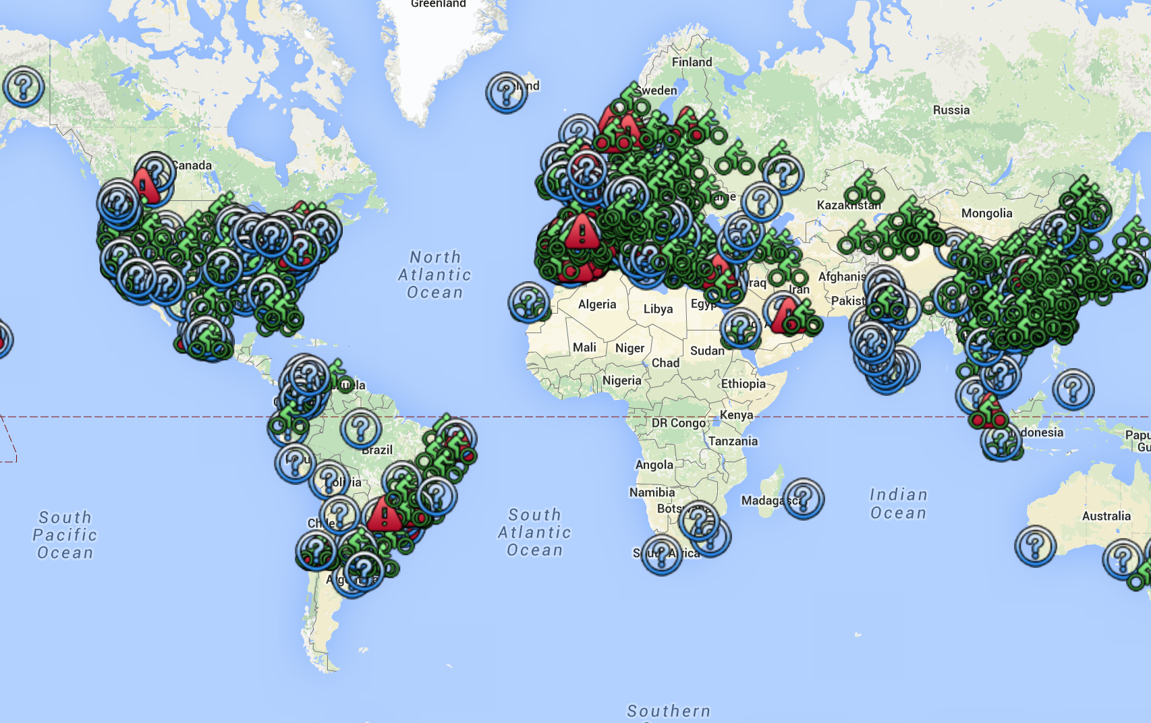
Bike Shares Working Group for OSM

Slide 2
Bike Shares working group for OSM 'boot strap' information for July 2016
The dropbox folder containing this file:
http://tinyurl.com/sotm16bikeshares
Fearless leader
Jim Walseth
jim.walseth@gmail.com
His github for BSWG
https://github.com/jwalseth/bikeshares
The wikipedia page with list of bike shares
https://en.wikipedia.org/wiki/List_of_bicycle-sharing_systems
The current OSM tagging scheme for bike shares
http://wiki.openstreetmap.org/wiki/Tag:amenity%3Dbicycle_rental

