Slide 1
Altimetrik Spatial Computing PoC
Altimetrik Poland
07 June 2020

Slide 2



















Altimetrik Introduction

Slide 3




Structured for Rapid, Repeatable Results
Digital Culture Infusion
Product/ Platform Engineering and Management
Data Driven Decision Sciences
DevOps, Cloud Site Reliability
Agile Coaching & Workshops
Platform lifecycle mgmt.
Data Engineering
Cloud adoption and migration
Catalyst Team Injection
Agile product development
Analytics and Visualization
Modern Pipelines
Design-led Engineering
Cloud-First, API-First Architecture
Data Science, Machine Learning
Automation
Site Reliability & Operations Support
Customer-centric Experiences
Managed support transformation
AI Driven Autonomics

Slide 4


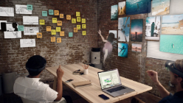
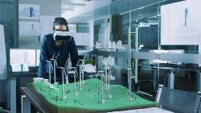

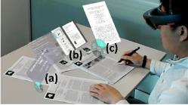
New Normal | Spatial computing for Business
With the New Normal, Businesses have to expand the computing horizon for its employees. Spatial computing allows employees to extend reality, shifting away from interacting with static computers, towards immersive, engaging technology of today. simulated virtual environments.
Step inside the computer – Extend reality
Virtual Reality
Mixed Reality
Reality

Slide 5
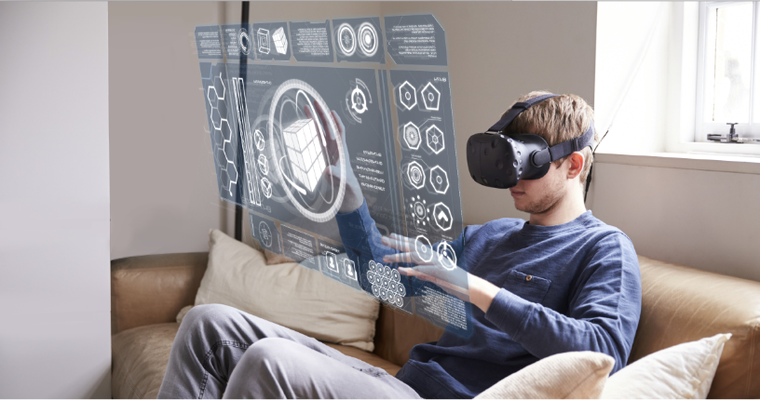
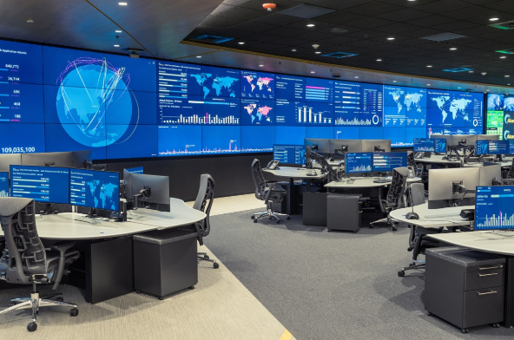
Spatial computing for Business | VR Uses
Virtual War room and presentation to bridge the physical barrier across locations. Interacting in a common Virtual space

Slide 6

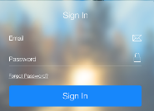
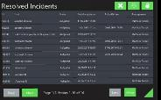
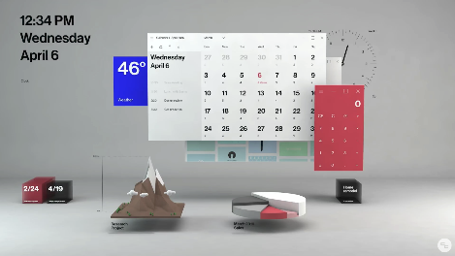
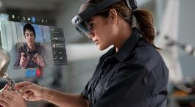
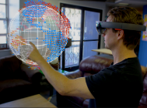
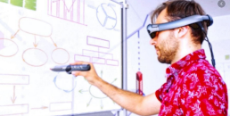
Spatial computing for Business | XR Uses
Virtual Workstation concepts to extending and expanding the spatial workspace for employees working from home. Use cases include productivity applications like Mail, Calendar, collaboration, meeting & white baording apps. More targeted applications like visualization engine, Ops Dashboards, ticketing integration, Splunk or Data flow Analytics engines

Slide 7







Basic XR Architecture
Edge components
VR - Oculus Quest, Sandbox Apps
XR – Microsoft HoloLens or equivalent
Content
container
Relay server
Security
Both Enterprise devices should have Work integration
Data Sync
Authentication endpoints
Photon
VR –Requires Photon for multi user positional integration
XR – Most apps will not need positional integration
Auth provider
Optional
Apps
AppServer
Content
container
Authentication endpoints
Apps
Auth provider

Slide 8
Spatial computing concepts | Pilot
Mixed Reality
Virtual Reality
Login and Authentication
Edge integration to browser & Intranet
Productivity app integration to calendar
One Visualization App
8 Weeks / 4 sprints
Microsoft HoloLens
1 US and 2 Nearshore Team
Login and Authentication
3 Screen War room
2 Dashboards and 1 Presentation
Multi viewers
8 Weeks / 4 Sprints
Occulus Quest
3 Member team
Pilot
Time
Device
Team
Work In Progress

Slide 9
Thank you

