Slide 1
Social acceptance of wind and impact on deployment – toy model
January 18, 2022

Slide 2
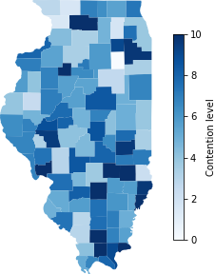
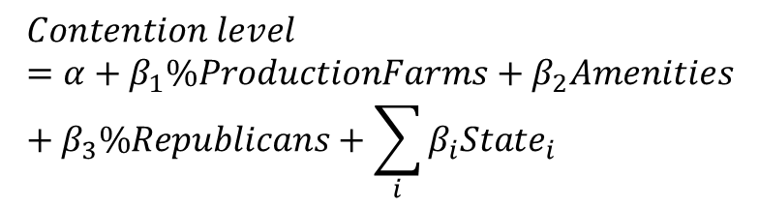
Toy model Overview
$$Contention level=α+β_{1}\%ProductionFarms+β_{2}Amenities+β_{3}\%Republicans+\sum_{i}{β_{i}State_{i}}$$
Primary research question: How much (and where) contention will affect wind deployment?
Case study: 2020-2035 period, Illinois
Each location (county) in the model is attributed a contention score based on Bessette & Mills, 2021
Assumption: Probability that a wind plant project is delayed in a location = contention score of the location
If a wind plant project is delayed, a new location is chosen in 1+ year (exact number depends on chosen delay penalty)
The model includes a simplified representation of land use and counties’ land availability
The model captures possible conflicts between locations’ contention and technical potential
Objective: maximizing wind power generation while minimizing contention during the 2020-2035 period → optimization performed using reinforcement learning
Contention level distribution in Illinois using Bessette & Mills (2021) model (counties’ characteristics are normally distributed from summary statistics rather than using actual datasets and therefore do not correspond to reality)

Slide 3
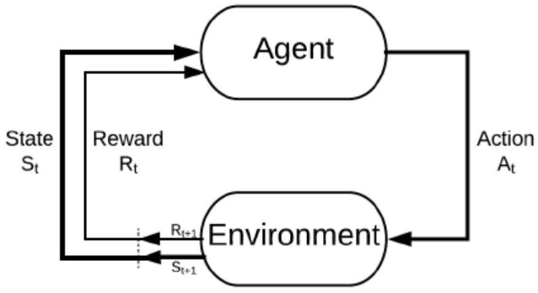
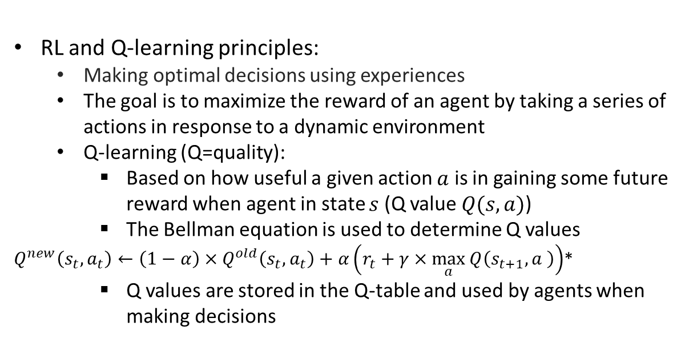
Toy model Overview
The model uses an agent-based modeling (ABM) framework and a reinforcement learning (RL) algorithm to minimize potential delays due to contention while maximizing power generation
Agents are used to model wind plant projects heterogeneity (e.g., regarding their number of turbines and installed capacity) and siting decisions (including their consequences in term of delays or successful siting)
RL (the Q-learning algorithm in our case) provides a means to optimize those decisions. The Q-learning algorithm is applied in a top-down way (i.e., one Q-table rather than agents having individual Q-tables)
RL and Q-learning principles:
Making optimal decisions using experiences
The goal is to maximize the reward of an agent by taking a series of actions in response to a dynamic environment
Q-learning (Q=quality):
Based on how useful a given action $a$ is in gaining some future reward when agent in state $s$ (Q value $Q(s,a)$)
The Bellman equation is used to determine Q values
$Q^{new}\left(s_{t},a_{t}\right)←\left(1−α\right)×Q^{old}\left(s_{t},a_{t}\right)+α\left(r_{t}+γ×\max_{a}{Q\left(s_{t+1},a \right)}\right)$*
Q values are stored in the Q-table and used by agents when making decisions
*Where the new Q value associated with state $s_{t}$ and action $a_{t}$ ($Q^{new}\left(s_{t},a_{t}\right))$ in the Q table is a function of the old Q value for that pair of state and action $Q^{old}\left(s_{t},a_{t}\right)$, the learning rate $α$, the discount rate $γ$, the reward $r_{t}$associated with action $a_{t}$ and the maximum expected future reward when being in state $s_{t+1}$ after taking action $a_{t}$, $\max_{a}{Q\left(s_{t+1},a \right)}$.

Slide 4
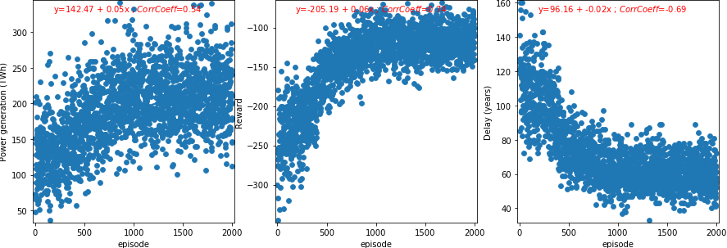
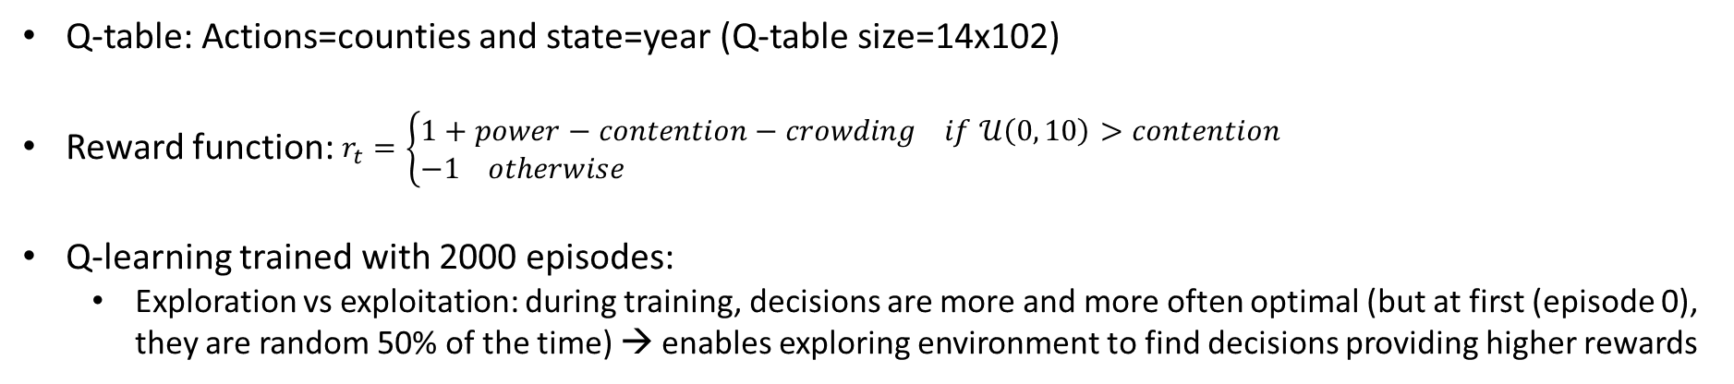
Toy model Overview
Q-table: Actions=counties and state=year (Q-table size=14x102)
Reward function: $r_{t}=\left\{\begin{aligned}&1+power−contention−crowding if 𝒰\left(0, 10\right)>contention \\ &−1 otherwise\end{aligned}\right.$
Q-learning trained with 2000 episodes:
Exploration vs exploitation: during training, decisions are more and more often optimal (but at first (episode 0), they are random 50% of the time) → enables exploring environment to find decisions providing higher rewards

Slide 5
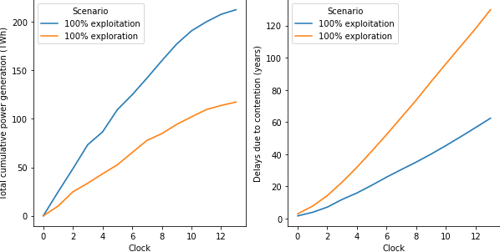
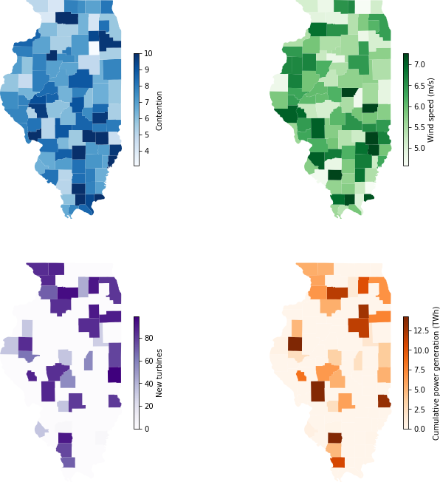
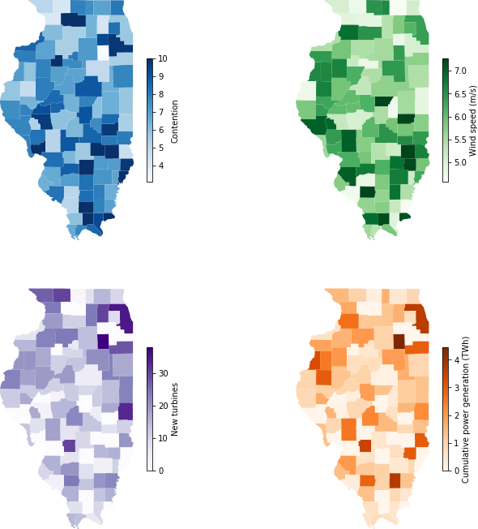



Toy model Results
C
100% exploitation (optimal) vs 100% exploration (random):
A
B
A: overall 2035 optimal siting – black circle=(high wind speed, low contention); red circles=(high wind speed, high contention); grey circles=(low wind speed, low contention)
B: overall 2035 random siting
C: Cumulative power generation (TWh) and delays (years) as a function of time for random siting and optimal siting. Optimal siting increases cumulative power generation by 80% and decreases delays by 50%

Slide 6
Supplementary Slides

Slide 7
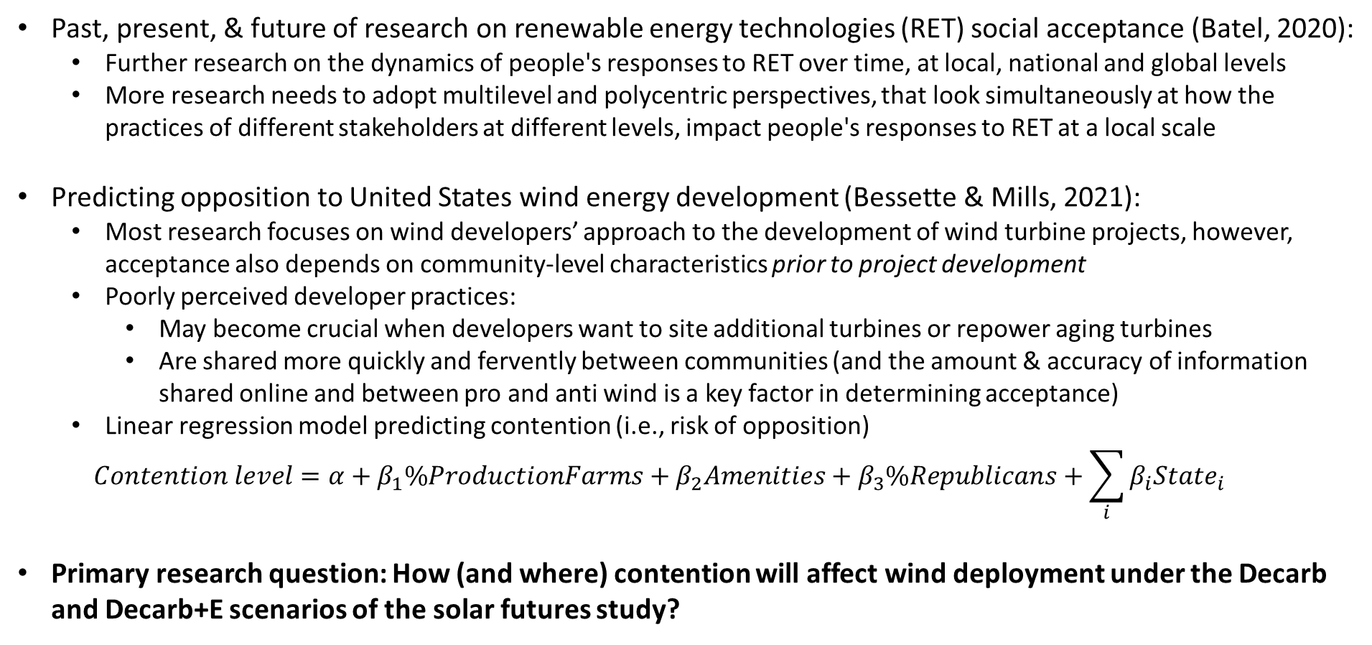
Introduction
Past, present, & future of research on renewable energy technologies (RET) social acceptance (Batel, 2020):
Further research on the dynamics of people's responses to RET over time, at local, national and global levels
More research needs to adopt multilevel and polycentric perspectives, that look simultaneously at how the practices of different stakeholders at different levels, impact people's responses to RET at a local scale
Predicting opposition to United States wind energy development (Bessette & Mills, 2021):
Most research focuses on wind developers’ approach to the development of wind turbine projects, however, acceptance also depends on community-level characteristics prior to project development
Poorly perceived developer practices:
May become crucial when developers want to site additional turbines or repower aging turbines
Are shared more quickly and fervently between communities (and the amount & accuracy of information shared online and between pro and anti wind is a key factor in determining acceptance)
Linear regression model predicting contention (i.e., risk of opposition)
$$Contention level=α+β_{1}\%ProductionFarms+β_{2}Amenities+β_{3}\%Republicans+\sum_{i}{β_{i}State_{i}}$$
Primary research question: How (and where) contention will affect wind deployment under the Decarb and Decarb+E scenarios of the solar futures study?

Slide 8
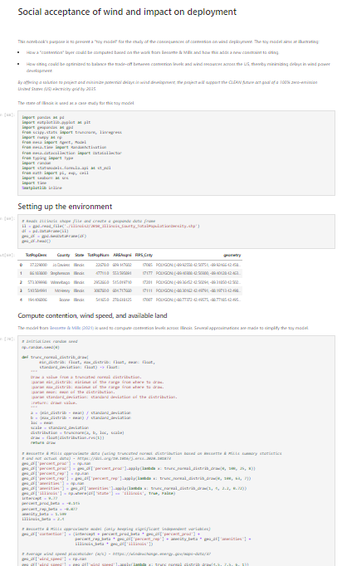
Toy model Overview
Implemented in a Jupyter Notebook (Python): https://github.com/jwalzberg/WindAcceptanceModel/blob/master/WindAcceptance.ipynb
ABM sets up the environment (Illinois characteristics such as level of contention by county and available land) and agents
Agents are heterogeneous:
They represent new wind plant project
They have their own number of turbines (drawn from a truncated normal distribution)
They have their own rotor diameter (also drawn from a truncated normal distribution)
Once wind plant project is sited, they are removed from the simulation
New agents are added every year (i.e., time step of the simulation)

Slide 9
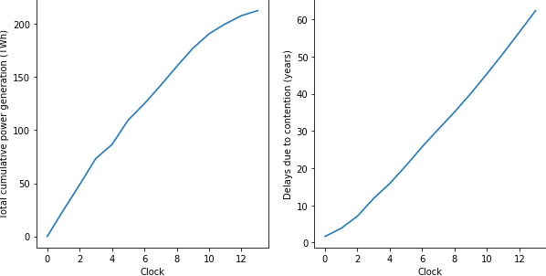
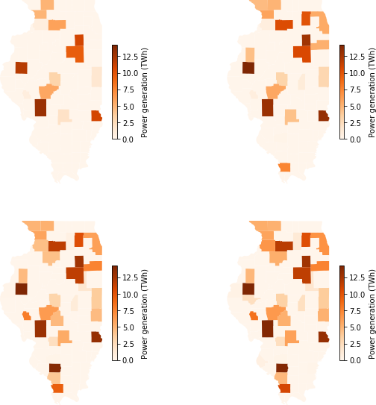
Toy model Results
C
Results with trained algorithm (average of 30 replicates) – 100% exploitation (100% of decisions are optimal):
A
B
A: overall 2035 results – black circle show counties with high wind speed and low contention (and high number of new turbines), red circles show counties with high wind speed and high contention (and low number of new turbines)
B: cumulative power generation (TWh) at different time of the simulation
C: Cumulative power generation (TWh) and delays (years) as a function of time
2025
2029
Overall results in 2035
2032
2035

Slide 10
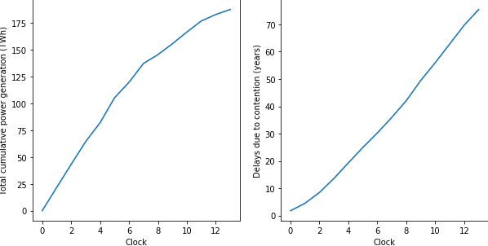
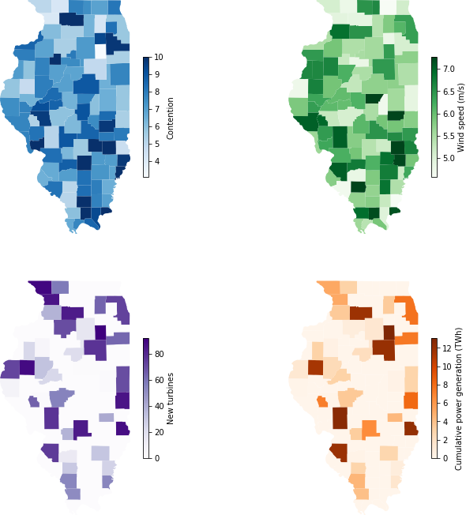
Toy model Results
C
100% exploitation (baseline) vs 100% exploitation (contention-blind):
A
B
A: overall 2035 optimal siting – black circle=(high wind speed, low contention); red circles=(high wind speed, high contention); grey circles=(low wind speed, low contention)
B: overall 2035 contention blind
C: Cumulative power generation (TWh) and delays (years) as a function of time for random siting; optimal siting increases cumulative power generation by 13% and decreases delays by 17%

Slide 11
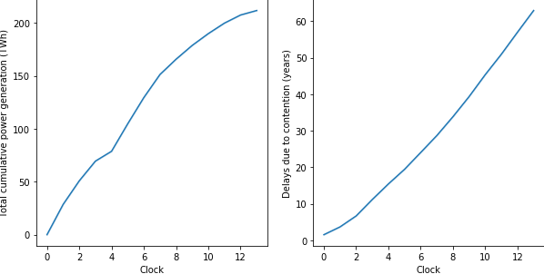
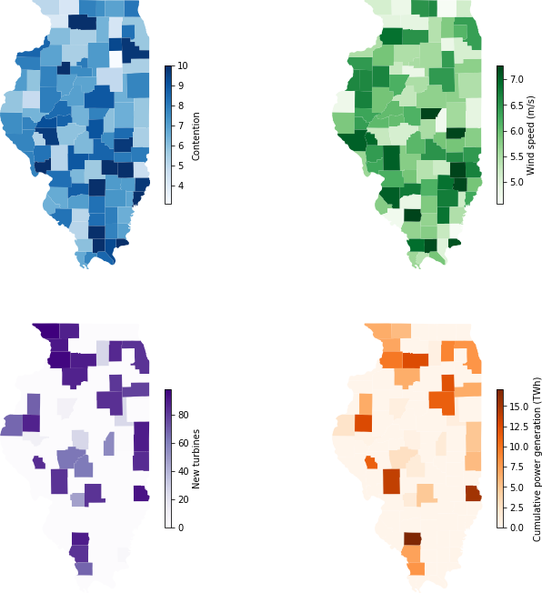
Toy model Results
C
A
B
A: overall 2035 optimal siting – black circle=(high wind speed, low contention); red circles=(high wind speed, high contention); grey circles=(low wind speed, low contention)
B: overall 2035 power generation blind
C: Cumulative power generation (TWh) and delays (years) as a function of time for random siting; optimal siting increases cumulative power generation by <1% and decreases delays by <1%

