Slide 1
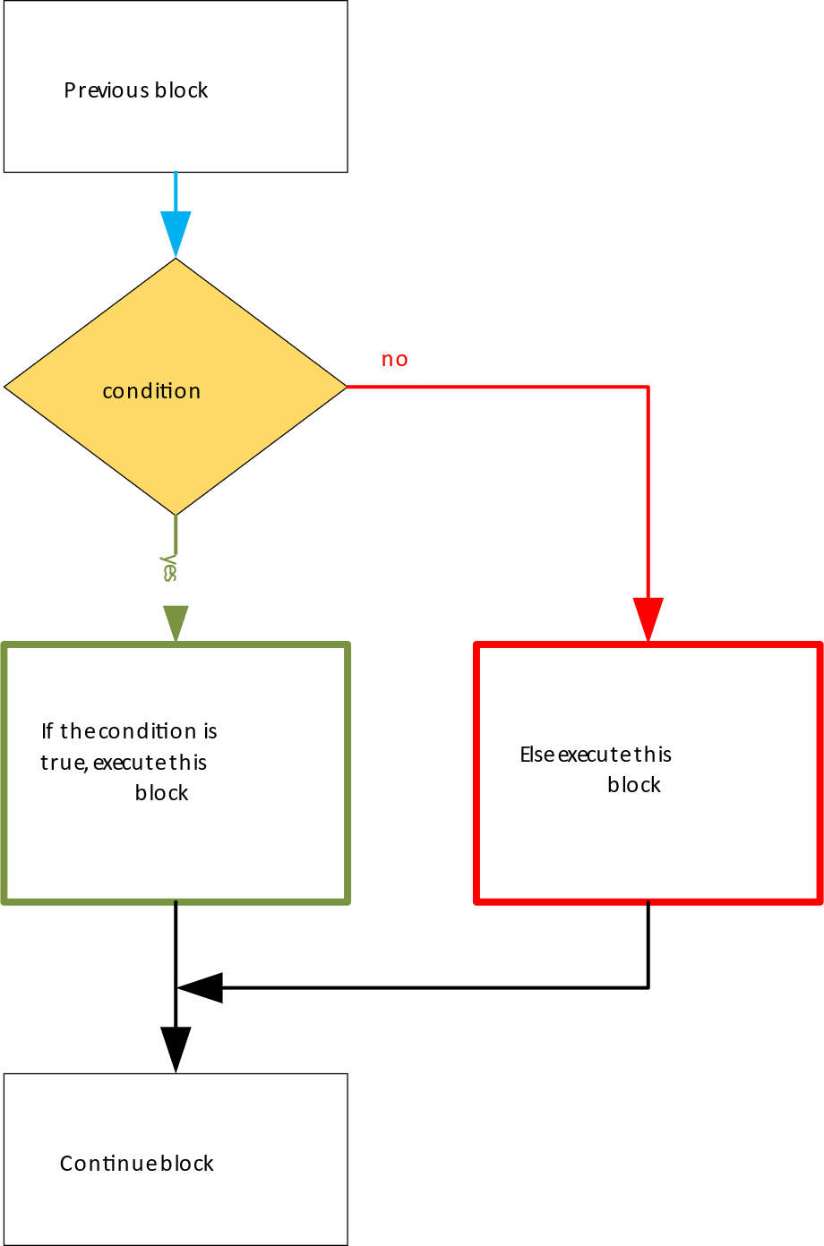
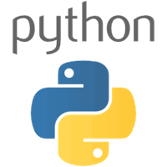
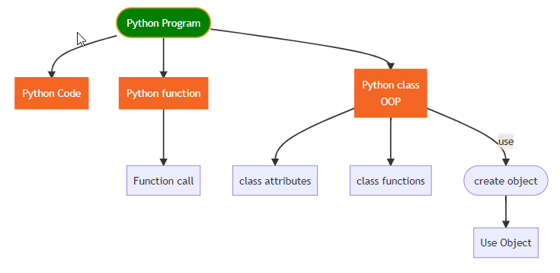
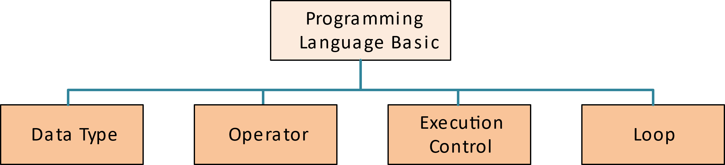
华夏中文学校 Python 新生班课程简介
Python language course is designed for student start from scratch, learn from language basic to OOP programing. Not only teach students how to write Python program, also teach them how to take class notes by using Markdown document, and how to write better code.
Try to build skill on functions, classes, dunder functions such as __init__(self), business logic, database, unit test, debugging, documentation. Very important, instructor will help each student write their own Python Notebook which include everything they have learned in the class, for future reference.
This course does NOT need more math background, it suites for any age of student. Actually, start learning computer language can be very early age of students.

Slide 2


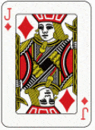
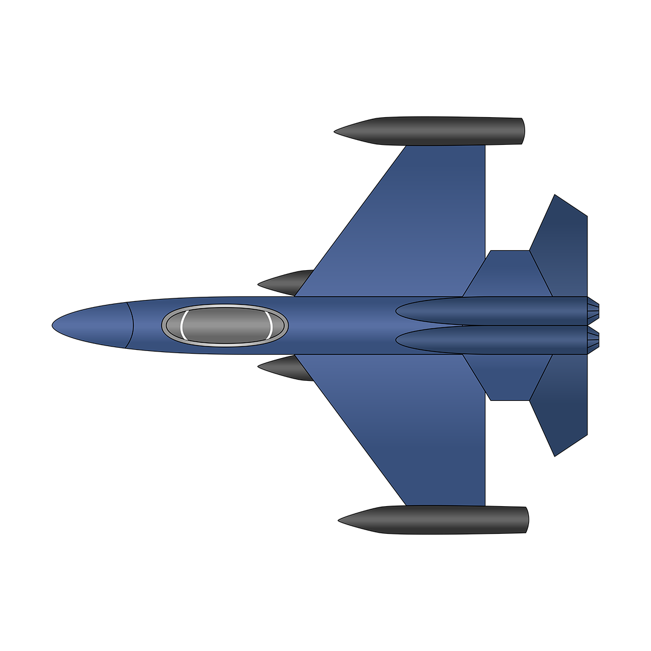
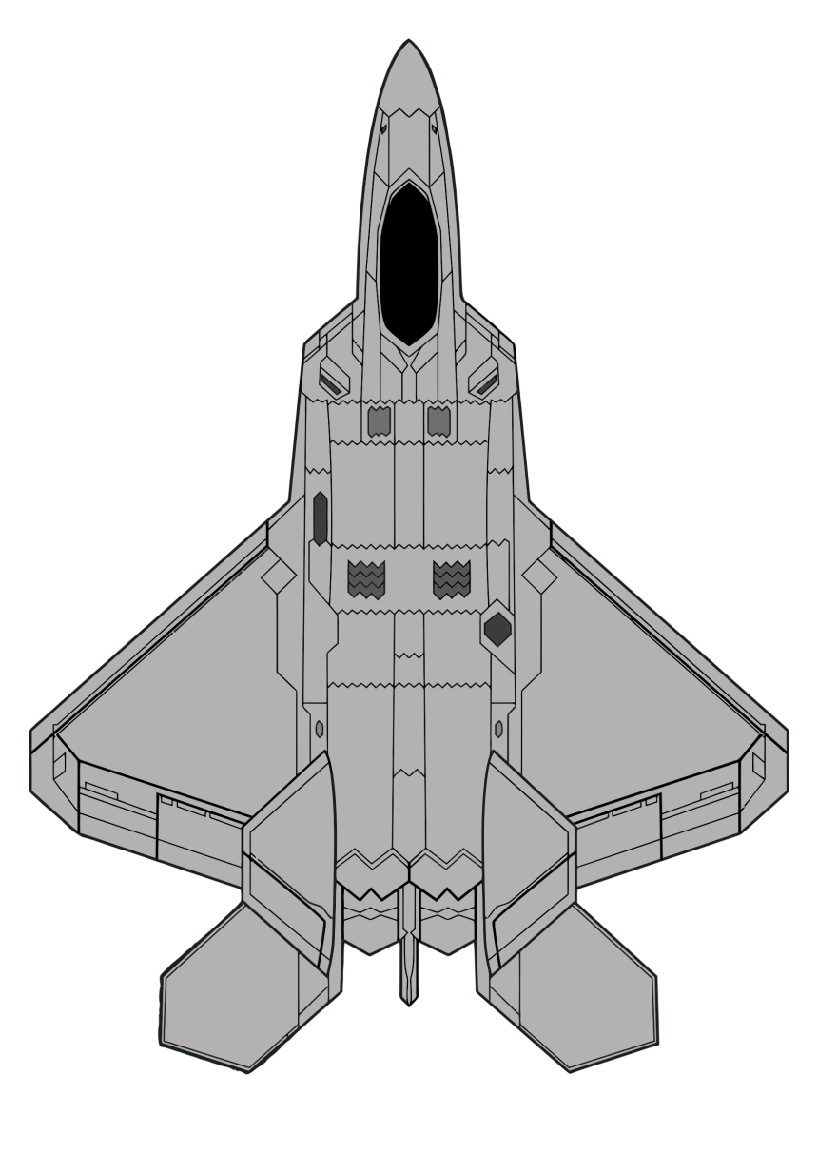
华夏中文学校 Python Game 课程简介
Python Game course is designed for students who has taken Python new and continue class, and wants learn more about Python Game programing.
In this class, students will use what they have learned about Python in the previous class, try to use those skill in Game development, such as Super class, Subclass, dunder functions, override functions, Game timer stick, how to loading image, display image, moving image on the screen, how to create sound effects while playing the game, how to use keyboard and mouse to control object in the game, and more… …
Very important, it is not only let students be able to write game, design their own game, also try to make their Python programing skill to be solid, and good foundation.

