Slide 1
W2017 Work Term Summary
People Detection and Fall Detection with Walabot
By: Fezza Haider

Slide 2
Overview
Before any falls can be detected, we need to detect the people in the room
Current SDK for Walabot can barely localize 3 people at a time: the two major problems with their built-in functions is that it doesn’t calibrate properly (i.e. background noise present) and the near-far problem
Since we are working directly with raw signals to localize people, we have to manually calibrate the radar
Near-far problem occurs when people are at different distances from a radar sensor; the people that are farther away are often mistaken as background noise and thus are not detected by the radar

Slide 3
People Detection
The next set of slides will provide details about the method I have developed for detecting people (note that this is all post-processing )

Slide 4
Step 1: Data Collection
Collect data using the “DataCollection.py” file; for the script to work, Walabot must first be connected to the computer via the USB cable
The calibration is already written into the script; a ‘Calibration Complete’ message is displayed in the terminal once it is done
Calibration must be done in an empty room every time. Here, Walabot scans the room 10 times and takes the average of those signals and stores them in a multidimensional array. Afterwards, each time Walabot scans the room, it subtracts the background signals that are stored in this array to provide noise-free data.
This file also shows live-updating graphs of the obtained signals and also saves each frame (I found it useful to save each frame because it helps with post processing)
Walabot has 40 tx-rx pairs; by default, this file writes data from all antenna pairs to a CSV file named ‘raw_data’
The raw signals here represent the amplitudes of the reflected signals at different time-of-flights (i.e. it returns the impulse response data)

Slide 5
Step 2: Choosing the Frame
Whenever data is collected, it is important to note at which frame people had walked into Walabot’s range (The frame numbers are shown in the terminal)
It usually takes the Walabot ~10 frames to properly detect everyone in range (yes, this much time is required even though people are stationary)
The chosen frame is important because it the data from this frame which will be used to localize the people in range

Slide 6
Step 3: Examining data from Certain Antenna Pairs
I previously mentioned that there are 40 tx-rx; however, not all these are used for localizing. To locate a person, I look at the intersection between the vertical and horizontal planes
Antenna Pairs for horizontal plane information = 1,2,9,25,26
Antenna Pairs for left vertical plane = 7,14
Antenna Pairs for right vertical plane = 32,34
The specific antenna pairs that I’ve chosen to represent these planes will make sense once you take a look at the next slide, which contains the antenna numbering of Walabot

Slide 7
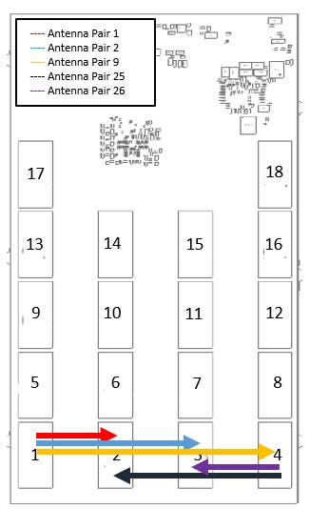
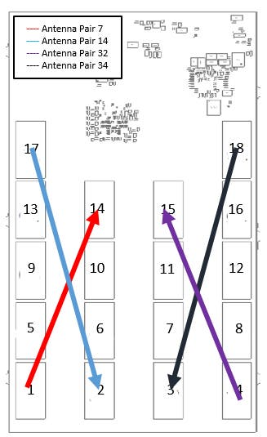
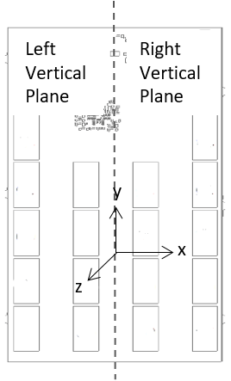
Horizontal Plane
Antenna Pairs
Vertical Plane
Antenna Pairs
Axes location w.r.t. Walabot

Slide 8
Step 4: Choosing Optimal Antenna Pairs
Now, for horizontal and vertical plane, we have to find the antenna pair that best represents the information from each plane. This is done on the basis of the maximum signal amplitude of a certain antenna pair, for the chosen frame
Choosing optimal antenna pair for horizontal plane (this one is fairly simple): out of the 5 tx-rx pairs (1,2,9,25,26), choose the one that has the highest, maximum signal amplitude
Choosing the optimal antenna pair for vertical plane (more complicated): recall that vertical plane is split into the left and the right sides
Here, the max signal amplitude from tx-rx pairs 7,14 needs to be compared with the max signal amplitude from tx-rx pairs 32,34
Look at the flowchart on the next slide, which explains the three possible cases that can occur when the above value are compared

Slide 9
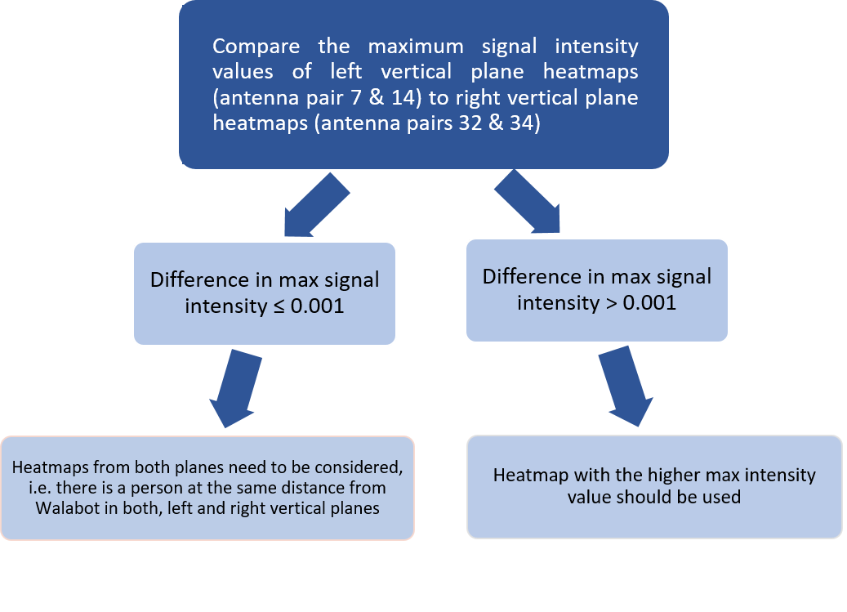

Slide 10
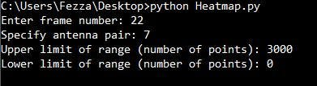
Step 5: Make Heatmaps for Chosen Antenna Pairs
The ‘Heatmap.py’ script should be used for this, which prompts the user for 4 parameters:
Frame number is the one determined in step 2
Antenna pair is one of the chosen ones for horizontal or vertical planes (note that this script only makes heatmap for one antenna pair at a time)
The upper range limit is set based on the number of points, for example, 3000 points makes a heatmap which corresponds to distance of 4.5m in the right and the left sides of the horizontal axis (see example heatmap on next slide)
The lower limit of range is initially set to 0; it is later modified to cancel out the signals from a localized person
‘Heatmap.py’ also needs to import a ‘TOF.csv’ file which has the roundtrip-distance values

Slide 11
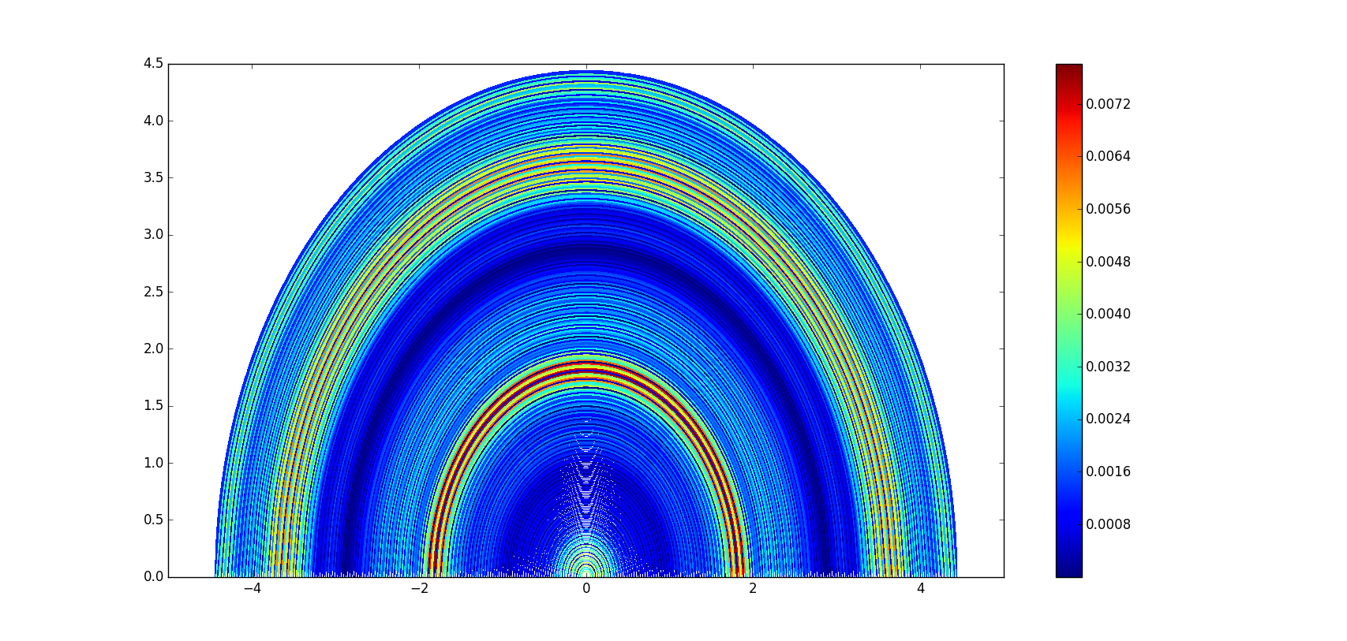
Heatmap made from antenna pair 25 (horizontal plane)
Signal amplitudes
z-distance (m)
x-distance (m)

Slide 12
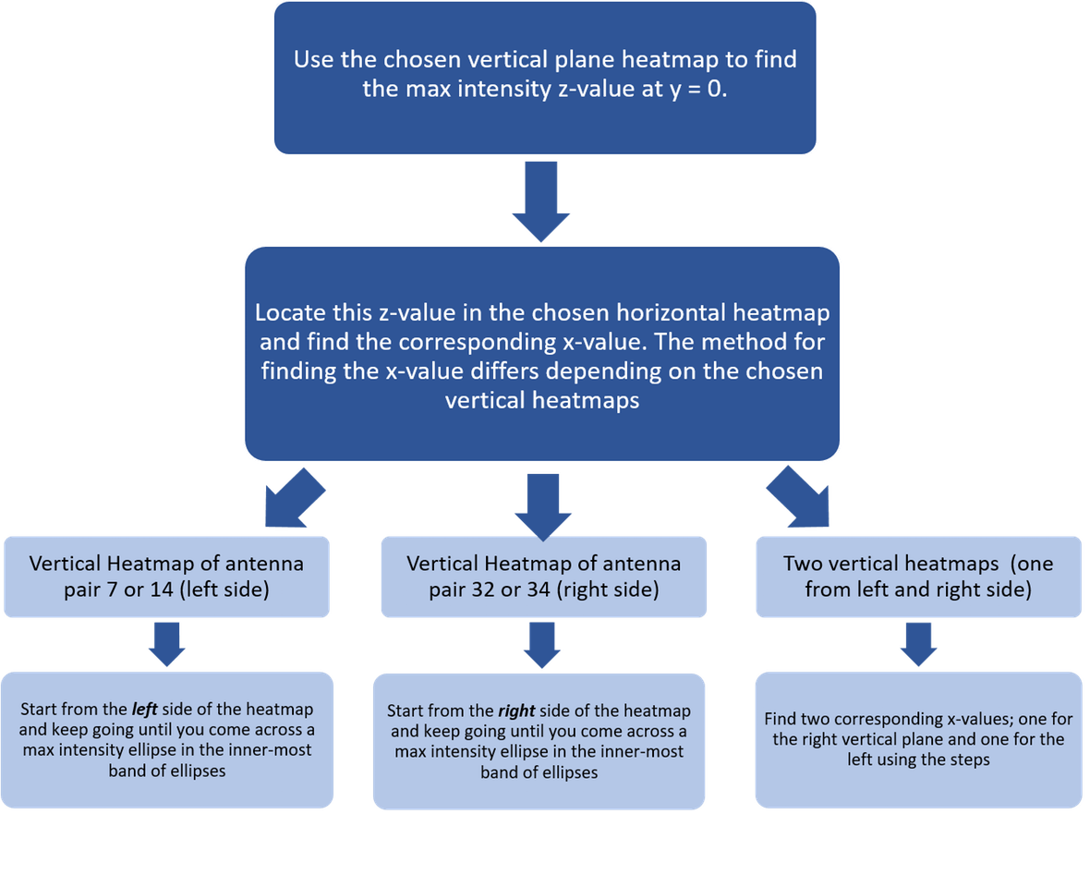
Step 6: Compare Horizontal and Vertical Planes
The z-value is determined from the vertical plane and the corresponding x-value is found in the horizontal plane. The following flowchart describes the 3 cases

Slide 13
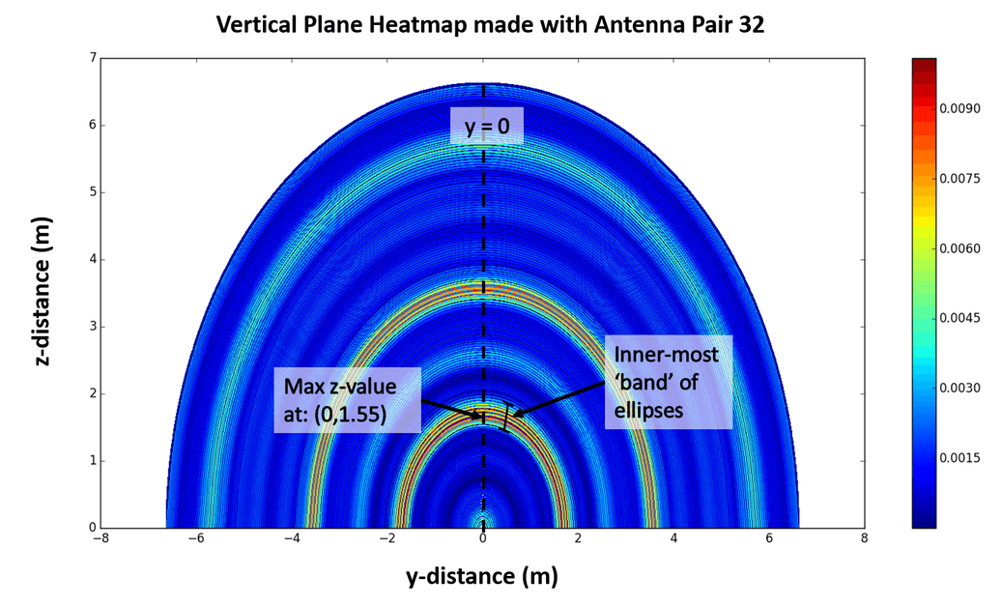
Step 6: Compare Horizontal and Vertical Planes (example)
Z-value of the inner-most band of ellipses at y=0 is determined by examining the vertical plane heatmap; this distance represents how far a person is from the Walabot

Slide 14
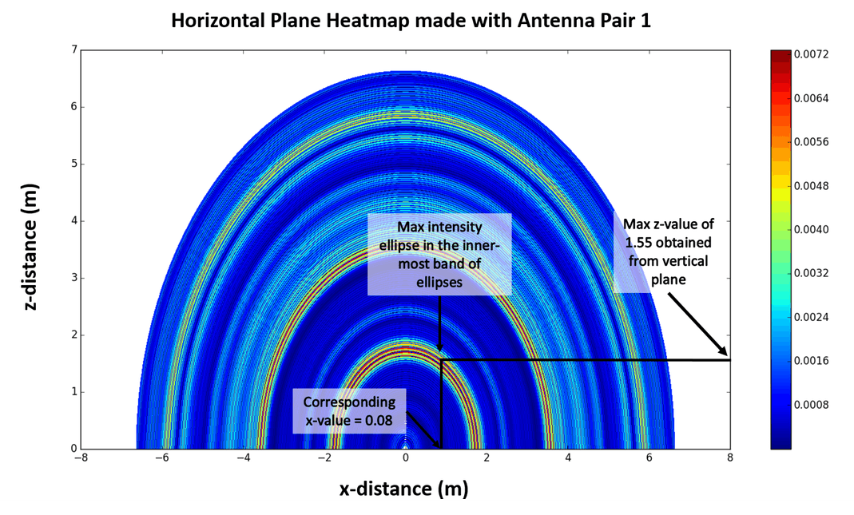

Step 6: Compare Horizontal and Vertical Planes (example)
Find the corresponding x-value from the previously determined z-value; x-value is found by using the horizontal plane; DON'T FORGET to record the signal strength of the person in both, vertical and horizontal planes

Slide 15
Step 7: Remove Localized Person and Remake Heatmaps
Recall the lower limit range parameter from the ‘Heatmap.py’ file.
This parameter is now used to remove the signals corresponding to the first localized person
It is also based on the number of data points
Usually, setting the lower range limit from ~1000-1500 cancels out the first person
An example of a heatmap before and after the first localized person is removed is given on the next slide
Note that re-making the heatmaps DOES NOT require you to re-choose the optimal antenna pairs; you simply need to make the heatmaps with the initially chosen antenna pairs and add a value for the ‘lower range limit’ parameter
Repeat steps 5 and 6 until all people are localized

Slide 16
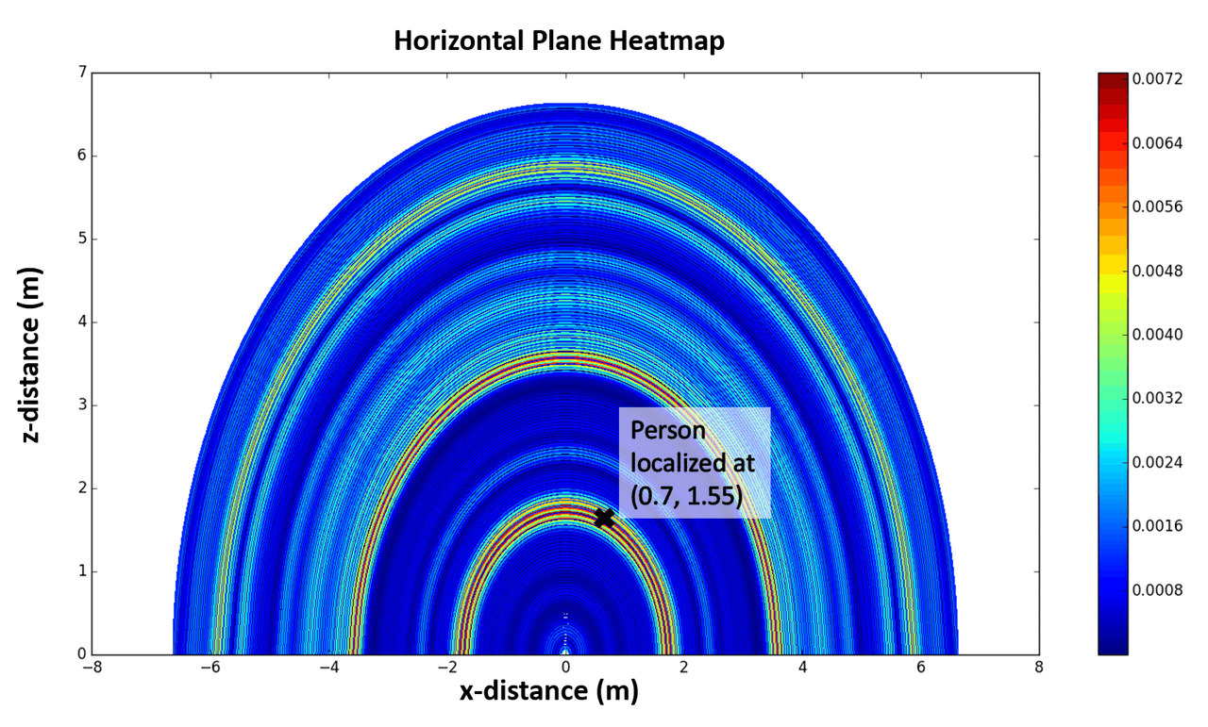
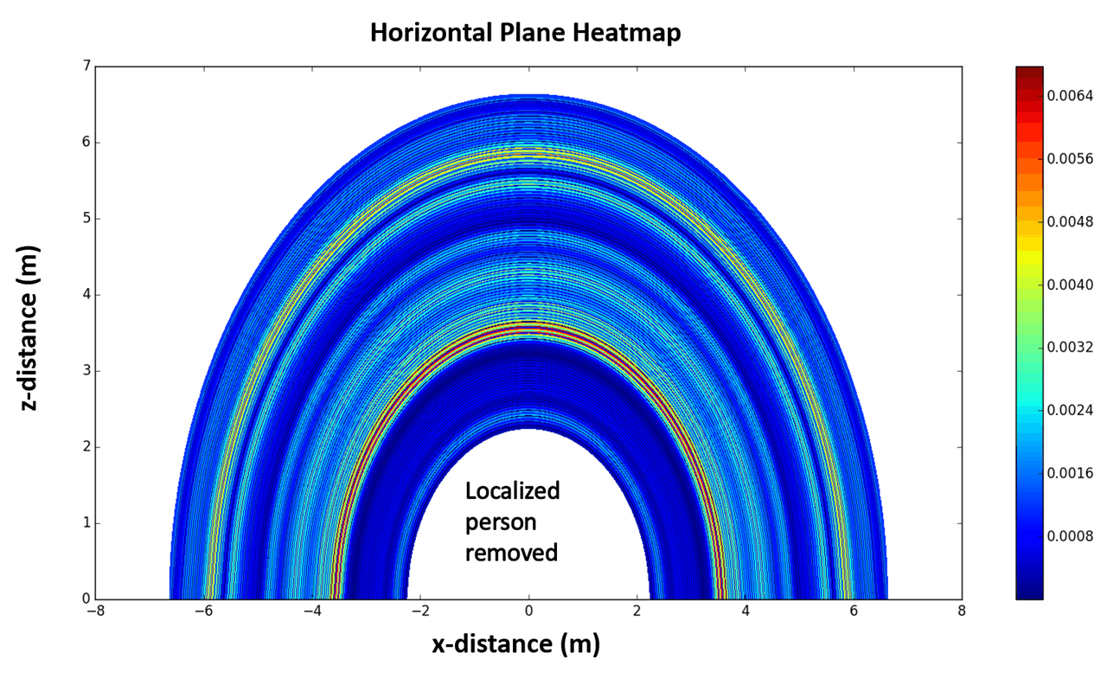
Before localized person is removed
After localized person is removed

Slide 17
Step 8: Determine Frame where Fall Detected
Another frame number to keep track of while collecting the data is the frame where a fall has occurred
The walabot usually detects a fall ~2-3 frames after it has occurred
Recall that the frame numbers are visible in the terminal
E.g. if a fall had occurred during frame 31, then it would be detected in 33rd or 34th frame
Now we have a new frame, where the fall has occurred
Need to localize the people again in this frame
Follow the same steps as before to localize

Slide 18
Step 9: Detecting a Fall
All test runs show a decrease in signal strength (for at least one person) when a fall occurs
From the conducted tests, there are two cases for detecting if a fall occurs:
Signal strength decreases for some and increases for some people (e.g. slides 17 and 24).
Signal strength decreases for all people (e.g. slides 5, 10 and 30)
The lowest % change in signal strength was 15%. Therefore, this value can be used as a preliminary threshold value, i.e. all of the detected targets must experience a change of at least 15% for a fall to detected.
More tests can be conducted once the fall detection is automated to help come up with a more accurate threshold value

Slide 19
Future Steps
Automate target localization, so it can be done in real-time
Targets will need to be localized for each frame of data collected
Increase the number of targets that can be detected
Incorporate ML into program so it can differentiate between people sitting or bending down

Slide 20
Information about Previous Tests and Data
The data files for all the tests that I conducted are uploaded on the Google Drive
I went through some extra steps for the people detection and target localization; this includes making all those roundtrip files (I had to manually extract the data from the chosen frame to make those)
The naming convention for the heatmaps in both ‘Fall Detection’ and ‘People Detection’ is as follows: NameOfRun_ChosenFrameNumber_UpperRangeLimit_Increment(don’t worry about this parameter, it doesn’t need to be changed )_SpecificAntennaPair
You can take a look at my powerpoints for fall detection and people detection to look at examples of how I localized more than two people and in different scenarios
Can also refer to my powerpoint for fall detection to see how I’m measuring the change in the signal strength (using the tables I have made there for different people in range can be helpful as well)
If you have any other questions, don’t hesitate to email me

