Slide 1
Announcements
HW4 due today
HW5 assigned today

Slide 2
Building a Predictive Parser
I.e., How to build the parse table for a
recursive-descent parser

Slide 3

Last Time: Intro LL(1) Predictive Parser
Predict the parse tree top-down
Parser structure
1 token of lookahead
A stack tracking parse tree frontier
Selector/parse table
Necessary conditions
Left-factored
Free of left-recursion

Slide 4
Today: Building the Parse Table
Review Grammar transformations
Why they are necessary
How they work
Build the selector table
FIRST(X): Set of terminals that can begin at a subtree rooted at X
FOLLOW(X): Set of terminals that can appear after X

Slide 5
Review of LL(1) Grammar Transformations
Necessary (but not sufficient conditions) for LL(1) parsing:
Free of left recursion
“No left-recursive rules”
Why? Need to look past the list to know when to cap it
Left-factored
“No rules with a common prefix, for any nonterminal”
Why? We would need to look past the prefix to pick the production

Slide 6
Why Left Recursion is a Problem (Blackbox View)
CFG snippet:
XList ⟶ XList x | x
Current parse tree:
XList
Current token:
x
How should we grow the tree top-down?
XList
(OR)
XList
x
XList
x
Correct if there are no more xs
Correct if there are more xs
We don’t know which without more lookahead

Slide 7
Why Left Recursion is a Problem (Whitebox View)
CFG snippet:
XList ⟶ XList x | x
Current parse tree:
XList
x
eof
Current token:
x
Parse table:
XList
XList x
ε
XList
x
XList
XList
x
x
(Stack overflow)
XList
x
eof
Stack
Current

Slide 8
Left Recursion Elimination: Review
Replace
A ⟶ A α | β
Head of the list
With
A ⟶ β A’
A’ ⟶ α A’ | ε
Where β does not start with A or may not be present
Preserve order (a list of α starting with β) but use right recursion

Slide 9
Left Recursion Elimination: Ex1
A ⟶ β A’
A’ ⟶ α A’ | ε
A ⟶ A α | β
β
E ⟶ id E’
E’ ⟶ cross id E’ | ε
E ⟶ E cross id | id
α
β
α

Slide 10
Left Recursion Elimination: Ex2
A ⟶ β A’
A’ ⟶ α A’ | ε
A ⟶ A α | β
E ⟶ TE’
E’ ⟶ + TE’ | ε
E ⟶ E + T | T
T ⟶ T * F | F
F ⟶ ( E ) | id
T ⟶ FT’
T’ ⟶ *FT’ | ε
F ⟶ ( E ) | id

Slide 11
Left Recursion Elimination: Ex3
A ⟶ β A’
A’ ⟶ α A’ | ε
A ⟶ A α | β
SList ⟶ SList D | ε
D ⟶ Type id semi
Type ⟶ bool | int
SList ⟶ ε SList’
SList’ ⟶ D SList’ | ε
D ⟶ Type id semi
Type ⟶ bool | int
SList ⟶ D SList | ε
D ⟶ Type id semi
Type ⟶ bool | int

Slide 12
Left Factoring: Review
Removing common prefix from grammar
Replace
A ⟶ α β₁ | … | α β_{m} | y₁ | … | y_{n}
With
A ⟶ α A’ | y₁ | … | y_{n}
A’ ⟶ β₁ | … | β_{m}
Where β_{i} and y_{i} are sequence of symbols with no common prefix
y_{i} May not be present, one of the β may be ε
Squash all “problem” rules starting with α together into one rule α A’
Now A’ represents the suffix of the “problem” rules

Slide 13
Left Factoring: Example 1
A ⟶ α A’ | y₁ | … | y_{n}
A’ ⟶ β₁ | … | β_{m}
A ⟶ α β₁ | … | α β_{m} | y₁ | … | y_{n}
α
β₁
α
β₂
α
β₃
γ₁
X ⟶ < a > | < b > | < c > | d
α
γ₁
X ⟶ < X’ | d
X’ ⟶ a > | b > | c >
β ₁
β ₂
β ₃

Slide 14
Left Factoring: Example 2
A ⟶ α A’ | y₁ | … | y_{n}
A’ ⟶ β₁ | … | β_{m}
A ⟶ α β₁ | … | α β_{m} | y₁ | … | y_{n}
β₁
β₂
Stmt⟶ id assign E | id ( EList ) | return
E ⟶ intlit | id
Elist ⟶ E | E comma EList
Stmt ⟶ id Stmt’ | return
Stmt’ ⟶ assign E | ( EList )
E ⟶ intlit | id
Elist ⟶ E | E comma EList

Slide 15
Left Factoring: Example 3
A ⟶ α A’ | y₁ | … | y_{n}
A’ ⟶ β₁ | … | β_{m}
A ⟶ α β₁ | … | α β_{m} | y₁ | … | y_{n}
α
β₁ = ε
α
β₂
S ⟶ if E then S | if E then S else S | semi
E ⟶ boollit
S ⟶ if E then S S’ | semi
S’ ⟶ else S | ε
E ⟶ boollit

Slide 16
Left Factoring: Not Always Immediate
A ⟶ α A’ | y₁ | … | y_{n}
A’ ⟶ β₁ | … | β_{m}
A ⟶ α β₁ | … | α β_{m} | y₁ | … | y_{n}
This snippet yearns for left-factoring
S ⟶ A | C | return
A ⟶ id assign E
C ⟶ id ( EList )
but we cannot! At least without inlining
S ⟶ id assign E | id ( Elist ) | return

Slide 17
Let’s be more constructive
So far, we’ve only talked about what precludes us from building a predictive parser
It’s time to actually build the parse table

Slide 18
Building the Parse Table
What do we actually need to ensure arbitrary production A ⟶ α is the correct one to apply?
Assume α is an arbitrary sequence of symbols.
What terminals could α possibly start with → we call this the FIRST set
What terminal could possibly come after A → we call this the FOLLOW set

Slide 19
Why is FIRST Important?
Assume the top-of-stack symbol is A and current token is a
Production 1: A ⟶ α
Production 2: A ⟶ β
FIRST lets us disambiguate:
If a is in FIRST(α), we know Production 1 is a viable choice
If a is in FIRST(β), we know Production 2 is a viable choice
If a is in only in one of FIRST(α) and FIRST(β), we can predict the production we need

Slide 20
FIRST Sets
FIRST(α) is the set of terminals that begin the strings derivable from α, and also, if α can derive ε, then ε is in FIRST(α).
Formally, let’s write it together
FIRST(α) =

Slide 21
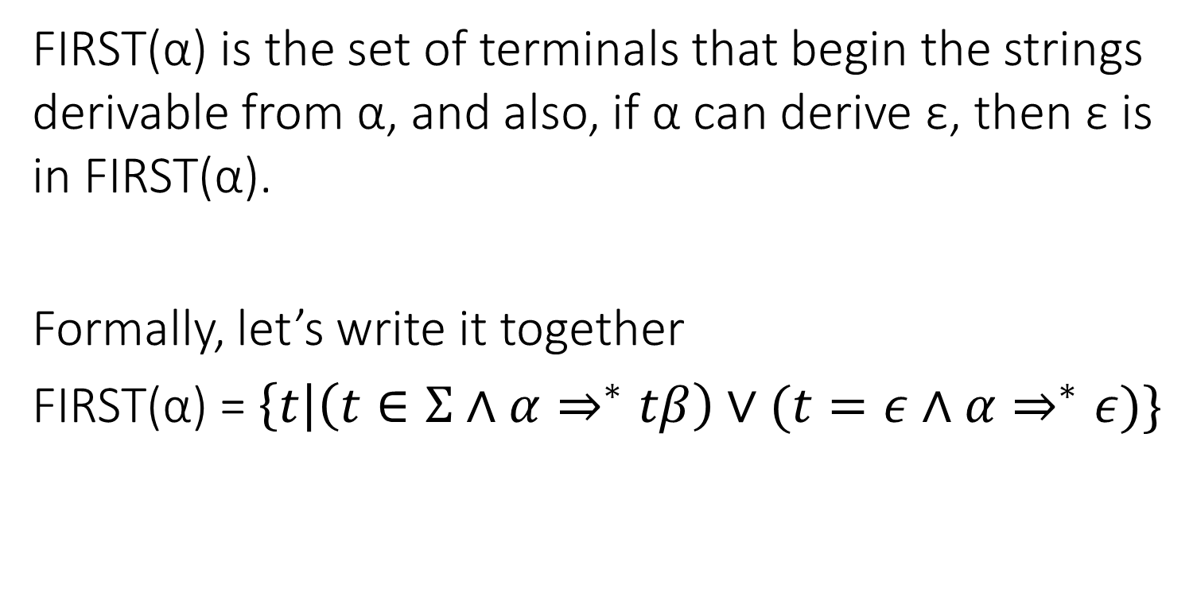
FIRST Sets
FIRST(α) is the set of terminals that begin the strings derivable from α, and also, if α can derive ε, then ε is in FIRST(α).
Formally, let’s write it together
FIRST(α) = $\left\{t\right|\left(t∈Σ∧α⇒^{∗}tβ\right)∨(t=ε∧α⇒^{∗}ε)\}$

Slide 22
FIRST Construction: Single Symbol
We begin by doing FIRST sets for a single, arbitrary symbol X
If X is a terminal: FIRST(X) = { X }
If X is ε: FIRST(ε) = { ε }
If X is a nonterminal, for each X ⟶ Y₁ Y₂ … Y_{k}
Put FIRST(Y₁) - {ε} into FIRST(X)
If ε is in FIRST(Y₁) , put FIRST(Y₂) - {ε} into FIRST(X)
If ε is also in FIRST(Y₂), put FIRST(Y₃) - {ε} into FIRST(X)
…
If ε is in FIRST of all Y_{i} symbols, put ε into FIRST(X)
Repeat this step until there are no changes to any nonterminal's FIRST set

Slide 23
FIRST(X) Example
Building FIRST(X) for nonterm X
for each X ⟶ Y₁ Y₂ … Y_{k}
Add FIRST(Y₁) - {ε}
If ε is in FIRST(Y_{1 to i-1}): add FIRST(Y_{i}) - {ε}
If ε is in all RHS symbols, add ε
FIRST(Factor)
= { intlit, lparens }
Exp | ⟶ | Term Exp'
Exp' | ⟶ | minus Term Exp' | ε
Term | ⟶ | Factor Term'
Term' | ⟶ | divide Factor Term' | ε
Factor | ⟶ | intlit | lparens Exp rparens
FIRST(Term’)
= { divide, ε }
FIRST(Term)
= { intlit, lparens }
FIRST(Exp’)
= { minus, ε}
FIRST(Exp)
= { intlit, lparens}

Slide 24
FIRST(α)
We now extend FIRST to strings of symbols α
We want to define FIRST for all RHS
Looks very similar to the procedure for single symbols
Let α =Y₁ Y₂ … Y_{k}
Put FIRST(Y₁) - {ε} in FIRST(α)
If ε is in FIRST(Y₁): add FIRST(Y₂) – {ε} to FIRST(α)
If ε is in FIRST(Y₂): add FIRST(Y₃) – {ε} to FIRST(α)
…
If ε is in FIRST of all Y_{i} symbols, put ε into FIRST(α)

Slide 25
Building FIRST(α) from FIRST(X)
Building FIRST(X) for nonterm X
for each X ⟶ Y₁ Y₂ … Y_{k}
Add FIRST(Y₁) - {ε}
If ε is in FIRST(Y_{1 to i-1}): add FIRST(Y_{i}) - {ε}
If ε is in all RHS symbols, add ε
Building FIRST(α)
Let α = Y₁ Y₂ … Y_{k}
Add FIRST(Y₁) - {ε}
If ε is in FIRST(Y_{1 to i-1}): add FIRST(Y_{i}) – {ε}
If ε is in all RHS symbols, add ε

Slide 26
FIRST(α) Example
Building FIRST(α)
Let α = Y₁ Y₂ … Y_{k}
Add FIRST(Y₁) - {ε}
If ε is in FIRST(Y_{1 to i-1}): add FIRST(Y_{i}) – {ε}
If ε is in all RHS symbols, add ε
E → TX
X → +TX | ε
T → FY
Y → *FY | ε
F → (E) | id
FIRST(E) = {(, id}
FIRST(T) = {(, id}
FIRST(F) = {(, id}
FIRST(X) = {+, ε}
FIRST(Y) = {*, ε}
FIRST(TX) = {(, id}
FIRST(+TX) = { + }
FIRST(FY) = { (, id }
FIRST (*FY) = { * }
FIRST( ( E ) ) = { ( }
FIRST( id ) = { id }

Slide 27
FIRST sets alone do not provide enough information to construct a parse table
If a rule R can derive ε, we need to know what terminals can come just after R

Slide 28
FOLLOW Sets: Pictorially
For nonterminal A, FOLLOW(A) is the set of terminals that can appear immediately to the right of A
X
S
A
B
X
Y
???
+
-
A
B
-
???
ε

Slide 29
FOLLOW Sets: Pictorially
For nonterminal A, FOLLOW(A) is the set of terminals that can appear immediately to the right of A
S
X
X
Y
A
B
R
A
B
-
+
-
R
ε
ε
ε
table[A,+] = R
table[A,-] = R
ε
ε

Slide 30
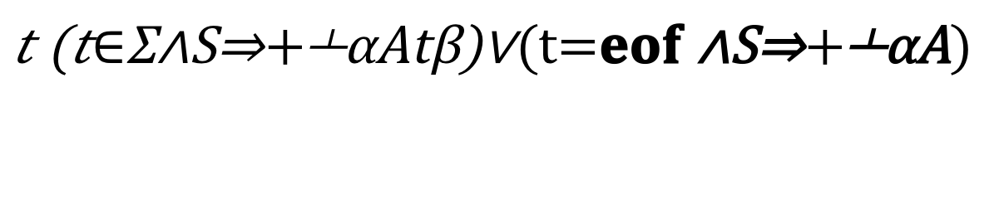
FOLLOW Sets
For nonterminal A, FOLLOW(A) is the set of terminals that can appear immediately to the right of A
Let’s write it together,
FOLLOW(A) =

Slide 31
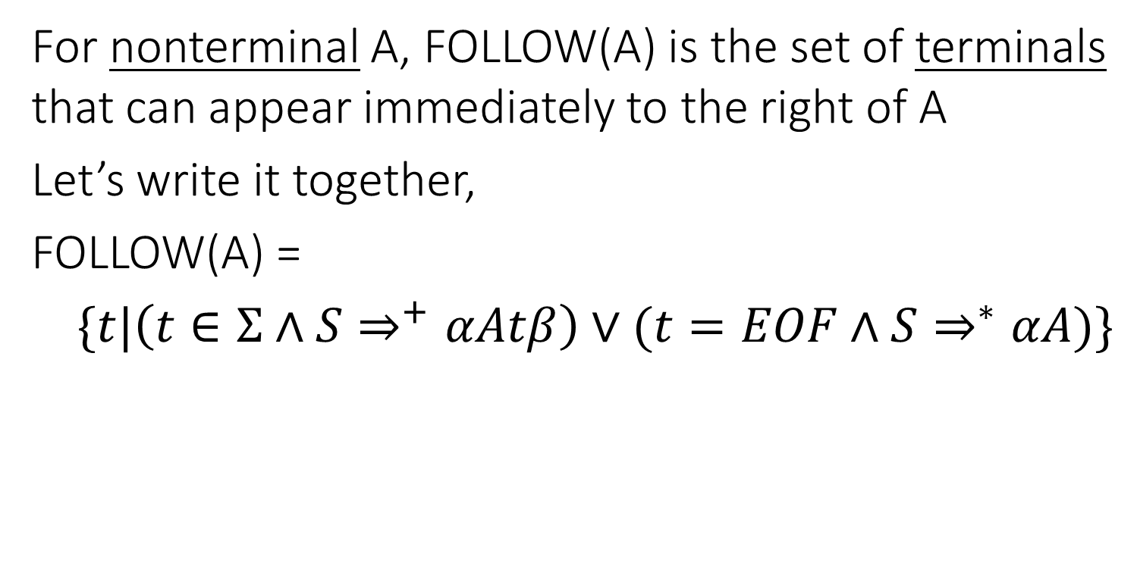
FOLLOW Sets
For nonterminal A, FOLLOW(A) is the set of terminals that can appear immediately to the right of A
Let’s write it together,
FOLLOW(A) =
$\{t|\left(t∈Σ∧S⇒^{+}αAtβ\right)∨(t=EOF∧S⇒^{∗}αA)\}$

Slide 32
FOLLOW Sets: Construction
To build FOLLOW(A)
If A is the start nonterminal, add eof
For rules X ⟶ α A β
Add FIRST(β) – {ε}
If ε is in FIRST(β) or β is empty, add FOLLOW(X)
Continue building FOLLOW sets until reach a fixed point (i.e., no more symbols can be added)
S
X
Y
Where α, β may be empty
A
B
-
???
ε
X
A
B
???
+
-

Slide 33
FOLLOW Sets Example
FOLLOW(A) for X ⟶ α A β
If A is the start, add eof
Add FIRST(β) – {ε}
Add FOLLOW(X) if ε in FIRST(β) or β is empty
S | ⟶ | B c | D B
B | ⟶ | a b | c S
D | ⟶ | d | ε
FIRST (S)
=
{ a, c, d }
FOLLOW (S)
=
{ eof }
FIRST (B)
=
{ a, c }
FOLLOW (B)
=
{ c, eof }
FIRST (D)
=
{ d, ε }
FOLLOW (D)
=
{ a, c }
FIRST (B c)
=
{ a, c }
FOLLOW (S)
=
{ eof, c }
FIRST (D B)
=
{ d, a, c }
FOLLOW (B)
=
{ c, eof }
FIRST (a b)
=
{ a }
FOLLOW (D)
=
{ a, c }
FIRST (c S)
=
{ c }
FOLLOW (S)
=
{ eof, c }
FOLLOW (B)
=
{ c, eof }
FOLLOW (D)
=
{ a, c }

Slide 34
Building the Parse Table
for each production X ⟶ α {
for each terminal t in FIRST(α){
put α in Table[X][t]
}
if ε is in FIRST(α){
for each terminal t in FOLLOW(X){
put α in Table[X][t]
}
}
}
Table collision ⬄ Grammar is not in LL(1)

Slide 35
Putting it all together
Build FIRST sets for each nonterminal
Build FIRST sets for each production’s RHS
Build FOLLOW sets for each nonterminal
Use FIRST and FOLLOW to fill parse table for each production

Slide 36
Tips n’ Tricks
FIRST sets
Only contain alphabet terminals and ε
Defined for arbitrary RHS and nonterminals
Constructed by starting at the beginning of a production
FOLLOW sets
Only contain alphabet terminals and eof
Defined for nonterminals only
Constructed by jumping into production

Slide 37
FIRST(α) for α = Y₁ Y₂ … Y_{k}
Add FIRST(Y₁) - {ε}
If ε is in FIRST(Y_{1 to i-1}): add FIRST(Y_{i}) – {ε}
If ε is in all RHS symbols, add ε
FOLLOW(A) for X ⟶ α A β
If A is the start, add eof
Add FIRST(β) – {ε}
Add FOLLOW(X) if ε in FIRST(β) or β empty
Table[X][t]
CFG
for each production X ⟶ α
for each terminal t in FIRST(α)
put α in Table[X][t]
if ε is in FIRST(α){
for each terminal t in FOLLOW(X){
put α in Table[X][t]
S | ⟶ | B c | D B
B | ⟶ | a b | c S
D | ⟶ | d | ε
Not LL(1)
FIRST (S)
=
{ a, c, d }
a
b
c
d
eof
FIRST (B)
=
{ a, c }
S
B c
B c
D B
FIRST (D)
=
{ d, ε }
FOLLOW (S)
=
{ eof, c }
D B
D B
FIRST (B c)
=
{ a, c }
FOLLOW (B)
=
{ c, eof }
a b
c S
B
FIRST (D B)
=
{ d, a, c }
FOLLOW (D)
=
{ a, c }
FIRST (a b)
=
{ a }
ε
ε
d
FIRST (c S)
=
{ c }
D
FIRST (d)
=
{ d }
FIRST (ε)
=
{ ε }

Slide 38




Why is a Table Collision a Problem?
CFG
S
S
S | ⟶ | B c | D B
B | ⟶ | a b | c S
D | ⟶ | d | ε
B
c
D
B
c $α$
ε
c $β$
a
b
c
d
eof
S
B c
B c
D B
Off Limits!
D B
D B
c$α$ c
current
token
B
a b
c S
c$β$
D
ε
ε
d

Slide 39
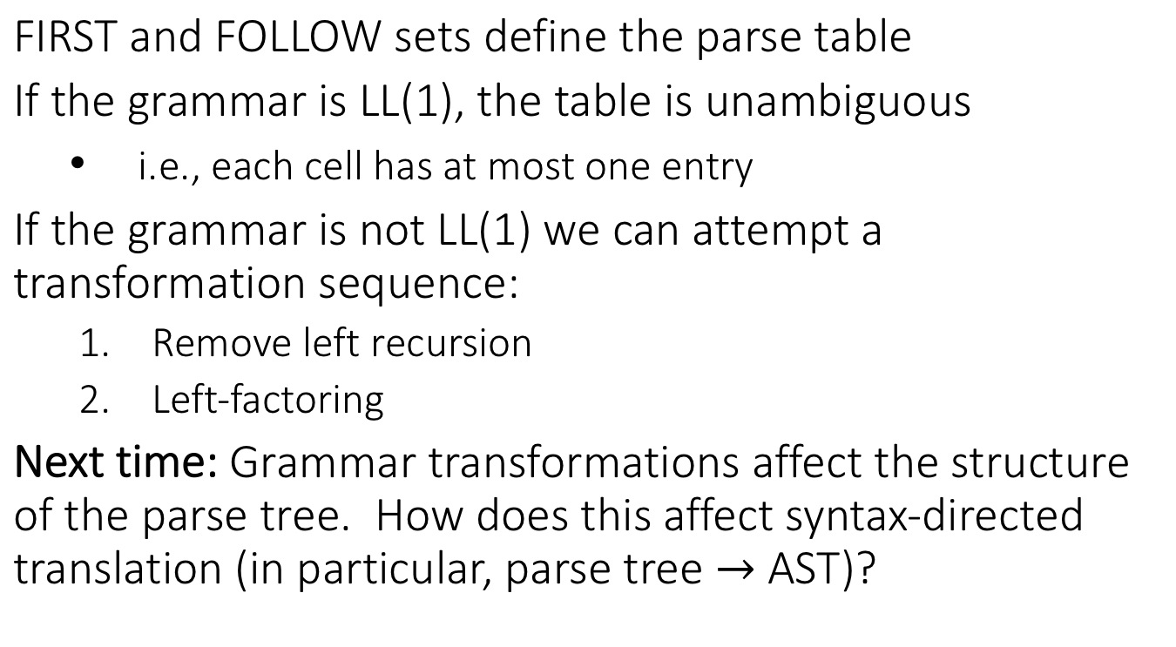
Recap
FIRST and FOLLOW sets define the parse table
If the grammar is LL(1), the table is unambiguous
i.e., each cell has at most one entry
If the grammar is not LL(1) we can attempt a transformation sequence:
Remove left recursion
Left-factoring
Next time: Grammar transformations affect the structure of the parse tree. How does this affect syntax-directed translation (in particular, parse tree AST)?

