Slide 1
Announcements
Midterm review this Thursday
Try the midterm I put online
Homework solutions now available

Slide 2
Semantic Analysis with Emphasis on Name Analysis
You’ll need this for P4
We’ll get back to Parsing next week

Slide 3
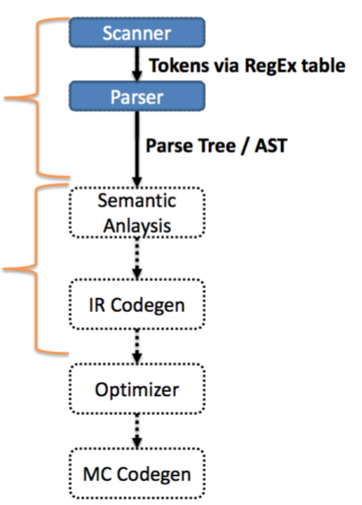
Where we are at
So far, we’ve only defined the structure of a program—aka the syntax
We are now diving into the semantics of the program

Slide 4
Semantics: The Meaning of a Program
The parser can guarantee that the program is structurally correct
The parser does not guarantee that the program makes sense:
void var;
Undeclared variables
Ill-typed statements
int doubleRainbow;
doubleRainbow = true;

Slide 5
Static Semantic Analysis
Two phases
Name analysis (aka name resolution)
For each scope
Process declarations, add them to symbol table
Process statements, update IDs to point to their entry
Type analysis
Process statements
Use symbol table info to determine the type of each expression (and sub-expression)

Slide 6
Why do we need this phase?
Code generation
Different operations use different instructions:
Consistent variable access
Integer addition vs floating point addition
Operator overloading
Optimization
Symbol table knows where a variable is used
Can remove dead code
Can weaken the type (e.g., int -> bool)
NOTE: pointers can make this occasionally impossible
Error checking

Slide 7
Semantic Error Analysis
For non-trivial programming languages, we run into fundamental undecidability problems
Does the program halt?
Can the program crash?
Sometimes practical feasibility as well
Combinations thread interleavings
Inter-procedural dataflow

Slide 8
Catch Obvious Errors
We cannot guarantee absence of errors…
…but we can at least catch some:
Undeclared identifiers
Multiply declared identifiers
Ill-typed terms

Slide 9
Name analysis
Associating ids with their uses
Need to bind names before we can type uses
What definitions do we need about identifiers?
Symbol table
How do we bind definitions and uses together?
Scope

Slide 10
Symbol table entries
Table that binds a name to information we need
What information do you think we need?
Kind (struct, variable, function, class)
Type (int, int × string → bool, struct)
Nesting level
Runtime location (where it’s stored in memory)

Slide 11
Symbol table operations
Insert entry
Lookup
Add new table
Remove/forget a table
When do you think we use these operations?

Slide 12
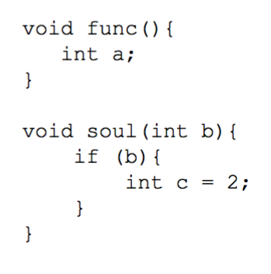
Scope: the lifetime of a name
Block of code in which a name is visible/valid
No scope
Assembly / FORTRAN
Static / most nested scope
Should be familiar – C / Java / C++

Slide 13
Many decisions related to scope!!

Slide 14
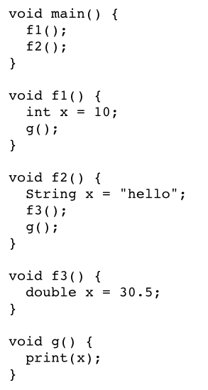
Static vs Dynamic Scope
Static
Correspondence between a variable use / decl is known at compile time
Dynamic
Correspondence determined at runtime

Slide 15
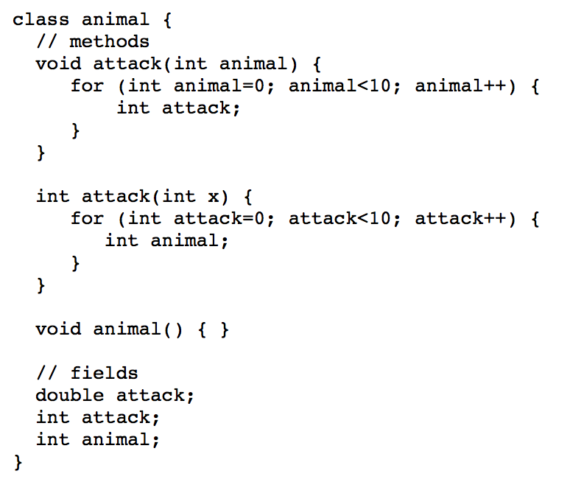
Exercises
What uses and declarations are OK in this Java code?

Slide 16
Exercises
void main() {
int x = 0;
f1();
g();
f2();
}
void f1() {
int x = 10;
g();
}
void f2() {
int x = 20;
f1();
g();
}
void g() {
print(x);
}
What does this print, assuming dynamic scoping?

Slide 17
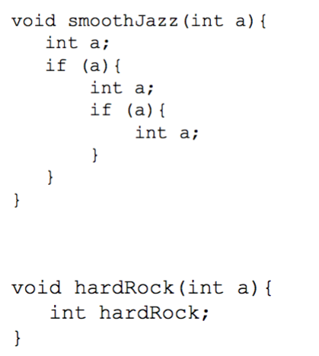
Variable shadowing
Do we allow names to be reused in nesting relations?
What about when the kinds are different?

Slide 18
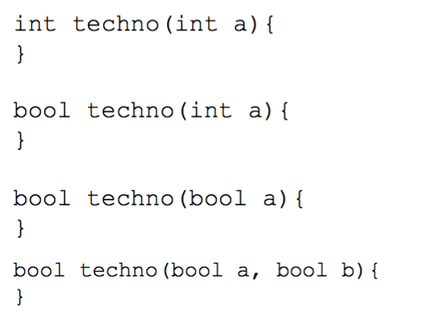
Overloading
Same name different type

Slide 19
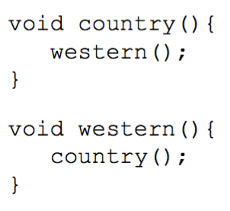
Forward references
Use of a name before it is added to symbol table
How do we implement it?
Requires two passes over the program
1 to fill symbol table, 1 to use it

Slide 20
Example
int k=10, x=20;
void foo(int k) {
int a = x;
int x = k;
int b = x;
while (...) {
int x;
if (x == k) {
int k, y;
k = y = x;
}
if (x == k) {
int x = y;
}
}
}
Determine which uses correspond to which declarations

Slide 21
Example
int (1)k=10, (2)x=20;
void (3)foo(int (4)k) {
int (5)a = x(2);
int (6)x = k(4);
int (7)b = x(6);
while (...) {
int (8)x;
if (x(8) == k(4)) {
int (9)k, (10)y;
k(9) = y(10) = x(8);
}
if (x(8) == k(4)) {
int (11)x = y(ERROR);
}
}
}
Determine which uses correspond to which declarations

Slide 22
Name analysis for our language
Time to make some decisions
What scoping rules will we allow?
What info does our project compiler need in its symbol table?
Relevant for P4

Slide 23
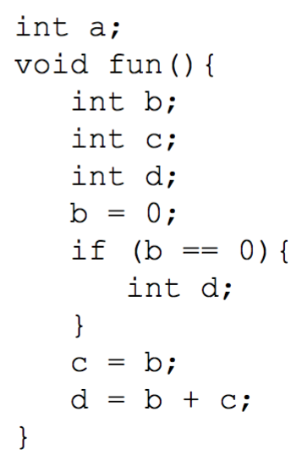
Our language is statically scoped
Designed for ease of symbol table use
global scope + nested scopes
all declarations are made at the top of a scope
declarations can always be removed from table at end of scope

Slide 24
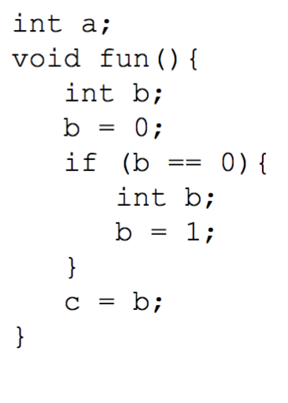
Our language: Nesting
Like Java or C, we’ll use most deeply nested scope to determine binding
Shadowing
Variable shadowing allowed
Struct definition shadowing allowed

Slide 25
Our language: Symbol table implementation
We want the symbol table to efficiently add an entry when we need it, remove it when we’re done with it
We’ll go with a list of hashmaps
This makes sense since we expect to remove a lot of names from scope at once
You did most of this in P1

Slide 26
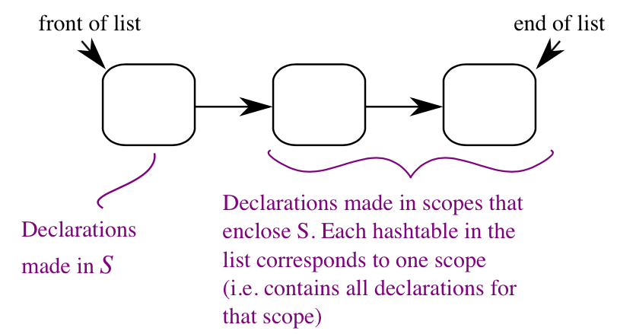
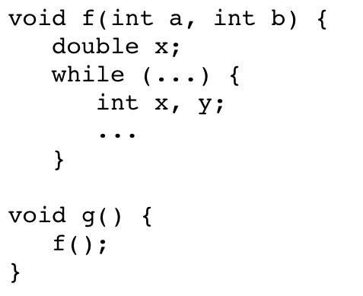
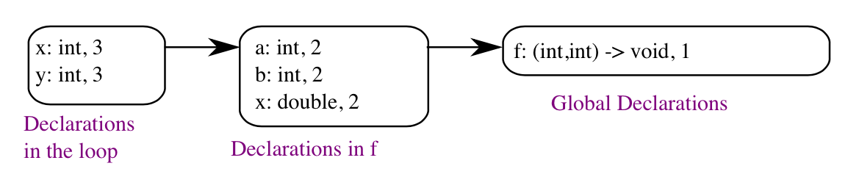
Example
g: () -> void, 1

Slide 27
Our language: Symbol kinds
Symbol kinds (= types of identifiers)
Variables
Carries a name, primitive type
Function declarations
Carries a name, return type, list of parameter types
Struct definitions
Carries a name, list of fields (types with names), size

Slide 28
Our language: Sym class implementation
There are many ways to implement your symbols
Here’s one suggestion
Sym class for variable definitions
FnSym subclass for function declarations
StructDefSym for struct type definitions
Contains it’s OWN symbol table for it’s field definitions
StructSym for when you want an instance of a struct

Slide 29
Implementing name analysis with an AST
At this point, we’re done with the Parse Tree
- All subsequent processing done on the AST + symbol table
Walk the AST, much like the unparse() method
Augment AST nodes where names are used (both declarations and uses) with a link to the relevant object in the symbol table
Put new entries into the symbol table when a declaration is encountered

Slide 30
Abstract Syntax Tree
int a;
int f(bool r) {
struct b{
int q;
};
cout << a;
}
DeclListNode
VarDeclNode
FnDeclNode
IntNode
IdNode
IntNode
IdNode
FormalListNode
FnNodeBody
Id types: Var, Function, Struct
VarDeclNode
StructDeclNode
WriteStmtNode
BoolNode
IdNode
DeclListNode
IdNode
Symbol Table
VarDeclNode
Sym
Type: Int
a
Sym
Type: bool
IntNode
IdNode
r
FnSym
RetType: Int
List<Type>: [bool]
f
StructDeclSym
fields
q
Sym
Type: Int
b

