Slide 1
Announcements
- H1 posted. Due Next Tuesday

Slide 2
Nondeterministic Finite Automata
CS 536

Slide 3
Previous Lecture
Scanner: converts a sequence of characters to a sequence of tokens
Scanner and parser: master-slave relationship
Scanner implemented using FSMs
FSM: DFA or NFA

Slide 4
This Lecture
NFAs from a formal perspective
Theorem: NFAs and DFAs are equivalent
Regular languages and Regular expressions

Slide 5

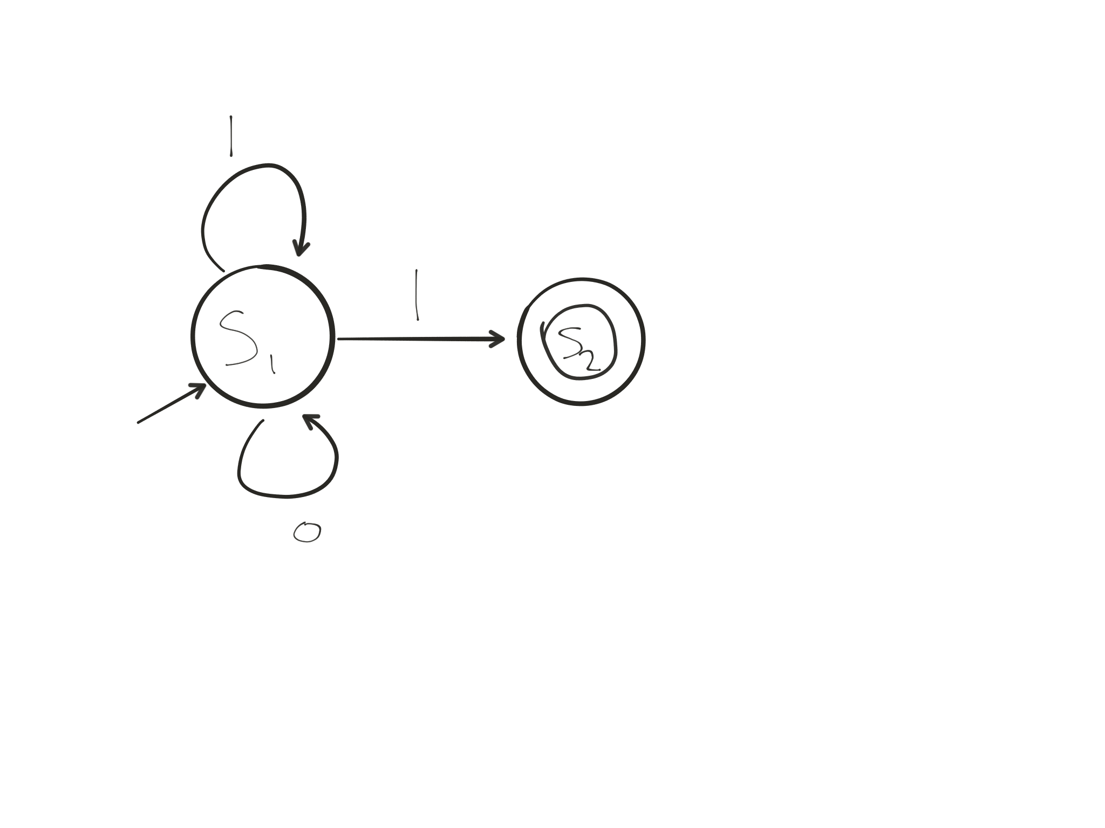



NFAs, formally
M ≡
finite set of states
final states
the alphabet
(characters)
start state
transition function
 | 0 | 1
s1 | {s1} | {s1, s2}
s2

Slide 6
NFA
To check if string is in L(M) of NFA M, simulate set of choices it could make
1 1 1
s1 s2 st st
s1 s1 s2 st
s1 s1 s1 s2
s1 s1 s1 s1
At least one sequence of transitions that:
Consumes all input (without getting stuck)
Ends in one of the final states

Slide 7

NFA and DFA are Equivalent
Two automata M and M’ are equivalent iff L(M) = L(M’)
Lemmas to be proven
Lemma 1: Given a DFA M, one can construct an NFA M’ that recognizes the same language as M, i.e., L(M’) = L(M)
Lemma 2: Given an NFA M, one can construct a DFA M’ that recognizes the same language as M, i.e., L(M’) = L(M)

Slide 8

Proving lemma 2
Lemma 2: Given an NFA M, one can construct a DFA M’ that recognizes the same language as M, i.e., L(M’) = L(M)
Idea: we can only be in finitely many subsets of states at any one time
possible combinations of states
Why?

Slide 9
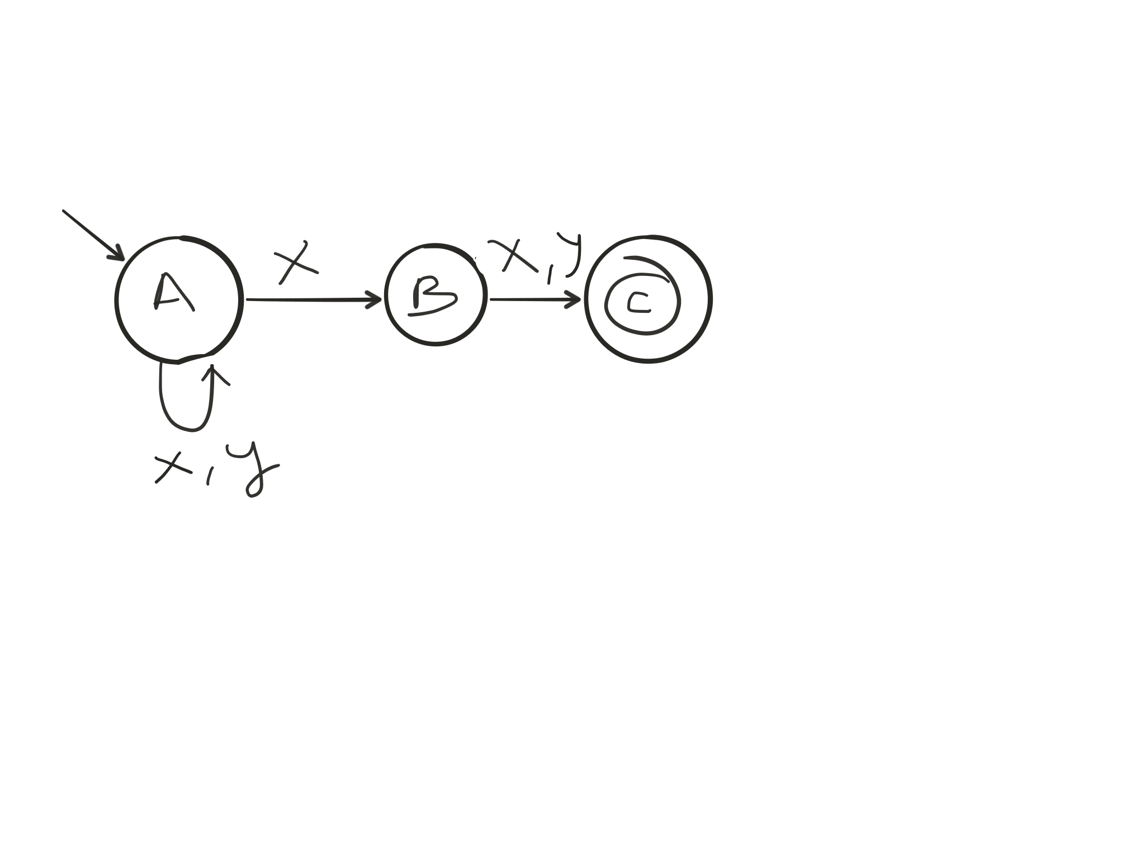
Why 2^|Q| states?
A B C
0 0 0 = {}
0 0 1 = {C}
0 1 0 = {B}
0 1 1 = {B,C}
1 0 0 = {A}
1 0 1 = {A,C}
1 1 0 = {A,B}
1 1 1 = {A,B,C}
Build DFA that
tracks set of states
the NFA is in!

Slide 10
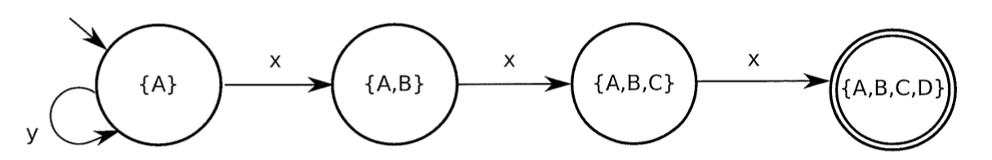
x
x,y
x,y
A
B
C
D
x,y
Defn: let succ(s,c) be the set of choices the NFA
could make in state s with character c
succ(A,x) = {A,B}
succ(A,y) = {A}
succ(B,x) = {C}
succ(B,y) = {C}
succ(C,x) = {D}
succ(C,y) = {D}

Slide 11
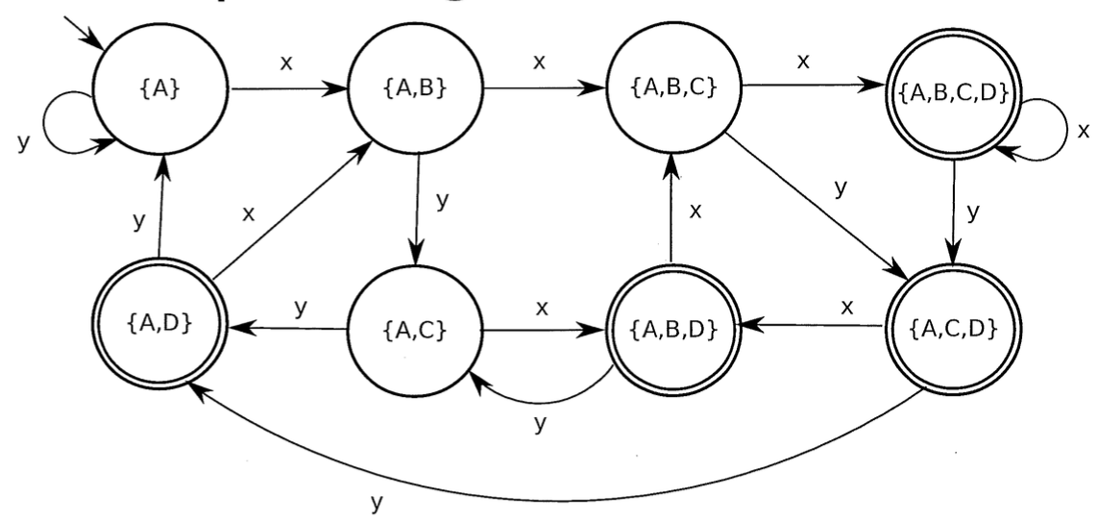
x
x,y
x,y
A
B
C
D
x,y
Build new DFA M’ where Q’ = 2^{Q}
succ(A,x) = {A,B}
succ(A,y) = {A}
succ(B,x) = {C}
succ(B,y) = {C}
succ(C,x) = {D}
succ(C,y) = {D}
To build DFA: Add an edge from state S on character c
to state S’ if S’ represents the union of states that all
states in S could possibly transition to on input c

Slide 12
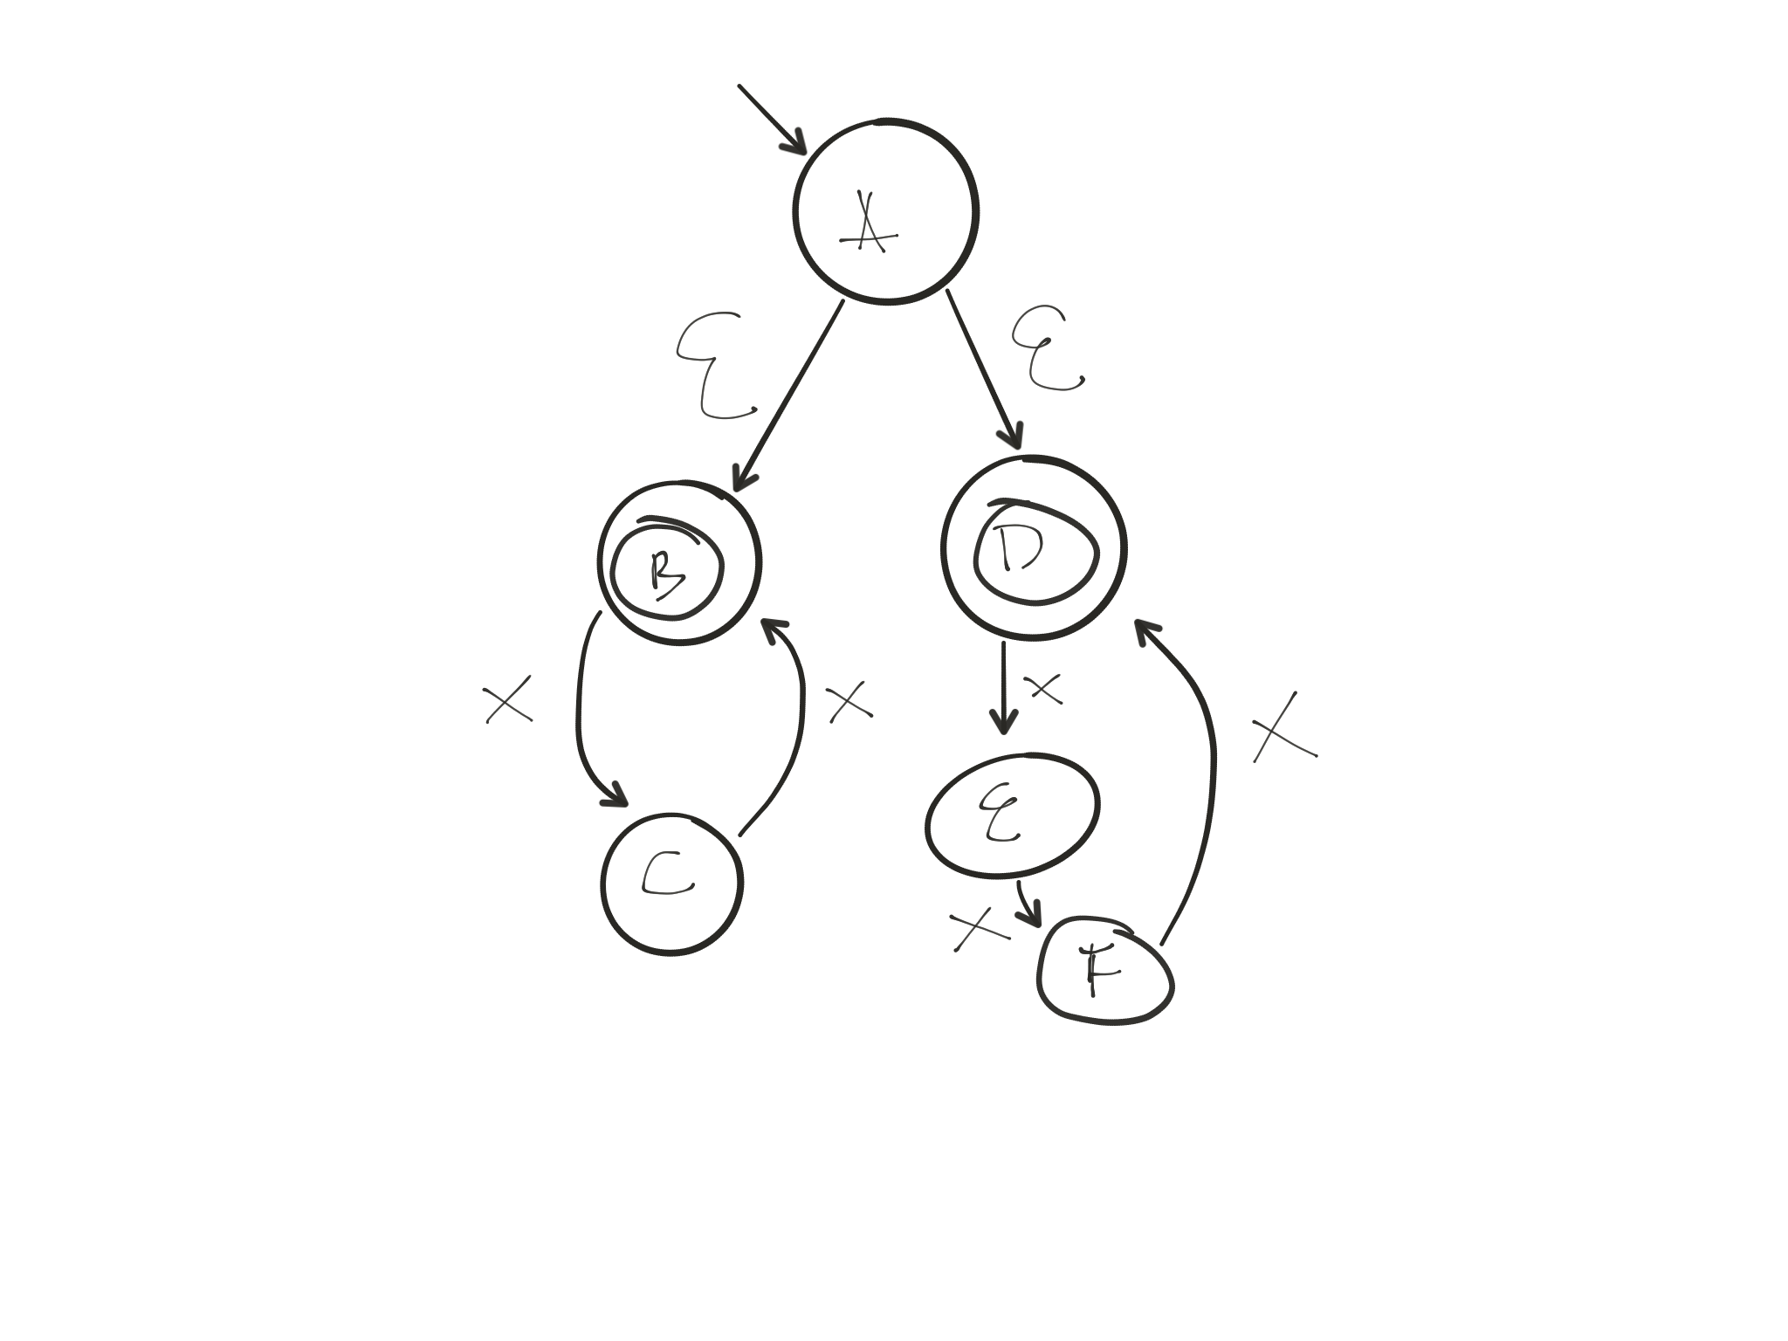
ɛ-transitions
Eg: x^{n}, where n is even or divisible by 3
Useful for taking union of two FSMs
In example, left side accepts even n;
right side accepts n divisible by 3
x x
AB C B
AD E F
A

Slide 13
Eliminating ɛ-transitions
We want to construct ɛ-free FSM M’ that is equivalent to M
Definition: eclose(s) = set of all states reachable from s in zero or more epsilon transitions
M’ components s is an accepting state of M’ iff eclose(s) contains an accepting state
s —c—> t is a transition in M’ iff q —c—> t for some q in eclose(s)

Slide 14
Eliminating ɛ-transitions
We want to construct ɛ-free NFA M’ that is equivalent to M
Definition: Epsilon Closure eclose(s) = set of all states reachable from s using zero or more epsilon transitions
 | eclose
A | {A, B, D}
B | {B}
C | {C}
D | {D}
E | {E}
F | {F}

Slide 15
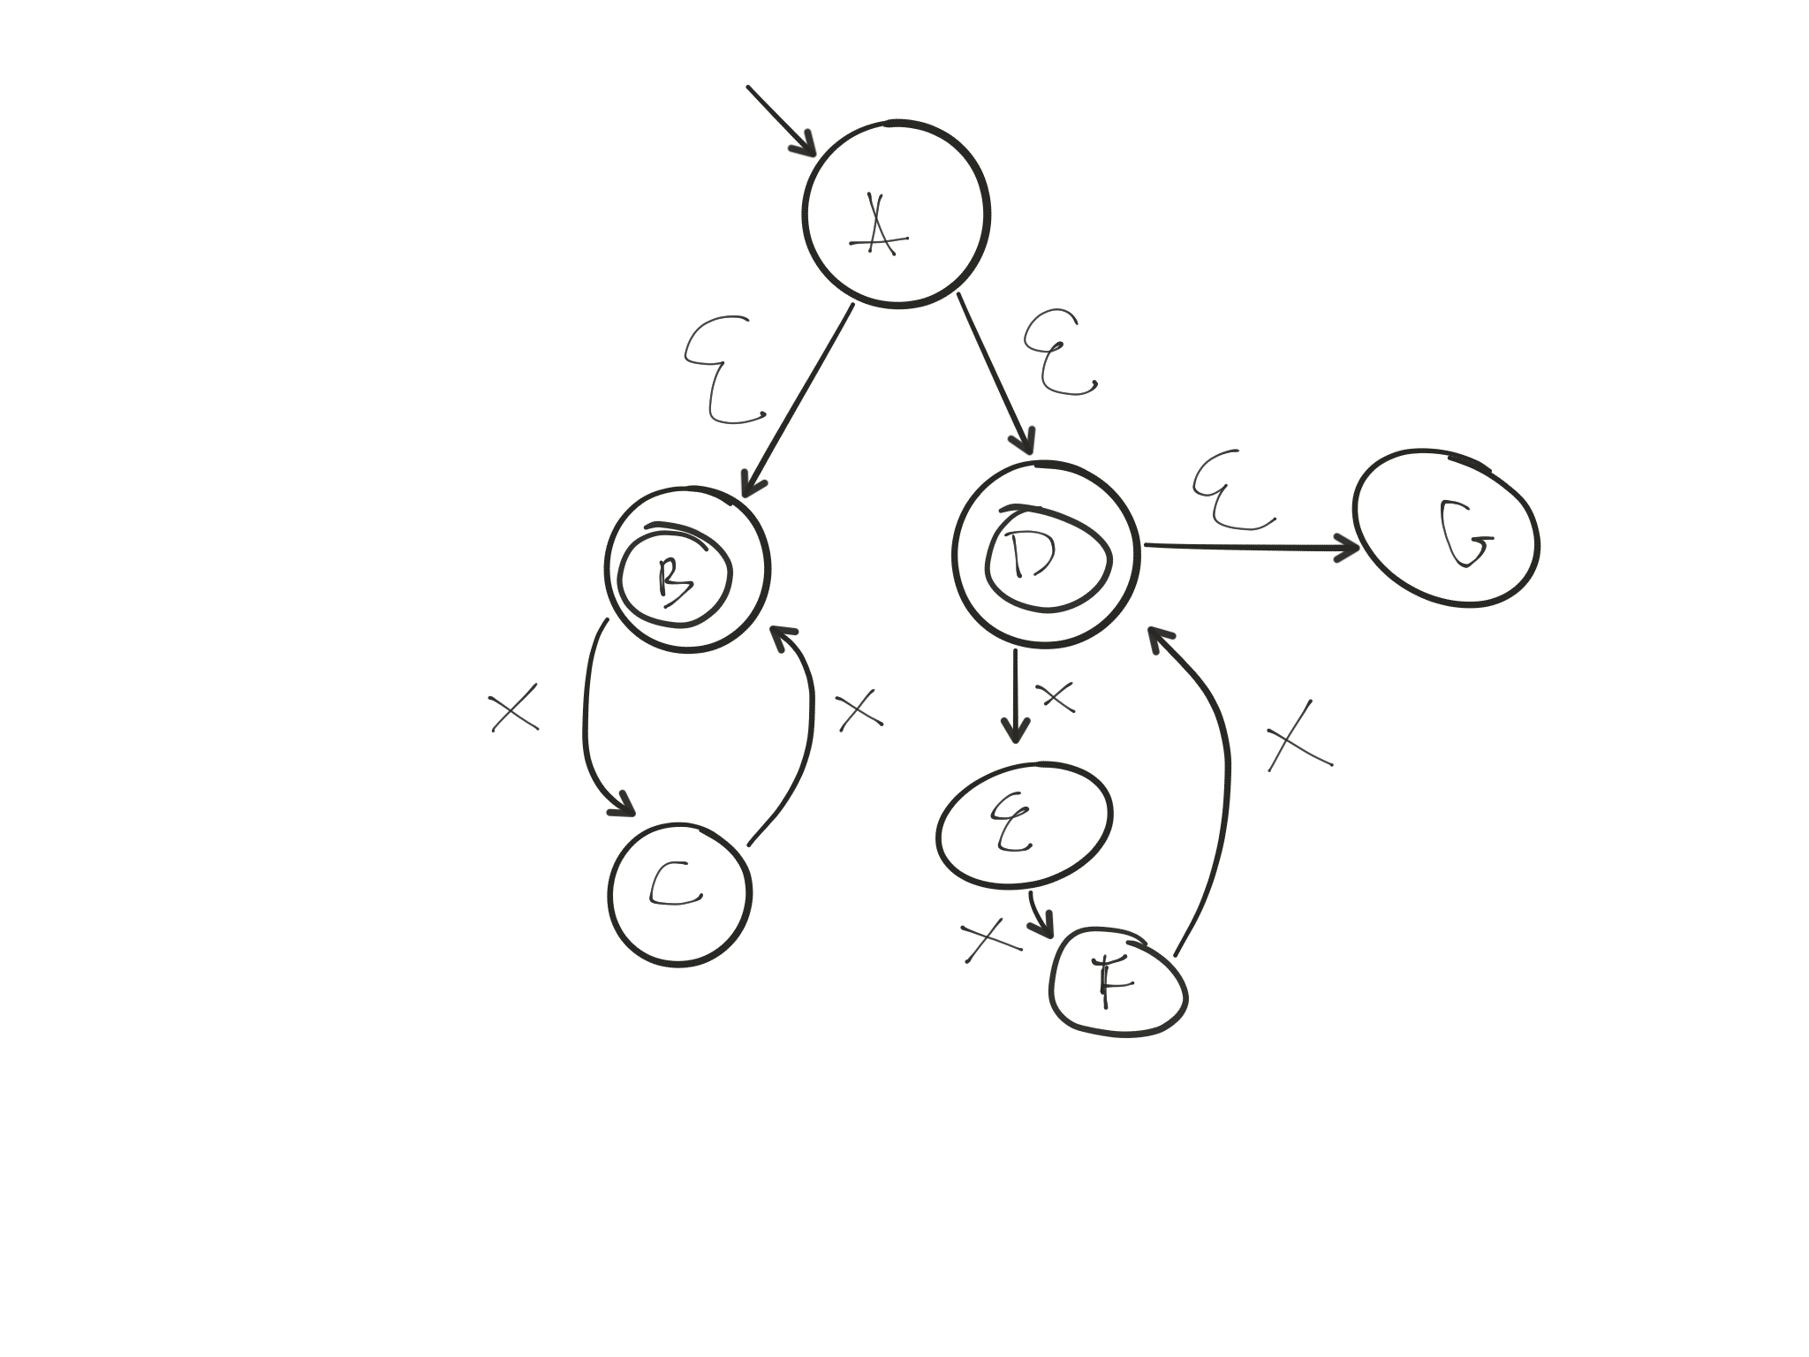
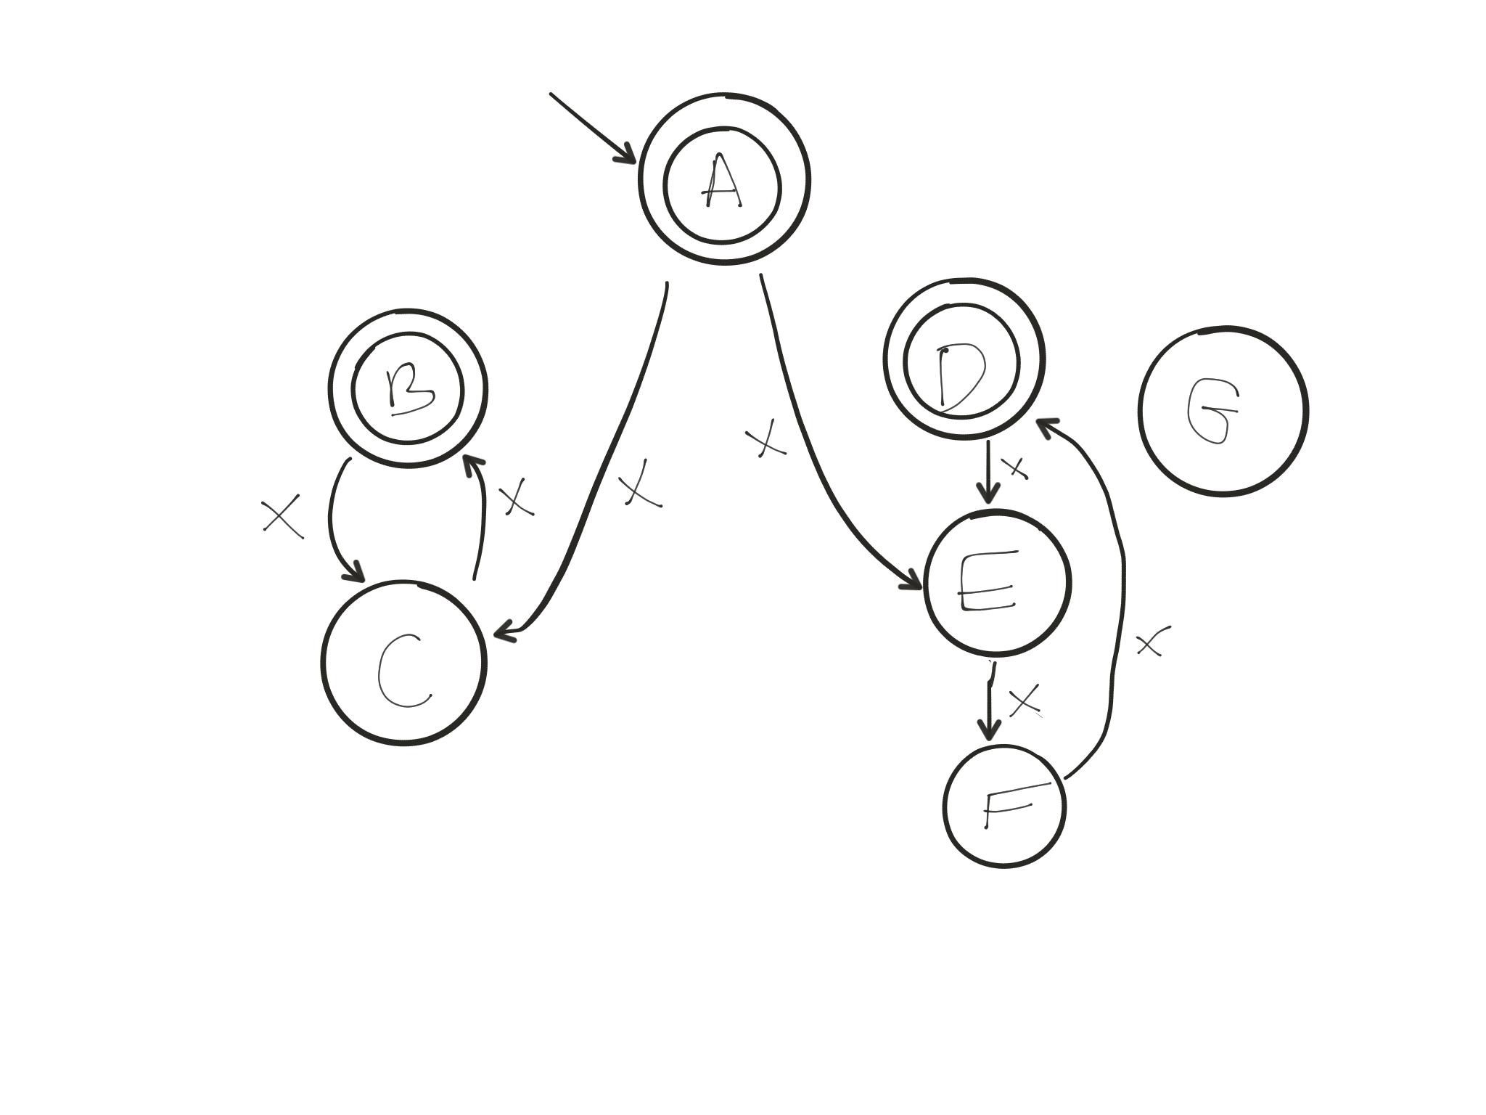
Def: eclose(s) = set of all states reachable from s in zero or more epsilon transitions
s is an accepting state of M’ iff eclose(s) contains an accepting state
s —c—> t is a transition in M’ iff q —c—> t for some q in eclose(s)

Slide 16
Recap
NFAs and DFAs are equally powerful
any language definable as an NFA is definable as a DFA
ɛ-transitions do not add expressiveness to NFAs
we showed a simple algorithm to remove epsilons

Slide 17
Regular Languages and Regular Expressions

Slide 18
Regular Language
Any language recognized by an FSM is a regular language
Examples:
Single-line comments beginning with //
Integer literals
{ε, ab, abab, ababab, abababab, …. }
C/C++ identifiers

Slide 19
Regular expressions
Pattern describing a language
operands: single characters, epsilon
operators: from low to high precedence
alternation “or”: a | b
catenation: a.b, ab, a^3 (which is aaa)
iteration: a* (0 or more a’s) aka Kleene star

Slide 20
Why do we need them?
Each token in a programming language can be defined by a regular language
Scanner-generator input: one regular expression for each token to be recognized by scanner
Regular expressions are inputs to a scanner generator

Slide 21
Regexp, cont’d
Conventions:
a+ is aa*
letter is a|b|c|d|…|y|z|A|B|…|Z
digit is 0|1|2|…|9
not(x) all characters except x
. is any character
parentheses for grouping, e.g., (ab)*
ɛ, ab, abab, ababab

Slide 22
Regexp, example
Hex strings
start with 0x or 0X
followed by one or more hexadecimal digits
optionally end with l or L
0(x|X)hexdigit+(L|l|ɛ)
where hexdigit = digit|a|b|c|d|e|f|A|…|F

Slide 23
Regexp, example
Single-line comments in Java/C/C++
// this is a comment
//(not(‘\n’))*’\n’

Slide 24
Regexp, example
C/C++ identifiers: sequence of letters/digits/ underscores; cannot begin with a digit; cannot end with an underscore
Example: a, _bbb7, cs_536
Regular expression
letter | (letter|_)(letter|digit|_)*(letter|digit)

Slide 25
Recap
Regular Languages
Languages recognized/defined by FSMs
Regular Expressions
Single-pattern representations of regular languages
Used for defining tokens in a scanner generator

Slide 26
Creating a Scanner
Last lecture: DFA to code
This lecture: NFA to DFA
Next lecture: Regexp to NFA
Scanner
This lecture: token to Regexp
Scanner Generator

