Slide 1
Top-down parsing

Slide 2
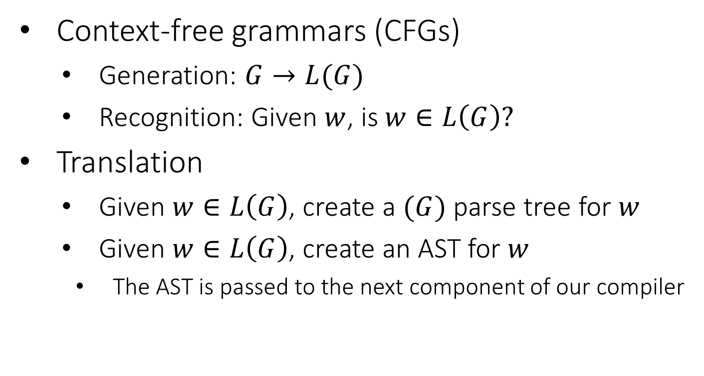
Parsing: Review of the Big Picture (1)
Context-free grammars (CFGs)
Generation: $G→L(G)$
Recognition: Given $w$, is $w∈L\left(G\right)?$
Translation
Given $w∈L\left(G\right)$, create a $(G)$ parse tree for $w$
Given $w∈L\left(G\right)$, create an AST for $w$
The AST is passed to the next component of our compiler

Slide 3
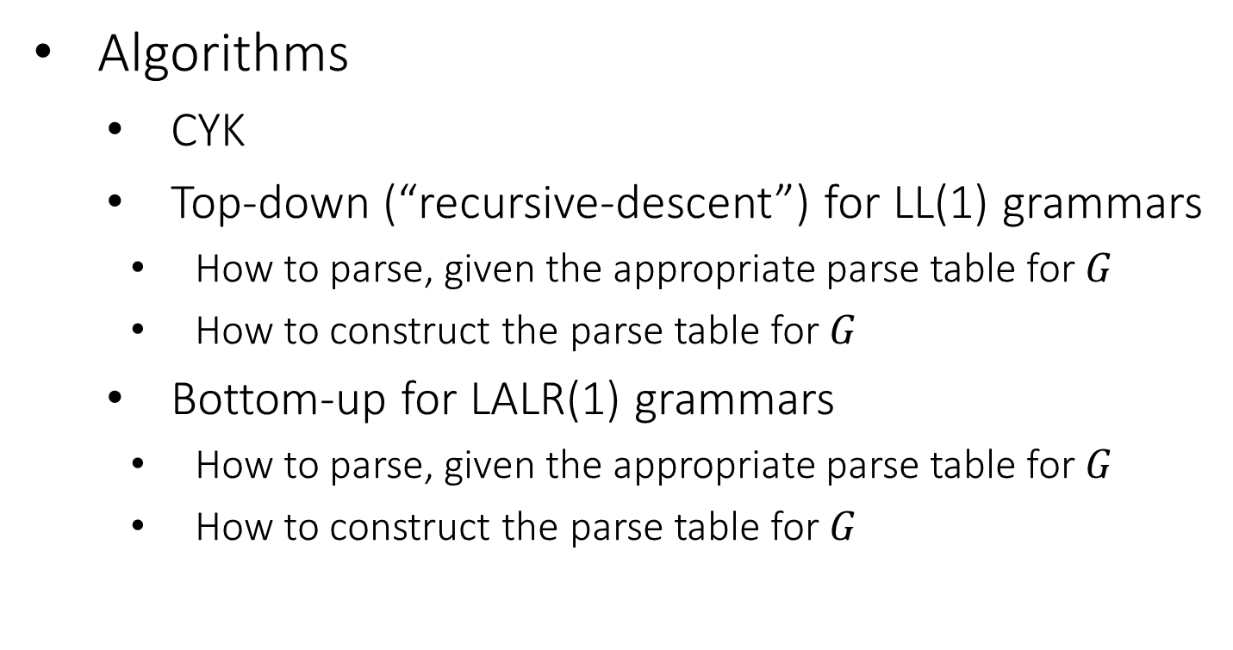
Parsing: Review of the Big Picture (2)
Algorithms
CYK
Top-down (“recursive-descent”) for LL(1) grammars
How to parse, given the appropriate parse table for $G$
How to construct the parse table for $G$
Bottom-up for LALR(1) grammars
How to parse, given the appropriate parse table for $G$
How to construct the parse table for $G$

Slide 4
Last time
CYK
Step 1: get a grammar in Chomsky Normal Form
Step 2: Build all possible parse trees bottom-up
Start with runs of 1 terminal
Connect 1-terminal runs into 2-terminal runs
Connect 1- and 2- terminal runs into 3-terminal runs
Connect 1- and 3- or 2- and 2- terminal runs into 4 terminal runs
…
If we can connect the entire tree, rooted at the start symbol, we’ve found a valid parse

Slide 5
Some Interesting properties of CYK
Very old algorithm
Already well known in early 70s
No problems with ambiguous grammars:
Gives a solution for all possible parse tree simultaneously

Slide 6
CYK Example
K
1,6
W
1,5
2,6
K | ⟶ | I W
K | ⟶ | I Y
W | ⟶ | L X
X | ⟶ | N R
Y | ⟶ | L R
N | ⟶ | id
N | ⟶ | I Z
Z | ⟶ | C N
I | ⟶ | id
L | ⟶ | (
R | ⟶ | )
C | ⟶ | ,
X
1,4
2,5
3,6
N
1,3
2,4
3,5
4,6
Z
X
1,2
2,3
3,4
4,5
5,6
I,N
L
I,N
C
I,N
R
id
(
id
,
id
)

Slide 7

Thinking about Language Design
Balanced considerations
Powerful enough to be useful
Simple enough to be parsable
Syntax need not be complex for complex behaviors
Guy Steele’s “Growing a Language”
https://www.youtube.com/watch?v=_ahvzDzKdB0

Slide 8
Restricting the Grammar
By restricting our grammars we can
Detect ambiguity
Build linear-time, O(n) parsers
LL(1) languages
Particularly amenable to parsing
Parseable by Predictive (top-down) parsers
Sometimes called recursive descent

Slide 9
Top-Down Parsers
Start at the Start symbol
Repeatedly: “predict” what production to use
Example: if the current token to be parsed is an id, no need to try productions that start with intLiteral
This might seem simple, but keep in mind that a chain of productions may have to be used to get to the rule that handles, e.g., id

Slide 10
Predictive Parser Sketch
Scanner
Parser
Col: terminal
Token Stream
Selector table
a
b
a
a
EOF
Row: nonterminal
current
“Work to do”
Stack

Slide 11
Example
S → ( S ) | { S } | ε
(
{
}
)
eof
(
)
{
}
eof
S
( S )
ε
{ S }
ε
ε
current
current
current
current
current
{
(
S
}
S
S
)
eof
“Work to do”
Stack

Slide 12
A Snapshot of a Predictive Parser
D
S
eof
C
t
The structure already seen
B
A
A
u
u
A
eof
“Work to do”
Stack
D
C
t
The structure that the parser expects to build
Input:
t
u
eof
Already processed
current
Not yet seen

Slide 13
Algorithm
stack.push(eof)
stack.push(Start non-term)
t = scanner.getToken()
Repeat
if stack.top is a terminal y
match y with t
pop y from the stack
t = scanner.next_token()
if stack.top is a nonterminal X
get table[X,t]
pop X from the stack
push production’s RHS (each symbol from Right to Left)
Until one of the following:
stack is empty
stack.top is a terminal that doesn’t match t
stack.top is a non-term and parse table entry is empty
accept
reject

Slide 14
Example 2, bad input: You try
S → ( S ) | { S } | ε
(
)
{
}
eof
S
( S )
ε
{ S }
ε
ε
INPUT
(
(
}
eof

Slide 15
This Parser works great!
Given a single token we always knew exactly what production it started
(
)
{
}
eof
S
( S )
ε
{ S }
ε
ε

Slide 16
Two Outstanding Issues
How do we know if the language is LL(1)
Easy to imagine a Grammar where a single token is not enough to select a rule
How do we build the selector table?
It turns out that there is one answer to both:
Any Idea?
S → ( S ) | { S } | ( )
If selector table has <=1 production per cell, then grammar is LL(1)

Slide 17
LL(1) Grammar Transformations
Necessary (but not sufficient) conditions for LL(1) Parsing:
Free of left recursion
No nonterminal loops for a production
Why? Need to look past list to know when to cap it
Left factored
No rules with common prefix
Why? We’d need to look past the prefix to pick rule

Slide 18
Left-Recursion
Recall, a grammar such that is left recursive
A grammar is immediately left recursive if this can happen in one step:
A → A α | β
Fortunately, it’s always possible to change the grammar to remove left-recursion without changing the language it recognizes

Slide 19
Why Left Recursion is a Problem (Blackbox View)
CFG snippet:
XList ⟶ XList x | x
Current parse tree:
XList
Current token:
x
How should we grow the tree top-down?
XList
(OR)
XList
x
XList
x
Correct if there are no more xs
Correct if there are more xs
We don’t know which without more lookahead

Slide 20
Why Left Recursion is a Problem (Whitebox View)
CFG snippet:
XList ⟶ XList x | x
Current parse tree:
XList
x
eof
Current token:
x
Parse table:
XList
XList x
ε
XList
x
XList
XList
x
x
(Stack overflow)
XList
x
eof
Stack
Current

Slide 21
Removing Left-Recursion
(for a single immediately left-recursive rule)
A → A α | β
A → β A’
A’→ α A’
| ε
Where β does
not begin with A

Slide 22
Example
A → β A’
A’→ α A’
| ε
A → A α | β
Exp → Factor Exp’
Exp’ → - Factor Exp’
| ε
Factor → intlit | ( Exp )
Exp → Exp – Factor
| Factor
Factor → intlit | ( Exp )

Slide 23
Let’s check in on the Parse Tree…
Exp → Exp – Factor
| Factor
Factor → intlit | ( Exp )
Exp → Factor Exp’
Exp’ → - Factor Exp’
| ε
Factor → intlit | ( Exp )
E
E
E
-
F
F
E
2
F
E
E
-
F
4
-
F
3
3
-
F
E
2
4
ε

Slide 24
… We’ll fix that later

Slide 25
General Rule for Removing Immediate Left-Recursion
A → α₁ | α₂ | … | α_{n} | A β₁ | A β₂ | … A β_{m}
A → α₁ A’ | α₂ A’ | … | α_{n} A’
A’ → β₁ A’ | β₂ A’ | … | β_{m} A’ | ε

Slide 26
Left Factored Grammars
If a nonterminal has two productions whose RHS have common prefix
→ Grammar it is not left factored and not LL(1)
Exp → ( Exp ) | ( )
Not left factored

Slide 27
Left Factoring
Given productions of the form
A → α β₁ | α β₂
A → α A’
A’ → β₁ | β₂

Slide 28
Combined Example
Exp → ( Exp ) | Exp Exp | ( )
Remove
Immediate left-recursion
Exp → ( Exp ) Exp' | ( ) Exp'
Exp' → Exp Exp' | ε
Left-factoring
Exp -> ( Exp''
Exp'' -> Exp ) Exp' | ) Exp'
Exp' -> Exp Exp' | ε

Slide 29
Where are we at?
We’ve set ourselves up for success in building the selection table
Two things that prevent a grammar from being LL(1) were identified and avoided
Not Left-Factored grammars
Left-recursive grammars
Next time
Build two data structures that combine to yield a selector table:
FIRST set
FOLLOW set

