Slide 1
Announcement: Midterm Prep
Midterm is Tuesday, 3/10 here
List of topics
Up to and including lecture on Tuesday’s the 5th
Length 1hr 10min
No extra material allowed – just bring a pen
Sample midterm available online
Recommended that you do this by Thursday
We’ll review it in class

Slide 2
Syntax Directed Translation for Top-Down Parsing

Slide 3
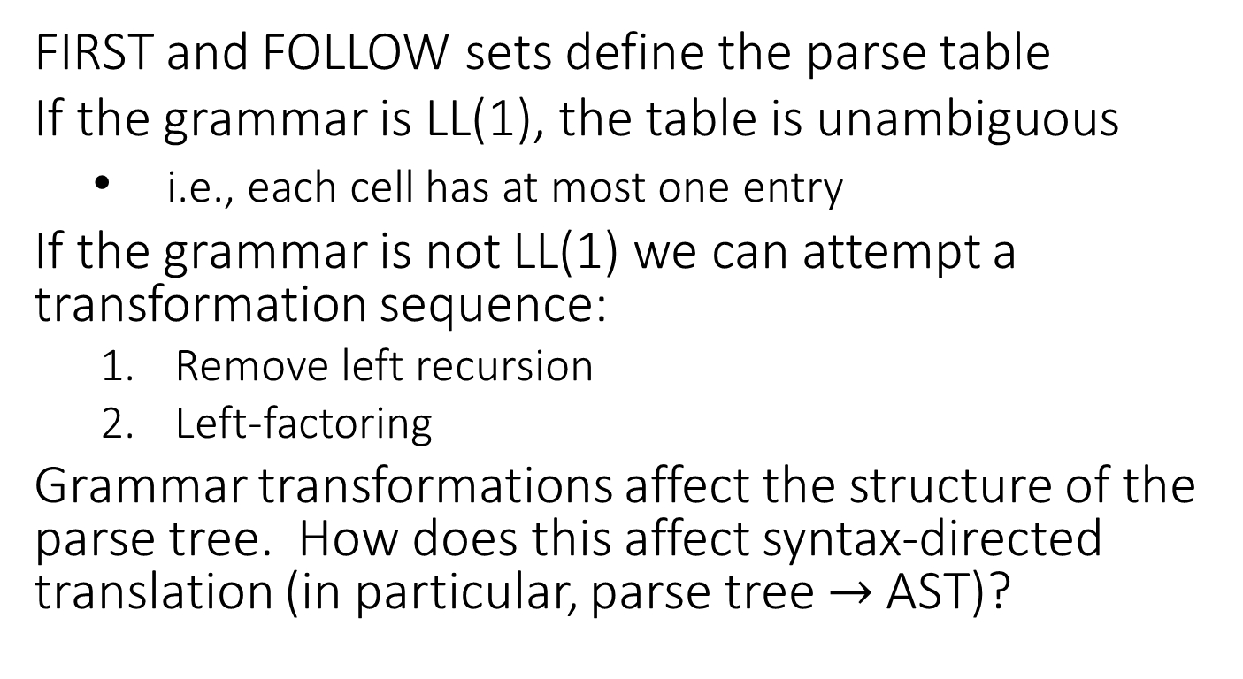
Last Time: Built LL(1) Predictive Parser
FIRST and FOLLOW sets define the parse table
If the grammar is LL(1), the table is unambiguous
i.e., each cell has at most one entry
If the grammar is not LL(1) we can attempt a transformation sequence:
Remove left recursion
Left-factoring
Grammar transformations affect the structure of the parse tree. How does this affect syntax-directed translation (in particular, parse tree $→$ AST)?

Slide 4
Today
Review Parse Table Construction
2 examples
Show how to do Syntax-Directed Translation using an LL(1) parser

Slide 5
FIRST(α) for α = Y₁ Y₂ … Y_{k}
Add FIRST(Y₁) - {ε}
If ε is in FIRST(Y_{1 to i-1}): add FIRST(Y_{i}) – {ε}
If ε is in all RHS symbols, add ε
FOLLOW(A) for X ⟶ α A β
If A is the start, add eof
Add FIRST(β) – {ε}
Add FOLLOW(X) if ε in FIRST(β) or β empty
Table[X][t]
CFG
for each production X ⟶ α
for each terminal t in FIRST(α)
put α in Table[X][t]
if ε is in FIRST(α){
for each terminal t in FOLLOW(X){
put α in Table[X][t]
S | ⟶ | B c | D B
B | ⟶ | a b | c S
D | ⟶ | d | ε
Not LL(1)
FIRST (S)
=
{ a, c, d }
a
b
c
d
eof
FIRST (B)
=
{ a, c }
S
B c
B c
D B
FIRST (D)
=
{ d, ε }
FOLLOW (S)
=
{ eof, c }
D B
D B
FIRST (B c)
=
{ a, c }
FOLLOW (B)
=
{ c, eof }
a b
c S
B
FIRST (D B)
=
{ d, a, c }
FOLLOW (D)
=
{ a, c }
FIRST (a b)
=
{ a }
ε
ε
d
FIRST (c S)
=
{ c }
D
FIRST (d)
=
{ d }
FIRST (ε)
=
{ ε }

Slide 6
FIRST(α) for α = Y₁ Y₂ … Y_{k}
Add FIRST(Y₁) - {ε}
If ε is in FIRST(Y_{1 to i-1}): add FIRST(Y_{i}) – {ε}
If ε is in all RHS symbols, add ε
FOLLOW(A) for X ⟶ α A β
If A is the start, add eof
Add FIRST(β) – {ε}
Add FOLLOW(X) if ε in FIRST(β) or β empty
Table[X][t]
CFG
for each production X ⟶ α
for each terminal t in FIRST(α)
put α in Table[X][t]
if ε is in FIRST(α){
for each terminal t in FOLLOW(X){
put α in Table[X][t]
S → ( S ) | { S } | ε
FIRST (S)
=
{ { , ( , ε }
FIRST ( ( S ) )
=
{ ( }
(
)
{
}
eof
FIRST ( { S } )
=
{ { }
S
( S )
ε
{ S }
ε
ε
FIRST ( ε )
=
{ ε }
FOLLOW ( S )
=
{ eof, ), } }

Slide 7
FIRST(α) for α = Y₁ Y₂ … Y_{k}
Add FIRST(Y₁) - {ε}
If ε is in FIRST(Y_{1 to i-1}): add FIRST(Y_{i}) – {ε}
If ε is in all RHS symbols, add ε
FOLLOW(A) for X ⟶ α A β
If A is the start, add eof
Add FIRST(β) – {ε}
Add FOLLOW(X) if ε in FIRST(β) or β empty
Table[X][t]
CFG
for each production X ⟶ α
for each terminal t in FIRST(α)
put α in Table[X][t]
if ε is in FIRST(α){
for each terminal t in FOLLOW(X){
put α in Table[X][t]
S → + S | ε
FIRST (S)
=
{ +, ε }
FIRST ( + S )
=
{ + }
+
eof
FIRST ( ε )
=
{ ε }
ε
S
+ S
FOLLOW ( S )
=
{ eof }

Slide 8
How’s that Compiler Looking?
Scanner
Scanner
Tokens via RegEx table
Parser
Parser
Parse Tree via Recursive Descent
Semantic Anlaysis
TODO: SDT on
transformed CFG
IR Codegen
Optimizer
MC Codegen

Slide 9
Implementing SDT for LL(1) Parser
So far, SDT shown as second (bottom-up) pass over parse tree
The LL(1) parser never needed to explicitly build the parse tree (implicitly tracked via stack)
Naïve approach: build the parse tree explicitly

Slide 10
Semantic Stack
Instead of building the parse tree, give parser second, semantic stack
Holds nonterminals’ translations
SDT rules converted to actions on semantic stack
Pop translations of RHS nonterms off
Push computed translation of LHS nonterm on
Translation goal:
Count the number of occurrences of matched pairs of rounded parens: “( … )”
Ignore occurrences of matched pairs of square brackets: “[ … ]”
CFG
SDT Rules
SDT Actions
Expr ⟶ ε
| ( Expr )
| [ Expr ]
Expr.trans = 0
Expr.trans = Expr₂.trans + 1
Expr.trans = Expr₂.trans
push 0
Expr₂.trans = pop; push Expr₂.trans + 1
Expr₂.trans = pop; push Expr₂.trans

Slide 11
Action Numbers
Need to define when to fire the SDT Action
Not immediately obvious since SDT is bottom-up
Solution
Number actions and put them on the symbol stack!
Add action number symbols at end of the productions
CFG
SDT Actions
Expr ⟶ ε
#1
#1
push 0
| ( Expr )
#2
#2
Expr₂.trans = pop; push Expr₂.trans + 1
| [ Expr ]
#3
#3
Expr₂.trans = pop; push Expr₂.trans

Slide 12
Action Numbers: Example 1
CFG
SDT Actions: Counting Max Parens Depth
Expr ⟶ ε
#1
#1
push 0
| ( Expr )
#2
#2
Expr₂.trans = pop; push(Expr₂.trans + 1)
| [ Expr ]
#3
#3
Expr₂.trans = pop; push(Expr₂.trans)
(
[
]
)
EOF
( Expr ) #2
[ Expr ] #3
ε #1
ε #1
ε #1
[
Expr
Expr
#1
(
]
Expr
#3
Root translation
)
(
[
]
)
eof
Expr
#2
0
eof
1
current
current
current
current
current
Work Stack
SemanticStack

Slide 13
No-op SDT Actions
CFG
SDT Actions: Counting Max Parens Depth
Expr ⟶ ε
#1
#1
push 0
| ( Expr )
#2
#2
Expr₂.trans = pop; push(Expr₂.trans + 1)
| [ Expr ]
#3
#3
Expr₂.trans = pop; push(Expr₂.trans)
Useless rule
CFG
SDT Actions: Counting Max Parens Depth
Expr ⟶ ε
#1
#1
push 0
| ( Expr )
#2
#2
Expr₂.trans = pop; push(Expr₂.trans + 1)
| [ Expr ]

Slide 14
Placing Action Numbers
Action numbers go after their corresponding nonterminals, before their corresponding terminal
Translations popped right to left in action
CFG
SDT Actions
Expr ⟶ Expr + Term
#1
#1
tTrans = pop ; eTrans = pop ; push(tTrans + eTrans)
| Term
Term ⟶ Term * Factor
#2
#2
fTrans = pop; tTrans = pop ; push(fTrans * tTrans)
| Factor
Factor ⟶ intlit
#3
push(intlit.value)
#3

Slide 15
Placing Action Numbers: Example
Write SDT Actions and place action numbers to get the product of a ValList (i.e. multiply all elements)
CFG
SDT Actions
List ⟶ Val List’
#1
#1
LTrans = pop ; vTrans = pop ; push(LTrans * vTrans)
List’ ⟶ Val List’
#2
#2
LTrans = pop; vTrans = pop ; push(LTrans * vTrans)
| ε
#3
#3
push(1)
Val ⟶ intlit
#4
push(intlit.value)
#4

Slide 16
Action Numbers: Benefits
Plans SDT actions using the work stack
Robust to previously introduced grammar transformations
CFG
Expr ⟶ Expr + Term #1
| Term
Term ⟶ Term * Factor #2
| Factor
Factor ⟶ #3 intlit
Expr ⟶ Term Expr’
Expr’ ⟶ + Term #1 Expr’
| ε
Term ⟶ Factor Term’
Term’ ⟶ * Factor #2 Term’
| ε
Factor ⟶ #3 intlit
SDT Actions
#1
tTrans = pop ; eTrans = pop ; push(tTrans + eTrans)
#2
fTrans = pop; tTrans = pop ; push(fTrans * tTrans)
#3
push(intlit.value)

Slide 17
Example: SDT on Transformed Grammar
CFG
SDT Actions
Expr ⟶ Term Expr’
Expr’ ⟶ + Term #1 Expr’
| ε
Term ⟶ Factor Term’
Term’ ⟶ * Factor #2 Term’
| ε
Factor ⟶ #3 intlit
| ( Expr )
#1
tTrans = pop ; eTrans = pop ; push(eTrans + tTrans)
#2
fTrans = pop; tTrans = pop ; push(tTrans * fTrans)
#3
push(intlit.value)
Notes:
First(Factor) = { intlit, ( }
First(Term’) = { *, }
First(Term) = { intlit, ( }
First(Expr’) = { +, }
First(Expr) = { intlit, ( }
First(Term Expr’) = { intlit, ( }
First(+ Term #1 Expr’) = { + }
First() = { }
First(Factor Term’) = { intlit, ( }
First(* Factor #2 Term) = { * }
First() = { }
First(#3 intlit) = { intlit }
First( ( Expr ) ) = { ( }
Follow(Expr) = { eof, ) }
Follow(Expr’) = { eof, ) }
Follow(Term) = { +, eof, ) }
Follow(Term’) = { +, eof, ) }
Follow(Factor) = { *, +, eof, ) }
+ * ( ) intlit eof
=====================================================================
Expr Term Expr’ Term Expr’
-----------------------------------------------------------------------------------------------------------------------
Expr’ + Term #1 Expr’
-----------------------------------------------------------------------------------------------------------------------
Term Factor Term’ Factor Term’
-----------------------------------------------------------------------------------------------------------------------
Term’ * Factor #2 Term’
-----------------------------------------------------------------------------------------------------------------------
Factor ( Expr ) #3 intlit
=====================================================================

Slide 18
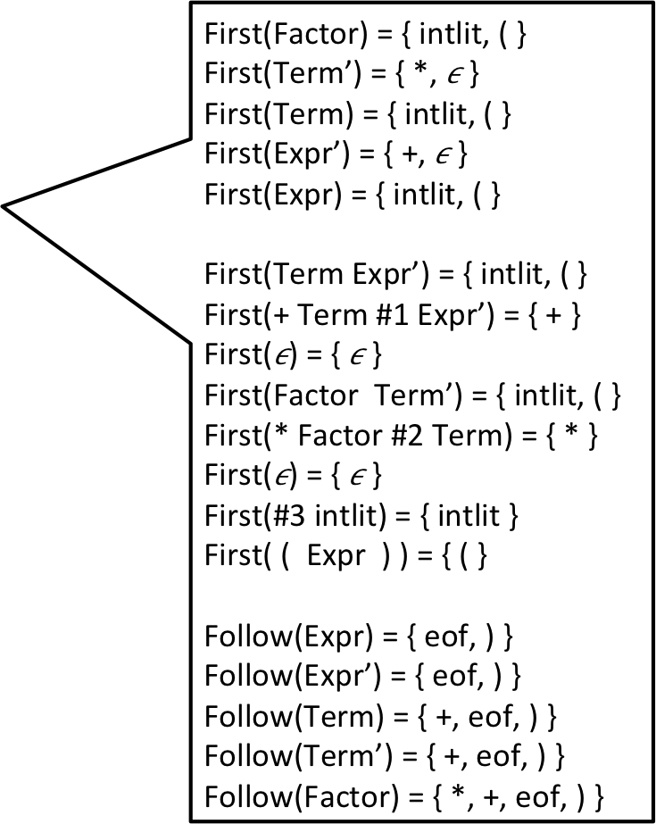
Example: SDT on Transformed Grammar
First(Factor) = { intlit, ( }
First(Term’) = { *, }
First(Term) = { intlit, ( }
First(Expr’) = { +, }
First(Expr) = { intlit, ( }
First(Term Expr’) = { intlit, ( }
First(+ Term #1 Expr’) = { + }
First() = { }
First(Factor Term’) = { intlit, ( }
First(* Factor #2 Term) = { * }
First() = { }
First(#3 intlit) = { intlit }
First( ( Expr ) ) = { ( }
Follow(Expr) = { eof, ) }
Follow(Expr’) = { eof, ) }
Follow(Term) = { +, eof, ) }
Follow(Term’) = { +, eof, ) }
Follow(Factor) = { *, +, eof, ) }
CFG
SDT Actions
Expr ⟶ Term Expr’
Expr’ ⟶ + Term #1 Expr’
| ε
Term ⟶ Factor Term’
Term’ ⟶ * Factor #2 Term’
| ε
Factor ⟶ #3 intlit
| ( Expr )
#1
tTrans = pop ; eTrans = pop ; push(eTrans + tTrans)
#2
fTrans = pop; tTrans = pop ; push(tTrans * fTrans)
#3
push(intlit.value)
Notes:
First(Factor) = { intlit, ( }
First(Term’) = { *, }
First(Term) = { intlit, ( }
First(Expr’) = { +, }
First(Expr) = { intlit, ( }
First(Term Expr’) = { intlit, ( }
First(+ Term #1 Expr’) = { + }
First() = { }
First(Factor Term’) = { intlit, ( }
First(* Factor #2 Term) = { * }
First() = { }
First(#3 intlit) = { intlit }
First( ( Expr ) ) = { ( }
Follow(Expr) = { eof, ) }
Follow(Expr’) = { eof, ) }
Follow(Term) = { +, eof, ) }
Follow(Term’) = { +, eof, ) }
Follow(Factor) = { *, +, eof, ) }
+ * ( ) intlit eof
=====================================================================
Expr Term Expr’ Term Expr’
-----------------------------------------------------------------------------------------------------------------------
Expr’ + Term #1 Expr’
-----------------------------------------------------------------------------------------------------------------------
Term Factor Term’ Factor Term’
-----------------------------------------------------------------------------------------------------------------------
Term’ * Factor #2 Term’
-----------------------------------------------------------------------------------------------------------------------
Factor ( Expr ) #3 intlit
=====================================================================

Slide 19
Example: SDT on Transformed Grammar
CFG
SDT Actions
Expr ⟶ Term Expr’
Expr’ ⟶ + Term #1 Expr’
| ε
Term ⟶ Factor Term’
Term’ ⟶ * Factor #2 Term’
| ε
Factor ⟶ #3 intlit
| ( Expr )
#1
tTrans = pop ; eTrans = pop ; push(eTrans + tTrans)
#2
fTrans = pop; tTrans = pop ; push(tTrans * fTrans)
#3
push(intlit.value)
 | + | * | ( | ) | intlit | eof
Expr |  |  | Term Expr’ |  | Term Expr’
Expr’ | + Term #1 Expr’ |  |  | ε |  | ε
Term |  |  | Factor Term’ |  | Factor Term’
Term’ | ε | * Factor #2 Term’ |  | ε |  | ε
Factor |  |  | ( Expr ) |  | #3 intlit
Notes:
First(Factor) = { intlit, ( }
First(Term’) = { *, }
First(Term) = { intlit, ( }
First(Expr’) = { +, }
First(Expr) = { intlit, ( }
First(Term Expr’) = { intlit, ( }
First(+ Term #1 Expr’) = { + }
First() = { }
First(Factor Term’) = { intlit, ( }
First(* Factor #2 Term) = { * }
First() = { }
First(#3 intlit) = { intlit }
First( ( Expr ) ) = { ( }
Follow(Expr) = { eof, ) }
Follow(Expr’) = { eof, ) }
Follow(Term) = { +, eof, ) }
Follow(Term’) = { +, eof, ) }
Follow(Factor) = { *, +, eof, ) }
+ * ( ) intlit eof
=====================================================================
Expr Term Expr’ Term Expr’
-----------------------------------------------------------------------------------------------------------------------
Expr’ + Term #1 Expr’
-----------------------------------------------------------------------------------------------------------------------
Term Factor Term’ Factor Term’
-----------------------------------------------------------------------------------------------------------------------
Term’ * Factor #2 Term’
-----------------------------------------------------------------------------------------------------------------------
Factor ( Expr ) #3 intlit
=====================================================================

Slide 20
CFG
SDT Actions
Expr ⟶ Term Expr’
Expr’ ⟶ + Term #1 Expr’
| ε
Term ⟶ Factor Term’
Term’ ⟶ * Factor #2 Term’
| ε
Factor ⟶ #3 intlit
| ( Expr )
#1
tTrans = pop ; eTrans = pop ; push(eTrans + tTrans)
#2
fTrans = pop; tTrans = pop ; push(tTrans * fTrans)
#3
push(intlit.value)
 | + | * | ( | ) | intlit | eof
Expr |  |  | Term Expr’ |  | Term Expr’
Expr’ | + Term #1 Expr’ |  |  | ε |  | ε
Term |  |  | Factor Term’ |  | Factor Term’
Term’ | ε | * Factor #2 Term’ |  | ε |  | ε
Factor |  |  | ( Expr ) |  | #3 intlit
#3
Input: 5 + 3 * 2 eof
intlit
Factor
current
Term’
Term
Expr’
Expr
eof
5
Work Stack
Semantic Stack
Notes:
First(Factor) = { intlit, ( }
First(Term’) = { *, }
First(Term) = { intlit, ( }
First(Expr’) = { +, }
First(Expr) = { intlit, ( }
First(Term Expr’) = { intlit, ( }
First(+ Term #1 Expr’) = { + }
First() = { }
First(Factor Term’) = { intlit, ( }
First(* Factor #2 Term) = { * }
First() = { }
First(#3 intlit) = { intlit }
First( ( Expr ) ) = { ( }
Follow(Expr) = { eof, ) }
Follow(Expr’) = { eof, ) }
Follow(Term) = { +, eof, ) }
Follow(Term’) = { +, eof, ) }
Follow(Factor) = { *, +, eof, ) }
+ * ( ) intlit eof
=====================================================================
Expr Term Expr’ Term Expr’
-----------------------------------------------------------------------------------------------------------------------
Expr’ + Term #1 Expr’
-----------------------------------------------------------------------------------------------------------------------
Term Factor Term’ Factor Term’
-----------------------------------------------------------------------------------------------------------------------
Term’ * Factor #2 Term’
-----------------------------------------------------------------------------------------------------------------------
Factor ( Expr ) #3 intlit
=====================================================================

Slide 21
CFG
SDT Actions
Expr ⟶ Term Expr’
Expr’ ⟶ + Term #1 Expr’
| ε
Term ⟶ Factor Term’
Term’ ⟶ * Factor #2 Term’
| ε
Factor ⟶ #3 intlit
| ( Expr )
#1
tTrans = pop ; eTrans = pop ; push(eTrans + tTrans)
#2
fTrans = pop; tTrans = pop ; push(tTrans * fTrans)
#3
push(intlit.value)
 | + | * | ( | ) | intlit | eof
Expr |  |  | Term Expr’ |  | Term Expr’
Expr’ | + Term #1 Expr’ |  |  | ε |  | ε
Term |  |  | Factor Term’ |  | Factor Term’
Term’ | ε | * Factor #2 Term’ |  | ε |  | ε
Factor |  |  | ( Expr ) |  | #3 intlit
+
Input: 5 + 3 * 2 eof
Term
intlit
current
current
current
Term’
#1
Expr’
eof
5
Work Stack
Semantic Stack
Notes:
First(Factor) = { intlit, ( }
First(Term’) = { *, }
First(Term) = { intlit, ( }
First(Expr’) = { +, }
First(Expr) = { intlit, ( }
First(Term Expr’) = { intlit, ( }
First(+ Term #1 Expr’) = { + }
First() = { }
First(Factor Term’) = { intlit, ( }
First(* Factor #2 Term) = { * }
First() = { }
First(#3 intlit) = { intlit }
First( ( Expr ) ) = { ( }
Follow(Expr) = { eof, ) }
Follow(Expr’) = { eof, ) }
Follow(Term) = { +, eof, ) }
Follow(Term’) = { +, eof, ) }
Follow(Factor) = { *, +, eof, ) }
+ * ( ) intlit eof
=====================================================================
Expr Term Expr’ Term Expr’
-----------------------------------------------------------------------------------------------------------------------
Expr’ + Term #1 Expr’
-----------------------------------------------------------------------------------------------------------------------
Term Factor Term’ Factor Term’
-----------------------------------------------------------------------------------------------------------------------
Term’ * Factor #2 Term’
-----------------------------------------------------------------------------------------------------------------------
Factor ( Expr ) #3 intlit
=====================================================================

Slide 22
CFG
SDT Actions
Expr ⟶ Term Expr’
Expr’ ⟶ + Term #1 Expr’
| ε
Term ⟶ Factor Term’
Term’ ⟶ * Factor #2 Term’
| ε
Factor ⟶ #3 intlit
| ( Expr )
#1
tTrans = pop ; eTrans = pop ; push(eTrans + tTrans)
#2
fTrans = pop; tTrans = pop ; push(tTrans * fTrans)
#3
push(intlit.value)
 | + | * | ( | ) | intlit | eof
Expr |  |  | Term Expr’ |  | Term Expr’
Expr’ | + Term #1 Expr’ |  |  | ε |  | ε
Term |  |  | Factor Term’ |  | Factor Term’
Term’ | ε | * Factor #2 Term’ |  | ε |  | ε
Factor |  |  | ( Expr ) |  | #3 intlit
#3
Factor
Input: 5 + 3 * 2 eof
intlit
Term
Term’
current
current
#1
Expr’
3
eof
5
Work Stack
Semantic Stack
Notes:
First(Factor) = { intlit, ( }
First(Term’) = { *, }
First(Term) = { intlit, ( }
First(Expr’) = { +, }
First(Expr) = { intlit, ( }
First(Term Expr’) = { intlit, ( }
First(+ Term #1 Expr’) = { + }
First() = { }
First(Factor Term’) = { intlit, ( }
First(* Factor #2 Term) = { * }
First() = { }
First(#3 intlit) = { intlit }
First( ( Expr ) ) = { ( }
Follow(Expr) = { eof, ) }
Follow(Expr’) = { eof, ) }
Follow(Term) = { +, eof, ) }
Follow(Term’) = { +, eof, ) }
Follow(Factor) = { *, +, eof, ) }
+ * ( ) intlit eof
=====================================================================
Expr Term Expr’ Term Expr’
-----------------------------------------------------------------------------------------------------------------------
Expr’ + Term #1 Expr’
-----------------------------------------------------------------------------------------------------------------------
Term Factor Term’ Factor Term’
-----------------------------------------------------------------------------------------------------------------------
Term’ * Factor #2 Term’
-----------------------------------------------------------------------------------------------------------------------
Factor ( Expr ) #3 intlit
=====================================================================

Slide 23
CFG
SDT Actions
Expr ⟶ Term Expr’
Expr’ ⟶ + Term #1 Expr’
| ε
Term ⟶ Factor Term’
Term’ ⟶ * Factor #2 Term’
| ε
Factor ⟶ #3 intlit
| ( Expr )
#1
tTrans = pop ; eTrans = pop ; push(eTrans + tTrans)
#2
fTrans = pop; tTrans = pop ; push(tTrans * fTrans)
#3
push(intlit.value)
 | + | * | ( | ) | intlit | eof
Expr |  |  | Term Expr’ |  | Term Expr’
Expr’ | + Term #1 Expr’ |  |  | ε |  | ε
Term |  |  | Factor Term’ |  | Factor Term’
Term’ | ε | * Factor #2 Term’ |  | ε |  | ε
Factor |  |  | ( Expr ) |  | #3 intlit
*
Factor
#2
Input: 5 + 3 * 2 eof
Term’
current
current
#1
Expr’
3
eof
5
Work Stack
Semantic Stack
Notes:
First(Factor) = { intlit, ( }
First(Term’) = { *, }
First(Term) = { intlit, ( }
First(Expr’) = { +, }
First(Expr) = { intlit, ( }
First(Term Expr’) = { intlit, ( }
First(+ Term #1 Expr’) = { + }
First() = { }
First(Factor Term’) = { intlit, ( }
First(* Factor #2 Term) = { * }
First() = { }
First(#3 intlit) = { intlit }
First( ( Expr ) ) = { ( }
Follow(Expr) = { eof, ) }
Follow(Expr’) = { eof, ) }
Follow(Term) = { +, eof, ) }
Follow(Term’) = { +, eof, ) }
Follow(Factor) = { *, +, eof, ) }
+ * ( ) intlit eof
=====================================================================
Expr Term Expr’ Term Expr’
-----------------------------------------------------------------------------------------------------------------------
Expr’ + Term #1 Expr’
-----------------------------------------------------------------------------------------------------------------------
Term Factor Term’ Factor Term’
-----------------------------------------------------------------------------------------------------------------------
Term’ * Factor #2 Term’
-----------------------------------------------------------------------------------------------------------------------
Factor ( Expr ) #3 intlit
=====================================================================

Slide 24
CFG
SDT Actions
Expr ⟶ Term Expr’
Expr’ ⟶ + Term #1 Expr’
| ε
Term ⟶ Factor Term’
Term’ ⟶ * Factor #2 Term’
| ε
Factor ⟶ #3 intlit
| ( Expr )
#1
tTrans = pop ; eTrans = pop ; push(eTrans + tTrans)
#2
fTrans = pop; tTrans = pop ; push(tTrans * fTrans)
#3
push(intlit.value)
 | + | * | ( | ) | intlit | eof
Expr |  |  | Term Expr’ |  | Term Expr’
Expr’ | + Term #1 Expr’ |  |  | ε |  | ε
Term |  |  | Factor Term’ |  | Factor Term’
Term’ | ε | * Factor #2 Term’ |  | ε |  | ε
Factor |  |  | ( Expr ) |  | #3 intlit
#3
Factor
intlit
#2
Input: 5 + 3 * 2 eof
Term’
current
2
current
#1
Expr’
3
eof
5
Work Stack
Semantic Stack
Notes:
First(Factor) = { intlit, ( }
First(Term’) = { *, }
First(Term) = { intlit, ( }
First(Expr’) = { +, }
First(Expr) = { intlit, ( }
First(Term Expr’) = { intlit, ( }
First(+ Term #1 Expr’) = { + }
First() = { }
First(Factor Term’) = { intlit, ( }
First(* Factor #2 Term) = { * }
First() = { }
First(#3 intlit) = { intlit }
First( ( Expr ) ) = { ( }
Follow(Expr) = { eof, ) }
Follow(Expr’) = { eof, ) }
Follow(Term) = { +, eof, ) }
Follow(Term’) = { +, eof, ) }
Follow(Factor) = { *, +, eof, ) }
+ * ( ) intlit eof
=====================================================================
Expr Term Expr’ Term Expr’
-----------------------------------------------------------------------------------------------------------------------
Expr’ + Term #1 Expr’
-----------------------------------------------------------------------------------------------------------------------
Term Factor Term’ Factor Term’
-----------------------------------------------------------------------------------------------------------------------
Term’ * Factor #2 Term’
-----------------------------------------------------------------------------------------------------------------------
Factor ( Expr ) #3 intlit
=====================================================================

Slide 25
CFG
SDT Actions
Expr ⟶ Term Expr’
Expr’ ⟶ + Term #1 Expr’
| ε
Term ⟶ Factor Term’
Term’ ⟶ * Factor #2 Term’
| ε
Factor ⟶ #3 intlit
| ( Expr )
#1
tTrans = pop ; eTrans = pop ; push(eTrans + tTrans)
#2
fTrans = pop; tTrans = pop ; push(tTrans * fTrans)
#3
push(intlit.value)
 | + | * | ( | ) | intlit | eof
Expr |  |  | Term Expr’ |  | Term Expr’
Expr’ | + Term #1 Expr’ |  |  | ε |  | ε
Term |  |  | Factor Term’ |  | Factor Term’
Term’ | ε | * Factor #2 Term’ |  | ε |  | ε
Factor |  |  | ( Expr ) |  | #3 intlit
#2
Input: 5 + 3 * 2 eof
Term’
2
Root translation
current
#1
3
Expr’
6
5
eof
11
Work Stack
Semantic Stack
Notes:
First(Factor) = { intlit, ( }
First(Term’) = { *, }
First(Term) = { intlit, ( }
First(Expr’) = { +, }
First(Expr) = { intlit, ( }
First(Term Expr’) = { intlit, ( }
First(+ Term #1 Expr’) = { + }
First() = { }
First(Factor Term’) = { intlit, ( }
First(* Factor #2 Term) = { * }
First() = { }
First(#3 intlit) = { intlit }
First( ( Expr ) ) = { ( }
Follow(Expr) = { eof, ) }
Follow(Expr’) = { eof, ) }
Follow(Term) = { +, eof, ) }
Follow(Term’) = { +, eof, ) }
Follow(Factor) = { *, +, eof, ) }
+ * ( ) intlit eof
=====================================================================
Expr Term Expr’ Term Expr’
-----------------------------------------------------------------------------------------------------------------------
Expr’ + Term #1 Expr’
-----------------------------------------------------------------------------------------------------------------------
Term Factor Term’ Factor Term’
-----------------------------------------------------------------------------------------------------------------------
Term’ * Factor #2 Term’
-----------------------------------------------------------------------------------------------------------------------
Factor ( Expr ) #3 intlit
=====================================================================

Slide 26
What about ASTs?
Push and pop AST nodes on the stack
Keep field references to nodes that we pop
“Evaluation” SDT Actions
CFG
#1
tTrans = pop ;
eTrans = pop ;
push(eTrans + tTrans)
Expr ⟶ Expr + Term #1
| Term
Term ⟶ #2 intlit
#2
push(intlit.value)
Transformed CFG
“AST” SDT Actions
Expr ⟶ Term Expr’
Expr’ ⟶ + Term #1 Expr’
| ε
Term ⟶ #2 intlit
#1
tTrans = pop ;
eTrans = pop ;
push(new PlusNode(tTrans, eTrans))
#2
push(new IntLitNode(intlit.value))

Slide 27
AST Example
intlit
+
EOF
T E’
Transformed CFG
“AST” SDT Actions
E
E ⟶ T E’
E’ ⟶ + T #1 E’
| ε
T ⟶ #2 intlit
#1
tTrans = pop ;
eTrans = pop ;
push(new PlusNode(tTrans, eTrans))
+ T
#1 E’
ε
E’
#2
push(new IntLitNode(intlit.value))
#2
intlit
T
1
+
2
+
3
eof
PlusNode
+
#2
+
#2
current
current
current
current
current
current
#2
T
intlit
T
intlit
IntLitNode
Value: 3
intlit
#1
#1
T
PlusNode
E’
E’
E
E’
eof
IntLitNode
Value: 2
Work Stack
Semantic Stack
IntLitNode
Value: 1

Slide 28
We now have an AST
At this point, we have completed the frontend for (a) compiler
Only recognize LL(1)
LL(1) is not a great class of languages
if (e1)
stmt1
if (e2)
stmt2
else
stmt3
Grammar Snippet
IfStmt -> if lparens Exp rparens Stmts
| if lparens Exp rparens Stmts else Stmts

