Slide 1
Parameter Passing

Slide 2
Roadmap
Last time
Discussed runtime environments
Described some conventions for assembly
Functions via stack
Dynamic memory via a heap
Today
Propagating values from one function to another

Slide 3
Outline
Parameter Passing
Different styles
What they mean
How they look on the stack

Slide 4

Vocabulary
Define a couple of terms that are helpful to talk about parameters
We’ve already obliquely talked about some of these

Slide 5
L- and R- Values
L-Value
A value with a place of storage
R-Value
A value that may not have storage
b = 2;
a = 1;
a = b+b;

Slide 6
Memory references
Pointer
A variable whose value is a memory address
Aliasing
When two or more variables hold same address

Slide 7

Parameter Passing
In definition:
void v(int a, int b, bool c) { … }
Terms
Formals / formal parameters / parameters
In call:
v(a+b,8,true);
Terms
Actuals / actual parameters / arguments

Slide 8
Types of Parameter Passing
We’ll talk about 4 different varieties
Some of these are more used than others
Each has it’s own advantages / uses

Slide 9
Pass by Value
On function call
Values of actuals are copied into the formals
C and java always pass by value
void fun(int a){
a = 1;
}
void main(){
int i = 0;
fun(i);
print(i); }

Slide 10
Pass by Reference
On function call
The address of the actuals are implicitly copied
void fun(int a){
a = 1;
}
void main(){
int i = 0;
fun(i);
print(i); }

Slide 11
Language Examples
Pass by value
C and Java
Pass by reference
Allowed in C++ and Pascal

Slide 12
Wait, Java is Pass by Value?
All non-primitive L-values are pointers
void fun(int a, Point p){
a = 1;
p.x = 5;
}
void main(){
int i = 0;
Point k = new Point(1, 2);
fun(i,k); }

Slide 13
Java – pass by value
public static void main( String[] args ){
Dog aDog = new Dog("Max");
foo(aDog);
if (aDog.getName().equals("Max")) {
System.out.println( "Java passes by value." );
} else if (aDog.getName().equals("Fifi")) {
System.out.println( "Java passes by reference." );
}
}
public static void foo(Dog d) {
d.getName().equals("Max");
d = new Dog("Fifi");
d.getName().equals("Fifi");
}
Demo

Slide 14
Pass by Value-Result
When function is called
Value of actual is passed
When function returns
Final values are copied back to the actuals
Used by Fortran IV, Ada
As the language examples show, not very modern

Slide 15
Pass by Value-Result – Example 1
int x = 1; // a global variable
void f(int & a)
{
a = 2;
// when f is called from main, a and x are aliases
x = 0;
}
main()
{
f(x);
cout << x; // 0 with call by ref, 2 with call by
// value-result
}

Slide 16
Pass by Value-Result – Example 2
void f(int &a, int &b)
{
a = 2;
b = 4;
}
main()
{
int x;
f(x, x);
cout << x; // Undefined different output with
// different compilers
}

Slide 17
Pass by Name
Conceptually works as follows:
When a function is called
Body of the callee is rewritten with the text of the argument
Like macros in C / C++

Slide 18
Call-by-need / lazy evaluation
int f(x,y)
{ return x+y;}
main()
{
int x = f(5, 6); //x=5+6
cout << x; //x is now evaluated
}

Slide 19
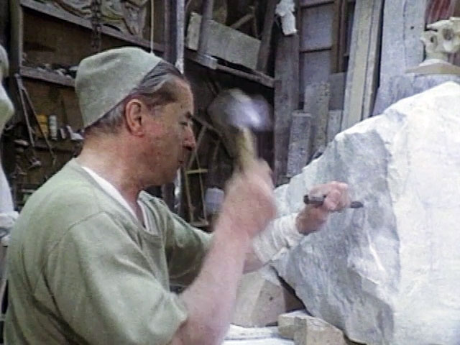
Implementing parameter passing
Let’s talk about how this actually is going to work in memory

Slide 20
Let’s draw out the memory
int g;
void f (int x, int y, int z){ x = 3 ; y = 4; z = y;
}
void main(){ int a = 1, b = 2, c = 3;
f(a,b,c);
f(a+b,7,8);
}
Consider pass-by-value and pass-by reference

Slide 21
Bad use of R-Values
Can prevent programs that are valid in pass by value from working in pass by reference
Literals (for example) do not have locations in memory
We will rely on the type checker to catch bad use of R-values

Slide 22
Let’s draw out the memory again
int g;
void f(int x, int y, int z){ x = 3 ; y = 4; z = y;
}
void main(){ int a = 1, b = 2, c = 3;
f(a,b,g);
f(a+b,7,8);
}
Consider pass by value-result
and pass by name

Slide 23
Efficiency Considerations
Pass by Value
Copy values into AR (slow)
Access storage directly in function (fast)
Pass by Reference
Copy address into AR (fast)
Access storage via indirection (slow)
Pass by Value-result
Strictly slower than pass by value
Also need to know where to copy locations back

Slide 24
Object Handling
void alter(Point pt, Position pos){ pos = pt.p;
pos.x++;
pos.y++;
}
void main(){ Position loc;
Point dot;
// … initialize loc with // x=1,y=2
// … initialize dot with loc
alter(dot, loc);
}
class Point{
Position p; }
class Position{ int x, y;
}
In java, loc and dot are pointers to objects (on the heap)
In C++, loc and dot are objects with no indirection (on the stack)

Slide 25
Roadmap
We learned about parameter passing
By-value, by-reference, by-value-result, by-name
How values traverse the stack
Next time
Allocating variables

